Slide 1
Writing Proposals
Kristin K. Madsen

Slide 2
What is a proposal? Selling your science, ideas, and project

Slide 3
Types of proposals
Request contributed talk at a conference
One paragraph, 4-8 sentences
Proposal for observing time at an observatory
4 – 6 pages
Proposal for grants
5 – 15 pages

Slide 4
How are proposals different from a paper?
Sales pitch:
Presenting your science or project to a ‘selection committee’
Page limits:
Proposals have page constraints. Short and sweet.
Fulfil requirements:
Proposal have specific information that must be covered and/or met

Slide 5
Proposal Writing

Slide 6
Goal versus Objective
A goal is an “aim toward which an endeavor is directed”
Usually qualitative rather than quantitative
Example: Ascertain the origin and evolution of the Solar System and to understand the potential for life beyond Earth
Example: Understand black hole growth over cosmic time scales
Example: Understand the explosion mechanism of Kepler
An objective is something that “one’s efforts or actions are intended to attain or accomplish”
Must be quantitative
Example: Determine if life exists at this Martian latitude and longitude within the top 5 cm of the surface
Example: Measure the spin of SMBH out to a redshift of 1
Example: Measure if there is Ti-44 in the remnant and find its distribution

Slide 7
Science Question
Observation – Must be based on a known phenomena or theory
Science Question – Must be articulated as a question
Hypothesis – Best when controversial
Prediction – Must verbalize a future state
Objective – Must confirm or refute the prediction
Measurement – Must be measurable and repeatable
Observation
Science Question
Measurement
Hypothesis
Objective
Prediction

Slide 8
What Makes a Compelling Science Question?
The science question must be hypothesis-driven
It should be devoid of jargon, acronyms and should be easily understandable by an educated person outside of the field
It should not be composed of more than one question
- Example: “What governed the accretion, supply of water, chemistry and internal differentiation of the inner planets and the evolution of their atmosphere, and what role did bombardment by large projectiles play?”
- Better: “What role does cometary water and planetary impacts play in the evolution of inner planetary atmospheres?”

Slide 9
Hypothesis / Prediction Pairs Example

Slide 10
Science Objectives Test Hypotheses They are not measurements
Don’t:
Do:
State objectives as “to measure” or:
State objectives as:
to quantify…
to determine if (hypothesis is true)…
to assess…
to characterize…
to distinguish between (hypothesis A, B or C)…
to place limits on…
to survey…
to discriminate between (hypothesis A, B or C)…
to understand…
TIP: If you can replace the verb in your objective with the word “measure” without changing its meaning, you don’t have a hypothesis based science objective.

Slide 11
Art of Story telling

Slide 12
The Hook
A narrative hook (or just hook) is a literary technique in the opening of a story that "hooks" the reader's attention so that they will keep on reading. The "opening" may consist of several paragraphs for a short story, or several pages for a novel, but ideally it is the opening sentence in the book (or proposal).
Don’t keep the reader in suspense. Make it clear from the beginning what they are dealing with
Don’t bombard them with irrelevant details and numbers
Keep it simple

Slide 13
Who is your audience?
Who is going to read it?
X-ray scientists same field
X-ray scientists different field
Non-experts outside of field
What are they going to do with it?

Slide 15
Layout of narrative
Open with the Science Goal and explain why it is important
Example: Understand black hole growth and its impact on the host galaxy
Then discuss the Science Question
How do black holes acquire their spin?
Layout the hypothesis and predictions
Low spin -> mergers; high spin -> through mergers
Finish with the Objective
Measure the spin of 5 SMBHs

Slide 16
Conference Abstracts

Slide 17
Abstract for conferences
How large is the conference?
Workshop: 40 – 100
Science topical meeting: 100 – 200
Divisional meetings (HEAD): 200 - 500
Societal meetings (AAS, COSPAR, IAU): 1000 <
Science Organizing Committee (SOC) picks the talks out of the abstracts
They may not be specialists in your field, or even in the same wavelength band
Responsibility of organizer and selection committee to give the audience something interesting to listen to

Slide 18
Abstract Layout
Do not copy the abstract from a paper – often too detailed
Avoid numbers
Do not have multiple paragraphs
4 – 8 sentences
Keep the reader in suspense, tease them, make them want to hear more!
Introduce topic: clusters, binaries, pulsars, theoretical, etc.
Object and problem
Result/findings

Slide 19
Example 1
The Complete Local-Volume Groups Sample (CLoGS) was created in response to the lack of unbiased galaxy group samples and is designed to avoid the selection biases generally present particularly in X-ray selected samples (strongly biased in favor of the X-ray bright, centrally-concentrated cool-core systems). This statistically-complete sample of 53 groups within 80 Mpc is intended to serve as a representative survey of groups in the local Universe. In addition to X-ray data from Chandra and XMM (100% complete at this point, using both archival and new observations), we have added GMRT radio continuum observations (at 235 and 610 MHz, complete for the entire sample) and IRAM 30 m and APEX telescope observations of CO(1-0) and CO(2-1) lines (complete for the group-dominant early-type galaxies in the sample). We find that 14 of the 26 high-richness groups are X-ray bright, and that ∼53–65 per cent of the X-ray bright groups have cool cores, a somewhat lower fraction than found by previous archival surveys. Approximately 30 per cent of the X-ray bright groups show evidence of recent dynamical interactions (mergers or sloshing), and ∼35 per cent of their dominant early-type galaxies host active galactic nuclei with radio jets. In the 26 high-richness groups, 92% of the dominant galaxies host detected radio sources, with a four order-of-magnitude range in luminosities. Roughly half are point-like, with another quarter hosting jets and most of the rest showing a diffuse morphology. Jet sources are more common in X-ray bright groups, with radio non-detections found only in X-ray faint systems. We find that central AGN are not always in balance with cooling, but may instead produce powerful periodic bursts of feedback heating. Of the 53 CLoGS dominant galaxies, 21 are detected in CO and we confirm our previous findings that they have low star formation rates (0.01–1 Msun/yr) but short depletion times (<1 Gyr) implying rapid replenishment of their gas reservoirs. A much higher fraction of our group-dominant galaxies (~60%) are AGN-dominated than is the case for the general population of ellipticals.

Slide 20
Example 2
There is observational evidence that the X-ray continuum source that creates the broad fluorescent emission lines in some Seyfert Galaxies may be compact and located at a few gravitational radii above the black hole. We consider the possibility that the compact X-ray emitting source may be powered by small scale flux tubes near the black hole that are attached to the orbiting accretion disk. Using three dimensional, time dependent force-free simulations, we find that the field linking the black hole and the disk can get twisted up by the differential rotation to try to form a magnetic tower. When the confinement provided by the field from the outer disk is strong, the forming magnetic tower can quickly become kink unstable, which leads to continuous reconnection and dissipates most of the extracted rotational energy relatively close to the black hole. Such a process may be able to heat up the plasma and produce strong X-ray emission. We estimate the energy dissipation rate and discuss its astrophysical implications.
Javier Garcia, selected abstract

Slide 21
Proposals to observatories and grants

Slide 22
Observatory Proposals
NASA AO (Announcement of Opportunity)
NuSTAR: https://heasarc.gsfc.nasa.gov/docs/nustar/nustar_prop.html
January 2024
Nicer: https://heasarc.gsfc.nasa.gov/docs/nicer/proposals/index.html
September 2023
Chandra: https://cxc.harvard.edu/proposer/
The Cycle 25 deadline is 15 March 2023 at 6pm
ESA XMM
https://www.cosmos.esa.int/web/xmm-newton/ao22
October 2023

Slide 23
What is a Time Allocation Committee (TAC)?
It is the review at which the proposals are evaluated and selected.
Before COVID they were in-person now mostly virtual
5-7 people form a topical panel and will review 30-60 proposals
Typically there is a primary and a secondary reviewer for each proposal
Proposal gets ranked by each reviewer initially (triage), then ranked again after discussion in the TAC
All proposals in panel are sorted and pass on to a merging panel

Slide 24
Dual Anonymous review
All of NASA missions are now Dual Anonymous
No personal information in the proposal
Implemented to reduce selection biases
Gender imbalance
Career imbalance
Other biases (e.g. personal opinions on selected individuals)
There will be links to a set of guidelines for Dual Anonymous available at the various mission AO websites
ESA reviews are NOT dual anonymous

Slide 25
Proposal outline
Abstract
Short concise summary of science goal, question, hypothesis and plan
Introduction
The Hook + science goal and objective; no details yet; personal voice, enthusiasm
Scientific justification
Science question, hypophysis and predictions
Feasibility and observing plan
Show that your proposed observing plan is sufficient to give you the data in your predictions and can prove/disprove your hypophysis
Conclusion: Summary of objective and plan

Slide 26
Example observing plans
One object for XX ks
One object for multiple exposures of XX ks with YY days, weeks, or months in between
ToO: List of objects with a trigger criteria (e.g. flux) + observing plan like 1) or 2)
List of objects each for XX ks, no trigger criteria

Slide 27
Science Justification
You have to justify that your exposure time and observing plan (e.g. multiple visits, specific timing) will get you the data you need to answer your hypothesis
Simulation of the expected spectrum
Response files are made available by the observatories for simulation
WEBPIMMS – provides approximate count rates for an input flux
WEBSPEC – provides a spectrum for a simple model input
XSPEC – fakeit for more complicated spectra

Slide 28
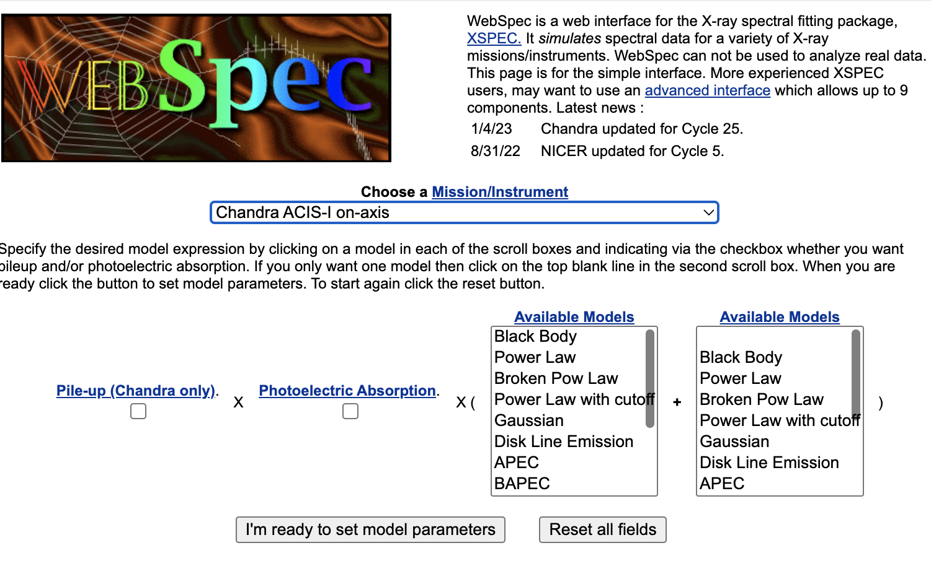
WEBSPEC

Slide 29
WebPIMMS

Slide 30
XSPEC
XSPEC> model “expected model”
XSPEC> fakeit backgroundfile
Input: arffile, rmffile, exposure time
XSPEC> fit your model and do error estimates
Be careful: don’t run it multiple times in a row. Always clear data before running it again.

Slide 31
Exercise

Slide 32
Write down for your project:
Science Goal
Science Question
Hypophysis
Predictions
Objective
Write abstract like you are applying for a talk
Can be used as your introduction at the final presentation

