Slide 1
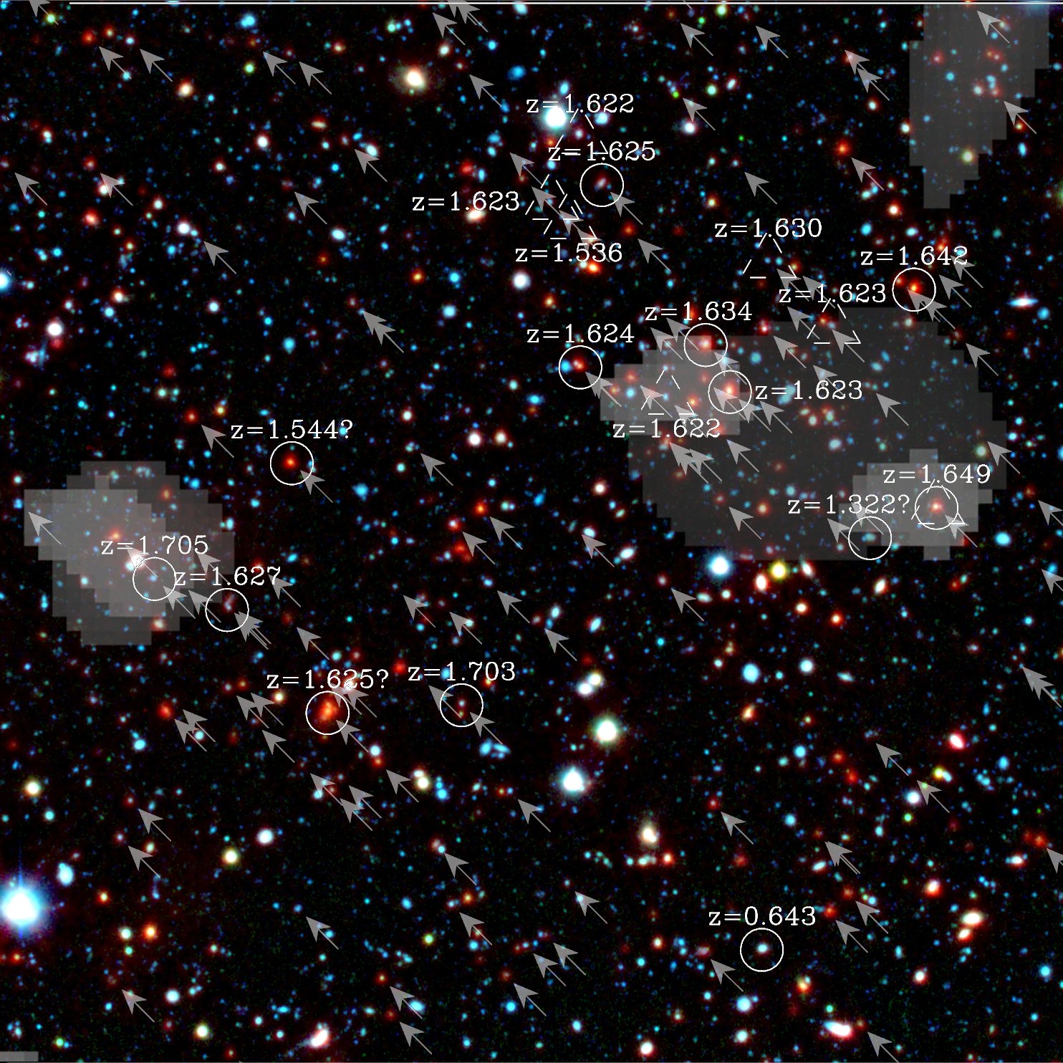
Exdended sources in ECDF-S
Alexis Finoguenov
Helsingin Yliopisto
UMBC

Slide 2
Fluctuations
down to 5x10⁻¹⁷
ergs/s/cm²

Slide 3
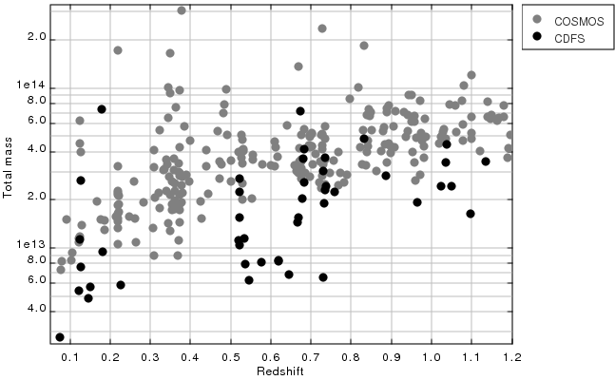
CDFS vs COSMOS

Slide 4
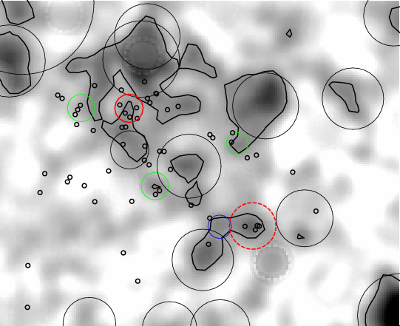
Kirk structure at z=1.6

Slide 5
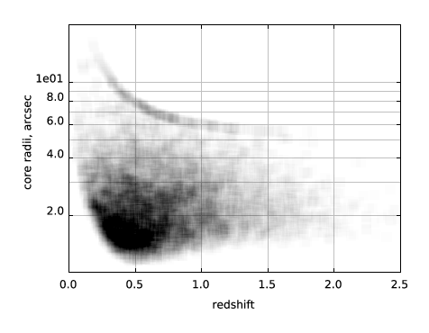
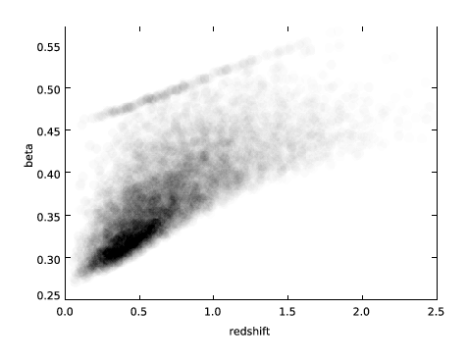
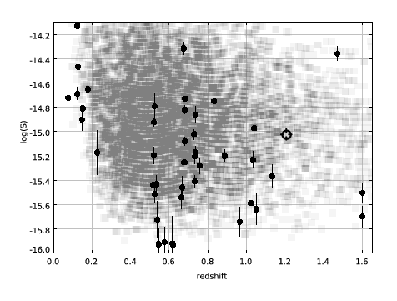
Random catalog

Slide 6
Reproducing the observed emission

Slide 7
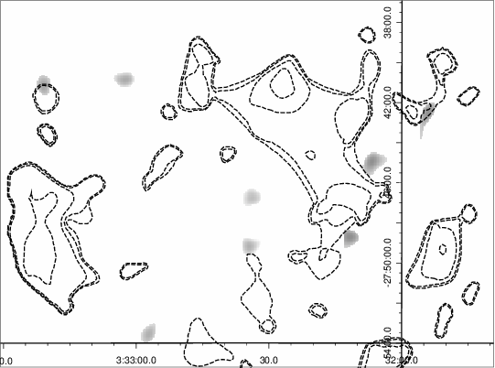
Simulated point sources

Slide 8
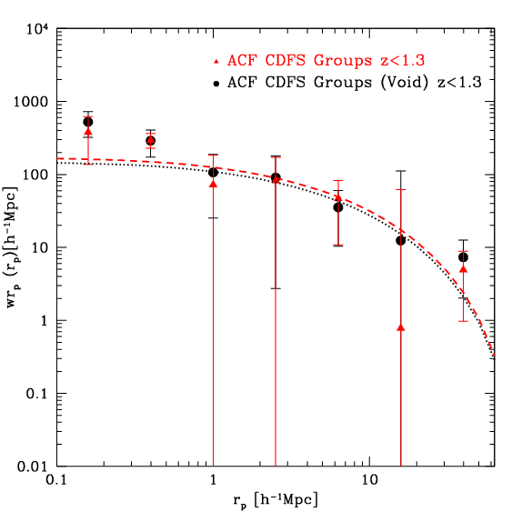
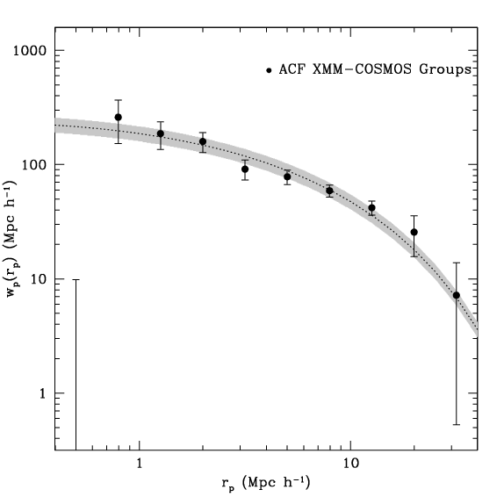
ACF of galaxy groups
b_obs/b_model=1.1±0.1
This constraints the deviations from the assumed scaling relation to be < 30% in total mass.

Slide 9
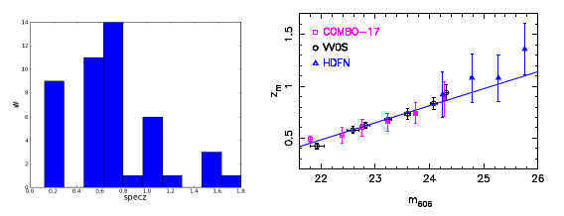
GEMS

Slide 10
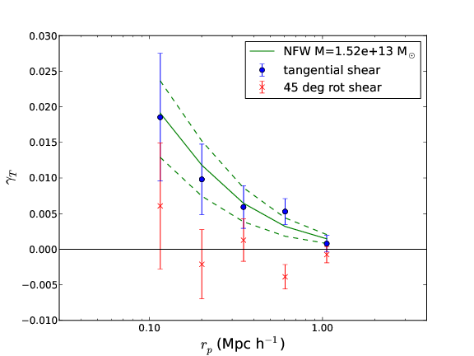
Lx-Mass from weak lensing
lgM=0.6lgLx+C
Ami Choi

Slide 11
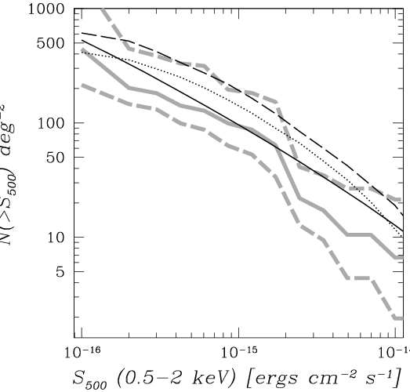
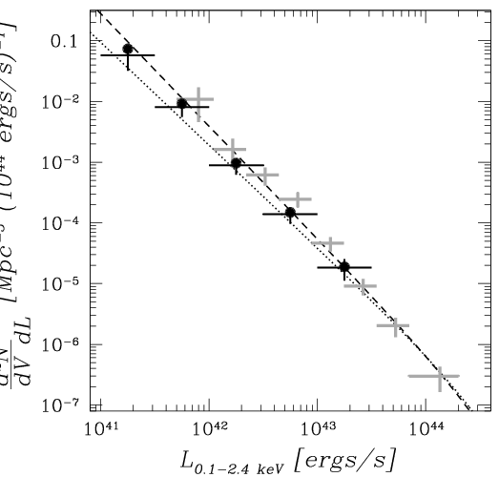
Groups vs LCDM
Finoguenov et al. 2010

Slide 12
dn/dz – the void is 0.3<z<0.6

Slide 13
Conclusions
ECDF-S delivered a very unique catalog of galaxy groups, probing interestingly low halo masses.
We have compared the mass calibration with the weak lensing signal and the clustering, finding a good agreement
Planck13 LCDM overpredicts the number of groups that should be visible in ECDF-S. Ths can be alleviated by ascribing 30% higher mass to each group.
Finally, the known lack of structure in CDFS is contained to 0.2<z<0.6 range.

Slide 14
Papers
Ziparo et al 2013ab : SF gradients in groups
Tanaka et al. 2013: z=1.6 group
Popesso et al: contribution of groups to the global SFR
Oh et al. 2014 AGN population in groups
Finoguenov et al. Catalog
Erfanianfar: Galaxy properties in deep fields
Mountrichas: clustering of AGNs outside groups
Athena+ white papers
Cappelluti: residuals
Ursino: WHIM

