Slide 1


Discovery of Relativistic Outflows in the Seyfert Galaxies Ark 564 and Mrk 590
Anjali Gupta
Columbus State
Ohio State University
Collaborators: Smita Mathur, Yair Krongold

Slide 2
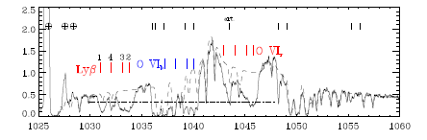
Low velocity outflows are ubiquitous
Seen in 50% of Seyfert galaxies.
NGC 3783 HST and FUSE

Slide 3
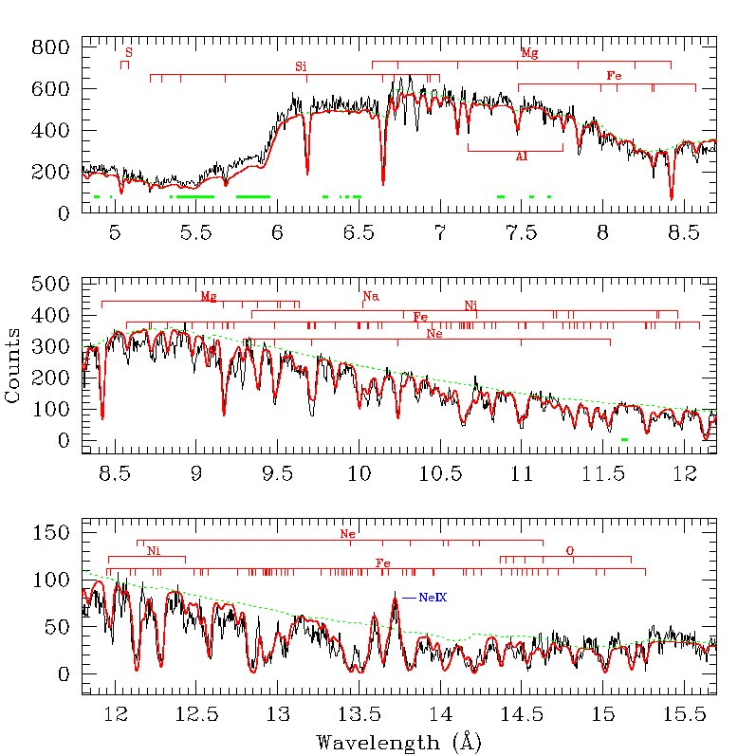
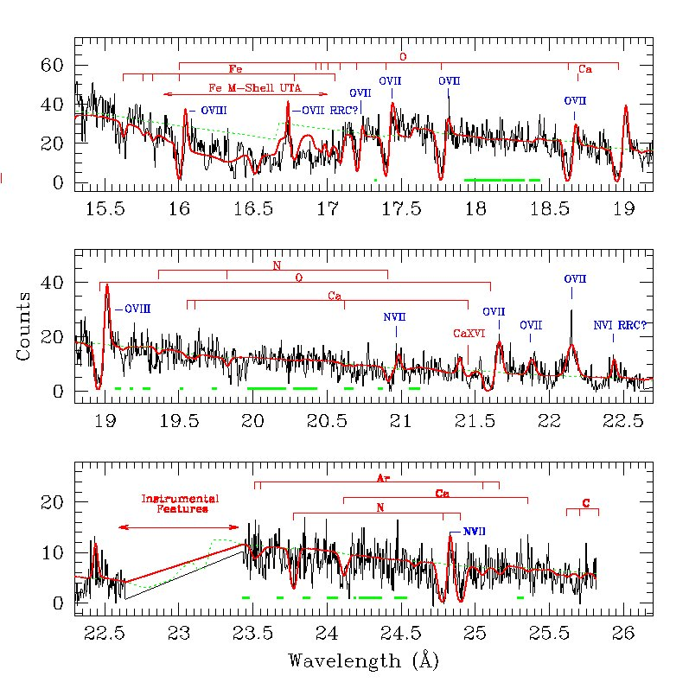
Warm Absorbers
Log ξ = 0 – 2 erg s⁻¹
N_{H} = 10²⁰ - 10²² cm⁻²
Outflow Velocity
100 – 1000 km s⁻¹
Krongold et al. 2003

Slide 4
Warm Absorbers
LIP: a low ionization parameter component, Fe UTA, UV lines
HIP: a high ionization parameter component, seen only in X-rays
In pressure equilibrium
Not efficient agents of feedback
Krongold et al.2003, 2007; Netzer et al. 2003

Slide 5
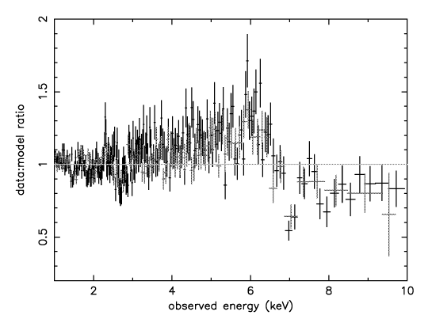
Discovery of UFOs
In PG1211+143: Pounds et al. 2003

Slide 6
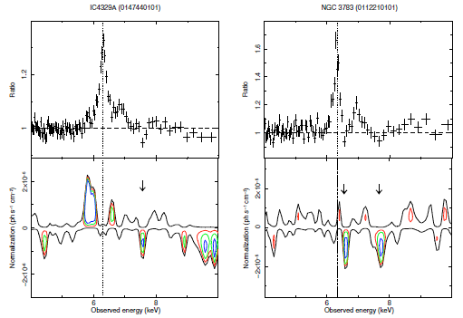
UFOs
Log ξ = 3 – 6 erg s⁻¹
N_{H} = 10²² - 10²⁴ cm⁻²
Outflow Velocity
0.1c – 0.3c
Tombesi et al. 2010

Slide 7
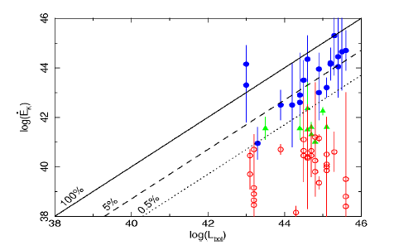
Kinetic Luminosity
UFOs
Warm Absorbers
From Tombesi et al. 2013

Slide 8
Issues with detected UFOs
Identified through blueshifted FeXXV and/or FeXXVI absorption lines only
All in low resolution CCD spectra.
Low significance absorption lines.
Parameterization of the photoionized plasma becomes difficult

Slide 9
Discovery of Relativistic Outflows in the Seyfert Galaxies Ark 564 and Mrk 590
Gupta et al. 2013; 2014

Slide 10
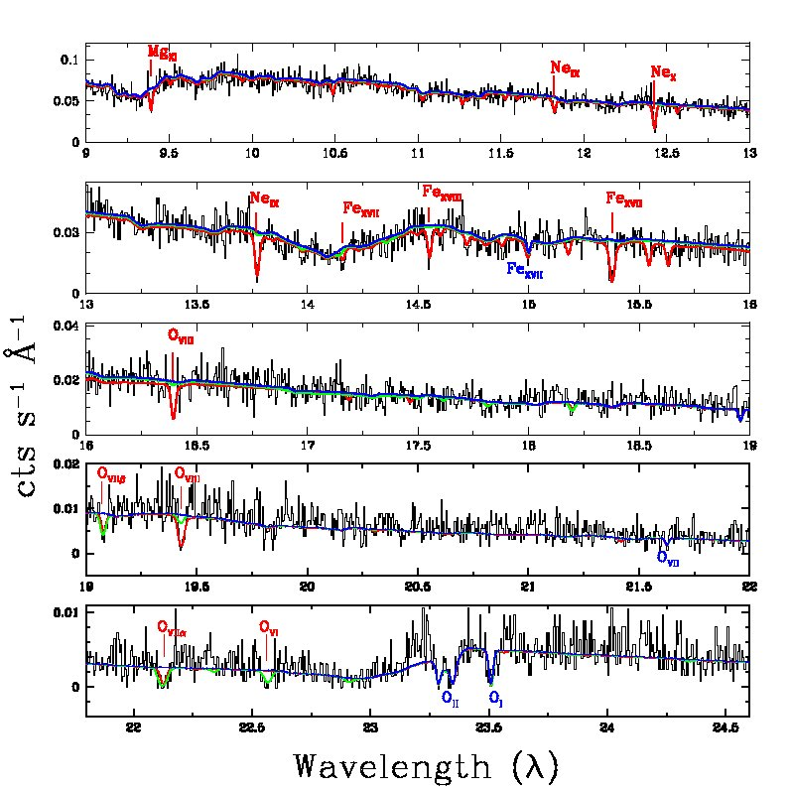
Low-velocity outflow in Ark 564

Slide 11
Discovery of relativistic outflow in
Ark 564
Velocity = 0.1c

Slide 12
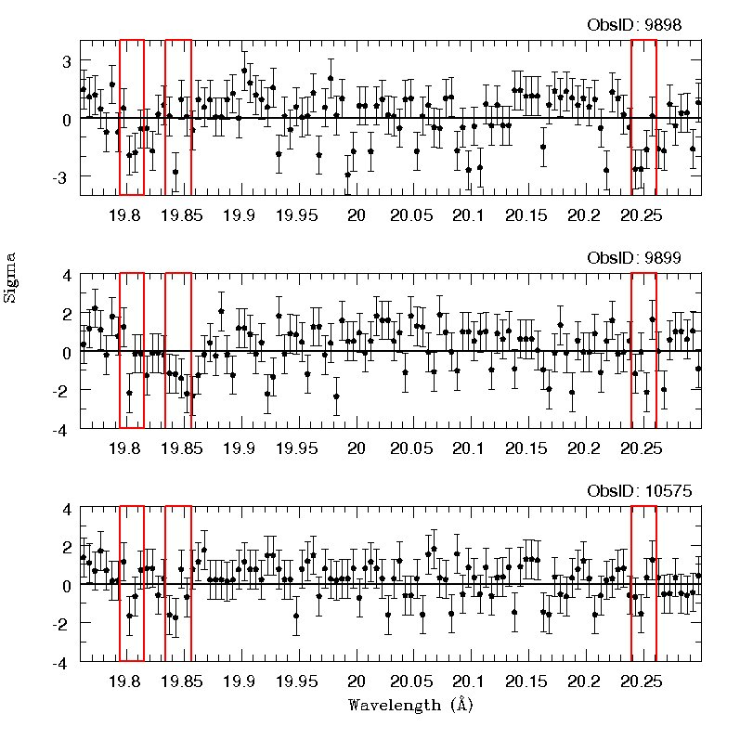

Slide 13
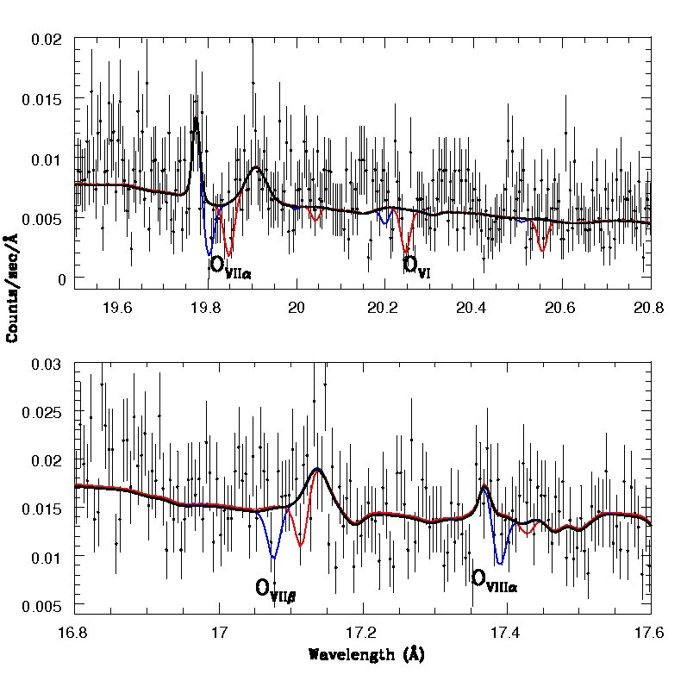
….well fit with photoionization model
Log ξ = 1.25/0.65 erg s⁻¹
N_{H} = 10^{19.8}/10²⁰ cm⁻²
Outflow Velocity
0.105c/0.103c

Slide 14
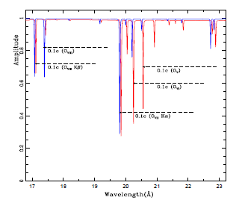
Two component photoionization model

Slide 15
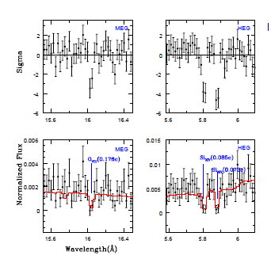
Relativistic outflow in Mrk 590
V = 0.081c - 0.176c

Slide 16
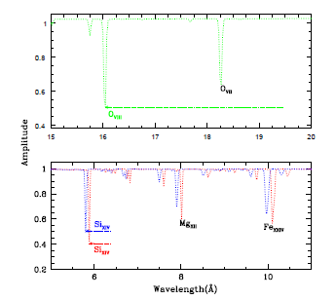
….and its photoionization model
HV-LIP
Log ξ = 2.24 erg s⁻¹
N_{H} = 10^{20.94} cm⁻²
Outflow Velocity = 0.176c
HV-HIP
Log ξ = 4.5 erg s⁻¹
N_{H} = 10^{23.5} cm⁻²
Outflow Velocity =
0.0867c/0.0738c

Slide 17
Kinetic Luminosity of Relativistic Outflows
HV-HIP Kinetic luminosity > 10⁴⁴ erg/s
c.f. X-ray luminosity: 7.0 x 10⁴² erg/s
HV-LIP Kinetic luminosity > 10⁴¹ erg/s

Slide 18
This IS a remarkable discovery!
Relativistic outflows known only in luminous quasars
-- BALQSOs in UV
-- Few in hard X-rays: Fe line
First example in soft X-rays: Robust!
-- better instrumental response
-- multiple lines at the same velocity
Physical parameters well determined.

Slide 19
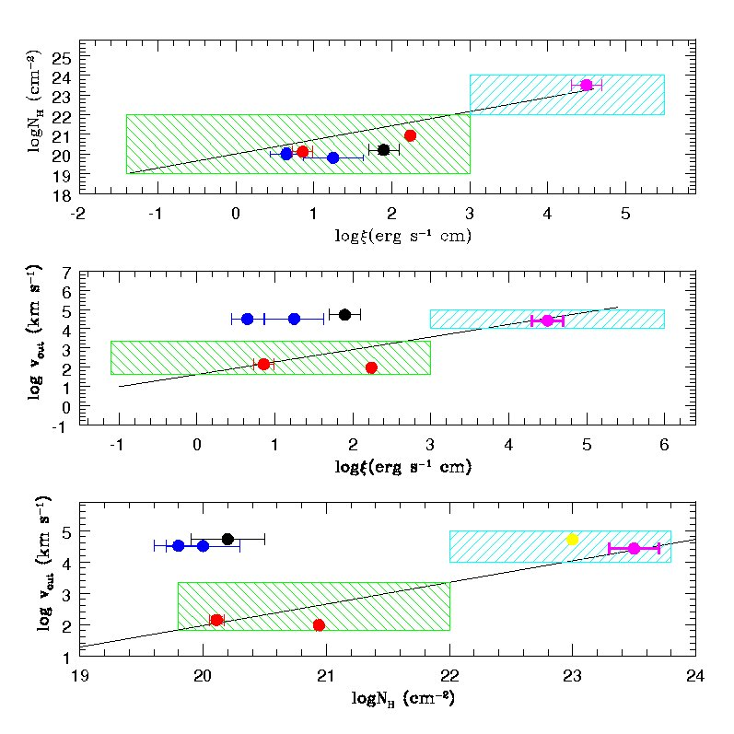
…..WA and UFO connection ?

Slide 20
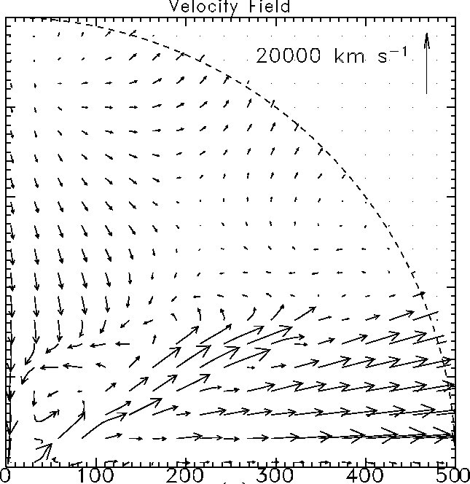
Disk-wind models of AGNs
Proga & Kallan 2004

Slide 21
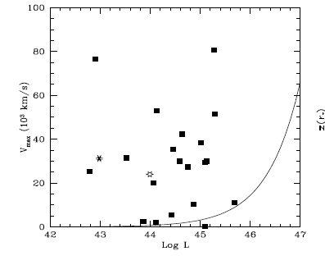
….unlike other AGN outflows

Slide 22

What is the driving mechanism?
Radiation pressure doesn’t work
Magneto-hydrodynamics?
Failed jets?
New Physics
Thank You

Slide 23
Theoretical Models
King (2012) shock wind models produce winds with velocities v∼0.1c, but in quasars accreting at Eddington limits. In this model a high velocity ionized outflow collides with the ISM of the host galaxy, losing much of its energy by efficient cooling resulting in a strongly shocked gas.
The magneto-hydrodynamic accretion-disk wind models of Fukumura et al. (2010a;b) predict high-velocity (vout≤0.6c) outflows. These models, how-ever, explain only the high-ionization high-velocity outflows, similar tothose observed byTombesi et al. (2012). In these models, ultra-high velocities are produced when UV to X-ray spectral slope is steep (αOX≤ −2), i.e. the AGNs are relatively UV bright (or X-ray faint).

Slide 24
What is the distance of the absorber from the nucleus?
Proposals span a factor of > 10⁶
from accretion disk to Kpc scale
narrow line region
n R²

Slide 25
Variability
Density
Distance

Slide 26
XMM Observations of NGC 4051
RGS → High resolution spectrum
EPIC → Variability
Krongold et al. 2007

Slide 27
Energy outflow rates
Kinetic power released: ~10³⁸ erg/s
c.f. bolometric luminosity: 2.5 x 10⁴³ erg/s
Energy injection rate in the surrounding
medium is significantly smaller than that
in feedback models
Scannapieco
Silk

