Slide 1
Relativistic Astrophysics in Active Galactic Nuclei
Chris Reynolds
Department of Astronomy &
Joint Space Science Institute (JSI)
University of Maryland College Park
USA
Notes:
Thank organizers

Slide 2
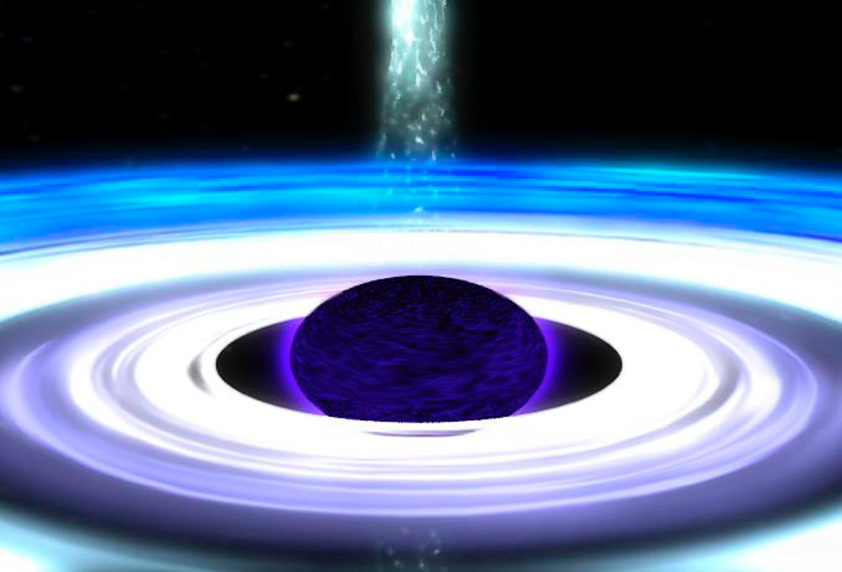
The disk/jet/wind system :
How much energy, and in what forms, do AGN pump out into their surroundings?
What is physics of disk/jet/wind, and their coupling?
What is physical nature of X-ray source in AGN?
The Black Hole :
Origin and growth history?
Really described by General Relativity?
Notes:
Since general crowd, one slide on the big picture of what we’re trying to do.
Heart is the black hole, like to learn how this monster got there
Also a powerful laboratory for studying GR --- theoretical physics community is in a state of true crisis trying to understand BHs and information
Sensible physicists suggesting that the ultimate resolution may change our macroscopic view of BH structure
More traditional astrophysics; disk/jet/wind system… amounts and forms of energy pumped out; physics of how everything works
Includes the physics of the X-ray source that so many of us spend our waking days looking at but still remains rather elusive.

Slide 3
Outline
Are AGN disks naked?
SMBH spin measurements; update and cautions
Relativistic modeling of X-ray reverberation signals
The (bright) future
Collaborators:
Laura Brenneman
Ed Cackett
Andrew Fabian
Erin Kara
Anne Lohfink
Jon Miller
Richard Mushotzky
Mike Nowak
Rubens Reis
Abdu Zoghbi
Notes:
Outline
Briefly address the issue of whether we can see the relativistic region of disk at all!
Brief update on SMBH spin
Before picking up discussion from Phil on reverberation
Collaborators – highlight ed, erin ,anne and abdu

Slide 4
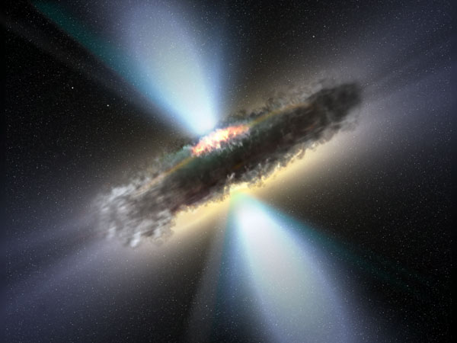
I : Can we even see the relativistic region?
Notes:
Can we see rel region… in some systems, clearly not. Type-2; distant dusty material
Know that there are lines of sight through this..

Slide 5
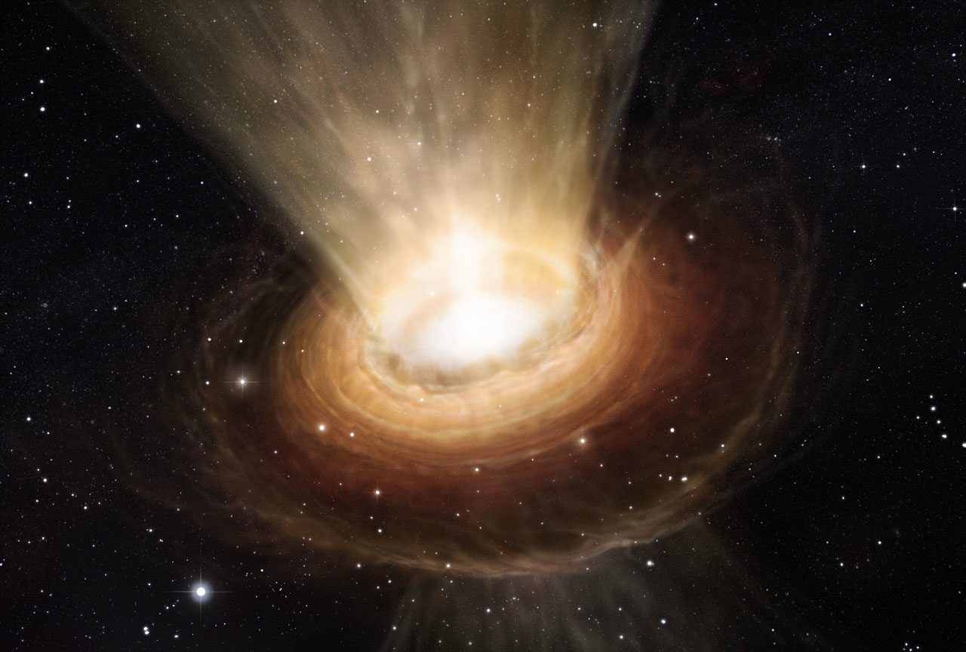
Notes:
Question becomes whether the inner disk is cloaked by CT winds

Slide 6
Can the central accretion disk generate a Compton-thick cloak?
Optical depth related to mass-flux or momentum of wind
Constraints from acceleration physics
Radiative driving – wind momentum capped by photon field momentum
Magnetocentrifugal acceleration – wind mass-flux limited by angular momentum available in disk
Thermal driving – only works at large distances (torus?)
Conclusion : The inner-disks of sub-Eddington AGN cannot support CT-winds
Reynolds (2012)
Notes:
Approach this with some very general arguments that I ran through a couple of years ago
Essentially, show that the optical depth of the wind can be expressed in terms of the mass-flux or, alternatiely, the mtm-flux
Ask what’s the maximum mtm-flux or mass-flux achievable by variois accelerating mechanisms that are proposed
Rad acc – rad acc; mtm of the wind limited by the photon field mtm
Mag cen – mass-flux limited by angular mtm in disk
Thermal driving of the wind --- doesn’t work at all in inner disk.
Source at Edd limit can absolutely drive powerful CT flows… not possible once source becomes sub-Edd by any degree.

Slide 7
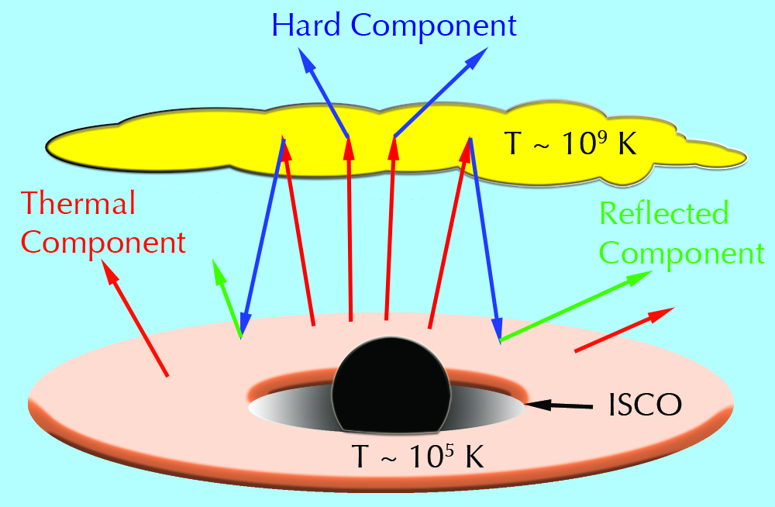
II : Supermassive Black Hole Spin
Notes:
Given that we can see all of the way into the heart of these AGN, let’s briefly turn to issues of spin
Familiar to many of you…basic picture is that we have a thin accretion disk around the SMBH truncates at the ISCO which is a function of spin.
Disk is irradiated by X-ray source

Slide 8
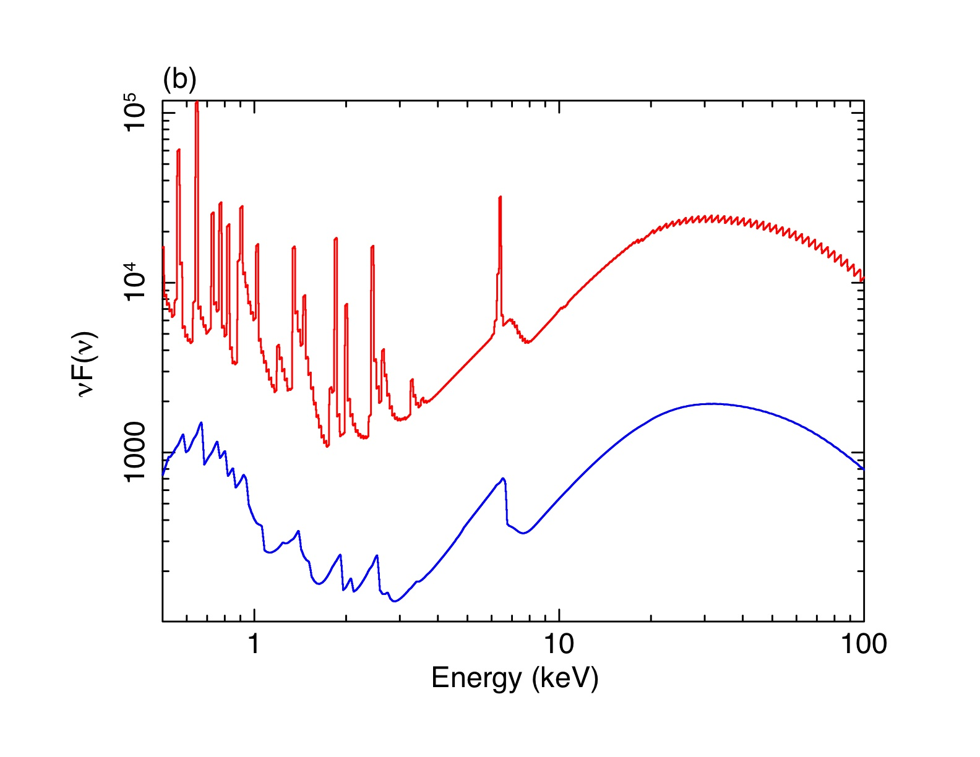
Rest frame
Observer frame
Notes:
Leading to a reflection spectrum (red) which is subject to relativistic Doppler and grav redshifting effects (blue).

Slide 9
Swift J2127.4+5654
XMM+NuSTAR (Marinucci et al. 2014)
(ratioed to simple powerlaw)
Notes:
Beautiful observations of this full reflection spectrum in recent XMM+NuSTAR campaigns
This is Swift 2127 – very clean object.

Slide 10
NGC1365 with XMM+NuSTAR (Walton et al. 2014)
Notes:
More messy object, NGC1365 that Dom Walton discussed in AGN session yesterday…
XMM reveals strong spectral variability due to large absorption changes
Once you de-absorb NuSTAR, remarkably constant relativistically smeared disk cpt

Slide 11
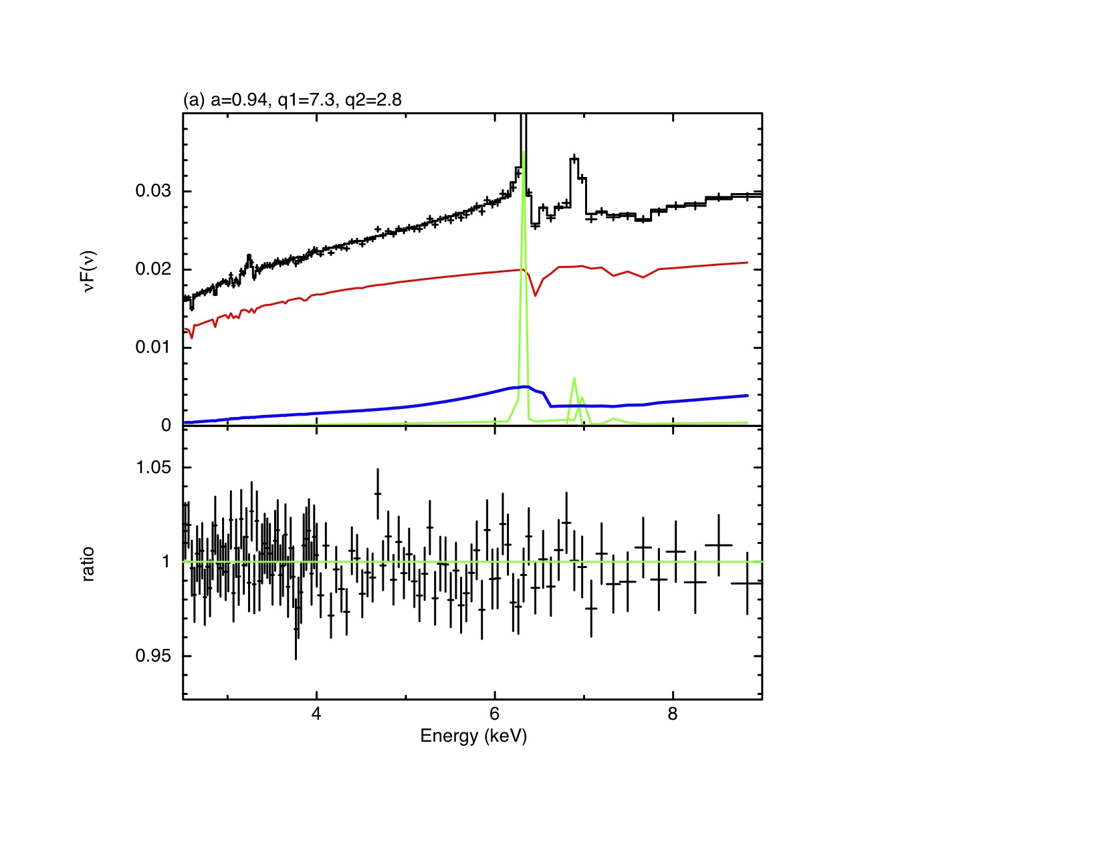
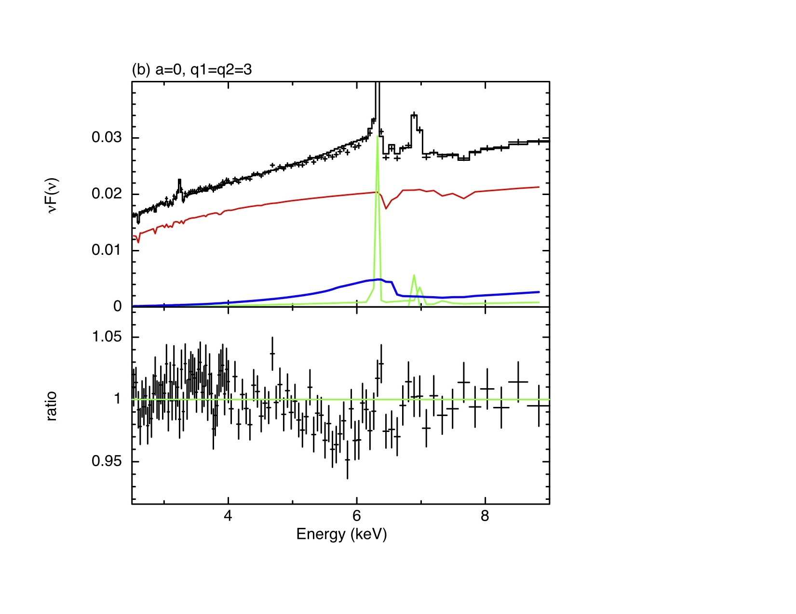
NGC3783 w/Suzaku (210ks)
Best Fit (a=0.94)
Force a=0 (and q=3)
Reynolds et al. (2012)
Notes:
Name of game is to fit your spectra; spin as free parameter
If data are of sufficient quality, constrain spin from strength
Example with NGC3783…

Slide 12
Current compilation of spin constraints
Many rapidly spinning BHs. More slowly spinning population may emerge at higher masses.
Reynolds (2013; arXiv:1302.3260)
… also see Sesana et al. (2014)
Notes:
Past 5 years have seen an explosion of published spin measurements; NuSTAR only accelaerting that process
Compilation from last year showing published spin measures; including only measurements that pass certain quality criteria that you can read about
Hints at mass dependent spin distribution, with rapid spins for BHs in 1-10 million range; emergence of more modest spins above that
Sesana used this to constrain growth history of BHs

Slide 13
Beware of conclusions regarding very very rapid spins!
For high spins (a>0.95), current quantitative measures are probably compromised by finite-thickness effects…
(Reynolds & Fabian 2008)
Notes:
Inject one word of caution – mainly aimed at the afficardos
You’ve got to beware of spectral fits that give you very high spins
Models that underlie spin constraints assume razor thin accretion disks
But disks have finite thickness; SS73 for rad-dom disks gives you roughly this
Finite thickness effects may be relevant and wil give a systematic error in spin measures
Tapering because, in SS73, the dissipation in the disk tails off to zero at ISCO
Unlikely to be true… strong torquing of the inner disk by material that is plunging inwards

Slide 14
Beware of conclusions regarding very very rapid spins!
For high spins (a>0.95), current quantitative measures are probably compromised by finite-thickness effects…
(Reynolds & Fabian 2008)

Slide 15
III : Variability and relativistic reverberation
Notes:
Move onto variability

Slide 16
The basic timescales of BH disks…
Light cross time of r ; t_{lc} = r/c = 1.4 M₈r₁ hours
Dynamical timescale ; t_{dyn} = Ω⁻¹ = 4.4 M₈r₁^{3/2} hours
Thermal timescale ; t_{th}=t_{dyn}/α = 1.8 M₈α₋₁r₁^{3/2} days
Viscous timescale ; t_{vis} = t_{th}/(h/r)² = 6 M₈α₋₁h₀²r₁^{7/2} months
M=10⁸M₈M_{sun}; r=10r₁r_{g}; α=0.1α₋₁; h=h₀r_{g}
Notes:
Recap the hierarchy of timescales.
Scaled to 10^8, r=10rg
LC fast;

Slide 17
The basic timescales of BH disks…
Light cross time of r ; t_{lc} = r/c = 1.4 M₈r₁ hours
REVERBERATION TIME DELAYS EFFECTS
Dynamical timescale ; t_{dyn} = Ω⁻¹ = 4.4 M₈r₁^{3/2} hours
RAPID CONTINUUM FLICKERING
Thermal timescale ; t_{th}=t_{dyn}/α = 1.8 M₈α₋₁r₁^{3/2} days
THERMAL INSTABILITY ?
Viscous timescale ; t_{vis} = t_{th}/(h/r)² = 6 M₈α₋₁h₀²r₁^{7/2} months
SECULAR CHANGES IN ACCRETION RATE
M=10⁸M₈M_{sun}; r=10r₁r_{g}; α=0.1α₋₁; h=h₀r_{g}
Notes:
LCT is the timescale of reverberation
VT is the timescale on which genuine changes in mdot expected
Aside, thermal timescale is often ignored despite the presence of a well known thermal instability in rad-dom disks char AGN
Evidence that AGN are doing interesting things on thermal timescale

Slide 18
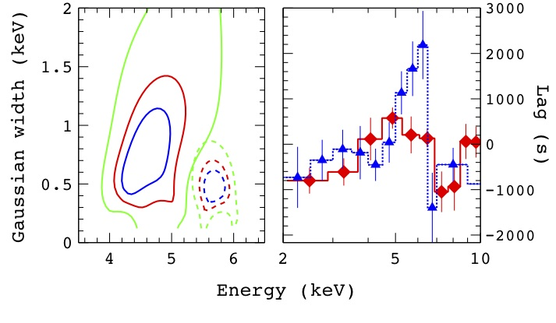
Iron line reverberation in NGC4151
(Zoghbi et al. 2012)
Notes:
Phil nicely summarized the observations of reverberation lags
Zoghbi detection of reverb delays in broad iron line I nNGC4151

Slide 19
Notes:
Expansion of that to a sample of objects by Kara et al
Finds common pattern of lags

Slide 20
Notes:
With lag ampliudes that scale with mass, as expected.

Slide 21
h=10r_{g}
Notes:
Phil laid out the mathematics of impulse functions
Since we have a clear physical picture for these lags, compute physical TFs

Slide 22
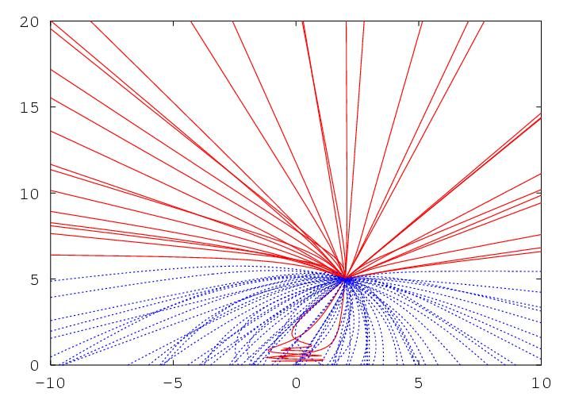
G.Miniutti
Reynolds et al. (1999)
Young & Reynolds (2000)
Notes:
Problem in GR ray-tracing…have some source that emits a flash, follow those photons as they propapage to the disk, follow the iron line photons as they propagate from the disk to the observer. Exercise I went through some years ago, construct TFs

Slide 23
h=10r_{g}
i=45º
a=0.998
Cackett, Zoghbi, Reynolds et al. (2014)
Notes:
Anatomy of the TF…
Slide is an instantaneous line profile
Sum over time, broad iron line
Sum over energy, integrated response

Slide 24
Illustration : response of 5-6keV lags to input parameters
Increasing h
Increasing h
Cackett, Zoghbi, Reynolds et al. (2014)
Notes:
Since we work in the Fourier domain, we need to take FT of response function and via the cross spectrum predict lags
Shows response function for various different heights; changes low-frequency lag as well as the frequency of phase wrapping

Slide 25
h/r_{g}
M_{BH}
Refl frac
NGC4151
Cackett, Zoghbi, Reynolds et al. (2014)
Notes:
Find that mass has very similar effect… not unexpected since to first order the thing your probing is light travel time… increase the numner of rg or the suze of one rg. Less obvious is that the dilution of the reflection also changes the measured lags in somewhat similar ways.
This is just frequency dependence… lags also have measured energy dependence

Slide 26
incl
Cackett, Zoghbi, Reynolds et al. (2014)
Notes:
Uncover is that the different frequencies are in essence filtering our view of the disk
Low frequency, see the whole disk… going to higher frequencies, dominated by the central rgions wehere broadening is extreme
Energy spectrum of lags, not frequency, that’s sensitive to inclination

Slide 27
Cackett, Zoghbi, Reynolds et al. (2014)
… also Emmanoulopoulos et al. (2014)
NGC4151
Notes:
Putting this altogether, we can fit these GR TFs to data, here NGC4151, to find the location of the X-ray source

Slide 28
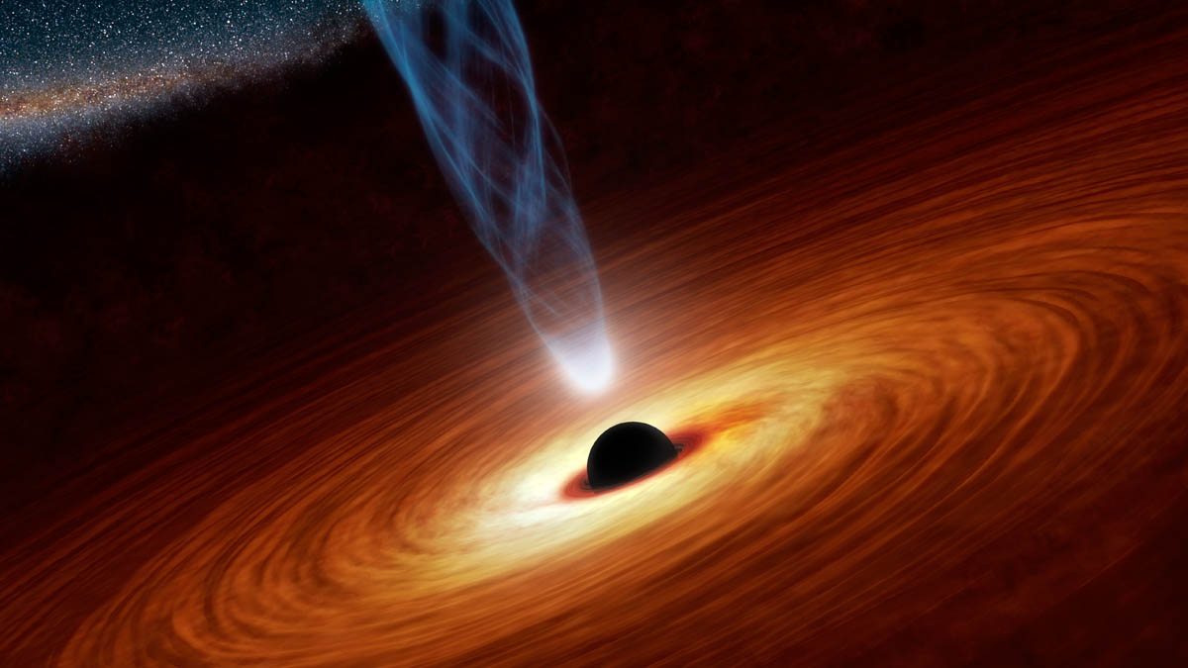

Slide 29
L~0.1L_{Edd}
X
X
X
X
X
X
Notes:
Another interesting possibility, motivated by my previou discussion of finite thicnkness effects, is to explore whether the lags could be consistent with reverberation from the eye-wall of the disk
X-ray source here… get reverberation across the this bowl enhanced by light-bending.

Slide 30
L~0.3L_{Edd}
X
X
X
X
X
X
Notes:
Esp. important for higher Mdot sources with thicker disks.

Slide 31
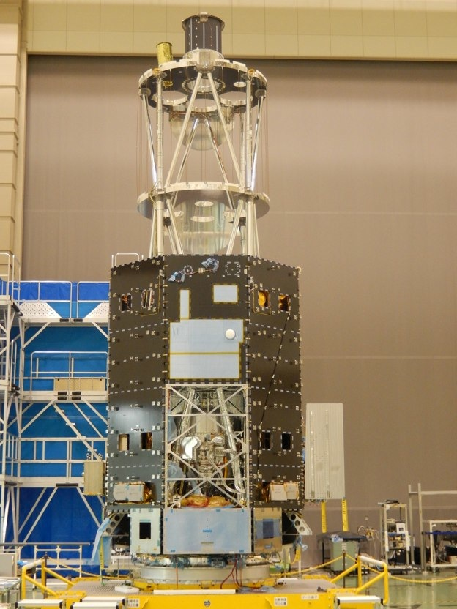
IV : Future Prospects
Astro-H
Notes:
Last minute, highlight how bright the future is for these studies.

Slide 32
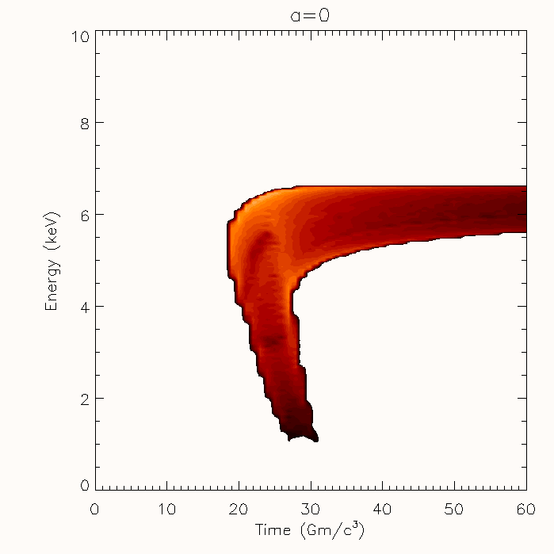
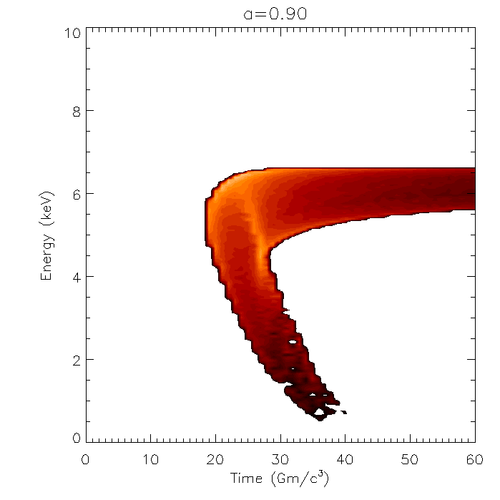
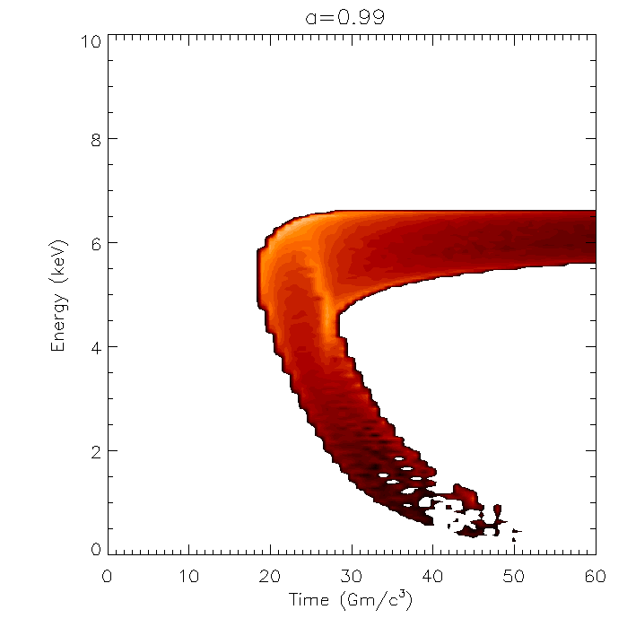
Transfer function encodes flare-position as well as geometry of space-time
Reynolds et al. (1999)
Young & Reynolds (2000)
Notes:
Ultimate goal is to really map out these TFs

Slide 33
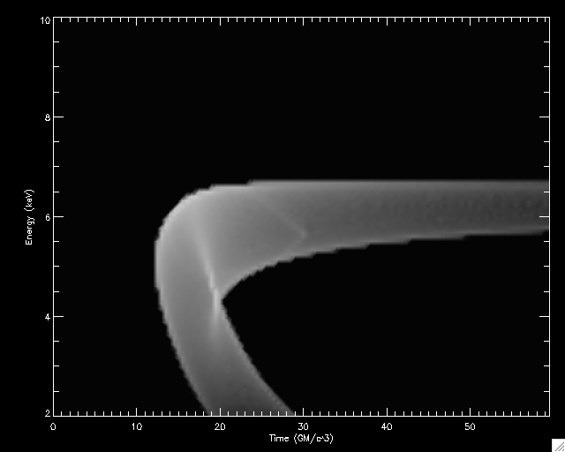
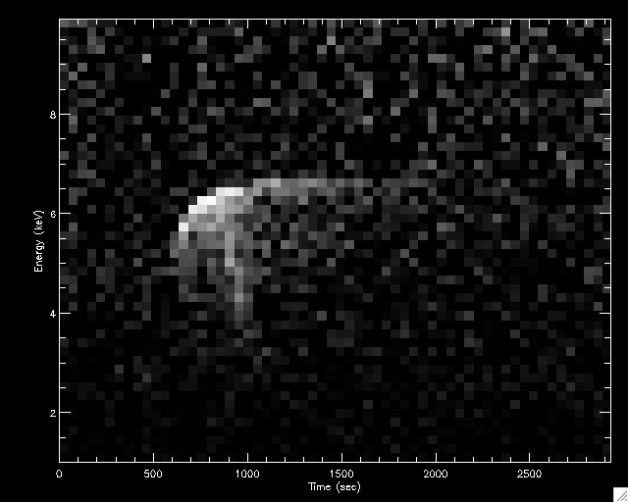
Individual reverberation events unlock full power of reverberation mapping
Requires next generation high-throughput mission
(ATHENA or even LOFT*)
Notes:
See individual flares
Trace structure of corona on flare-by-flare basis
Powerful test of disk geometry, spacetime

Slide 34
Conclusions
X-ray spectroscopy and timing providing powerful and complementary tools for probing relativistic physics
SMBH spin measurements maturing… providing interesting input for SMBH growth models
Relativistic reverberation seen in ~10 objects, providing puzzling picture of X-ray source

Slide 35
Backup slides

Slide 36
900ks Chandra/HETG (e.g. see Krongold et al. 2003, Netzer et al. 2003)
Brenneman, Reynolds et al. (2011)

Slide 37
Spins as input to semi-analytic BH growth models
Sesana et al. (2014)

Slide 38
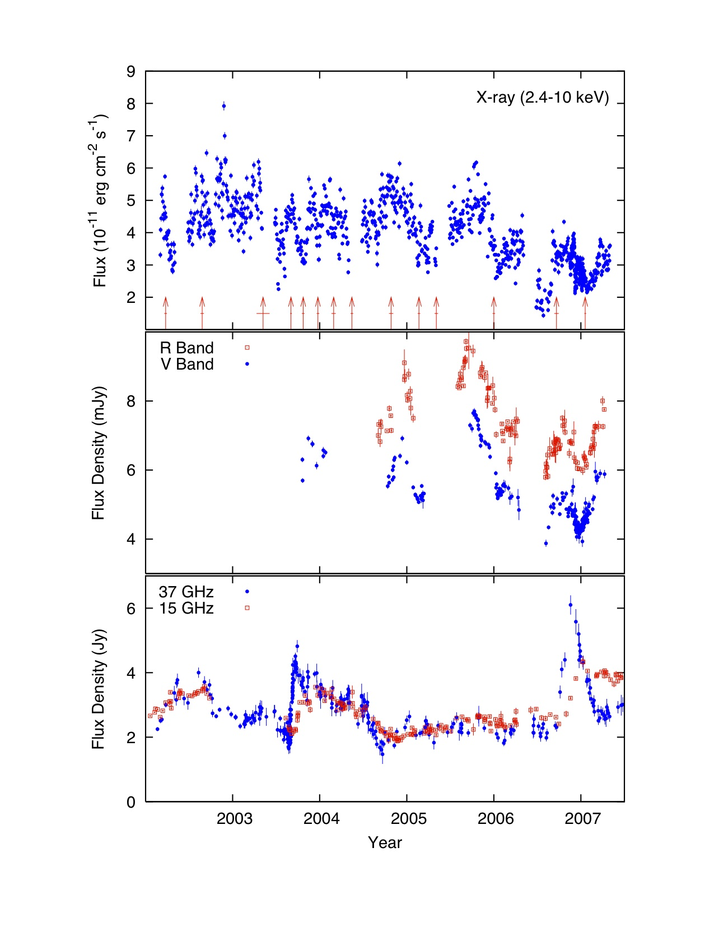
Broad line radio galaxy 3C120
Marscher et al. (2002)
Chatterjee et al. (2009)
Notes:
Something a little different… sample has one radio-loud object 3C120
BLRG… undergo jet cycle.
X-rays associated with disk, radio associated with jet
Observationally, X-rays dip just before radio flares… production of a new VLBI knot

Slide 39
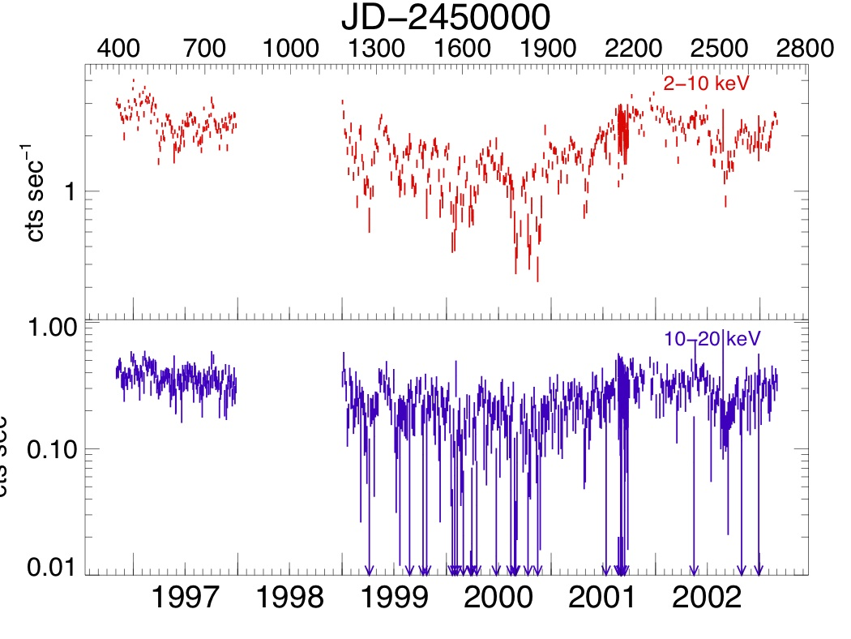
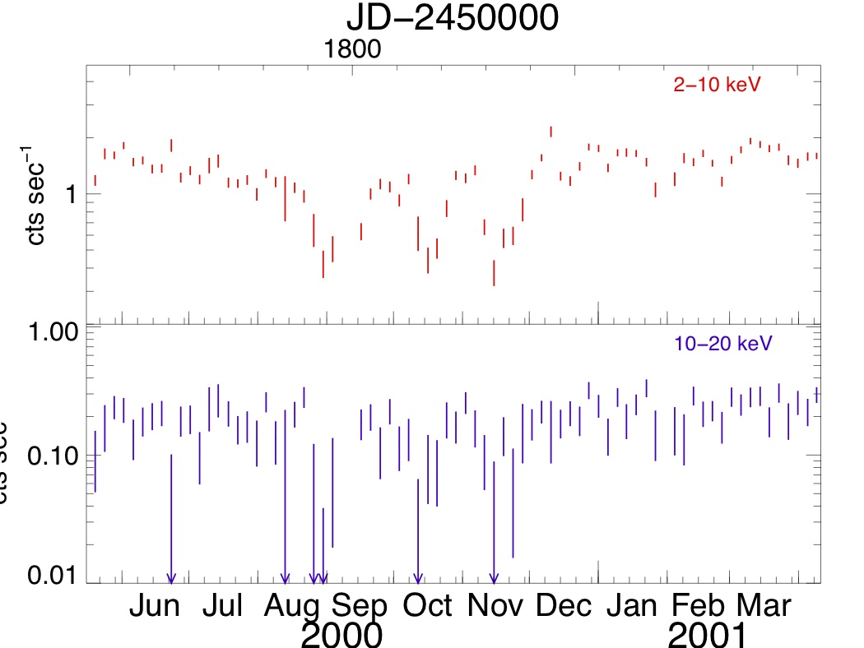
Similar phenomena in radio-quiet AGN?
RXTE lightcurve of Fairall 9 (Markowitz et al. 2003; Lohfink et al. 2012)
M=2.5x10⁸M_{sun}
t_{th}=4.7 r₁^{3/2}α₋₁ days
t_{vis}=1.2 r₁^{7/2}α₋₁h₀² years=
5 day cadence

Slide 40
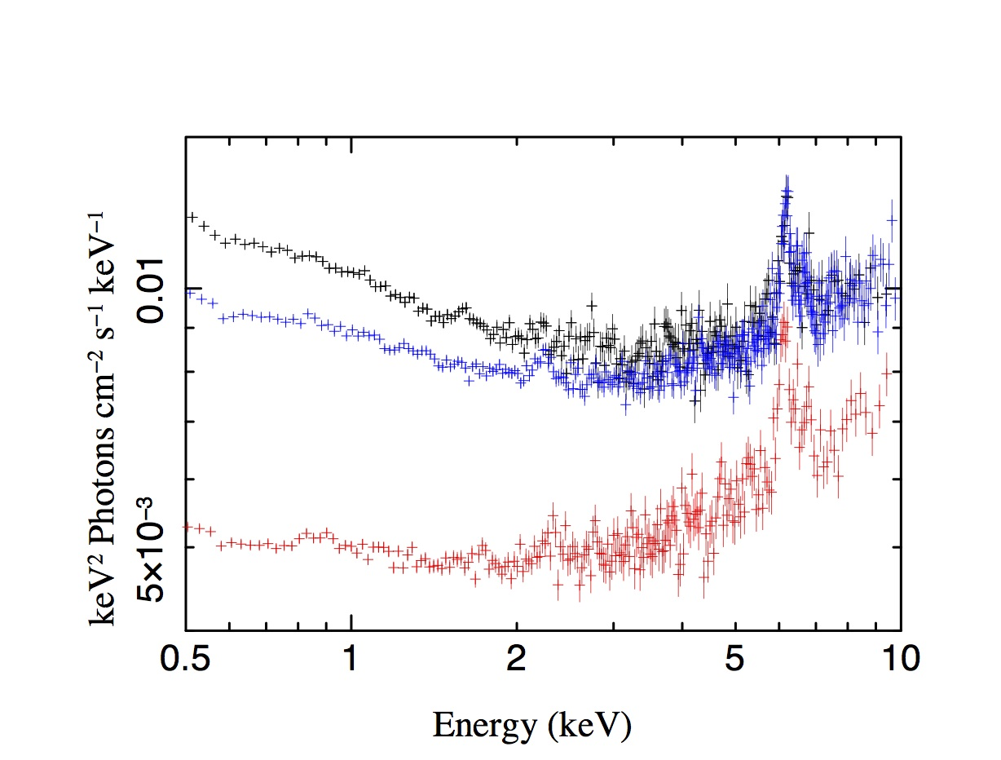
Fairall 9 : Dip and non-dip XMM spectra
(courtesy of Anne Lohfink)

Slide 41
h=10r_{g}
Reynolds et al. (1999)

Slide 42
Inner disk reverberation in MCG-5-23-16
(Zoghbi et al. 2014)
Implies h~10r_{g}

Slide 43
Uttley et al. (2014)

Slide 44
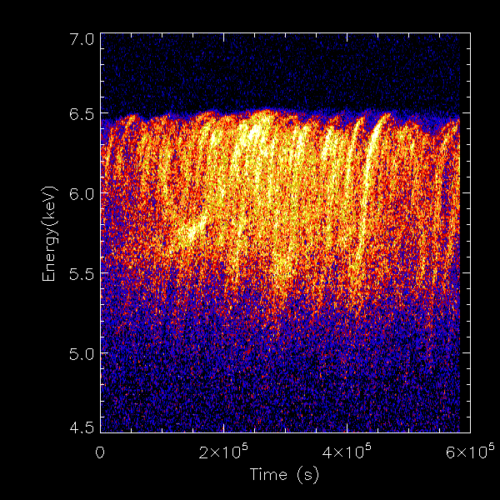
Effect will be particularly pronounced if X-ray source is a disk-hugging corona.
Iron line intensity as function of energy and time.
Armitage & CSR (2003)
Arcs trace orbits of disk material around black hole… can be compared with predicted GR orbits
Athena simulation
(assuming 3x10⁷ Msun black hole)
Notes:
Specific experiments that we could do with Con-X
Search for the orbit variations that I just discussed
Right panel shows iron line intensity as function of energy and time… theoretical
Simulated Con-X data
Arcs correspond to orbital motions of bright regions
Fit those arcs with rel. orbits to determine M, radius and spin
One sign of the breakdown of GR would be M or spin measurements that change with radius!

Slide 45
Very rapid UV variability in
Fairall 9… compact (<10r_{g}) and hot (T>8x10⁴K).
UV from the innermost disk “flashed” by X-ray micro-flares? (Lohfink et al. 2014)

