Slide 1
NuSTAR + XMM Observations of NGC 1365:
A Constant Inner Disc
Dom Walton
Caltech
G. Risaliti, F. Harrison, E. Kara, M. Parker, E. Rivers,
on behalf of the NuSTAR active galaxy working groups
XRU 2014
Notes:
Hello!

Slide 2
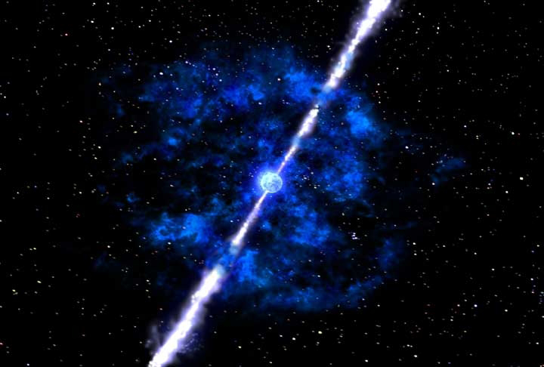
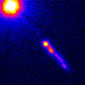
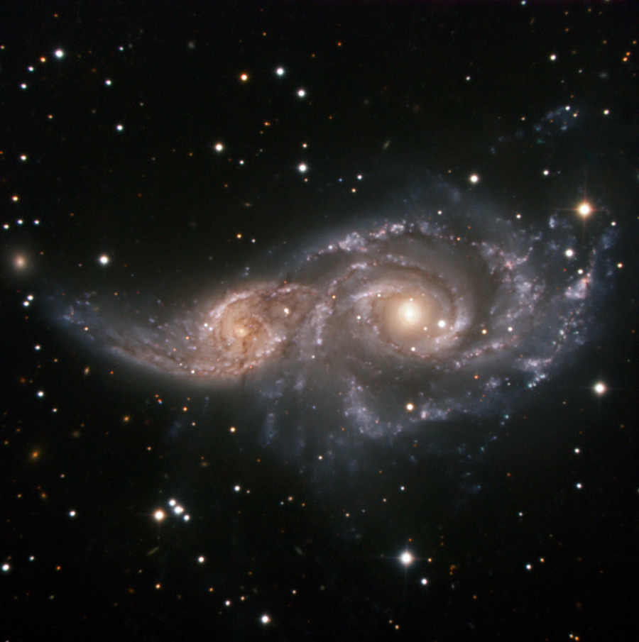
Black Hole Spin
Supernova & gamma-ray bursts
(stellar black hole binaries)
Relativistic jets (both stellar black hole binaries and active galaxies)
Galaxy evolution and supermassive black hole formation (active galaxies)
XRU 2014
D. Walton
Notes:
BH spin useful for many astronomical topics!

Slide 3
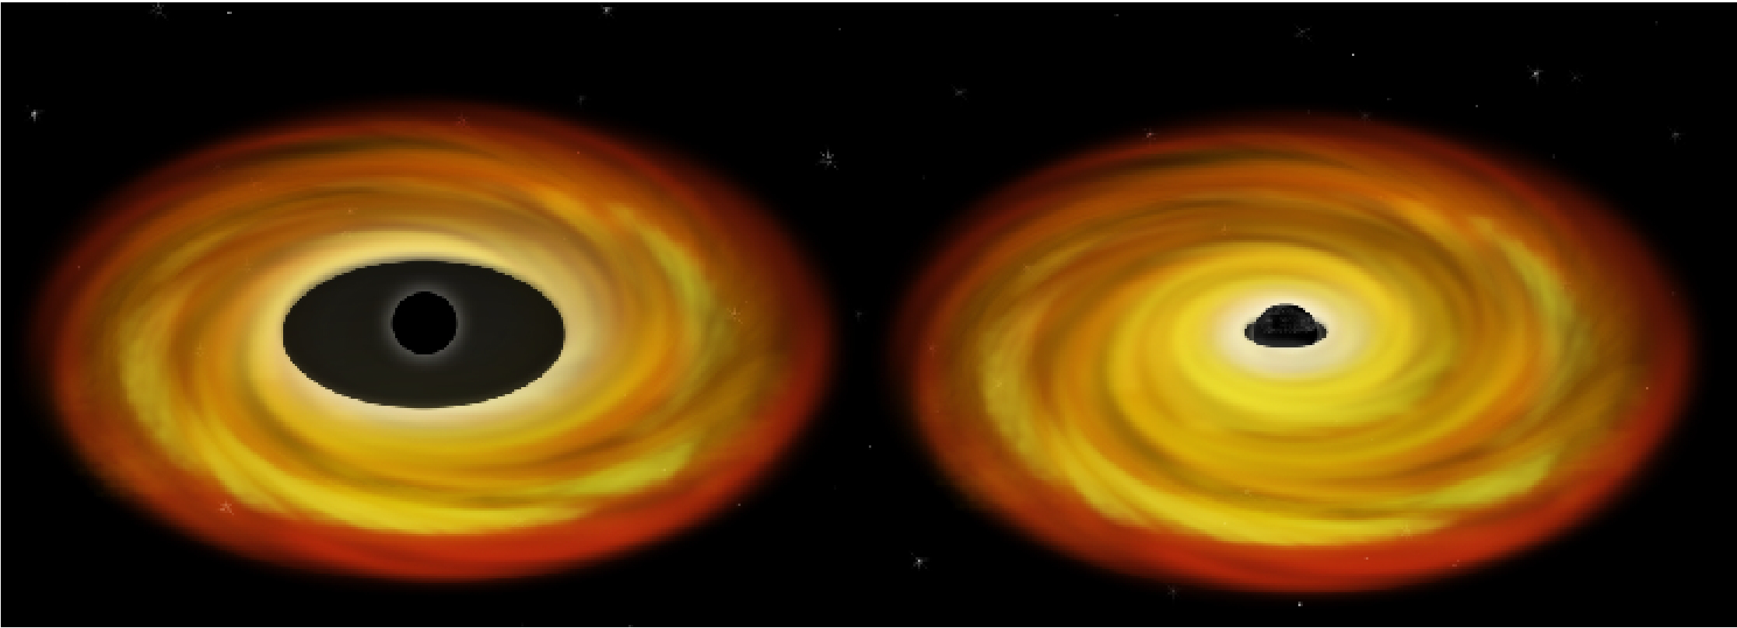
Measuring Black Hole Spin
a* = 0
a* = 1
NASA/CXC/M.Weiss
The radius of the innermost stable circular orbit depends on the spin (Bardeen et al. 1972).
XRU 2014
D. Walton
Notes:
In GR, there comes a point around a BH at which it becomes impossible to be in a stable orbit
This radius depends on BH spin

Slide 4
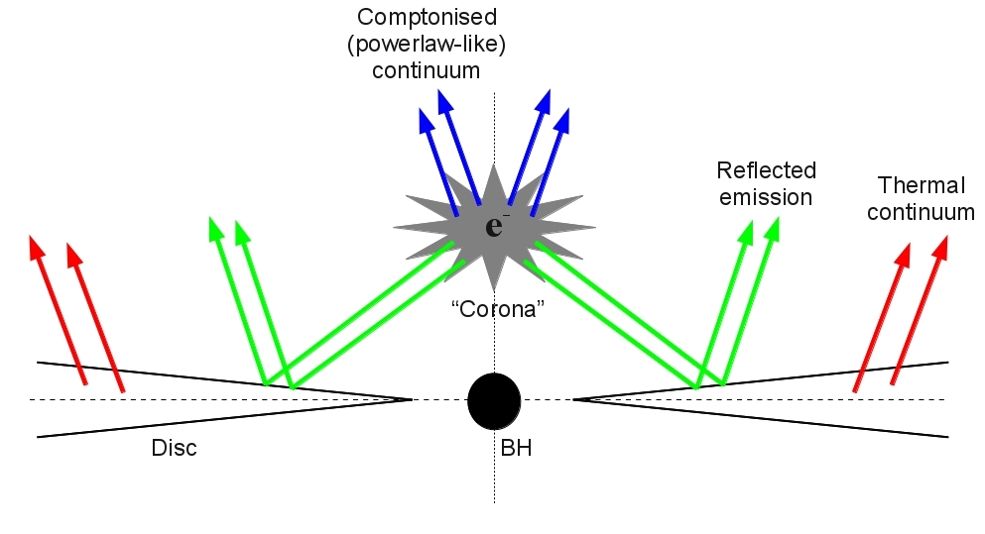
Relativistic Disk Reflection
νf_{ν}
νf_{ν}
ν
ν
XRU 2014
D. Walton
Notes:
Rough schematic of basic accretion geometry
Optically-thick disk emits thermal blackbody radiation, Compton scattered by hot electrons
Comptonised emission in then irradiates the accretion disk, producing a third ‘reflected’ emission component

Slide 5
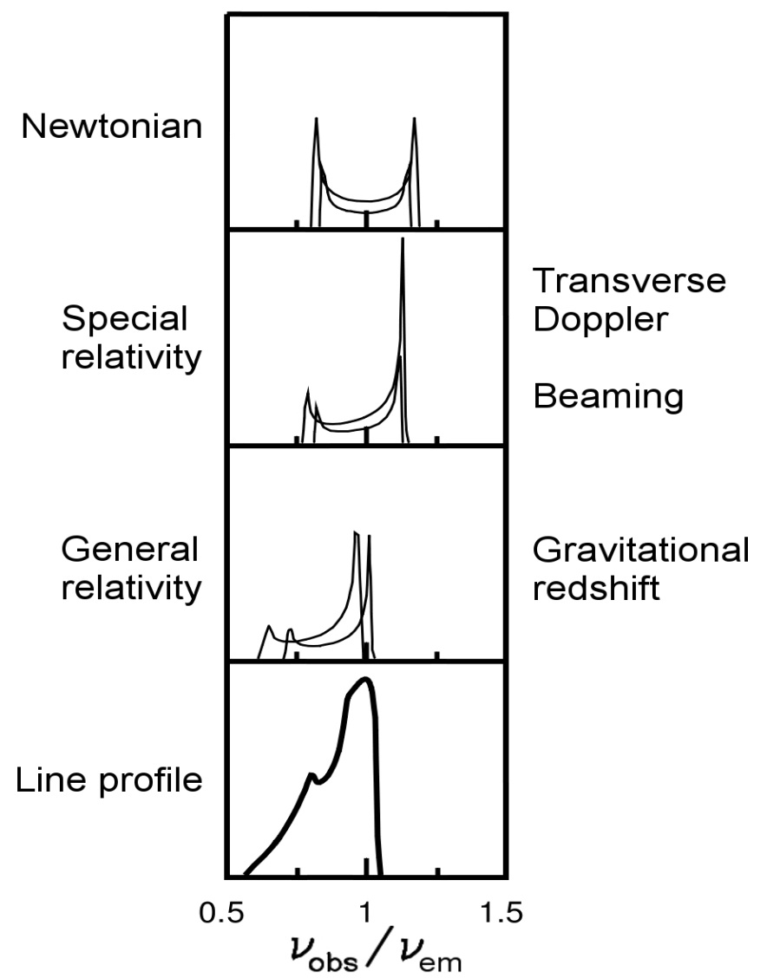
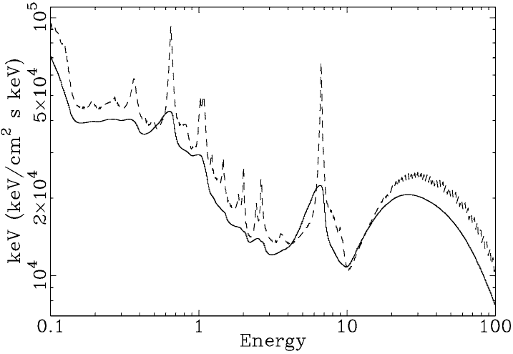
Relativistic Disk Reflection
Characterising the disc reflection component is one way in which we can measure black hole spin for both binaries and active galaxies
NuSTAR
Fabian et al. (2000)
XRU 2014
D. Walton
Notes:
NuSTAR bandpass ideally suited for studying reflection: “a reflection machine”
Reflection method can be applied to both AGN and GBHBs

Slide 6
NuSTAR Spin Program
NuSTAR is performing observations of both Galactic black hole binaries and active galaxies with the purpose of constraining their spin,
including (among others):
Active galaxies:
Galactic binaries:
Source | Coordination
NGC 1365 | XMM (x4)
MCG-6-30-15 | XMM
Mrk 335 | Suzaku
Swift J2127 | XMM
NGC 4151 | Suzaku
3C 120 | XMM
Fairall 9 | XMM
Source | Coordination
Cygnus X-1 | Suzaku
GRS 1915+105 | -
4U 1630-47 | -
4U 1957+11 | XMM
IC 10 X-1* | Chandra
(see also talk by G. Matt tomorrow)
XRU 2014
D. Walton
*Thermal continuum method to be utilized
Notes:
Focus for a bit on NGC1365

Slide 7
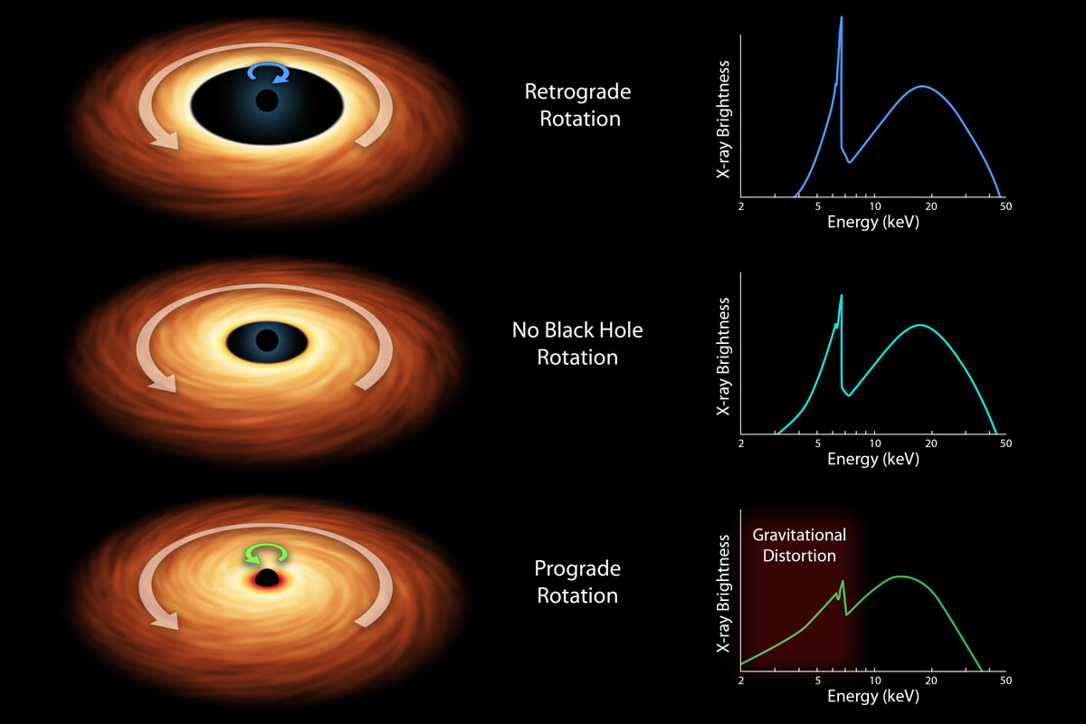
Black Hole Spin: Recap
XRU 2014
D. Walton
Notes:
Talk about reflection vs absorption degeneracy here
Introduce previous 1365 result
Only the first of 4 coordinated XMM+NuSTAR observations!

Slide 8
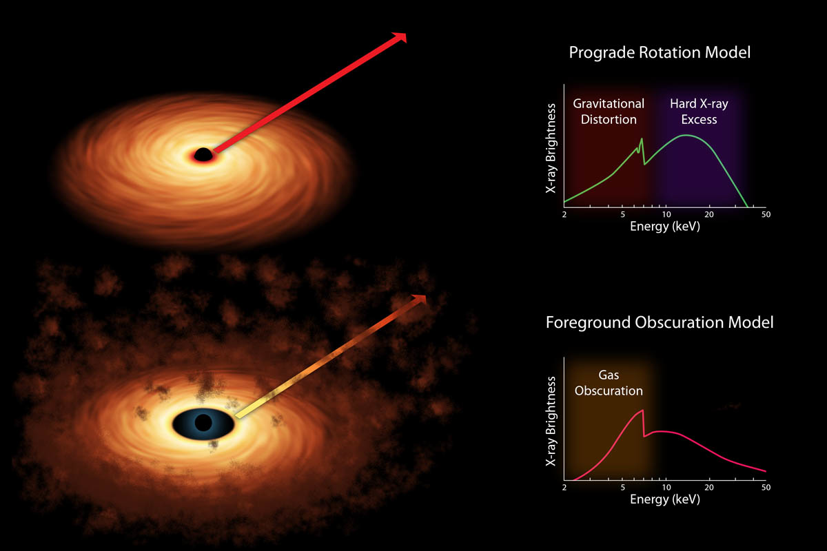
Complex Absorption
XRU 2014
D. Walton
Notes:
Talk about reflection vs absorption degeneracy here
Introduce previous 1365 result
Only the first of 4 coordinated XMM+NuSTAR observations!

Slide 9
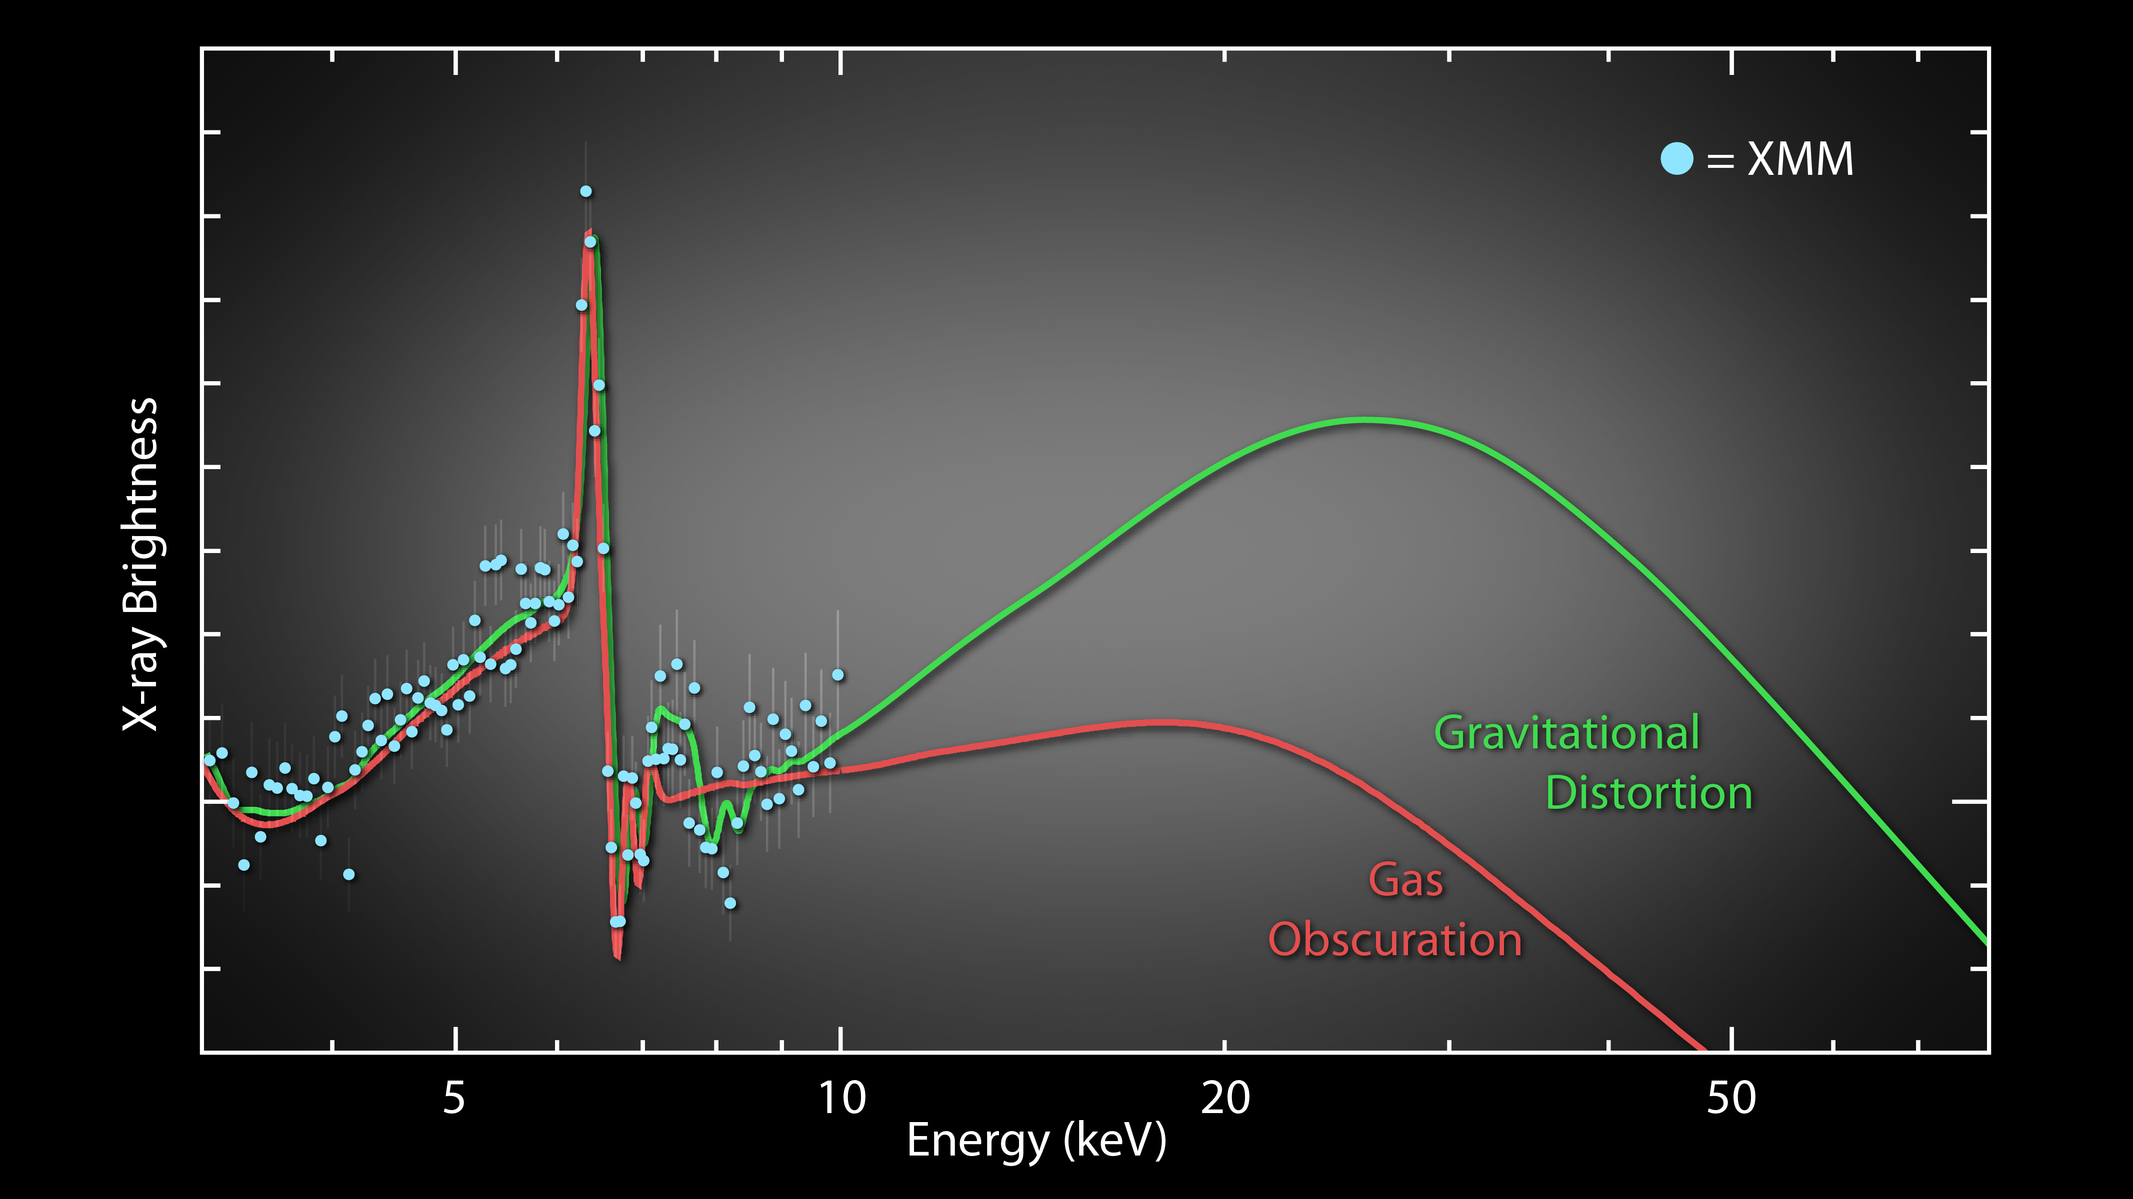
NGC 1365
NGC 1365
Risaliti et al. (2013, Nat)
XRU 2014
D. Walton
Notes:
Talk about reflection vs absorption degeneracy here
Introduce previous 1365 result
Only the first of 4 coordinated XMM+NuSTAR observations!

Slide 10
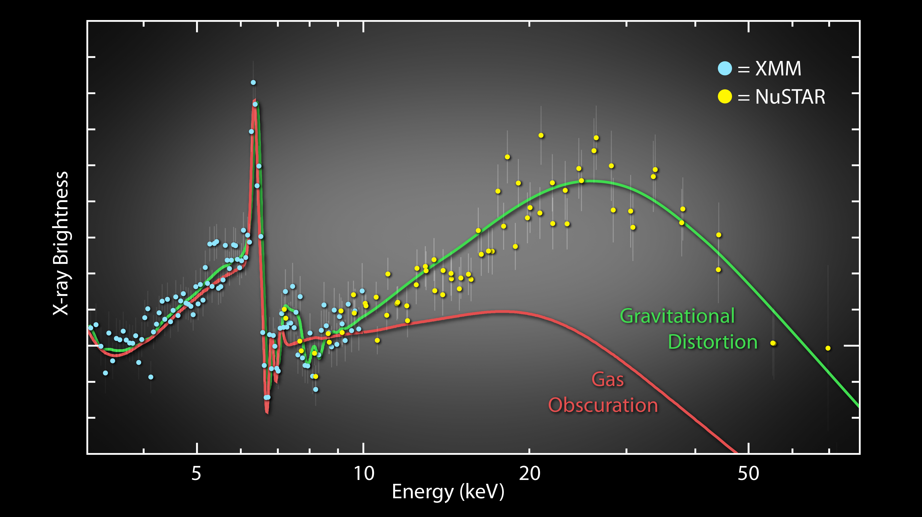
NGC 1365
NGC 1365
Risaliti et al. (2013, Nat)
XRU 2014
D. Walton
Notes:
Talk about reflection vs absorption degeneracy here
Introduce previous 1365 result
Only the first of 4 coordinated XMM+NuSTAR observations!

Slide 11
NGC 1365: NuSTAR+XMM
XMM
NuSTAR
Walton et al. (2014)
Characteristic signatures of disc reflection present regardless of the level of line-of-sight absorption (see poster F28 by E. Rivers focusing on absorption variability)
XRU 2014
D. Walton
Notes:
All four NuSTAR+XMM observations of NGC1365
Left: XMM count spectra, showing drastic spectral variability, dominated by variable absorption
Right: Characteristic disk reflection signatures always present
XMM below 10 keV, NuSTAR above 10 keV
Shameless plug for The Blizzard

Slide 12
NGC 1365: Variability
Walton et al. (2014)
Displays both long and short timescale variability,
some intrinsic, some due to variable absorption
XRU 2014
D. Walton
Notes:
Lightcurves
Some intrinsic variability, some absorption variability

Slide 13
NGC 1365: NuSTAR+XMM
Extracted spectra from 16 time intervals
Modelled data above and below 10 keV separately
Below 10 keV: absorbed powerlaw and broad iron emission line
Above 10 keV: powerlaw (same as below 10 keV) and a reflected continuum (pexrav)
Good correlation between EW of the broad line and R
Walton et al. (2014)
XRU 2014
D. Walton
Notes:
Quantities are RELATIVE to the continuum, i.e. not plotting flux vs flux

Slide 14
NGC 1365: NuSTAR+XMM
Walton et al. (2014)
The black hole spin and the disc inclination obtained are consistent for all four observations, even allowing for variable, partially covering absorption
XRU 2014
D. Walton
Notes:
Spin and inclination constraints for the four observations are consistent!

Slide 15
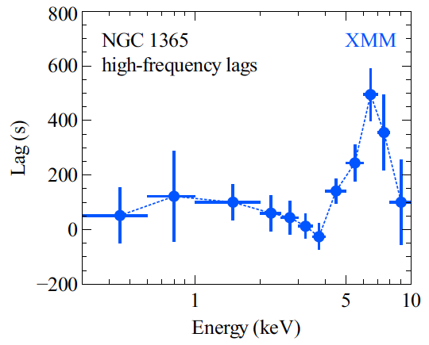
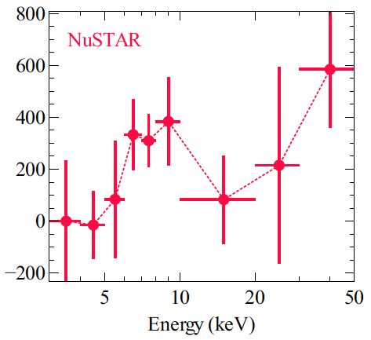
NGC 1365: X-ray Reverberation
Kara et al. (2014, sub.)
Clear reverberation (time delay) from the broad Fe K line, and marginal detection from the Compton hump, implies a compact
(R <~ 10 R_{G}) emission region (Uttley, Kara, Zoghbi talks tomorrow)
XRU 2014
D. Walton
Notes:
Reverberation lag seen at high frequencies, confirms reflection model

Slide 16
Conclusions
Our 4 coordinated NuSTAR + XMM observations of NGC 1365 reveal an extreme level of absorption variability, yet show the same characteristic signatures of reflection from the inner accretion disc
Broad Fe K line and the Compton hump are correlated, each observation independently returns the same BH spin and disc inclination, and X-ray reverberation now detected
These results confirm NGC 1365 hosts a rapidly rotating BH
The combination of NuSTAR and XMM allows us to resolve long-standing degeneracies regarding the interpretation of the spectral features observed from AGN
XRU 2014
D. Walton

Slide 17
NGC 1365: NuSTAR+XMM
Walton et al. (2014; sub.)
Correlation between EW_{broad} and R is not simply due to parameter degeneracies associated with the simple models used
XRU 2014
D. Walton

