Slide 1
Anatomy of the AGN in NGC 5548: Discovery of a fast and massive outflow
Jelle Kaastra
Jerry Kriss, Massimo Cappi, Missagh Mehdipour, Pierre-Olivier Petrucci, Katrien Steenbrugge, Nahum Arav, Ehud Behar, Stefano Bianchi, Rozenn Boissay, Graziella Branduardi-Raymont, Carter Chamberlain, Elisa Costantini, Justin Ely, Jacobo Ebrero, Laura Di Gesu, Fiona Harrison, Shai Kaspi, Julien Malzac, Barbara De Marco, Giorgio Matt, Paul Nandra, Stéphane Paltani, Renaud Person, Brad Peterson, Ciro Pinto, Gabriele Ponti, Francisco Pozo Nuñez, Alessandra De Rosa, Hiromi Seta, Francesco Ursini, Cor de Vries, Dom Walton, Megan Whewell

Slide 2
Why a campaign on NGC 5548?
AGN outflows: feedback for galaxy evolution
How do outflows work?
How much mass & energy?
Key quantity: distance outflow
Outflow response to changes L ➔ distance
Successful campaign on Mrk 509 in 2009
Time for another target: NGC 5548
One of two best studied Seyfert 1 galaxies (2400 publications over half a century)

Slide 3
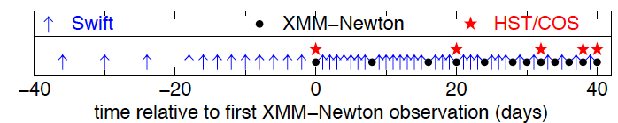
Set-up campaign
14 x 50 ks with XMM-Newton (RGS, EPIC, OM)
6 x HST/COS
4 x NuSTAR
4 x INTEGRAL
3 x Chandra LETGS
Daily Swift monitoring (XRT, UVOT)
Ground-based support (Israel, Chile)
Core June/July 2013, 2 observations ½ year later

Slide 4
Surprise: very low soft X-ray flux
Notes:
First spectrum was even 3 x lower than rest; Flux 30 x lower; NLR features comparable to 2002

Slide 5
Strong absorption but normal high-E flux

Slide 6
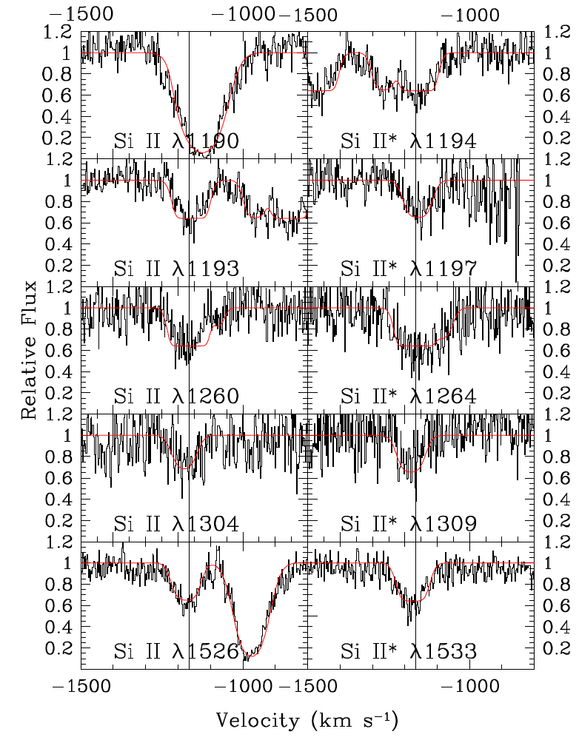
Appearance of lowly ionised gas
Notes:
Lots of new, narrow low-ionisation lines never seen before in NGC 5548 *** At previously known outflow velocities
Some are density-dependent *** ➔ n=10⁵ cm⁻³, distance 5 pc

Slide 7
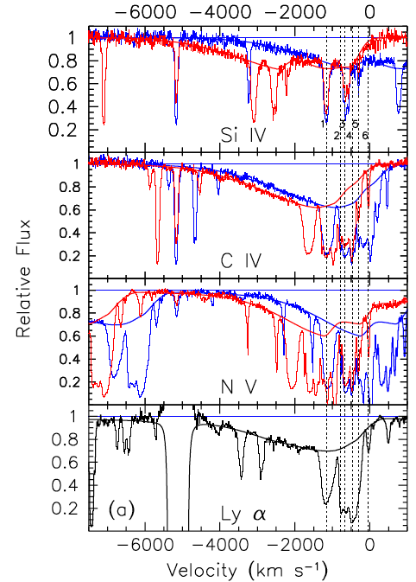
UV broad absorption lines
Notes:
C IV line; Narrow absorption lines known for > 2 decades; see reduced blue wing in all resonance lines (abs from ground state), but not in non-res lines like He II 1640 (=Halpha in He); EW correlates with continuum

Slide 8
Obscuring stream
Two components:
Main: log ξ = -1.2, N_{H}=10²⁶ m⁻², f_{cov}=0.86 (X-ray) and ~0.3 in UV; produces UV BAL
Second: almost neutral, N_{H}=10²⁷ m⁻², f_{cov}=0.3 (X-ray) and <0.1 in UV
Partial covering inner BLR, v up to 5000 km/s, inside WA ➔ distance few light days (~10¹⁴ m, 0.003 pc)
Obscuration already 3 years ongoing

Slide 9
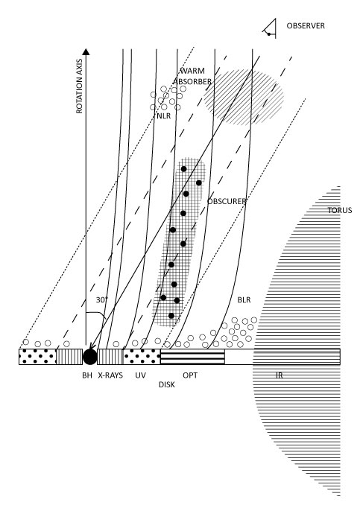
What is going on?

Slide 11
Shielding

Slide 12
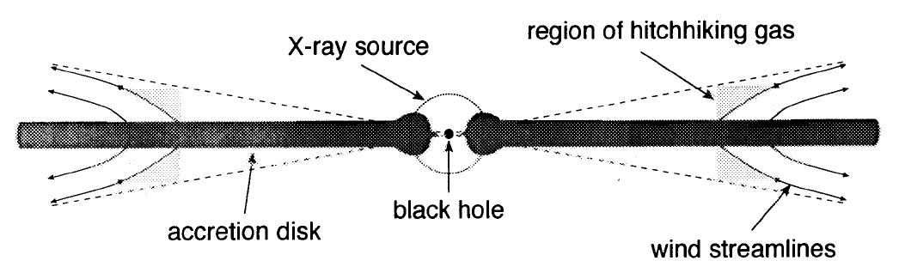
Importance for feedback
(Murray et al. 1995)

Slide 13
Conclusion
New obscuring stream appears in NGC 5548
  Fast
  Clumpy
  Long-lasting
  Close to BLR
  Likely from accretion disk
Importance: X-ray shielding process for feedback
See also next 5 talks & posters F10, F36
Movie
Press release & paper tomorrow end of the day

