Slide 1
Origin of the Seemingly Broad Iron-Line Spectral Feature in Seyfert Galaxies
Ken EBISAWA (JAXA/ISAS)
with
H. INOUE, T. MIYAKAWA, N. ISO, H. SAMESHIMA,
M. MIZUMOTO, H. YAMASAKI

Slide 2
Publication related to this talk
  Inoue, Miyakawa and Ebisawa, 2011, PASJ, 63S, 669
    Methods and application to Suzaku MCG-6-30-15
  Miyakawa, Ebisawa and Inoue, 2012, PASJ, 64, 140
    MCG-6-30-15 with Suzaku and Chandra
  Mizumoto, Ebisawa and Sameshima, PASJ submitted
    1H0707-495 with Suzaku and XMM
  Iso et al., to be submitted to PASJ
    ~20 Seyfert1 galaxies with Suzaku
  Yamasaki et al. in preparation
    IRAS13224-3809 and other NLSy1 galaxies
Essentially, we propose the same model for all these sources.

Slide 3
Structure of the talk
Introduction
Variable Double Partial Covering (VDPC) model
Application of the VDPC model to observations
Geometry around the central engine
Conclusions

Slide 4
Structure of the talk
Introduction
Variable Double Partial Covering (VDPC) model
Application of the VDPC model to observations
Geometry around the central engine
Conclusions

Slide 5
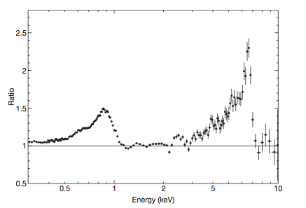
1. Introduction
Examples of seemingly broad iron K- and L-line features
Iron-K
Iron-L
Iron-K
1H0707-495 with XMM (Fabian+ 2009)
MCG-6-30-15 with ASCA (Tanaka+ 1995)

Slide 6
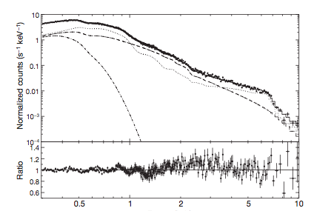
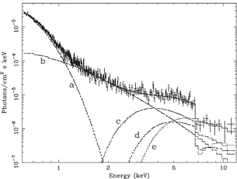
Two degenerate spectral models
Relativistic disk reflection model
Disk reflection
component
1H0707-495 with XMM (Fabian+ 2009)
X-ray emission region is required to be very compact (~Rs) so that the relativistic disk reflection takes place
Direct
component
Partial covering model
1H0707-495 with XMM (Tanaka+ 2004)
Direct
component
Partial covering clouds with a size of ~several Rs at a radius of ~100 Rs
Absorbed
component
The same spectra can be fitted by the completely different models.

Slide 7
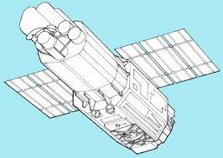
How can we distinguish the two degenerate spectral models?
Partial covering and relativistic disk reflection do not work simultaneously
Absorbing clouds
~10 Rs (2cm)
X-ray emission
Region ~Rs (2mm)
X-rays
Satellite
Distance to the absorbing clouds
~100Rs (20cm)
When the absorbing cloud size is larger than the X-ray source size,
partial covering does NOT take place (always full-covering)

Slide 8
How can we distinguish the two degenerate spectral models?
Partial covering and relativistic disk reflection do not work simultaneously
X-ray emission
Region ~10Rs (2cm)
Absorbing clouds
~10 Rs (2cm)
X-rays
Satellite
Distance to the absorbing clouds
~100Rs (20cm)
Only when the X-ray source size is greater than or
comprative to the absorber size, partial covering does take place

Slide 9
How can we distinguish the two degenerate spectral models?
If we can find evidence of the partial covering
  The X-ray emission region is extended
  Relativistic disk reflection does not take place
  Controversy is over…

Slide 10
Structure of the talk
Introduction
Variable Double Partial Covering (VDPC) model
Application of the VDPC model to observations
Geometry around the central engine
Conclusions

Slide 11
Structure of the talk
Introduction
Variable Double Partial Covering (VDPC) model
Application of the VDPC model to observations
Geometry around the central engine
Conclusions

Slide 12
2. Variable Double Partial Covering (VDPC) model
Satellite
X-ray source
( 1- α+ α exp(-N_{H}^{(k)}σ(ξ_{k})) × (1-α + α exp(-N_{H}^{(n)}σ(ξ_{n}))
Partial covering by thick and cold absorbers with the partial covering fraction α
Partial covering by thin and hot absorbers with the same α
Responsible for iron K-edge
Responsible for iron L-edge

Slide 13
However, It is hard to imagine two separate layers with the same partial covering fraction so…
Satellite
X-ray source

Slide 14
However, It is hard to imagine two separate layers with the same partial covering fraction so…
Satellite
X-ray source
Thick and cold core responsible for the iron K-edge
Thin and hot envelope responsible for the iron L-edge
Presumably, the partial absorbers have inner structures;
thick and cold core and thin and hot envelope

Slide 15
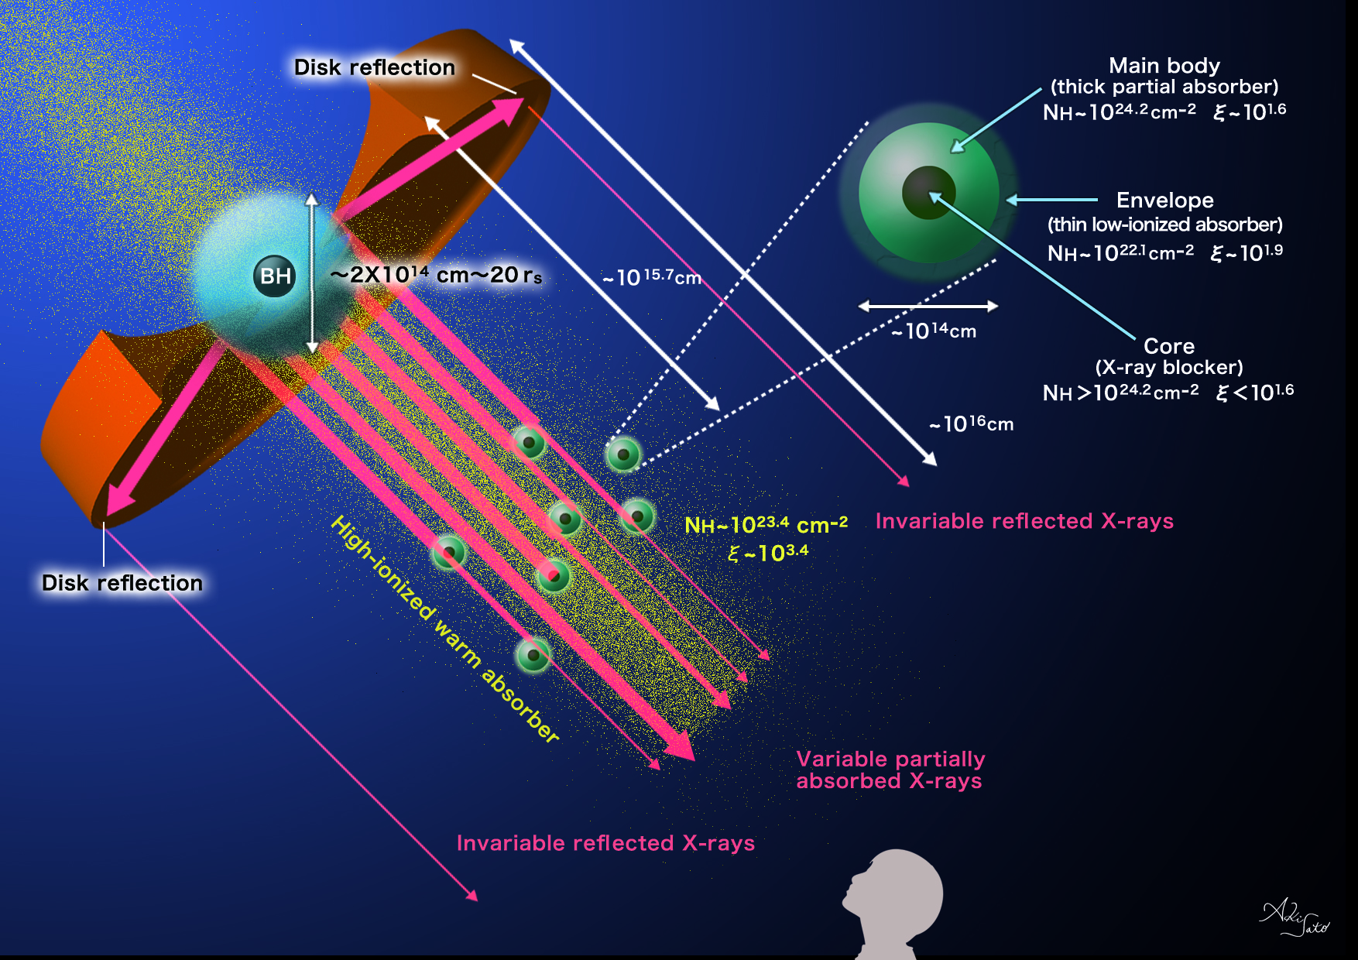
Miyakawa, Ebisawa and Inoue (2012)

Slide 16
Variable Double Partial Covering Model
Intrinsic luminosity and spectral shape hardly variable below ~a day.
Variation of covering fraction explains most short-term spectral variations.
Notes:
このモデルは最小限のパラメータでスペクトル変化を説明するわけですが、そのパラメータとは、BHからのX線を電離吸収体が隠している割合を示す、カバーリングファクターというパラメータです。また、このモデルではX線源の光度ほとんど変化しないと考えています。
下の図はずざく衛星が観測したMCG−6の強度別スライススペクトルで、横軸がエネルギー、縦軸が強度を表しています。モデルの成分として、赤でdirect componentと青で吸収成分を表しています。
右の図は、さきほど示したモデルの状況において、X線源を真正面から見たときの様子を表しています。
電離吸収体がX線源をほとんど覆っている場合、スペクトルの強度は小さくなります。

Slide 17
Variable Double Partial Covering Model
Intrinsic luminosity and spectral shape hardly variable below ~a day.
Variation of covering fraction explains most short-term spectral variations.
Extended
X-ray source
direct component
absorbed component
Partial absorbers with inner structure
MCG-6-30-15 (Miyakawa, Ebisawa and Inoue 2012)
Notes:
このモデルは最小限のパラメータでスペクトル変化を説明するわけですが、そのパラメータとは、BHからのX線を電離吸収体が隠している割合を示す、カバーリングファクターというパラメータです。また、このモデルではX線源の光度ほとんど変化しないと考えています。
下の図はずざく衛星が観測したMCG−6の強度別スライススペクトルで、横軸がエネルギー、縦軸が強度を表しています。モデルの成分として、赤でdirect componentと青で吸収成分を表しています。
右の図は、さきほど示したモデルの状況において、X線源を真正面から見たときの様子を表しています。
電離吸収体がX線源をほとんど覆っている場合、スペクトルの強度は小さくなります。

Slide 18
Variable Double Partial Covering Model
Intrinsic luminosity and spectral shape hardly variable below ~a day.
Variation of covering fraction explains most short-term spectral variations.
Covering fraction varies
MCG-6-30-15 (Miyakawa, Ebisawa and Inoue 2012)
Notes:
電離吸収体がX線源を隠す割合が減っていくと、direct componentが増えて吸収成分が減ります。
逆に、電離吸収体が隠すと、direct componentが減り、吸収成分が増えます。
この変化を表しているのがカバーリングファクターというパラメータです。

Slide 19
Variable Double Partial Covering Model
Intrinsic luminosity and spectral shape hardly variable below ~a day.
Variation of covering fraction explains most short-term spectral variations.
Covering fraction varies
MCG-6-30-15 (Miyakawa, Ebisawa and Inoue 2012)

Slide 20
Variable Double Partial Covering Model
Intrinsic luminosity and spectral shape hardly variable below ~a day.
Variation of covering fraction explains most short-term spectral variations.
Covering fraction varies
MCG-6-30-15 (Miyakawa, Ebisawa and Inoue 2012)

Slide 21
Variable Double Partial Covering Model
Intrinsic luminosity and spectral shape hardly variable below ~a day.
Variation of covering fraction explains most short-term spectral variations.
Covering fraction varies
MCG-6-30-15 (Miyakawa, Ebisawa and Inoue 2012)

Slide 22
Variable Double Partial Covering Model
Intrinsic luminosity and spectral shape hardly variable below ~a day.
Variation of covering fraction explains most short-term spectral variations.
Covering fraction varies
MCG-6-30-15 (Miyakawa, Ebisawa and Inoue 2012)

Slide 23
Variable Double Partial Covering Model
Intrinsic luminosity and spectral shape hardly variable below ~a day.
Variation of covering fraction explains most short-term spectral variations.
Covering fraction: Null
MCG-6-30-15 (Miyakawa, Ebisawa and Inoue 2012)

Slide 24
Structure of the talk
Introduction
Variable Double Partial Covering (VDPC) model
Application of the VDPC model to observations
Geometry around the central engine
Conclusions

Slide 25
Structure of the talk
Introduction
Variable Double Partial Covering (VDPC) model
Application of the VDPC model to observations
Geometry around the central engine
Conclusions

Slide 26
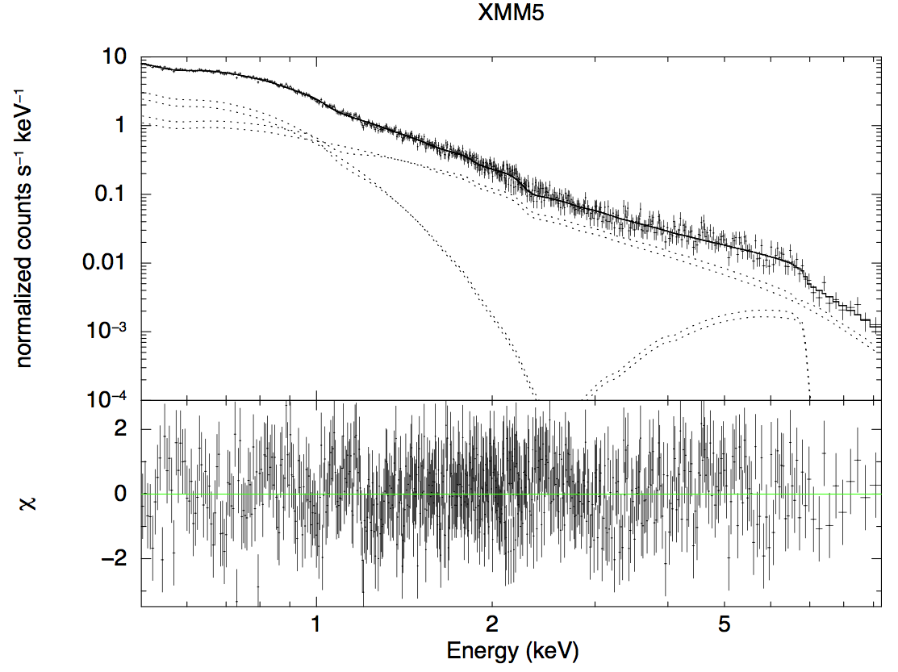
3. Application of the VDPC model to observations: spectral fits
Iron L-feature
due to thin/hot absorber
1H0707-495 (XMM, EPIC)
Power-law
component
Iron K-feature due to
thick/cold absorber
Optically thick disk
component
Thick/cold absorber:
N_{H}~10²⁴cm⁻², ξ~10^{0.1-0.3}
Thin/hot absorber:
N_{H}~10²³cm⁻², ξ~10³
Mizumoto, Ebisawa and Sameshima (2014)

Slide 27
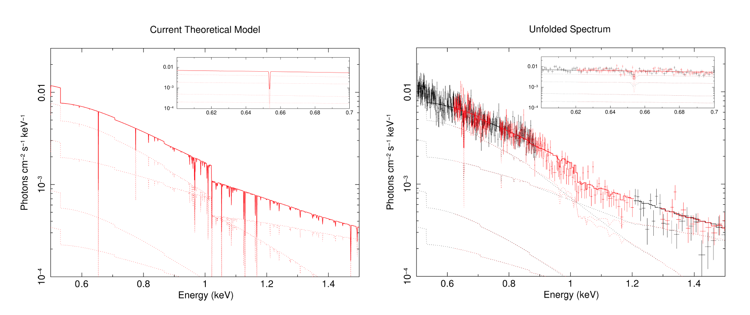
1H0707+495 iron-L and other low-energy feature
Model (based on EPIC)
RGS spectral fit
Mizumoto, Ebisawa and Sameshima (2014)
Iron-L and weak absorption line features
consistent with the RGS spectra

Slide 28
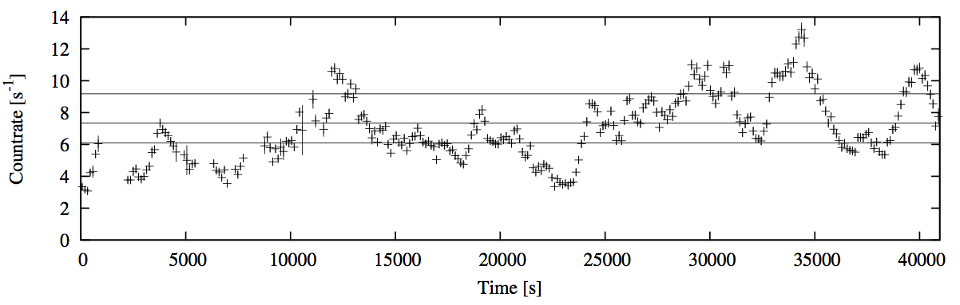
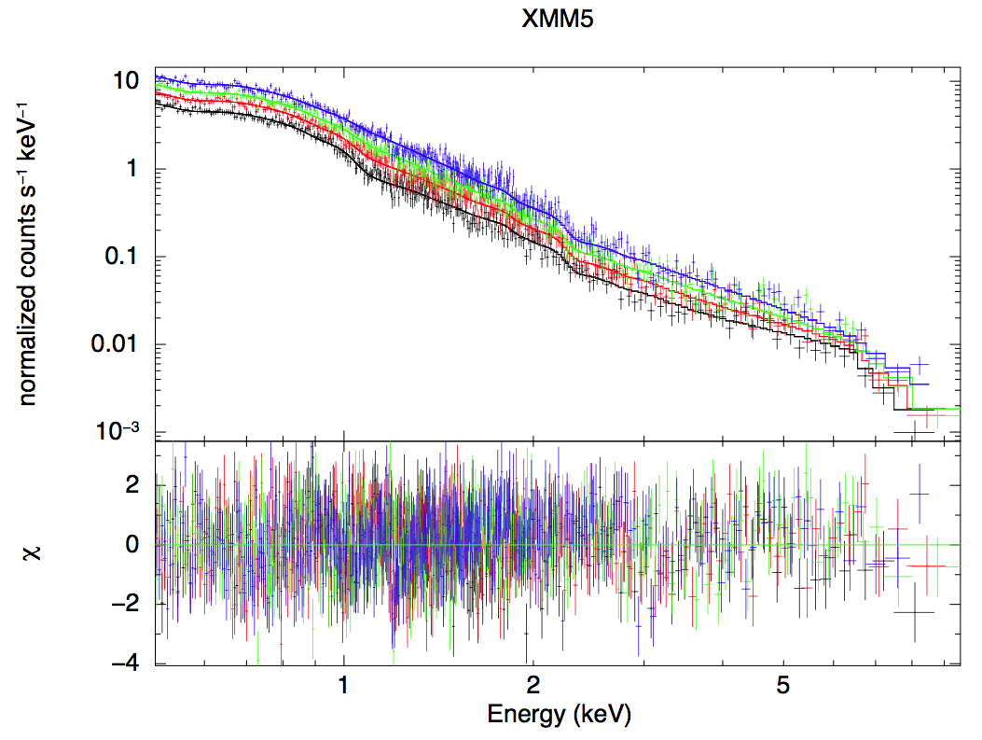
3. Application of the VDPC model to observations: flux-sorted spectral fits
1H0707-495 (XMM)
Observation within ~a day is divided into four different flux levels
Flux-sorted spectra are fitted simultaneously only varying the partial covering fraction.
Mizumoto, Ebisawa and Sameshima (2014)

Slide 29
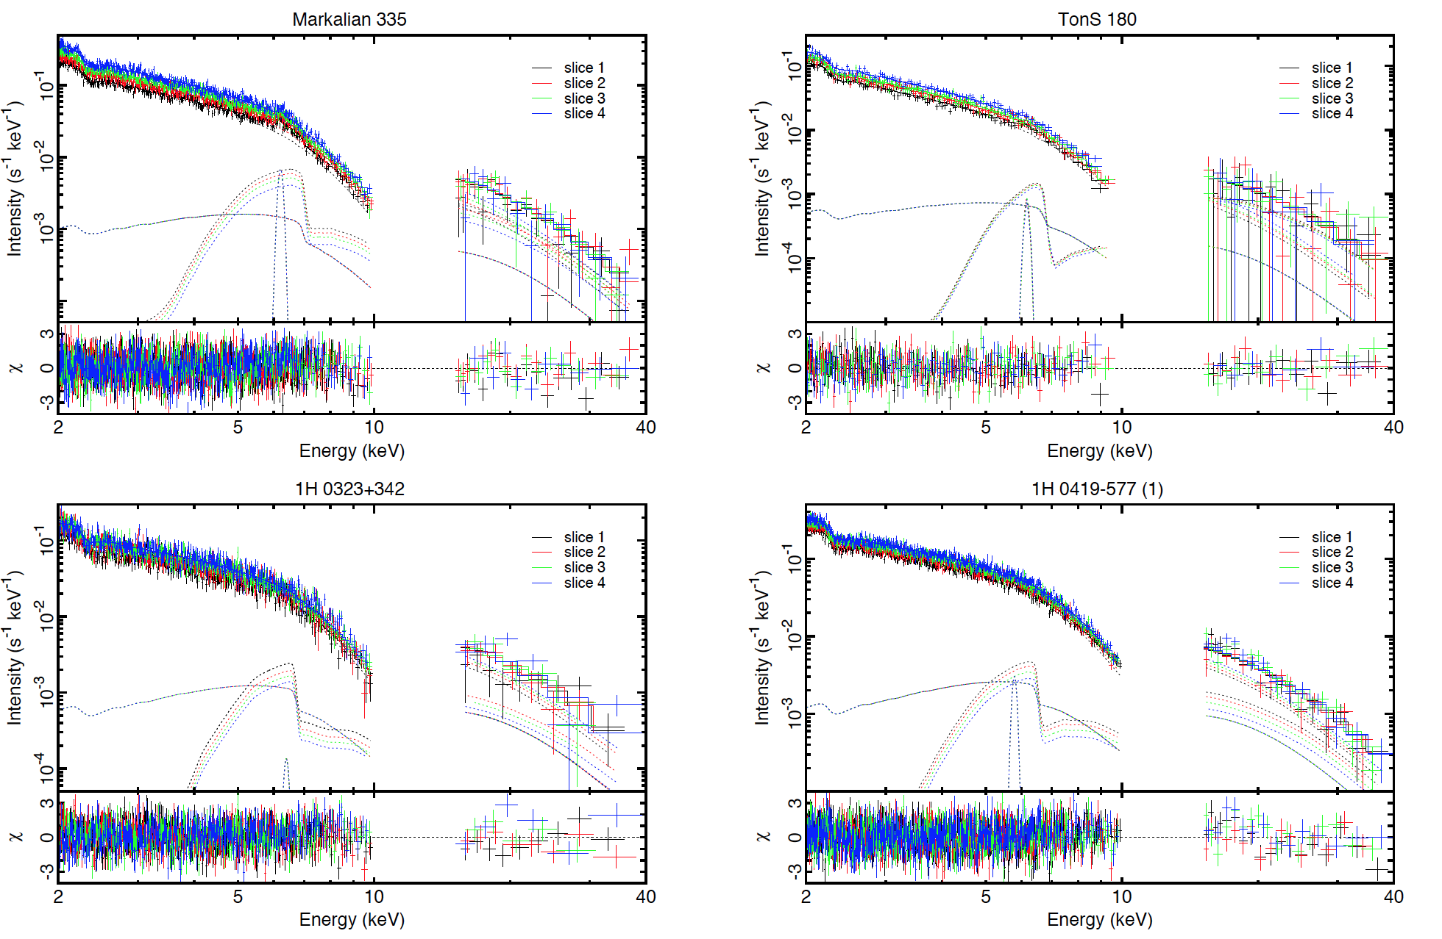
Flux-sorted spectra fitted simultaneously only varying the partial covering fraction.
Iso et al. (2014)

Slide 30
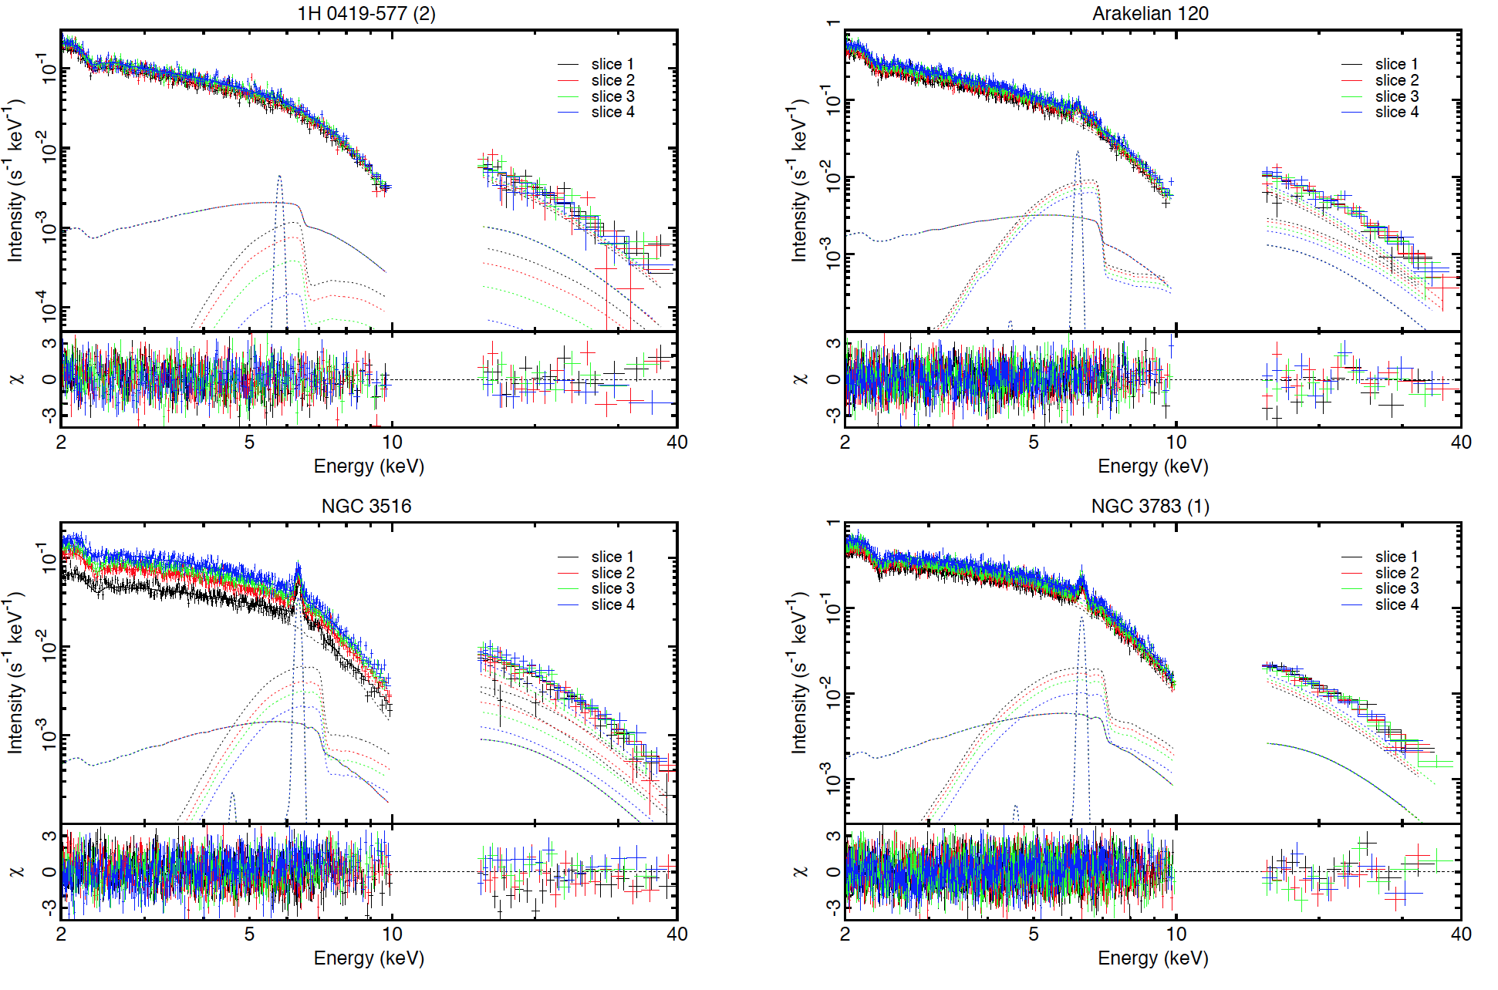
Flux-sorted spectra fitted simultaneously only varying the partial covering fraction.
Iso et al. (2014)

Slide 31
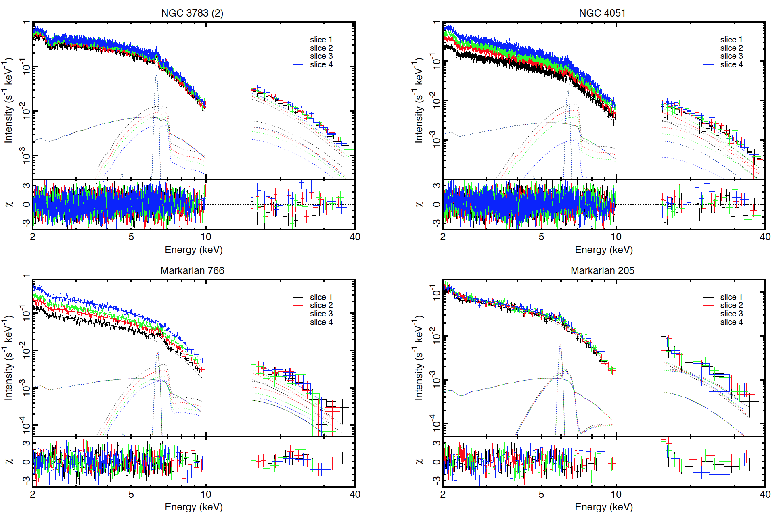
Flux-sorted spectra fitted simultaneously only varying the partial covering fraction.
Iso et al. (2014)

Slide 32
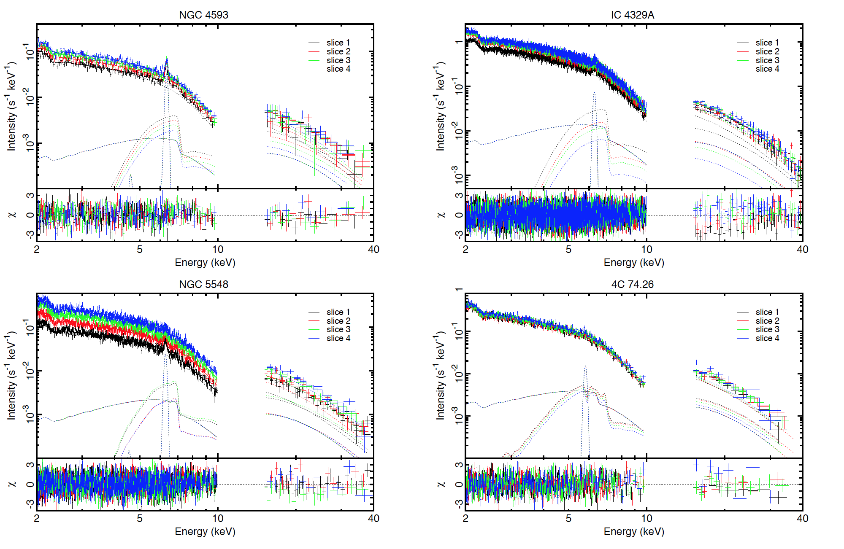
Flux-sorted spectra fitted simultaneously only varying the partial covering fraction.
Iso et al. (2014)

Slide 33
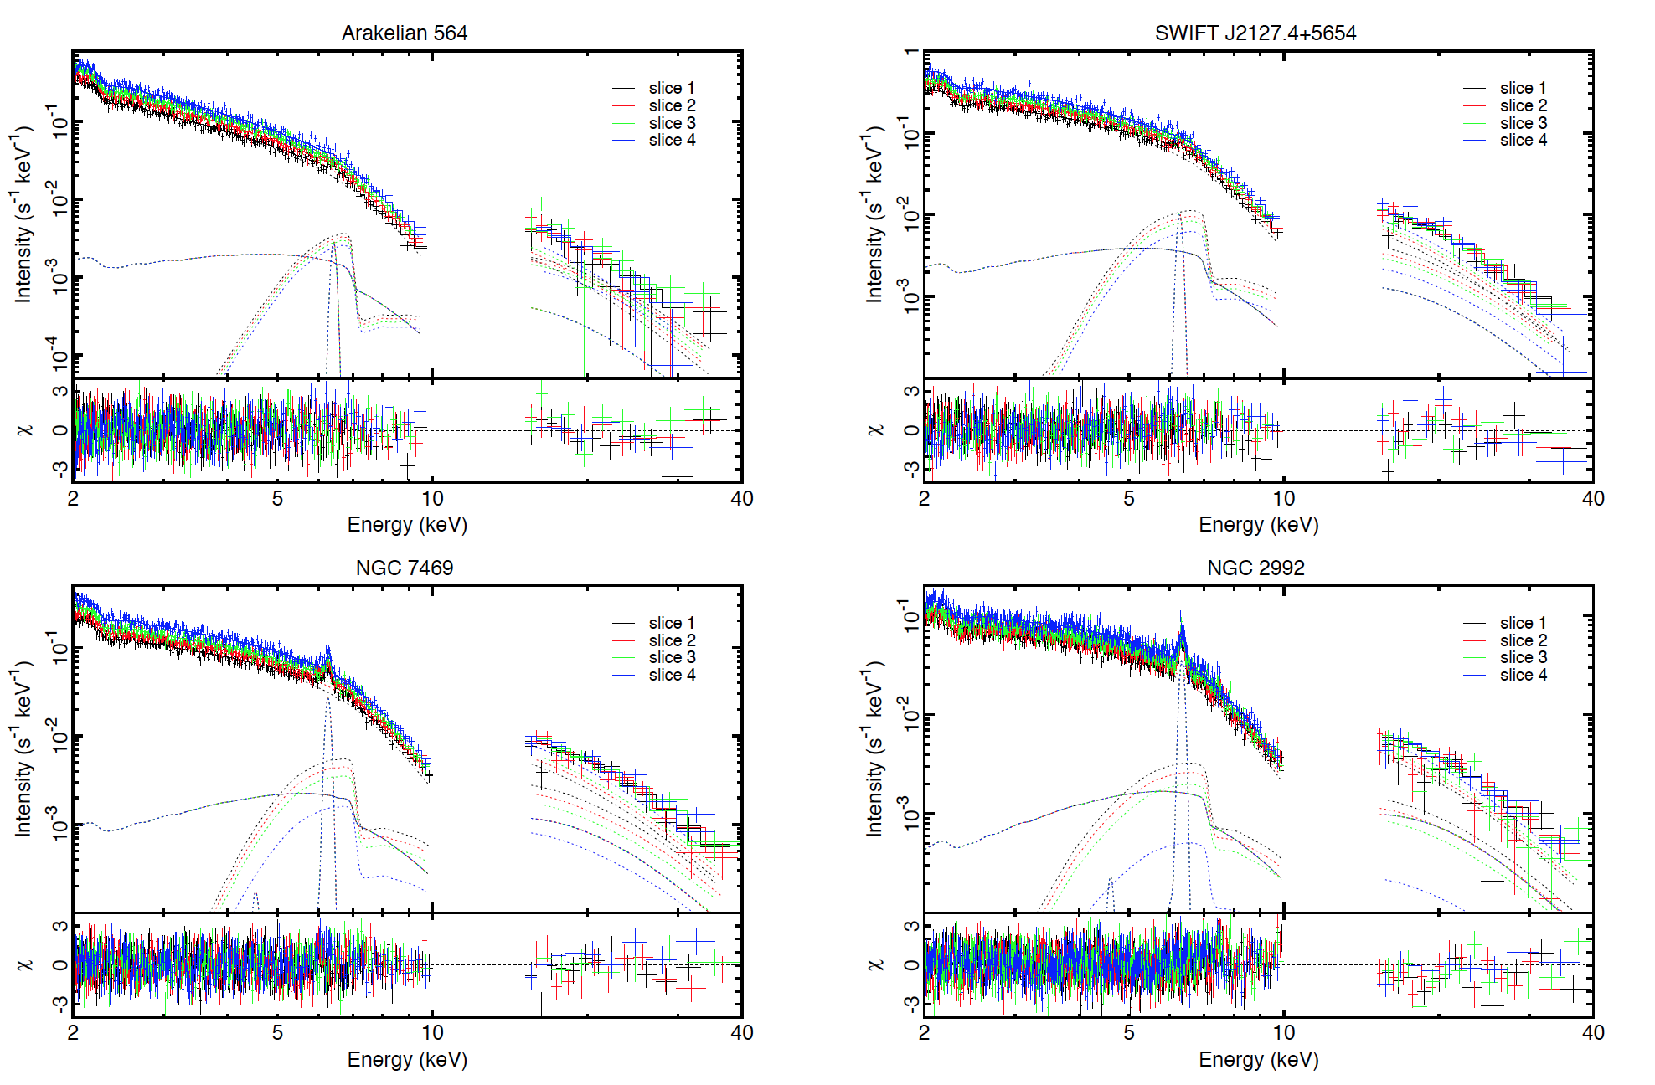
Flux-sorted spectra fitted simultaneously only varying the partial covering fraction.
Iso et al. (2014)

Slide 34
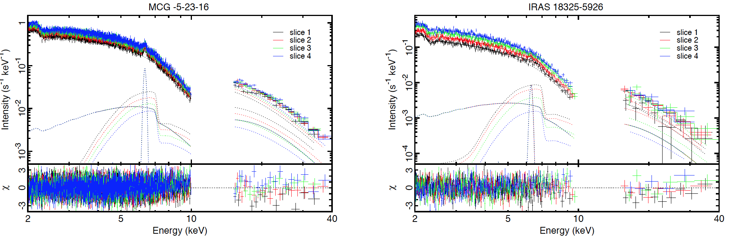
Flux-sorted spectra fitted simultaneously only varying the partial covering fraction.
Iso et al. (2014)

Slide 35
3. Application of the VDPC model to observations: RMS spectra
〜10⁴ sec
〜10⁵ sec
(Matsumoto+ 2003)
MCG-6-30-15 with ASCA
Energy dependence of Root Mean Square (RMS) variation
RMS spectra of the Seyfert galaxies with broad iron features show significant drop at the iron K energy band

Slide 36
3. Application of the VDPC model to observations: RMS spectra
In the VDPC model, variations of the direct component and the absorbed component cancel each other
This is most effective in the iron K- energy band
RMS spectral characteristics of MCG-6-30-15 explained (Inoue, Miyakawa, Ebisawa 2011; Miyakawa, Ebisawa and Inoue 2012)

Slide 37
3. Application of the VDPC model to observations: RMS spectra
In the VDPC model, variations of the direct component and the absorbed component cancel each other
This is most effective in the iron K- energy band
direct compoent
absorbed
component
reflection
Iron line
Iso et al. (2014)

Slide 38
3. Application of the VDPC model to observations: RMS spectra
解析
Observed Root Mean Square spectrum is explained by only variation of the covering fraction
Black:data
Red:model
Iso et al. (2014)
Notes:
次にRMSスペクトルとモデルを比較しました。
図はNGC3516のRMSスペクトルで、データとモデルがよく一致しています。
また、鉄輝線あたりの時間変動も再現できています。

Slide 39
Example of
other sources
Black:data
Red:model
Iso et al.
(2014)

Slide 40
Example of
other sources
Black:data
Red:model
Iso et al.
(2014)

Slide 41
Example of
other sources
Black:data
Red:model
Iso et al.
(2014)

Slide 42
3. Application of the VDPC model to observations: light curves
We examine if light curves (512 sec bin) in different energy bands are explained by the VDBC model.
From the 0.5-10 keV counting rates, we calculate α for each bin, from which we calculate model light curves in 0.5-1.0 keV (Soft), 1.0 keV-3.0 keV (Medium) and 3.0-10 keV (Hard).
Compare the simulate light curves in the three energy bands with the observed ones.

Slide 43
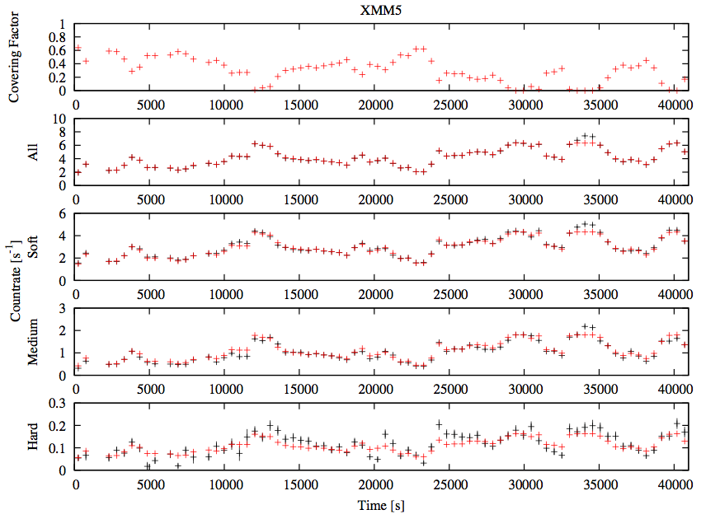
Red: model
Black: data
1E0707-495 with XMM
Mizumoto, Ebisawa and Sameshima (2014)

Slide 44
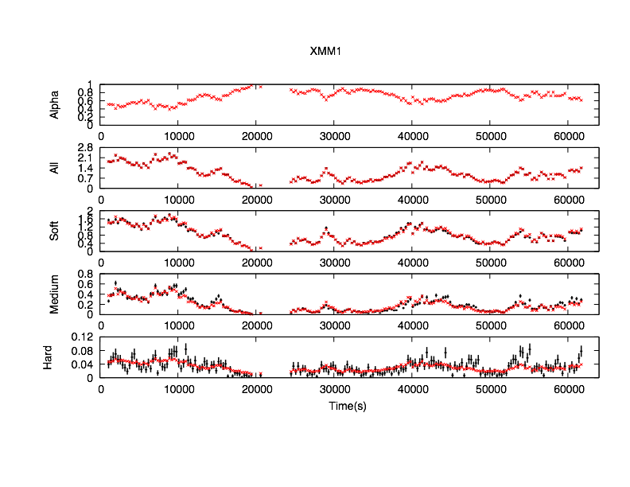
Red: model
Black: data
IRAS13224-3809 with XMM
Yamasaki et al. (2014)

Slide 45
3. Application of the VDPC model to observations: light curves
Soft band (0.5-1.0 keV) light curves are explained by the VDPC model.
Agreement between model and data is reasonably good in Medium (1.0-3.0 keV) and Hard (3.0 -10keV) band, but worse in higher energies.
Deviation in the Hard band presumably indicates intrinsic variation of the hard spectral component.

Slide 46
Structure of the talk
Introduction
Variable Double Partial Covering (VDPC) model
Application of the VDPC model to observations
Geometry around the central engine
Conclusions

Slide 47
Structure of the talk
Introduction
Variable Double Partial Covering (VDPC) model
Application of the VDPC model to observations
Geometry around the central engine
Conclusions

Slide 48
4. Geometry around the central engine
Covering fraction can be large (α>0.9) in the VDPC model.
Significant fluorescent iron lines (6.4 keV) are not observed.
  → Absorbers are preferential located in the line of sights

Slide 49
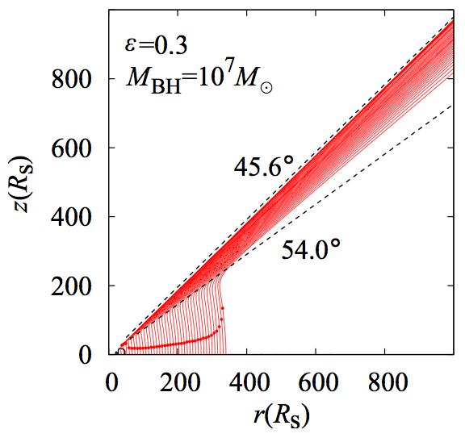
4. Geometry around the central engine
Disk winds simulation:
outflows are limited in a narrow
range of the zenith angle
Partially
Absorbed
X-rays
Our line of sight is aligned to the outflow?
Nomura et al. (2013)

Slide 50
Structure of the talk
Introduction
Variable Double Partial Covering (VDPC) model
Application of the VDPC model to observations
Geometry around the central engine
Conclusions

Slide 51
Structure of the talk
Introduction
Variable Double Partial Covering (VDPC) model
Application of the VDPC model to observations
Geometry around the central engine
Conclusions

Slide 52
5. Conclusions
We systematically studied Seyfert galaxies which are known to have “seemingly” broad iron line features.
We propose the Variable Double Partial Covering model, where the central X-ray source is partially covered by absorbing clouds with an internal ionization structure.
The seemingly broad iron K- and L- features are explained by the K- and L-edges due to the cold/thick core and the hot/thin envelope of the absorbing cloud, respectively.
Spectral variation below timescales of ~day is mostly explained by only change of the partial covering fraction.
Evidence of the partial covering indicates the central X-ray source being extended (~>10 Rs), which refute the “relativistic disk reflection ” model.

