Slide 1

AGNs in Dwarf Galaxies? Evidence from WISE and XMM-Newton
Nathan J. Secrest
Collaborators: Shobita Satyapal (GMU), Seth Mowry (GMU), Mario Gliozzi (GMU), Teddy Cheung (NRL)

Slide 2
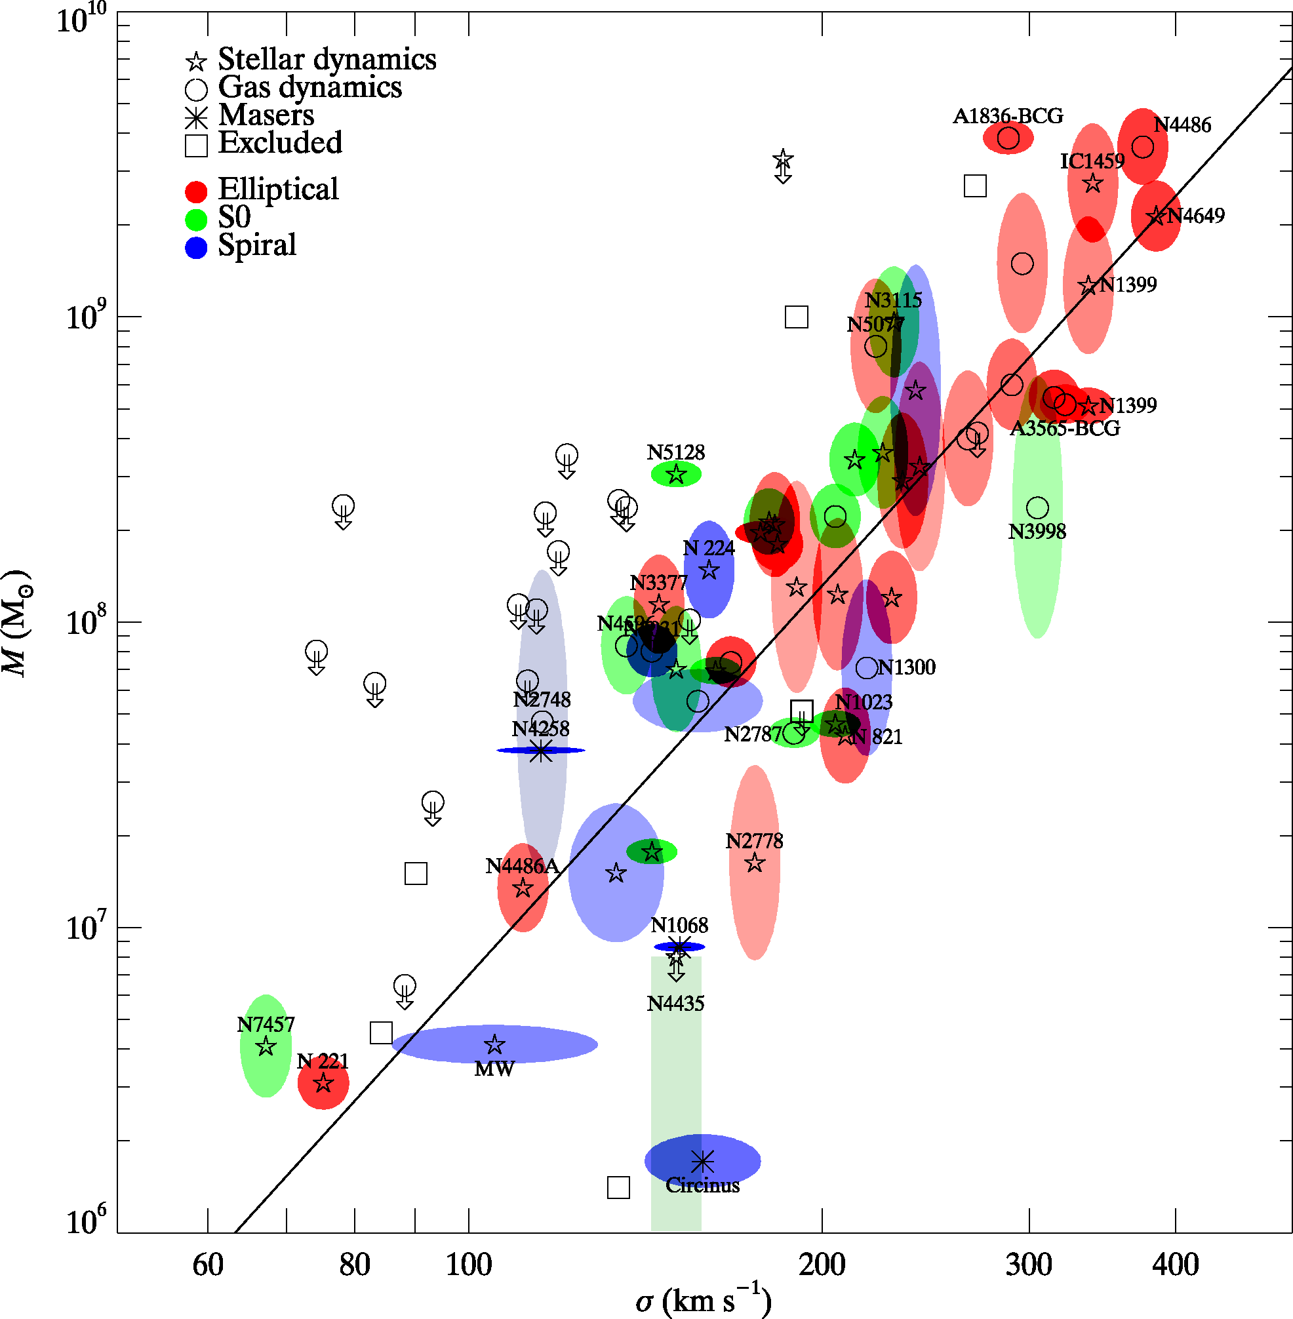
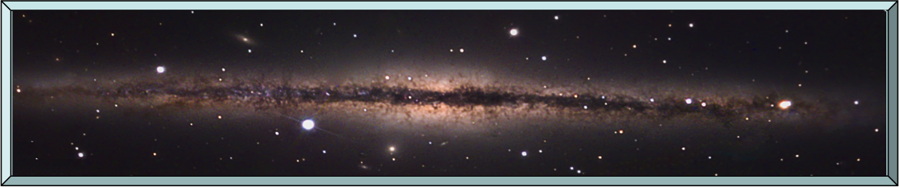
Background
M_{BH} and M_{bulge} correlated through mergers+AGN feedback
10⁵-10⁶ M BHs found in bulgeless galaxies!
Merger-free pathways for BH growth?
Late-type bulgeless galaxies dusty and AGNs weak → optical studies miss!
Gultekin et al. (2009)
Notes:
billion+ M_Sol 700 million years after the BB

Slide 3
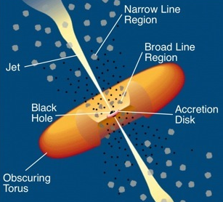
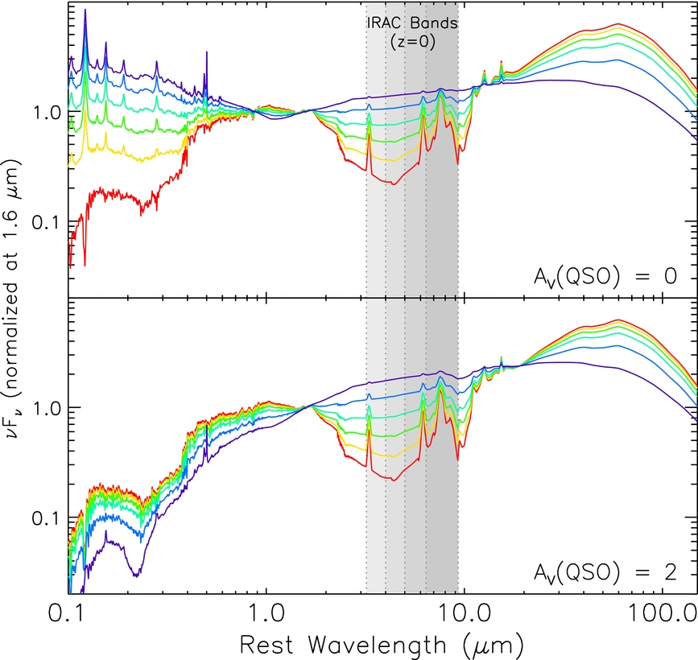
Previous Work
Mid-IR:
  AGN-heated dust (T = 1000-1500 K) produces distinctive SED between 3-10 μm
  Passes through intervening gas/dust
  Wide-Field Infrared Survey Explorer (WISE): Full-sky coverage at 3.4, 4.6, 12, and 22 μm
Pure AGN
Starburst
(Donley et al. 2012)
Notes:
Most of the mid-IR emission in galaxies comes from thermally-reprocessed radiation from dust grains. In AGNs, the dust can get to much higher temperatures, producing a distinctly different mid-IR spectral energy distribution, as you can see from this figure. Here we plot the flux vs. wavelength for a purely star forming galaxy, shown in red. As you can see, there is a broad peak in the optical and near_IR part of the spectrum due to stellar emission, followed by a dip in the spectrum and another peak at longer wavelengths from thermally reprocessed radiation from dust. Shown in purple, is the SED of a powerful AGN (the other curves represent varying contributions of AGN and starlight emission to the total galaxy light). As you can see, in the mid-IR, where the stellar emission falls, the SED of the AGN shows significant emission due to extremely hot dust emission. You can see that you can easily distinguish between these two photmetrically in the infrared using the infrared color , which is the ratio of the fluxes in two infrared bands in the shaded region.

Slide 4
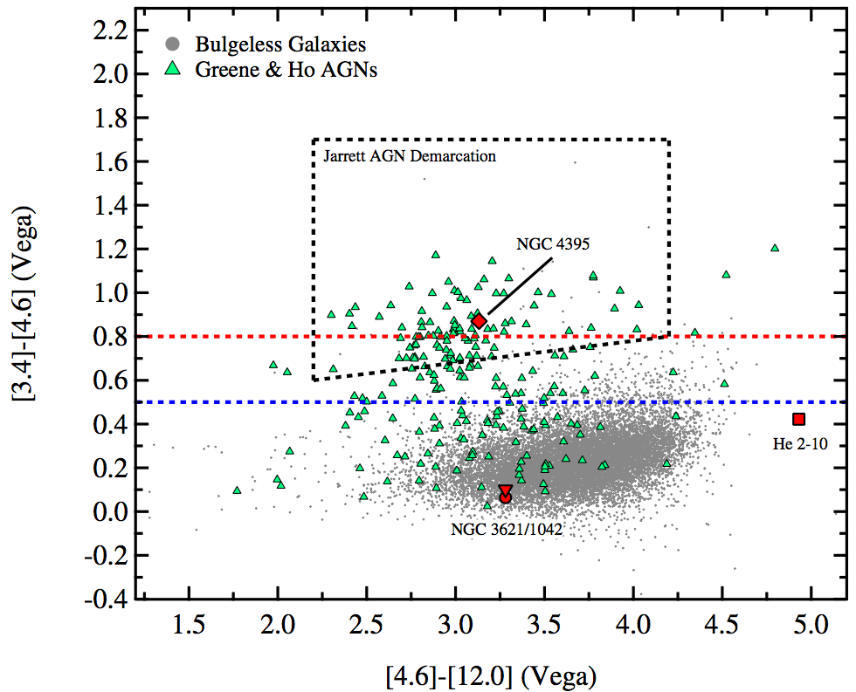
Previous Work
13,862 bulgeless galaxies with WISE colors
353 with evidence for AGN activity!
Mid-IR selected AGNs a factor of 6 higher than optical studies indicate!
Satyapal et al. (2014)

Slide 5
Previous Work
Mid-IR AGN fraction goes up with decreasing mass?

Slide 6
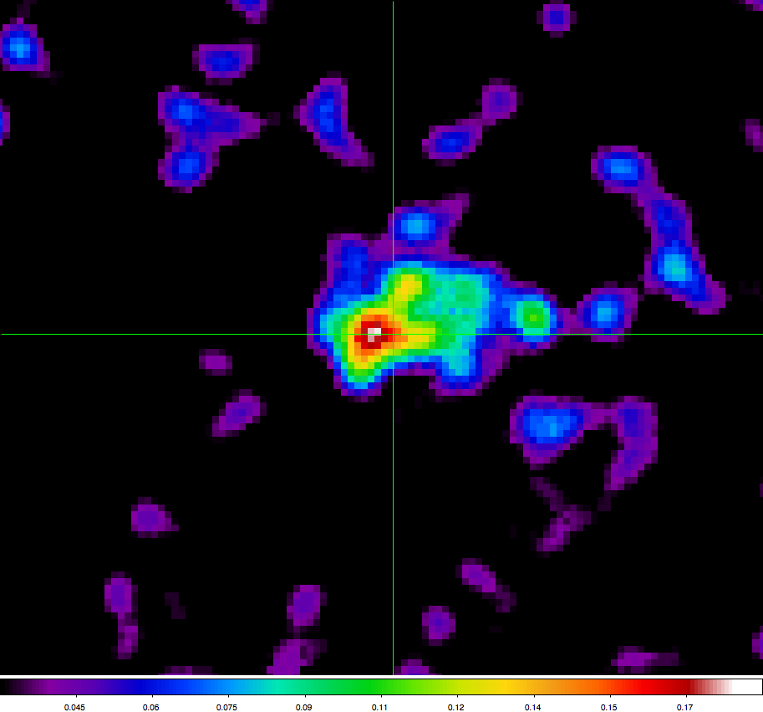
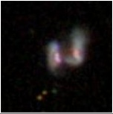
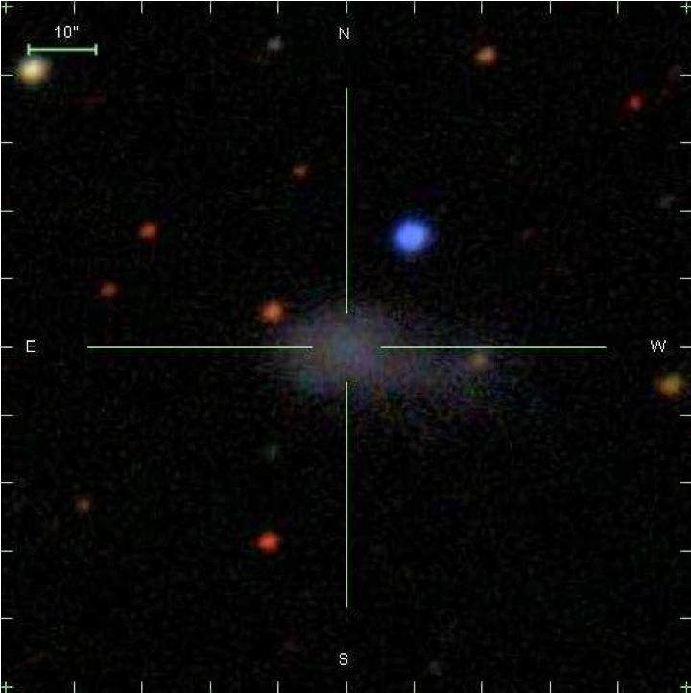
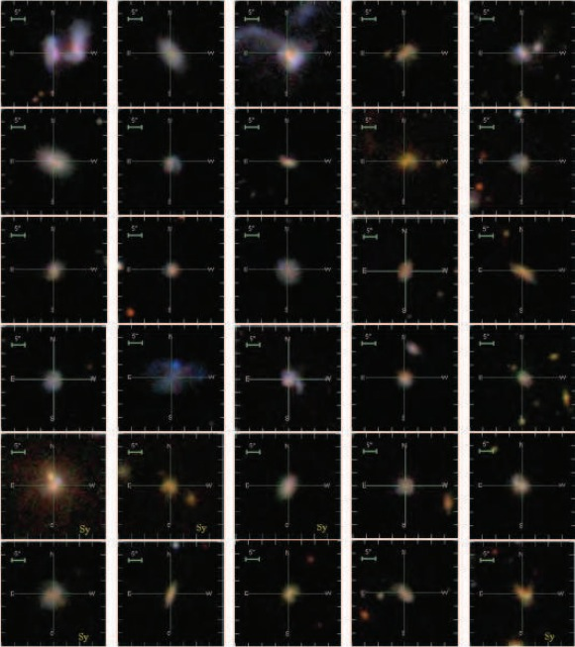
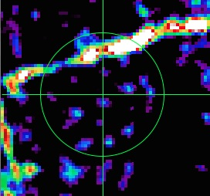
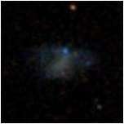
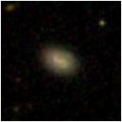
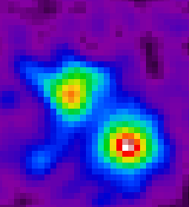
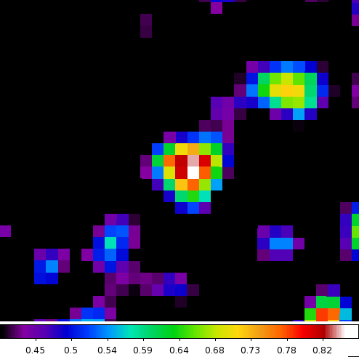
Current Work
Observed 4 of the mid-IR selected bulgeless galaxies with XMM
At least 3/4 have X-ray sources!
The rest of this talk will concentrate on this source, J1329
(Satyapal et al. 2014)

Slide 7
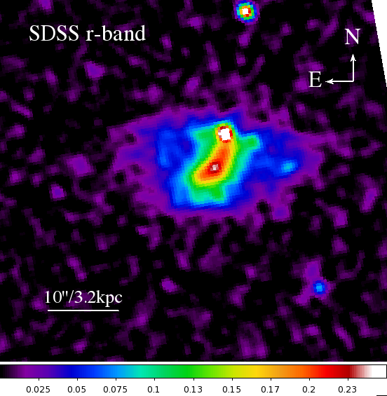
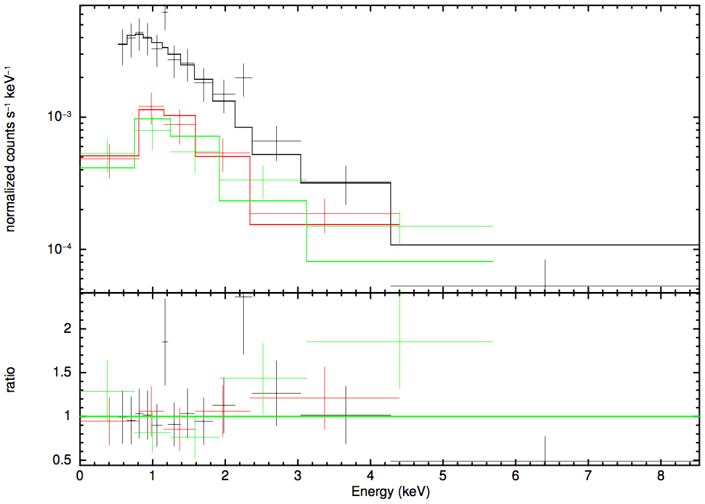
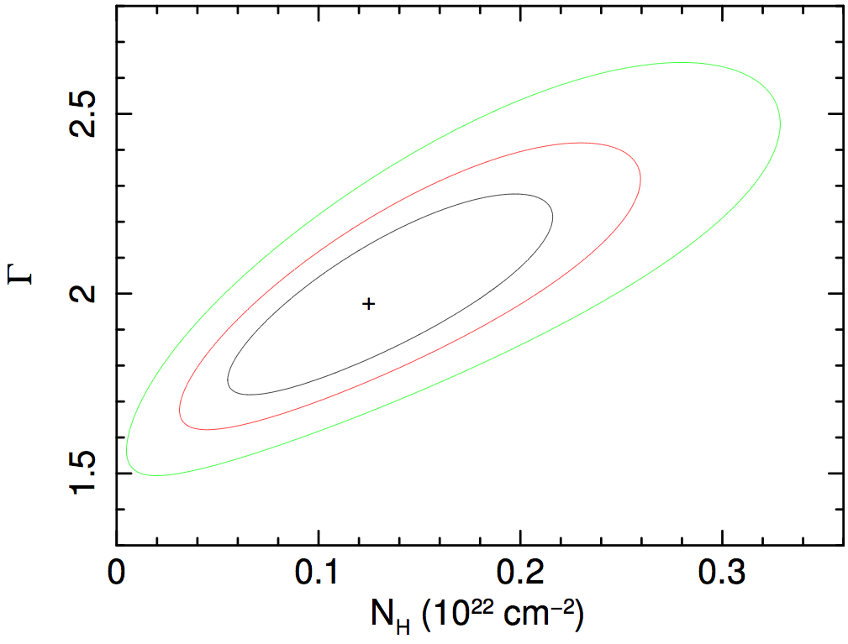
Current Work
J1329:
d = 71.1 Mpc
log(M/M) = 8.3
(LMC: 9.5)
12+log(O/H)=8.3
The rest of this talk will concentrate on this source, J1329
Best-fit: Γ = 2.0
N_{H} = 10²¹ cm⁻²
L_{X} = 3 x 10⁴⁰ erg s⁻¹
Notes:
Expected L_X from Lehmer et al. 2010: ~ 2x 10^37

Slide 8
An AGN?
AGN-like mid-IR colors
Typical power-law X-ray spectrum
What else could it be?

Slide 9
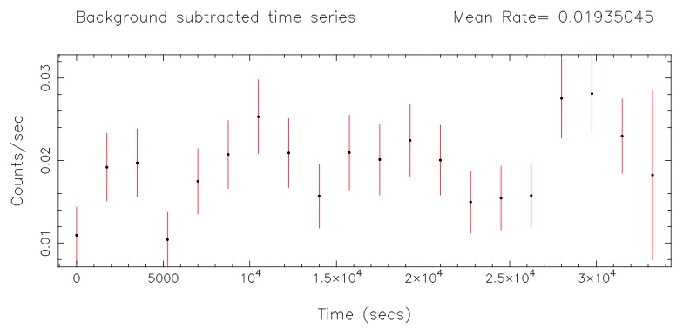
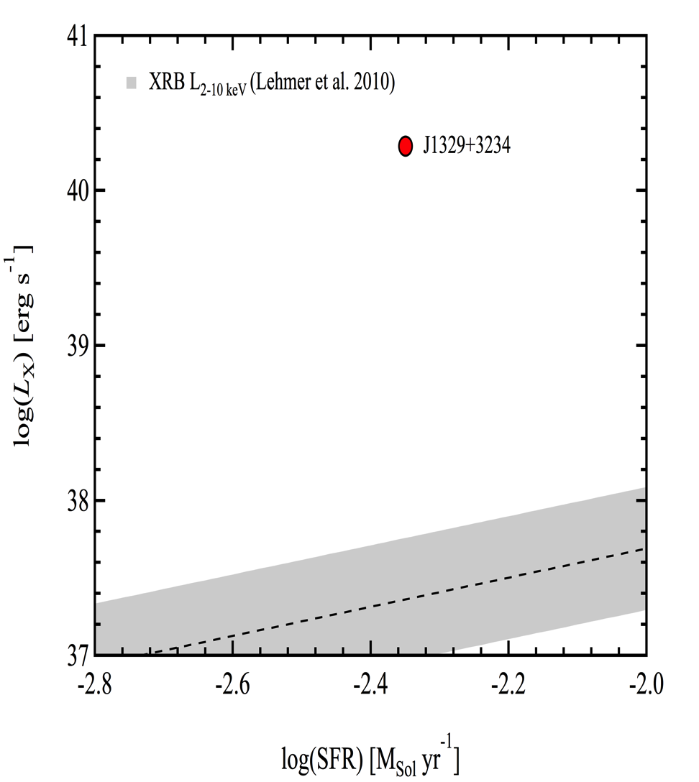
HMXBs?
HMXBs: L_{X} ~ 10³⁷⁻³⁸ erg s⁻¹
Source also variable: P_{constant} ~ 0.1% (2-10 keV)
→ Likely single source!
log(SFR) = -2.350 M yr⁻¹
→ L₂₋₁₀ _{keV} 1,000 times brighter than expected! (Lehmer+2010)
Secrest et al. (2014, in prep.)

Slide 10
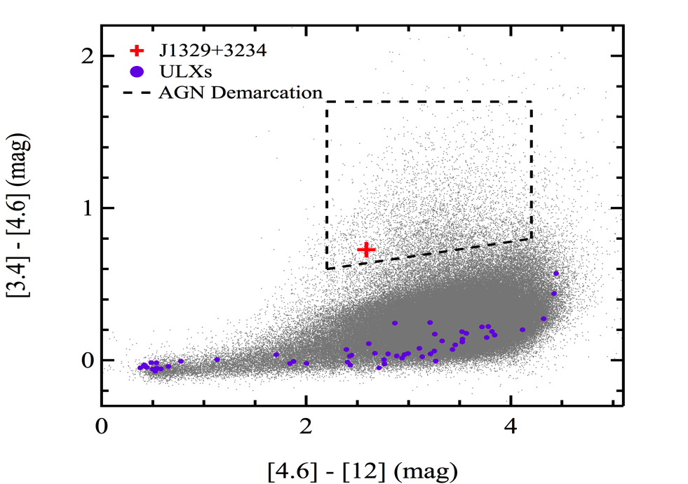
ULXs/beaming?
Not a starburst galaxy…
Walton et al. (2011) ULX catalog 470 → WISE → 59 ULXs with XMM & WISE detections
None with WISE point source emission!
Reddest: W1-W2=0.57
  - J1329: W1-W2 = 0.727
Secrest et al. (2014, in prep.)

Slide 11
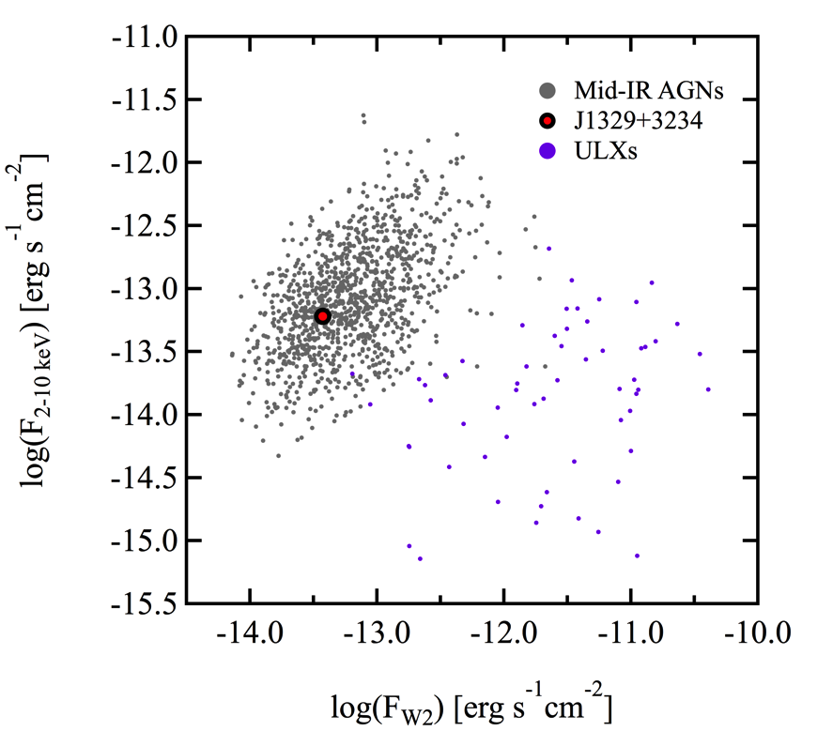
ULXs/beaming?
Let’s say they do have point sources…
ULX F_{x}/F_{W2} uncorrelated, occupies entirely different locus
J1329: AGN-like F_{x}/F_{W2}
➔ Beaming unlikely
Secrest et al. (2014, in prep.)

Slide 12
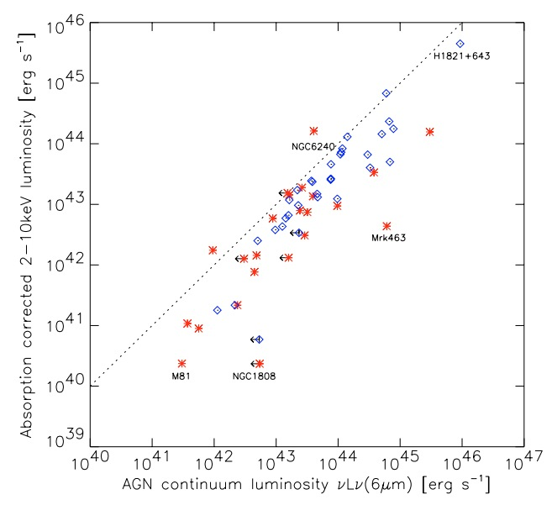
Another way to see it…
J1329
Adapted from Lutz et al. (2004)

Slide 13
VLA Data
February: RMS = 5.35 μJy A/A C/X observations
No VLA detection: Upper limit on BH mass?
  Fundamental Plane (Gultekin+2009 ver.): M_{BH, 3σ} < 10⁷ M
Eddington mass: ~ 10³-10⁴ M (κ = 10 - 100)

Slide 14
Conclusions
Follow-up X-ray observations show that WISE is a potentially a highly effective tool for finding obscured AGNs, perhaps even in dwarf galaxies.
J1329 hosts a likely AGN with M_{BH} > 10³-10⁴ M
If J1329 is typical of follow-up X-ray observations, fraction of obscured AGNs could be a factor of 6 higher in bulgeless/dwarf galaxies.
Much work left to do in this rich field!

