Slide 1

A New Cosmological Distance Measure Using AGN X-Ray Variability
Stefano Bianchi
Fabio La Franca, Gabriele Ponti, Enzo Branchini, Giorgio Matt
The X-ray Universe 2014 - 17 June, 2014, Dublin, Ireland

Slide 2
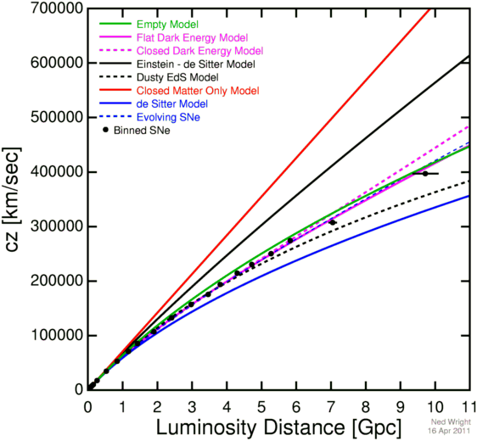
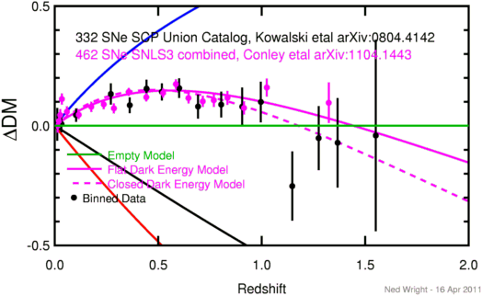
One of the most important results of observational cosmology
is the discovery of the accelerating expansion of the universe, using SNeIa as standard candles
However, the use of SNeIa
is difficult beyond z ∼ 1 and limited up to z ∼ 2
Given their high luminosities, there have been several studies on the use of AGN as standard candles

Slide 3
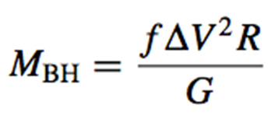
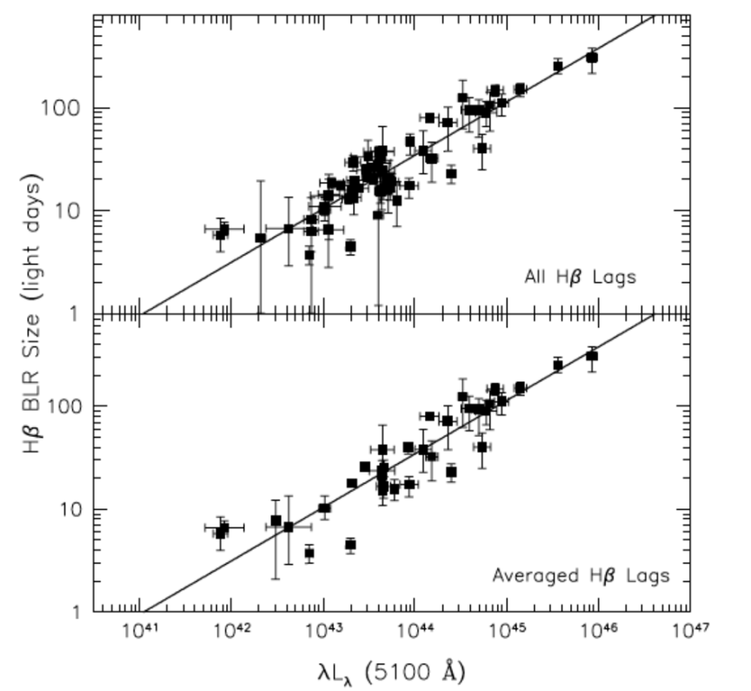
Virial BH Masses: From Reverberation Mapping to Single-Epoch Methods
The BLR in AGN is powered by photoionization from the central source. RM lags provide an estimate of its size. If we assume that the BLR is virialized and dominated by the gravitational field of the central BH, then the BH mass is
Geometrical
Factor
BLR Velocity (FWHM)
BLR Radius (RM lag)
Bentz et al. 2009
RM observations found a tight correlation between the BLR size and the optical continuum luminosity. A slope of alpha = 0.5 is found, as expected, if U and the electron density are more or less constant, and/or if the BLR size is set by dust sublimation
It was suggested to use the R - L relation (~0.15 dex) as an absolute luminosity indicator, although RM is very time consuming and still limited to local AGN

Slide 4
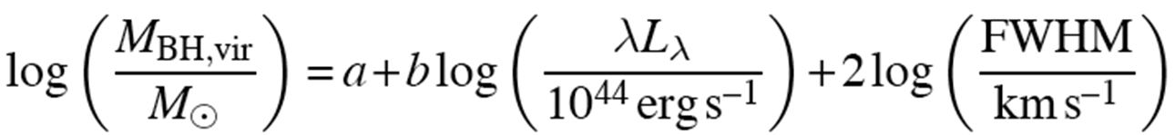
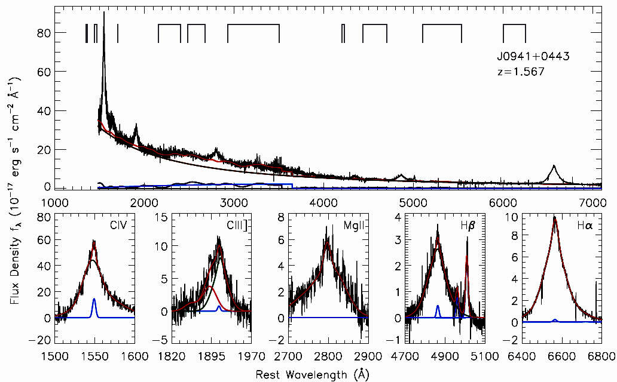
Virial BH Masses: From Reverberation Mapping to Single-Epoch Methods
The observed R-L relation provides a much less expensive way to estimate the size of the BLR, allowing a single-epoch virial BH mass estimator: from the same spectrum, one estimates the BLR size from the measured luminosity using the R-L relation, and the width of the broad emission line (typically, Hβ or MgII 2798Å or CIV 1459Å). The derived BH masses have uncertainties ~0.5 dex
Shen & Liu 2012

Slide 5
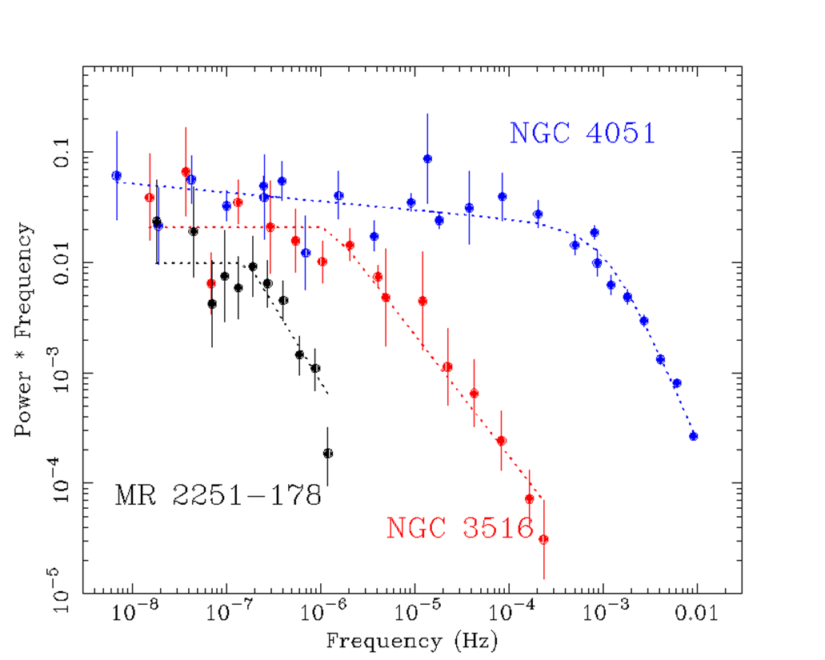
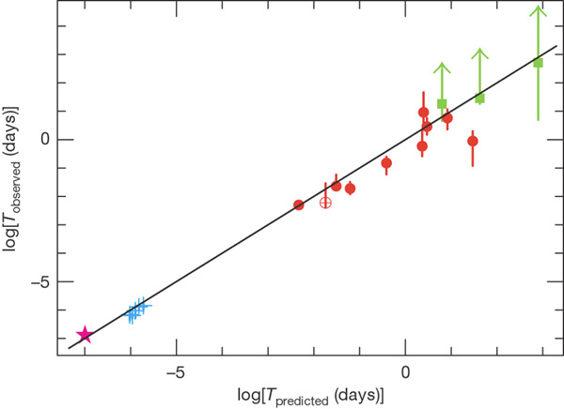
BH Mass and X-ray Variability
AGN X-ray PSDs are generally well modeled by two power laws, P(ν) ∝ 1/ν^{n}, where the PSD slope is n∼1 down to a break frequency, ν_{b}, that scales primarily with M_{BH}, and then steepens to n∼2 at larger frequencies
McHardy et al. 2006
10⁶ M
AGN
GBHs
The break frequency scale with M_{BH} in all accreting BHs
Uttley et al. 2005
10⁸ M
10⁷ M

Slide 6

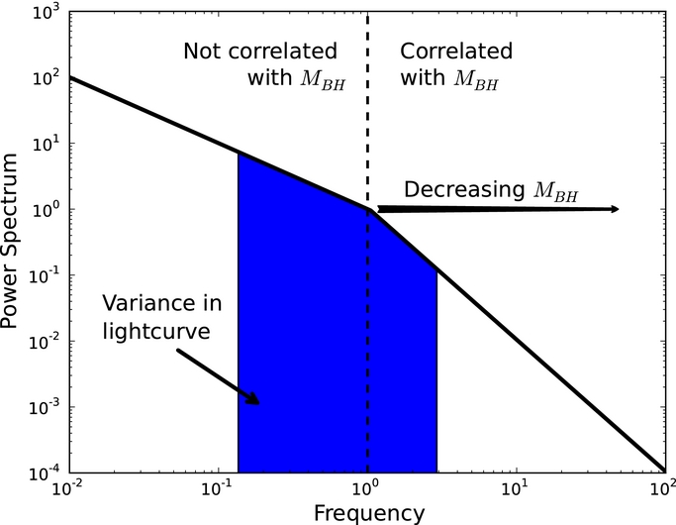
BH Mass and X-ray Variability
AGN X-ray PSDs are data demanding, requiring high-quality data on different timescales. On the contrary, the excess variance is a robust estimator as it corresponds to the integral of the PSD on the timescales probed by the data
The scaling of the characteristic frequencies of the PSD with M_{BH} induces a dependence of the excess variance with M_{BH} (if computed at frequencies above ν_{b})
Kelly et al. 2013

Slide 7

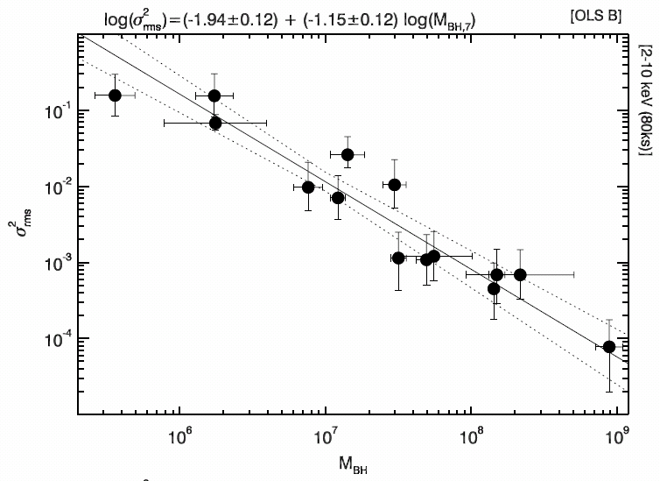
BH Mass and X-ray Variability
Several studies have indeed found a significant anti-correlation between M_{BH} and X-ray variability
(Nandra et al. 1997; Turner et al. 1999; Lu & Yu 2001; O’Neill et al. 2005; McHardy et al. 2006; Gierliński et al. 2008; Zhou et al. 2010; Ponti et al. 2012; Kelly et al. 2013)
The constants depend on the timescale and the energy range where the variable flux is measured
According to X-ray variability studies on samples of AGNs whose M_{BH} has been measured with reverberation mapping techniques, these kinds of relationships could have spreads as narrow as 0.2–0.4 dex
(Zhou et al. 2010; Ponti et al. 2012; Kelly et al. 2013)
Ponti et al. 2012

Slide 8

Single Epoch M_{BH} estimate
X-ray variability M_{BH} estimate
α~0.5 (R-L relation)
β~2 (virial motion)
We have a luminosity (distance) estimator!
It should be noted that in many previous studies a correlation between the AGN luminosity and X-ray variability has been measured
(e.g., Ponti et al. 2012; Shemmer et al. 2014, and references therein).
Such a correlation is the projection on the L–rms plane of our proposed three-dimensional relationship among L, rms, and ∆V.
If this is the case, we should measure a more significant and less scattered relation than previously reported using only L and rms

Slide 9
Calibration: The Sample
CAIXA
Catalogue of AGN In the XMM-Newton Archive
(Bianchi et al. 2009, Ponti et al. 2012)
rms (2-10 keV, 20ks) with significance greater than 1.2σ
Hβ, L₅₁₀₀ OR Paβ
40 AGN (mostly with z<0.1)
38 with Hβ
18 with Paβ

Slide 10

Calibration: The Fits
The square of the virial product, using L₅₁₀₀ and FWHM Hβ, is strongly correlated with the rms
(N=31, r =−0.73, P∼3×10⁻⁶)
The observed and intrinsic (subtracting in quadrature the data uncertainties) spreads are 1.12 dex and 1.00 dex
If the same sample is used, the linear correlation between L₅₁₀₀ and rms has a spread of 1.78 dex, while the correlation coefficient is −0.36 (P~5x10⁻²)
The virial product is significantly better correlated with the AGN variability than the luminosity alone

Slide 11

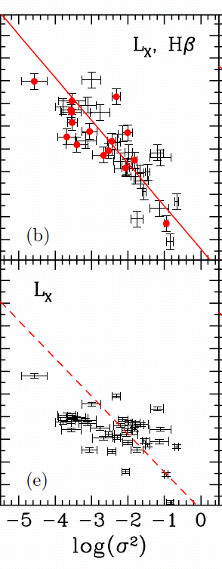
Calibration: The Fits
Slightly better results are obtained if the intrinsic 2–10 keV luminosity is used to compute the virial product
(N=38, r =−0.81, P∼3×10⁻¹⁰)
In this case, the total and intrinsic spreads are 1.06 dex and 0.93 dex
Also in this case, the virial product is better correlated with rms than L_{X} alone
is (r=−0.57 and spread 1.36)

Slide 12
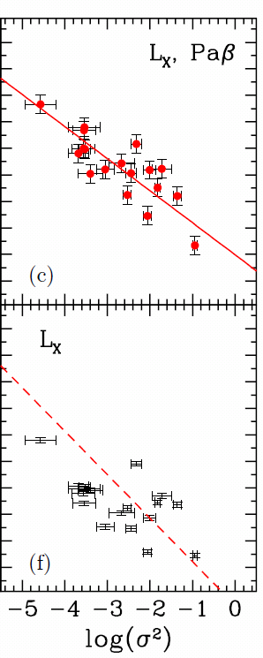
Calibration: The Fits
If the virial product is computed using L_{X} and Paβ, the spreads considerably decrease down to 0.71 dex (total) and 0.56 dex (intrinsic)
(N=18, r =−0.82, P~3×10⁻⁵)
The correlation between L_{X} only and rms has instead a less significant coefficient r =−0.63 (P~4×10⁻³) and a larger spread of 1.33 dex

Slide 13
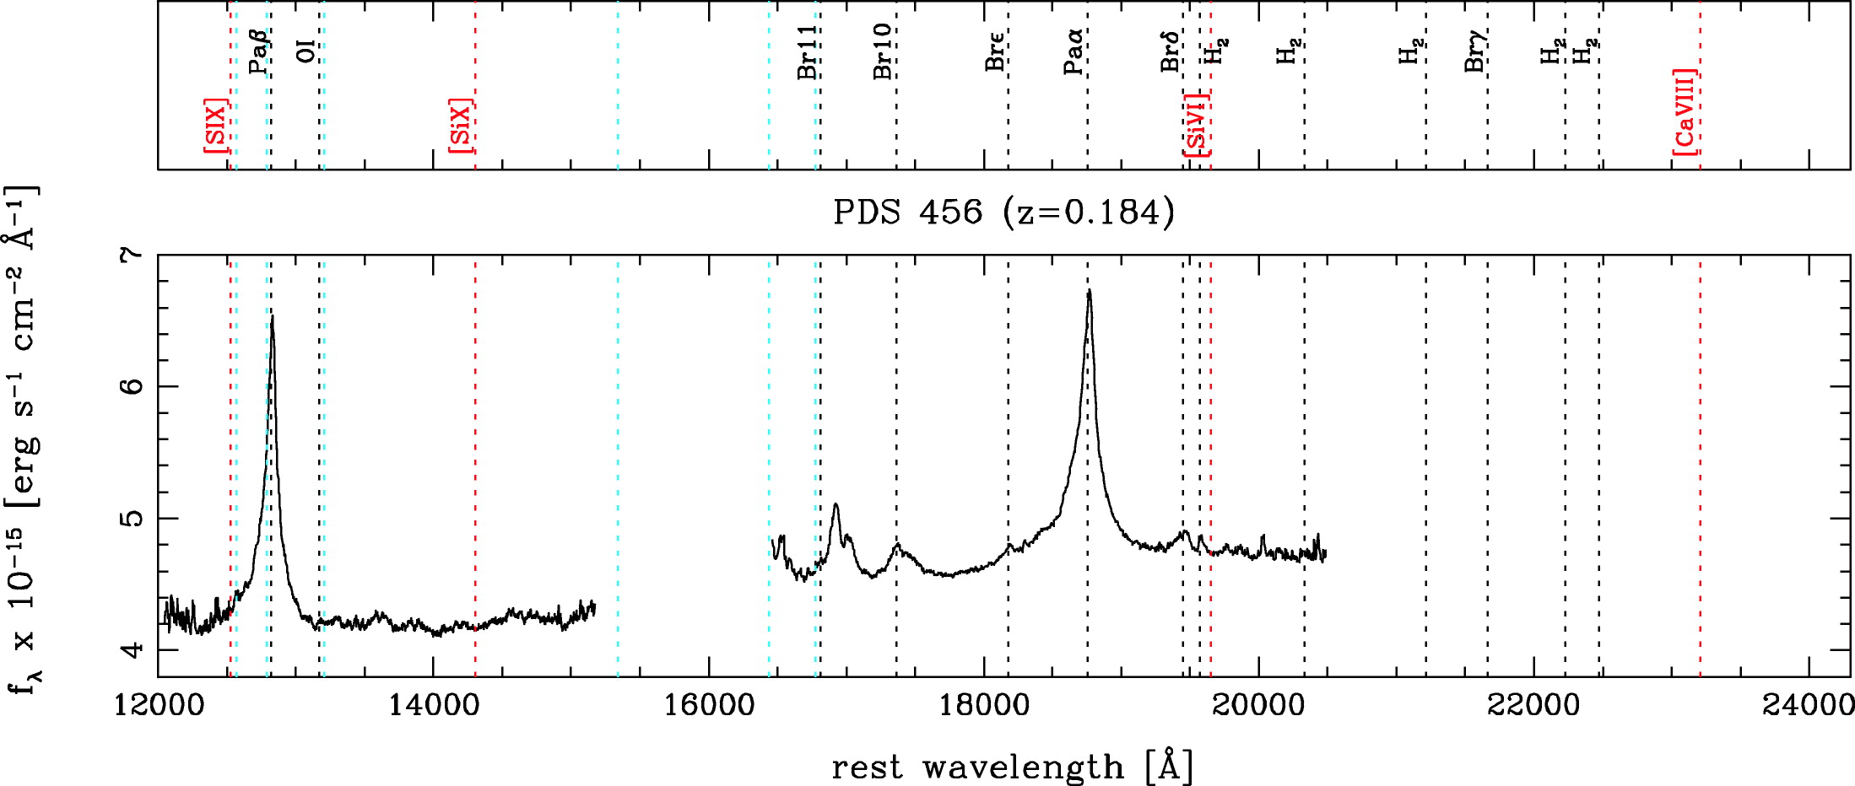
The fits described above show that highly significant relationships exist between the virial products and the AGN X-ray flux variability. These relationships allow us to predict the AGN 2–10 keV luminosities
The less scattered relation has a spread of 0.6–0.7 dex and is obtained when the Paβ line width is used
This could be either because the Paβ broad emission line, contrary to Hβ, is observed to be practically unblended with other chemical species or, as our analysis is based on a collection of data from public archives, the Paβ line widths, which come from the same project (Landt et al. 2008, 2013), could have therefore been measured in a more homogeneous way
Landt et al. 2008

Slide 14
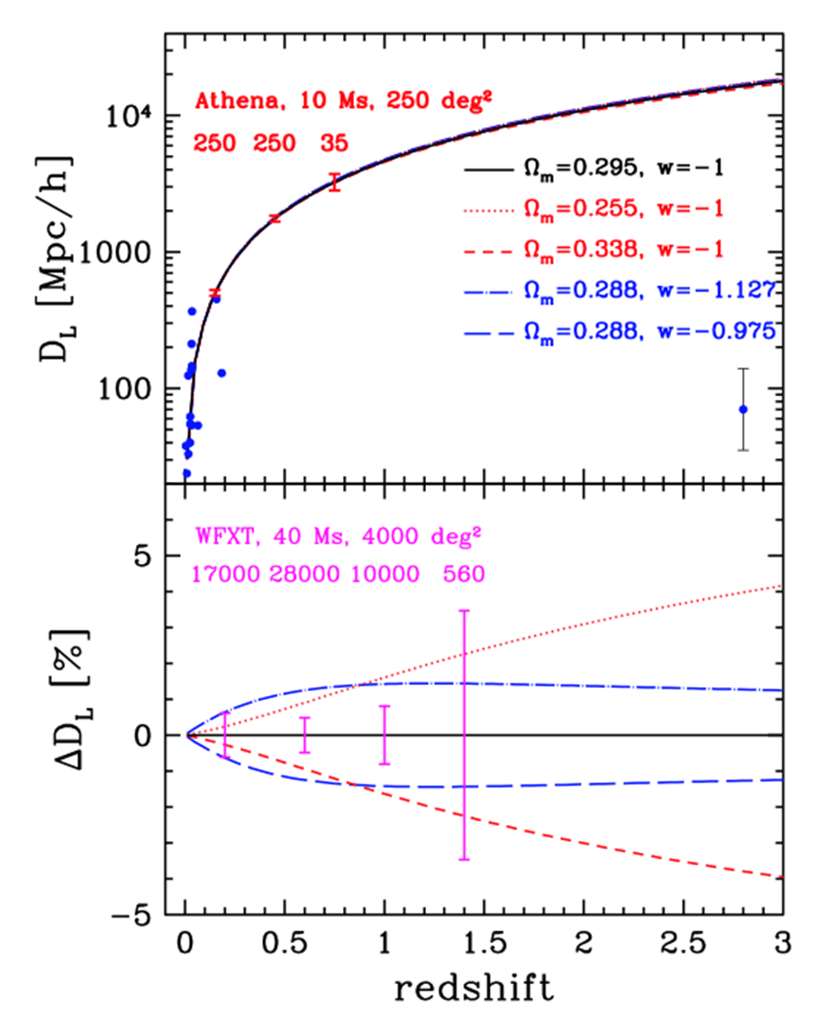
To use this method to measure the cosmological distances and then the curvature of the universe, it is necessary to obtain reliable variability measures at relevant redshifts. The relations based on the Hβ line are the most promising, as they can be used up to z∼3 via NIR spectroscopic observations (e.g., with the James Webb Space Telescope)
Our XMM measures, using LX and Paβ
With the proposed Athena survey, our estimator will provide a cosmological test independent from SNeIa able to detect possible systematic errors larger than 0.1 mag @z<0.6. Significantly lower uncertainties can be reached by using all the data from the whole Athena lifetime
ATHENA survey (10 Ms, 250 deg²): D_{L} could be measured with a 0.02 dex uncertainty @z<0.6 and with a 0.06 dex uncertainty @0.6<z<0.9

Slide 15
In order to further exploit our proposed rms-based AGN
luminosity indicator at higher redshifts to constrain the universe geometry, a dedicated X-ray telescope with a ∼2deg² large field of view could be used. With a 40 Ms long program, it would be possible to measure D_{L} with less than 0.003 dex (0.015 mag) uncertainties at a redshift below 1.2 and an uncertainty of less than 0.02 dex (0.1 mag) in the redshift range 1.2 <z < 1.6
We conclude that our estimator has the prospect to become a cosmological probe even more sensitive than current SNeIa if applied to AGN samples as large as that of a hypothetical future survey carried out with a dedicated mission
More details in La Franca et al., 2014, ApJ, 787, 12L

