Slide 1
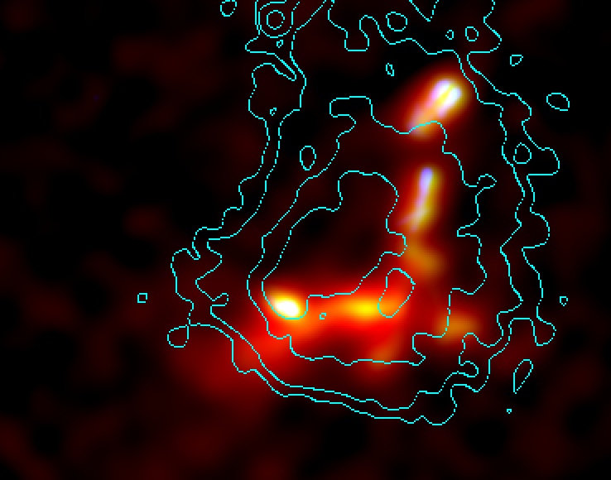
A Wild Ride for Abell 2443:
100 ksec Chandra contours with GMRT + VLA radio
A High Impact Velocity Merger with a Shock, Cold Front, & Relic
Tracy Clarke (NRL)
Tony Mroczkowski (NRC at NRL), Scott Randall (CXC), Craig Sarazin (UVA), Elizabeth Blanton (BU), Simona Giacintucci (UMCP), Will Dawson (LLNL), Nathan Golovich (UC Davis), Huib Intema (NRAO), John ZuHone (GSFC)

Slide 2
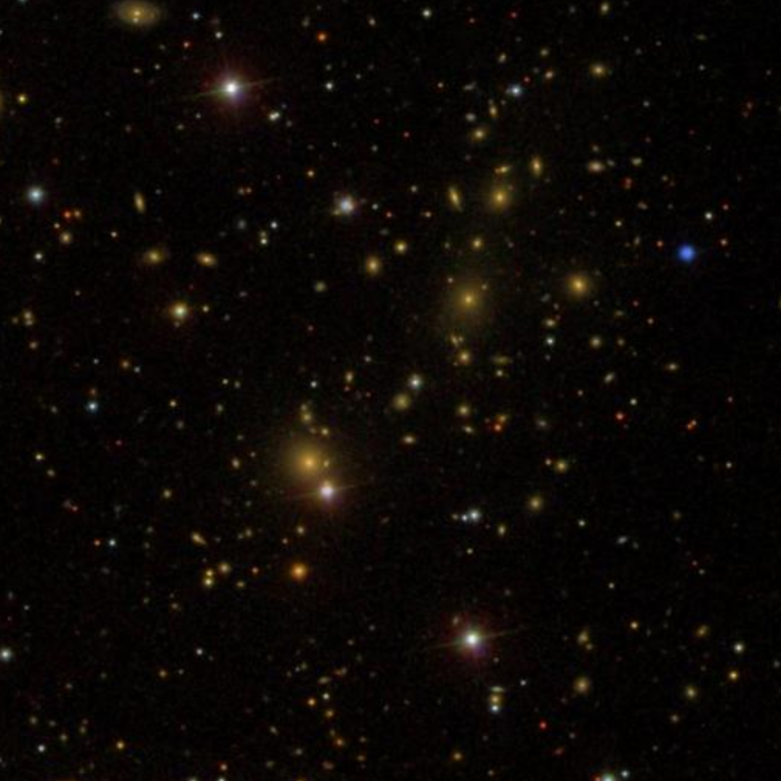
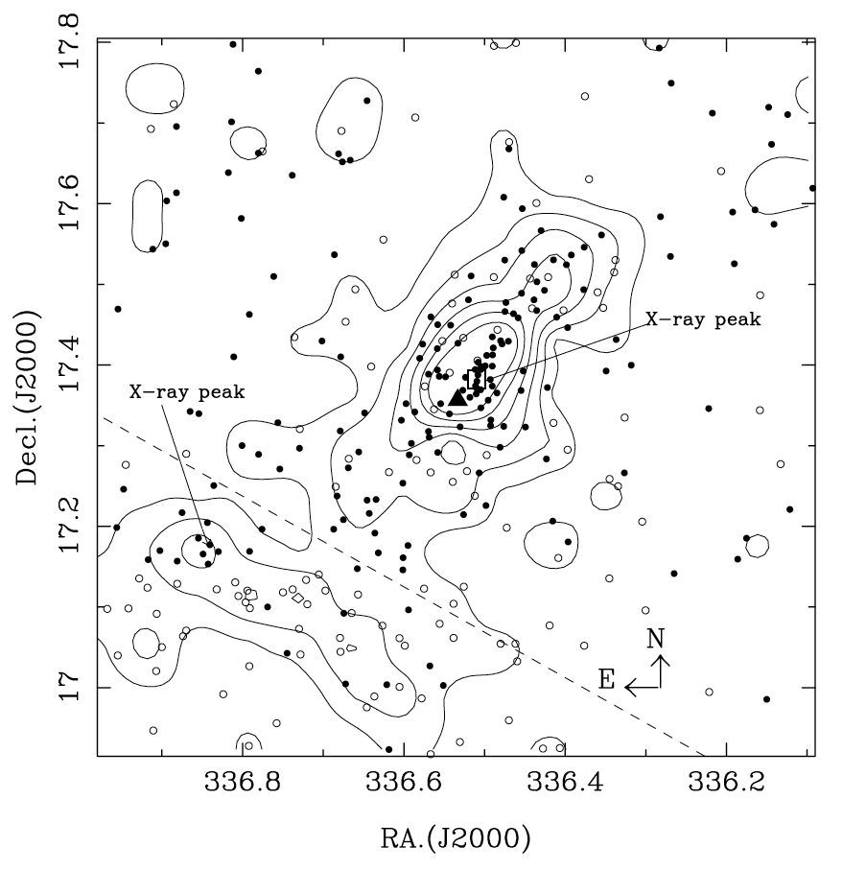
Abell 2443
Abell 2443 is a z=0.108 cluster with two dominant galaxies near the core (4 photo-z member ellipticals within 1-mag of the cD)
Photometric galaxy density (Wen et al. 2007) is elongated NW-SE and connects to ZwCl 2224.2+1651 at 2 Mpc (unknown redshift)
ZwCl
A2443
2 Mpc
200 kpc
Wen et al. (2007)

Slide 3
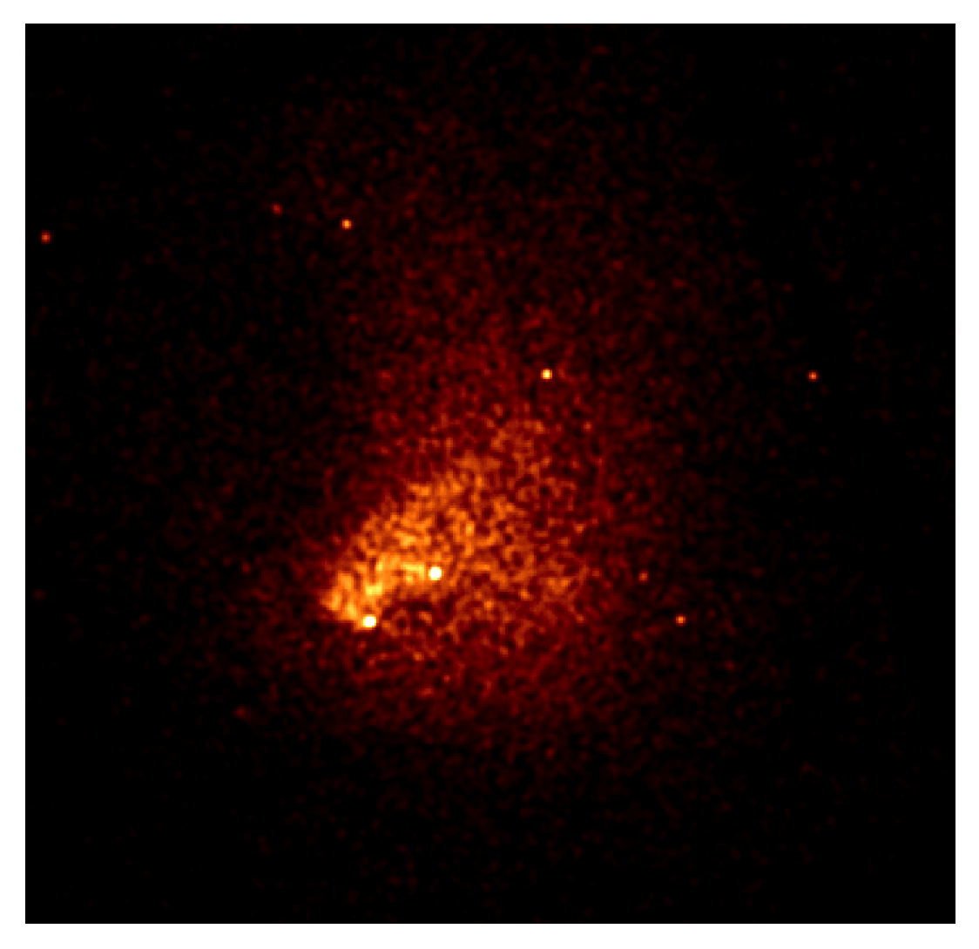
Chandra View of A2443
16 ks Chandra exposure showed elongation & edges (Clarke et al. 2013)
New 100 ks Chandra exposure on ACIS-I:
Elongated morphology with clear substructure in core & tail to NE
X-ray counterpart to cD + background source NW of cD
Edge near cD (cold front)
Edge to SE (shock)
Clear merger signatures
200 kpc

Slide 4
Chandra View of A2443
16 ks Chandra exposure showed elongation & edges (Clarke et al. 2013)
New 100 ks Chandra exposure on ACIS-I:
Elongated morphology with clear substructure in core & tail to NE
X-ray counterpart to cD + background source NW of cD
Edge near cD (cold front)
Edge to SE (shock)
Clear merger signatures
200 kpc

Slide 5
Chandra Temperature Maps
T binning map (O’Sullivan et al. 2005) for > 1000 net counts
Cold core with sharp edges stands out surrounded by hot ‘ring’ of gas
contbin (Sanders 2006) on surface brightness (S/N > 80, > 3000 net counts)
Cold core and hot surroundings agrees well with binning map
200 kpc
200 kpc

Slide 6
Chandra Edge Analysis
Outer SE Edge (‘Shock’):
Fit SE outer edge with 3D density models of two power-laws with a discontinuous jump (Randall et al. 2009)
Surface brightness edge not sharp & T drop slightly inside edge suggest complex geometry

Slide 7
Chandra Edge Analysis
Inner SE Edge (‘Cold Front’):
Inner edge is very sharp but narrow with complex emission outside.
Cometary shape consistent with a remnant merging core.

Slide 8
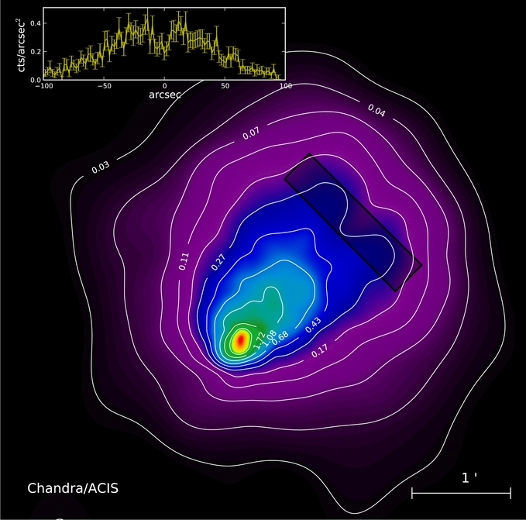
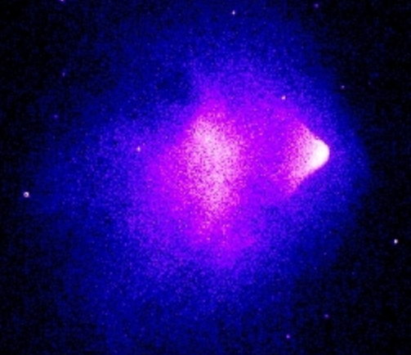
A2443 Merger Geometry
Adaptively soothed (point source free) image:
Bright cometary head & bifurcated tail - similar to ‘el Gordo’ (z=0.87)
Lack of sharp shock edge suggests significant line-of-sight component to merger (i.e. merger axis inclined to los)
Infalling system: NW to SE
NASA: Bullet cluster
200 kpc
470 kpc
“el Gordo” cluster (Menanteau et al. 2012)

Slide 9
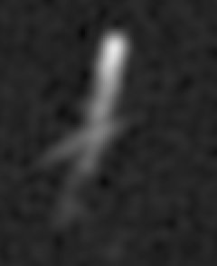
Radio Galaxies in A2443: High Resolution
VLA: 330 MHz
GMRT: 610 MHz
Tailed
galaxies
Second brightest
cD galaxy
‘Tailed’
cD galaxy
60 kpc
Unusual ‘bar’ across radio tail points between X-ray tails
Relic arc
140 kpc

Slide 10
A2443 Radio/X-ray Connection?
Tailed radio source follows X-ray cometary structure
60 kpc

Slide 11
A2443 Component Velocities
contbin to separate merging bullet from main cluster:
Regions have S/N > 90, combined regions have > 13000 & > 32000 net cts (inner/outer)
Fit Fe-line complex separately for the bullet-like component and surrounding gas
Core significantly blueshifted (z_{b}=0.0989+0.0049-0.0041) compared to surroundings (z_{s}=0.1155+0.0050-0.0018)
Velocity diff. is δv= 4500+1700-1400 km/s
‘Bullet’ (z=0.3) δv= 2600 km/s (Springel & Farrar 2007)
‘el Gordo’(z=0.87) δv= 2250 km/s (Molnar & Broadhurst 2014)
Uncertainty on velocity fits are dominated by region choice.
200 kpc

Slide 12
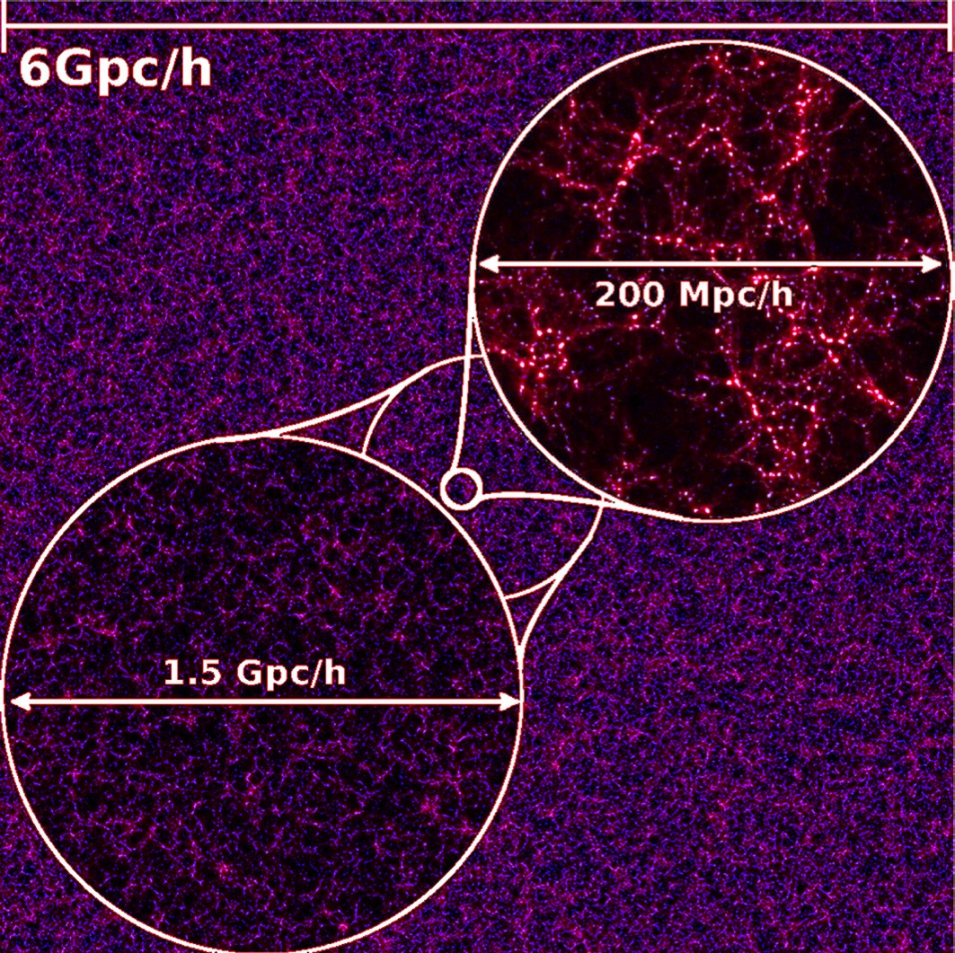
Predictions from Jubilee Simulation
Watson et al. (2014) N-body sims. (DM only) using 6000³ particles within concordance Λ CDM
Reproduces halo mass function
Volume of 6 Gpc/h is large enough to sample rare systems
Objects like the Bullet cluster exist in the tail of collisional velocity distribution
Watson et al. (2014)

Slide 13
Predictions from Jubilee Simulation
Relative pairwise halo velocities vs halo separation
Halo-halos (blue), subhalo-halo (red)
Original and corrected Bullet data points are shown
Bullet cluster velocity is only extreme for separation
A2443 (1σ green lines) appears extreme for any separation
Low statistics of rare mergers at fixed redshift.
Θ_{A2443} = 15°
Watson et al. (2014)

Slide 14
On-Going Simulations with Smaller Box
Similar simulation to Watson et al. (box size 1/1000). Gadget2 N-body solver.
Similar velocities but more systems at smaller impact parameter in same z=0.3 slice (work in progress to expand simulations). Adding more slices.
Θ_{A2443} = 15°
Polisensky et al.

Slide 15
Radio Galaxies in A2443: High Resolution
VLA: 330 MHz
GMRT: 610 MHz
VLA: 1400 MHz
Radio ‘knee’
Relic arc
140 kpc

Slide 16
Low Resolution Radio: Ultra-Steep Spectrum Relic
GMRT: 235 MHz
VLA: 330 MHz
500 kpc
East
loop
West
loop
Radio ‘knee’
Relic
‘Feet’
150 MHz

Slide 17
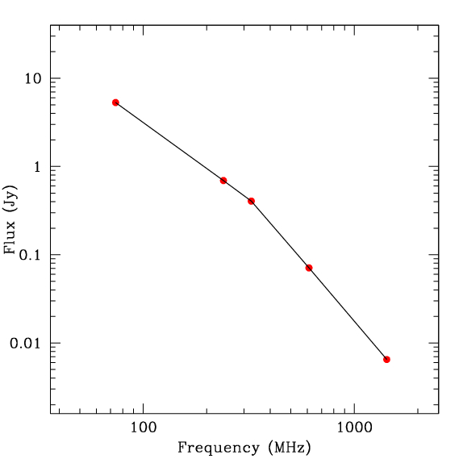
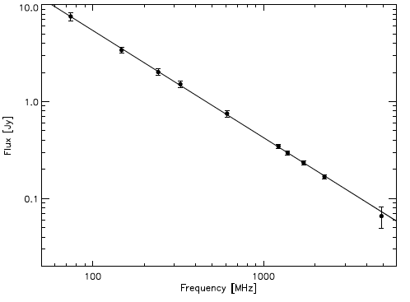
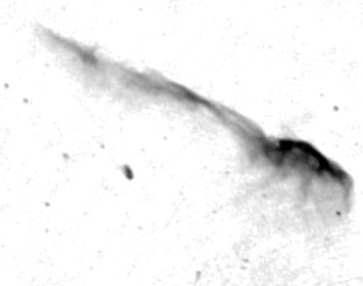
Relic: Integrated Radio Spectrum
Abell 2443
Toothbrush Relic
Ultra-steep spectrum relic likely adiabatically compressed plasma (Ensslin & Gopal-Krishna 2001)
α = -1.1
74 MHz
α = -1.7
α = -1.8
van Weeren et al. (2012)
240 MHz
325 MHz
α = -2.8
Ogrean plenary talk (Tuesday am) shock-accelerated relic
610 MHz
α = -2.8
1425 MHz

Slide 18
Merger Connection to USS Relic
GMRT 240 MHz contours on csmooth map
Low frequency USS relic consists of sharp feature south of southern tail and large surrounding region
Southern tailed galaxy appears to fill in inner region between bifurcated tails
Tailed source may be cD of secondary cluster. Observations sugguest the merger occurred at very small impact parameter.
200 kpc

Slide 19
Merger Connection to USS Relic
GMRT 240 MHz contours on contbin temperature map
Relic traces edge of hot gas south of the core and extends to hot eastern region
200 kpc

Slide 20
Summary
A2443 surface brightness shows dynamically complex merger state:
  Central cold front leading a bifurcated tail
  Outer ‘shock’ edge is hard to define, suggesting significant los component
  Temperature fits show cold core surrounded by a hot ring
Merger scenario: infalling system coming toward us from NW to SE
  Fits with shock edge being less distinct due to projection
  Hot ring is shock heated gas projected on cooler core of infalling system
Spectral fits show velocity difference of v>3000 km/s indicating that A2443 is in the extreme range for merger velocities
Next Steps
Keck DEIMOS spectroscopy with up to 200 slits this coming weekend
IRAM NIKA 1.2 and 2 mm priority B program approved for this fall to look for thermal and kinetic Sunyaev-Zel’dovich signals (kinetic expected at the 5σ level)
High time resolution velocity measurements from simulations
Radio spectral mapping along and across the relic

Slide 22
Tests of Velocity Systematics
Using CIAO 4.6 and CALDB 4.6.1.1 (latest calibration as of March 2014). Also used CALDB 4.6.0 & 4.5.9 and CIAO 4.5.
Fits to entire region and only the iron line complex give a similar result.
An independent reduction with CHAV, which includes a temperature dependent charge transfer inefficiency and gain correction depending on Au instrumental lines – results consistent.
Checked spatial dependence in gain by extracting chip coordinates and fitting deep, recent VFAINT ACIS-I observations of the Coma Cluster and A401. We found no chip-based systematic discrepancies.
Observation has a significant focal plane temperature change so we tested the most susceptible region of the chip for effects that would change the line energies – we found none. We also tested temperature dependence by fitting first and second half of data looking at the energies of three instrument lines (Au lines 11.41 keV, Au 8.66 keV, and Ni 7.46 keV). No systematic shifts found in CIAO or in CHAV.
Partial list of other things: cstat vs chisq, binning in 3 different bin sizes, unbinned counts with cstat, mekal vs apec, switching RMF and ARF of each region with that from the other, many contbin realizations, …

