Slide 1
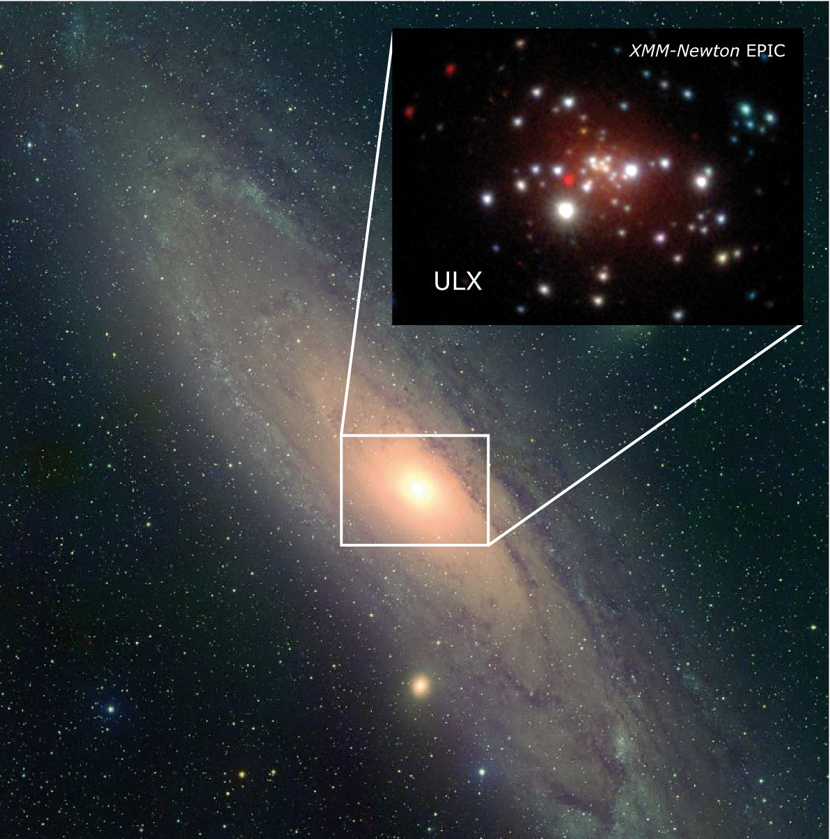
The ultraluminous state refined: spectral and temporal characteristics of super-Eddington accretion
Tim Roberts
Andy Sutton (Durham)
Matt Middleton (Cambridge)
Dom Walton (Caltech)
Lucy Heil (Amsterdam)
et al…

Slide 2
ULXs as super-Eddington accretors
NuSTAR data for NGC 1313 X-1 (Bachetti et al. 2013)
Spectrum is NOT analogous to common sub-Eddington states – implies super-Eddington ‘ultraluminous’ state (Gladstone et al. 2009)
KEY QUESTION:
What’s the physics of this new accretion state – how does super-Eddington accretion work?

Slide 3
Starting point
Gladstone, Roberts & Done (2009)
Spectral sequence:
Broadened disc regime
Hard ultraluminous regime
Soft ultraluminous regime
In Gladstone et al. we attributed this sequence to increasing accretion rate: is this true? Or are other factors at play?
1 10 1 10 1 10
Energy (keV)

Slide 4
How do we say more about ULX physics?
X-ray spectral states in BHs show related timing & spectroscopy characteristics
Is this true of ULXs?
Empirical study
Classify 89 obs from 20 ULXs into 3 distinct regimes based on empirical spectral model
Recover deabsorbed fluxes, hardness
Calculate fractional variability on 200 s timescale in broad, soft & hard bands
Sutton, Roberts & Middleton (2013)

Slide 5
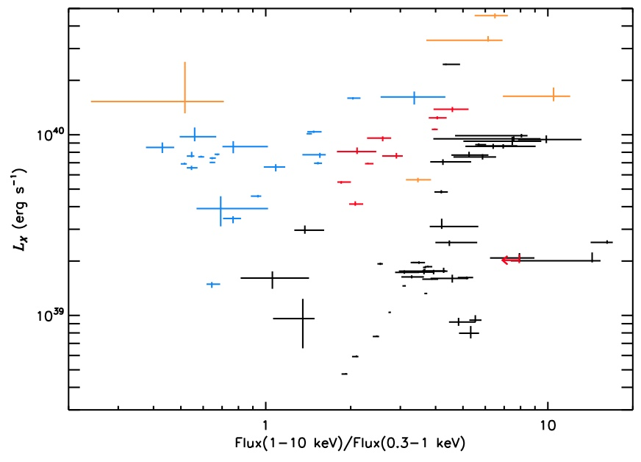
Hardness-intensity diagram
Soft & hard ultraluminous (UL) found at similar L_{X}
Higher L_{X} discs – massive stellar BHs or hard UL with weak soft component?
Broadened disc
Hard ultraluminous
Soft ultraluminous
High absorption
Below ~ 3 ×10³⁹ erg s⁻¹ broadened discs dominate: ~ Eddington stellar mass BHs?

Slide 6
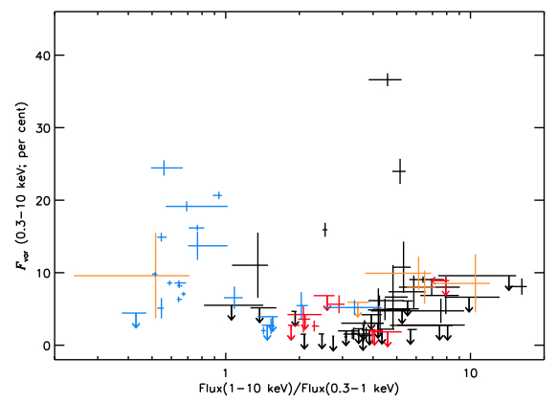
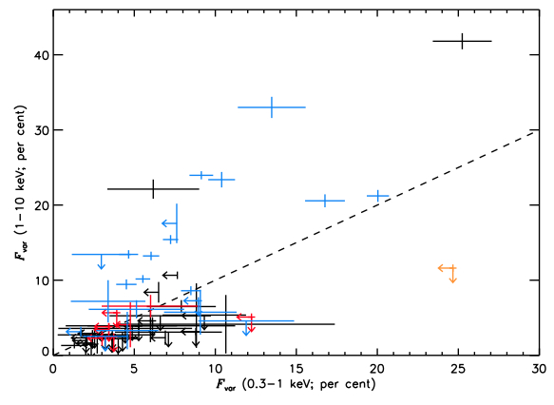
Hardness-variability diagrams
Blah
Low F_{var} (< 10%) in most disc & all hard UL
High F_{var} mainly seen in some soft UL; stronger above 1 keV; not persistent
Broadened disc
Hard ultraluminous
Soft ultraluminous
High absorption

Slide 7
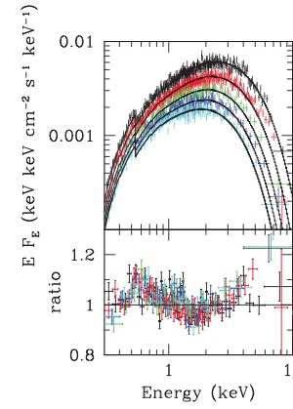
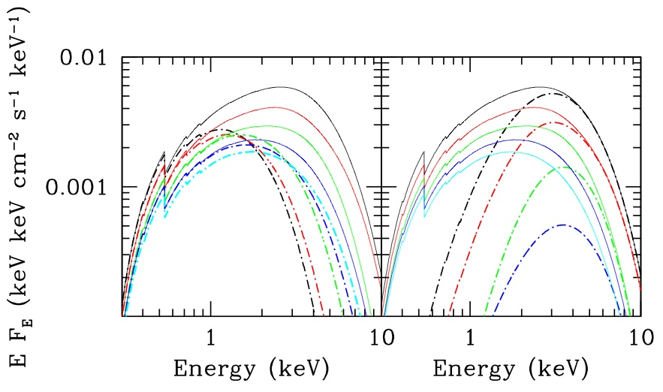
What are the broadened discs?
Dominate at ~L_{Edd} for 10 M BHs
Best data: not well fit by disc models
2 component models work well, e.g. advective disc plus thick corona
Same 2 components as UL state – emergent UL spectra?
Left: XMM data for M31 ULX, fit with BHSPEC model (Middleton et al. 2012)
Below: 2 component fits to same data – advective disc (left) and cool, thick corona (right)

Slide 8
Do we understand accretion disc spectra?
But: similar residuals in TD state CCD spectra of Galactic BHs?
Sutton et al. (submitted) – reprocessing fraction same as TD state – same geometry?
Broadened discs simply most luminous TD objects?
Are disc spectra well understood?
GX339-4 – EPIC pn & RXTE spectrum at ~ 10% L_{Edd} (Kolehmainen et al. 2011)

Slide 9
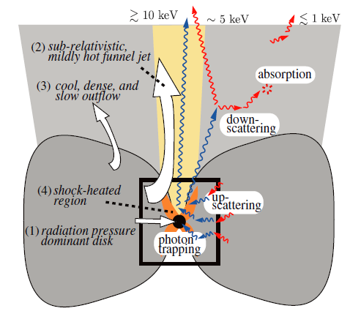
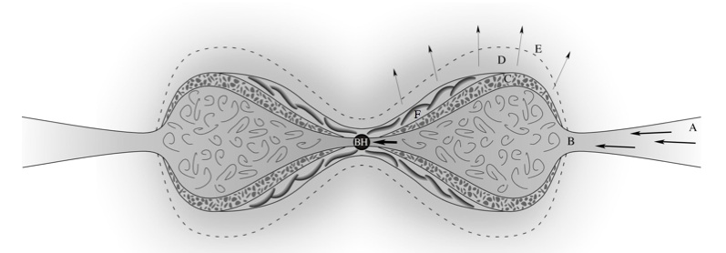
Super-Eddington models
Optically-thick wind launched from loosely bound top layers
‘Standard’ disc
Model of super-Eddington disc from Dotan & Shaviv (2011)
Disc becomes radiation-pressure dominated
Kawashima et al. (2012)
Super-Edd models naturally explain 2-component spectra as optically thick wind + inner disc
Poutanen et al. (2007) – inclination critical for observed spectrum: so on-axis HUL, off-axis SUL

Slide 10
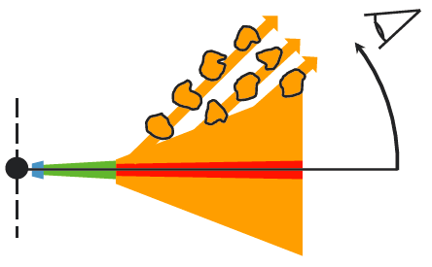
Origin of variability
Takeuchi et al. (2013)
Variability seen predominantly in wind-dominated ULXs
Face-on systems show little variability
Explanation: extrinsic hard variability imprinted by edge of clumpy wind passing through line of sight
Middleton et al. (2011)

Slide 11
Regime change
Do ULXs switch between different regimes?
King (2009) – m goes up, funnel opening angle decreases
For constant line-of-sight expect to see switch from hard to soft – seen in two ULXs
.
NGC 1313 X-1
Hard ultraluminous
Soft ultraluminous
NGC 5204 X-1

Slide 12
Winds
Walton et al. (2013)
Interpretation predicated on presence of wind
Any direct evidence for presence of wind material?
No narrow emission lines around Fe K in deep Suzaku observation of a hard ULX, Ho IX X-1
But hard – so not viewed through wind!
Top: change in χ² statistic for addition of narrow Gaussian feature; bottom: limits on line equivalent width

Slide 13
More winds
Middleton et al. (2014).
Long known that soft ULXs can have extensive fit residuals
Can be fitted by thermal plasma
But also explained by absorption from broadened, partially ionised and blueshifted (v ≈ 0.1c) material –outflowing wind!
Combined NGC 5408 data – left: continuum model; right: continuum model plus broad, partially ionised absorber

Slide 14
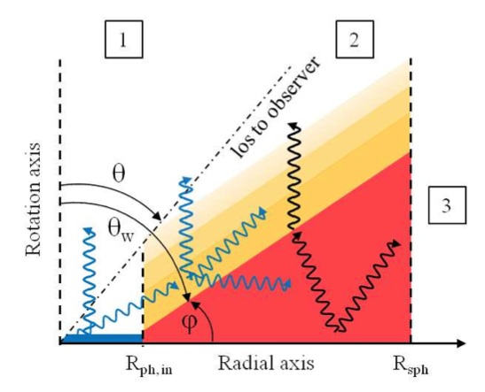
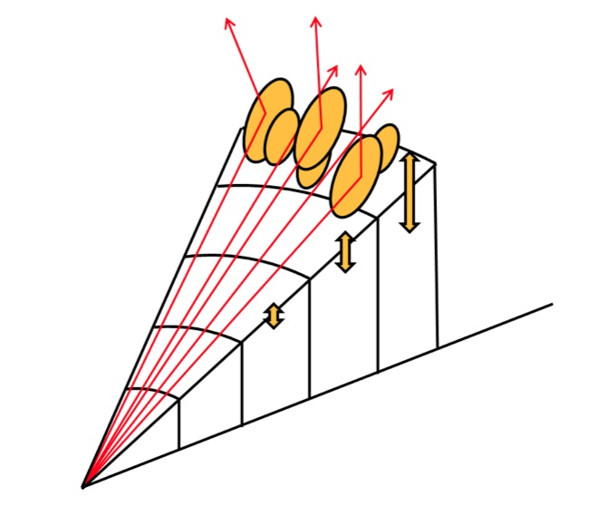
Refining the UL state
Middleton et al. (submitted).
Return to model predictions (e.g. Poutanen et al. 2007) to find new tests
Qualitatively consider: effects of inclination on photon propagation; damping of intrinsic disc variability

Slide 15
New predictions/better explanations
Possible dependence of variability on mass accretion rate – at higher rates, increased wind so greater damping of intrinsic variability & effect of clumps averages out
Evolution of spectra with inclination angle and mass accretion rate better justified; type 1 (HUL) to type 2 (SUL) if off-axis
Type 3 (close to edge-on): should be faint & spectrally soft, and likely bright UV sources

Slide 16
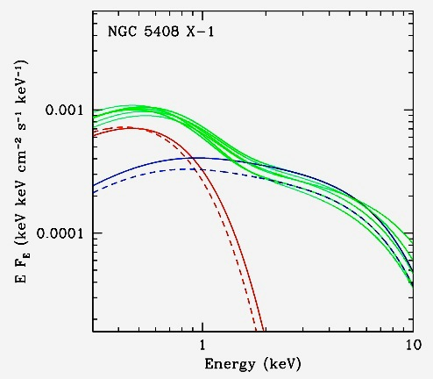
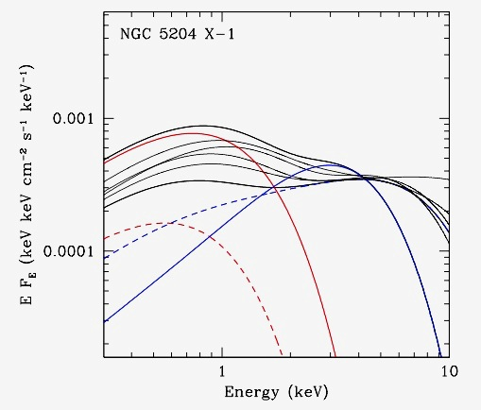
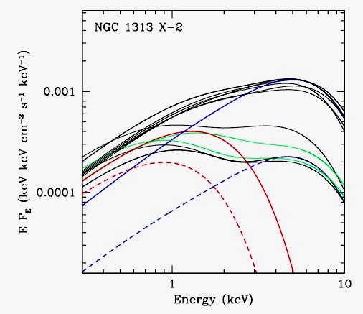
Some examples of evolution
Predictions seem to be justified by data
Best fitting models for multiple epochs of XMM data – green spectra when also variable. Red/blue are soft/hard components for least (dotted) and most (solid) luminous epochs
Type 2
Type 1 to Type 2
Type 1

Slide 17
Conclusions
Not just spectra: also behaviour of most ULXs inconsistent with sub-Eddington IMBHs!
Can explain properties of most ULXs in framework of super-Eddington accretion
We can now qualitatively explain the range of ULX spectra in terms of 2 properties: accretion rate and inclination

Slide 18
ULXs and super-Eddington accretion
Now appears likely most ULXs harbour stellar remnant BHs accreting at or above the Eddington limit (Feng & Soria 2011)
Evidence: ultraluminous state X-ray spectra (Gladstone et al. 2009); X-ray luminosity functions (Swartz et al. 2011; Mineo et al. 2012); relation to star formation (King 2004) etc…
Exception: most luminous ULXs, at ~ 10⁴¹ erg s⁻¹ (Farrell et al. 2009, Sutton et al. 2012)
How does super-Eddington accretion work?

Slide 19
Classification scheme
Classify using:
(i) disc temperature
(ii) power-law slope
Weaknesses where absorption high or curvature very pronounced in harder component of 2-component spectra
Power-law
Disc

Slide 20
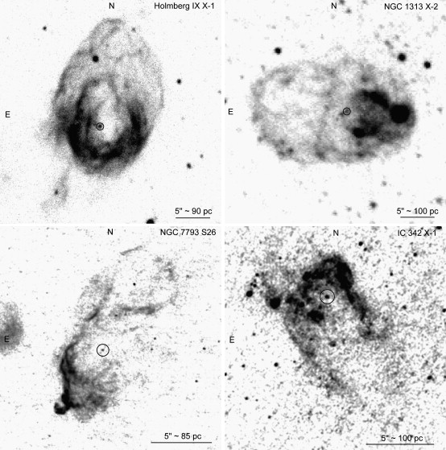
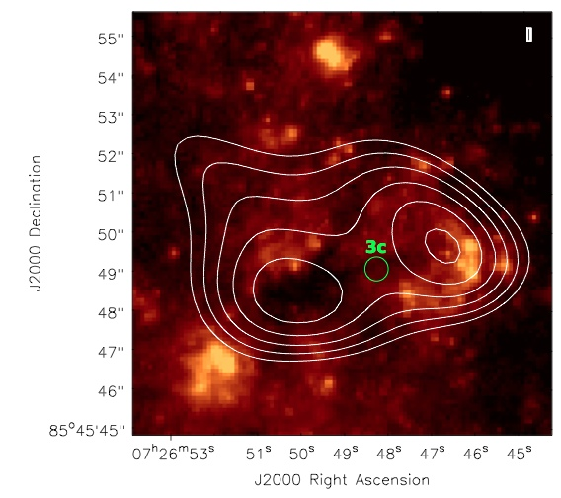
What happens to these winds?
Hα emitting ULX bubble nebulae (Feng & Soria 2011)
Natural explanation for ULX nebulae in optical & radio
Nebulae seen around all spectral regimes, e.g. NGC 1313 X-2 (broadened disc), Ho IX X-1 & IC 342 X-1 (hard UL), Ho II X-1 & NGC 5408 X-1 (soft UL)
Radio nebula contours on HST image for NGC 2276 extreme ULX (Mezcua et al. submitted)

