Slide 1
Deep X-ray Observations of PSR J1119-6127: Do High-B Pulsars Born with Massive Progenitors?
Stephen C.-Y. Ng (HKU)
Collaborators: V. M. Kaspi (McGill), W. G. G. Ho (Southampton), P. Weltevrede (Jodrell Bank), S. Bogdanov (Columbia), R. Shannon (ATNF), & M. E. Gonzalez (UBC)

Slide 2
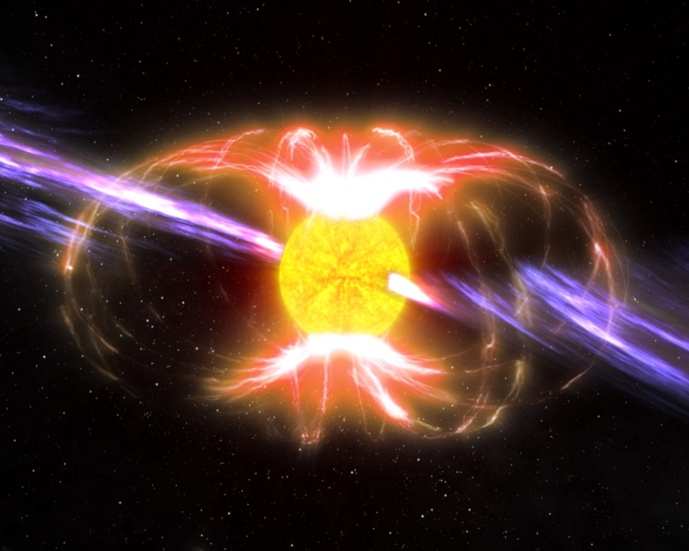
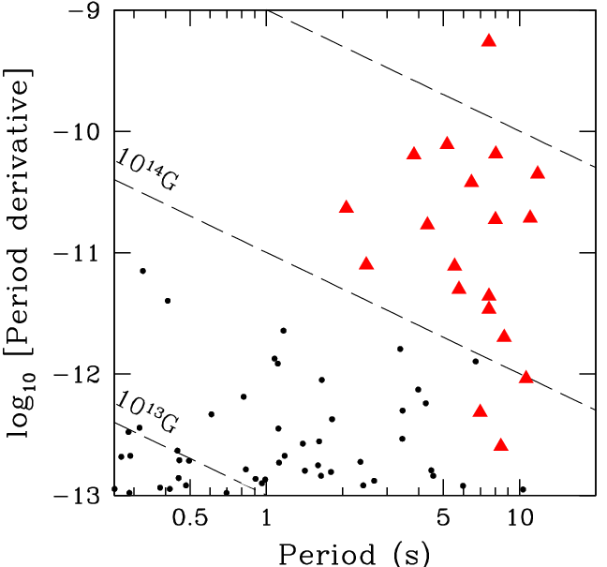
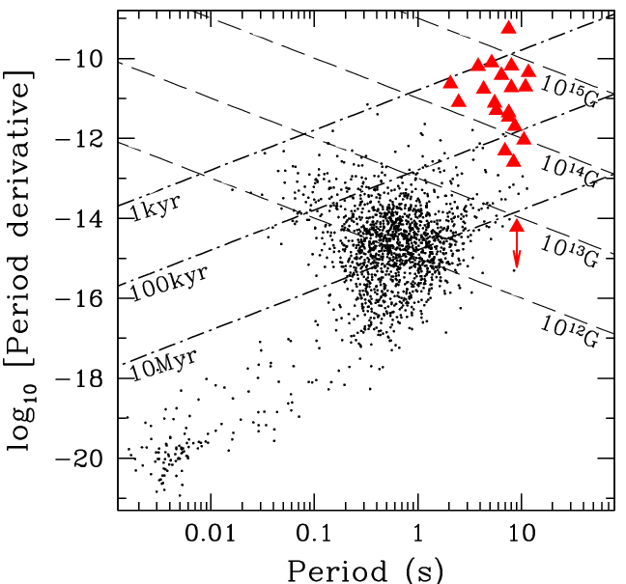
Pulsar P−Ṗ Diagram
ATNF
NASA/CXC

Slide 3
Pulsar P−Ṗ Diagram
ATNF
NASA/CXC

Slide 4
High-B Radio Pulsars
Comparable spin-down-inferred B-fields as magnetars
But similar properties as normal radio pulsars
Radio to γ-ray pulsations
Rotation-powered
Transition objects, key to understand magnetars
see Ng & Kaspi (2011) for a review

Slide 5
High-B Radio Pulsars
Name | B (10¹³G) |  | Name | B (10¹³G)
J1847-0130 | 9.3 |  | J1119-6127 | 4.1
J1718-3718 | 7.4 |  | J0847-4316 | 2.7
J1814-1744 | 5.5 |  | J1846-0257 | 2.7
J1734-3333 | 5.2 |  | B0154+61 | 2.1
J1819-1458 | 5.0 |  | B1916+14 | 1.6
J1846-0258 | 4.8 |  | B1509-58 | 1.5

Slide 6
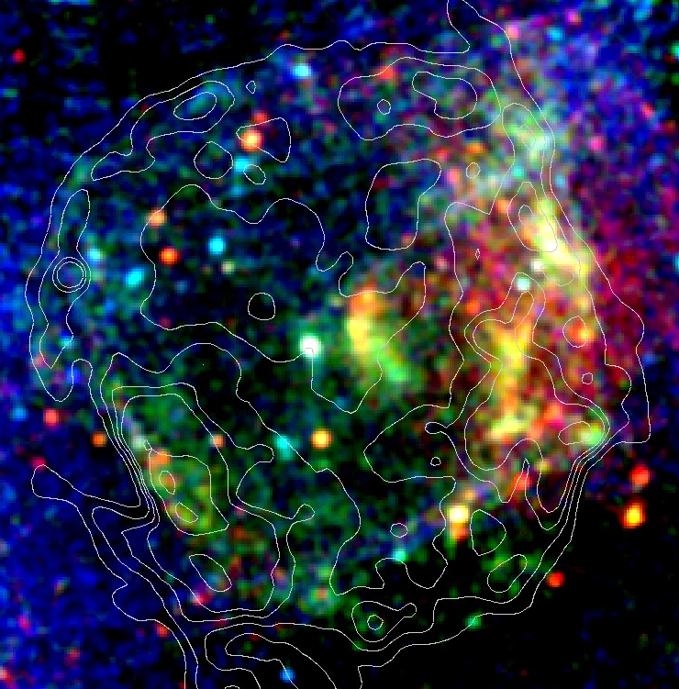
PSR J1119−6127 / G292.2−0.5
XMM-Newton 100ks
d = 8.4 kpc
B = 4.1×10¹³G
age = 1.7 kyr
10′
Ng et al. (2012)
Notes:
Thermal, but pulsed, exceeding the polar cap heating for 1e-5 E-dot

Slide 7
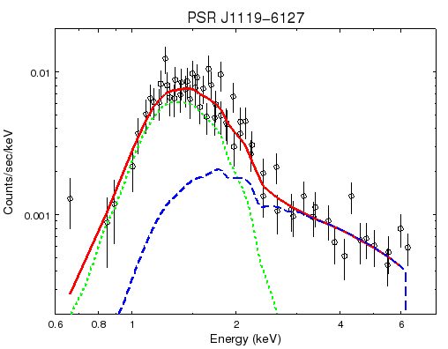
PSR J1119−6127 / G292.2−0.5
XMM-Newton 100ks
XMM-Newton 100ks
d = 8.4 kpc
B = 4.1×10¹³G
age = 1.7 kyr
10′
Ng et al. (2012)
Notes:
Thermal, but pulsed, exceeding the polar cap heating for 1e-5 E-dot

Slide 8
Blackbody Temperature
Hottest among all known radio pulsars!
But R = 3km
Ng et al. (2012)

Slide 9
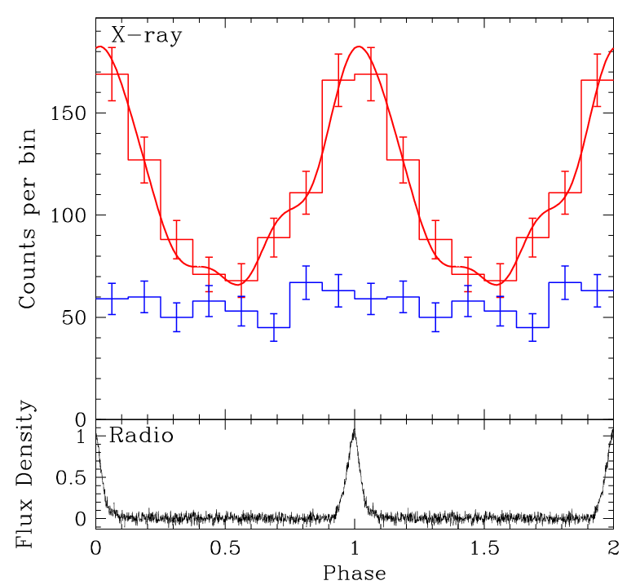
Blackbody Temperature
Hottest among all known radio pulsars!
But R = 3km
Pulsations below 2.5keV ⇒ thermal origin
0.5-2.5keV
2.5-10keV
Ng et al. (2012)

Slide 10
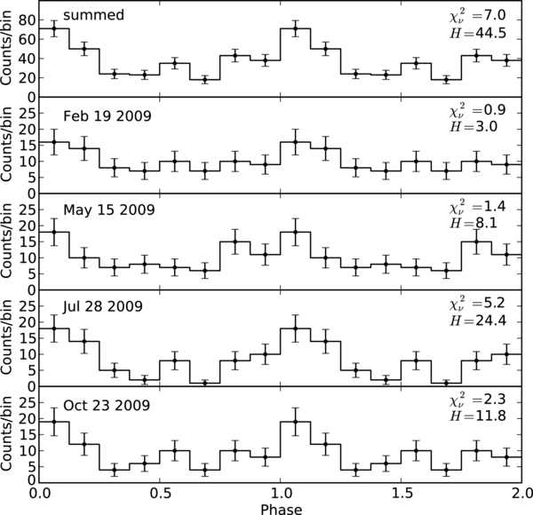
Radio-X-ray Alignment
J1819-1458
J1718-3718
McLaughlin et al. (2007)
Zhu et al. (2011)

Slide 11
Blackbody Temperature
Polar-cap heating? (unlikely)
Magnetically channeled fallback material?
Anisotropic heat conduction?
Non-uniform heating from B-field decay?

Slide 12
PSR J1119−6127 / G292.2−0.5
XMM-Newton 100ks
R = 21 pc
age =1.7 kyr
v = 1.2×10⁴ km/s = 0.04 c !
21pc
10′
Ng et al. (2012)

Slide 13
PSR J1119−6127 / G292.2−0.5
XMM-Newton 100ks
R = 21 pc
age =1.7 kyr
v = 1.2×10⁴ km/s = 0.04 c !
10′
Ng et al. (2012)
Notes:
1. Underabundance: consistent with shocked stellar wind, no sign of reverse shock. 2. Low ionization timescale => recently shocked 3. Low temperature => low shock velocity?

Slide 14
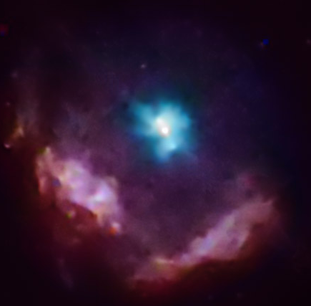
Progenitor
Supernova explosion in a cavity:
SN Type Ib/c
Wolf–Rayet progenitor ( >30M)
Similar to other high B-field pulsars:
J1846−0258 / Kes 75 (Morton et al. 2007)
B1509−58 / MSH 15−52 (Gaensler et al. 1999)
also magnetars
Massive progenitors ⇒ higher B-field pulsars?
Fossil B-field?
Initial spin?
NASA/CXC/CfA/P.Slane et al.

Slide 15
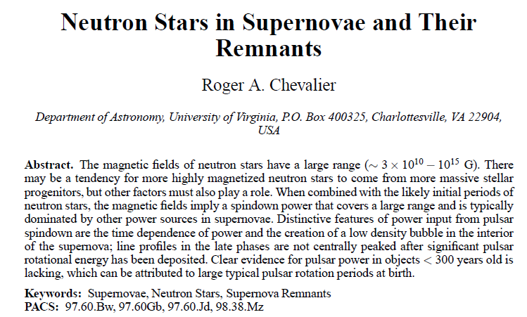
Massive Progenitors
Chevalier (2010)

Slide 16
Massive Progenitors
All 3 high-B radio pulsars found in supernova remnants seem to have massive progenitors
Higher surface field for massive stars? (e.g. Petit et al. 2008)
Rapidly spinning core => effective dynamo?
Origin of magnetars?

Slide 17
Summary
High-B radio pulsars in X-rays:
thermal spectrum
single-peaked pulsed profile aligned with radio pulse
=> Magnetic field effects on heating / heat transport
Connection with massive progenitors

