Slide 1
NuSTAR results and future observation plans for magnetars and rotation-powered pulsars
Hongjun An¹ and the NuSTAR Team
¹McGill University

Slide 2
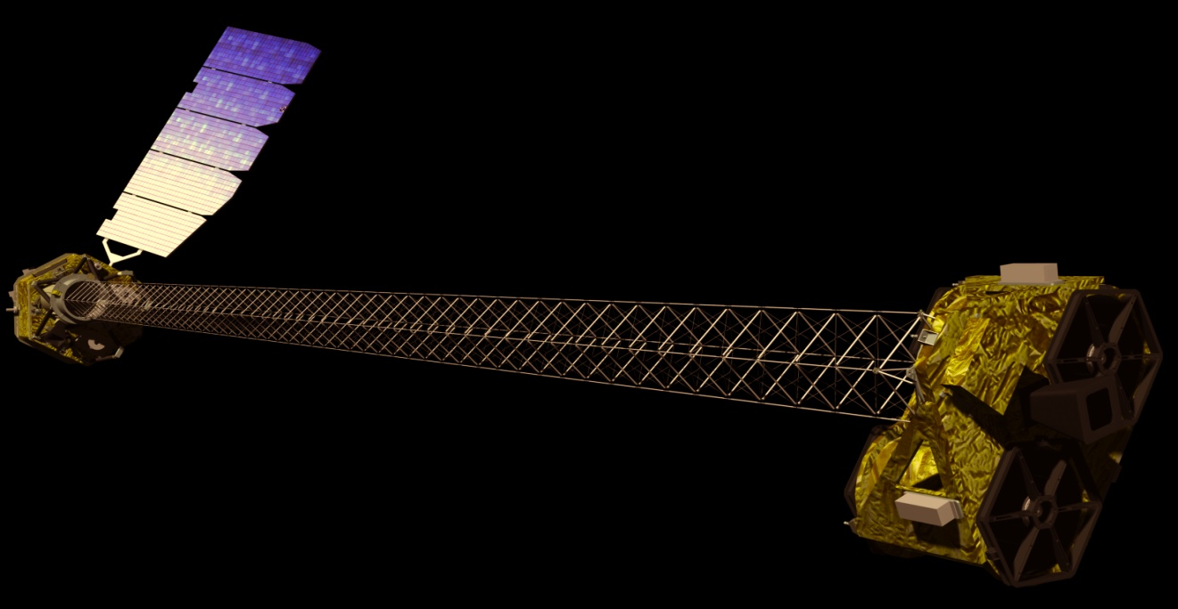
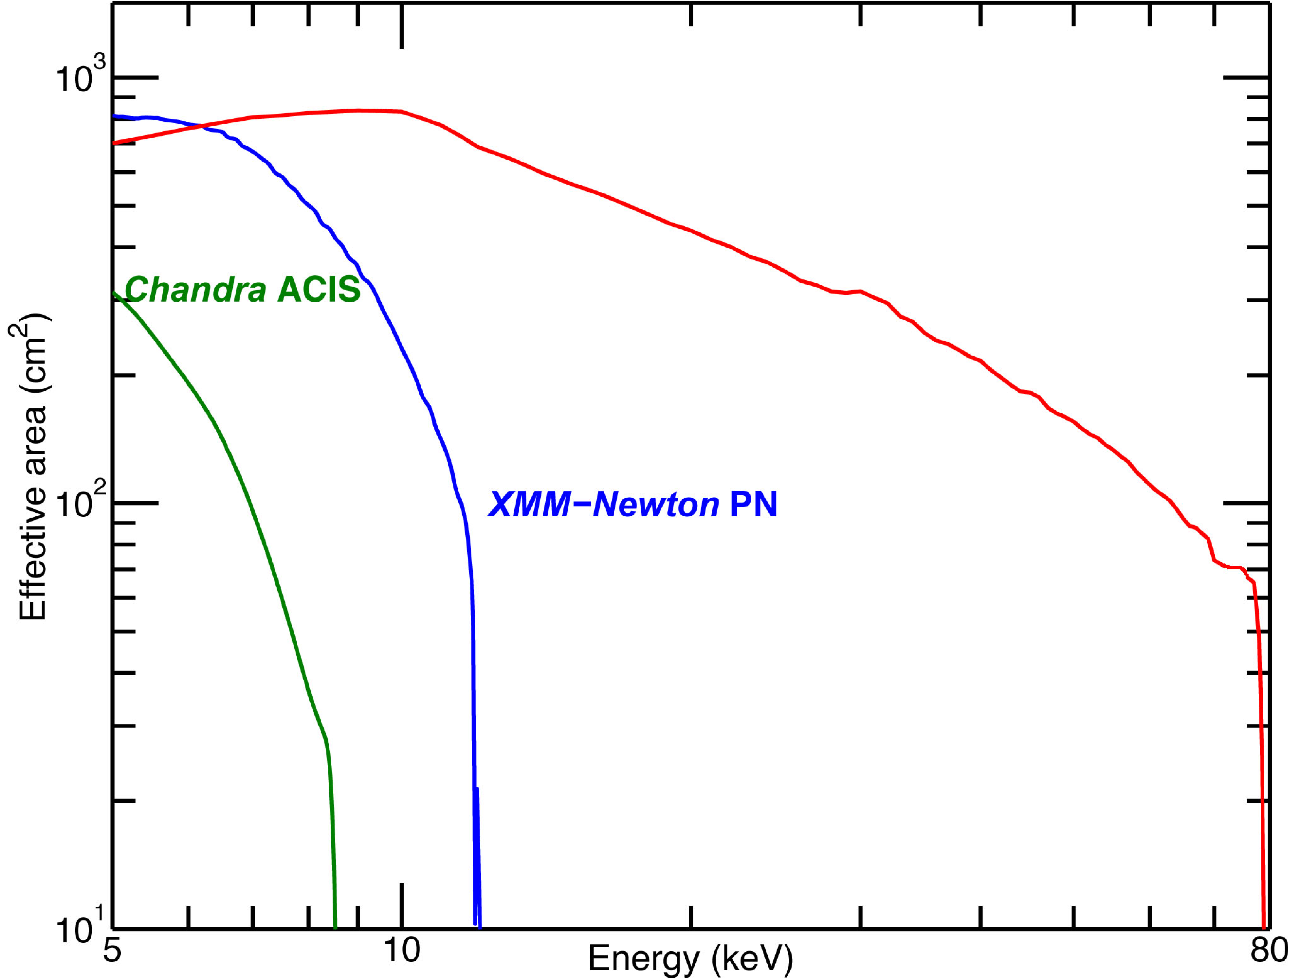
NuSTAR is the first focusing telescope operating in the 3—79 keV band
~10 m
Launched on 2012 June 13
Focusing in the hard X-ray band (>10 keV)
Two orders of magnitude better sensitivity in the 10—79 keV
Harrison et al. 2013arXiv1301.7307H (2013)
Notes:
Let me first introduce NuSTAR to you. NuSTAR is the first focusing telescope operating in the 3—79 keV band. It was launched in 2012 June. It is composed of two focusing hard X-ray optics and two detectors in the focal plane. The focal length is approximately 10 m. NuSTAR’s effective area is a little smaller than that of XMM Netwon PN detector below 6 keV, but larger above. NuSTAR is the most sensitive telescope in the 10—79 keV band, having two orders of magnitude better sensitivity that other current hard band telescopes.

Slide 3
Performances
1 Ms Sensitivity
3.2 x 10⁻¹⁵ erg/cm²/s (6 – 10 keV)
1.4 x 10⁻¹⁴ (10 – 30 keV)
Timing
relative 100 s
absolute 3 ms
Field of View
FWZI 12.5’ x 12.5’
FWHI 10’ @ 10 keV
8’ @ 40 keV
6’ @ 68 keV
Spectral response
energy range 3-79 keV
threshold 2.0 keV
E @ 6 keV 0.4 keV FWHM
E @ 60 keV 1.0 keV FWHM
Imaging
HPD 58”
FWHM 18”
Localization 2” (1-sigma)
Target of Opportunity
response <24 hr (reqmt)
typical 6-8 hours
80% sky accessibility
Notes:
Here are NuSTAR’s performance parameters. It’s Field of View about 10’ at 10 keV, and a little smaller at higher energies. The angular resolution is 58’’ HPD, and 18’’ FWHM. The timing resolution is 2 micro seconds, but accuracy is a little worse because of clock drift. Spectral resolution is 0.4 keV at 6 keV, and ToO response time is typically 6—8 hours.

Slide 4
Baseline mission science
Science Group | Working Group Chair
Galactic Surveys, Galactic Center | Chuck Hailey
Supernovae and ToOs | Steve Boggs
Supernova remnants and Pulsar Wind Nebulae | Fiona Harrison
Magnetars and Rotation-Powered Pulsars | Vicky Kaspi
Galactic Binaries | John Tomsick
Ultraluminous X-ray Sources | Fiona Harrison
Extragalactic Surveys | Daniel Stern
Blazars and Radio Galaxies | Greg Madejski, Paolo Giommi
Obscured AGN | Daniel Stern
AGN Physics | Giorgio Matt
Galaxy Clusters | Allan Hornstrup, Silvano Molendi
Starburst Galaxies | Ann Hornschemeier
Solar Physics | David Smith
http://www.nustar.caltech.edu/for-astronomers/science-working-groups
Notes:
NuSTAR has many science goals as shown here, including four major goals; Locating massive black holes in the universe, Galactic center survey, understanding relativistic jets in supermassive black holes, and understanding explosion mechanism and nucleosynthesis in the supernovae.
Here I am going to focus on the Magnetars and rotation-powered pulsars with NuSTAR, chaired by Vicky Kaspi.

Slide 5
NuSTAR is planning on observing many magnetars and RPPs
Target list:
4 magnetars, two rotation-powered pulsars, one white dwarf
Magnetar ToO: 150 ks+ Magnetar Observing
1E 2259+586: 170 ks Magnetar May. 2013
1E 1048-5937: 400 ks Magnetar
1E 1841-045: 45 ks+ Magnetar Nov. 2012
Geminga: 50 ks RPP Sep. 2012
PSR J1023+0038: 100 ks RPP/LMXB
AE Aquarii : 126 ks White Dwarf Sep. 2012
Heavy weighting towards magnetars
Notes:
Here is the list of magnetars and rotation-powered pulsars which NuSTAR observed, is observing, or plan to observe. Among seven priority A targets, four were observed (red), one is being observed, and two will be observed soon. 3 magnetars, one rotation-powered pulsar, and one pulsar-like white dwarf were observed. The ToO is being done on the new Galactic center magnetar, SGR J1745-29.
The list as you see here are heavily weighted towards magnetars.

Slide 6
What we want to study using NuSTAR
Notes:
Now I am going to talk about NuSTAR observations and analysis results done until now. Some results are already published, but I like to say most of the results are yet preliminary. The first one I want to talk about is SGR J1745-29, the magnetar in the direction of Galactic center, discovered very recently – a few weeks ago.

Slide 7
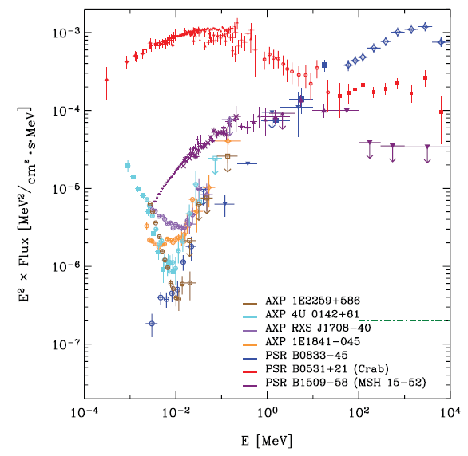
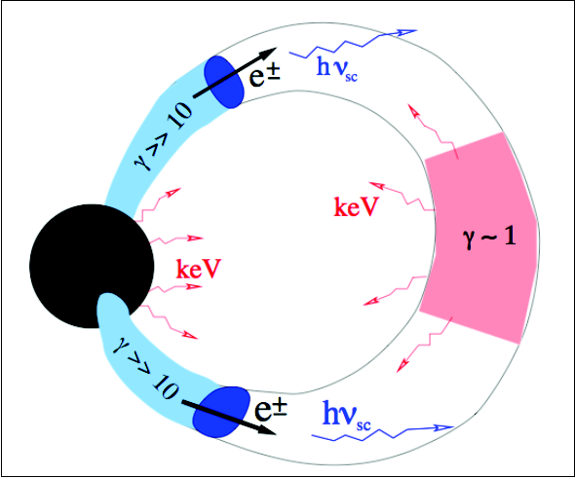
We are attempting to understand the hard X-ray emission mechanism
Kuiper et al. ApJ, 645, 556, 2006
Beloborodov, ApJ, 762, 15, 2013
Thursday: Beloborodov and Hascoet
Hard power-law spectral components were detected in several magnetars (Kuiper et al. ApJ, 645, 556, 2006)
The hard emission was unpredicted and not understood
Using NuSTAR, we will try understand the emission mechanism
Notes:
Now I am going to talk about what NuSTAR’s Magnetar/Rotation-powered pulsar working group wants to learn. Quiescent magnetars used to be thought as soft sources, emitting blackbody radiation modified by the atmosphere and the magnetosphere. In 2006, Kuiper et al. showed that some quiescent magnetars showed very hard spectrum in the hard band above 10 keV, as you see here the rising spectrum. This was unpredicted and not yet understood. Recently, Beloborodov proposed an electron-positron outflow model to explain the hard emission. NuSTAR is the most sensitive telescope in the energy ranges interested, so it is suitable to study this phenomenon.

Slide 8
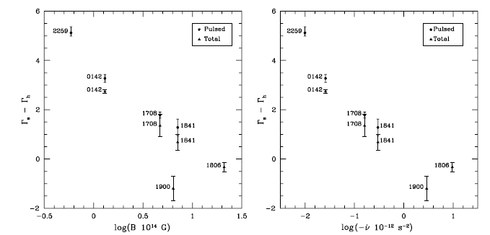
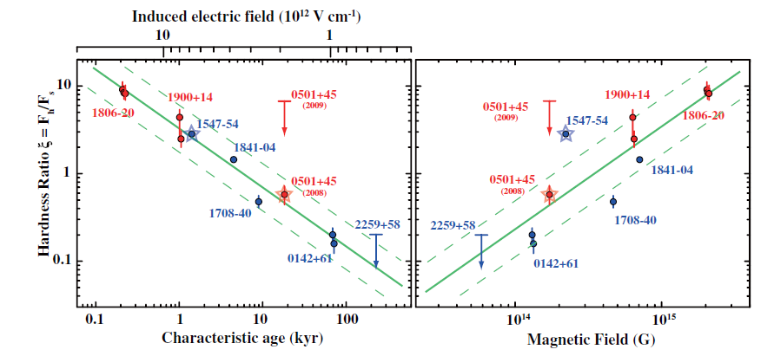
We are attempting to understand the hard X-ray emission mechanism
Kaspi & Boydstun, ApJ, 710, L115, 2010
Enoto et al. ApJ, 722, L162, 2010
Putative correlations in magnetars
_{s}- _{h} v.s spin-inferred magnetic field strengths
Hardness ratio v.s spin-inferred magnetic field strengths
Notes:
Another interesting phenomena we want to study are the putative correlations recently reported. Kaspi & Boydstun reported a correlation between the difference of soft and hard band photon index and the spin-inferred magnetic fields. And Enoto et al. reported a correlation between the hardness ratio and the magnetic field or characteristic age in magnetar class. The correlations seem to be fairly strong but is not fully understood yet. By observing some magnetars which are not yet detected in the hard band, we can update the correlations.

Slide 9
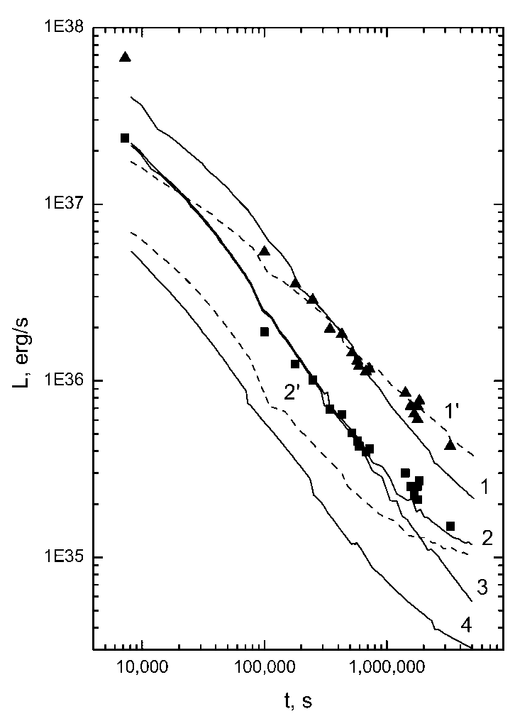
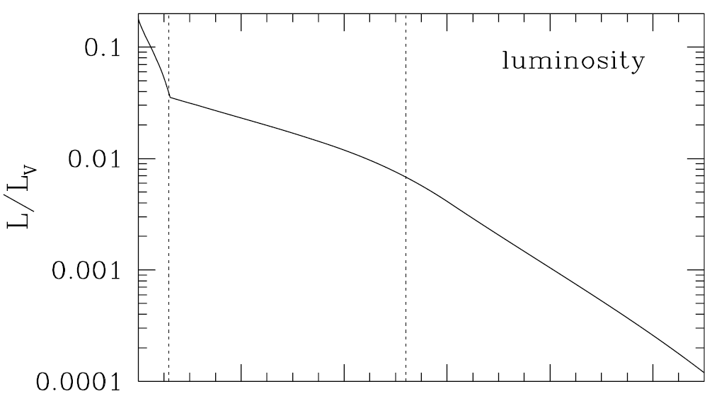
Understanding transient cooling of magnetars using magnetar ToO
Lyubarsky et al. ApJ, 580, L69, 2002
Beloborodov, ApJ, 703, 1044, 2009
L~t^{-0.7}
t
Soft-band flux relaxation can be understood using the crustal cooling or the magnetospheric untwisting models
Relaxation in the hard band was not yet detected; NuSTAR can make the first sensitive detection
Notes:
Another interesting physics to study is the transient flux relaxation. Magnetars sometimes show outbursting activities, where the flux may increase by orders of magnitude. Outbursts are assumed to be caused by crustal fractures accompanying heat deposit inside the star or twist of external magnetic field. The flux then decays over days to months to its quiescent value. We can learn the interior or the magnetosphere by studying the flux decay. There are two physical models for the flux decay. One in the left is the crustal cooling model by Lyubarsky et al., where heated crust passively cools as the magnetar radiates, from the cooling we can infer the interior properties. An alternative model by Beloborodov in the right is to explain the cooling as untwisting the twisted magnetic fields. The models have been successful in explaining the relaxation in the soft band below 10 keV. However, the decay in the hard band has not yet detected. NuSTAR will try to detect it and we may find a new interesting physics.
We are currently monitoring SGR 1745-29 for this purpose using the ToO program.

Slide 10
NuSTAR will observe rotation-powered pulsars and a pulsar-like white dwarf
Rotation-powered pulsars typically show a simple power-law spectrum in the X-ray band
- Geminga: One of the brightest pulsars in the gamma-ray band
Archetype for X-ray faint/Gamma ray bright RPPs
- J1023+0038: A transient object between MSP and LMXB
(Archibald et al. Science, 324, 1412, 2010)
A pulsar-like white dwarf ?
- AE Aquarii: Magnetic CV
Detection of non-thermal spectrum and a sharp pulsation
Notes:
We are also interested in studying rotation-powered pulsar, and a unique pulsar-like white dwarf. For rotation powered-pulsars, we have the following two sources in the target list: Geminga and J1023+0038. Geminga is the brightest pulsar in the gamma-ray band and could be an archetype for X-ray faind/Gamma-ray bright pulsars. J1023+0038 is a unique MSP/LMXB transient object, and studying it in the hard band may reveal an interesting link between the two categories. Finally, we will also observe a special white dwarf. The white dwarf AE Aquarii is one of the fastest rotating white dwarfs, which has very large spin-down rate comparable to RPP’s. In 2008, Terada et al. reported a detection of non-thermal spectrum and a sharp pulsation in the hard band, suggesting a pulsar-like particle acceleration in the magnetosphere of the white dwarf. However, the hard band detection was not very significant (~1 sigma), so we want to measure the spectrum and pulse profile in the hard band accurately.

Slide 11
NuSTAR results to date
SGR J1745-29 and ToO: Magnetar
Notes:
Now I am going to talk about NuSTAR observations and analysis results done until now. Some results are already published, but I like to say most of the results are yet preliminary. The first one I want to talk about is SGR J1745-29, the magnetar in the direction of Galactic center, discovered very recently – a few weeks ago.

Slide 12
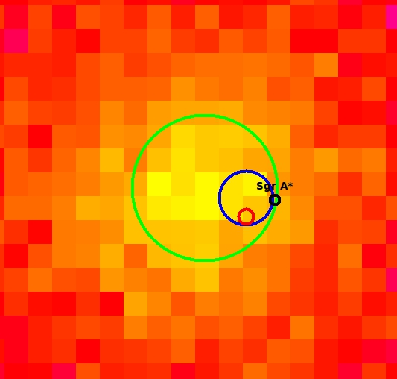
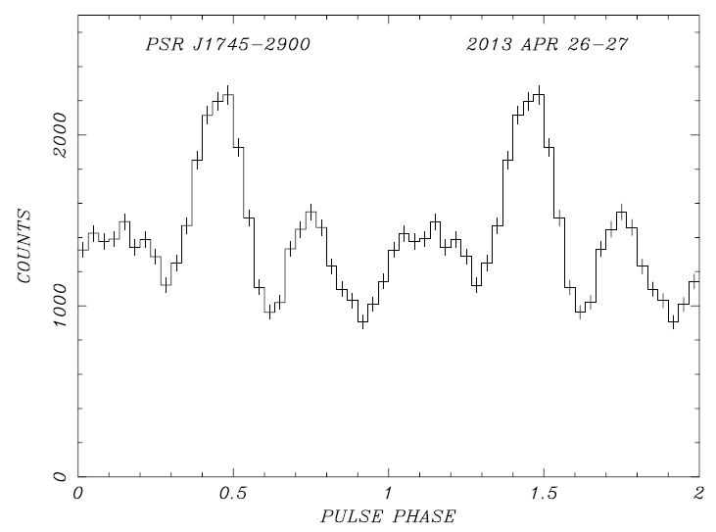
NuSTAR discovered 3.76 s pulsation in the direction of Galactic center region
Green: NuSTAR position
Blue: Swift position
Red: Chandra position
Black: Sgr A*
NuSTAR image
Following Swift detection of an SGR-like burst, NuSTAR discovered 3.76 s pulsation
(Mori et al. ApJL, 2013, accepted)
Located in the Galactic center, 3’’ away from sgr A* (Rea et al. Atel 5032)
4th magnetar detected in the radio band
(Eathogh et al. ATel 5058, Shannon & Johnston arXiv:1305.3036)
Notes:
After the Swift detection of an SGR-like burst, NuSTAR triggered ToO and discovered 3.76 s pulsations from the source. Here is NuSTAR image with Chandra and Swift XRT position circles. This is NuSTAR measured pulse profile. This source was a very “hot” issue at least because it is very close to the sgr A*. Anyway, the pulsation and SGR-like burst were enough for people to call this a magnetar. And here are more.

Slide 13
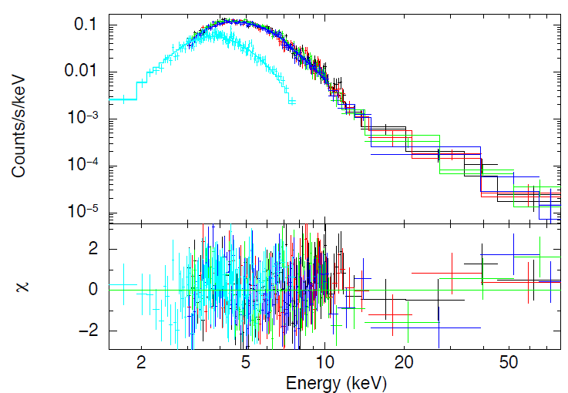
NuSTAR identified the source as a transient magnetar
Spin period: 3.76354455(71) s
MJD 56409.2657
Spin-down rate: 6.8 ± 1.5  10⁻¹² s s⁻¹
Spin-inferred B: 1.6  10¹⁴ G
Spectrum: BB+PL model
N_{H}=14.20^{+0.71}_{-0.65}  10²² cm⁻²
kT=0.956^{+0.015}_{-0.017} keV
=1.47^{+0.46}_{-0.37}
Luminosity: ~3  10³⁵ erg s⁻¹ (2—10 keV)
(d=8 kpc) 3.5  10³⁵ erg s⁻¹ (2—79 keV)
Rotation power: 5  10³³ erg s⁻¹
NuSTAR + Swift
The source was identified as a transient magnetar using the NuSTAR and Swift data
(Mori et al. ApJL, 2013, submitted)
NuSTAR is monitoring the source using the ToO program
Notes:
Using NuSTAR and Swift, we measured its spin-down rate and spectrum. Its X-ray luminosity far exceeds the spin-down power, so a true magnetar. However, its quiescent luminosity, which is not yet measured, is estimated to be smaller than the spin-down power. So we call it a transient magnetar. After firmly identifying the source, we are monitoring the source using the ToO program to study its spectral relaxation.

Slide 14
NuSTAR results to date
1E 1841-045: Magnetar
Notes:
The next object I would like to talk about is the magnetar 1E 1841-045.

Slide 15
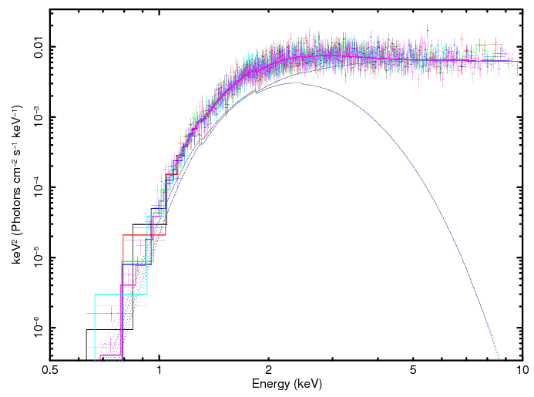
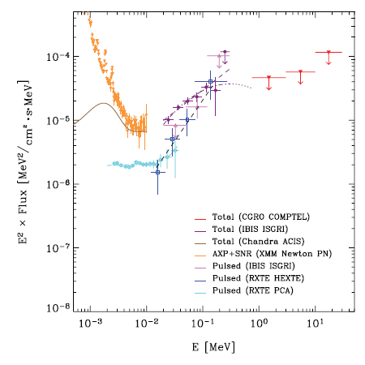
1E 1841-045 is a magnetar in the Kes 73 supernova remnant
Kuiper et al. ApJ, 645, 556, 2006
XMM-Newton
Soft Band spectrum was well measured with XMM-Newton
Blackbody (kT~0.45 keV) + power law (~2)
A hard power-law component was detected above ~10 keV
(Kuiper et al. 2004)
Notes:
1E 1841-045 is a magnetar in the Kes 73 supernova remnant. Its soft band spectrum was well measured with XMM-Newton. Here this is the soft band sepctrum of the source, which is modelled with a blackbody having kT~0.45 keV and a power law with Gamma~2. This is one of the first sources that Kuiper et al. reported the surprising hard spectral component here. And of course, this is one of the brightest magnetar in the hard band, so suitable for spectral modeling study.

Slide 16
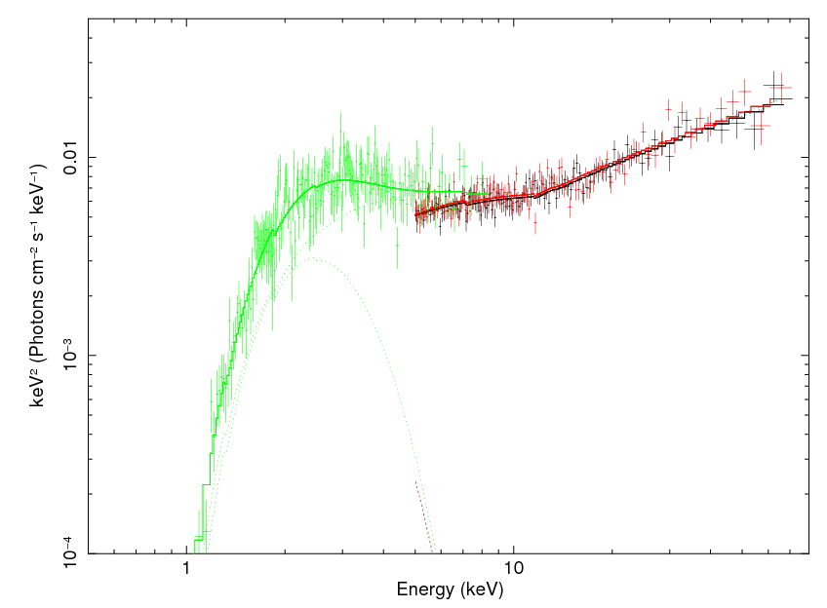
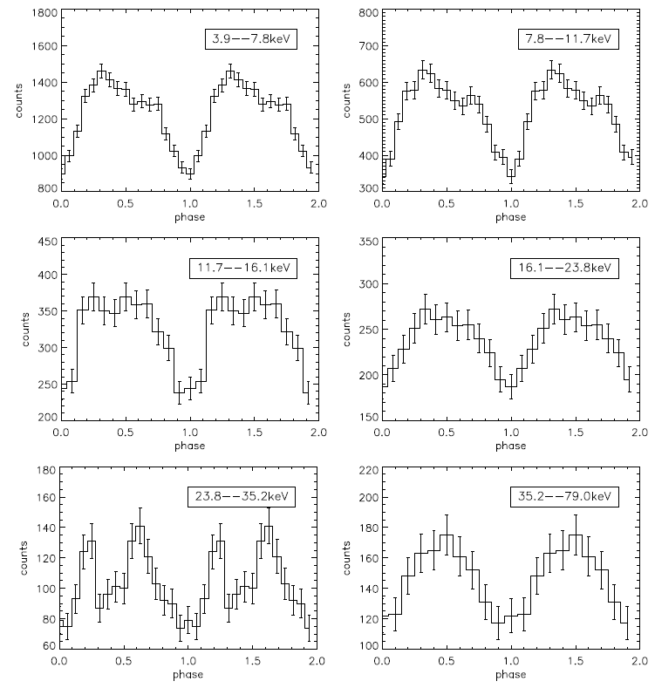
We use the electron-positron outflow model to constrain emission geometry
BB + broken power-law model fit
Preliminary
Similar to RXTE profile
--- Swift
--- NuSTAR A
--- NuSTAR B
NuSTAR+Swift results:
Good agreement with Kuiper et al. (2006) but not with Morii et al. (2010)
Found a interesting pulse profile in the ~24—35 keV band
Electron-positron outflow model
(Thursday, Romain Hascoët)
Doubly peaked
Notes:
We measured its spectrum, and first used a phenomenological model – blackbody plus broken power law. Our results agree well with those reported by Kuiper et al. in 2006. We also used the electron-positron outflow model, developed by Beloborodov and applied to this source by Romain Hascoet, and obtained the following parameters for the hard X-ray emission geometry. The model will be presented in details by Romain Hascoet on Thursday. The solutions we obtained are not unique unfortunately; we found two possible solutions. However, the parameters are relatively well constrained and physically acceptable.

Slide 17
NuSTAR results to date
1E 2259+586: Magnetar
Notes:
We also finished observing 1E 2259+586. It is a low field magnetar, having lower magnetic field strength than some high-B RPPs.

Slide 18
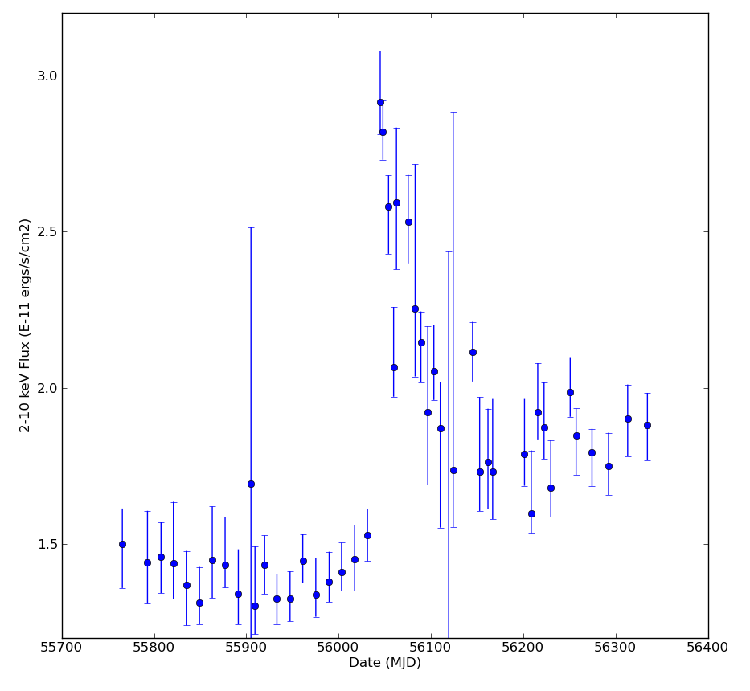
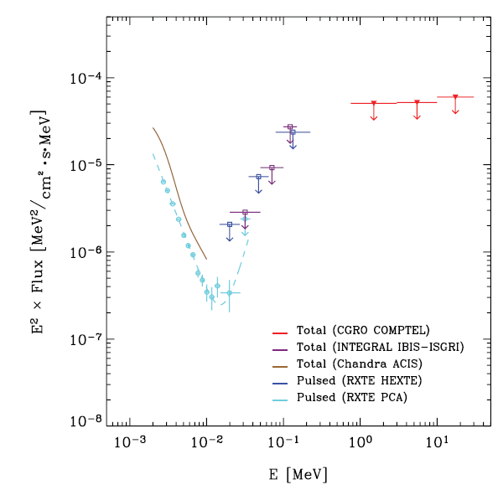
Hard X-ray emission from 1E 2259+586 was detected only marginally
Outburst in 2012, Archibald et al. Nature, accepted
Kuiper et al. ApJ, 645, 556, 2006
Soft Band spectrum is well described with a blackbody plus power-law model having kT~0.4 keV and ~3.7
A hard power-law component was only marginally detected above ~10 keV
Anti-glitch following an outburst in 2012
Notes:
Soft band spectrum of the source is well described with a blackbody plus power law, having kT 0.4 keV and gamma 3.7. In the hard band, this source was only marginally detected. NuSTAR can help to measure the hard band spectrum and compare it with other magnetars’.

Slide 19
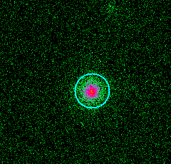
NuSTAR observed 1E 2259+586 for 170 ks
Preliminary
NuSTAR 30ks
Red/Black: NuSTAR 55 ks
Green: Swift 30 ks
1’
Analysis being done by Julia Vogel at Lorentz Livermore National Laboratory
Just finished 170-ks observations
More results are coming soon
Notes:
We just finished observing this source a few days ago. So I am presenting the initial 30-ks results only. The source was well detected, and its spectrum measured with the 30-ks observation is consistent with its soft band spectrum. We may find something very interesting with full 170-ks data.

Slide 20
NuSTAR results to date
Geminga: Rotation-powered pulsar
Notes:
The next object is Geminga, a gamma-ray bright rotation-powered pulsar.

Slide 21
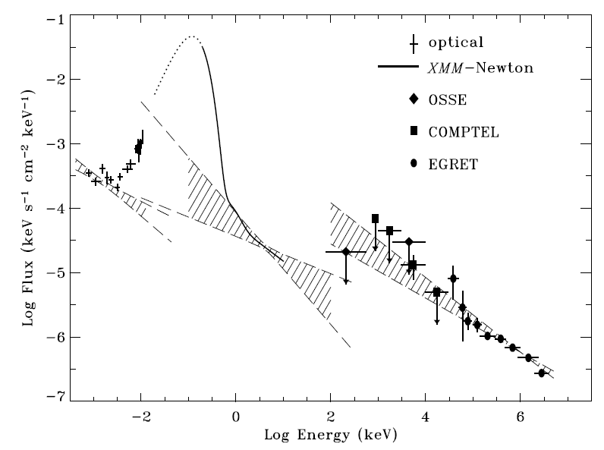
Geminga is a radio-quiet gamma-ray pulsar
Kargaltsev et al. (2005)
A radio-quiet gamma-ray pulsar
The X-ray spectrum does not seem to extend to the optical or gamma-ray band (Kargaltsev et al. ApJ, 625, 307, 2005)
NuSTAR can fill the gap in the hard X-ray band to see if there is a break
Notes:
Geminga is a radio-quiet gamma-ray pulsar. The soft-band X-ray spectrum was well measured using XMM-Newton. However, the soft X-ray spectrum modelled with a blackbody plus power law does not seem to connect to gamma-ray or optical bands. This means that there may be a break in the hard X-ray band. So we wanted to measure the hard X-ray band spectrum.

Slide 22
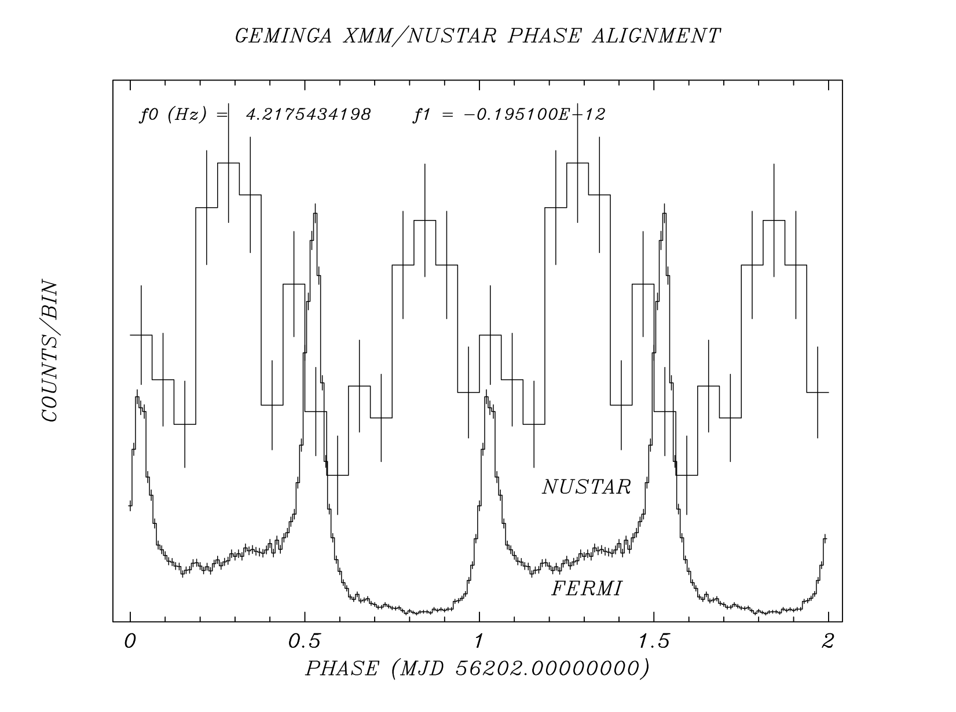
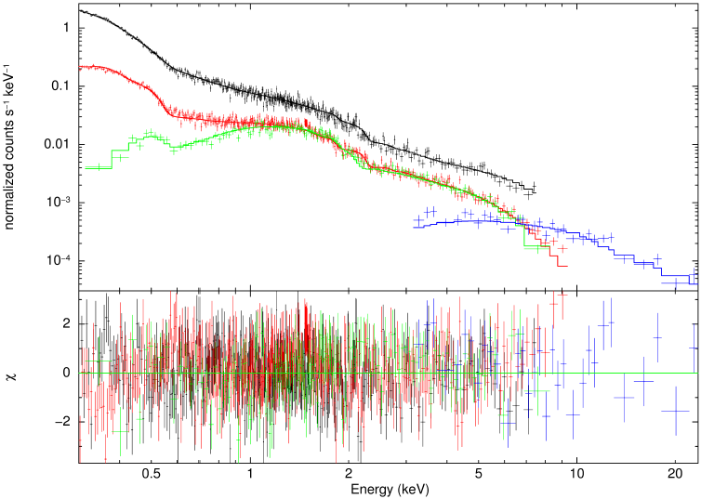
X-ray spectra with NuSTAR spectrum hints a spectral break in the X-ray band
Preliminary
Blue: NuSTAR
Black: XMM PN
Red: XMM MOS
Greed: Chandra
237 ms pulsation
Analysis being done by Francois Dufour at McGill University
Detected 237 ms pulsations
Combining soft-band spectrum hints a spectral break
Results are sensitive to the soft-band spectrum
Notes:
Firstly, we detected the 237 ms pulsations from the source. Combining soft- and hard-band spectra tells us that there may be spectral break at ~4 keV, and the hard spectrum can be connected to the gamma-ray. However, we could not collect enough events in the hard band. Therefore, uncertainty is relatively large, and the hard-band spectrum is strongly affected by the soft-band model. So we are trying to use several soft-band models to see how the results changes.

Slide 23
NuSTAR results to date
AE Aquarii: pulsar-like white dwarf
Notes:
The next one is the pulsar-like white dwarf, AE Aquarii.

Slide 24
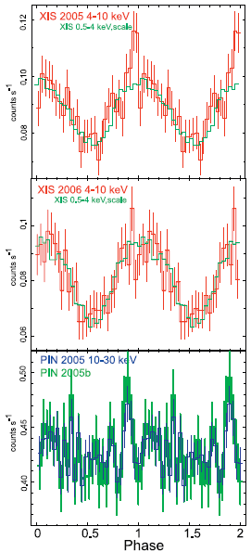
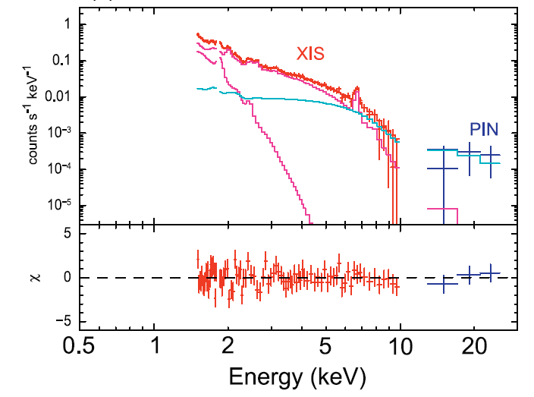
Non-thermal spectral component and sharp pulsation above ~10 keV were detected
Terada et al. PASJ, 60, 387 (2008)
One of the fastest rotating white dwarfs (P=33 s)
Large spin-down power (6  10³³ erg/s)
A non-thermal spectral component and a spiky pulsation were detected above ~10 keV
Suggesting particle acceleration in the magnetosphere like RPPs
Notes:
AE Aquarii is a magnetic CV belonging to Intermediate polar. It is one of the fastest rotating white dwarfs, and has very large spin-down power. It has many interesting characteristics. However, its spectrum and spiky pulsations in the hard band is most interesting. In 2008, Terada et al. reported that they detected a non-thermal spectral component and very spiky pulsations in the hard X-ray band above 10 keV, which have not been seen in other CVs. They then suggested that the hard X-ray emission is from the synchrotron process of accelerated particles in the white dwarf’s magnetosphere. Since their detection in the hard band is not very significant as you can see in the spectrum and the pulse profile, we used NuSTAR to first confirm the detection.

Slide 25
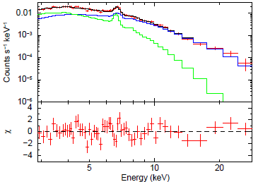
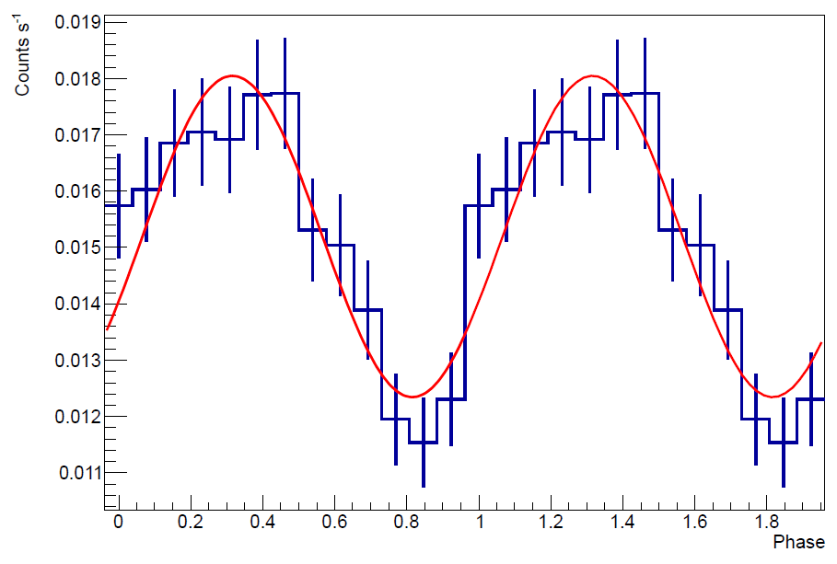
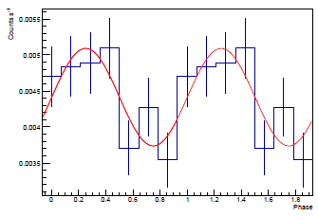
NuSTAR did not detect the non-thermal component or spiky pulsation
Preliminary
6—10 keV
10—20 keV
Analysis done by Takao Kitaguchi at RIKEN
Two temperature thermal model is preferred to a thermal+power-law model
No sharp pulsation was detected above ~10 keV
Working on constraining the mass and radius using a model (Takayuki Hayashi, PhD Thesis)
Notes:
We observed the source for 125 ks using NuSTAR. Here is the spectrum we measured. We tried to fit the spectrum with a two temperature thermal plasma model or a thermal plasam plus power-law model as in Terada et al. Unfortunately, we could not rule out any of them. However, we found that the two temperature plasma model is preferred. So we do not confirm the non-thermal spectrum. Furthermore, we do not see the spiky pulsation in the pulse profile. The pulse profile is sinusoidal, similar to that in the soft band.
This source is still an interesting source because the highest temperature we measure is very low compared other Intermediate polars. So usual white dwarf accretion models do not work, and we are trying to use a different model to find its mass and radius, which will be compared to an independent spectral measurements.

Slide 26
Near Future observations
PSR J1023-0038 and 1E 1048-5937
Notes:
Now I am going to talk about objects that we will observe probably soon, a rotation-powered pulsar J1023-0038 and a magnetar 1E 1048-5937.

Slide 27
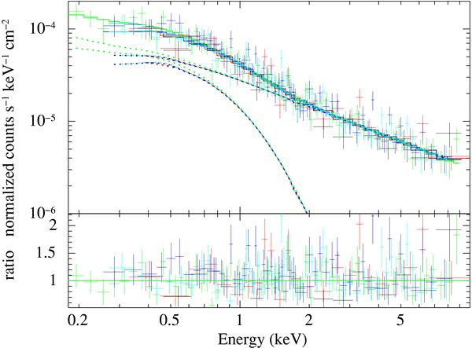
PSR J1023-0038 is a qLMXB/RPP transient object
Spin period: 1.7 ms
Orbital period: 0.2 day
Spectrum: PL model
N_{H} < 5  10¹⁹ cm⁻²
=1.26(4)
Unabs. Flux: 4.66(17)  10⁻¹³ erg/s
XMM-Newton
Archibald et al. ApJ, 722, 88 (2010)
A qLMXB/RPP transient object (Archibald et al. Science, 324, 1412, 2010)
(see also IGR J18245-2452, Atel 4925, 4981, 5069, …)
A possible template for understanding non-thermal emission in qLMXBs
100-ks observation will determine the photon index to 0.07
Notes:
J1023-0038 is a unique LMXB/RPP transient. It used to be an LMXB but in 2010, it was observed in the radio band, behaving like a rotation- powered pulsar. Its soft-band spectrum was well measured with XMM-Newton and we well use NuSTAR to see its behavior in the hard band.

Slide 28
1E 1048-5937
Kaspi & Boydstun, ApJ, 710, L115, 2010
_{H}~1.5
_{H}~1.5
Hard X-ray emission not clearly detected yet
Assuming the putative correlation, detectable with NuSTAR
Notes:
1E 1048 is the magnetar whose outburst in 2002 helped to unify the AXPs and SGRs. However, this source was not detected in the hard band. If the correlation reported by Kaspi & Boydstun 2010 is right, we expect its hard photon index to be ~1.5. In such case, the hard-band spectrum of the source can be measured with a 400-ks observation, and the putative correlation can be tested.

Slide 29
Summary
NuSTAR observed three magnetars, one rotation-powered pulsar, and one pulsar-like white dwarf
More complete data analyses for the observed objects are on-going
NuSTAR will keep observing magnetars and rotation-powered pulsars

Slide 30
Backup
Priority A
Magnetar ToO: 150 ks+ Magnetar Observing
1E 2259+586: 170 ks Magnetar Observed
1E 1048-5937: 400 ks Magnetar
AE Aquarii : 126 ks White Dwarf Observed
Geminga: 50 ks RPP Observed
PSR J1023+0038: 100 ks RPP/LMXB
1E 1841-045: 45 ks+ Magnetar Observed
----------------------------------------------------------------------------------------------------
Priority B
Magnetar ToO obs: 100 ks Magnetar
PSR J0437-4715: 100 ks RPP
4U 0142+61: 110 ks Magnetar
SGR 1806-20: 110 ks Magnetar
RXS 1708-4009: 155 ks Magnetar
SGR 1900+14: 80 ks Magnetar
Vela: RPP

