Slide 1
The Properties of the Progenitor, Neutron Star, and Pulsar Wind in SNR Kes 75
Joseph Gelfand (NYUAD / CCPP)
Pat Slane (CfA)
Tea Temim (NASA / GSFC)

Slide 2
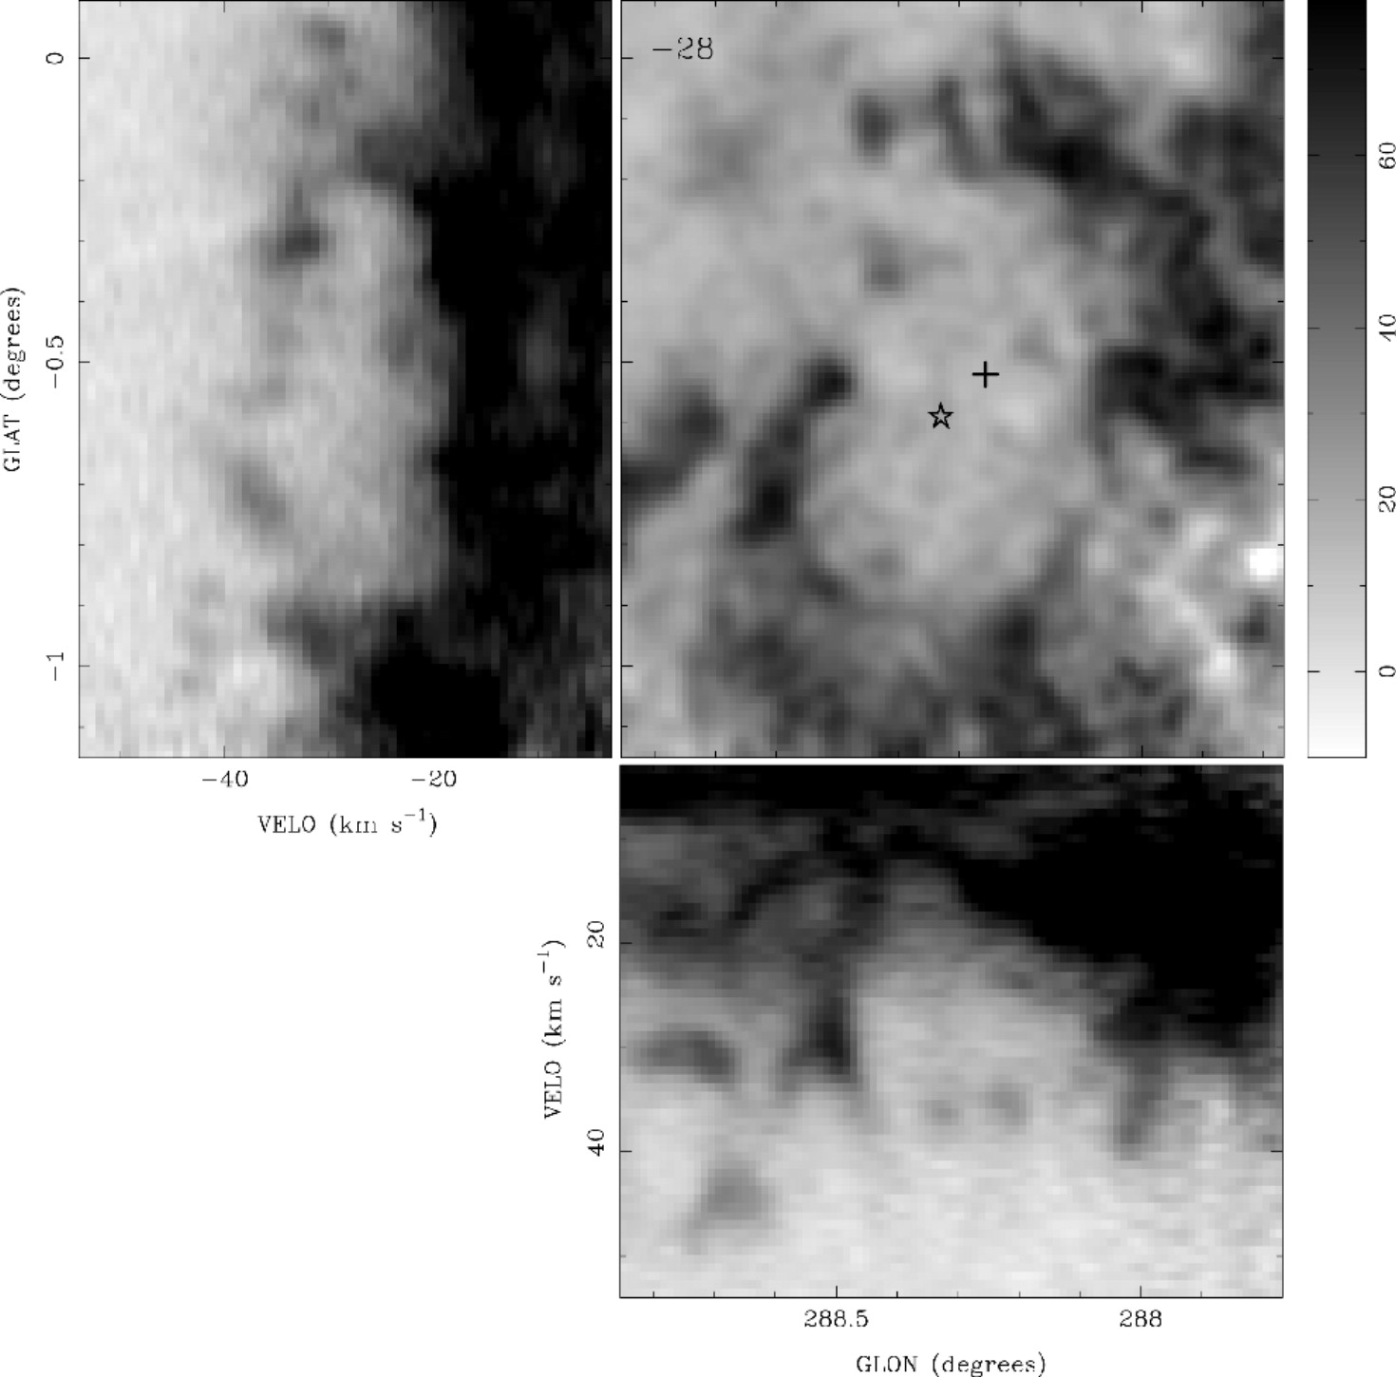
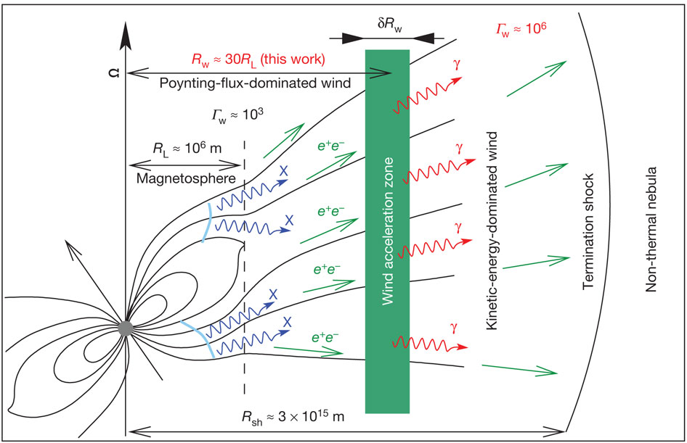
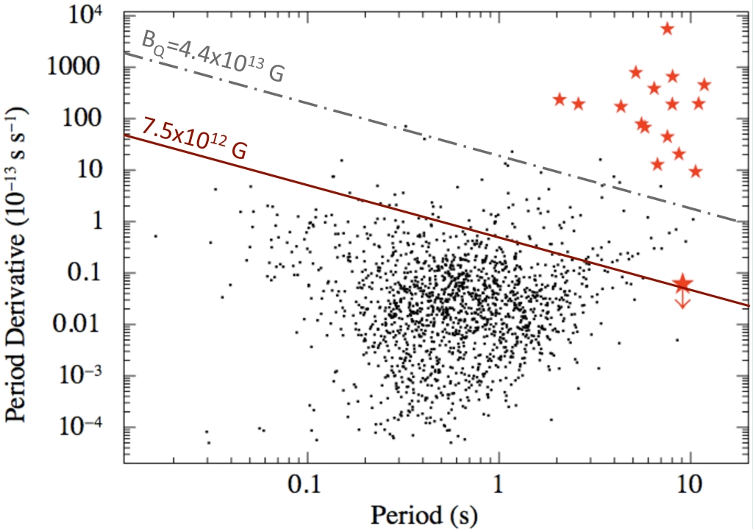
Neutron Stars with Strong Surface Magnetic Fields
Observational evidence for neutron stars with ≥10^{13.5} G surface magnetic fields
“Magnetars”
High-B Radio Pulsars
X-ray Dim Isolated Neutron Stars
Lots of questions:
What creates the strong fields?
Initially fast rotation?
Very massive progenitors?
How do they evolve?
How are they similar / different from “normal” isolated neutron stars?
Answers requires measuring properties of progenitor, neutron star, and pulsar wind
(Rea et al., 2010)
(Aharonian et al., 2012, Nature, 482, 507)
(Pons et al., 2009, A&A, 496, 207)
(Gaensler et al. 2005, ApJ, 620, L95)

Slide 3
Pulsar Wind Nebula inside a Supernova Remnant
Neutron Star
Initial Spin Period / Spin-down Luminosity
Spin-down Timescale
Braking Index
Progenitor Supernova
Ejecta Mass
Initial Kinetic Energy
Pulsar Wind
Fraction of energy in magnetic fields, electrons / positrons
Acceleration mechanism: minimum and maximum particle energy, energy spectrum
(Credit: X-ray: NASA/CXC/Eureka Scientific/M.Roberts et al.; Radio: NRAO/AUI/NSF)

Slide 4
Schematic of a Pulsar Wind Nebula inside a Supernova Remnant
Neutron Star
Supernova Remnant
Pressure: P_{snr}(R_{pwn})
Velocity: v_{snr}(R_{pwn})
Density: ρ_{snr}(R_{pwn})
Ejecta mass: M_{ej}
Kinetic energy: E_{sn}
Density ISM: n_{ism}
Termination Shock
Magnetic Field: η_{B}Ė
Electrons: η_{e}Ė
Injection Spectrum
Pulsar Wind
Swept-up Material
Mass: M_{sw,pwn}
Velocity: v_{pwn}
Pulsar Wind Nebula
Pressure: P_{pwn}
Magnetic Field: B_{pwn}
(Gelfand et al. 2009, ApJ, 703,2051)

Slide 5
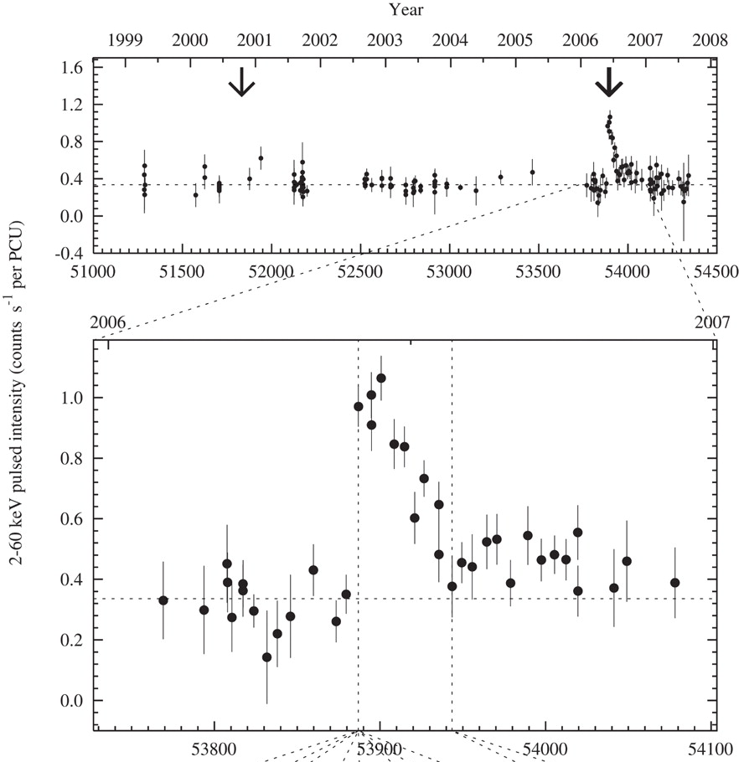
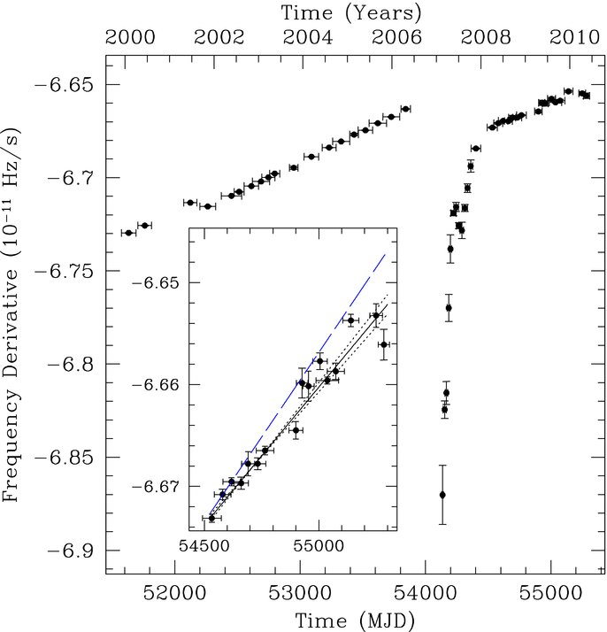
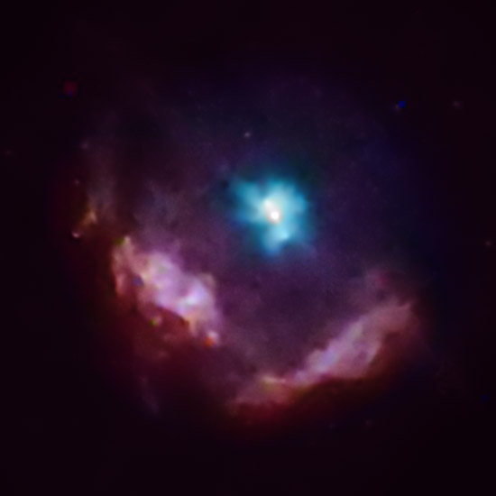
Properties of Kes 75
Supernova Remnant
Radio, Infrared, and X-ray detection
Pulsar Wind Nebula
Radio, X-ray, and TeV γ-ray detection
Neutron Star (PSR J1846–0258)
Pulsed X-ray emission
Magnetar-like X-ray flux and timing variability
(Gavriil et al. 2008, Science, 319, 1802)
(Livingstone et al. 2011, ApJ, 730, 66)
Credit: NASA/CXC/GSFC/F.P.Gavriil et al.

Slide 6
MCMC Model Fit of Kes 75
Unknowns:
Mass M_{ej} and initial kinetic energy E_{sn} of supernova ejecta
Density of the surrounding medium n_{ism}
Values of τ_{sd} and Ė₀ (P₀) of the central neutron star
Content of the pulsar wind (η_{B} and η_{e})
Injection spectrum
Background Photon Field
Origin of Hard X-rays
Distance
Good fit requires
Hard X-ray emission not solely emitted by PWN.
If TeV emission dominated by PWN, require photon field in addition to CMB

Slide 7
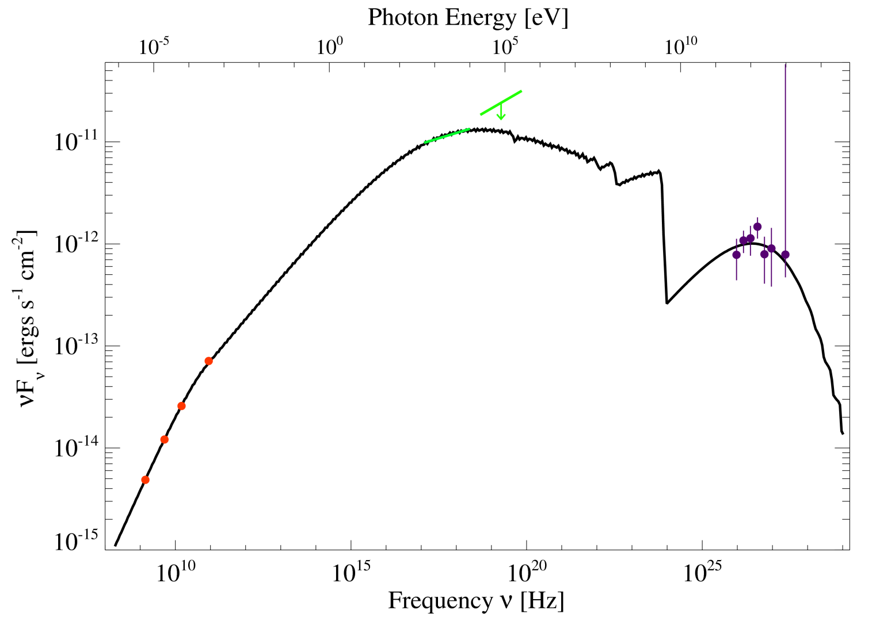
MCMC Best Fit
Quantity | Observed | Predicted
PWN Radius | 12.0 ± 0.7 arcsec | 12.0 arcsec
SNR Radius | 1.75 ± 0.18 arcmin | 1.89 arcmin
1.4 GHz Flux Density | 348 ± 52 mJy | 411 mJy
4.7 GHz Flux Density | 247 ± 37 mJy | 259 mJy
15 GHz Flux Density | 172 ± 26 mJy | 173 mJy
89 GHz Flux Density | 80 ± 12 mJy | 79 mJy
0.5 – 10 keV Photon Index | 1.90 ± 0.01 | 1.91 ± 0.004
0.5 – 10 keV Flux | (3.45 ± 0.11)×10⁻¹¹ ergs/cm²/s | 3.44×10⁻¹¹ ergs/cm²/s
20 – 100 keV Flux | < 2.9×10⁻¹¹ ergs/cm²/s | 2.0×10⁻¹¹ ergs/cm²/s
0.5 – 10 TeV Photon Index | 2.29 ± 0.24 | 2.36 ± 0.01
1 TeV Photon Density | (6.2 ± 0.8)×10⁻¹³ photons/TeV/cm²/s | 6.1×10⁻¹³ photons/TeV/cm²/s

Slide 8
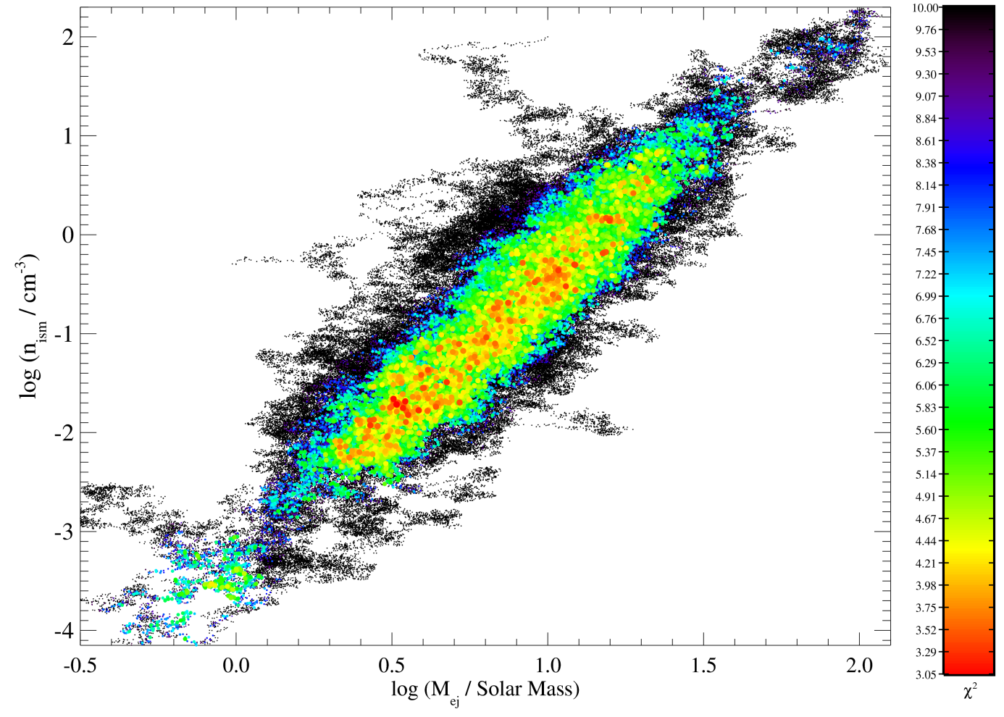
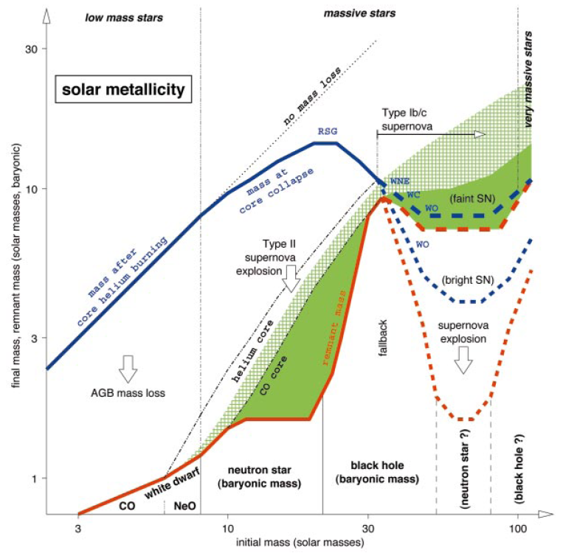
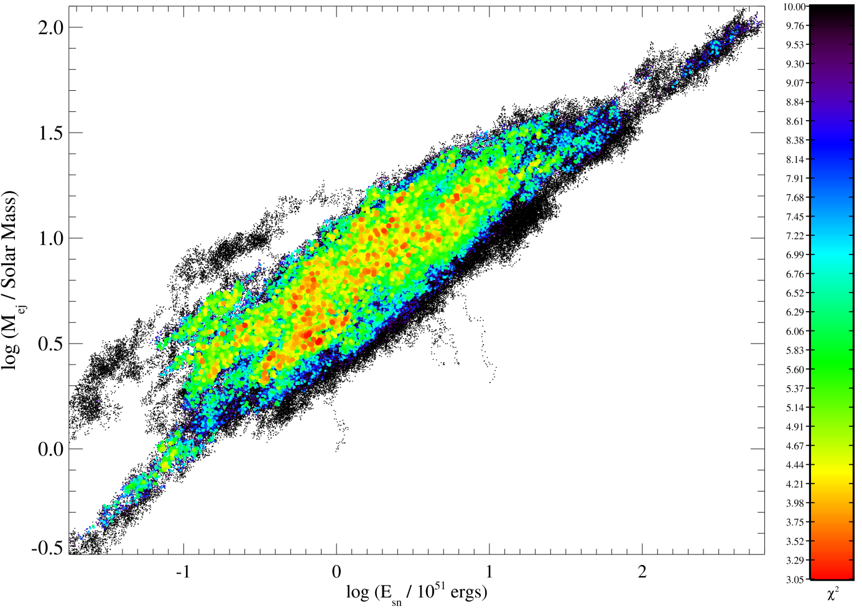
Progenitor Star
Wide range of allowed parameters
E_{sn} = 10⁵⁰ – 10⁵² ergs
M_{ej} = 2 – 20 M☼
Stellar evolution models predict M_{ej} ≈ 4 – 20 M☼
Most massive (Wolf-Rayet) stars have low M_{ej}
Wolf-Rayet scenario allowed
Slightly sub-energetic supernova
Low density ISM
100
100
10
30
1
Very Preliminary
10
Ejecta Mass M_{ej} [M☼]
0.1
ISM Density n_{ism} [cm⁻³]
3
10⁻²
1
10⁻³
10⁻⁴
0.3
0.3
1
3
10
30
100
10⁵⁰
10⁵¹
10⁵²
10⁵³
Ejecta Mass M_{ej} [M☼]
(Woosley et al. 2002, RvMP, 74, 1015)
Supernova Explosion Energy E_{sn} [ergs]

Slide 9
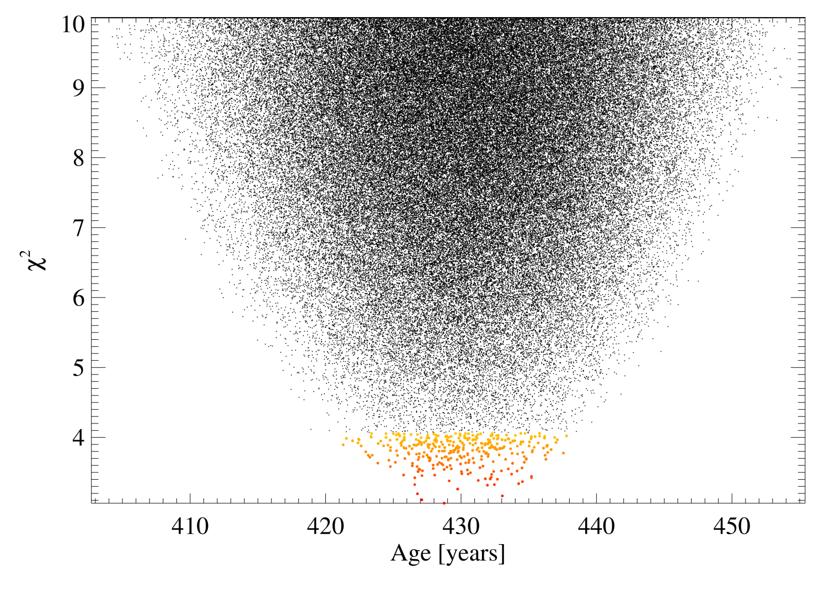
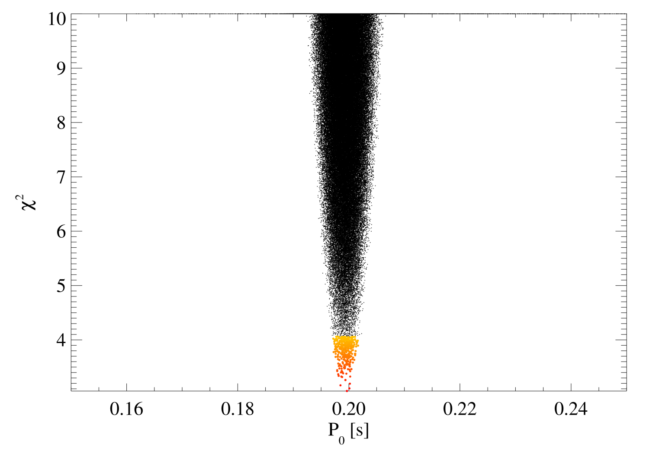
Spin-down Properties of PSR J1846-0258
Constant (pre-flare) braking index p = 2.65
Initial spin period P₀ ~ 200 ms
Dynamo favors P₀ ~ 2 ms
Spin-down timescale τ_{sd} ~ 440 – 460 years
Age ~ 420 – 440 years
Very Preliminary
400
420
440
460
480
500
Spin down timescale τ_{sd} [years]

Slide 10
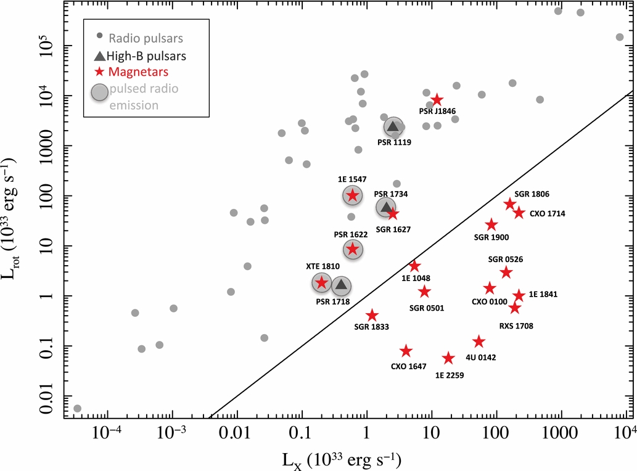
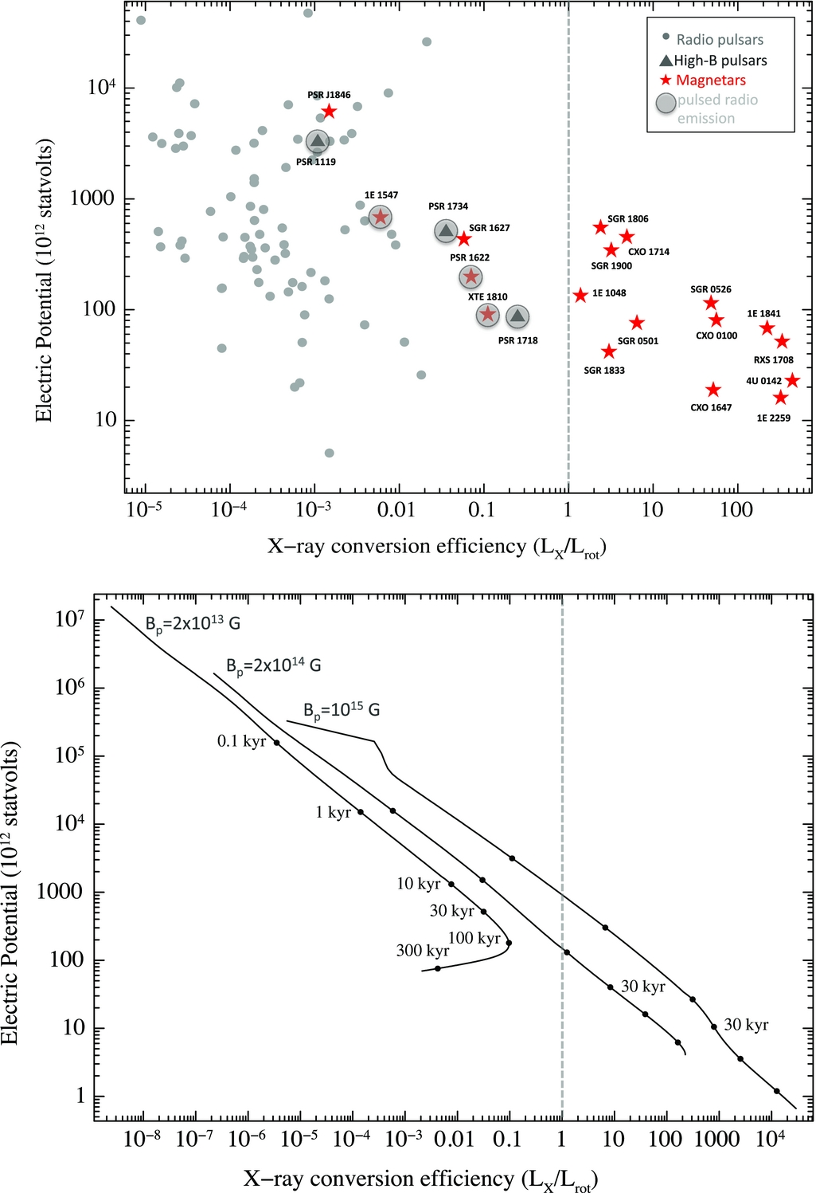
Evolution of PSR J1846-0258
Transient pulsed radio emission from some high-B neutron stars
Only those with L_{x} < Ė
Theory: Radio emission mechanism same as normal pulsars
Spin-down decreases potential, magnetic field evolution heats surface
PSR J1846-0258 born with dipolar magnetic field B_{p}=2×10¹⁴ G
Age =430 yr agrees with evolutionary model
(Rea et al., 2012, ApJL, 748, L12)
(Rea et al., 2012, ApJL, 748, L12)
(Rea et al., 2012, ApJL, 748, L12)
(Rea et al., 2012, ApJL, 748, L12)

Slide 11
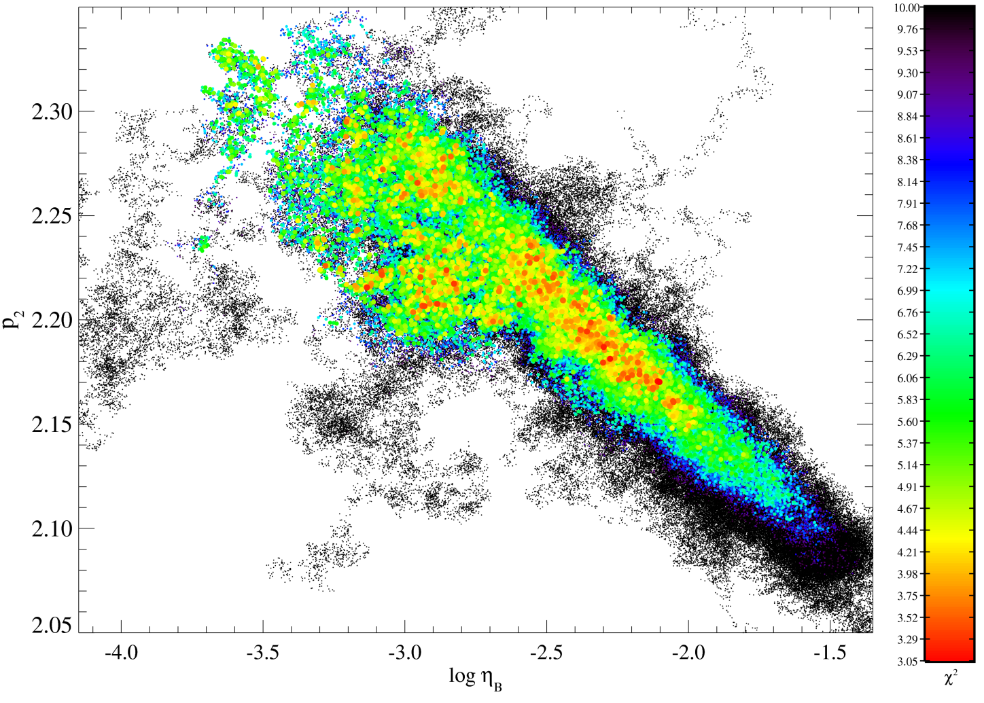
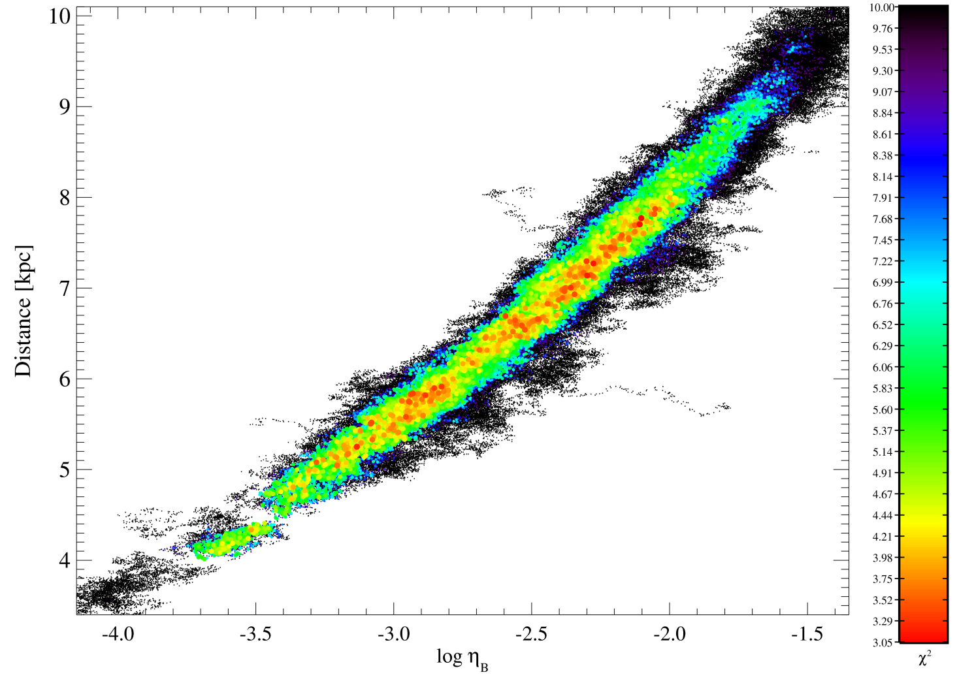
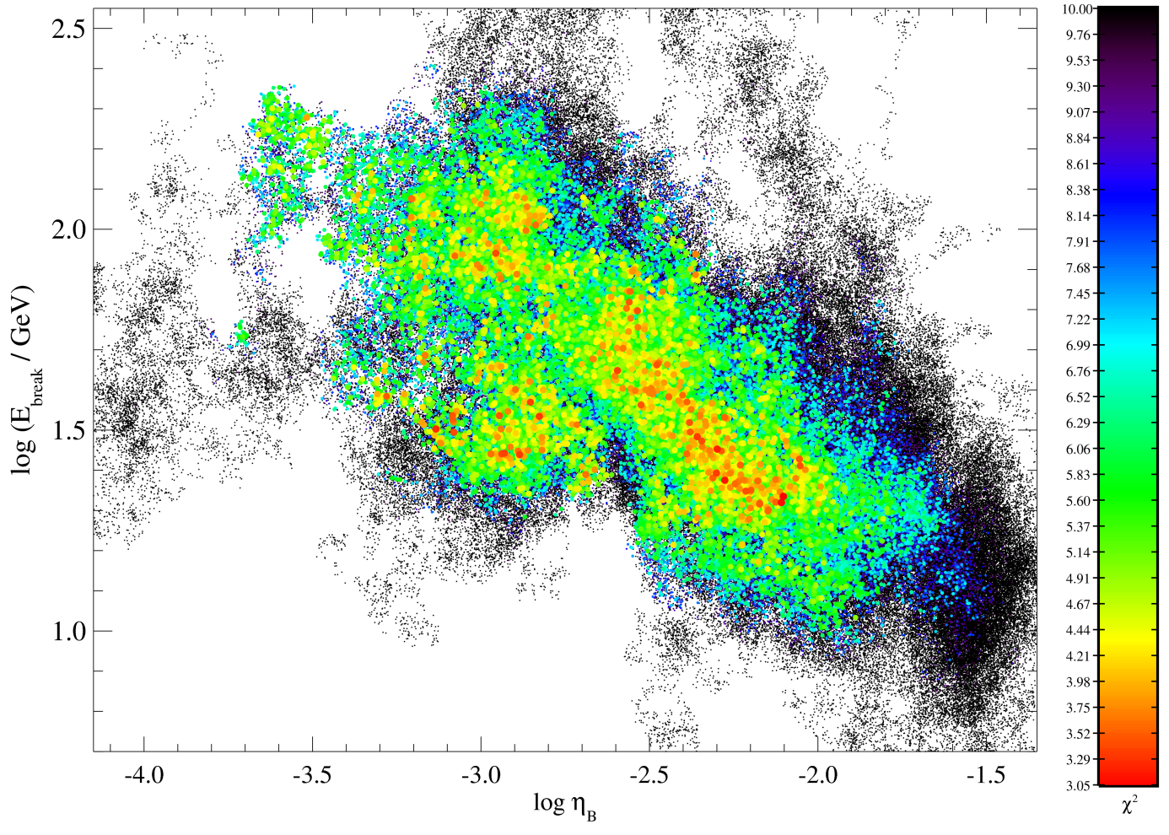
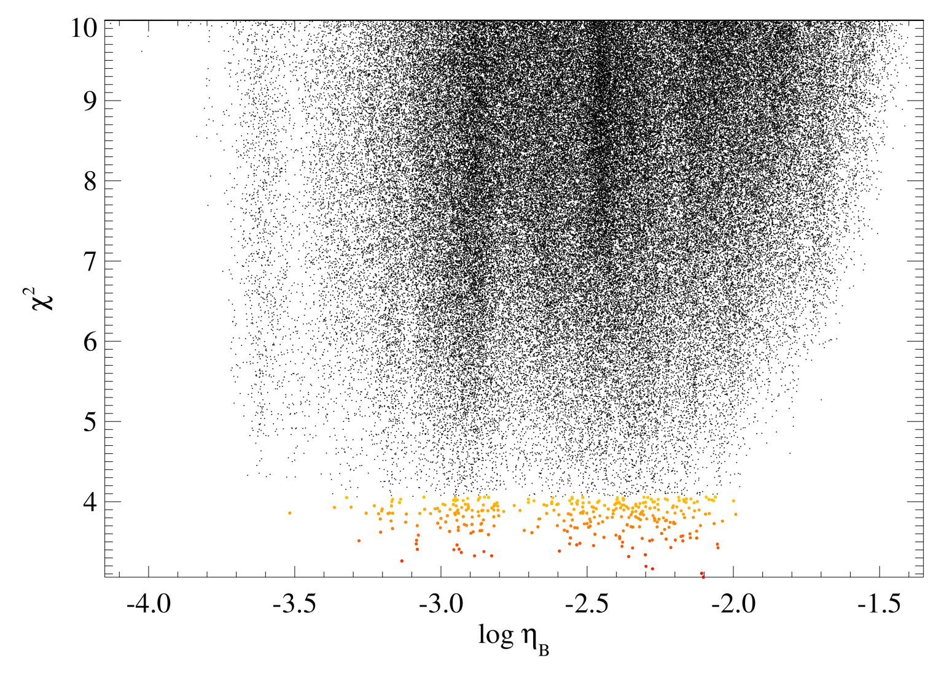
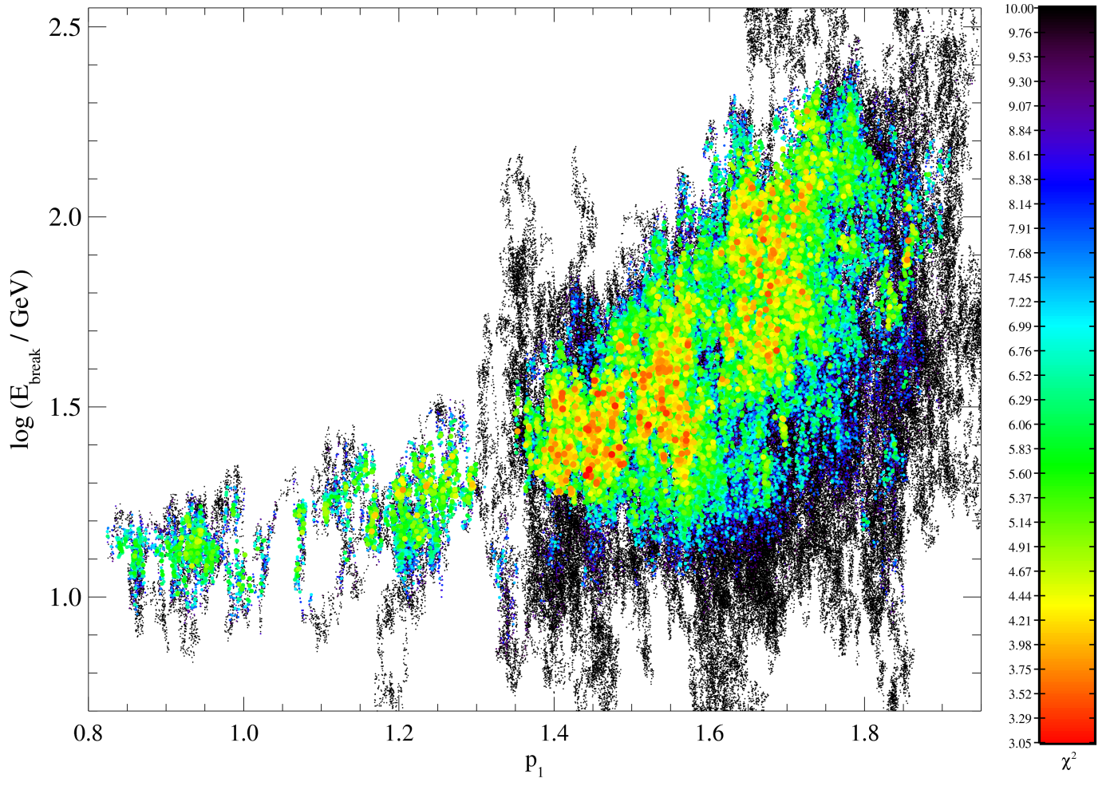
Wind of PSR J1846-0258
Weakly magnetized wind
η_{B} < 0.01
Degenerate with distance
Broken power-law particle injection spectrum
E_{min} < 10 GeV
E_{max} > 1 PeV
E_{break} and p₂ depend on η_{B}
p₁ sensitive to E_{break}
Fairly “normal” values
300
300
-p₁
100
100
Very Preliminary
Number per Unit Energy
E_{break}
-p₂
Break Energy E_{break} [GeV]
Break Energy E_{break} [GeV]
30
30
10
E_{max}
10
E_{min}
Energy

Slide 12
Summary & Future Directions
Progenitor Star
Wolf-Rayet progenitor possible
Favors slightly low energy supernova in low density ISM
Initial Spin Period
P₀ » 2 ms
Inferred age, observed X-ray luminosity consistent with some theories
“Normal” pulsar wind
Future work
Stellar wind bubble environment?
Changing braking index?
Thank You!
(Credit: NASA/CXC/GSFC/F.P.Gavriil et al.)
Notes:
You know, the things I hope to do one day.

Slide 14
How can we measure the initial spin period of a neutron star?
Ideal system
“Stable” rotator
Independent age estimate
Actual systems
Unstable rotators
Uncertain ages
(Gavriil et al. 2011, ApJ, 736, 138)

Slide 15
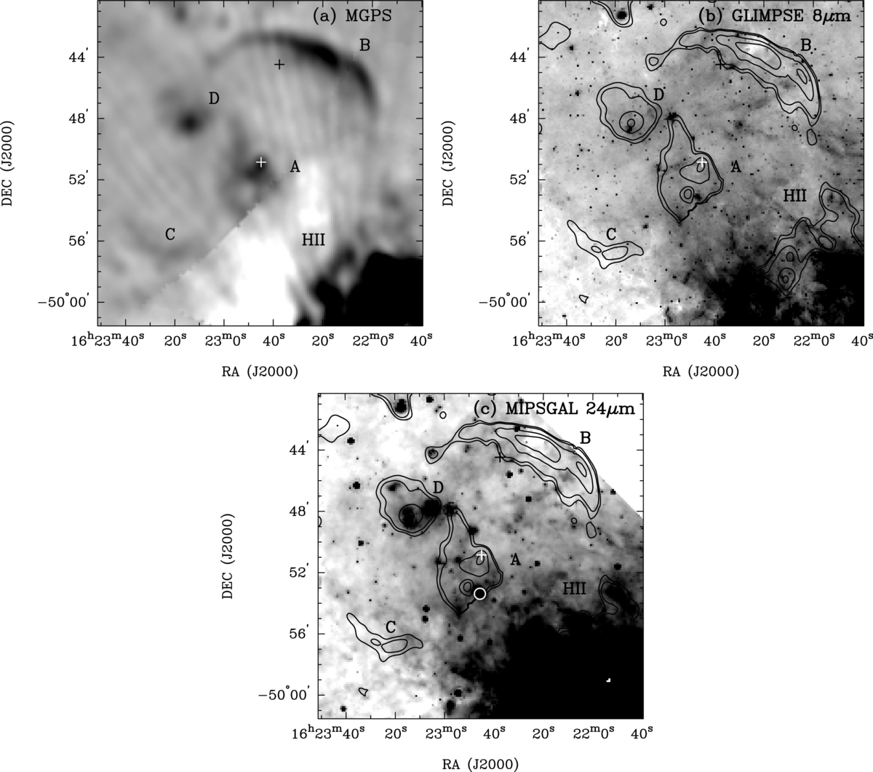
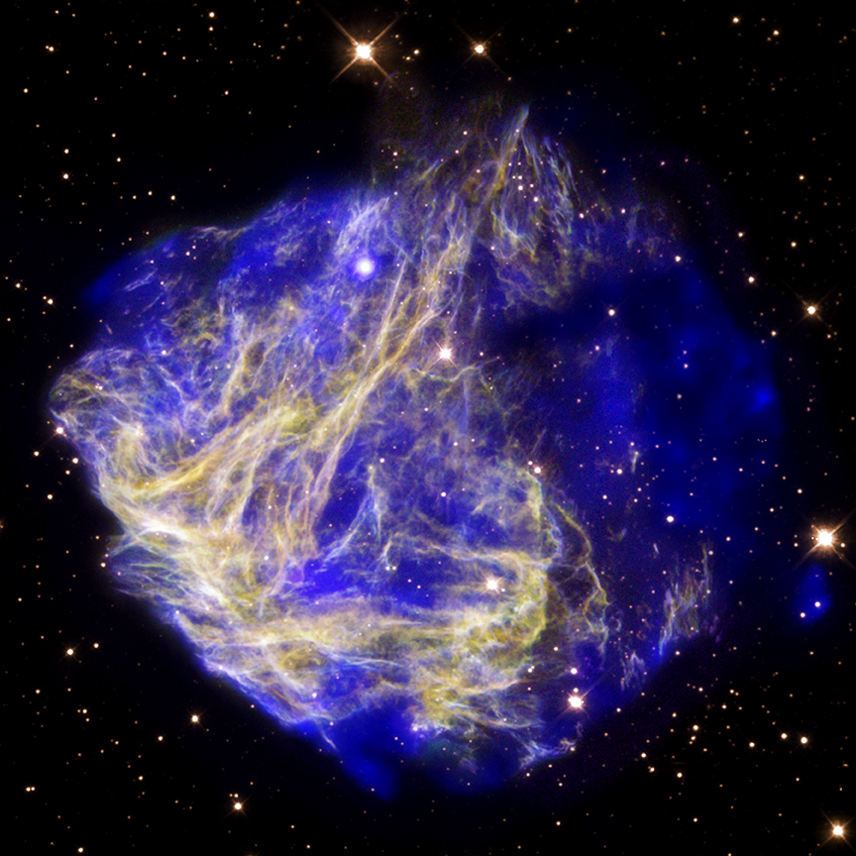
How can we measure the mass of the progenitor star?
Environment
Stellar wind bubble, HI shell
Very difficult
Supernova Remnant
Must be ejecta dominated
Lots of uncertainties
1E 1048.1-5937
PSR J1622-4950
(Anderson et al. 2012, ApJ, 751, 53)
(Gaensler et al. 2005, ApJ, 620, L95)
(X-ray: NASA/CXC/Penn State/S.Park et al.; Optical: NASA/STScI/UIUC/Y.H.Chu & R.Williams et al.)

Slide 16
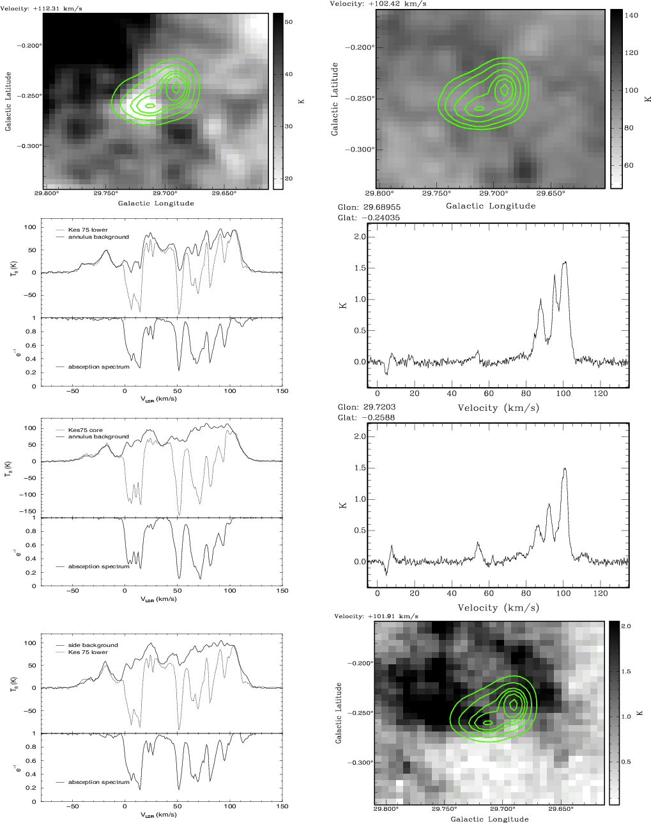
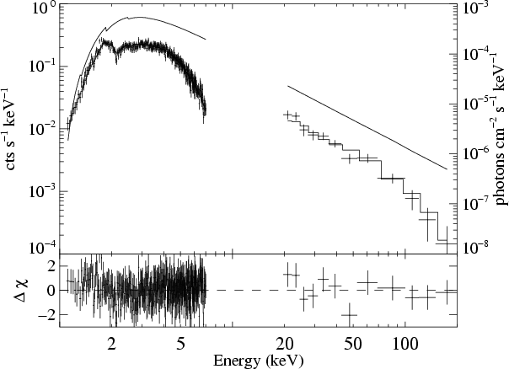
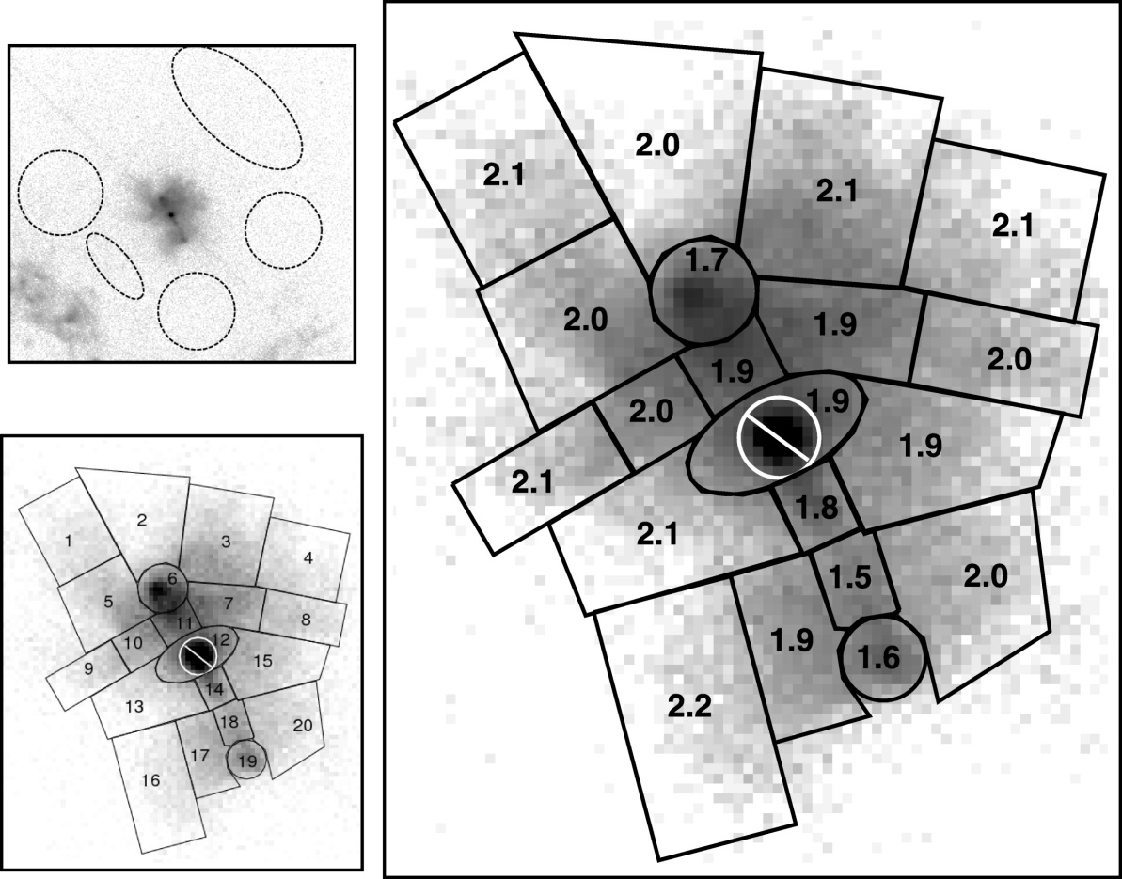
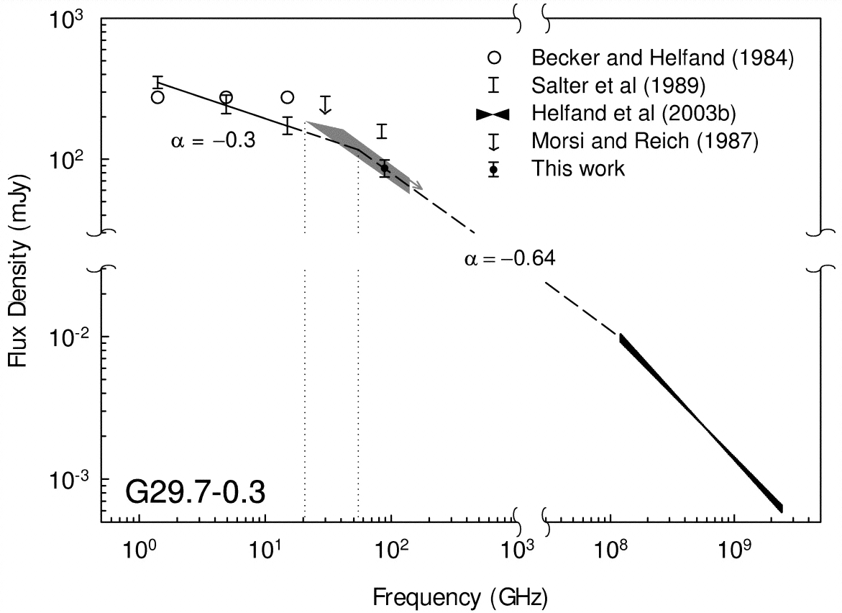
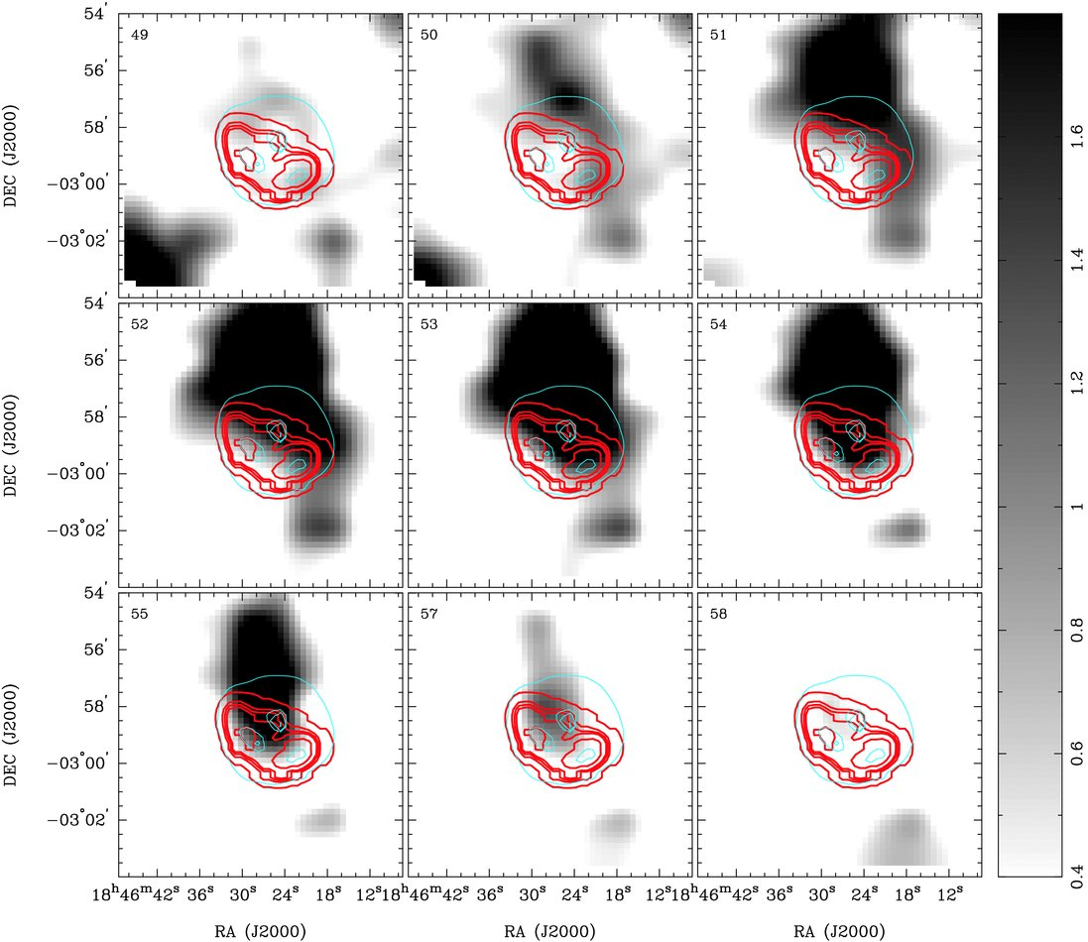
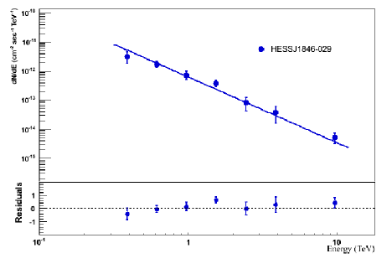
Properties of Kes 75
Observed Properties:
Distance (Near or Far)
PWN Radius
SNR Radius
Radio Spectrum
0.5-10 keV X-ray Spectrum
Hard X-ray Spectrum
TeV Spectrum
Characteristic Age and current Ė
Neutron Star Braking Index
(Bock & Gaensler 2005, ApJ, 626, 343)
(McBride et al. 2008, A&A, 477, 249)
(Ng et al. 2008, ApJ, 686, 508)
(Livingstone et al. 2011, ApJ, 730, 66)
(Terrier et al. 2008, AIPC, 1085, 386)
(Leahy & Tian 2008, A&A, 480, L25)
Credit: NASA/CXC/GSFC/F.P.Gavriil et al.
(Su et al. 2009, ApJ, 694, 376)

Slide 17
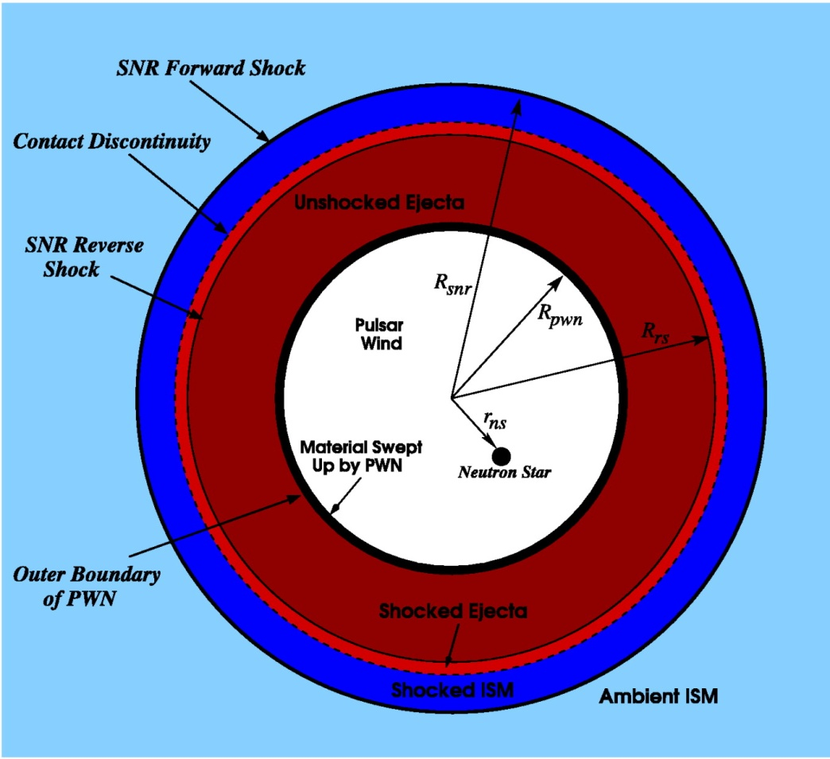
Evolutionary Model for a Pulsar Wind Nebula Inside a Supernova Remnant
Homogeneous ISM, PWN
One-zone model
Dynamical evolution determined by motion of swept-up material
Difference in pressure between PWN and SNR results in net force
PWN’s emission dominated by synchrotron radiation and Inverse Compton scattering of electrons off background photons
4πR_{pwn}²P_{pwn}
Pulsar Wind Nebula
4πR_{pwn}²P_{snr}(R_{pwn})
(Gelfand et al. 2009, ApJ, 703,2051)
Supernova Remnant
(Figure 6; Gelfand et al. 2007)

