Slide 1
Linking the soft γ-ray pulsar population with the Fermi LAT pulsar population: completing the high-energy picture
Lucien Kuiper¹ & Wim Hermsen^{1,2}
¹SRON Netherlands Institute for Space Research
²Astronomical Institute “Anton Pannekoek”,
University of Amsterdam

Slide 2
Outline of presentation
Introduction Fermi LAT (>100 MeV) pulsar population
Observational status of pulsar emission in the hard X-ray / soft γ-ray window (> 20 keV)
◊ Increase of sample: How?
Work horses
◊ Current (secure) member list
◊ Zoom-in on some recent 'new' members AX J1838.0-0655,
PSR J2229+6114 and IGR J18490-0000
Population comparisons
Summary & conclusions

Slide 3
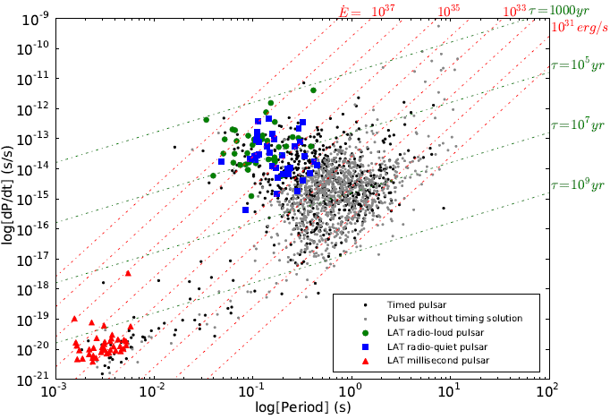
High-energy γ-ray (>100 MeV) pulsar population
Sample used in this work: # 101
from https://confluence.slac.stanford.edu/
display/GLAMCOG/Public+List+of+LAT-
Detected+Gamma-Ray+Pulsars
2nd Fermi LAT Pulsar Catalogue: # 117
Preliminary
Radio-loud : 41
Radio quiet: 36
Ms pulsars : 40
(recycled)
Young pulsars: 77
(non-recycled)
Maximum luminosity at GeV energies
Credit: Fermi pulsar team

Slide 4
Soft γ-ray pulsar population (> 20 keV)
Step 1
Identification of energetic point-sources in supernova remnants (radio), unidentified
CGRO EGRET/LAT (>100 MeV), INTEGRAL (>20 keV) or HESS/VERITAS/Magic
(> 300 GeV) error regions by using the sensitive X-ray instruments aboard Chandra,
RXTE, XMM-Newton and Suzaku
Step 2
Follow-up with instruments with sensitivity above ~20 keV: Workhorses
With presently available sensitivities long exposures are required, sometimes summing (archival) data collected over years from:
a) RXTE PCA ( 2 - 60 keV; non-imaging)
b) RXTE HEXTE (15-250 keV; non-imaging)
c) INTEGRAL IBIS ISGRI (15-300 keV; imaging)
d) NuStar ( 3 - 80 keV; imaging)
[e) Suzaku HXD PIN (12 - 60 keV; non-imaging)
f) Swift BAT (15-150 keV; imaging)]
Good imaging is required to avoid source confusion,
particularly in Galactic Plane regions, and to disentangle
pulsed and DC (PWN) emission

Slide 5
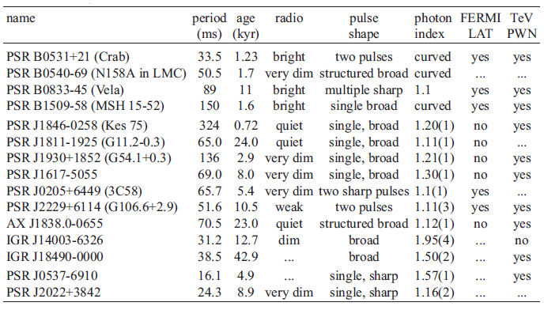
Soft γ-ray pulsar population (> 20 keV): 15 members

Slide 6
AX J1838.0-0655
Discovered in 2008 as an energetic 70.5 ms X-ray
pulsar using RXTE PCA data (ATEL #1392;
Gotthelf & Halpern (2008))
Associated with HESS J1837-069
Characteristic age: 22.6 kyr
Hard X-ray photon index Γ ~ 1.36(2) at 14.2 keV
(Kuiper & Hermsen 2013; in prep.)
Since discovery RXTE monitoring ➞ pulsar ephemeris
9.9σ
5.3σ
9.7σ
7.2σ
3.3 Ms
Since its discovery a large timing glitch
has been detected (Atel #2446; Kuiper & Hermsen)!

Slide 7
Decoupling pulsed/DC spectra
➞ underlying PWN spectrum!
Total emission from AX J1838.0-0655
Suzaku XIS 0.7-10 keV (42.2 ks): Γ=1.27±0.11; Anada et al. (2009)
INTEGRAL ISGRI 20-300 keV : Γ=1.72±0.07; this work; consistent with Malizia et al. (2005)
DC spectrum breaks above ~50 keV

Slide 8
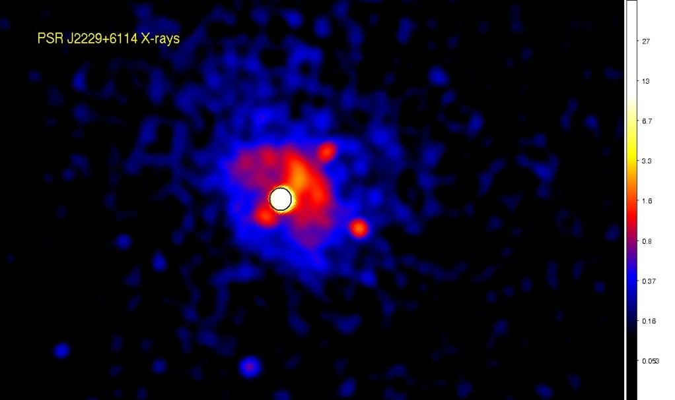
PSR J2229+6114: the energetic young pulsar in 3EG J2227+6122
Discovered by Halpern et al. 2001 in
unid. EGRET error region at radio
freq. and at X-rays (ASCA):
P = 51.6 ms; τ_{c}=10.5 kyr
Bright PWN (see below)
Pulsations, also detected now by
AGILE and Fermi above 100 MeV: a broad asymmetric pulse
Recent detection of extended TeV emission with Veritas (VER J2227+608) from near environment
12.3σ
8.2σ
2.5σ
Archival RXTE PCA/HEXTE data reveal
pulsed emission up to ~30 keV using
~220 ks exposure with hard spectrum,
photon index Γ = 1.11(3)
95 ks CXO ACIS-I

Slide 9
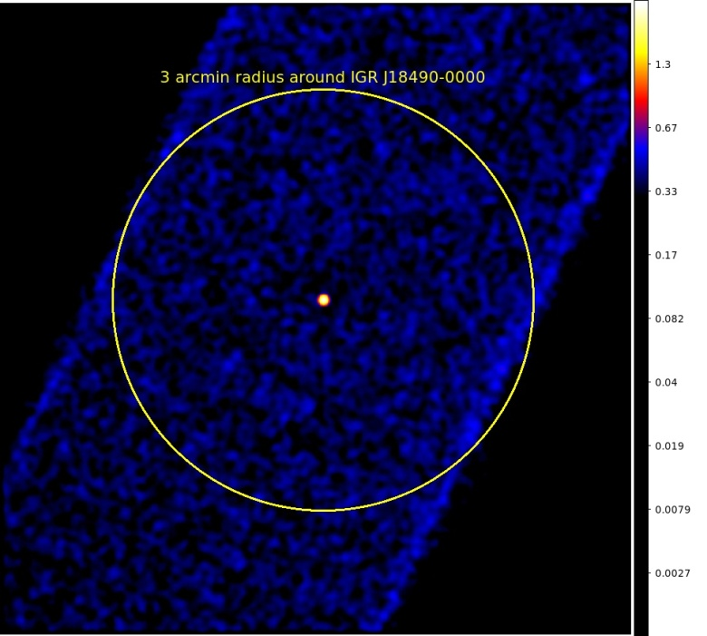
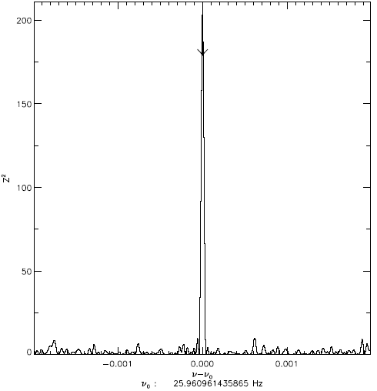
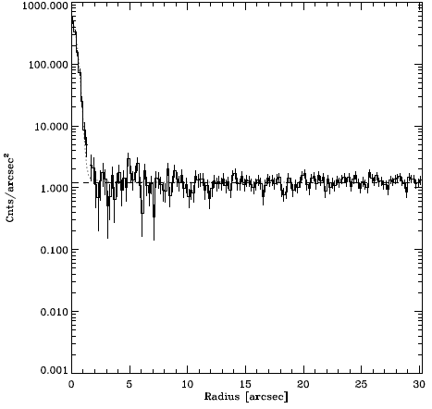
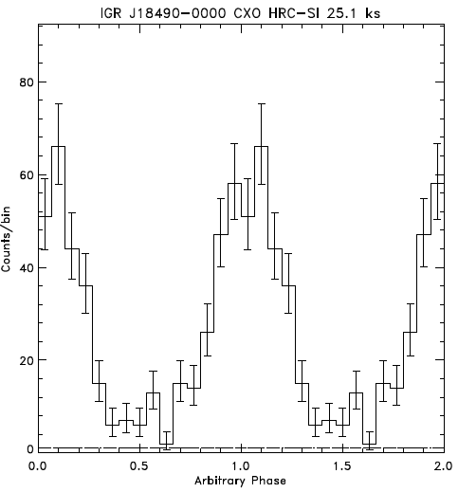
IGR J18490-0000
I) Chandra HRC-SI
Nov. 20, 2011 (25.1 ks)
II) Chandra ACIS-S
Nov. 16, 2012 (22.7 ks)
Goals:
1) Evidence for diffuse
emission?
2) Pulsed fraction?
(reported; P_{f} ~ 0.25
PCA based; Gotthelf
et al., 2011)
14.5σ
No pronounced diffuse
emission seen in HRC-S data
P_{f} = 0.77 +/- 0.04

Slide 10
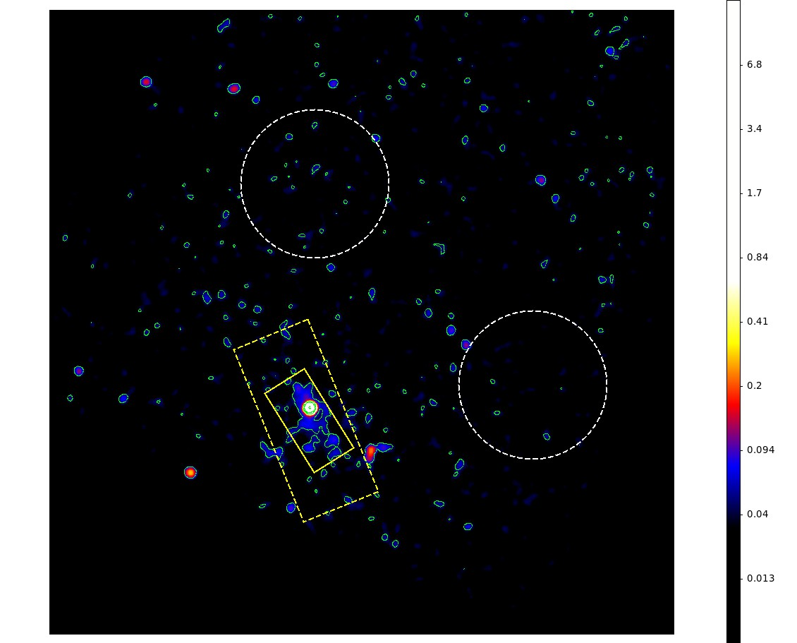
IGR J18490-0000: Chandra ACIS-S spatially resolved spectral analysis
2-10 keV
HE-spectrum (Total; unabs. )
ACIS-S (5" source): 1.08+/- 0.02
EPIC MOS 1+2 : 1.13 +/- 0.01
EPIC Pn (SWM) : 1.23 +/- 0.01
Pulsed
EPIC Pn (SWM) : 1.14 +/- 0.01
2 circular "bg" regions (r = 60") and 2
rectangular "diffuse" PWN emission extraction
regions (150" x 65" and 75" x 37.5"
minus 5" radius source region) :
Weak, hard PWN emission Γ = 1.18 +/- 0.05
about 5 x weaker than PSR emission

Slide 11
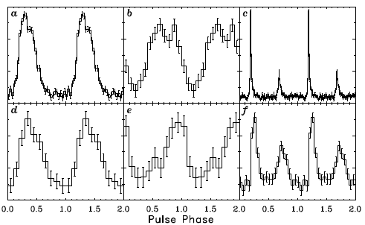
Soft γ-ray pulsar characteristics
Spectral view (1 keV – 10 GeV)
Profile morphology:
Single sharp pulse : #2
Two (sharp) pulses : #3 (All LAT)
Multiple sharp : #1 (Vela; LAT)
Single (structured) : #9 (1509-58;LAT)
broad pulse
1509-58
AX J1838.0-0655
0205-6449
1846-0258
IGR J18490-0000
2229+6114
Maximum luminosity at MeV energies!

Slide 12
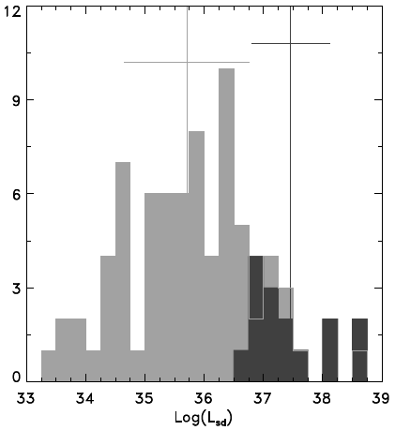
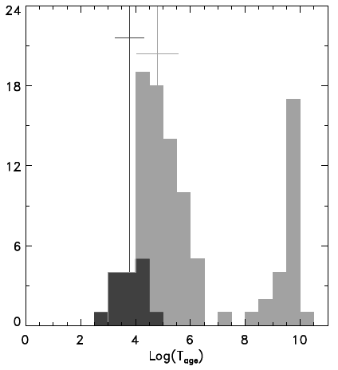
35.70 +/- 1.05
37.46 +/- 0.66
Light grey: Fermi LAT pulsars (76 entries)
Dark grey: Soft γ-ray pulsars (16 entries)
Spin-down
luminosity
(non-recycled)
12.35 +/- 0.37
12.49 +/- 0.48
~60 x more
energetic
3.78 +/- 0.52
4.80 +/- 0.76
Characteristic
age/time scale
Surface magnetic
field strength
~10 x
"younger"
Comparable distributions!

Slide 13
Summary & Conclusions
The number of pulsars detected at soft γ-rays has increased to 15 [+1]
Above 100 MeV now more than 117 pulsars detected by Fermi LAT, only 5 pulsars in both samples…
The soft γ-ray pulsar population is younger and more energetic than the LAT one
Soft γ-ray pulsars reach max. luminosity at MeV energies, the LAT pulsars do so in
GeV range
The large majority of the soft γ-ray pulsars has single broad (asymmetric/
structured) pulses contrary to the LAT pulsars, showing mainly double pulses
Soft γ-ray pulsars are in general associated with bright X-ray/TeV PWNe
The current missions sensitive for hard X-rays are not / hardly sensitive enough to detect the “GeV-pulsars” ➞ need more sensitive missions (NuSTAR; Astro-H; AstroSat; LOFT; and MeV missions like e.g. DUAL, GRIPS)
Open questions: Why no detection of pulsed non-thermal X-ray emission (>2 keV) from PSR J1119-6127, (1.6 kyr) PSR J1357-6429 (7.3 kyr) and PSR J1124-5916 (2.9 kyr), while we have Fermi LAT detections and TeV detections of two?
Instead soft pulsed X-ray emission (< 2 keV; thermal?) has been detected…
What about: PSR J1833-1034 (G21.5-0.9): LAT plus TeV/soft γ-ray (ISGRI) detection, but NO X-ray pulsations…

Slide 14
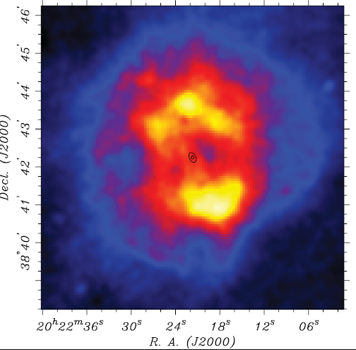
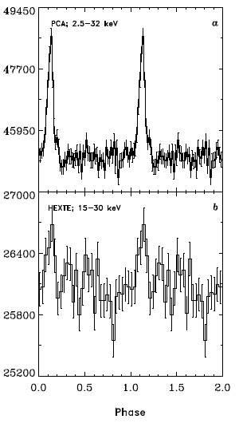
PSR J2022+3842 in G76.9+1.0
24σ
Arzoumanian et al. (2011), ApJ 739, 39
Fast and energetic radio pulsar: P = 24.3 ms,
L_{sd}=1.2E38 erg/s
Sharp single pulse X-ray lightcurve
Hard pulsed X-ray spectrum: Γ = 1.16(2)
3.9σ

Slide 15
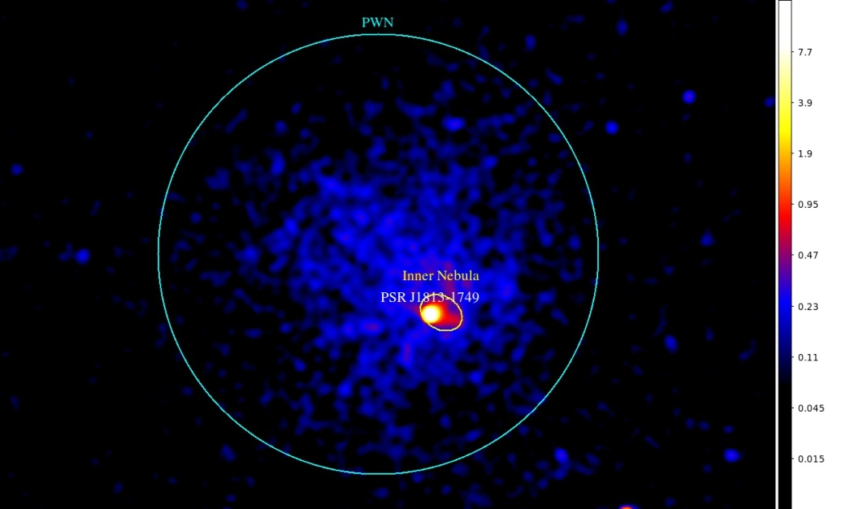
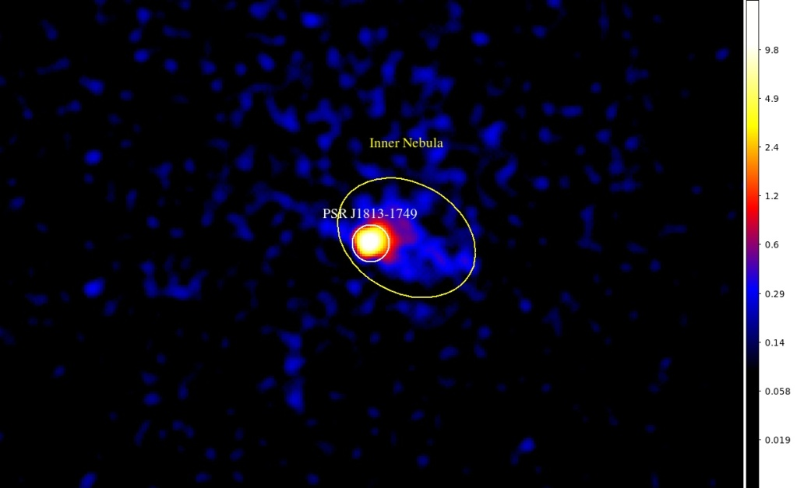
A new candidate soft γ-ray pulsar: PSR J1813-1749 in G12.82-0.02 and associated with HESS J1813-178 / IGR J18135-1751
Putative pulsar and PWN discovered by
Helfand et al. (2007) using 30 ks CXO
ACIS data (15/09/2006; see left 2 panels).
X-ray Spectra obtained for point-source ('PSR'; < 2"), Inner Nebula (6" x 8") and PWN (r = 80").
An energetic 44.7 ms X-ray pulsar was detected by Gotthelf & Halpern (2009) using XMM-Newton EPIC-pn data from a 98 ks obs. performed on 27/03/2009.
(broad pulse; hard spectrum > 2 keV)
Additional XMM and CXO obs. taken in 2011/2012 yielded the spin-down:
L_{sd} = 5.6E37 erg/s ; τ = 5.6 kyr
Revisiting now 125.8 ks RXTE PCA data
taken between 16-20 Nov. 2007 with only ONE operational PCU and at 30' offset angle.

Slide 16
A new candidate soft γ-ray pulsar: PSR J1813-1749 in G12.82-0.02 and associated with HESS J1813-178 / IGR J18135-1751
Restricted period search using 2-20 keV PCA data yielded ~5σ signal (single trial) near predicted period!
PCA pulsed spectrum (black) consistent with XMM-Newton pulsed spectrum (dark-orange), and >3σ signal for 10-20 keV energy band
ISGRI Total
XMM-EPIC Total
(PSR+Inner Nebula)
Solid orange:
CXO PSR (upper)
CXO IN (lower)
Dashed: PSR + IN
Consistent HE-spectral picture!

