Slide 1
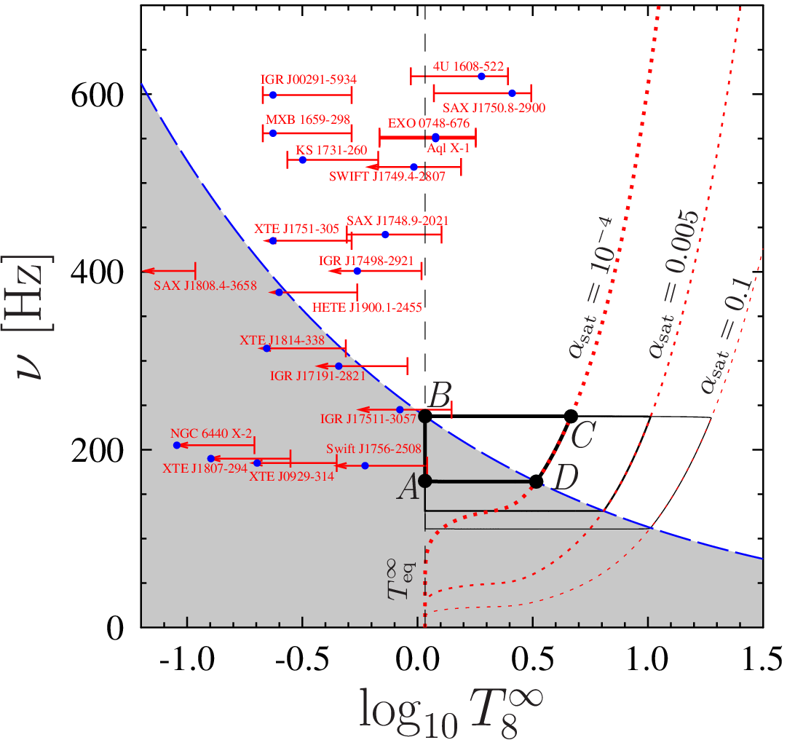
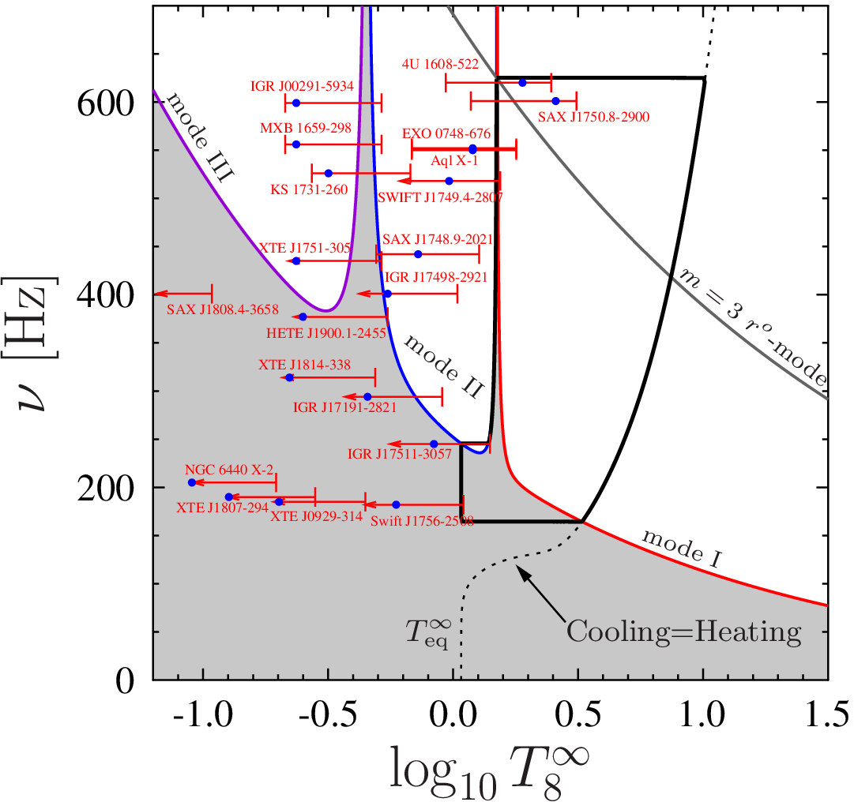
Observationally consistent evolution scenario for neutron stars in LMXBs
M. E. Gusakov, A. I. Chugunov, E. M. Kantor
Ioffe Institute, Saint-Petersburg
arXiv:1305.3825

Slide 2
Neutron stars in LMXBs and r-mode instability
Problem: Many neutron stars (NSs) fall well outside the stability region.
This fact contradicts existing evolution scenarios.
Andersson et al., The Transient Gravitational-Wave Sky, arXiv:1305.0816:
“Very recent work [Ho, Andersson, & Haskell, PRL, 107 (2011),101101], comparing the predicted r-mode instability window to observed accreting systems, suggests that our understanding is far from complete. The generally accepted r-mode model would lead to a large number of observed systems in fact being unstable. This is an obvious problem that needs to be addressed by improving our models. It is, however, not clear what the missing piece of the puzzle may be.”

Slide 3
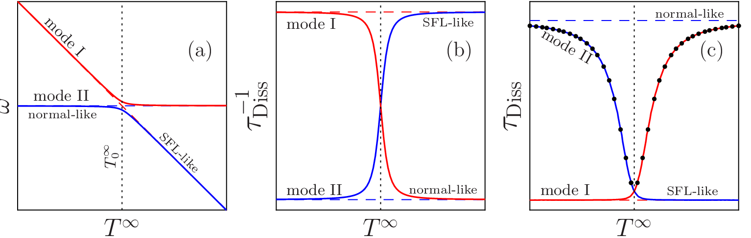
Normal and superfluid modes: avoided crossings
(See poster B3 by Gusakov et al. for details)
Two types of modes exist in superfluid NSs: normal and superfluid.
Eigenfrequencies of superfluid modes are temperature dependent.
In an approximation of completely decoupled modes, the frequencies of
superfluid and normal modes can intersect at some temperatures.
In reality, the mode coupling leads to avoided crossings of frequencies.
As temperature varies, superfluid mode turns into the normal mode
and vice versa.

Slide 4
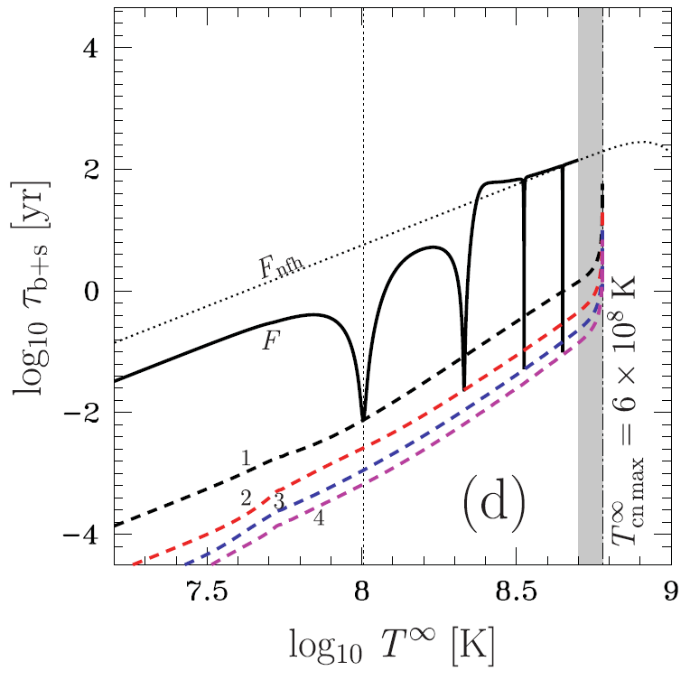
Normal and superfluid modes: resonance damping
Resonance damping of normal modes in the vicinity of avoided crossings with superfluid modes is confirmed by direct calculations for nonrotating NSs
Kantor&Gusakov (2011);
Gusakov et al. (2013)
Similar results were obtained for zero-temperature r-modes of rotating superfluid NSs
Lee & Yoshida (2003)
Yoshida & Lee (2003)
Gusakov et al., MNRAS 428 (2013), 1518

Slide 5
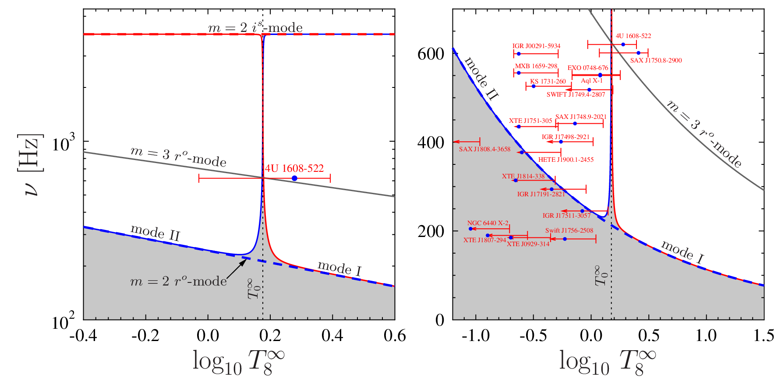
New instability windows
(See poster B3 by Gusakov et al. for details)
Avoided crossings of normal and superfluid modes take place at specific temperatures. As temperature varies, the normal mode turns into superfluid one and vice versa.
Main assumption:
Consequence:
A stability peak appears, which is limited by m=3 r-mode instability

Slide 6
Many mode regime of NS evolution
[generalization of one mode evolution by Owen et al. (1998); Ho & Lai (2000)]
Amplitude of mode i:
Spin frequency:
Spin down due to mode dissipation
Spin up due to accretion
Thermal balance:
Heating owing to dissipation of each of the excited modes:
Saturation:

Slide 7
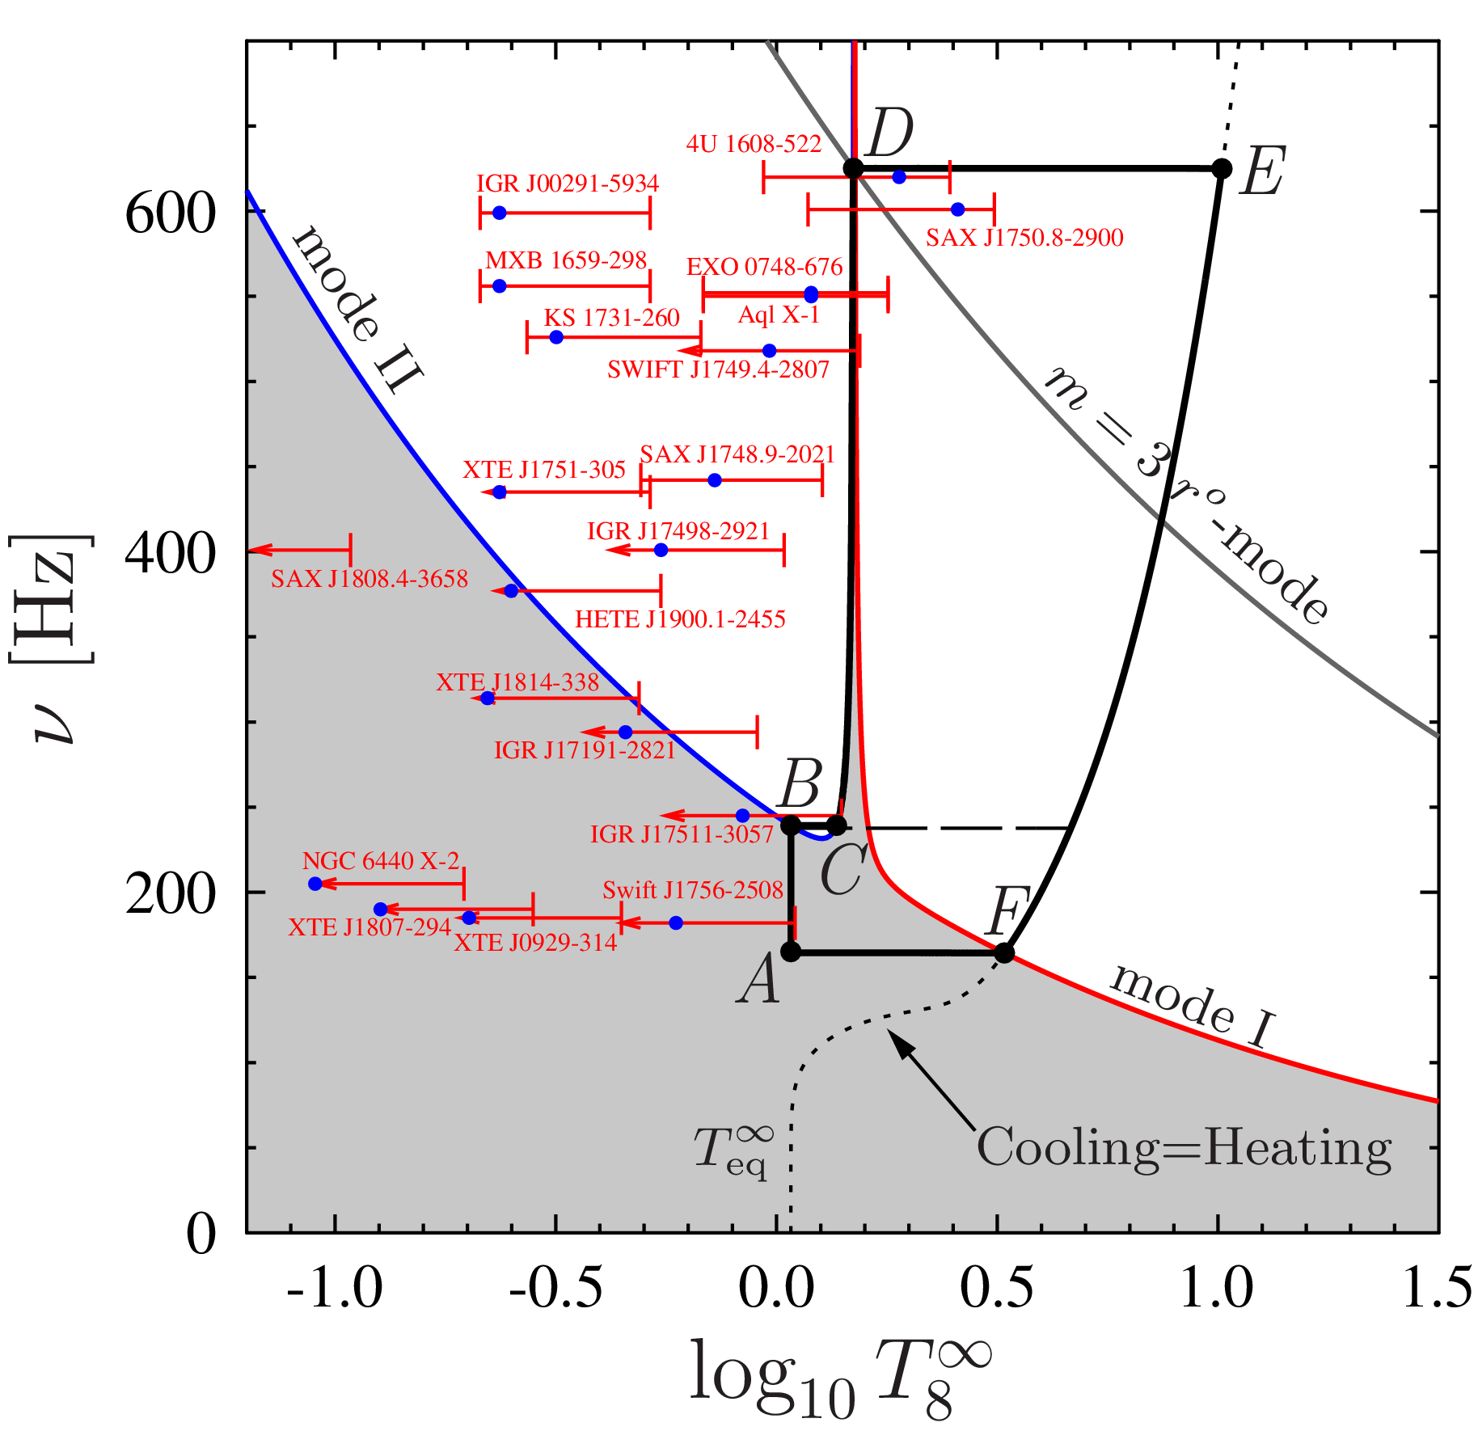
Evolution of NSs in LMXBs: climbing up the stability peak
Absent in the standard scenario

Slide 8
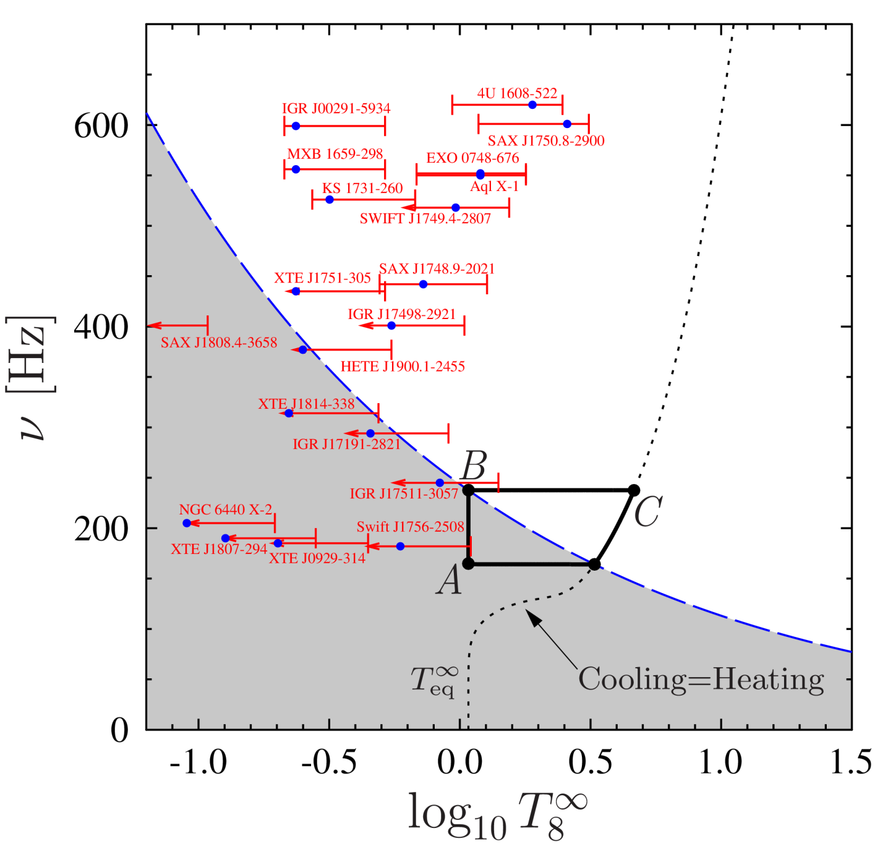
Evolution of NSs in LMXBs: climbing up the stability peak
Absent in the standard scenario

Slide 9
Evolution of NSs in LMXBs: climbing up the stability peak
Absent in the standard scenario
High temperature is supported by damping of the mode II
NS is attached to the stability peak by the mode II instability
NS spins up, if

Slide 10
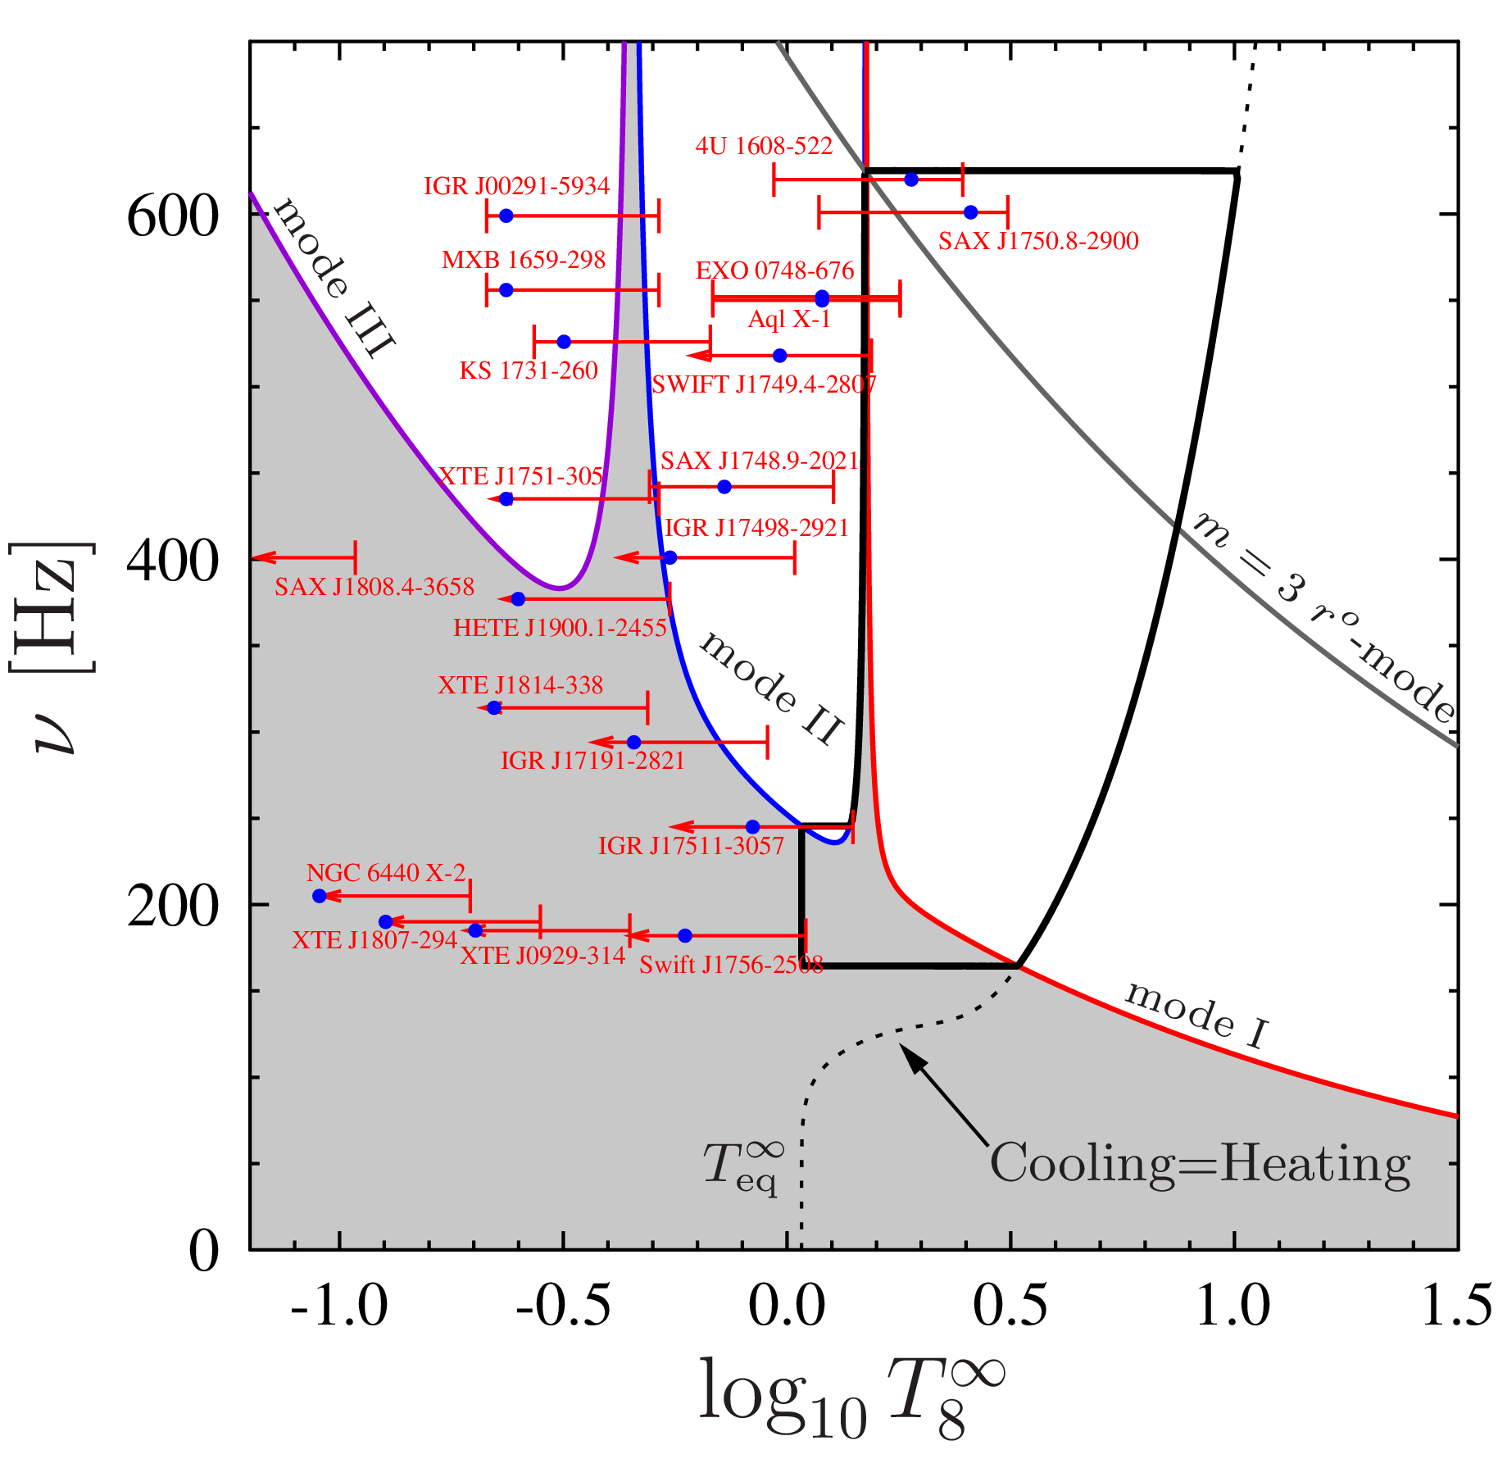
Low temperature NSs: low temperature avoided crossing
A number of avoided crossings can take place
Climbing up the low temperature stability peak

Slide 11
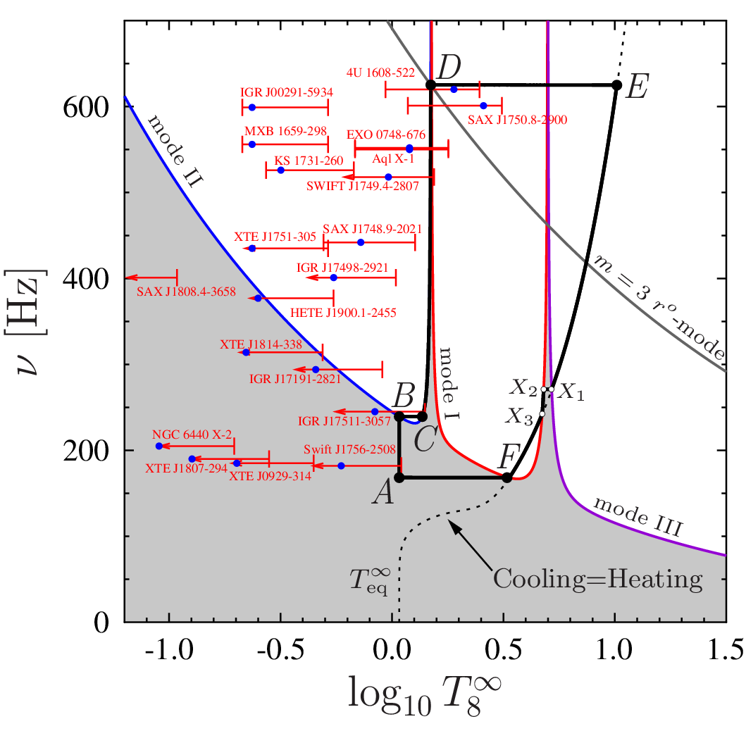
High temperature avoided crossings
High temperature avoided crossings are also possible
They do not affect the scenario significantly
A strong heating is required at the stage X₂X₃ to maintain high temperature
Spin down through mode I dissipation dominates
The scenario is very stable with regard to variation of model parameters

Slide 12
Results and Conclusions
Resonance coupling of normal and superfluid modes plays the key role in the evolution of NSs in LMXBs
It allows us to explain the existence of rapidly rotating warm NSs and cutoff of their spin frequency distribution at >730 Hz [D. Chakrabarty et al., Nature 424 (2003), 42]
A phenomenological model of resonance coupling is developed and justified
Avoided crossings lead to enhanced damping and formation of the stability peak, limited by m=3 r-mode instability
NSs spend significant amount of time climbing up the stability peak
Temperatures of rapidly rotating NSs in our model are fixed to the resonance temperatures
The scenario can be applied to millisecond pulsars
See arXiv:1305.3825 for details

