Slide 1
MODELING STATISTICAL PROPERTIES OF THE X-RAY EMISSION FROM AGED PULSAR WIND NEBULAE Rino Bandiera – INAF – Oss. Astrof. di Arcetri

Slide 2
TOWARDS A GOOD SAMPLE OF PULSAR WIND NEBULAE
Originally relatively few objects
In radio Weiler 1983
Very few X-ray PWNe Seward 1989
Labelled as “short-lived” (up to ~10⁴ yr) Weiler & Panagia 1978
A change of paradigm
A large fraction of H.E.S.S. unidentified sources are PWNe e.g. Hinton & Hofmann 2009
Follow-up campaigns in X-rays (nebula) & radio (pulsar)
They are typically “aged” PWNs (~10⁴ - 10⁶ yr)
Now about 70 objects known e.g. Kargaltsev et al. 2013
Some intriguing statistical trends

Slide 3
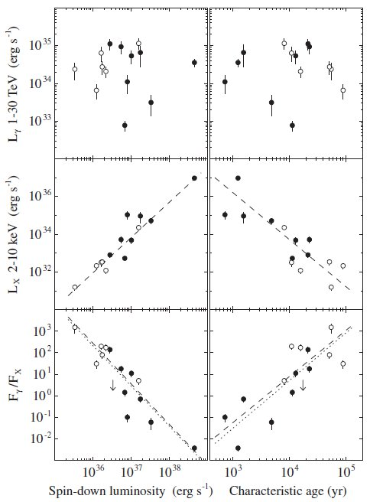
“EVOLUTION” OF X-RAY EMISSION
Mattana et al. 2009
Evidence for an evolution of the X-ray luminosity (while no clear correlation in the TeV range).
Excellent correlation with Edot
(Believe it or not)
and /or with PSR spin-down age
Proposed explanation: “The X-ray emission traces the recent history of the nebula, whereas the γ -ray emission traces a longer history, possibly up to the pulsar birth.”

Slide 4
EVOLUTION IN SIZE
Bamba et al. 2010
Search for very low surface brightness X-ray emission around pulsars with ages up to ~10⁵ yr
Unexpected result: “A systematic study of a sample of eight of these PWNe, together with Chandra data sets, has revealed that the nebulae keep expanding up to 100 kyr”

Slide 5
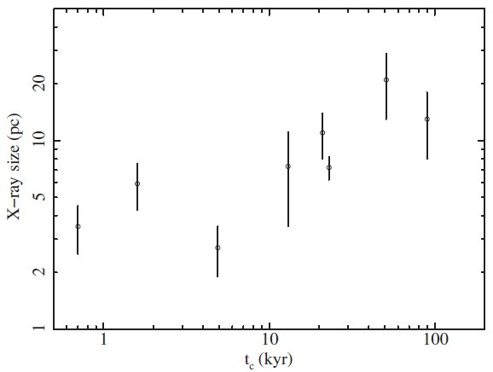
PROPOSED EXPLANATION BY BAMBA ET AL.
Stringent limit on synchrotron lifetimes for the electrons
Extensions of 20-30 pc would require B~1 μG
B must decrease in time down to very low values
Diffusion is important, so that time scale for the escape is smaller than the PWN age.
Anyway, large extents for old PWNe are surprising. They should have been crushed by the reverse shock.
MSH 15-52
Kes 75

Slide 6
A DIFFERENT …AND MAYBE NATURAL KIND OF EXPLANATION (Bandiera, in prep.)
HYPOTHESIS: the observed (Bamba et al.; Mattana et al.) correlations DO NOT outline the evolution of a “typical” PWN.
They originate instead as a COMBINED EFFECT of PWNe evolving under different conditions. Relevant parameters are:
AND, IN THE SAMPLE, ALL POSSIBLE CASES ARE WEIGHTED WITH THEIR PROBABILITY OF DETECTION

Slide 7
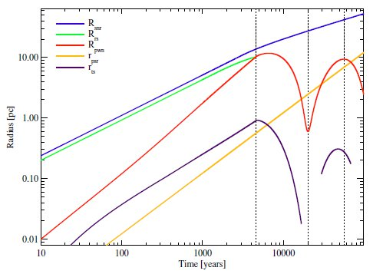
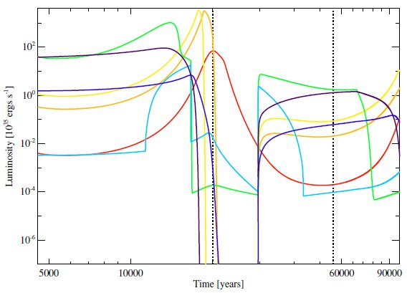
MODELING THE PWN EVOLUTION
PWN interacting with the outer SNR One-zone models e.g. Gelfand et al. 2009, Bucciantini et al. 2011
When the PWN is brighter?
When it is very young
At the beginning of Sedov phase (reverberation phase) PWN crushed by the SNR reverse shock, strong increase of B
X-rays
Gelfand et al. 2009

Slide 8
COMPLEMENTARITY BETWEEN ANALYTIC & NUMERICAL MODELS
Functional dependence on the various parameters
1st Phase (t < τ_{o}): - PWN expanding in SN ejecta (flat) - constant Edot
Energy eq.:
Magnetic flux cons.:
2nd Phase (t < τ_{o} , still free expanding ejecta)

Slide 9
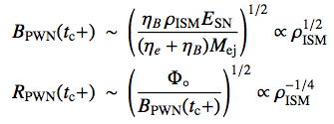
PWN crushing (at a time t >> τ_{o}) “reverberation” Reverse shock, beginning of Sedov phase
PWN compression, B enhancement (with flux conservation) FROM TO

Slide 10
A “FICTITIOUS” TIME DEPENDENCE
ASSUMPTIONS:
Leading dependence is that on ISM density (large variations)
Aged PWNe preferentially detected near the crushing phase
ISM density can be associated to either time, or Edot (for a dipole-like case) leading to the following “fictitious” trends:

Slide 11
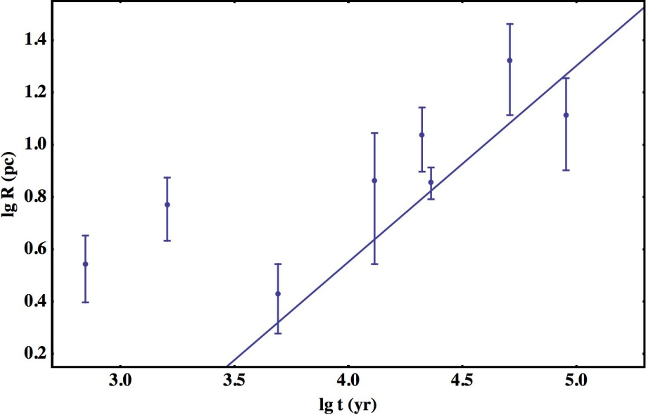
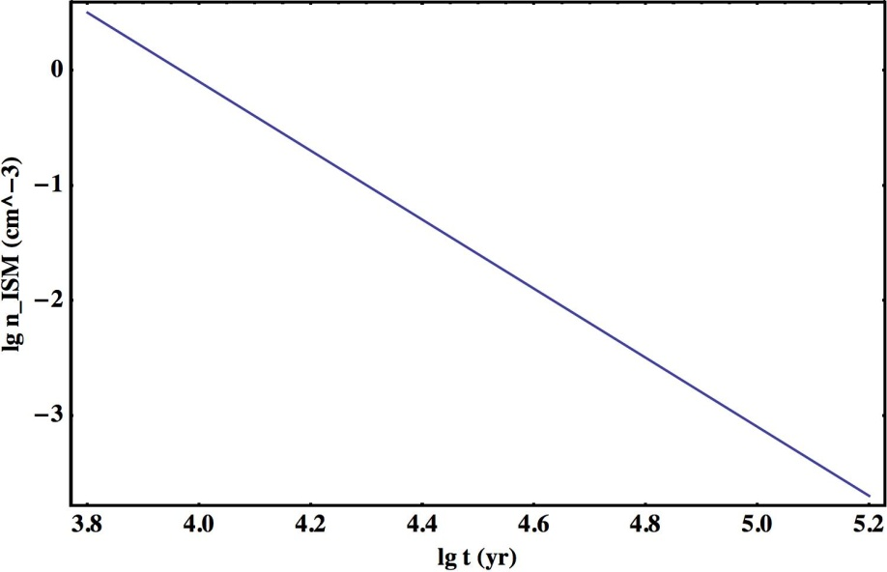
LINKING TO A NUMERICAL MODEL
Gelfand et al. 2009
Parameters:
Derived quantities:
Matching Bamba et al. relation
with zero free parameters
Required n_{ISM} values
are quite reasonable

Slide 12
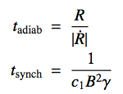
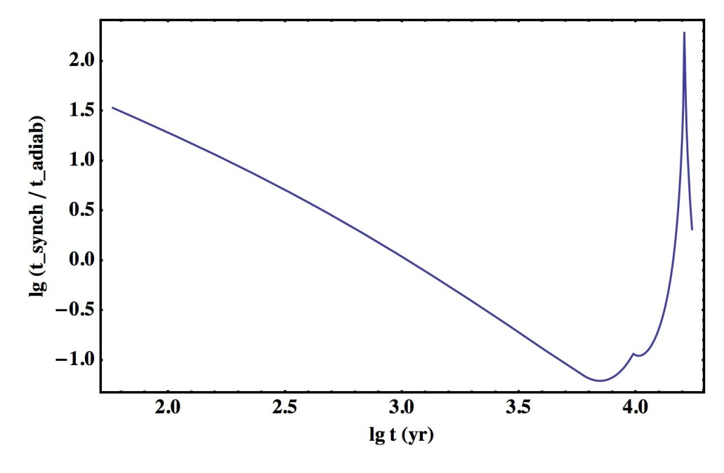
ON THE X-RAY LUMINOSITY
Synchrotron basics:
Adiabatic vs synch-dominated evolution
For the X-ray emitting electrons:
Adiabatic evolution at t_{c-}
Synchrotron-dominated evolution, at t_{c+} ???
Numerical model nearly consistent with Gelfand et al. 2009
Emission drops at t_{eq}, where t_{adiab}=t_{synch}
t_{c-}
t_{eq}
t_{c+}

Slide 13
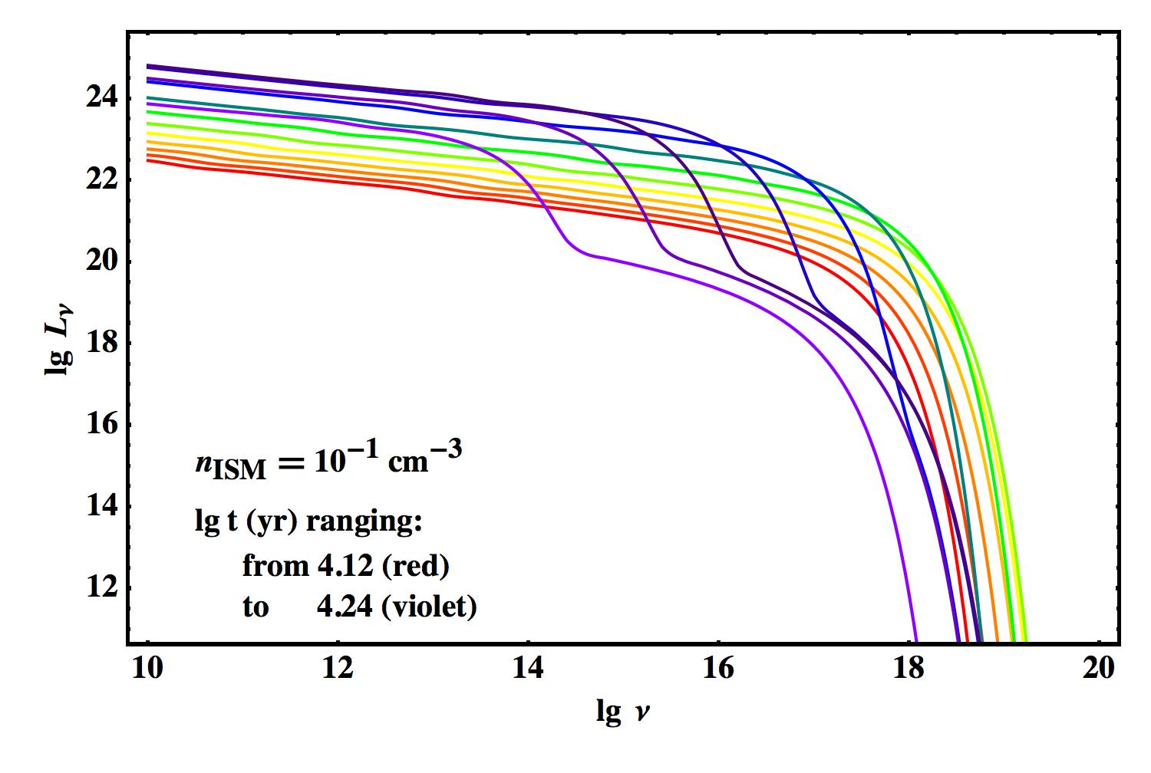
Evolution of the synchrotron spectrum:
(cutoff rapidly moving towards lower frequencies)

Slide 14
BUT, if PWN X-ray emission switches off at t_{eq}, Bamba et al. empirical relation cannot be explained any longer !!
R_{eq} is independent of n_{ISM} !
In order to save that explanation X-ray emitting electrons must be adiabatically dominated up to t_{c+} !
A LESS EFFECTIVE COMPRESSION FROM THE REVERSE SHOCK ?

Slide 15
X-RAY EMISSION
Assume α ≅ 2 power-law for the injected electrons. Apart from a logarithmic factor (about 20) at the denominator, at t<t_{c} we have:
The synchrotron emission is given by:
Before the compression phase:
and

Slide 16
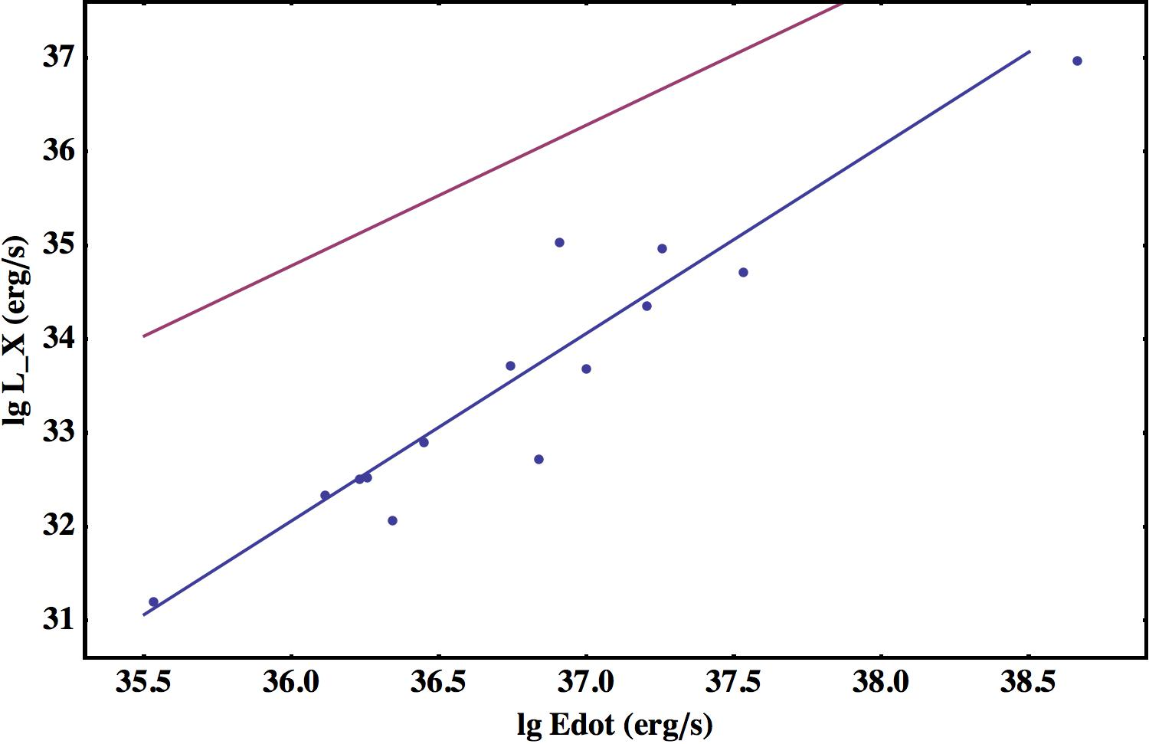
During the compression phase, the synchrotron emission evolves as follows:
Comparison with Mattana et al. data (including also the logarithmic factor).
The multiplying factor is
not so important. More
important the slope.
Mattana et al. 2011
1.87 ± 0.04
BUT, E.G.
Vink et al. 2011
1.29 ± 0.20
slope=3/2
slope=2
R_{c+}
R_{c-}

Slide 17
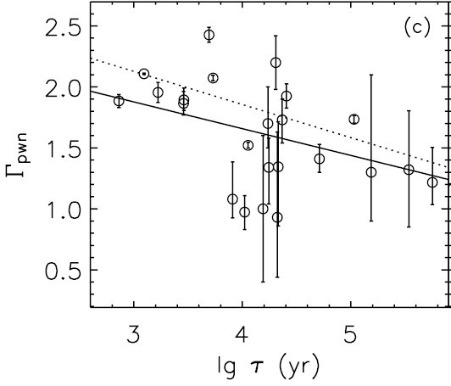
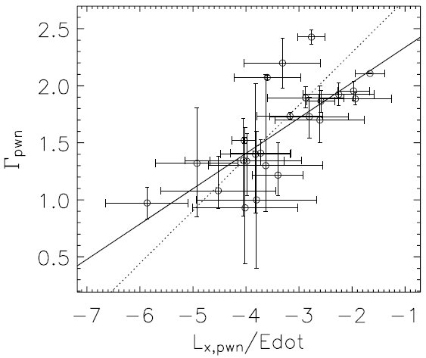
X-RAY SPECTRAL INDEX
IF NEGLIGIBLE SYNCH.LOSSES, HARDER SPECTRA
Gotthelf 2003
Correlation between PSR and PWN X-ray spectral index
Both decrease with τ (and increase with Edot)
Li et al. 2008
They do not confirm correlation between Γ_{PSR} and Γ_{PWN}.
CONFIRMED instead time dependence of Γ_{PWN} (two bunches?)

Slide 18
SUMMARY
Simplified model for the evolution of old PWNe (but still inside the associated SNR)
Working hypothesis: observed X-ray correlations as a combined effect of objects evolving in different ambient densities
Assumption: aged PWNe are best detected near the reverberation time
RESULTS:
R_{PWN}(t)
L_{X}(Edot)
Harder X-ray spectra for older PWNe
Even after compression, the evolution of X-ray emitting electrons must be adiabatically dominated

