Slide 1
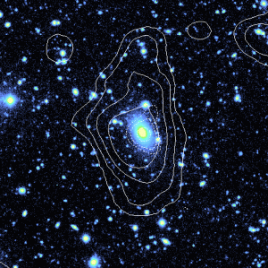
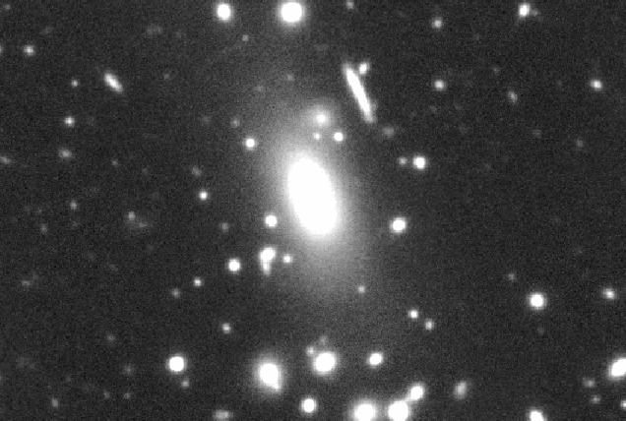
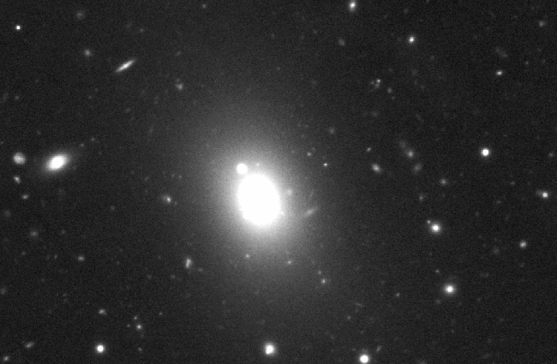
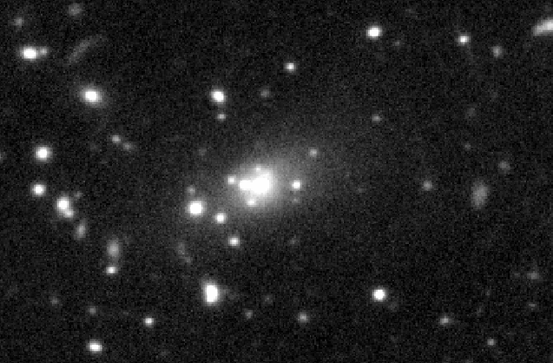
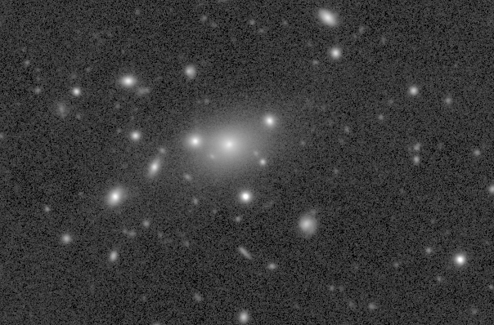
Fossil Groups Origins (FOGO) project:
X-ray scaling relations in Fossil systems
J. Alfonso L. Aguerri (IAC)
R. Barrena (IAC, Spain), A. Biviano (OAT, Italy), S. Borgani (UT, Italy), W. Boschin (TNG, Italy), N. Castro-Rodriguez (IAC, Spain), E. M. Corsini (UP, Italy), S. De Grandi (INAF-OAB, Italy), (C. del Burgo (Uninova, Portugal), E. D’Onghia (CfA, USA), M. Girardi (OAT, Italy), J. Iglesias-Páramo (IAA, Spain), E. Jimenez-Bailón (UNAM, Mexico), J. Méndez-Abreu (IAC; Spain), N. Napolitano (OAC, Italy), R. Sánchez-Janssen (ESO, Chile), M. Santos-Lleo (XMM, Spain), J. M. Vilchez (IAA, Spain), S. Zarattini (IAC, Spain)

Slide 2
What is a Fossil system?
Ponman et al (1994) discovered the galaxy RX J1340.6+4018 an elliptical galaxy dominated system.
The elliptical galaxy was surrounded by an X-ray emitting halo of hot gas suggesting a large amount of dark matter
This was interpreted as an evolved group of galaxies. The central galaxy has eaten all L* galaxies arround.

Slide 3
What is a Fossil system?
The observational definition of these systems was given by Jones et al. (2003)
  RX extended emission with Lx>10^42 erg/s
  Magnitude gap between the brightest and the second brightest galaxies: m1-m2>2 in the R filter
  Recently: m1-m4>4.5 (Dariush et al. 2010)
Are these systems important?
These systems are as common as poor and rich galaxy clusters together: n ∼ (1 − 4) × 10−6 h−3 Mpc−3 (Vikhlinin et al. 1998; Jones et al. 2003; Santos et al. 2007; La Barbera et al. 2009; Voevodkin et al. 2010).
They hosts the most massive and luminous galaxies in the Universe. The formation of these streme objects could be challenge for structure formation models.
Fossil systems could be a challenge for structure formation models. They could show one order to magnitude less substructure than predicted by CDM theory (see D’Onghia & Lake 2005; But see also Zibetti et al. 2010).

Slide 4
Two formation scenarios
One interpretation is that they represent the end product of galaxy merging in group or clusters (D’Onghia & Lake 2005; von Benda Beckman et al. 2008; Sommer-Larsen 2006; Dariush et al. 2010)
Other formation scenario suggest that Fossil Systems are systems formed as deficient in L* galaxies.
This formation scenario suggest that fosill systems are “failed groups or clusters” (Mulchaey & Zabludoff 1999; Proctor et al. 2012).
In these systems the majority of of the availabe gas was initially used in the formation of the central galaxy rather than in several with intemediate luminosity.

Slide 5
Fossil Groups Origins
(FOGO project)
In 2008 only ~10 fossil systems were analyzed (Ponman et al. 1994; Jones et al. 2003; Méndez de Oliveira et al. 2006; Khosroshahi et al. 2006, 2007)
These small samples do not provide strong conclusions about the origin and evolution of these systems.
New sample of fossil systems were discovered increasing the old ones. Special interest the sample fro SDSS-DR5 (Santos et al. 2007). This is a unique sample:
  Evolution of fossil groups during the last 6 Gyr
  Large range of Lx luminosities (Lx= [10^42, 10^44] erg/s)
  Large range of magnitudes of the BGGs (Mr=[-21.5,-25.5])
We proposed a project in order to study systematically this large sample of 34 FGs.

Slide 6
FOGO Project
ITP programm: We obtained 52 observing nights in the perios 2008-2010 at: 4m WHT, 2.5m INT, 3.8m TNG, and 2.5m NOT
Available database:
  Optical imaging: Deep r-band images of 34 FGs, limiting surface brightness ~28 mag/arcsec². Limiting magnitude ~23 in r-band. Instruments: ALFOSC at NOT and WFC at INT
  Near-Ir imaging: Deep K-band images for 20 FGs. Limiting surface brightness ~21 mag/arcsec² and limiting magnitude ~19.5 in K-band. Instrument: LIRIS at WHT
  Multiobject spectroscopy: for 28 FGs. We expect ~1000 members. Instruments: WYFOS at WHT and DOLORES at TNG
  Integral spectroscopy for 9 groups. Instrument: INTEGRAL at WHT
Xray data observations: 6 objects from XMM and Chandra archives. SUZAKU data for 10 objects for global X-ray properties (Lx, Tx).

Slide 7
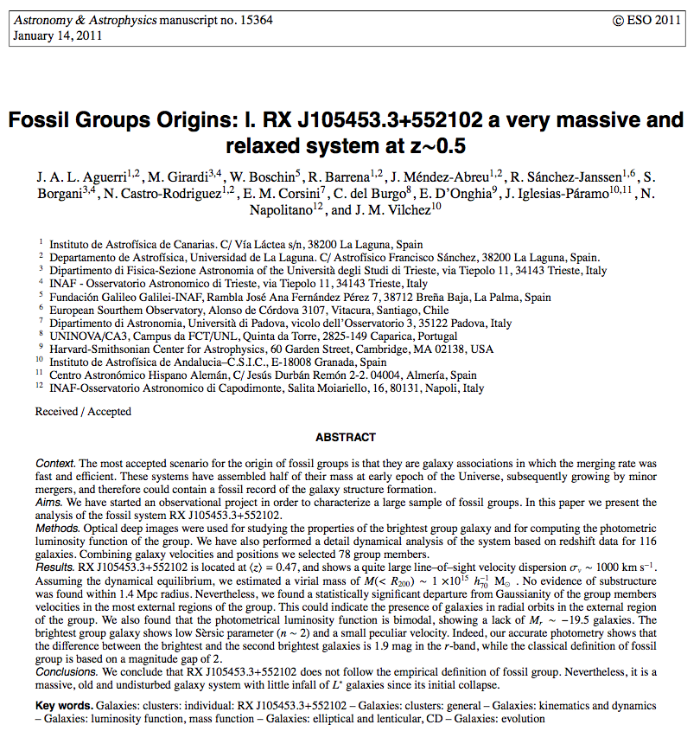
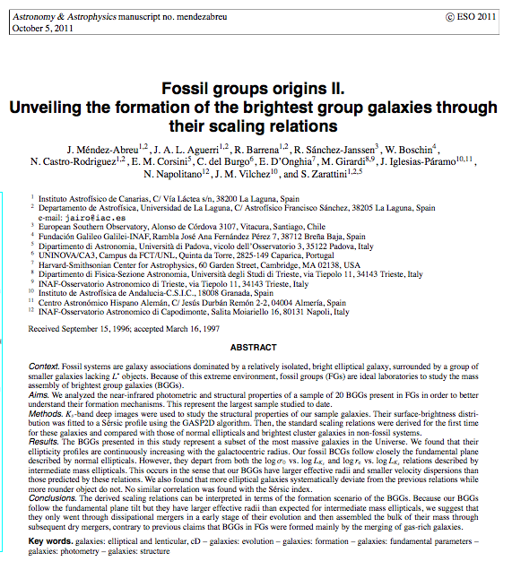
First Fogo results in the optical and near-infrared
Aguerri et al. 2011, A&A, 527, 143
Méndez-Abreu et al. 2012, A&A, 537, 25

Slide 8
X-ray scaling relations
We will show in this talk the FOGO results on X-ray scaling
relations in fossil systems. In particular, we will show the
relations concerning:
1.- L_{opt}-L_{X} relation
2.- L_{BCG}-L_{X} relation

Slide 9
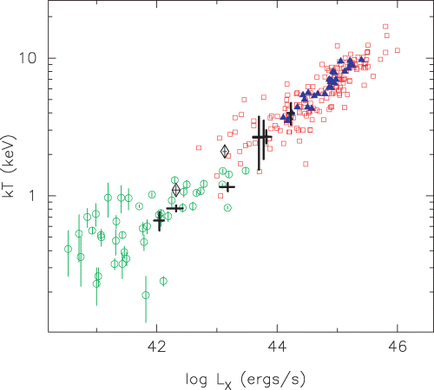
X-ray scaling relations: L_{opt}-L_{X}
Harrison et al. 2012
Khosroshahi et al. 2007
Fossil and non-fossil systems show similar scaling relations involving Lx and
Tx (Khosroshahi et al. 2007; Voevodkin et al. 2009; Proctor et al. 2012;
Harrison et al. 2012).

Slide 10
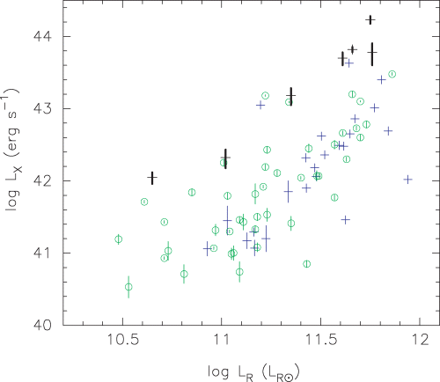
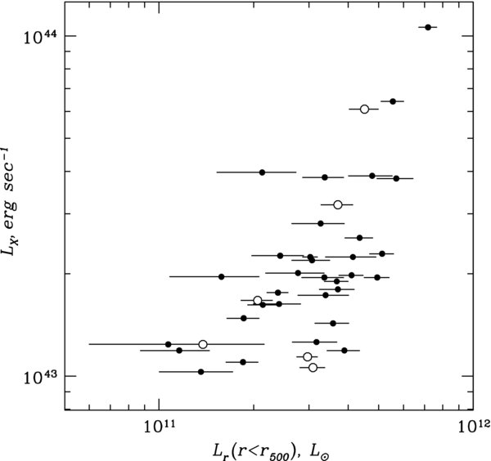
X-ray scaling relations: L_{opt}-L_{X}
Kosroshahi et al. (2007) found that FGs shows different Lx-Lr relation than non-fossil systems. They interpreted as FGs are more luminous in X-ray than non-fossil for a given Lr.→ Different gravitational potential (more cuspy) due to early formation.
Proctor et al. (2011) also found an offset of FGs in the Lx-Lr relation. Nevertheless they interpreted as FGs are deficient in optical luminosity for a given Lx → “failed groups or clusters”
Kosroshahi et al (2007)
Voevodkin et al. (2009) and Harrison et al. (2012) found no difference between fossil and non-fossil systems in the Lx-Lopt relation.
Harrison et al. 2012
Voevodkin et al. (2009)

Slide 11
X-ray scaling relations: L_{opt}-L_{X}
Our results on the Lx-Lopt relations using the 34 FGs candidates from Santos et al. (2007).
For comparison: the RASS-SDSS galaxy cluster survey. This consists on 114 nearby galaxy systems covering a large range of masses (Popesso et al. 2004).
We take care to apply homogeneus procedures to these FGs and the Comparison cluster sample→ We computed Fully consistent Lx and Loptical luminositites.
The X-ray luminosities were recomputed from ROSAT counts rates (Voges et al. 1999, 2000). We took into account the Total Galactic HI column Density. We used a procedure based on PIMMS using X-ray APEC models with Z=0.4 Z_sun
The optical luminosity is given by
Girardi et al. 2012, in prep

Slide 12
X-ray scaling relations: L_{opt}-L_{X}
No significant differences have been observed between Fossil and non-fossil systems in the Lx-Lopt plane.
For a given Lx Fossil systems show similar optical luminosity within R500 than non-fosill systems.
Girardi et al. 2012, in prep

Slide 13
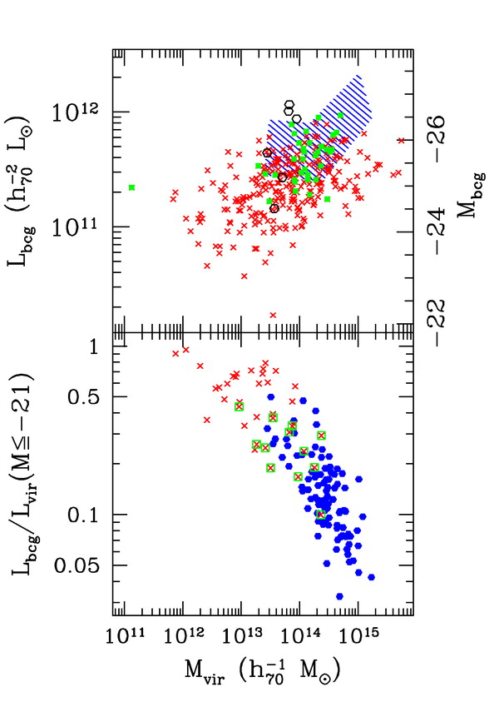
X-ray scaling relations: L_{BCG}-L_{X}
Lin & Morh (2004) found a correlation between the luminosity of the brightest cluster galaxy (BCG) and the mass of the host cluster.
They conclude that BGCs in clusters grow by merging other galaxies as the host clusters grow hierarchically.
They expeculate with the position of Fossil systems in the L_{BCG}-L_{X} plane.
Lin & Morh 2004

Slide 14
X-ray scaling relations: L_{BCG}-L_{X}
Recently, Harrison et al. (2012) has observed that BCGs in fossil systems are located in the upper envelope of the L_{BCG}-T_{X} relation.
For a fixed T_{X} BCGs in Fossil systems are more massive than BCGs in non fossil ones.
Harrison et al. 2012

Slide 15
X-ray scaling relations: L_{BCG}-L_{X}
We have analyzed the dispersion of the L_{X}-L_{BCG} relation as a function of m₁-m_{2.}
We have computed the absolute magnitud of the central galaxies and the L_{x} of the systems in an homogeneus way. Thus, M_{r} was obtained from SDSS and L_{X} from ROSAT counts rate.
We have taken a large sample of fossil systems from the literature: Mendes de Oliveira et al. (2009), Adami et al. (2010); Harrison et al. (2012); Khosroshahi et al. (2007); La Barbera et al. (2012); Miller et al. (2012); Proctor et al. (2012); Santos et al. (2007)
Aguerri et al. 2012, in prep

Slide 16
X-ray scaling relations: L_{BCG}-L_{X}
Similar result is obtained in the M_{star}-L_{X} plane
Most of the BCGs in fossil systems are more massive for a fixed L_{X} than those in non-fossil ones.
There is a fraction (about 30%) of fossil systems showing BCGs with smaller mass (luminosity). Similar to clusters with small m₁-m₂
The most massive BCGs can be explained by mergers of galaxies. Nevertheless, the less massive ones not
We can expeculate that there are two kinds of fossil systems: Those formed by mergers and those which could be “failed clusters” or systems with different merging history.
Aguerri et al. 2012, in prep

Slide 17
Conclusions
The FOGO project is a multiwavelength study of fossil galaxy systems in order to study the properties of the BGGs and the galaxy population of these systems
We have investigated the L_{opt}-L_{X} and L_{BCG}-L_{X} relations in our fossil systems
The distribution of our fossil systems in the L_{opt}-L_{X} plane is similar than non-fossil ones. Thus, fossil systems do not show a deficient optical luminosity for a given L_{x} luminosity of the host cluster.
In general, for a given L_{X,} the brightest cluster galaxies in fossil systems are more massive than in non-fossil ones.
There is a fraction (30%) of fossil systems showing less massive central galaxies. These galaxies can not be explained by transformation of non-fossil in fossil systems by mergers.
These results probably indicate several origins for fossil systems

