Slide 1
Metal jumps across sloshing cold fronts: the case of A496
Simona Ghizzardi, Sabrina De Grandi, Silvano Molendi

Slide 2
Sloshing cold fronts and metals
.
Several clusters host cold fronts, contact discontinuities associated to cold gas moving in a hotter ambient plasma.
Cold fronts in cool core clusters are thought to be induced by minor mergers and to develop through a sloshing mechanism (Ascasibar and Markevitch 2006).
Among the properties characterizing cold fronts, the metal abundance across the discontinuity is only available for a handful of objects (e.g. Centaurus, Perseus)
A general picture for the metal behavior during the evolution of sloshing cold fronts is still missing.

Slide 3
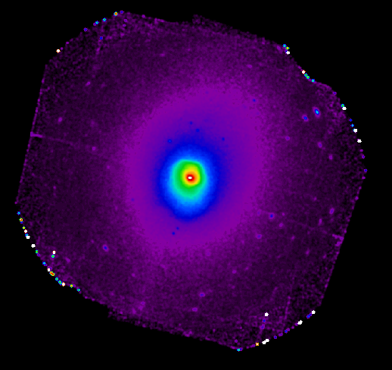
XMM observation of A496
We analyzed a long (120 ksec) XMM-Newton observation of A496 to study the metal distribution in this cluster and its correlation with the cold fronts.
A496 is a nearby (z ~ 0.032) bright cool core cluster.
It hosts 4 cold fronts.

Slide 4
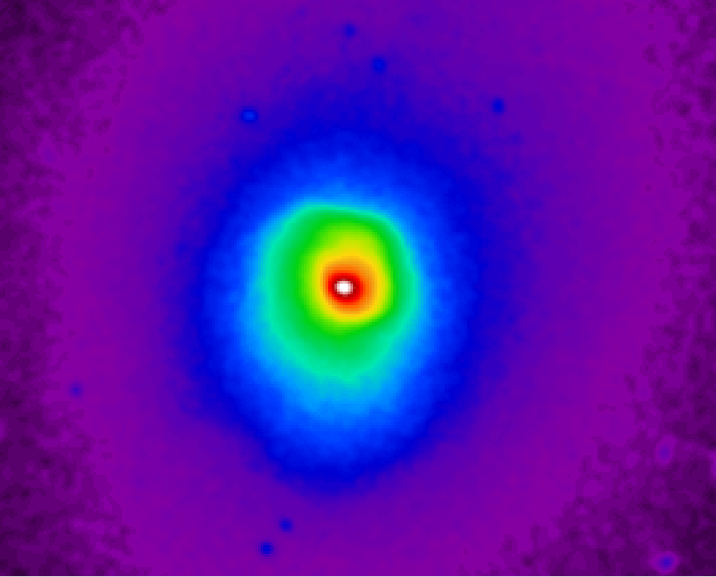
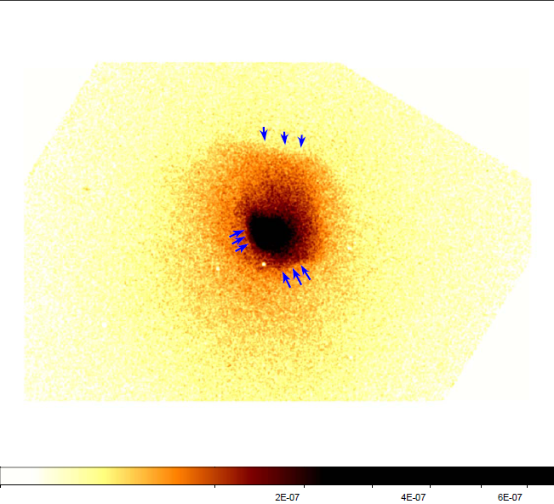
A496 surface brightness map
The XMM surface brightness map reveals a number of discontinuities.
The most prominent SB jump is in the NNW direction (30º-120º).
In the S (240º-330º) direction two fronts are detected.
The main NNW front and the innermost S one had been detected also using Chandra data by Dupke + 2007 who also find a discontinuity close to the center E of the peak.
N (75º-120º)
XMM
NW (30º-75º)
SSW (240º-330º)
Chandra
S (240º-285º)
Chandra couldn’t see the outermost S discontinuity.
Dupke + 2007

Slide 5
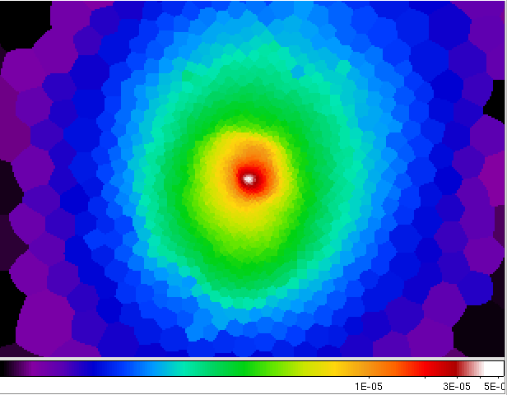
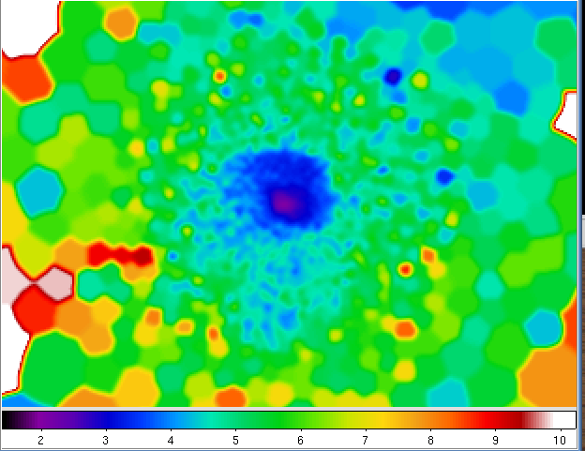
Surface brightness and temperature maps
To verify that these discontinuities are cold fronts we need to check the temperature behavior. We use the WVT + Broad Band Fitting method (Rossetti + 2007) to build Surface Brightness and Temperature maps.
Maps show that the gas inside the fronts is colder than the gas outside the fronts
Surface brightness
Temperature

Slide 6
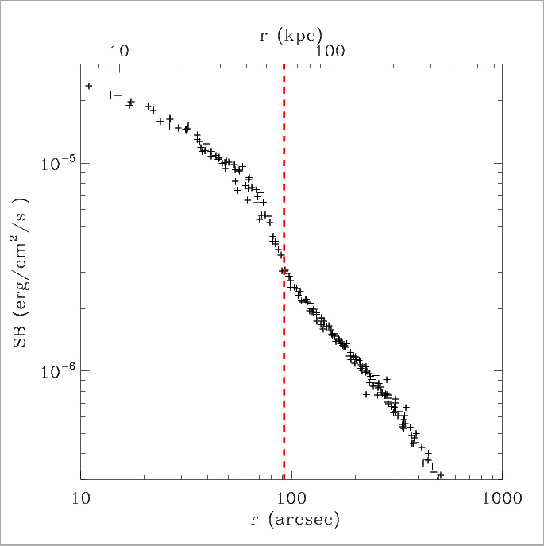
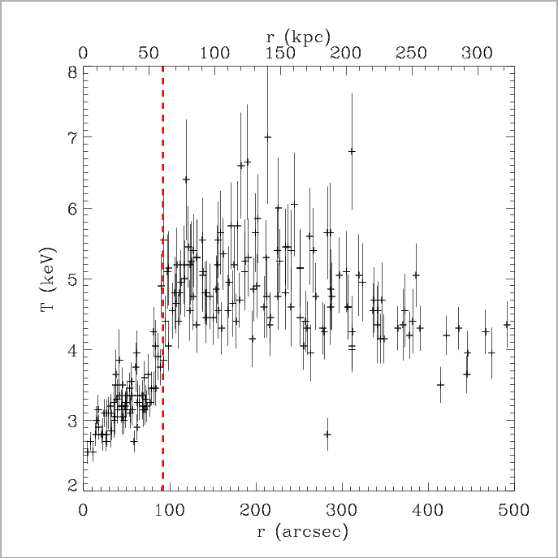
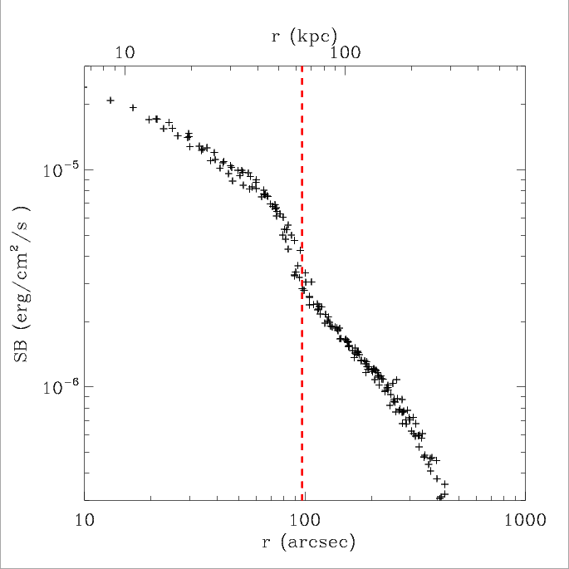
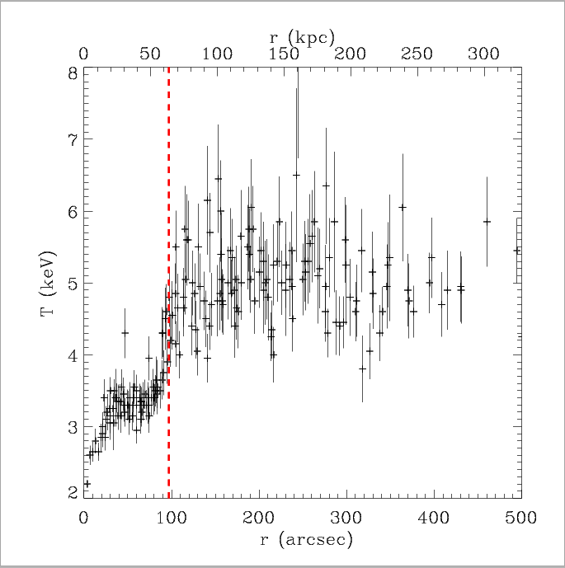
The NW discontinuities: sectors 30º-75º and 75º-120º
Starting from the SB and T maps, we built the profiles in the sectors of interest to check the temperature behavior and classify all the detected discontinuities as cold fronts.
r_{cf} ~ 100 arcsec (~ 60 kpc)

Slide 7
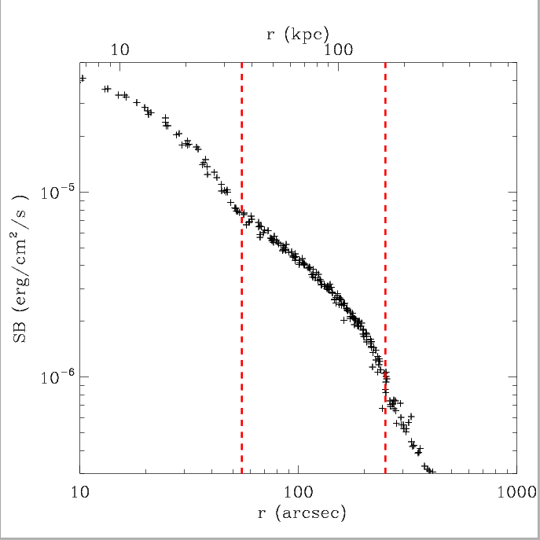
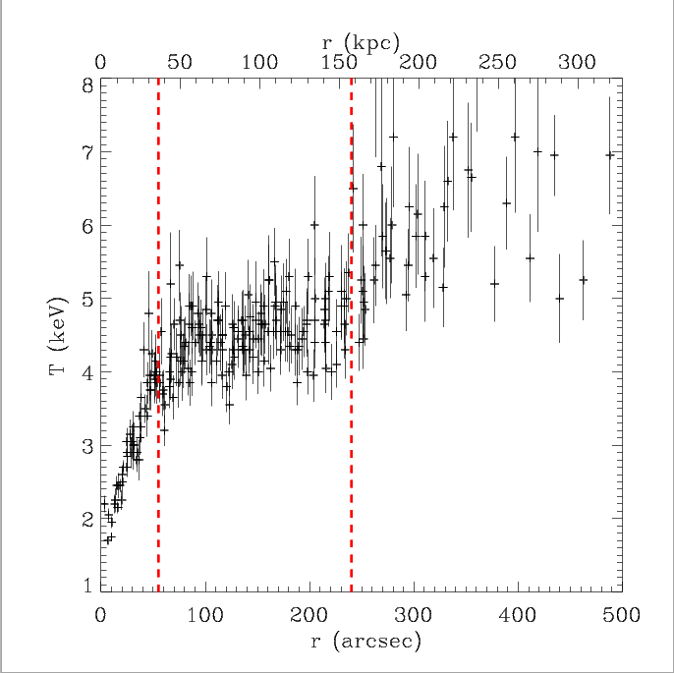
The S discontinuities: sector 240º-285º
The S sector (240º-285º) hosts two cold fronts.
r_{cf 1}~ 55 arcsec (~ 40 kpc)
r_{cf2} ~ 240 arcsec (~ 160 kpc)
The presence of multiple cold fronts in a cool core cluster is generally a signature of the onset of the sloshing mechanism.

Slide 8
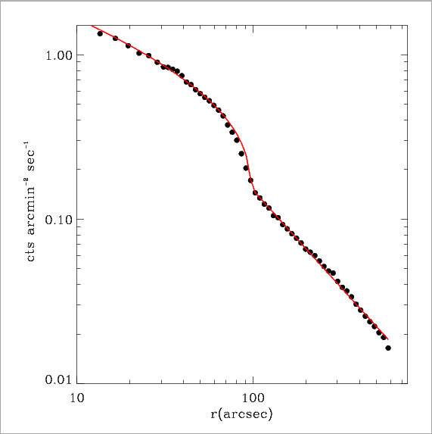
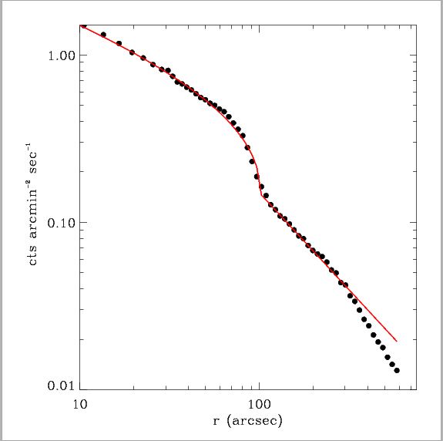
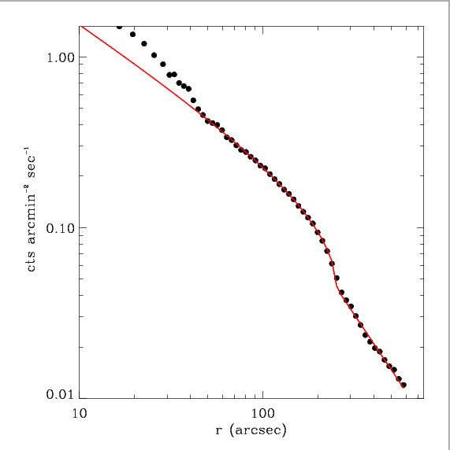
Modelization of cold fronts
30º-75º
75º-120º
240º-285º
For each cold front we modeled the density profile using two power laws and we derived Mach numbers for all the three sectors
M = 0.72 +/- 0.04
M=0.60 +0.09/-0.11
M=0.57 +0.19/-0.4

Slide 9
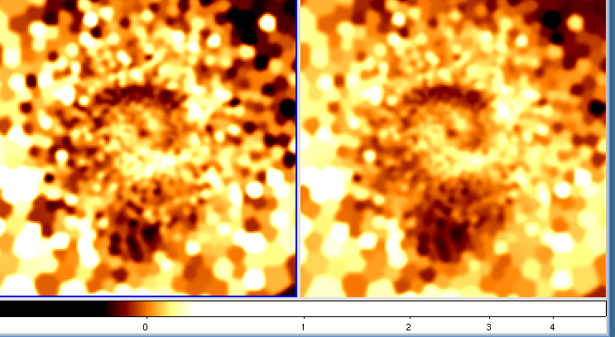
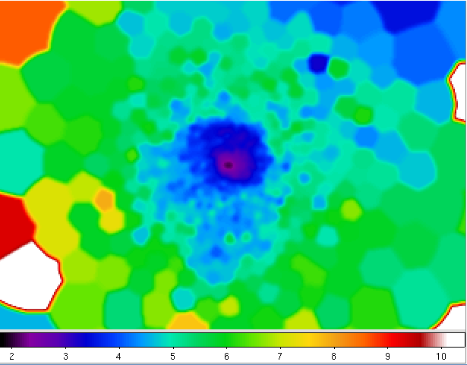
Temperature and entropy residual maps
The temperature map shows the typical spiral-like pattern which can be found when a sloshing cold front is developing in a cool core.
The spiral pattern can be better recognized in the temperature (T) and entropy (S) residual maps .
The detected cold fronts correspond to the edge of the spiral. The southern cold front is located at the tail of the spiral.
Temperature
Entropy

Slide 10
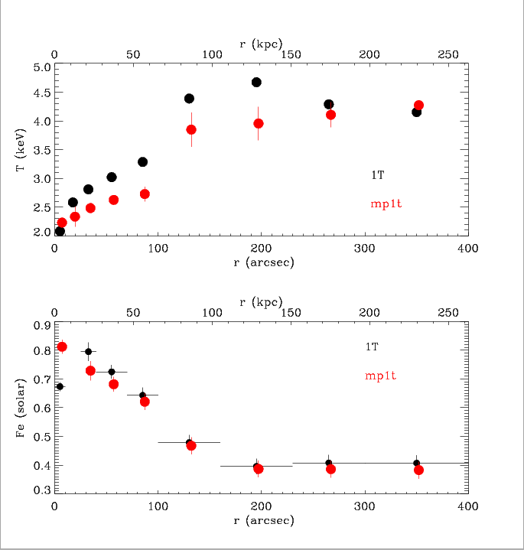
Models for spectral fitting
We fitted spectra using different models : 1T, 2T, 4T, multiphase (mphase)
Results for metallicity are stable and do not significantly change using different models. Differences are within 1-2 %.

Slide 11
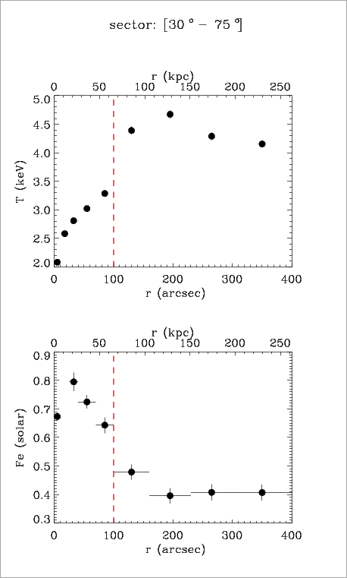
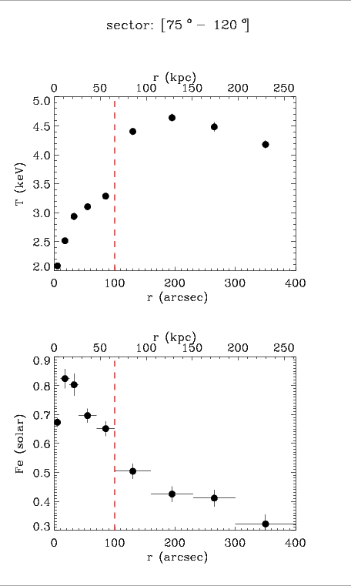
Fe abundance across NNW cold fronts
We extracted the spectra in the sectors hosting cold fronts and fitted them with a vapec 1T model. The Fe profile is typical of a cool core cluster. The metallicity is high in the center (0.9 solar) and decreases when moving towards the outskirts, down to the value 0.3 (solar).
The Fe profiles in the NNW main cold front show that the abundance drops across the front similarly to what has been observed in other cool core clusters.

Slide 12
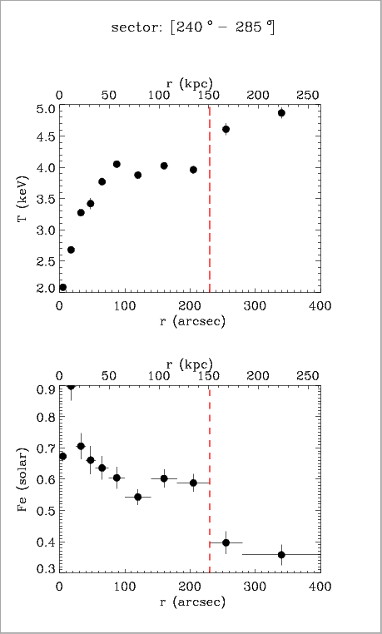
Fe abundance across the S cold front
In the southern sector the Fe abundance drops across the external front.
The abundance reaches the value 0.3-0.4 in the outskirts. The metallicity profile in the region within the front (50-150 kpc from the peak) is roughly constant Z ~ 0.6.

Slide 13
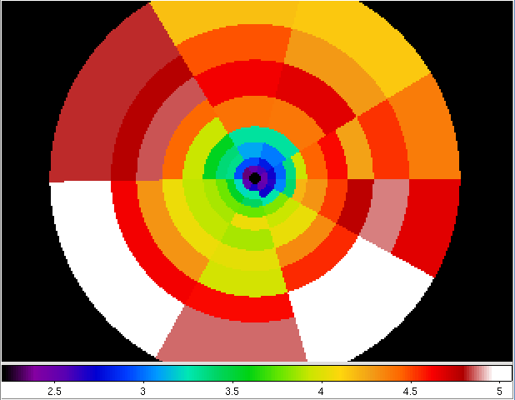
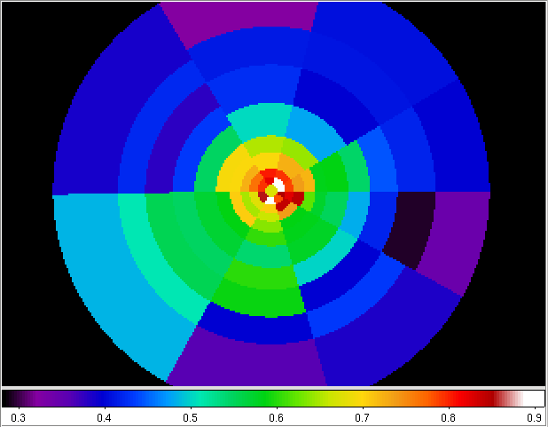
Metallicity map
We divided the cluster into sectors and rings in such a way as to match cold fronts positions and we built the temperature and metallicity map for A496. Spectra are fitted using a vapec 1T model.
An excess of metal abundance is detected in the region inside the outermost southern cold front, on the tail of the spiral.
Temperature
Metallicity

Slide 14
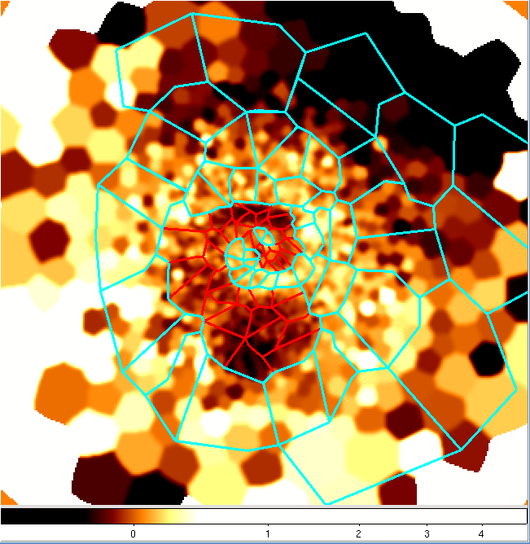
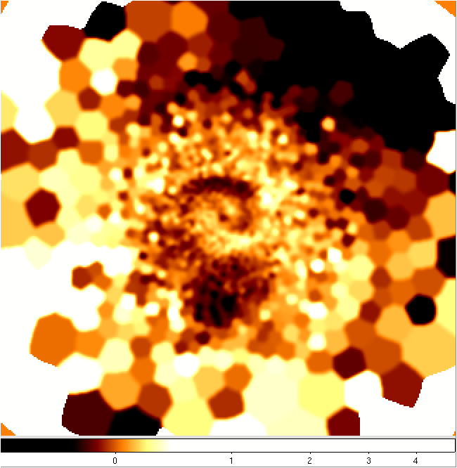
Metals on the spiral
To study the possible correlation between the spiral pattern and the metal distribution, we selected a number of polygons following the spiral configuration.
We divided the polygons into two classes : IN and OUT the spiral.

Slide 15
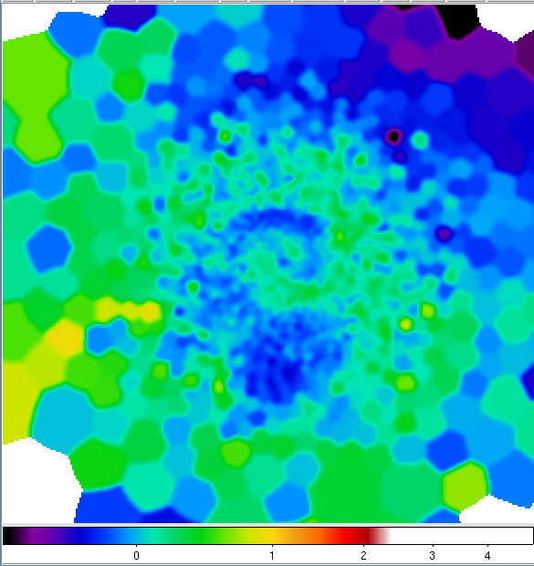
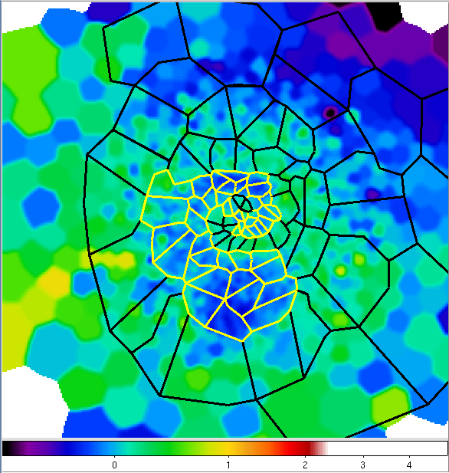
Metals on the spiral
To study the possible correlation between the spiral pattern and the metal distribution, we selected a number of polygons following the spiral configuration.
We divided the polygons into two classes: IN (regions on the spiral) and OUT (regions outside the spiral).

Slide 16
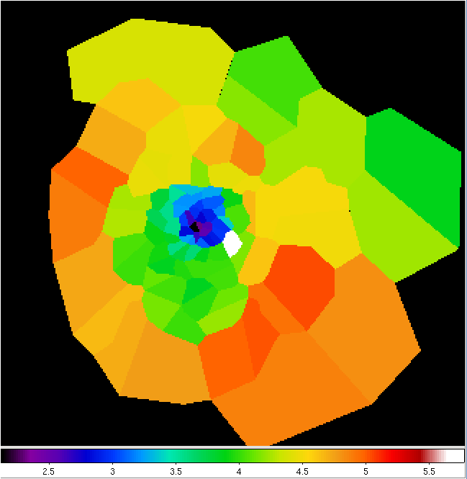
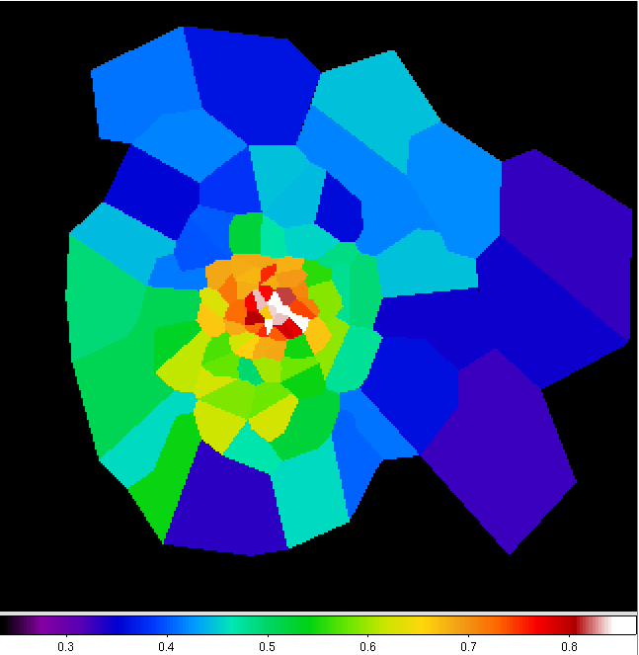
Temperature and metallicity maps
The T and Z sharply drop across the NNW cold front and Z is high in all the regions lying on the spiral
T
Z

Slide 17
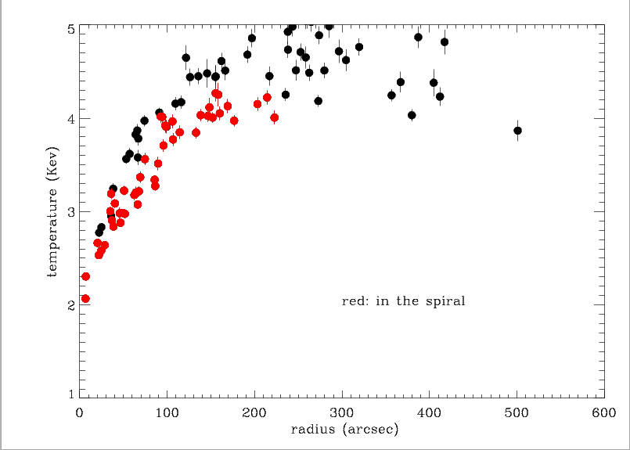
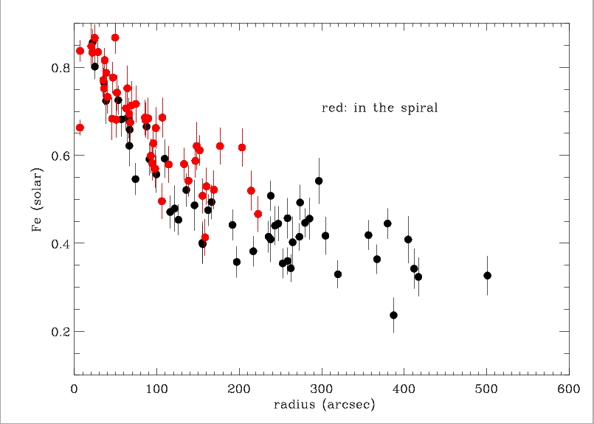
Temperature and Fe profiles on the spiral
The temperature in the spiral regions is lower and the metallicity is higher. The spread between points on the spiral and outside the spiral increases with the radius.
The largest metal excess is found in regions located on the spiral tail.
The metallicity profile shows that the gas on the tail does not come from the center of the cluster but from a region located at ~ 100 arcsec (~60 kpc) from the peak

Slide 18
Metals in a sloshing scenario
When a minor merger event triggers the sloshing mechanism in the core of a cluster, the central cool and metal rich gas is displaced outwards in a hotter and less abundant region of the cluster. This displacement creates the cold front feature and a metal discontinuity across the front is expected.
As the colder gas sloshes towards the center of the potential well, it carries the metals so it keeps its high metallicity and the metal jump across the head of the front is preserved.
When the cooler and richer gas starts flowing back towards the center, the external cold front lying on the outer extension of the spiral detaches and it adiabatically expands outwards. Cold gas and metals spread out and an excess of metal abundance is distributed in a wide region corresponding to the tail of the spiral structure.

Slide 19
Summary
We analyzed a long XMM observation of A496
We detected 3 cold fronts: the most prominent front is NNW (r ~60 kpc) of the peak. Two cold fronts are located S of the peak (~ 40 kpc and 160 kpc resp.) . The outermost cold front had not been detected by Chandra.
The temperature and entropy maps show a spiral pattern. The detected cold fronts correspond to the edge of the spiral.
Metal abundances drop across the fronts.
An excess of metallicity has been detected in the regions lying on the spiral; the excess is particularly high on the tail of the spiral.
We draw a possible scenario for metal behavior during the sloshing mechanism.

