Slide 1

A New Magnetar Candidate Located Outside the Galactic Plane?
Joe Callingham | Sean Farrell | Bryan Gaensler | Geraint Lewis
Sydney Institute for Astronomy (SIfA) | The University of Sydney | Australia
Image credit: NASA

Slide 2
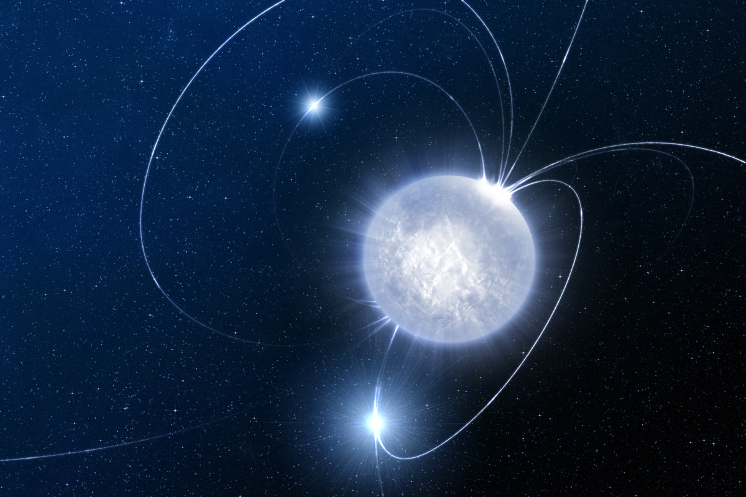
A New Magnetar Candidate
Magnetars…
Magnetars are neutron stars with surface magnetic fields ~10¹⁴ – 10¹⁵ G (Duncan & Thompson 1992)
Historically divided into two classes of object: anomalous X-ray pulsars (AXPs) and soft gamma repeaters (SGRs)
Magnetic field strengths derived from slow spin periods (~2 – 12 s) and high spin derivatives
Steady-state (non-outburst) X-ray luminosities ~10³² – 10³⁵ erg s⁻¹
X-ray and gamma ray emission thought to be powered by magnetic stresses in neutron star crust
Image credit: ESO/L. Calçada

Slide 3
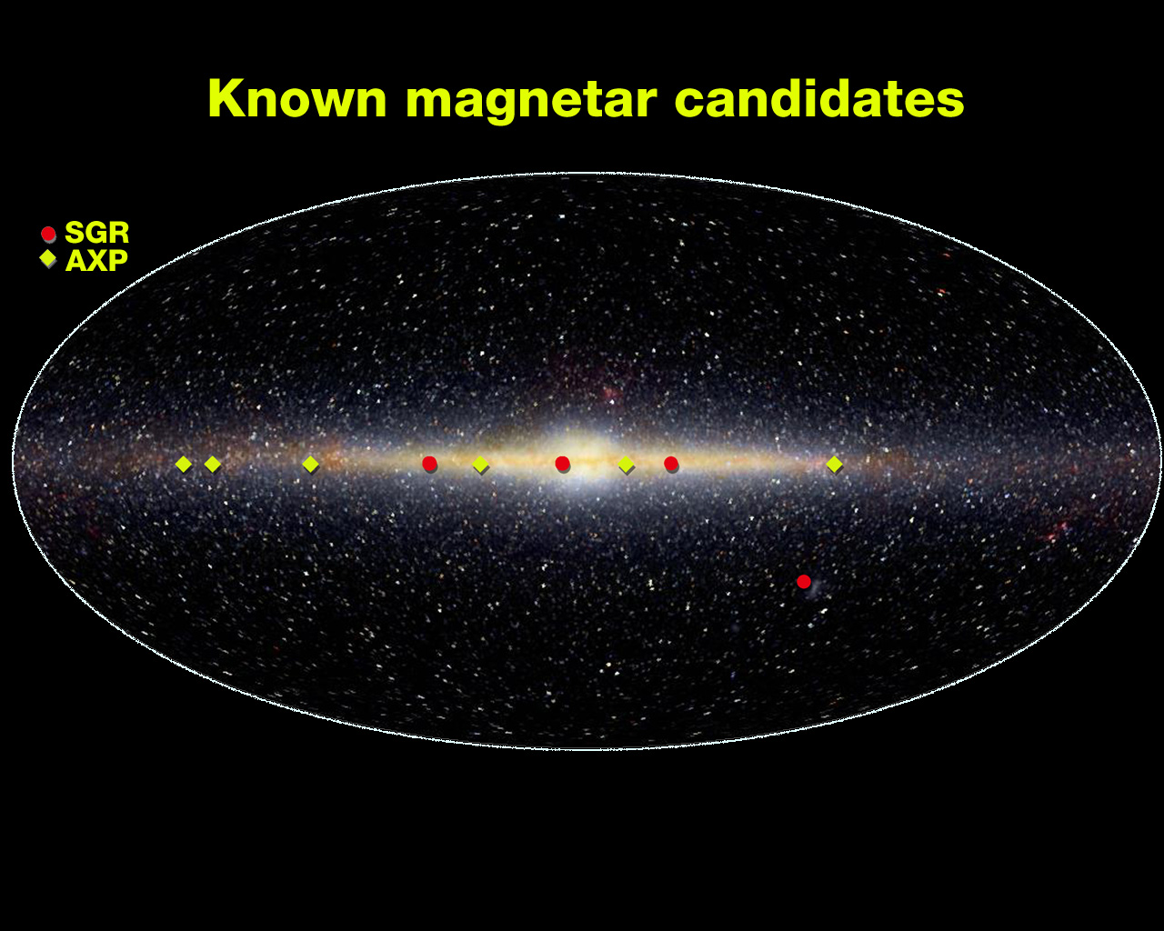
A New Magnetar Candidate
The known sample of magnetars…
Currently 21 magnetars known:
  9 SGRs (7 confirmed, 2 candidates)
  12 AXPs (9 confirmed, 3 candidates)
Two magnetars in the Magellanic clouds, all others located within Galactic plane
Reports of SGRs in M 31 and M 81 unconfirmed (transient sources)
Association of AXPs with supernova remnants implies ages < 10,000 yr and space velocities
< 500 km s⁻¹ (Gaensler et al. 2001)
Outdated plot!
Image credit: E. Wright (UCLA)/COBE/NASA
http://www.physics.mcgill.ca/~pulsar/magnetar/main.html

Slide 4
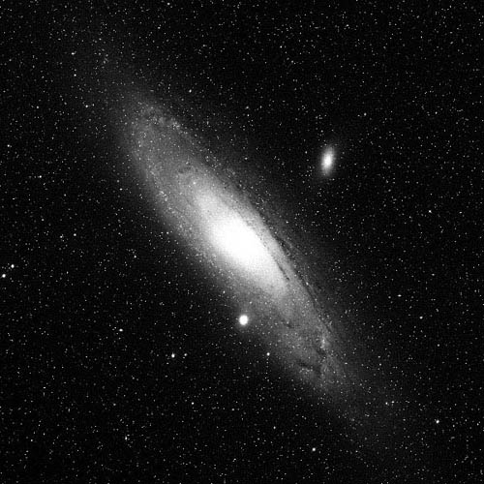
A New Magnetar Candidate
A new candidate magnetar or a black hole X-ray binary?
Bright X-ray point source detected serendipitously in Jan 2008 during XMM-Newton survey of M 31
(Stiele et al. 2011)
X-ray spectrum fitted with absorbed disc blackbody plus power law model, consistent with black hole low mass X-ray binary
N_{H} = 1.68 x 10²¹ cm⁻²
T_{in} = 0.462 keV
Γ = 2.55
L_{x} = 2.04 x 10³⁸ erg s⁻¹
Χ²/dof = 173.89/145
M 31 with position of magnetar candidate indicated by red circle

Slide 5
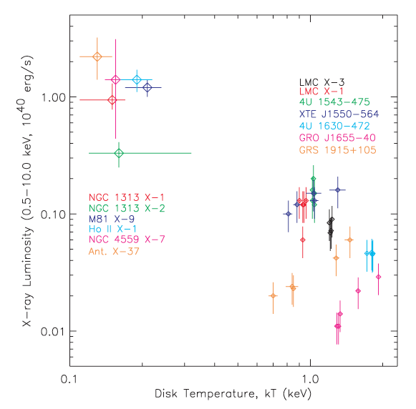
A New Magnetar Candidate
Arguments against a black hole X-ray binary…
ULXs
Steep photon index implies black hole not in low/hard spectral state
No variability detected in light curve, also inconsistent with low/hard state
If black hole, should be in disc-dominated state where disc extends to innermost stable circular orbit
Inner disc temperature too low for stellar mass black hole (should peak at ~1 – 2 keV), instead implying ~200 M black hole
Derived luminosity gives Eddington fraction of ~0.5%, inconsistent with disc dominated state
Unlikely to be black hole LMXB
BH binaries
Magnetar candidate
Inner disc temperature vs luminosity for black hole binaries and ULXs (Miller et al. 2004)

Slide 6
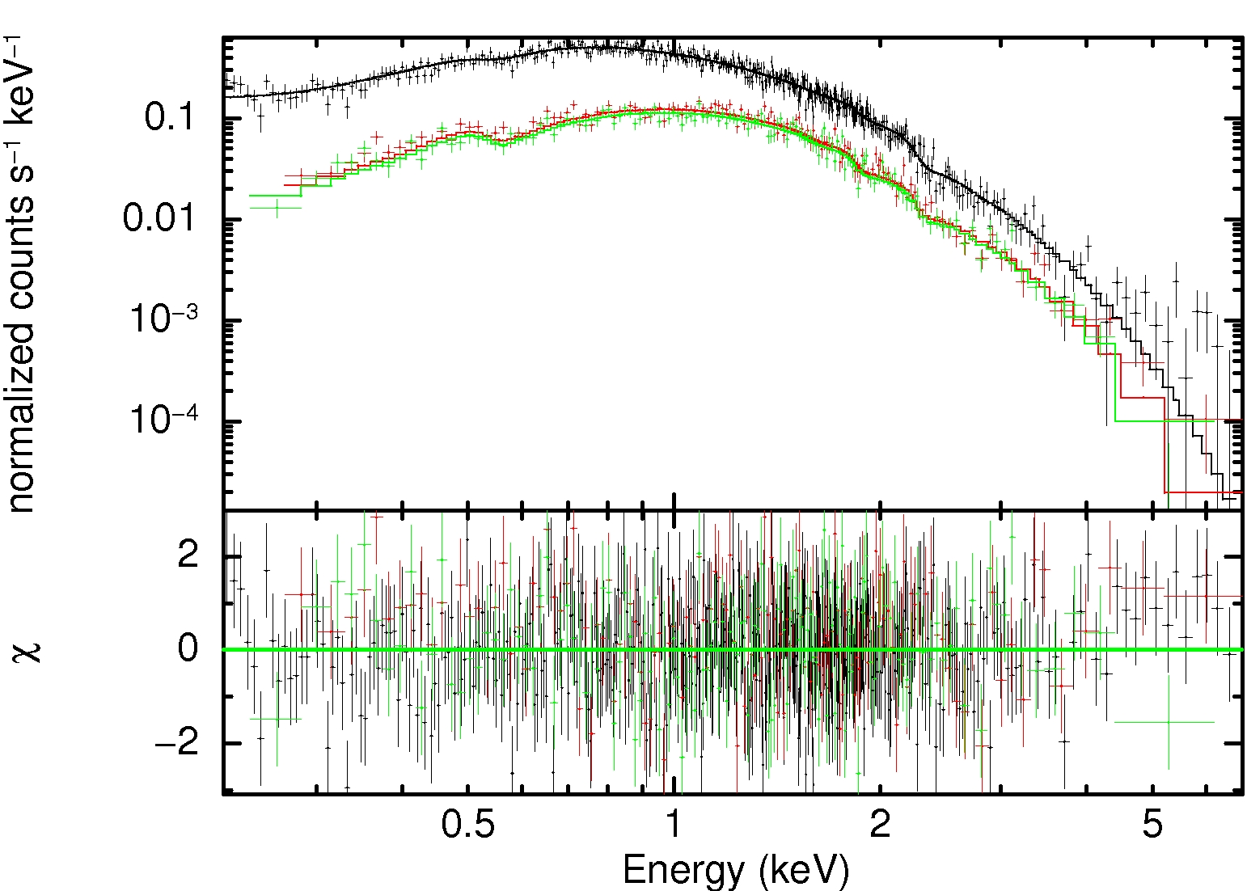
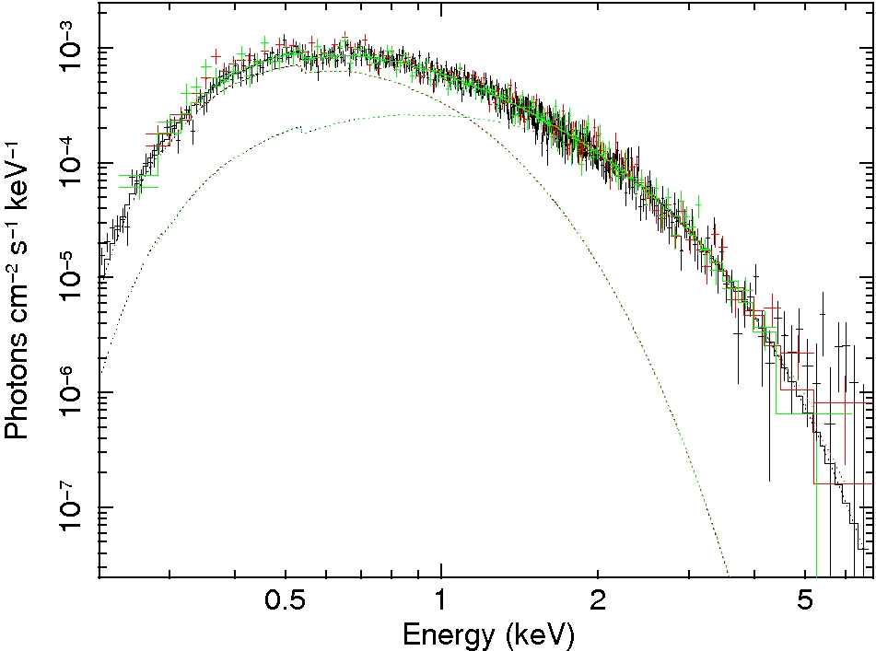
A New Magnetar Candidate
Alternative explanations…
Spectrum consistent with absorbed bremsstrahlung, blackbody + power law, or double black body models
Bremsstrahlung temp very low (0.98 keV) with no line emission
Abs(bbody+pow) and abs(bbody+bbody) models give parameters consistent with magnetars:
Bbody+pow: kT = 0.37 keV, Γ = 3.7
Bbody+bbody: kT = 0.207, 0.44 keV
Discussion of alternative magnetar explanation to be published in Callingham et al. (2011)
EPIC spectra fitted with abs(bbody+bbody) model

Slide 7
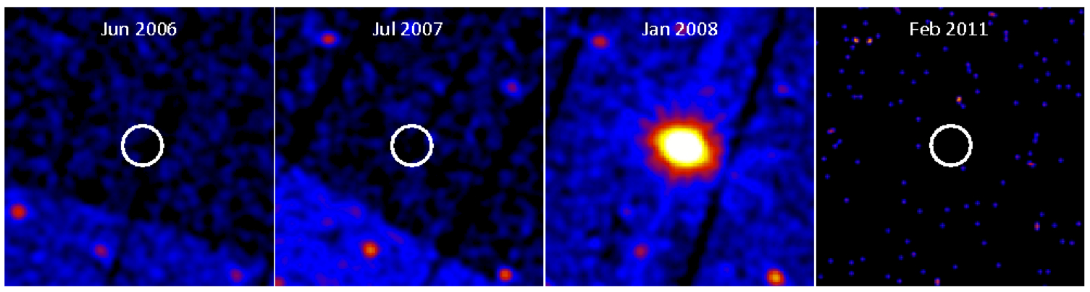
A New Magnetar Candidate
X-ray variability…
Not detected in previous observations with XMM, Chandra, Swift and ROSAT
Follow-up Swift observation in Feb 2011 also failed to detect source at 2XMM position
Upper limits indicate variability by factor of more than ~100 over long timescales
XMM and Swift (bottom right) images of the magnetar candidate

Slide 8
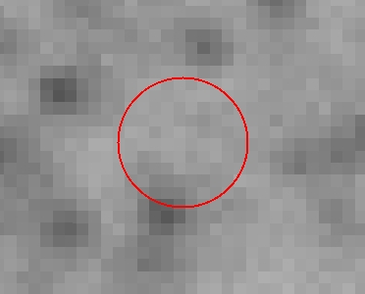
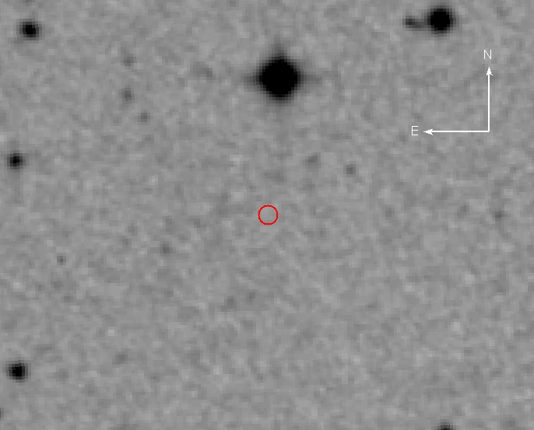
A New Magnetar Candidate
Search for an optical counterpart…
Deep optical imaging of M 31 taken with CFHT as part of PAndAS program (McConnachie et al. 2009)
No optical counterpart within XMM error circle down to g = 26.5 mag and i = 25.5 mag
No near-IR counterpart in 2MASS down to J = 17.5 mag, H = 16.3 mag, K = 16.1 mag
No UV counterpart detected by OM down to uvw1 = 20.1 mag and uvm2 = 19.3 mag
Non-detections indicate X-ray to optical flux ratio of F_{x}/F_{o} > 2,000
N
E
CFHT g-band image with X-ray position of magnetar candidate shown with the red circle (radius 1”)

Slide 9
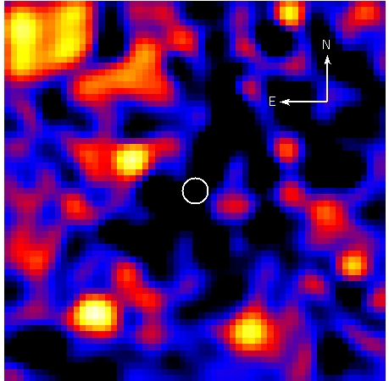
A New Magnetar Candidate
Search for a radio counterpart…
No radio counterpart in NVSS image consistent with the X-ray position
Additional radio surveys of M 31 also don’t show any radio counterpart within X-ray error circle
(Gelfand et al. 2004)
Nearest radio source 1.5’ away, unlikely to be related
NVSS radio image with the X-ray position of the candidate magnetar shown with the white circle (radius = 30”)

Slide 10
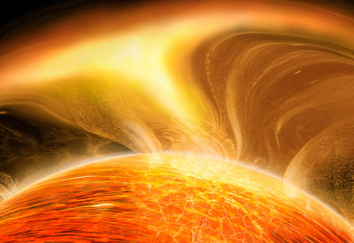
A New Magnetar Candidate
Investigating the nature of the source…
Black hole X-ray binary ruled out based on lack of variability, inner disc temperature, and luminosity
Slope of power law too steep for neutron star X-ray binary
Transient nature rules out isolated cooling neutron star or rotation powered pulsar
F_{x}/F_{opt} ratio inconsistent with foreground star (< 0.01) or background AGN (< 10)
X-ray spectrum inconsistent with cataclysmic variable (plasma temp too low, no line emission)
Also not consistent with novae (kT ~ 0.02 – 0.09 keV typically)
Transient behaviour, X-ray spectrum, and lack of optical counterpart totally consistent with magnetar
Artist’s impression of a magnetar burst.
Image credit: Scientific American

Slide 11
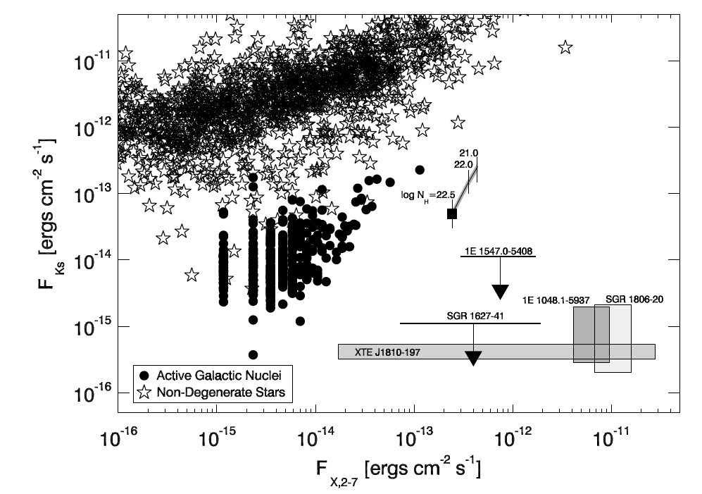
A New Magnetar Candidate
Comparison with other magnetars…
Magnetar candidate
X-ray flux vs near-IR K_{s}-band flux for AGN, stars and magnetars (Gelfand & Gaensler 2007)

Slide 12
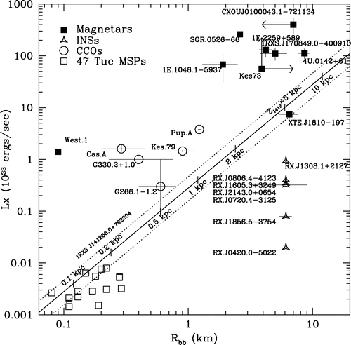
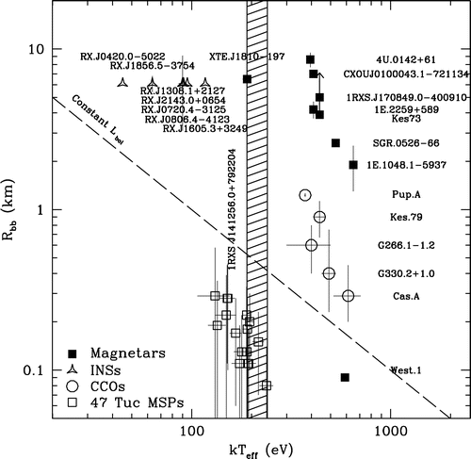
A New Magnetar Candidate
Comparison with other magnetars…
10 kpc
1 kpc
Black body radius vs luminosity and temperature for magnetars, isolated neutron stars, central compact objects, and millisecond pulsars (from Rutledge, Fox & Shevchuk 2008)

Slide 13
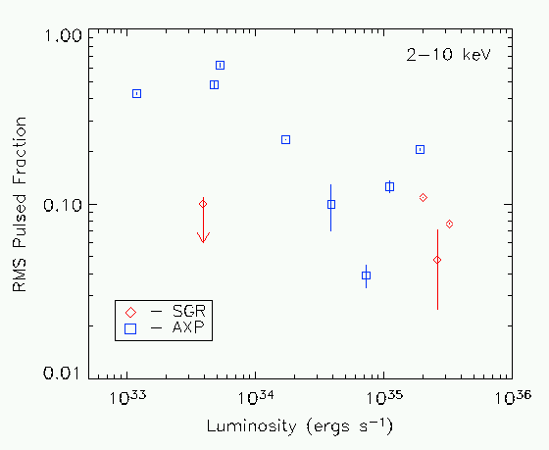
A New Magnetar Candidate
Comparison with other magnetars…
Magnetar luminosity is anti-correlated with pulsed fraction
Void in upper right can be explained by strong thermal surface emission
Void to lower left is certainly a selection effect
No pulsations detected in EPIC data of new candidate
Pulsed fraction upper limit is 7% (5σ)
Implies higher end of luminosity range
Plot of magnetar X-ray luminosity vs pulsed fraction. Blatantly stolen from a talk I think by Peter Woods

Slide 14
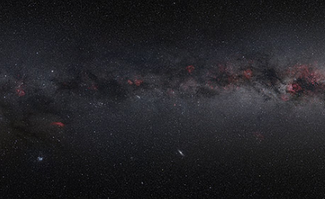
A New Magnetar Candidate
Explaining the high Galactic latitude…
Candidate is coincident with outer regions of M 31, so could be extragalactic
Derived luminosity at M 31 distance (~0.8 Mpc) is ~5 x 10³⁷ erg s⁻¹
Blackbody emitting radii at M 31 distance are > 120 km
High luminosity and large radii argue against an M 31 magnetar
Assuming age < 10,000 yr and velocity < 500 km s⁻¹, magnetar could have traveled ~5 pc out of plane
Line of sight distance would be ~13 pc, making it unfeasibly close
(L~10²⁷ erg s⁻¹)
Projection of the magnetar candidate in the Milky Way.
Image credit: N. Risinger

Slide 15
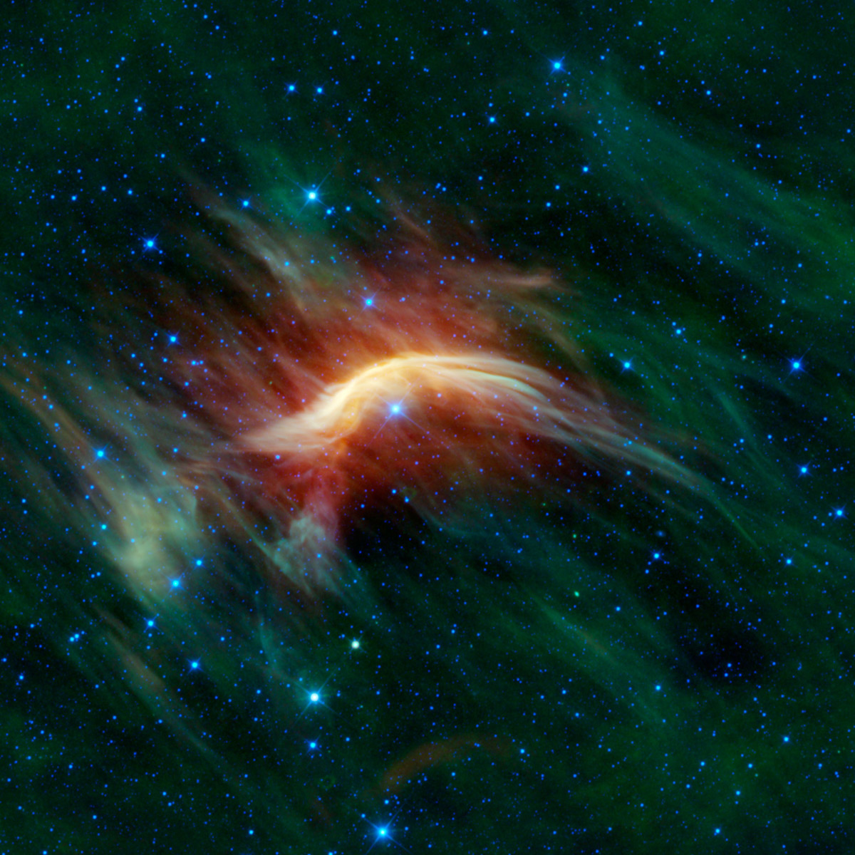
A New Magnetar Candidate
Explaining the high Galactic latitude…
If luminosity is ~10³² – 10³⁵ erg s⁻¹, implies distance of ~0.7 – 24 kpc
Assuming age < 10,000 yr, derived spatial velocity implausibly high at
> 10,000 km s⁻¹
For spatial velocity < 500 km s⁻¹, derived age high for magnetar at > 10⁶ yr
However, see Nanda et al. (2010) for discussion of old low B-field SGR
Alternatively, position outside plane can be explained by runaway massive progenitor star
Only need low spatial velocity for progenitor to travel outside plane within lifetime of massive star (~10⁶ yr)
Lack of radio supernova remnant easily explained by low density environment
Infrared image of the runaway star Zeta Oph
Image credit: NASA/JPL/WISE team

