Slide 1
The deep sky under the X-ray limelight:
The XMM ultra-deep survey in the CDFS
Andrea Comastri
INAF-Osservatorio Astronomico Bologna ITALY
P. Ranalli (UniBO), R. Gilli (INAF-BO), C. Vignali (UniBO),
K. Iwasawa (ICC-Barcelona), I. Georgantopoulos (INAF-BO), N. Cappelluti (INAF-BO), E. Rovilos (INAF-BO), X. Barcons (IFCA), F.J. Carrera (IFCA), S. Falocco (IFCA), M. Brusa (MPE), H. Brunner (MPE), I. Balestra (MPE), A. Merloni (MPE), A. Finoguenov (MPE), F. Civano (CfA), F. Fiore (INAF-Roma), F. Nicastro (INAF-Roma), S. Puccetti (ASI), V. Mainieri (ESO), P. Rosati (ESO), P. Tozzi (INAF-TS), N. Brandt (PSU), J. Silverman (IPMU)
Thanks to M. Diaz Trigo & I. De la Calle for obs planning

Slide 2
Outline
Deep and Hard X-ray surveys: why ?
The XMM deep field in the CDFS
Recent results and ongoing science projects
Future perspectives

Slide 3
Science Drivers
How many highly obscured AGN are missing ? How much
do they contribute to the accretion history (XRB) and mass budget in the Universe ?
Search for and spectral characterization of the most
obscured AGN beyond the local Universe
Peculiar/rare objects, X-ray emission from galaxies, long term variability, …
Since M_{BH} - Host(M,L,σ) -> tight link between accretion processes and host galaxy evolution
How strong is the absorption induced feedback ? How are heavy obscuration, star formation and gas accretion linked each other ?
SMBH in a cosmological context

Slide 4
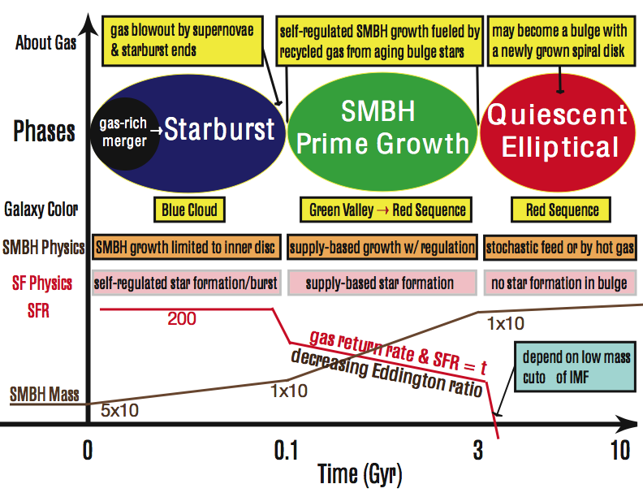
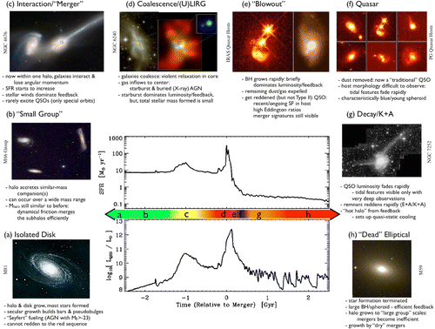
AGN and galaxy co-evolution:
Unified models revised
Early on Strong galaxyinteractions= violent star-bursts Heavily obscured QSOs
When galaxies coalesce accretion peaks QSO becomes optically visible as AGN winds blow out gas.
Later times SF & accretion quenched red spheroid, passive evolution
Compton Thick
BH Growth
Coeval SB-AGN
Timescales of these phases are little constrained (so far)
Timescales of these phases are little constrained (so far)
Hopkins+08
Cen 2011

Slide 5
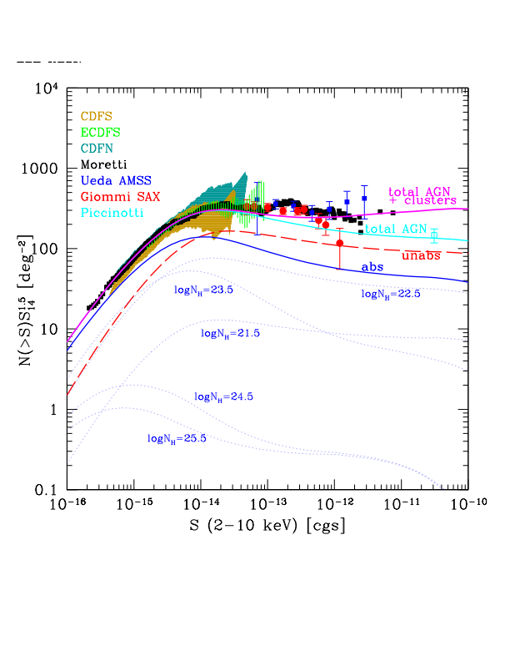
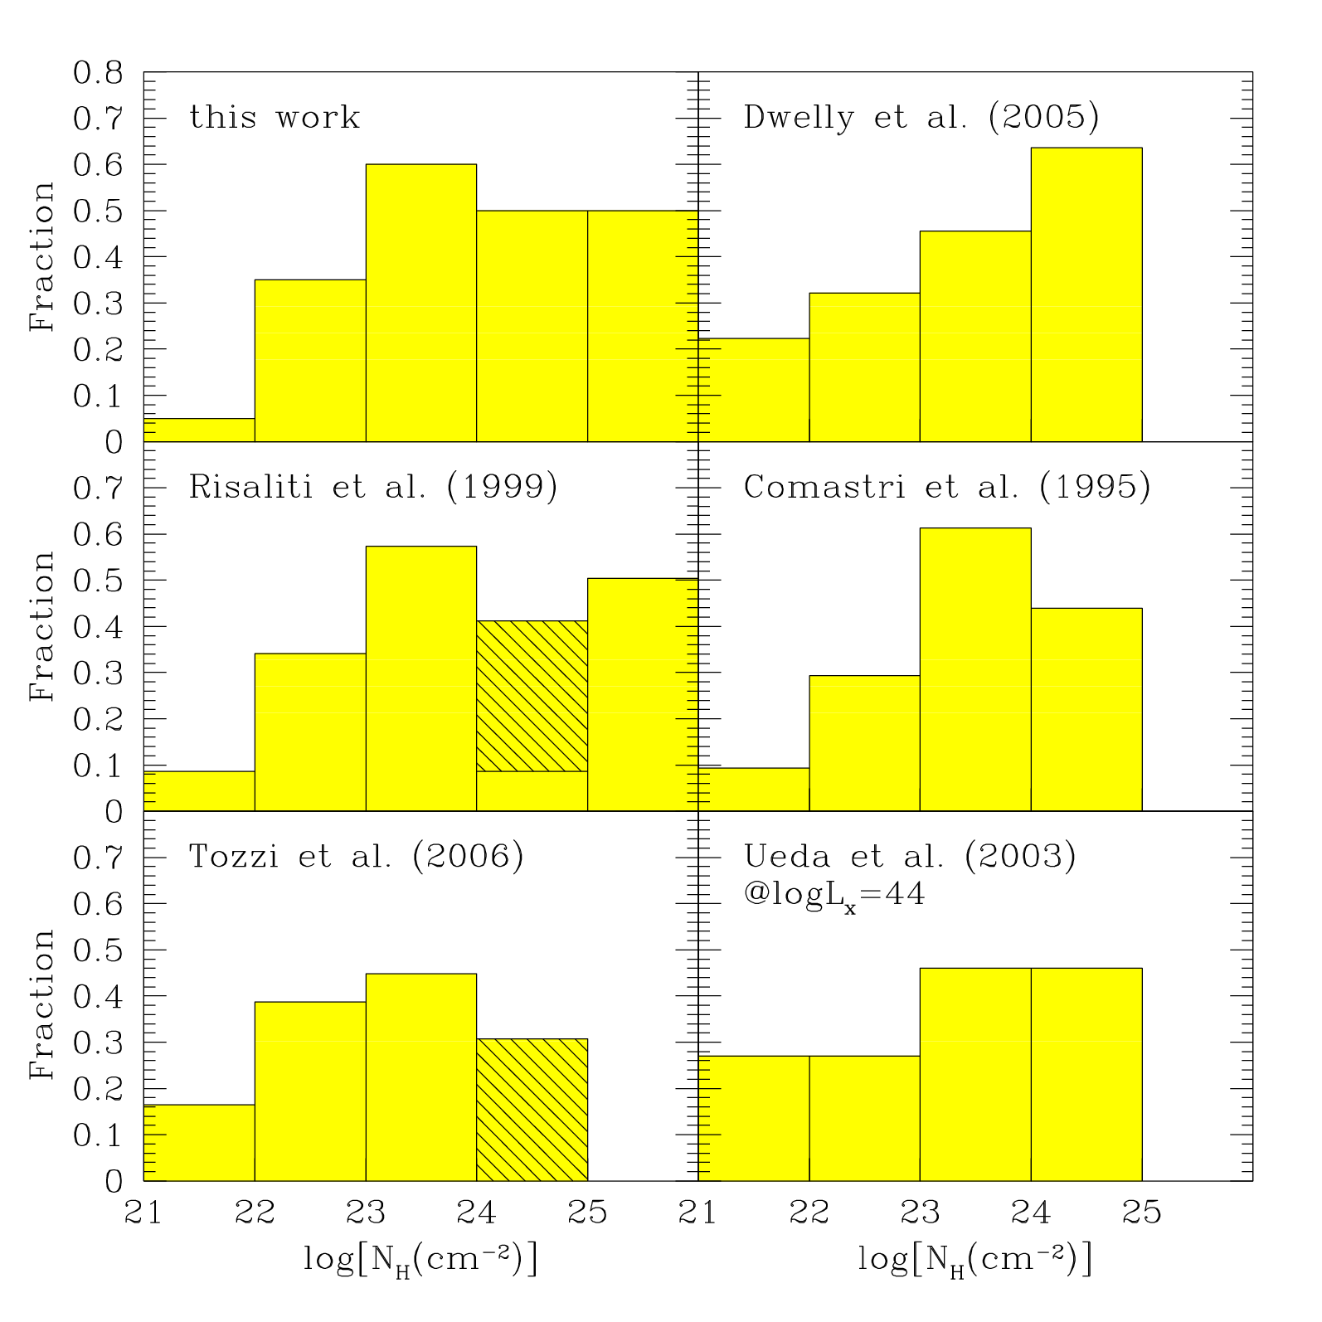
Obscured Accretion
Gilli+07
21 22 23 24 25
Compton Thick and Obscured (logN_{H} > 23) are abundant
nearby… what happens at moderate to high-z?

Slide 6
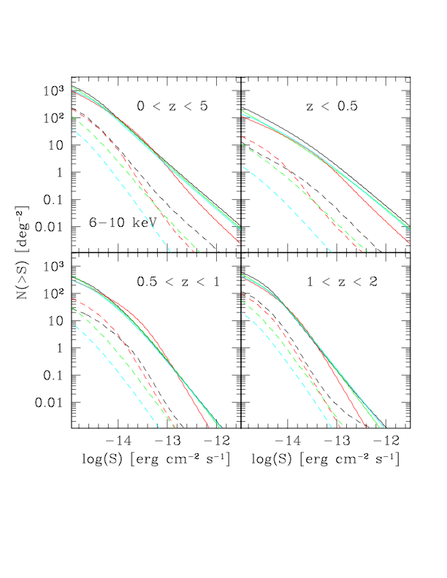
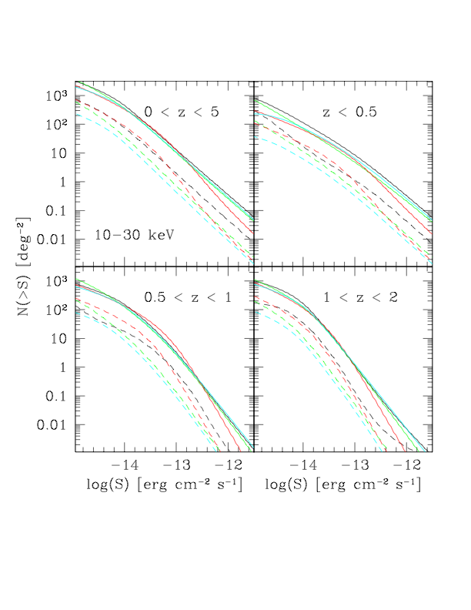
Hard X-ray Counts
10-30 keV
(i.e. NuSTAR)
Brighter fluxes
-> “low z”
6-10 keV
Accessible from both XMM & NuSTAR
XMM goes deeper
- > “high z”
Ballantyne+11

Slide 7
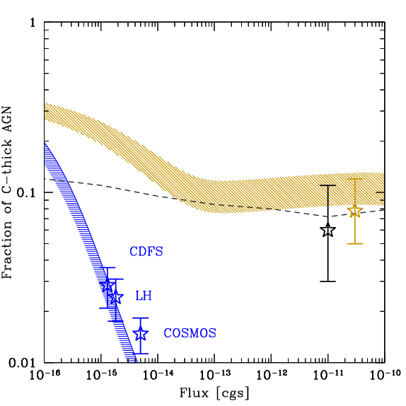
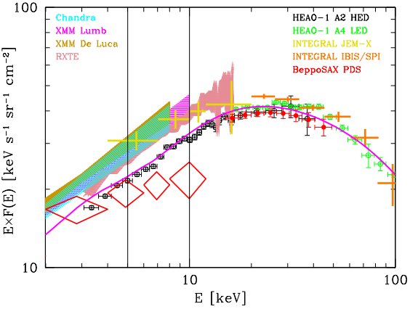
The fraction of C-thick AGN
> 10 keV
2-10 keV
Resolved fraction decreases
with energy: 90% @ 1 keV
50% at 8 keV 1-2% @ 30 keV
Notes:
7

Slide 8
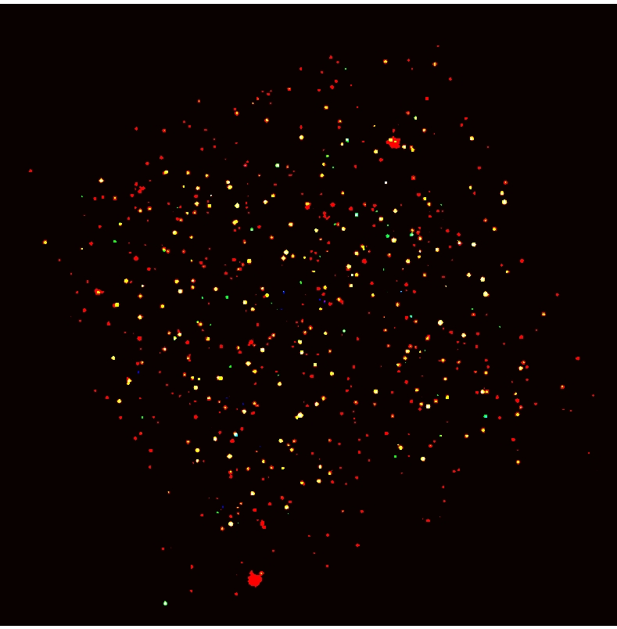
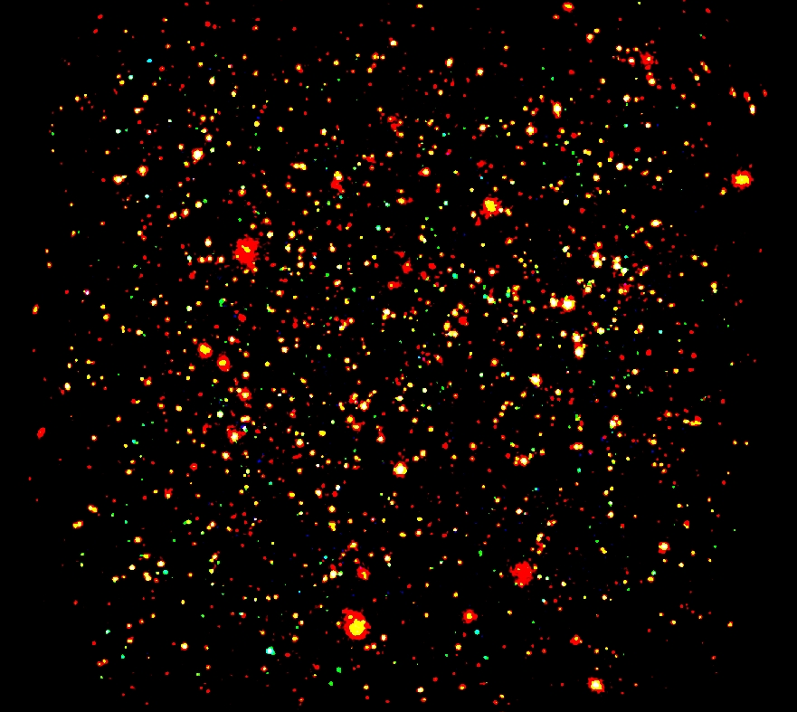
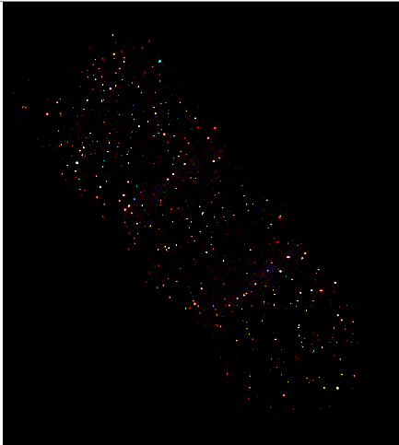
Large area
X-ray surveys
Chandra-COSMOS 0.9deg² 1.8 Ms
PI Elvis
XMM-COSMOS 2 deg² 1.5 Ms
PI Hasinger
AEGIS-X 0.7 deg² ~3.4Ms PI Nandra

Slide 9
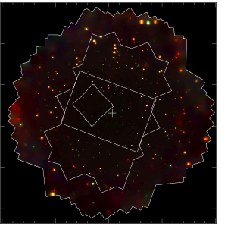
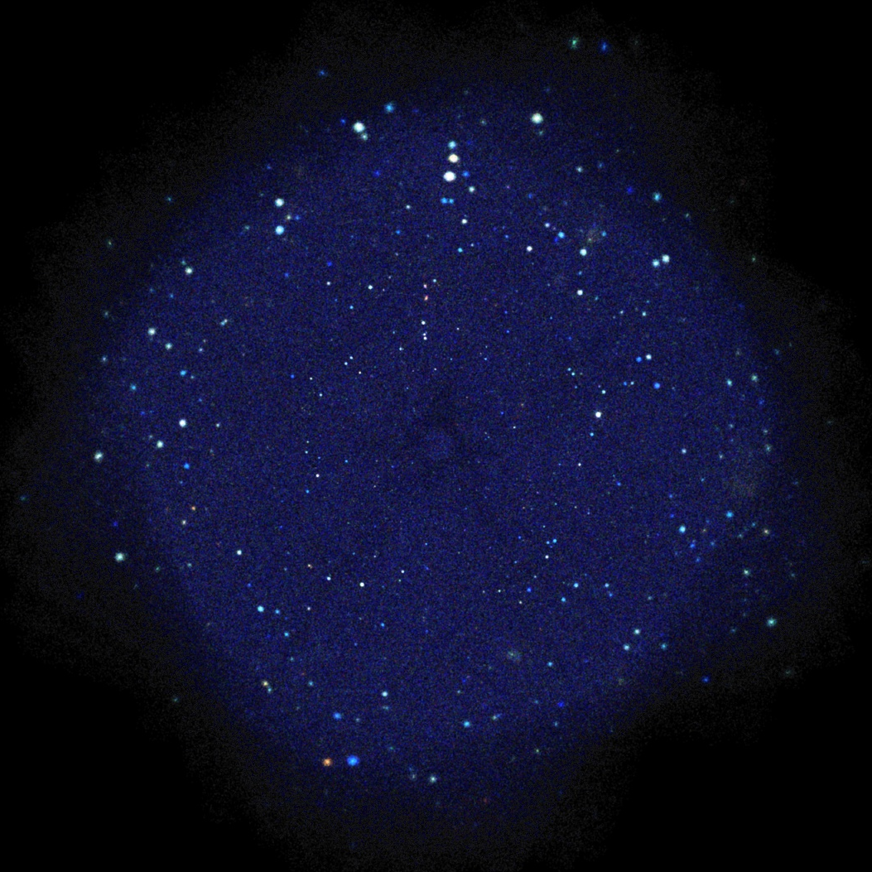
The deepest X-ray field
4Ms Chandra Deep Field South
red = 0.3 -1 keV
green = 1 - 2 keV
blue = 2 -7 keV
Limiting flux >~ 10⁻¹⁷ erg cm⁻² s⁻¹
in the 0.5-2 keV band
PI Brandt

Slide 10
X-ray surveys in Berlin 2011
M. Brusa (talk 28.6) The search of obscured AGN in COSMOS and CDFS
V. Mainieri (talk 27.6) --> Host galaxies properties of QSO2 in COSMOS
D. Burlon (talk 30.6) --> Type 2 AGN fraction in Swift/BAT samples
Lusso (talk 30.6) --> Type 2 AGN SED and bolometric corrections
V. Allevato (talk 30.6) --> Bias evolution and clustering properties in XMM-COSMOS
I. Balestra (poster # G01) --> SED of obscured AGN in CDFS
A. Bongiorno (poster # G02) --> SED fitting decomposition and AGN hosts mass function
E. Rovilos (poster #G40) --> Star formation properties of obscured AGN
F. Civano (poster #G07) --> High redshift (z>3) AGN in C-COSMOS
M. Salvato (poster #G41) --> Photometric redshifts for Chandra & XMM COSMOS AGN
P. Chaudhary (poster #G05 ) Rest frame stacking of 2XMM sources: FeK
S. Falocco (poster #G15 )Stacking of X-ray spectra of deep surveys

Slide 11
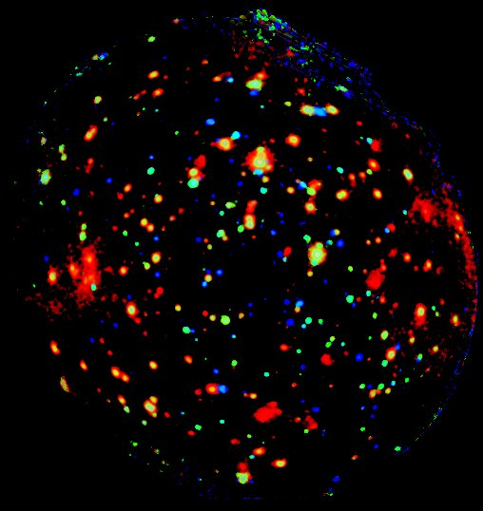
~3 Ms XMM image of the Chandra Deep Field South
~0.3 deg²
Goals:
Resolve the XRB in the 5-10 keV band
Fine spectroscopy of distant heavily obscured AGN
red = 0.4 -1 keV
green = 1 - 2 keV
blue = 2 -8 keV
Agios Nikolaos - Crete 08/10/10

Slide 12
Data Management
Total exposure: 3.3 Ms
Clean exposures: 2.4 Ms (pn), 2.8 Ms (mos)
33 observations!
8 in years 2001-2002 (“archival data”)
4 in summer 2008
8 in winter 2009
4 in summer 2009
9 in winter 2010
33 obs x 3 cameras = 99 event files!
+ 33 attitudes...
99 lightcurves to clean...
99 x (number of bands) images...
99 x (number of sources) x (spectra, bkg, rmf, arf) ~ 50.000 files
Events cannot be merged
The resulting files are too
big for SAS to handle.

Slide 13
ISSUES
Background level
Confusion in the 0.5-2 keV
to a lower extent in the 2-10 keV

Slide 14
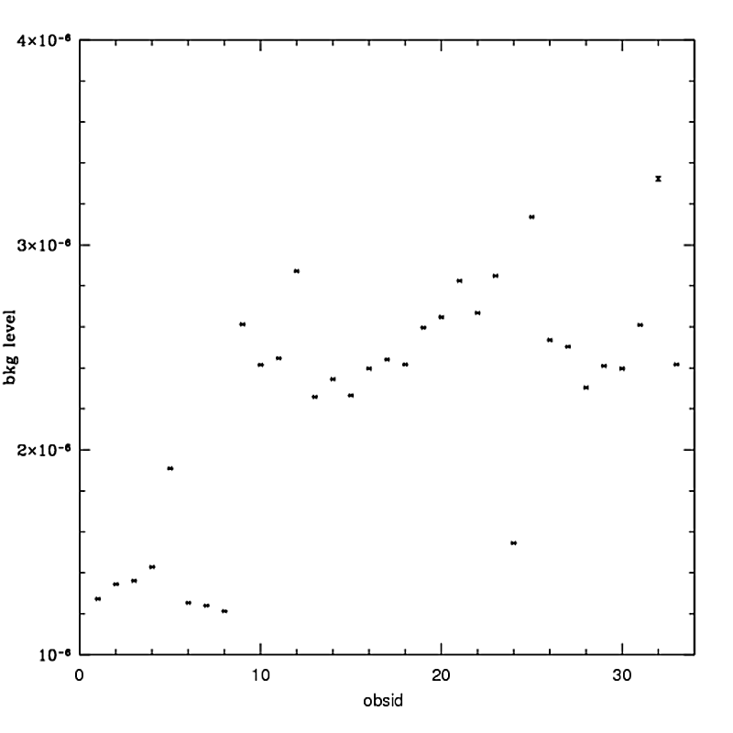
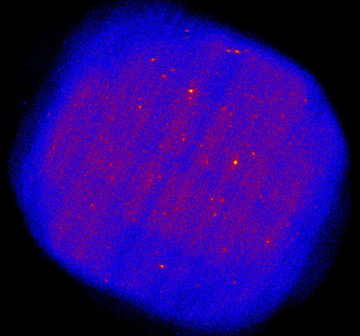
Background
counts/s/active pixel
pn background
level rose
since 2002
5-10 keV
2001-2002
2008-2010

Slide 15
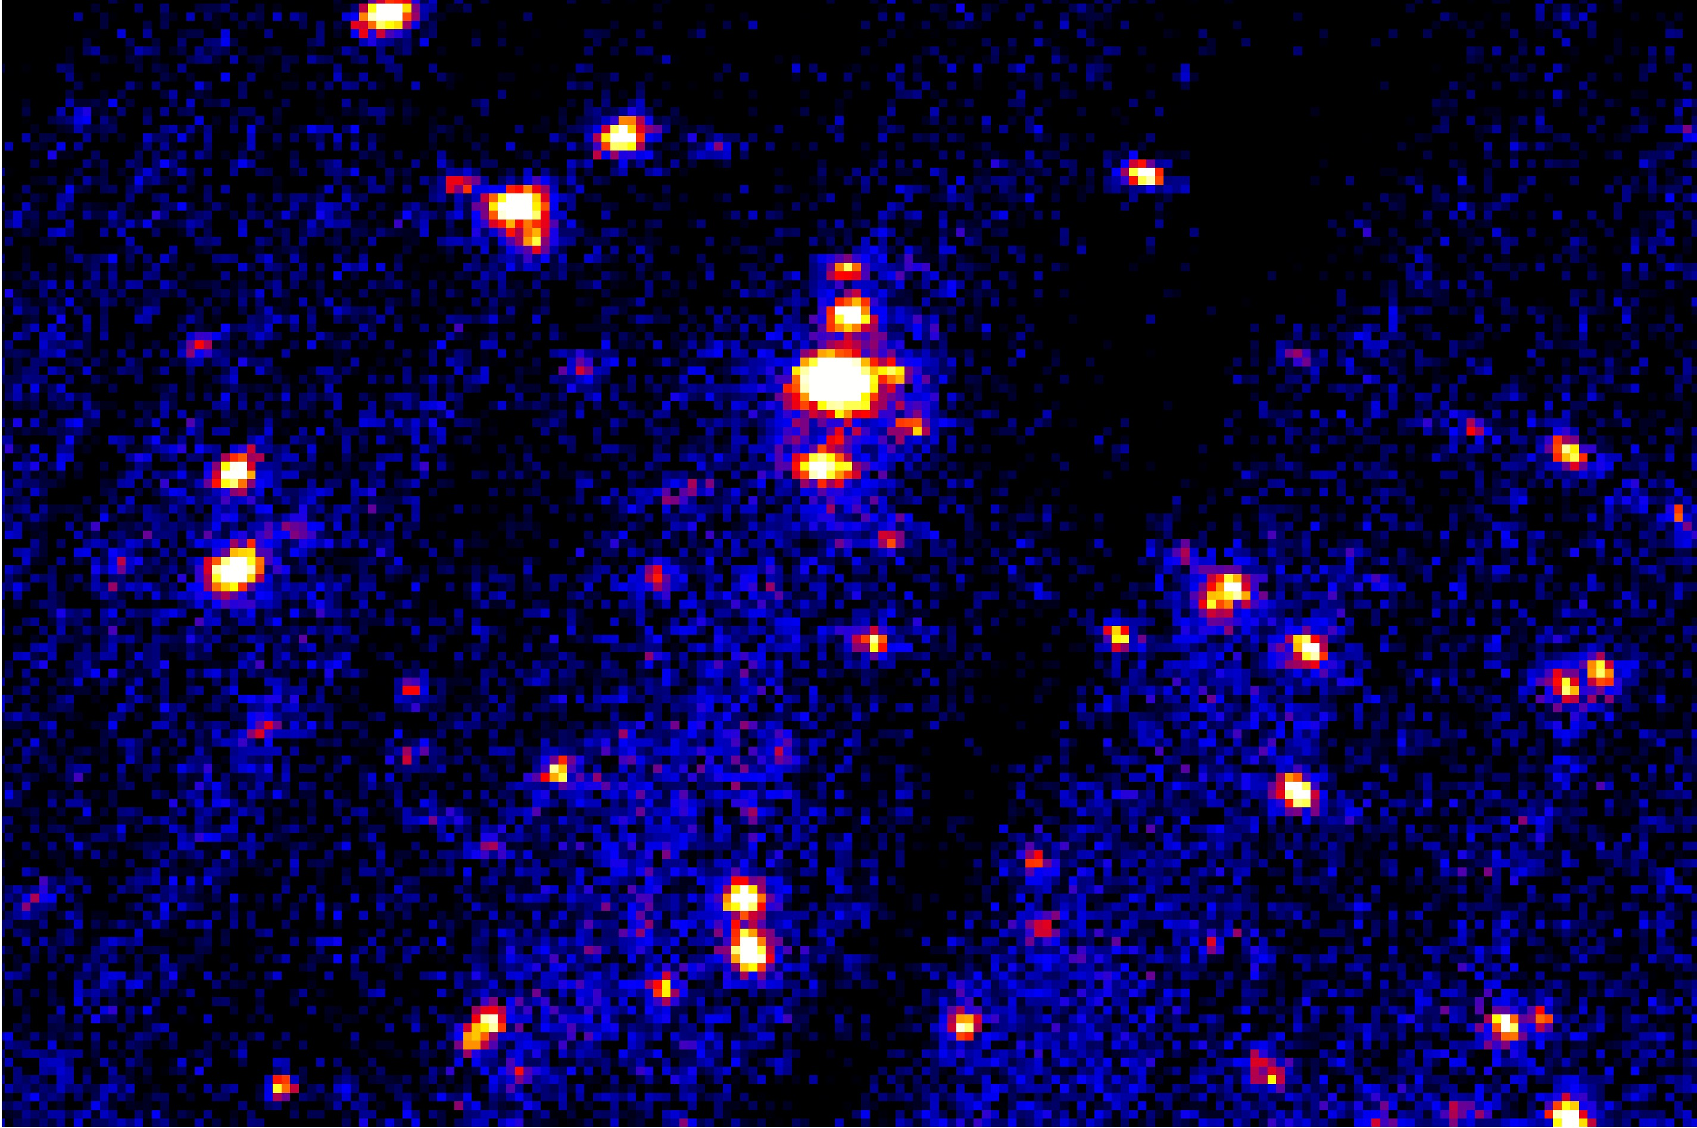
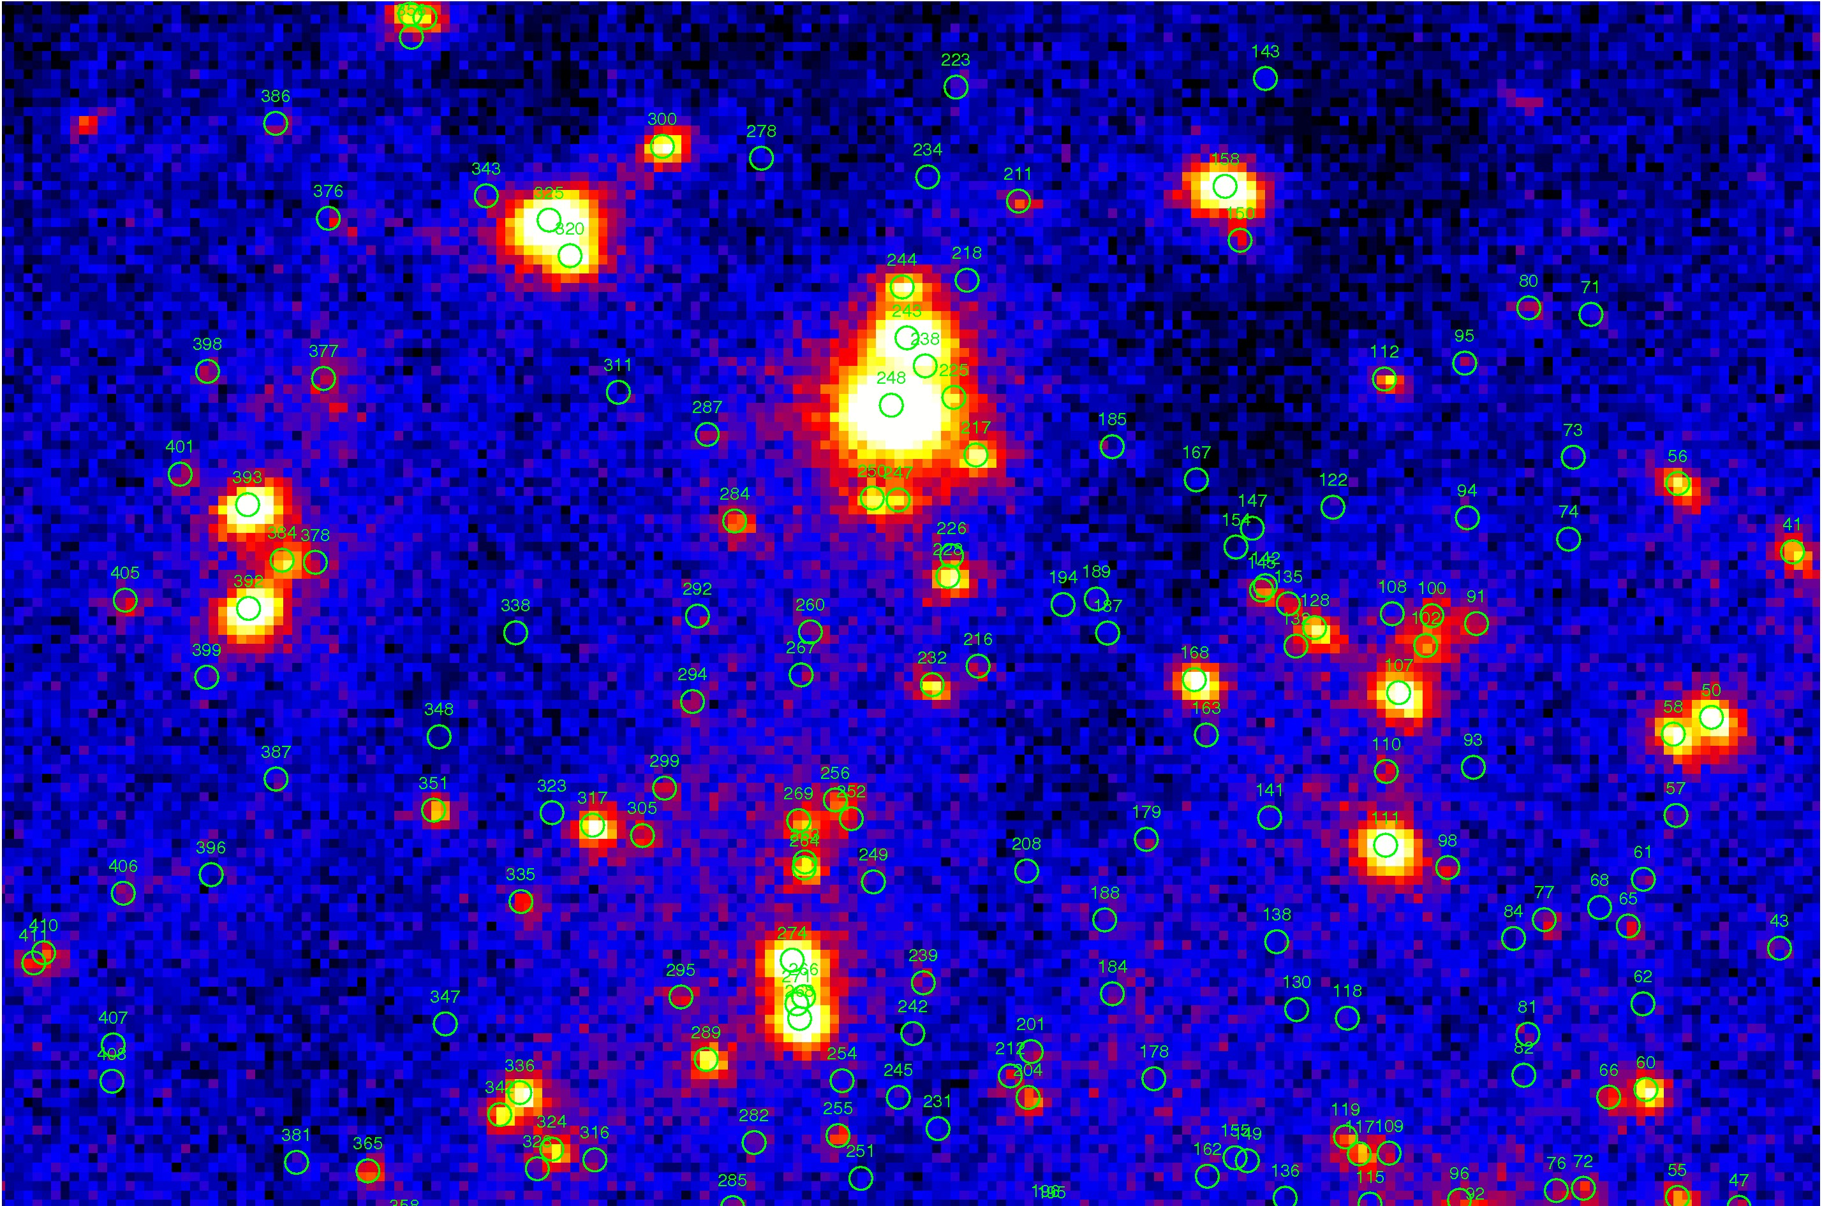
Confusion

Slide 16
X-ray catalogue and logN-logS
Source detection and catalogues - PWD plus SAS-EMLdetect detection algorithms
2-10 keV, 4σ: 411 sources
5-10 keV, 4σ: 197 sources
2-10 keV, >10σ AND 1 Ms exposure -> 130 sources

Slide 17
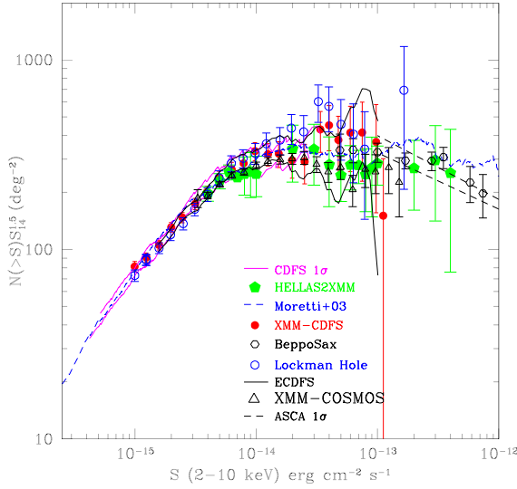
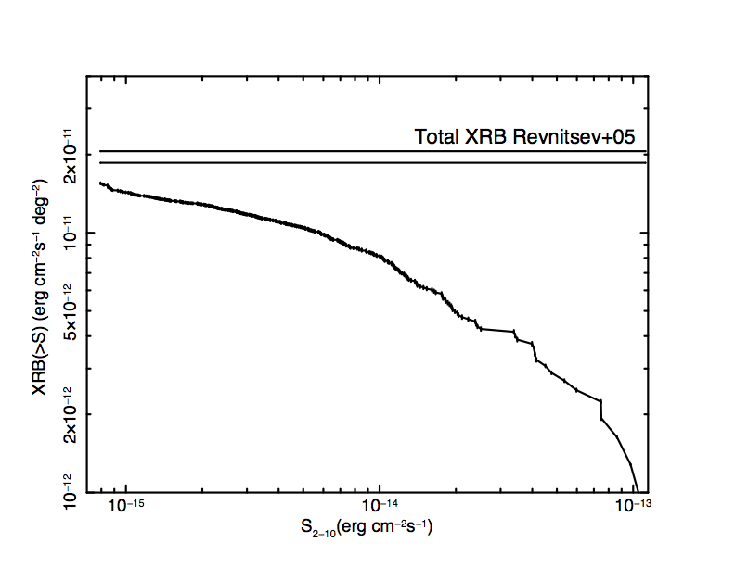
Hard X-ray Counts
F(2-10 keV) ~ 8 x 10⁻¹⁶ cgs
-> 5 x 10⁻¹⁶
Resolved fraction 79+-4 %

Slide 18
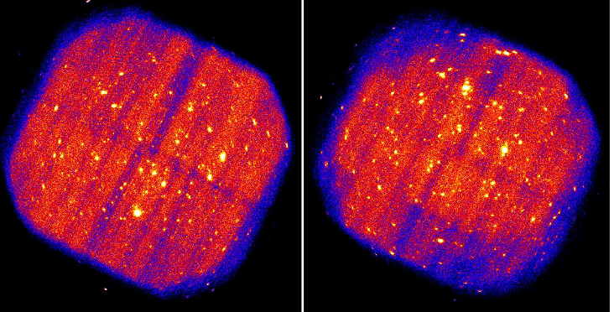
Simulations
Dedicated simulations are being run with a novel recipe for particle background subtraction
Ranalli+ in preparation

Slide 19
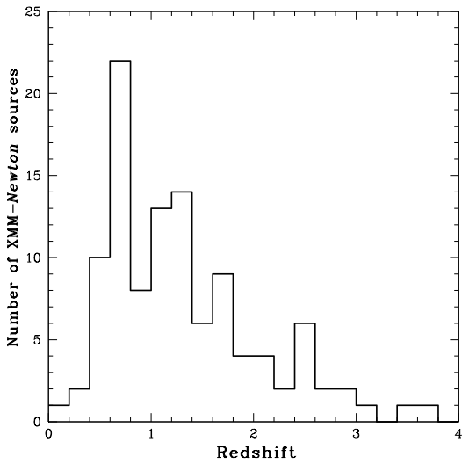
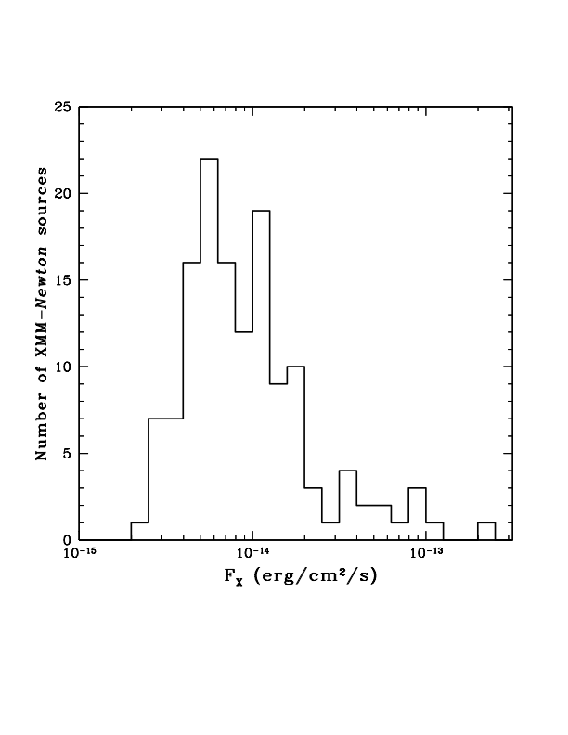
Spectral Analysis
2-10 keV, >10σ AND 1 Ms exposure -> 130 sources
2-10 keV

Slide 20
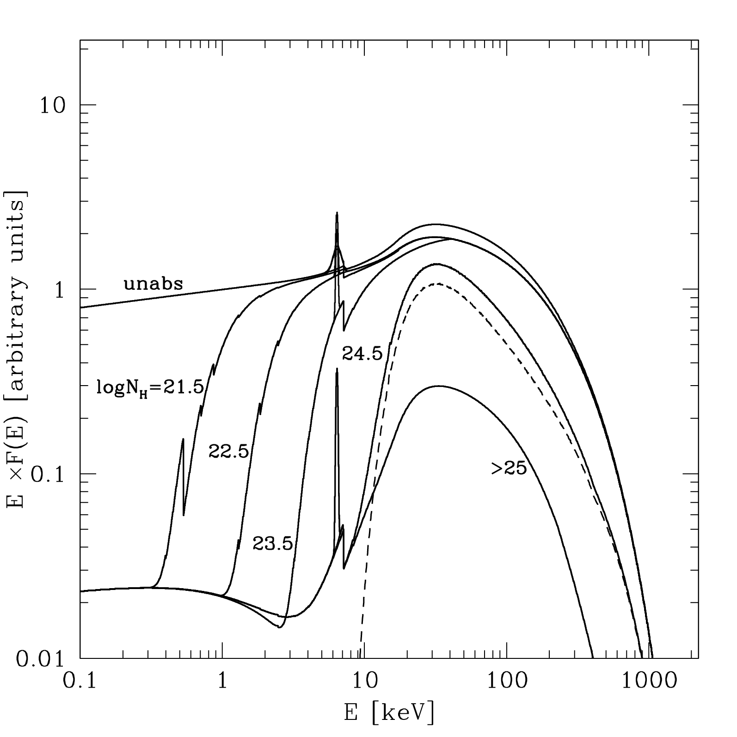
Spectral Analysis
Baseline model:
Soft Component
(scattered/reflected)
+ intrinsic absorbed
spectrum + line(s)
Compton-Thick:
Mildly (log N_{H} =24-25)
Heavily (log N_{H} >25)
Reflected
component
observer
Transmitted
component

Slide 21
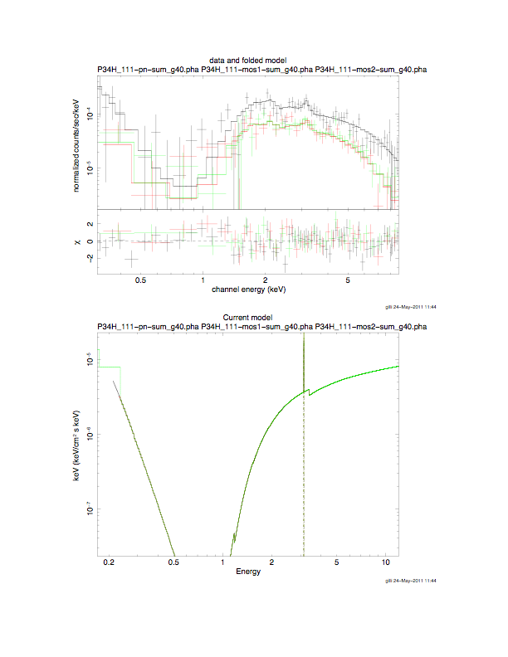
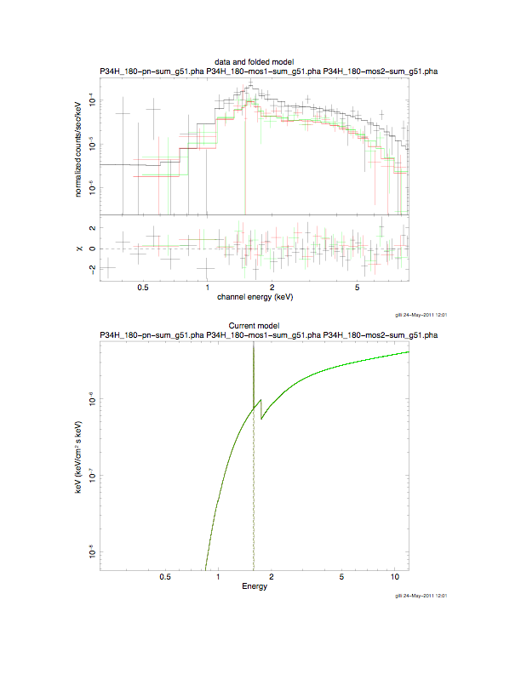
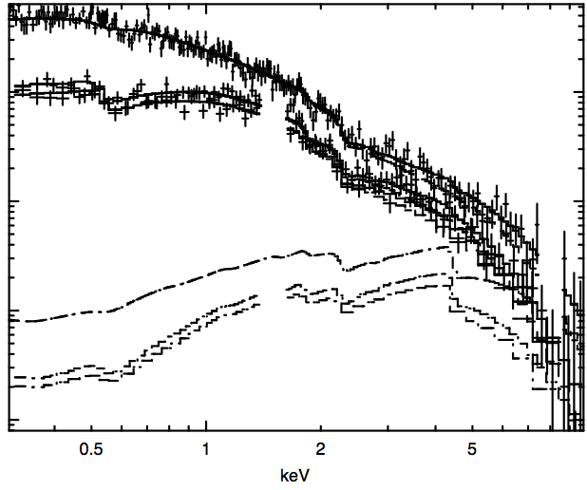
Spectral Survey
Baseline
Absorbed spectrum
Power law plus
Reflection

Slide 22
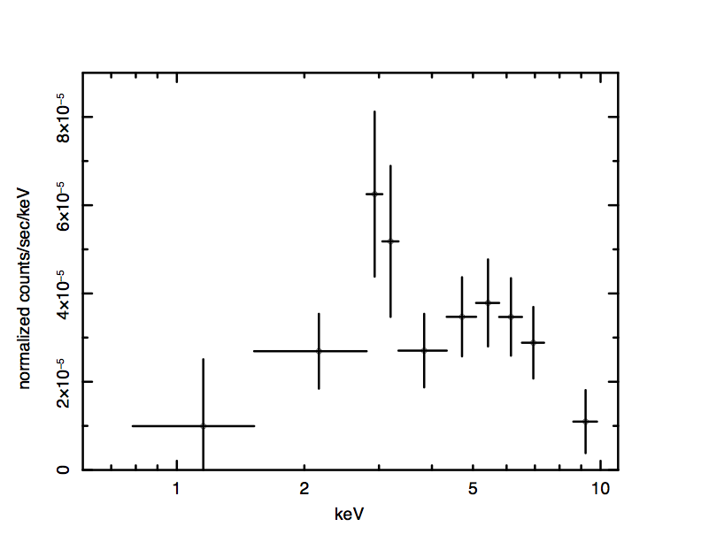
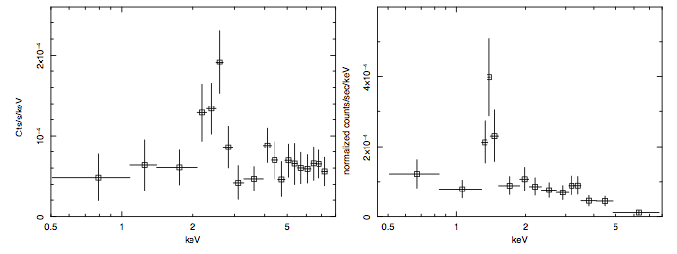
Distant C-thick AGN in the XMM-CDFS
#66 N_{H} ~ 10²⁴ cm⁻²
z=1.185; L~ 2 x 10⁴⁴
XID 153
z=1.53
XID 202
z=3.70
Would not have been selected
with multi-λ techniques (IR/Opt Georgantopoulos talk)

Slide 23
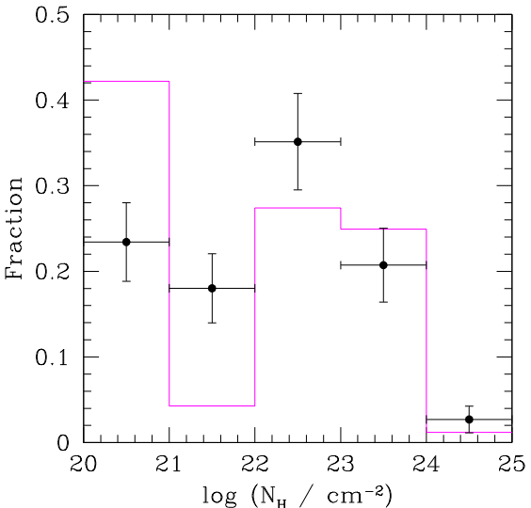
Absorption Distribution
Observed
vs
Predicted (GCH07)
logN_{H} < 22 ?
Uncertainties
associated to N_{H}
measurements at low
column densities
Or
revise model
parameters

Slide 24
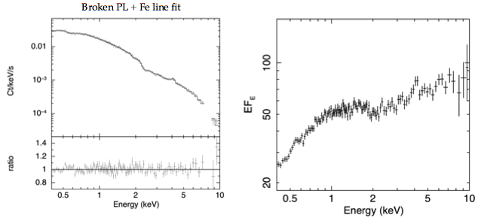
Bright sources
Brightest source in the field - unobscured Seyfert 1 @ z = 0.543
Variability in both soft and hard bands on years timescale
Soft excess : broken power law fit.
Marginally resolved iron line at 6.4 keV EW ~ 110 eV.
The 2-10 keV luminosity is about 10⁴⁴ erg/s.

Slide 25
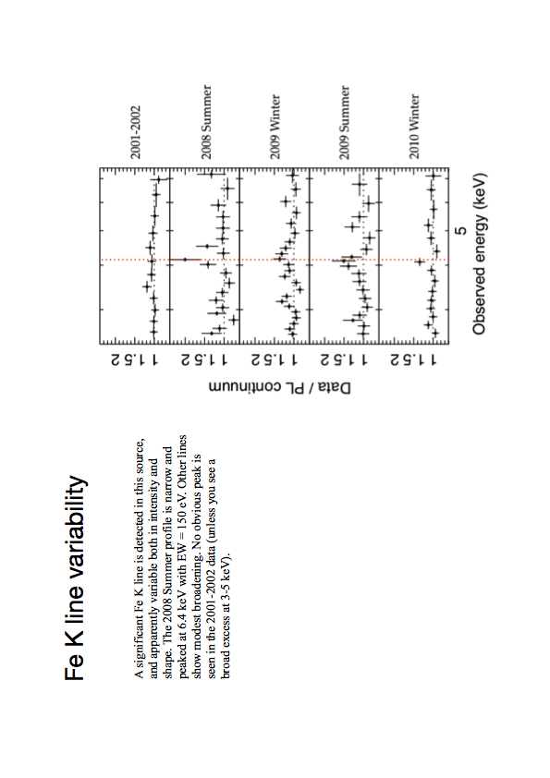
Iron line variability
The Fe K line is variable both in intensity and shape.
The 2008 Summer profile is narrow and peaked at 6.4 keV with EW ~ 150 eV.
No obvious peak is seen in the 2001-2002 data
Iwasawa+11

Slide 26
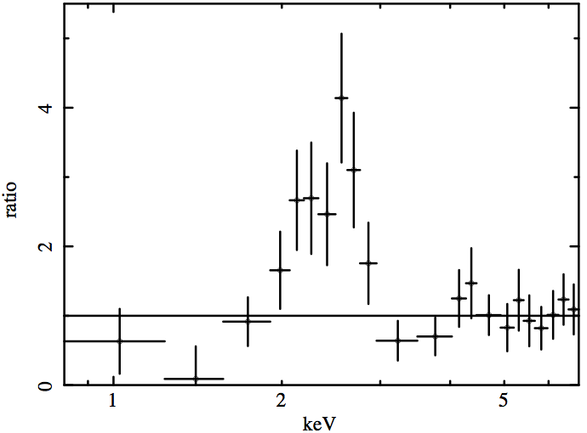
Iron Line Spectroscopy at high-z
z=1.53 AC+11
(pn data only)
Reflection plus
6.4 and 6.96 keV
Lines (same EW)
Reflection plus
6.6 keV line plus
absorption
~2.5 x 10²³ cm⁻²

Slide 27
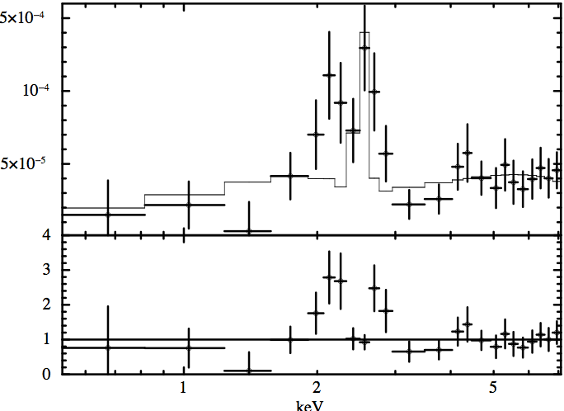
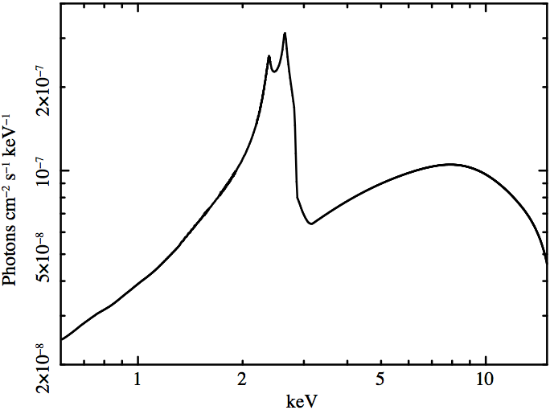
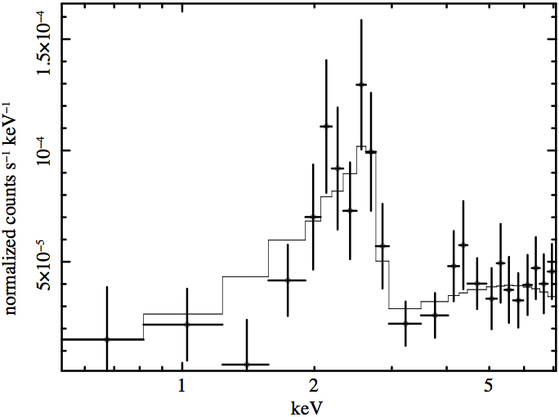
Iron Line Spectroscopy at high-z
Self-consitent
Reflection plus
Relativistic
Blurring
Neutral
2 x Solar
i = 50 deg
XSHOOTER+EVLA
ALMA prop

Slide 28
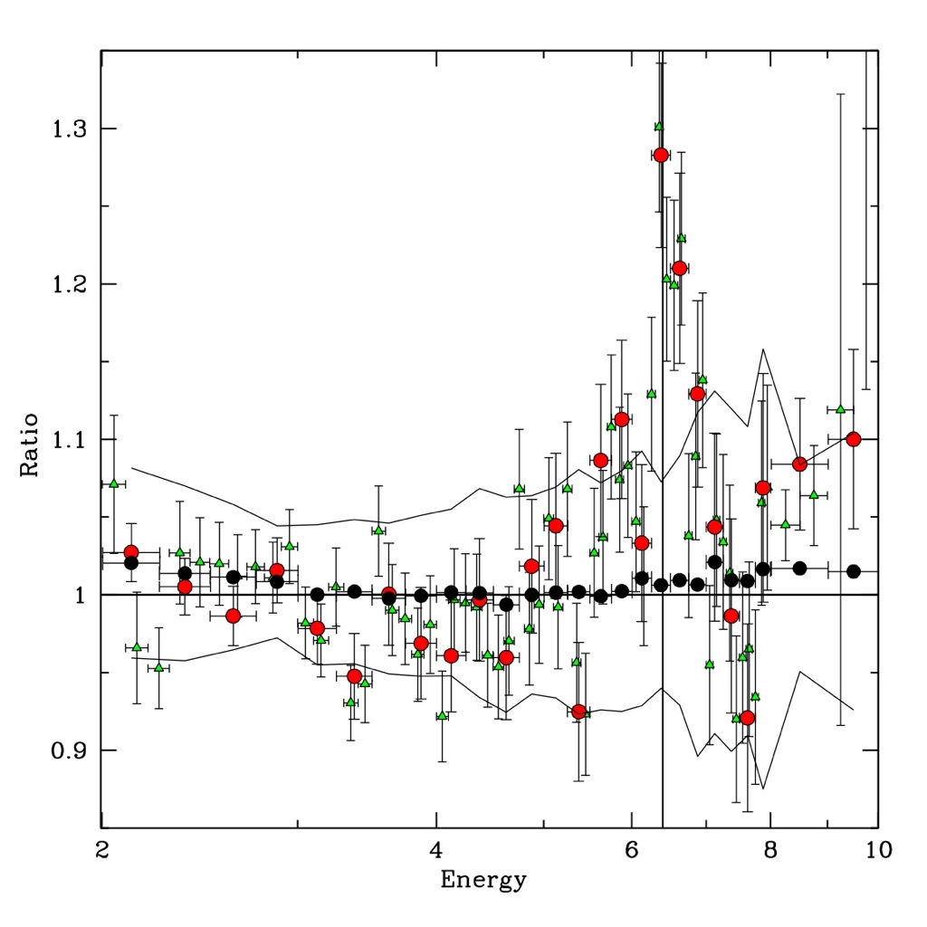
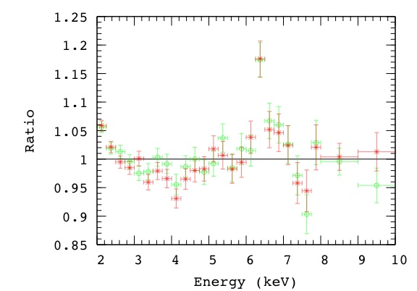
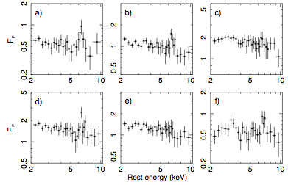
Stacking
CDFS+N Brusa+11
2XMM
Chaudhary+11 POSTER
COSMOS sources
Iwasawa+11 submitted
L and z bins
Falocco+ in prep

Slide 29
Future Perspectives
eROSITA: large samples of luminous obscured AGN over a broad range of redshifts (Predhel talk)
NuSTAR & ASTRO-H: many relatively nearby (z < 1) obscured & Compton Thick AGN up to ~100 keV (Harrison & Takahashi talks )
Athena census of obscured accretion over the SMBH growth golden age (z~ 1-3) (Nandra talk )

Slide 30
Summary
Hard X-ray (5-10 keV) logN-logS and resolved XRB fraction
Systematic spectral analysis and stacking
Synergies with Chandra deep survey in the CDFS
Multiwavelength approach
(especially Far Infrared HERSCHEL and submillimeter ALMA)

