Slide 1
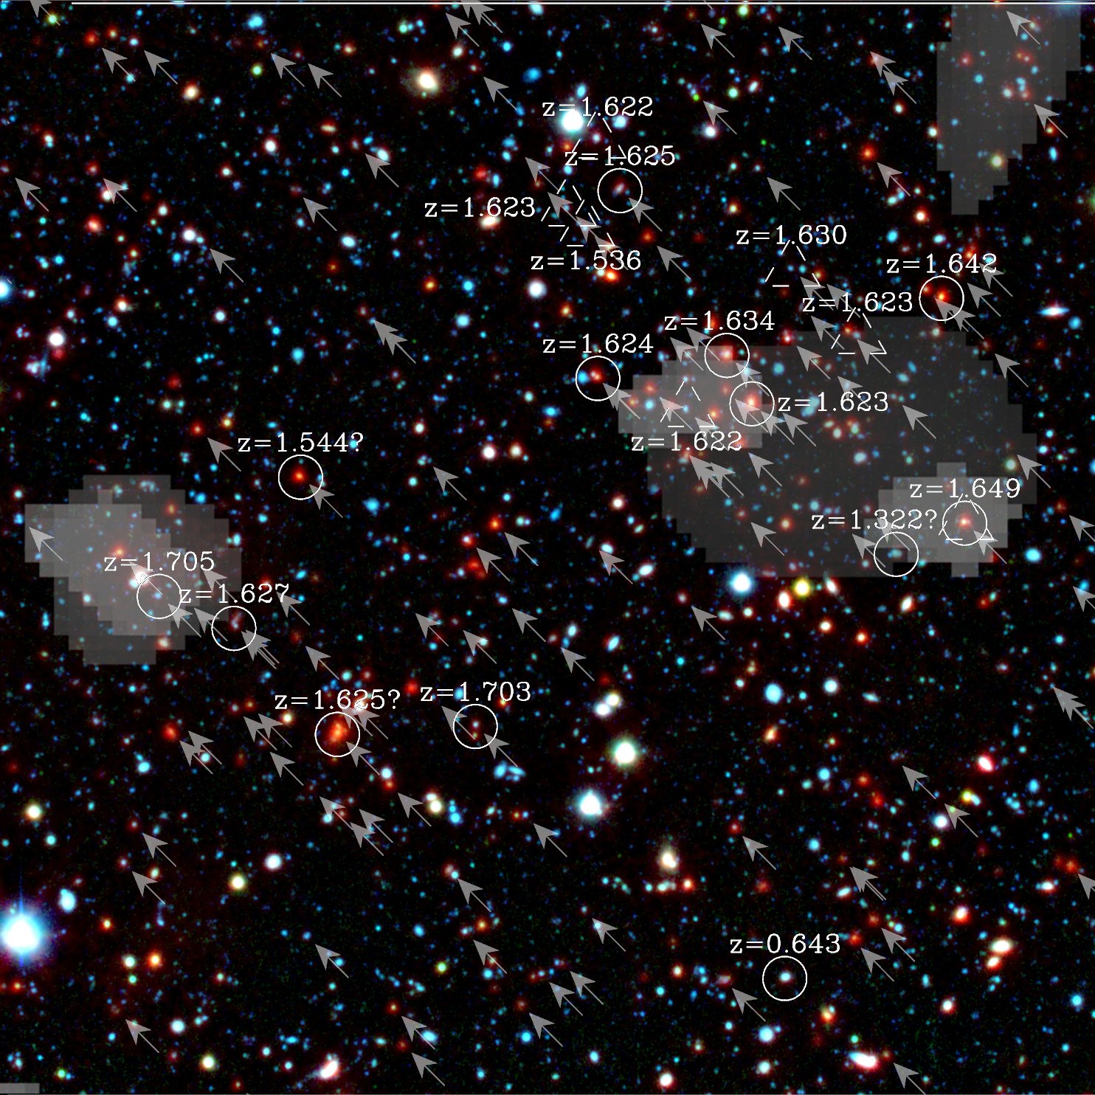
XMM-Newton surveys of X-ray galaxy groups
Alexis Finoguenov
MPE/UMBC
+
S.Giodini, V.Allevato, M. Tanaka, A. Leauthaud, O. Ilbert, N.Cappelluti, J.Silverman, K. Kovac, V.Smolcic, JP Kneib, H. McCracken, S. Lilly, N.Scoville, G.Hasinger, M. Elvis, A. Comastri, M. Cooper, J. Mulchaey, P.Nandra
+COSMOS, CDFS, DEEP2, CFHTLS teams

Slide 2
Why study galaxy groups?
Baryonic budget of the Universe
Galaxy evolution f(r,M,z)
well defined size
well defined mass
Central galaxy start to dominate the total stellar mass
Bridges between clusters and the field

Slide 3
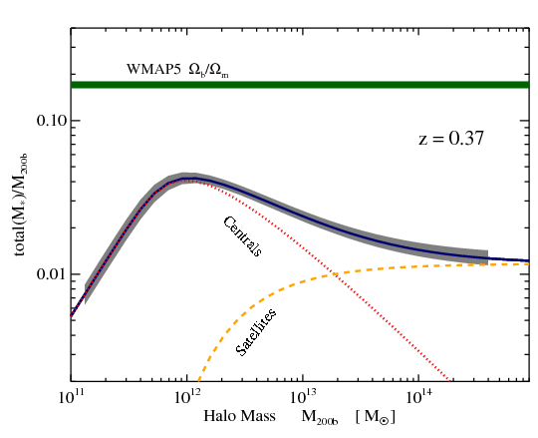
Groups and their galaxies
?

Slide 4
Contiguous X-ray cluster surveys in context
-16
l=1000
CDFS 0.3 sq.deg. 50cl
Lockman Hole, 0.3sq.deg. 30cl
CDFN 0.2deg2 30 cl
SXDF 1.1 deg2: 100 cl
-15
XMM-COSMOS 2deg2: 300cl
Flux 0.5-2 keV (cgs)
DEEP2 2.6 sq.degs
20 deg2 XMM-LSS (Pierre’ 04) 600 cl
SZ-CA (Boehringer’07)
-14
-13
100 deg: XMM-CFHTLS: 60 massive clusters
Area

Slide 5
Groups are not scaled down clusters!
Quenched galaxies
Mass=>feedback (AGN) quenching
Field: mainly dwarf galaxies are quenched by environment
Both components are seen in 3.e13 groups
Clusters are dominated by environmental quenching

Slide 6
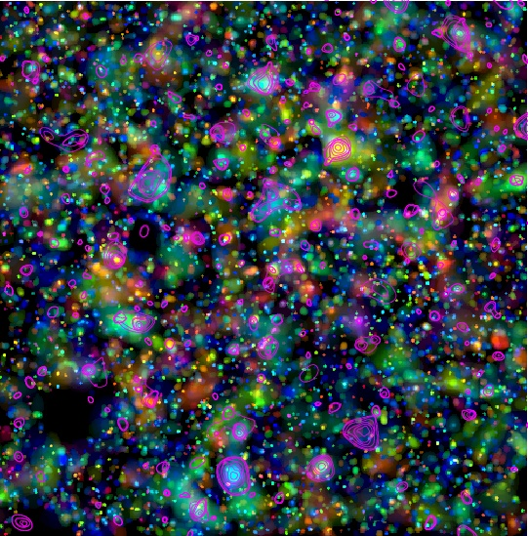
COSMOS
Mass calibration
Variety of groups
Galaxy properties:
stellar mass
SFR
AGN
Morphology
LSS
l=3000
Photoz
z=0.8
z=0.6
z=0.4
z=0.2
IAB<25
1.4Mio
galaxies
X-ray
contours

Slide 7
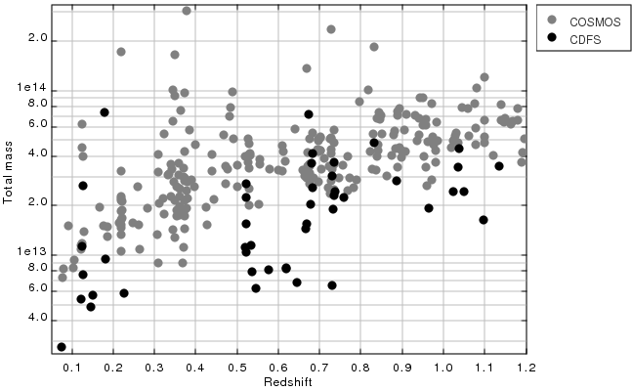
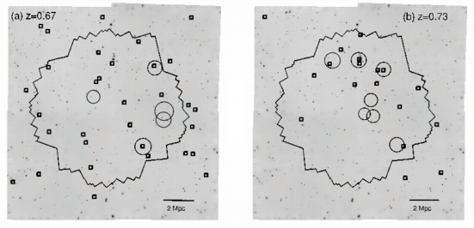
Groups and LSS
zCOSMOS groups
K.Kovac

Slide 8
Lx-Mass from weak lensing
lgM=0.6lgLx+C

Slide 9
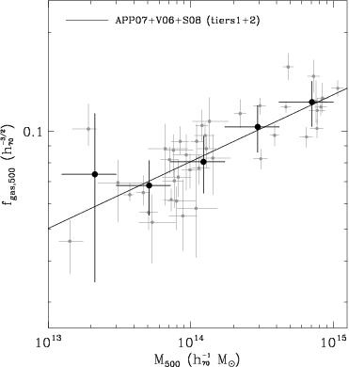
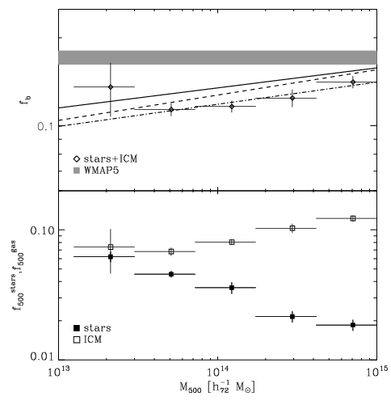
Stellar content of galaxy groups
Less gas
More stars

Slide 10
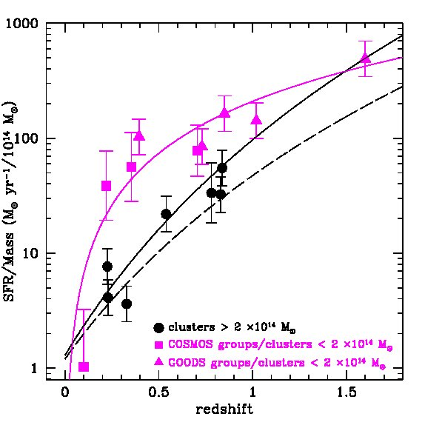
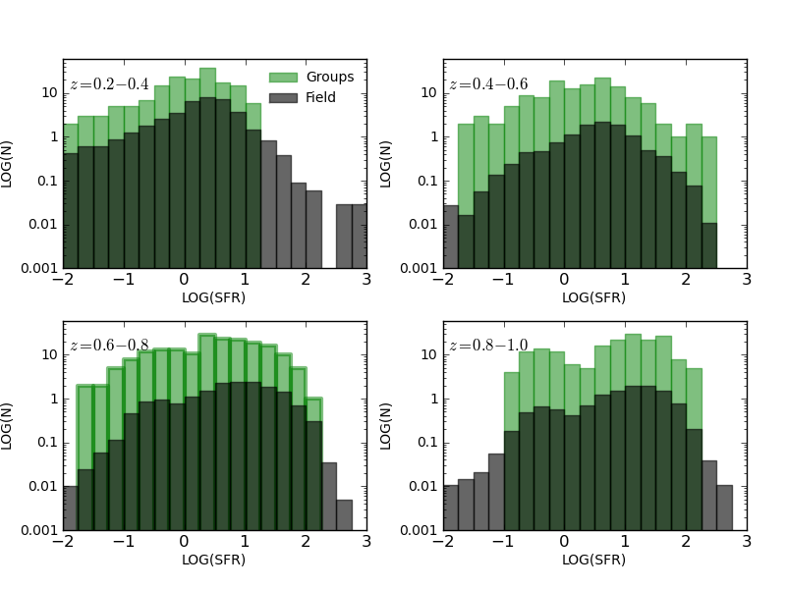
SFR
Herschel
results

Slide 11
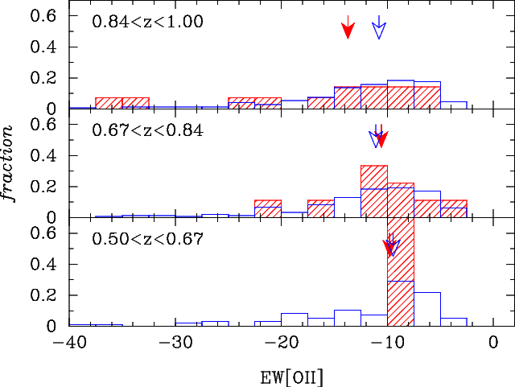
Increased red [OII] emitters in groups at high redshifts
groups
field
Not only the fraction, but the strengths of [OII] increases as well.
Based on the 30-band photometry (NUV-r from Ilbert et al. 2010), we find these red [OII] emitters are not undergoing active star formation. The [OII] emission is likely due to AGNs.
Tanaka, AF, et al. submitted .

Slide 12
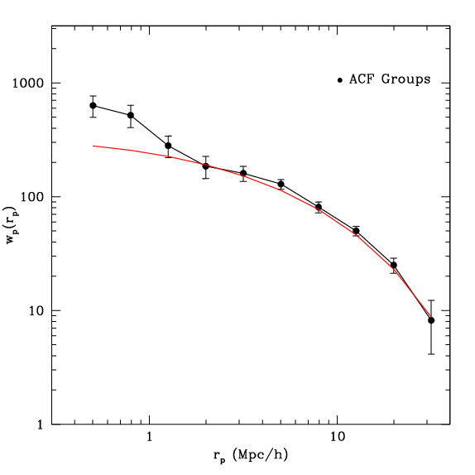
Resolving LSS with X-ray groups

Slide 13
Radio AGN HOD: marked mass function

Slide 14
Next steps: z~1 – DEEP2
Erfanianfar, AF, in prep.

Slide 15
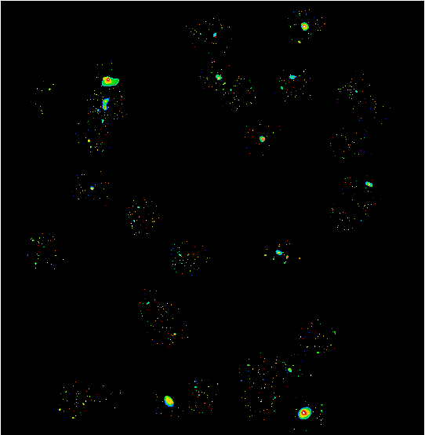
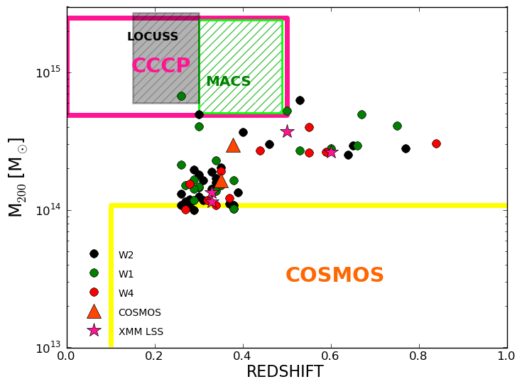
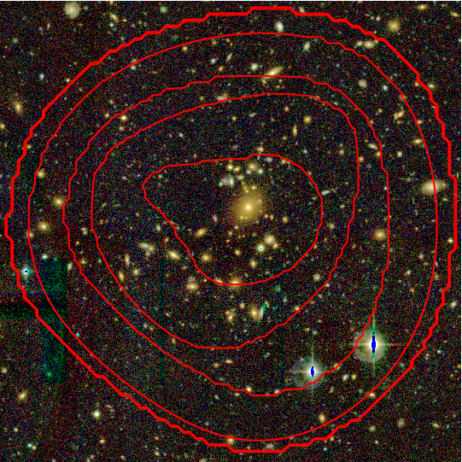
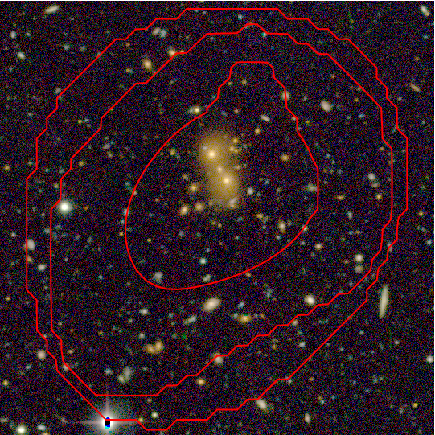
CFHTLS
Lerchster, …, AF et al. 2011;
Mirkazemi, AF, et al. in prep.

Slide 16
Summary
Survey of groups explore parameter space opened by both X-ray observations and the multiwavelength data
Contrary to cosmology goals, in group studies the least massive group is the most treasured
Unprecedented XMM coverage of COSMOS and CDFS enabled the study of barionic budget of groups and environmental dependence of SFR to a z~1
Extension of those surveys towards higher-z (DEEP2) and higher mass (CFHTLS) have been achieved
Near future of group research is associated with Ultra-VISTA and CANDELS datasets

Slide 17
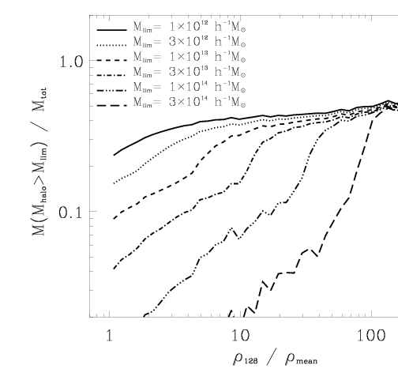
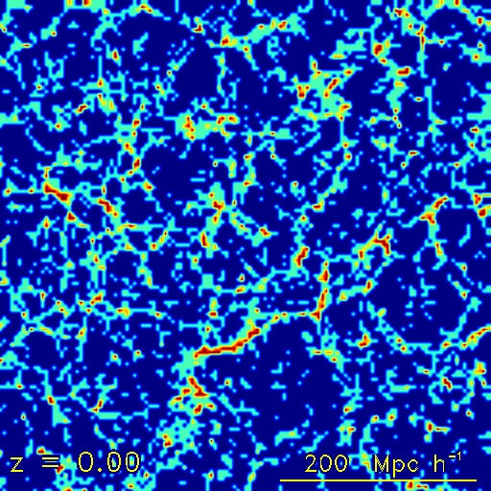
Simulations…
Fraction of matter resolved in groups
A. Faltenbacher, AF, N. Drory 2010 ApJ

Slide 18
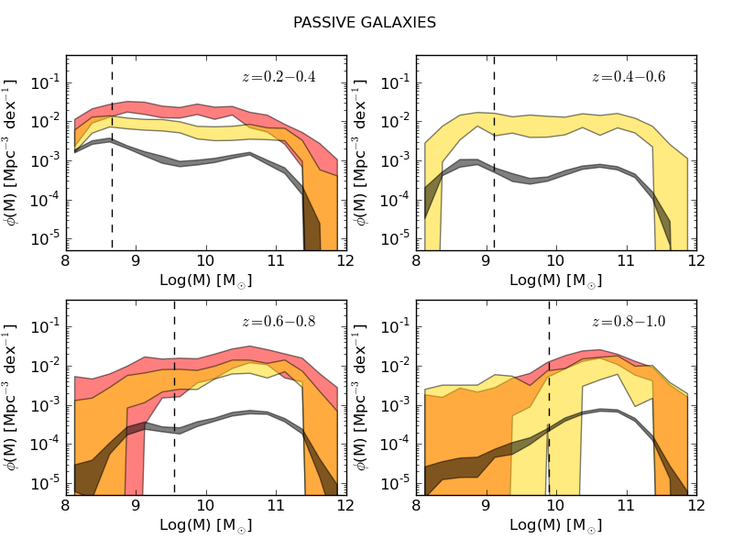
GSMF – active vs passive

