Slide 1
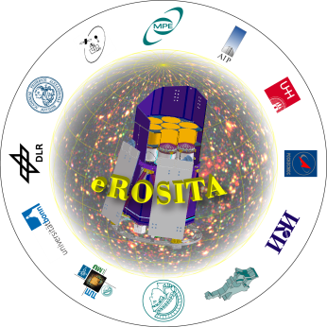
eROSITA
Mirror Module Development
Design
Manufacturing
Recent X-Ray tests
Status
Vadim Burwitz, Peter Friedrich on behalf of the eROSITA team

Slide 2
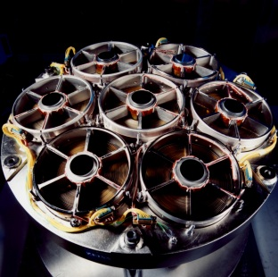
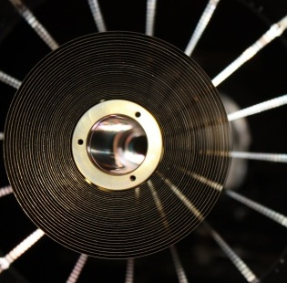
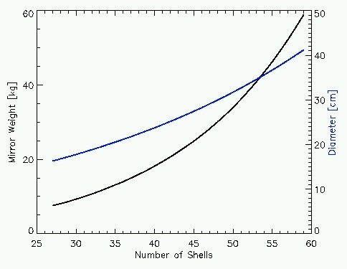
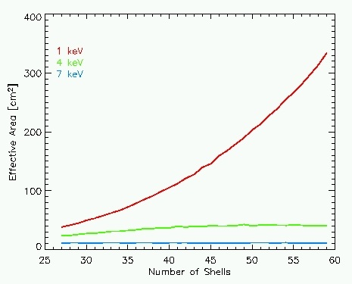
Mirror Design
From ABRIXAS (ROSITA, DUO) to eROSITA
ABRIXAS
eROSITA
ABRIXAS
eROSITA
Diameter
1 keV
Weight
4 keV
7 keV
Number of mirror shells
Number of mirror shells
Weight and diameter of the mirror system depending on the number of mirror shells
Effective area of the mirror system for different energies depending on the number of mirror shells

Slide 3
Mirror Design
From ABRIXAS (ROSITA, DUO) to eROSITA
Much larger collecting area (factor 5 at low energies)
Better on-axis angular resolution (15″ on-axis)
Larger field-of-view (61′ Ø)

Slide 4
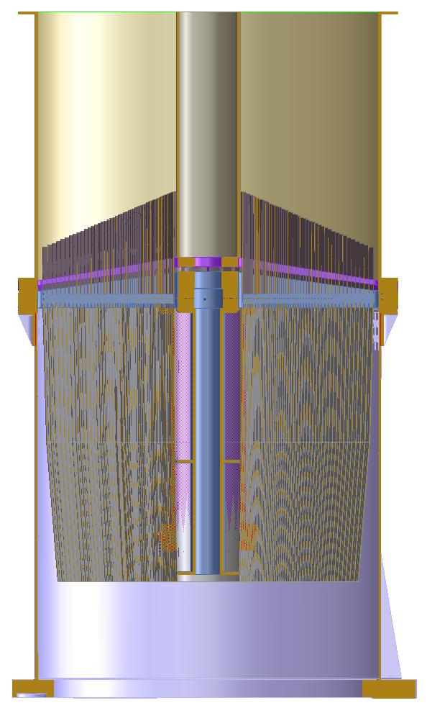
Mirror Design
Basic Data of the eROSITA Telescope
Mirror Type Wolter 1
Number of mirror modules 7
Orientation of mirror modules parallel
Degree of nesting 54
Focal length 1600 mm
Largest mirror diameter 365 mm
Smallest mirror diameter 76 mm
Micro-roughness <0.5 nm
Energy range ~0.2 – 10 keV
Coating Gold (> 50 nm)
Field-of-view 61’ ∅
Notes:
Basic data of the x-ray optics

Slide 5
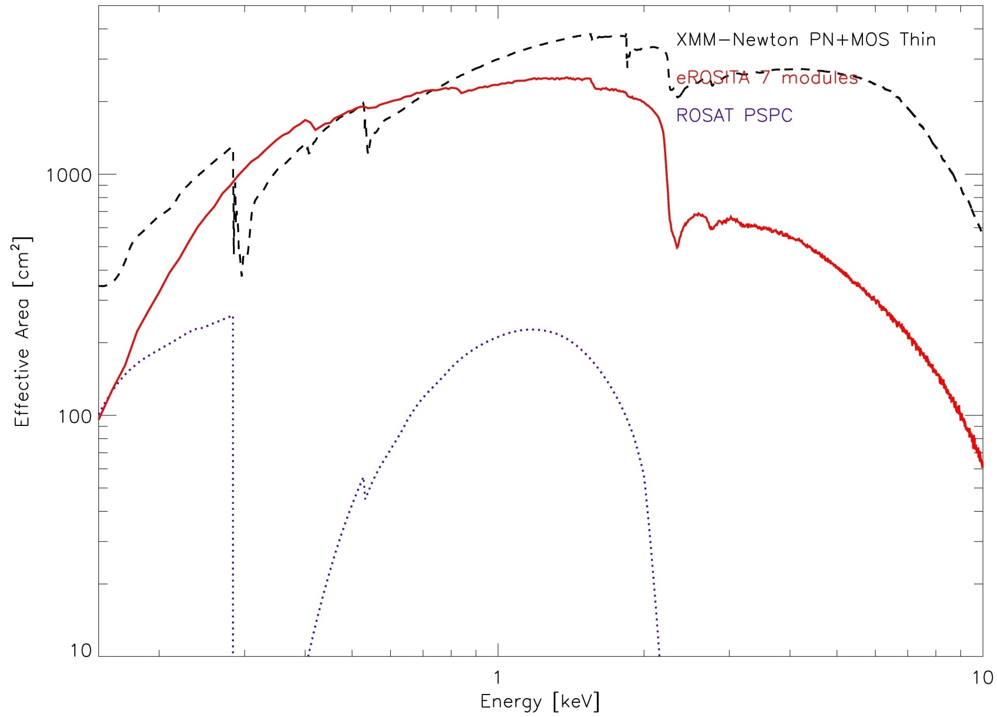
Comparison with XMM and ROSAT
On-axis effective area

Slide 6
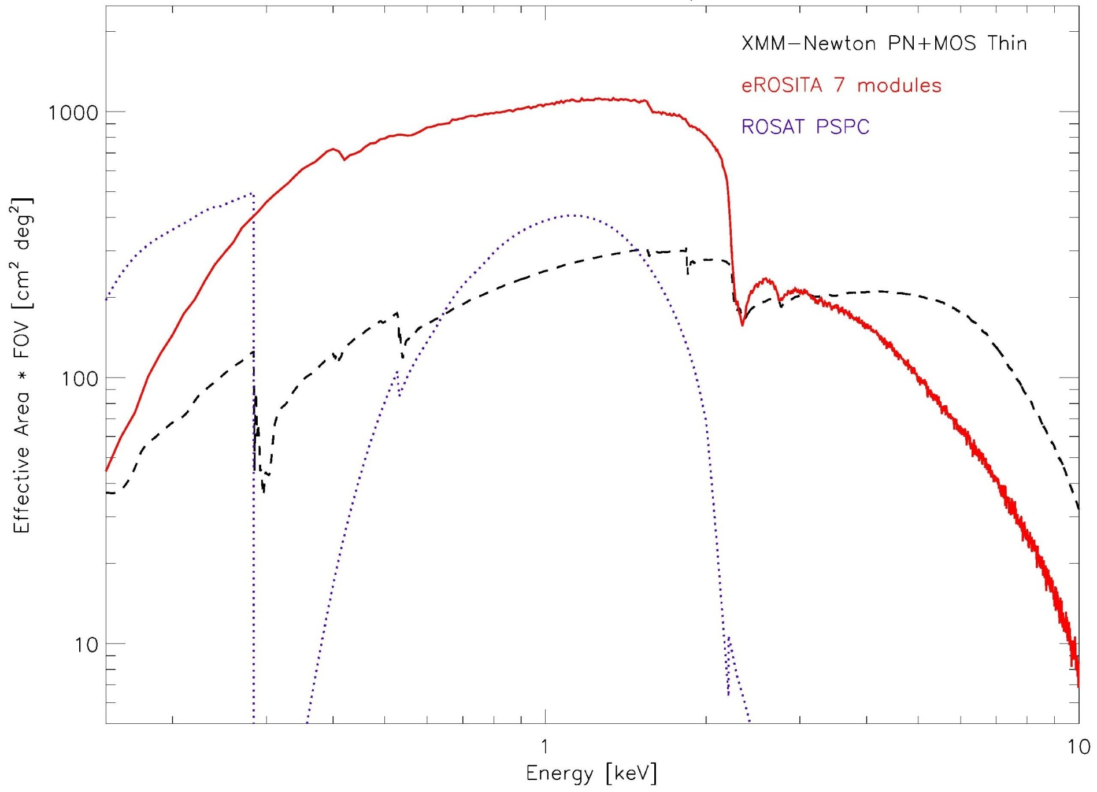
Comparison with XMM and ROSAT
Grasp: effective area × field-of-view

Slide 7
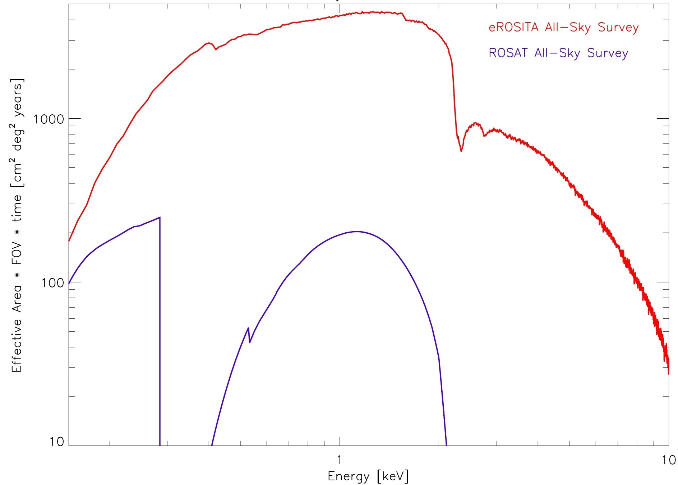
Comparison with ROSAT
Survey efficiency: effective area × field-of-view × survey duration

Slide 8
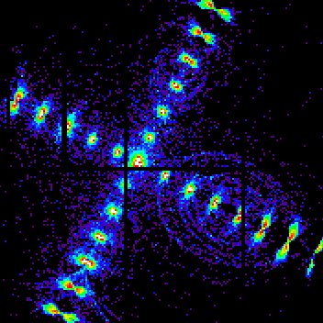
Point Spread Function (PSF)
61’
eROSITA design (calc.)
from ABRIXAS test
Notes:
Point spread function

Slide 9
Vignetting Function
FoV

Slide 10
Point Spread Function (PSF)
Angular Resolution Error Budget Summary
On-Axis PSF: 15’’ HEW
Average PSF over the 61’ FOV: 26’’ HEW
Angular resolution of the survey: ~30’’ HEW
mirror system
15’’ → detector, structure, attitude

Slide 11
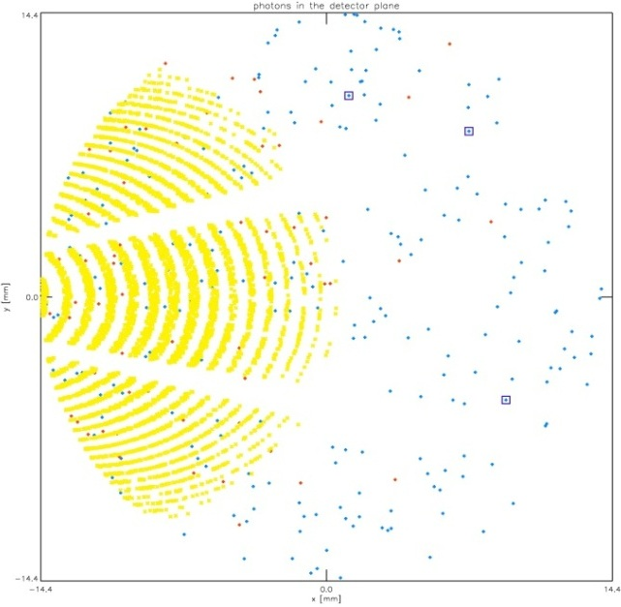
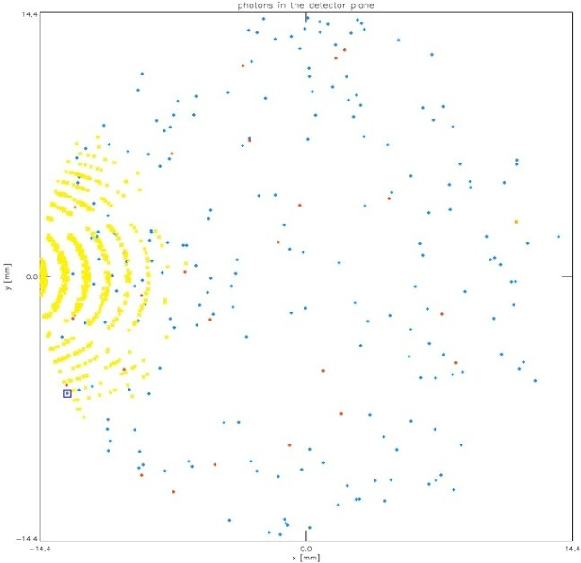
X-Ray Baffle against Straylight
without baffle
source 1° off-axis
with baffle

Slide 12
X-Ray Baffle against Straylight
System of 54 cylindrical shells
  height outer 50 mm, height inner 110 mm, wall thickness 125 µm
Straylight reduction from ~30% to ~1.5% @1keV (~43% to ~4% @4keV)
mounted on spider wheel on top of mirror module
QM ready and under test

Slide 13
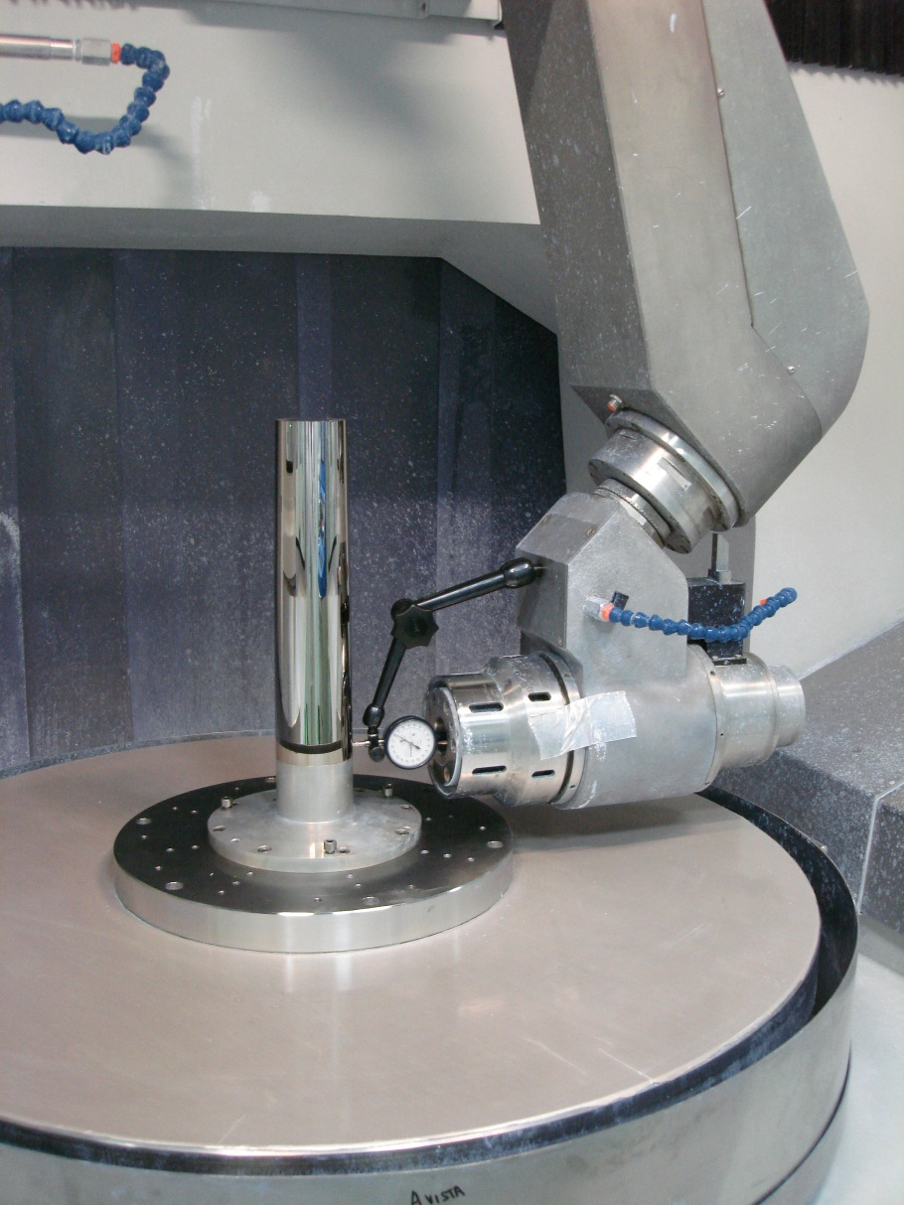
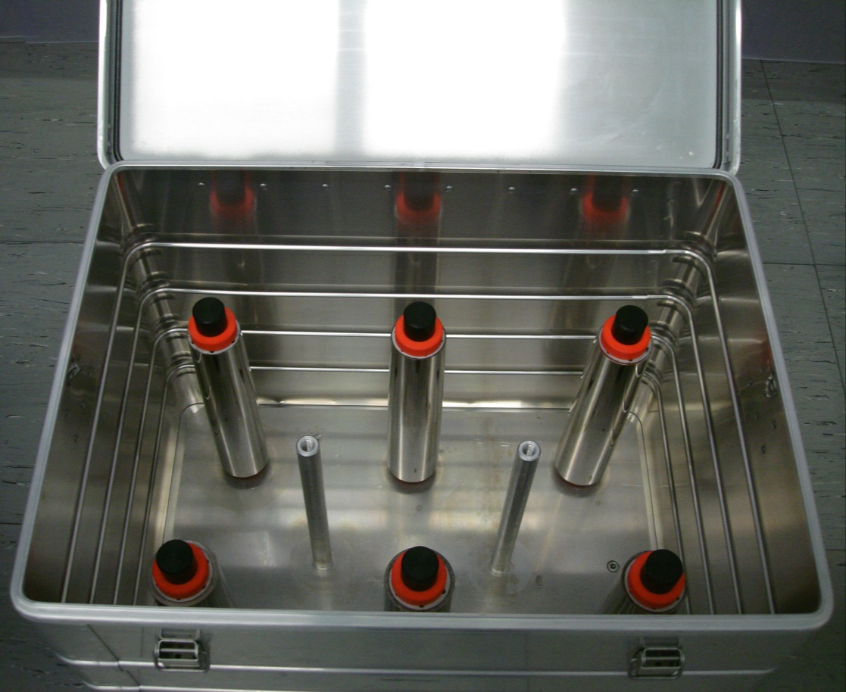

Mandrels
Refurbished ABRIXAS mandrels
Polishing of new mandrels

Slide 14
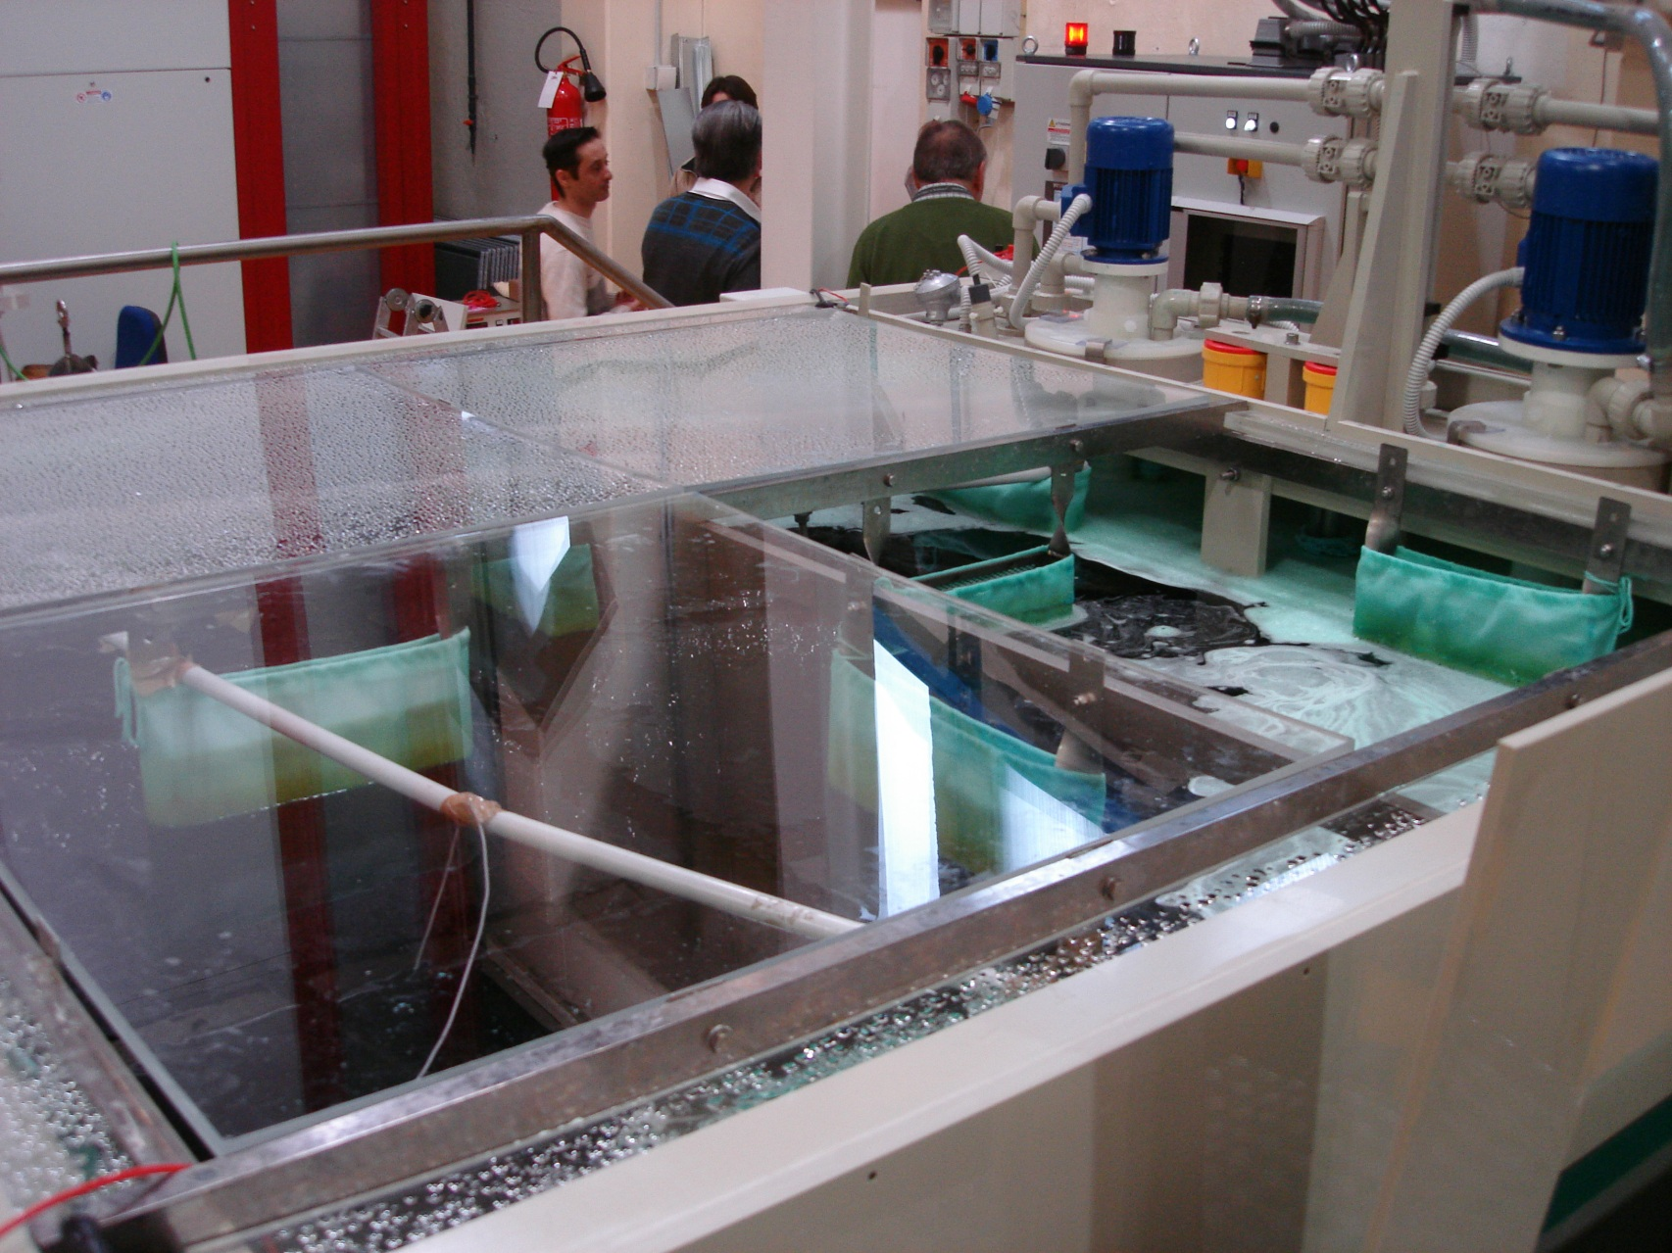
Electroforming Baths

Slide 15
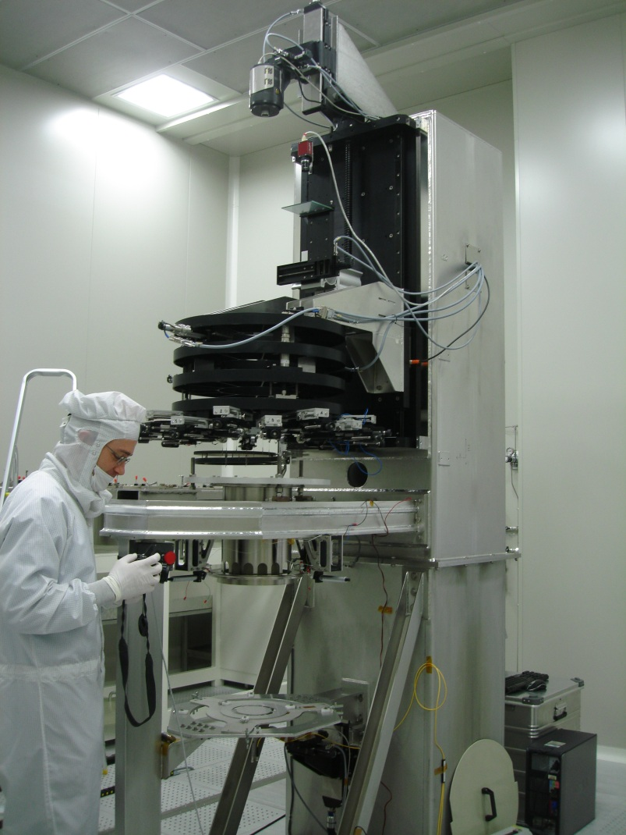
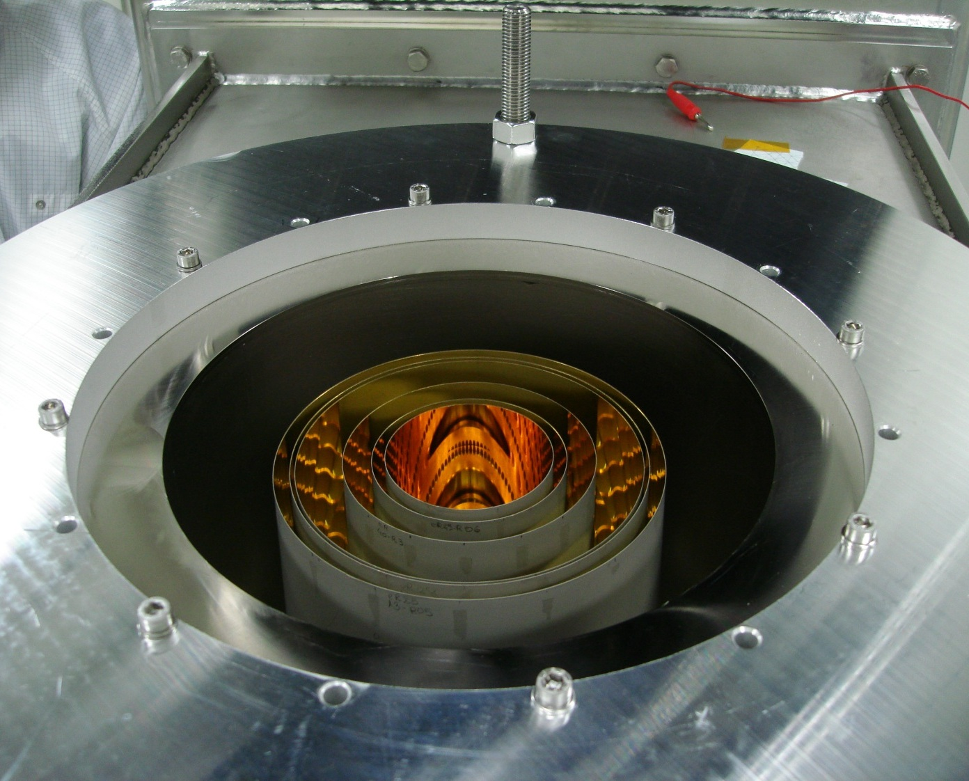
Vertical Optical Bench
(mirror integration facility)

Slide 16
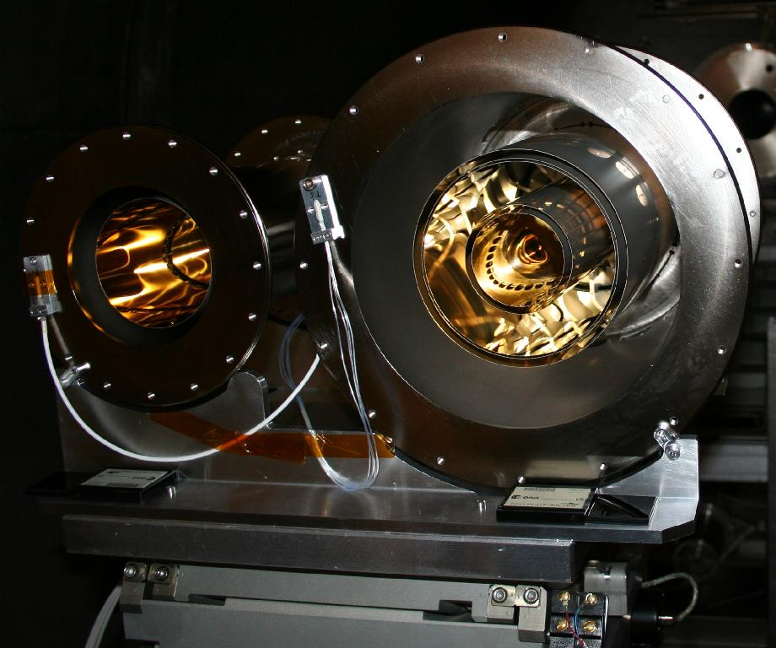
Test Mirrors

Slide 17
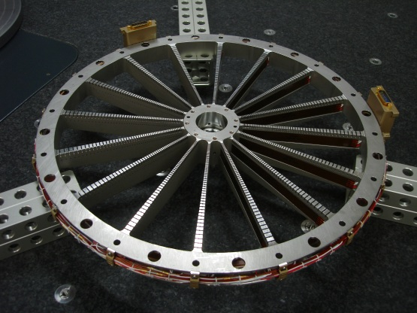
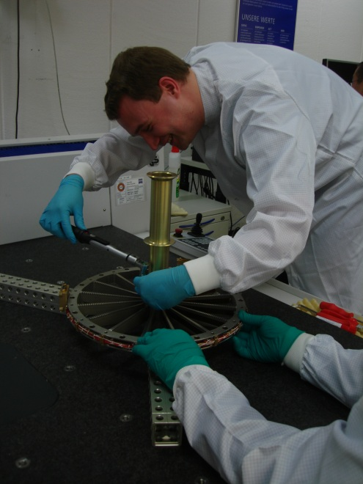
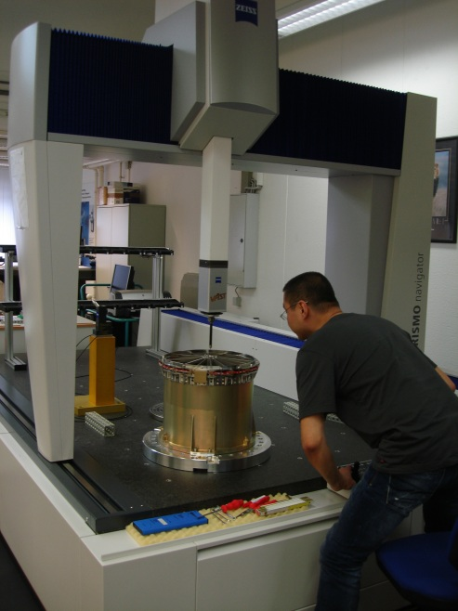
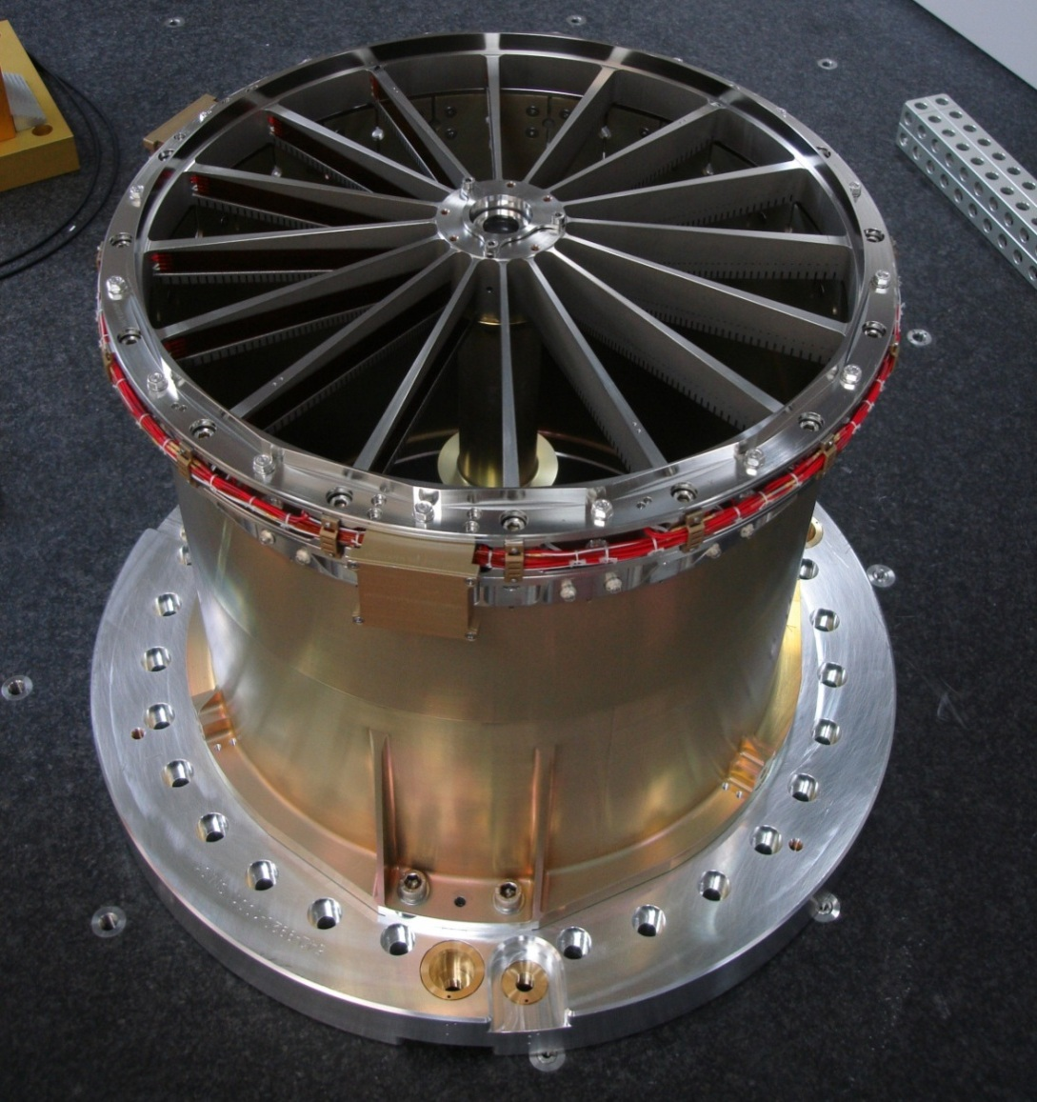
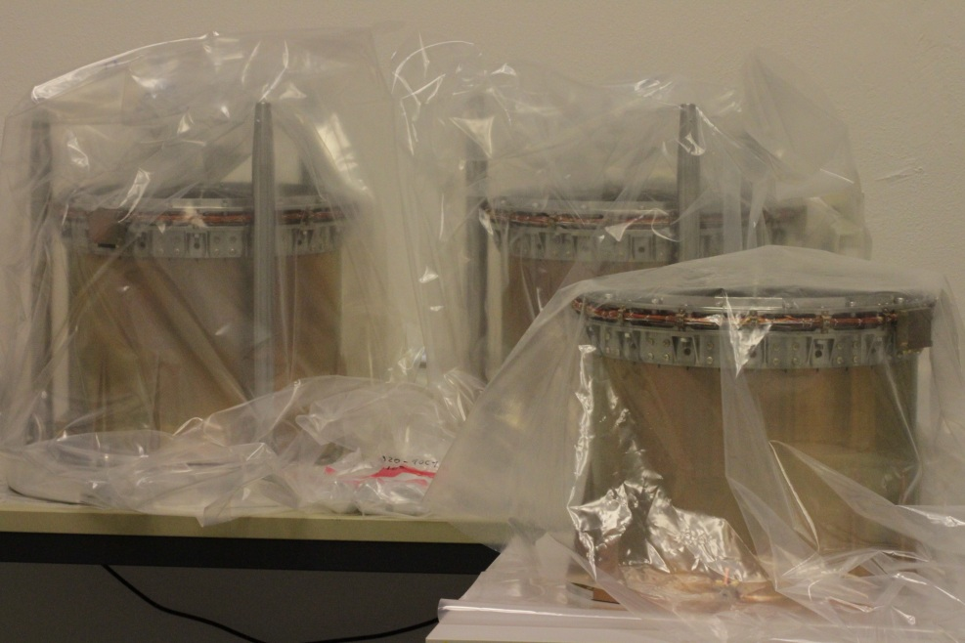

Mirror Module Structure

Slide 18
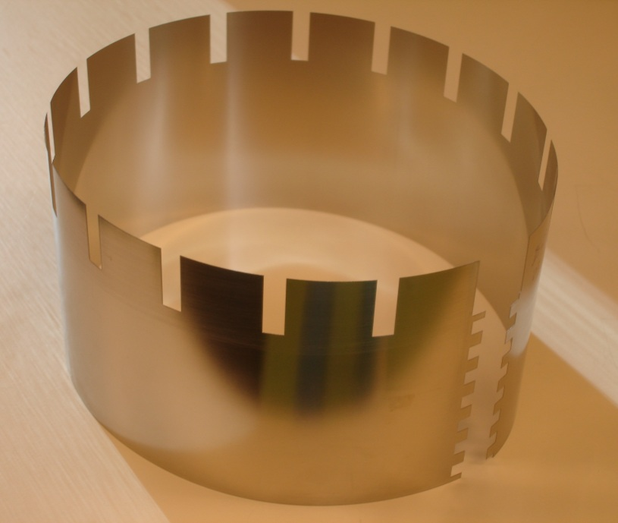
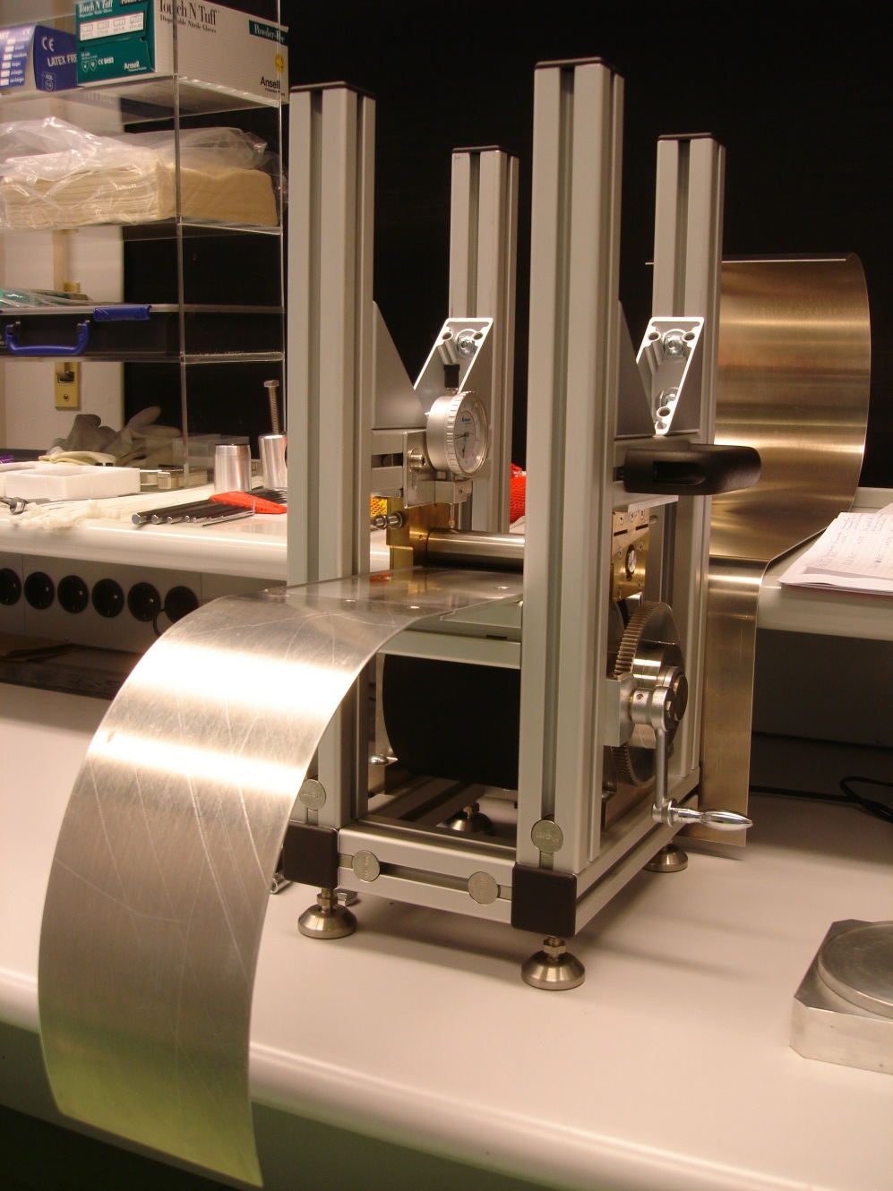
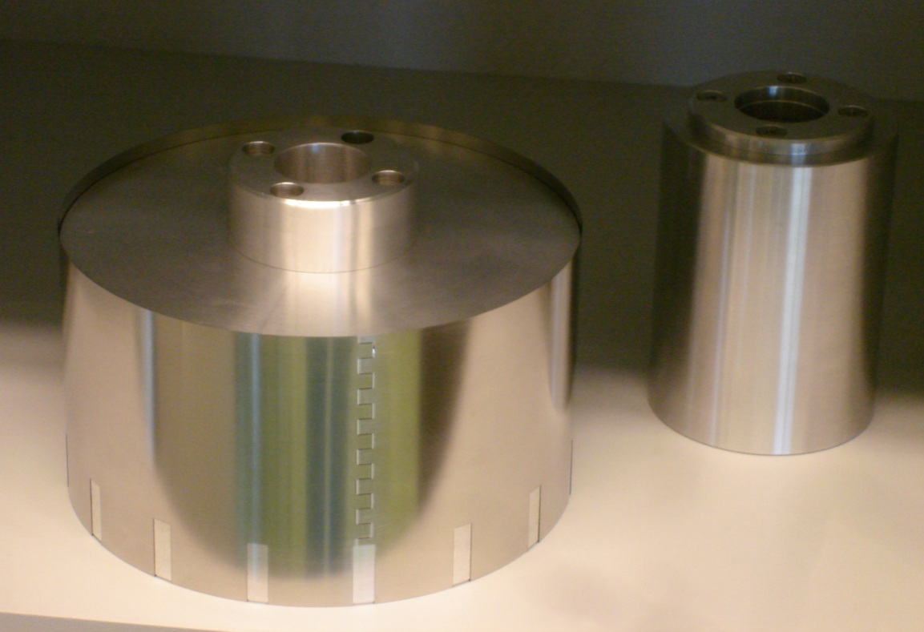

X-Ray Baffle

Slide 19
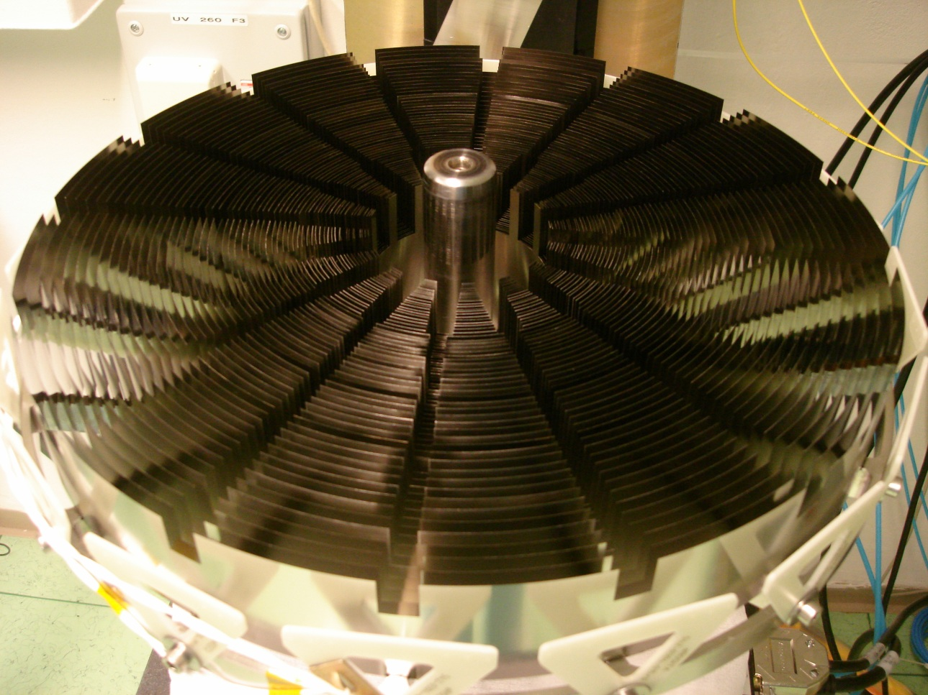
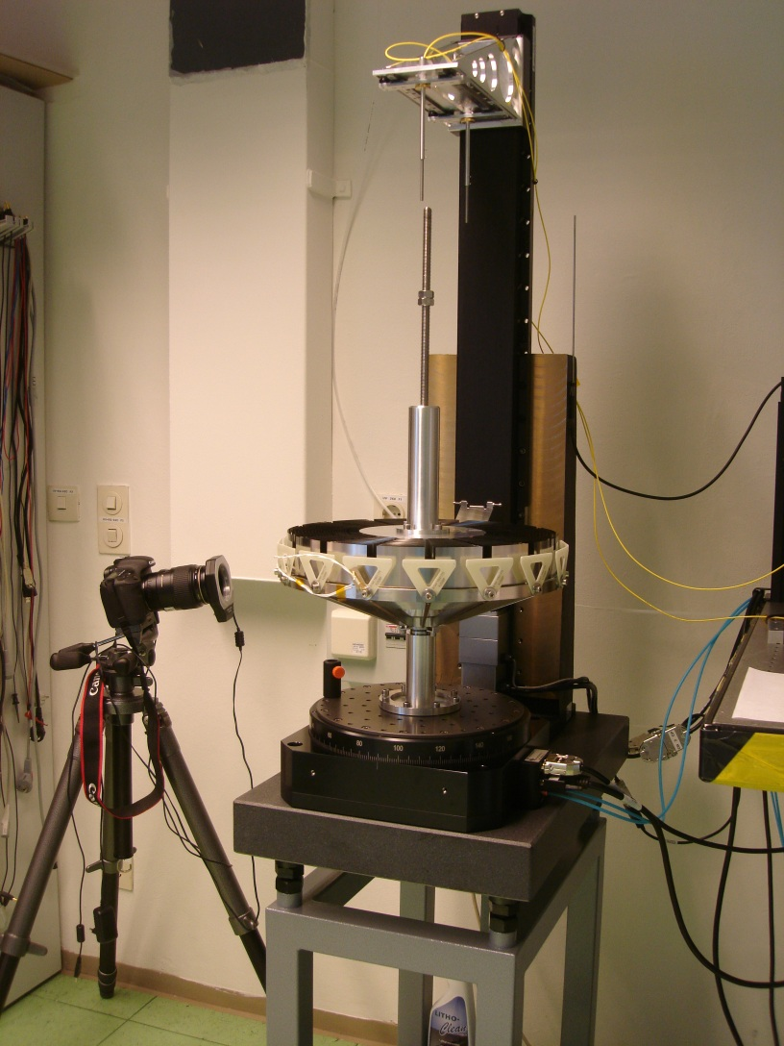
X-Ray Baffle
X-ray baffle QM
Rotation table for Integration

Slide 20
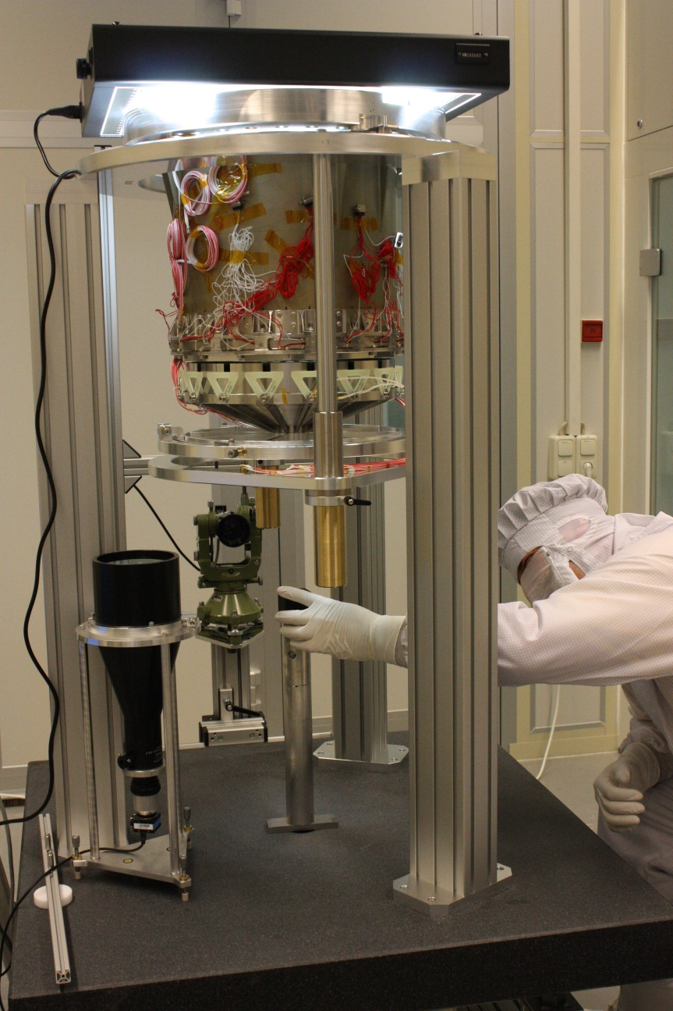
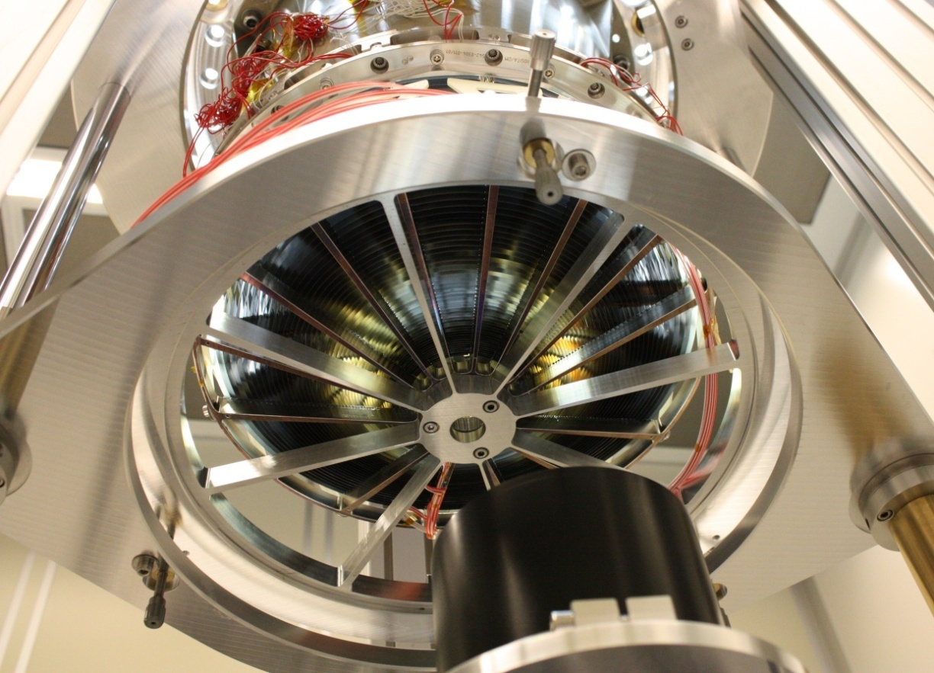
X-Ray Baffle
…under optical control
alignment to MM…

Slide 21
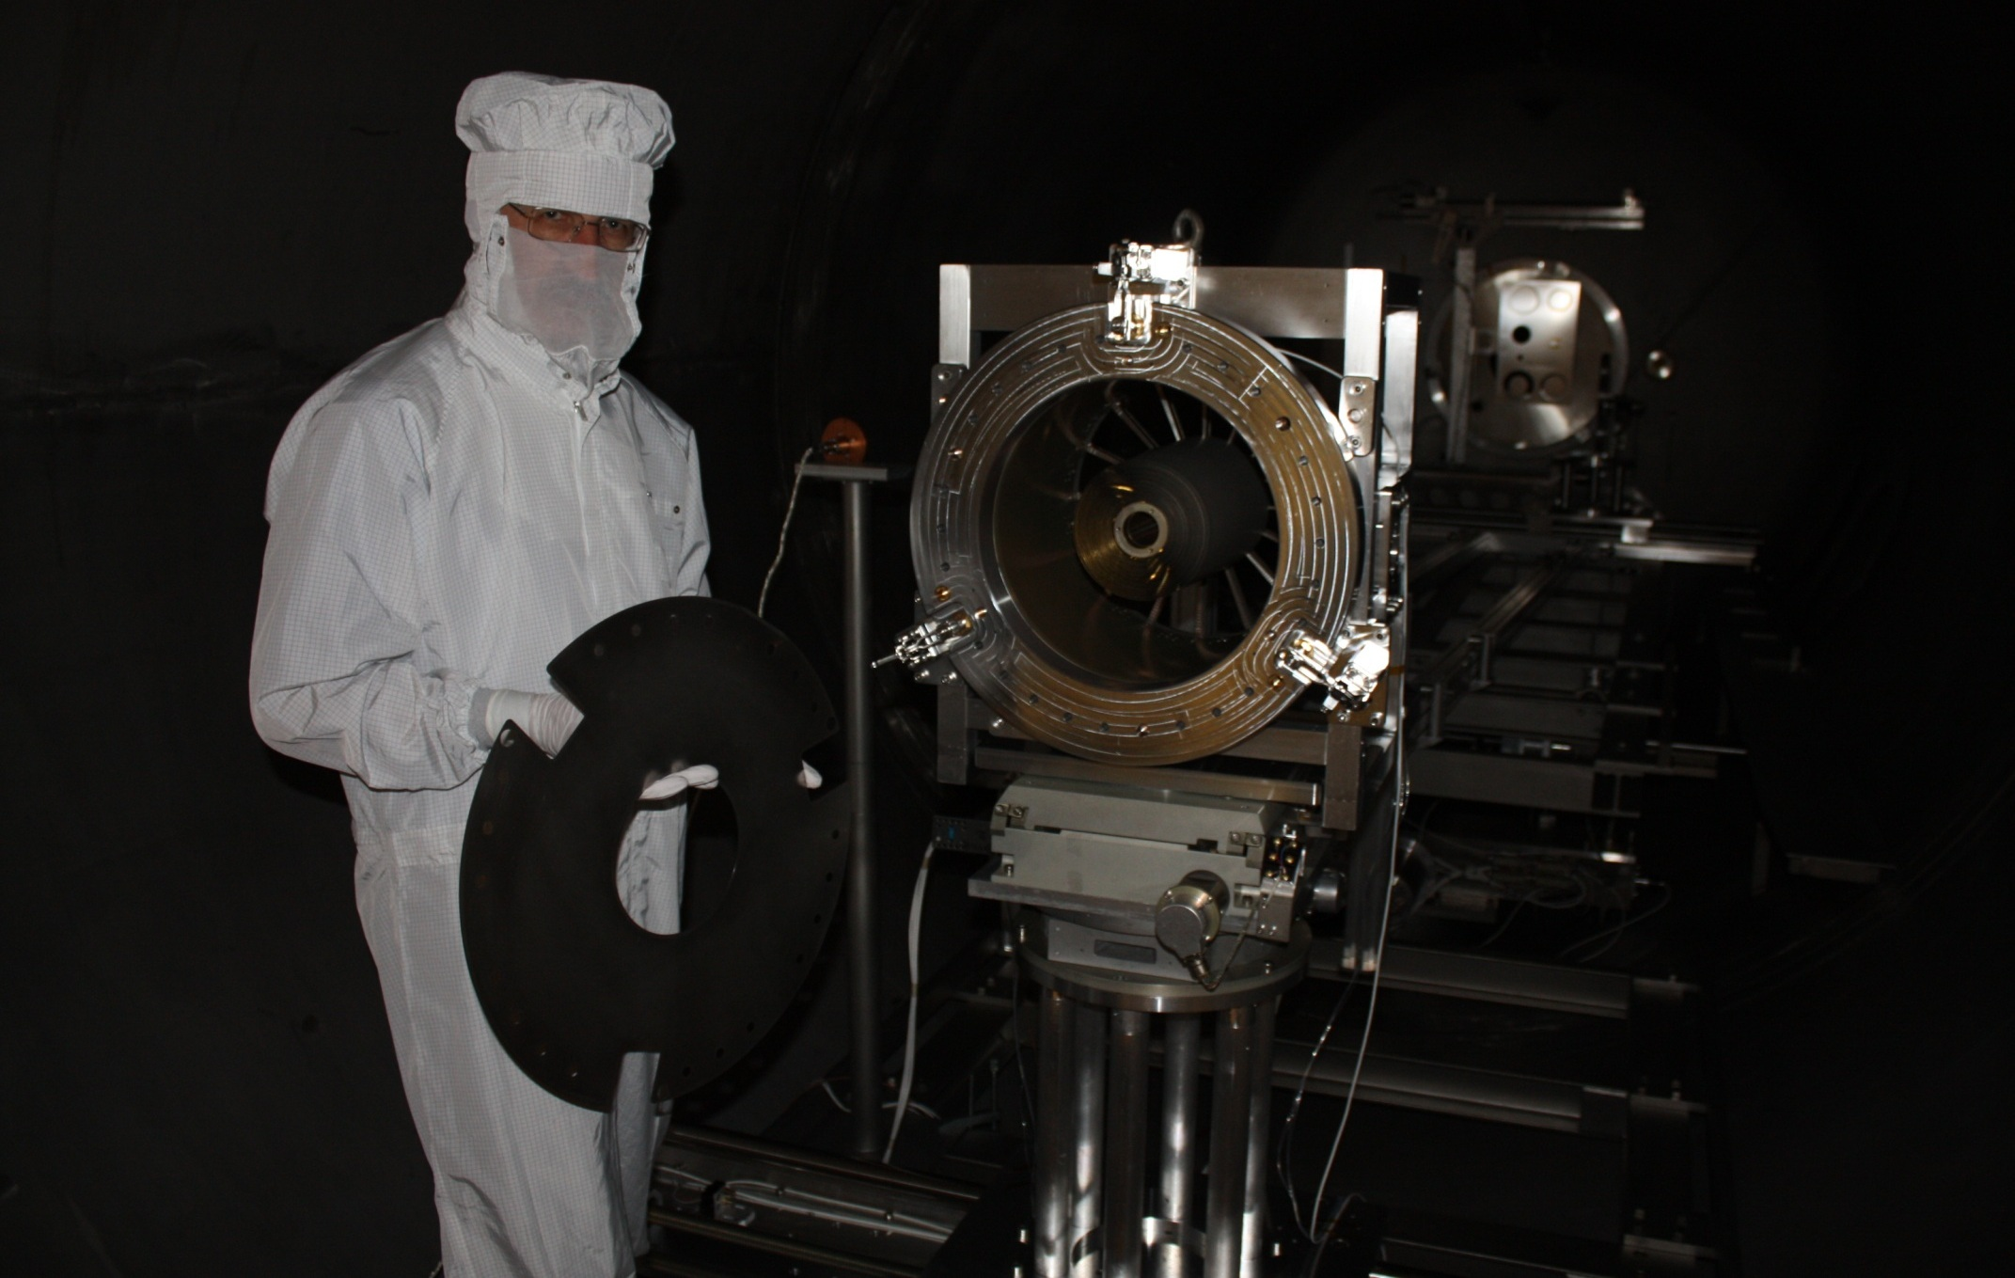
X-Ray Test Facility PANTER

Slide 22
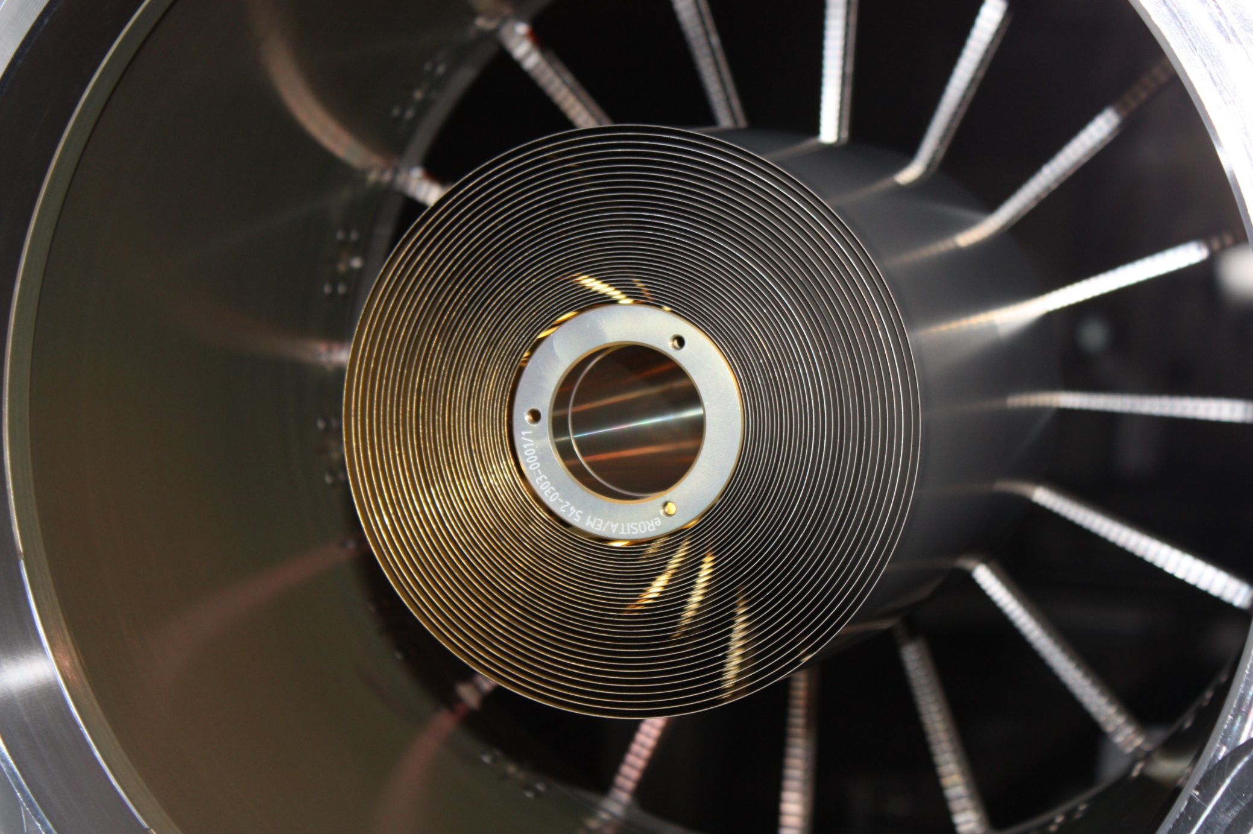
FM1 with 31 shells in X-Ray Test

Slide 23
PSF of FM1 with 31 shells
MM and Mirror Groups
Target | Energy | PSF |  |  | Date
 |  | HEW* | W90 | scattering
C-K | 0.28 keV |  |  |  | 8th June 2011
Al-K | 1.49 keV | 16.0 arcsec | 74.3 arcsec | 5.1% | 6th June 2011
Ag-L | 2.98 keV | 16.3 arcsec | 92.8 arcsec | 6.9% | 8th June 2011
Cr-K | 5.41 keV | 17.0 arcsec | 130.3 arcsec | 9.5% | 10th June 2011
Cu-K | 8.04 keV | 15.6 arcsec | 140.9 arcsec | 11.8% | 8th June 2011
Group | Energy | PSF |  |  | Date
 |  | HEW* | W90 | scattering
Shells 40-54 | 1.49 keV | 13.8 arcsec | 43.5 arcsec | 2.5% | 7th June 2011
Shells 24-39 | 1.49 keV | 17.8 arcsec | 94.6 arcsec | 5.2% | 7th June 2011
Shells 34-39 | 1.49 keV | 19.5 arcsec | 101.6 arcsec | 9.0% | 9th June 2011
Shells 28-33 | 1.49 keV | 17.3 arcsec | 100.6 arcsec | 8.4% | 10th June 2011
Shells 24-27 | 1.49 keV | 16.5 arcsec | 84.5 arcsec | 3.2% | 7th June 2011
Shells 24-27 | 5.41 keV | 20.9 arcsec | 186.7 arcsec | 14.3% | 10th June 2011
*HEW determined by using the sub-pixel resolution which is based on the detailed analysis of split events; the effective resolution from this method is approximately 5 arcsec.

Slide 24
Spatial Resolution (HEW)
for comparison:
(from Friedrich et al. SPIE 1998)
Goal: 42’’ HEW on-axis
Basic goal: 60’’ HEW in the survey (integration over all off-axis angles)

Slide 25
Eff. Area of FM1 with 31 shells
MM and Mirror Groups
Target | Energy | Effective Area |  |  | Date
 |  | measured | calculated | loss / win
C-K | 0.28 keV | 113.299 cm² | 119.89 cm² | -5.5% | 8th June 2011
Al-K | 1.49 keV | 106.770 cm² | 118.38 cm² | -9.8% | 6th June 2011
Cr-K | 5.41 keV | 57.714 cm² | 63.69 cm² | -9.4% | 8th June 2011
Cu-K | 8.04 keV | 24.350 cm² | 28.84 cm² | -15.6% | 8th June 2011
Group | Energy | Effective Area |  |  | Date
 |  | measured | calculated | loss / win
Group 40-54 | 1.49 keV | 28.322 cm² | 34.29 cm² | -17.4% | 6th June 2011
Group 24-39 | 1.49 keV | 79.655 cm² | 84.09 cm² | -5.3% | 6th June 2011
Group 34-39 | 1.49 keV | 21.876 cm² | 23.83 cm² | -8.2% | 6th June 2011
Group 28-33 | 1.49 keV | 30.594 cm² | 32.45 cm² | -5.7% | 6th June 2011
Group 24-27 | 1.49 keV | 26.004 cm² | 27.81 cm² | -6.5% | 6th June 2011

Slide 26
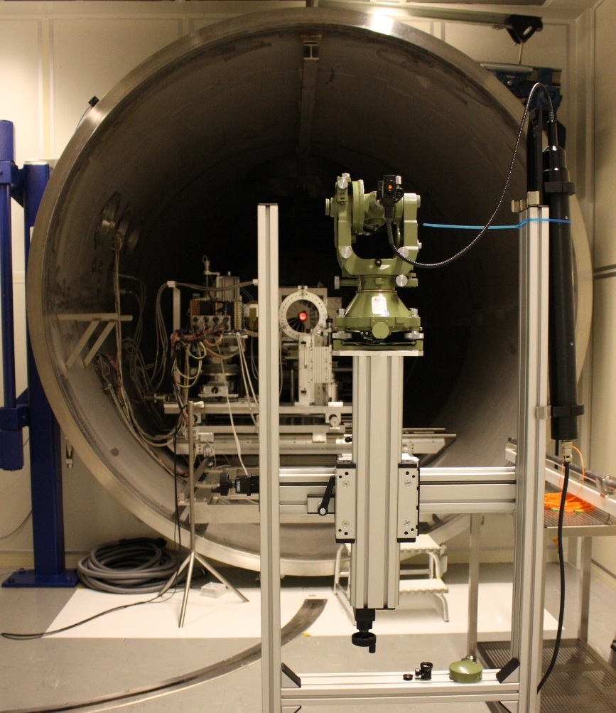
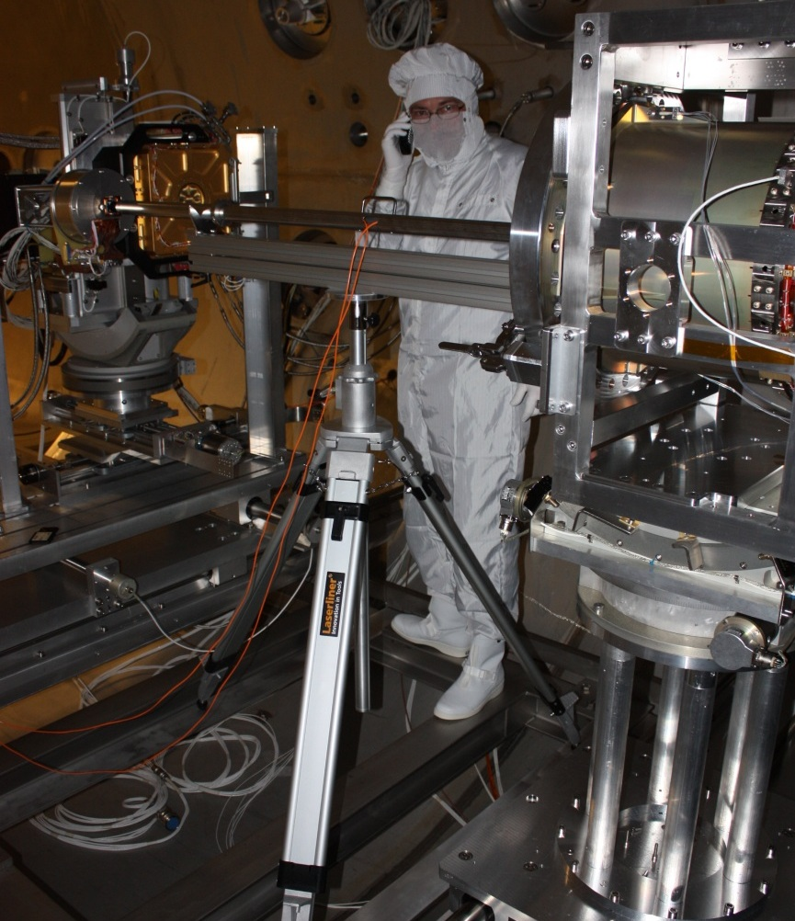
Optical Axis Alignment and Focus
The X-ray optical axis is defined by the HEW minimum of a PSF cross-scan.
The alignment of the X-ray optical axis is measured with respect to the reference mirror; accuracy ≈ 10″.
The focal length is measured with a mechanical-optical gauge giving the distance between the in-focus position of the detector and the reference mirror in the MM; accuracy ≤ 0.1 mm.

Slide 27
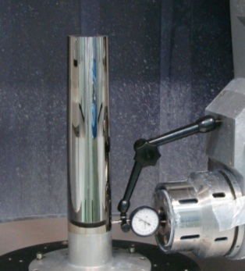
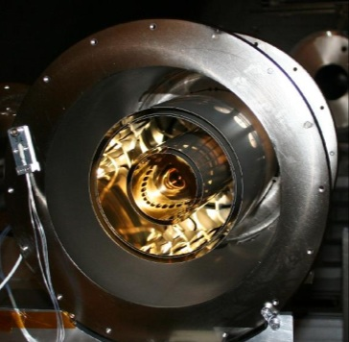

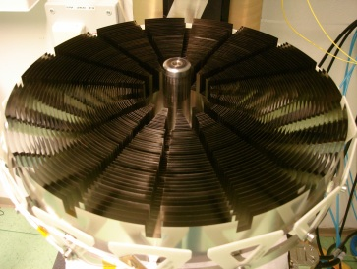
Status Summary
Mandrels:
27 refurbished ABRIXAS mandrels available
11 new mandrels completed, other 16 in progress
(Completed MLT Mandrels 1,12,17,18, 20, 22, 23, 24, 25, 26, 27, Zeiss refurbished 28-54)
Mirror Module DM and Test Mirrors:
DM (3 real mirror shells + 24 dummy shells) X-ray tested before and after vibration / thermal cycling
4 “multi-shell drums” with 5 or 6 mirror shells tested:
HEW 14.8”, 20.8”, 22.8”, 16.1” (corrected for pixel resolution)
alignment contribution: 2.9”, 7.8”, 11.3”, 3.8”
Mirror Module FMs:
all 8 FM structures (1 spare) ready for mirror integration
integration of FM 1 and FM 2 have been started
X-rays test of partially integrated FMs (15/31 shells) are successfully done; no significant alignment contribution
X-ray Baffle:
QM has been built (improvements for FM identified)
successful integration to mirror module DM, first X-ray test
now vibration test and thermal vacuum test

