Slide 1
[Ne V]-selected heavily obscured AGN
at the epoch of the X-ray background
R. Gilli
M. Mignoli
C. Vignali
A. Comastri
G. Zamorani
K. Iwasawa

Slide 2
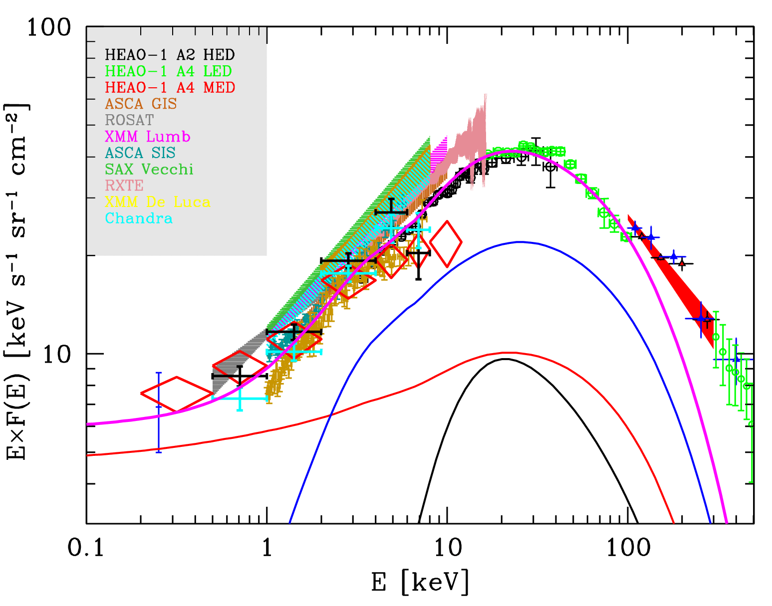
Compton-thick AGN and the missing XRB
classic argument: distant C-thick AGN needed to explain from
~10 to 30% of the 20 keV
(Comastri+95, Gilli+07, Ballantyne+06, Treister+09)
Their XLF and evolution essentially
unknown: often assumed to be
the same of less obscured AGN
thin
thick
unobscured

Slide 3
When was the missing XRB emitted?
Predicted peak
at z~0.7-0.8

Slide 4
The multi-λ search for C-thick AGN
Heavily obscured accretion mostly unconstrained beyond the local Universe
Selection techniques:
Hard (>10 keV) X-ray surveys (peak of X-ray spectrum)
INTEGRAL/Swift, limited sensitivity → only local Universe
Deep X-ray surveys: X-ray reflected emission / flat spectra
(e.g. CDFS-CDFN: Tozzi +06, Georgantopoulos +07,09)
IR-surveys: reprocessed emission, heated dust
(Polletta +06, Daddi+07; Fiore+08, Alexander+08, Bauer+09, Luo+11)
Spectroscopic surveys: high-ionization emission lines like
[OIII]5007 (Maiolino +98, Risaliti +99, Zakamska +03, Vignali +06,09, +many others)
[OIV]26um (Spitzer/IRS, local Universe; Diamond-Stanic +09, Rigby +09)
[NeV]3426 (this talk)

Slide 5
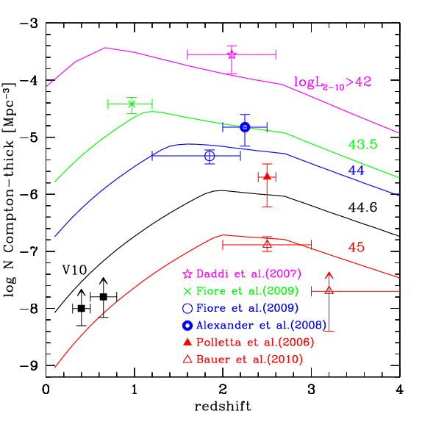
Space density of C-thick AGN
Adapted from Vignali+10

Slide 6
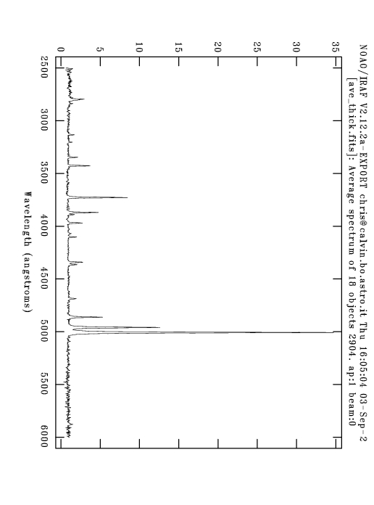
Spectroscopic surveys: [O III]5007 is standard to select obscured AGN
Composite spectrum of
30 SDSS QSO-2 at z=0.3-0.7
from Zakamska +03
[OIII]5007
X-ray observations of ~30 SDSS QSO2 show that
~50% have Lx/LOIII ratio a factor of >50 lower
than expected ➔ candidate C-thick QSOs
(Vignali+10)
But only 3 out of 887
[O III]-selected QSO2s
in the SDSS are at z>0.8

Slide 7
Spectroscopic surveys:[NeV]3426 selection
[OIII]5007
[OII]3727
[NeV]3426
[NeV] cons
*It is a factor of ~9 weaker than [OIII] and suffers from heavier extinction ➔ selects only objects with “clean” NLR
[NeV] pros
*unambiguous AGN marker
(E_{ion} >~0.1 keV)
*visible from z~0.1 up to z~1.5, while [OIII] only up to z~0.8

Slide 8
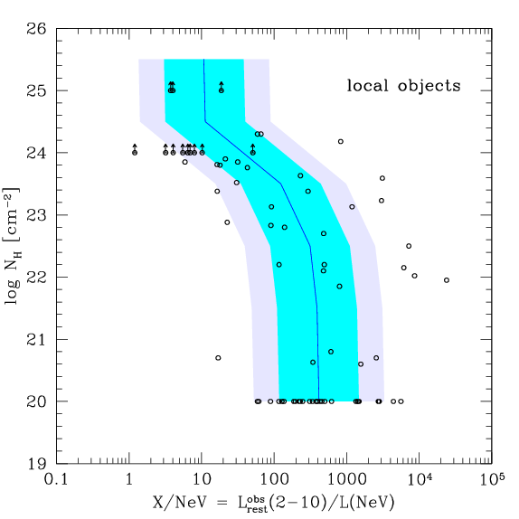
X/NeV diagnostic ratio
Calibration on a sample
of 74 local Seyferts
80% of objects with
X/NeV < 100 are heavily
obscured, logNH>23
Essentially all objects
with X/NeV < 15 are C-thick
selection is clean but not
complete
See similar plots for [OIII]
by Maiolino +98, Cappi +06,
Panessa +06

Slide 9
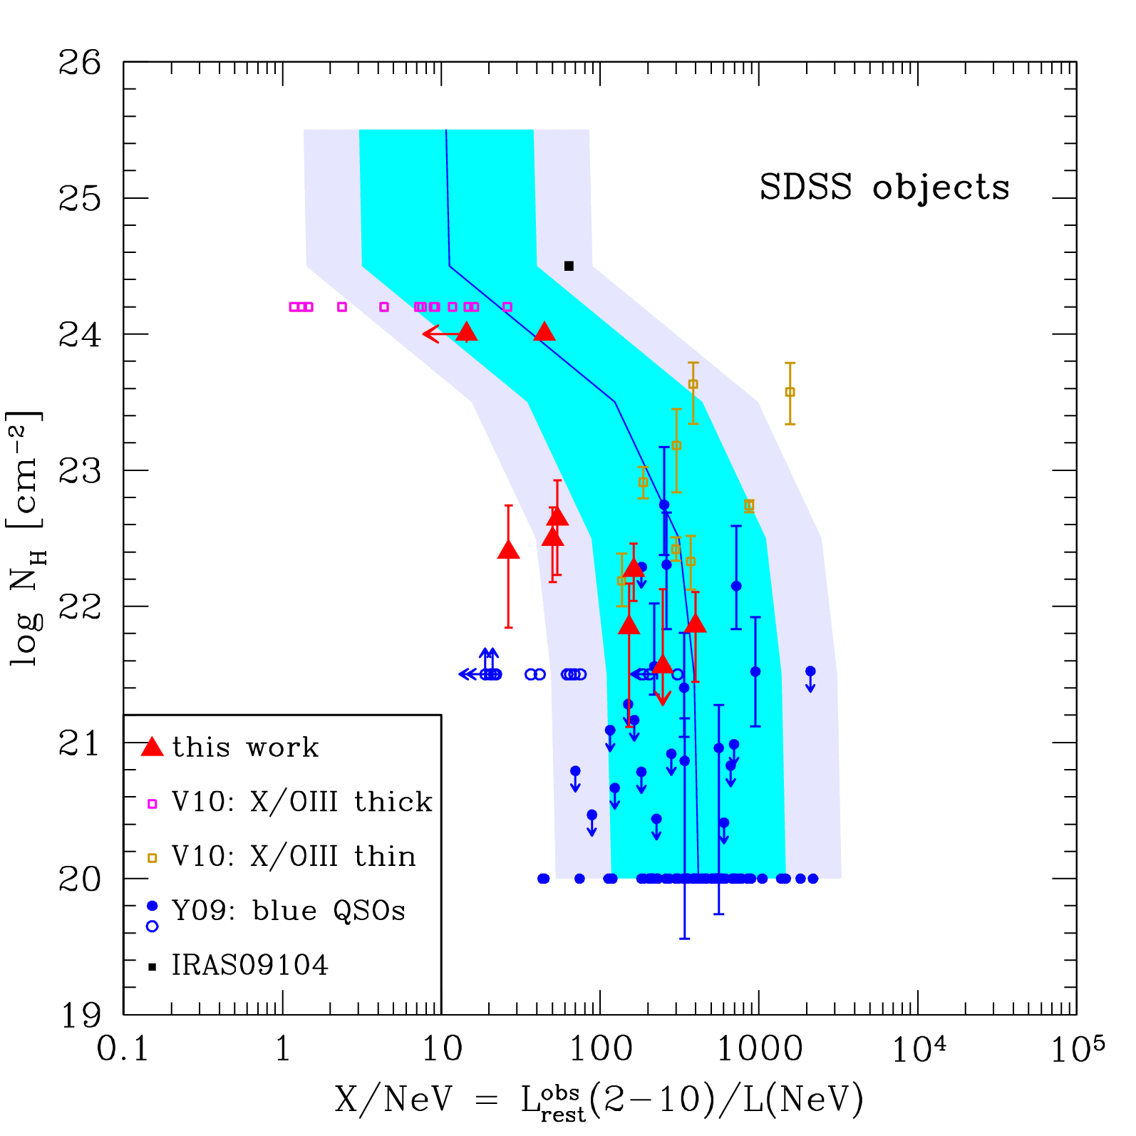
Application to SDSS QSOs
SDSS/XMM blue QSOs by (Young+09)
C-thin QSO based on
X/OIII ratio (Vignali+10)
C-thick QSO based on
X/OIII ratio (Vignali+10)
9 NeV-selected QSOs at z=0.85-1.30 observed with 10 ks ACIS-S each (Gilli+10)

Slide 10
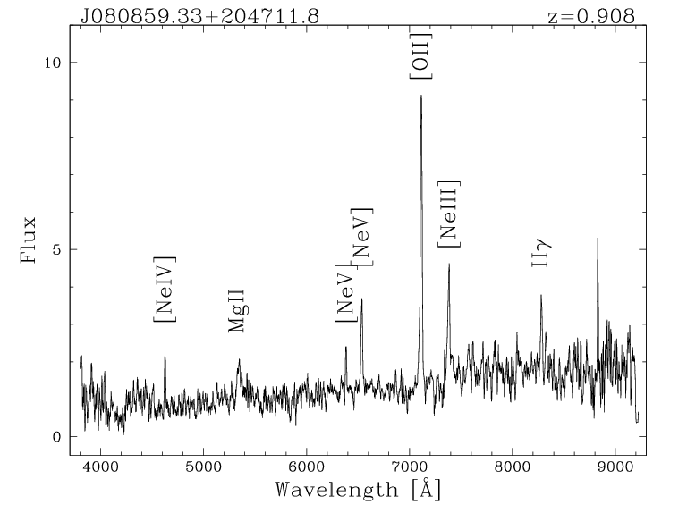
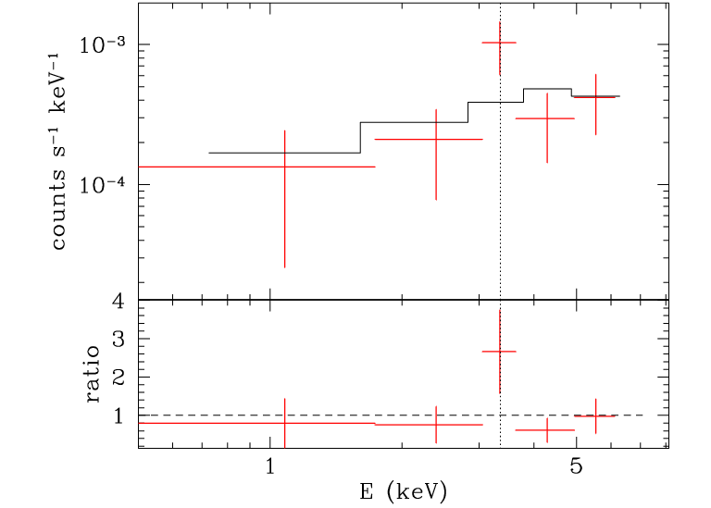
A candidate [NeV]-selected C-thick QSOs
Γ = -1.2
EW > 0.7 keV
L₍₂₋₁₀₎ obs. = 10⁴⁴ erg/s
Prominent Fe Kα line over a very hard
continuum ➔ sign of Compton-reflection
to be observed with 80ks XMM

Slide 11
The [OII]/[NeV] ratio in QSOs (Lx ≥ 10⁴⁴ erg/s)
z>0.4 QSOs
Evidence for enhanced star formation with increasing absorption in z>0.4 QSOs? (see also Kim+06) ➔
consistent with merger-driven
evolutionary sequence

Slide 12
Extension to COSMOS
COSMOS
The 20k zCOSMOS-Bright catalogue
includes 18141 galaxies and AGN
with measured redshifts to I_{AB}<22.5
(93% spectroscopic completeness).
~7400 galaxies with 0.65<z<1.20 all searched for [NeV] emission
94 [NeV]-selected type-2 AGN, 72 fall in the deep area covered
by Chandra (up to 200ks exposure), median z ~ 0.9
(there are 60 type-1 AGN in zCOSMOS in the same redshift range)
SDSS

Slide 13
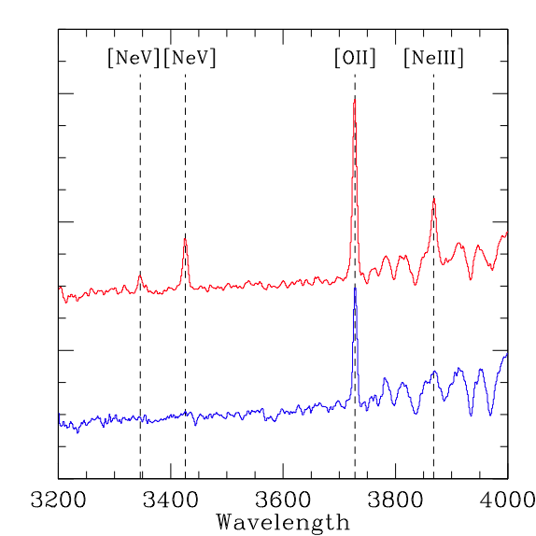
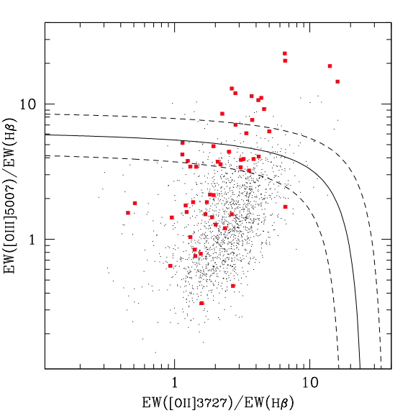
Comparison with other AGN2-selections
Composite spectra
Diagnostic diagram (DD) at z<0.9
Type-2 AGN
[NeV]-selected
SF galaxies
Only ~ 1/3 of [NeV] type-2 within the DD type-2 region, and only
~ 1/3 of DD-selected type-2 are [NeV] emitters.
~150 zCOSMOS optically normal
galaxies with X-ray emission
(AGN, logLx>42)

Slide 14
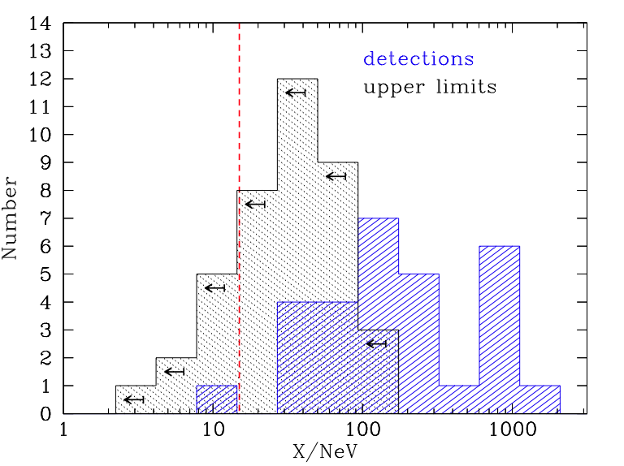
[NeV] & C-Thick AGN in zCOSMOS
23 NL-AGN detected by Chandra, 49 undetected.
9/72 (13%) are good C-Thick candidates [X/NeV<15].
46/72 (64%) are obscured AGN (logNH>23) [X/NeV<100] but could be also Compton-Thick
(X-rays upper limits)
➔ 13% < C-thick fraction < 53%
C-Thick
C-Thin

Slide 15
Next steps and developments
Obtain new X-ray observations of [NeV]-selected SDSS QSO2s.
Measure the space density of [NeV]-selected type-2 AGN in COSMOS, whole
sample and C-thick candidates
Assess completeness of [NeV]-selection vs other techniques (X-ray, DD, IR)
Deeper observations than Chandra 200ks would be needed to improve limits on
X/NeV and reliability of C-thick candidates: 4Ms CDFS, 2Ms CDFN, AEGIS are
obvious fields to extend this technique

