Slide 1
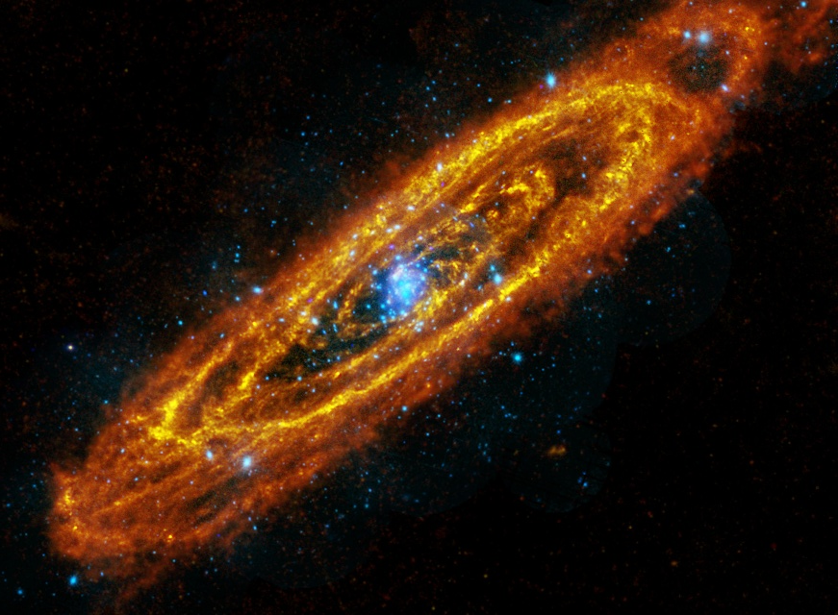
Characterising the timing and spectral properties of ULXs
Matthew Middleton, Tim Roberts, Chris Done, Andrew Sutton, Floyd Jackson

Slide 2
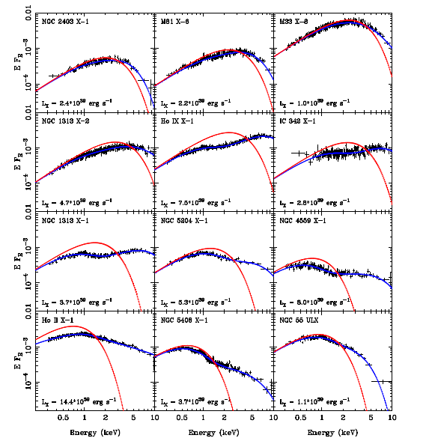
Wide range of ULX spectral shapes
Gladstone, Roberts & Done 2009
The X-ray Universe 2011, Berlin Matthew Middleton

Slide 3
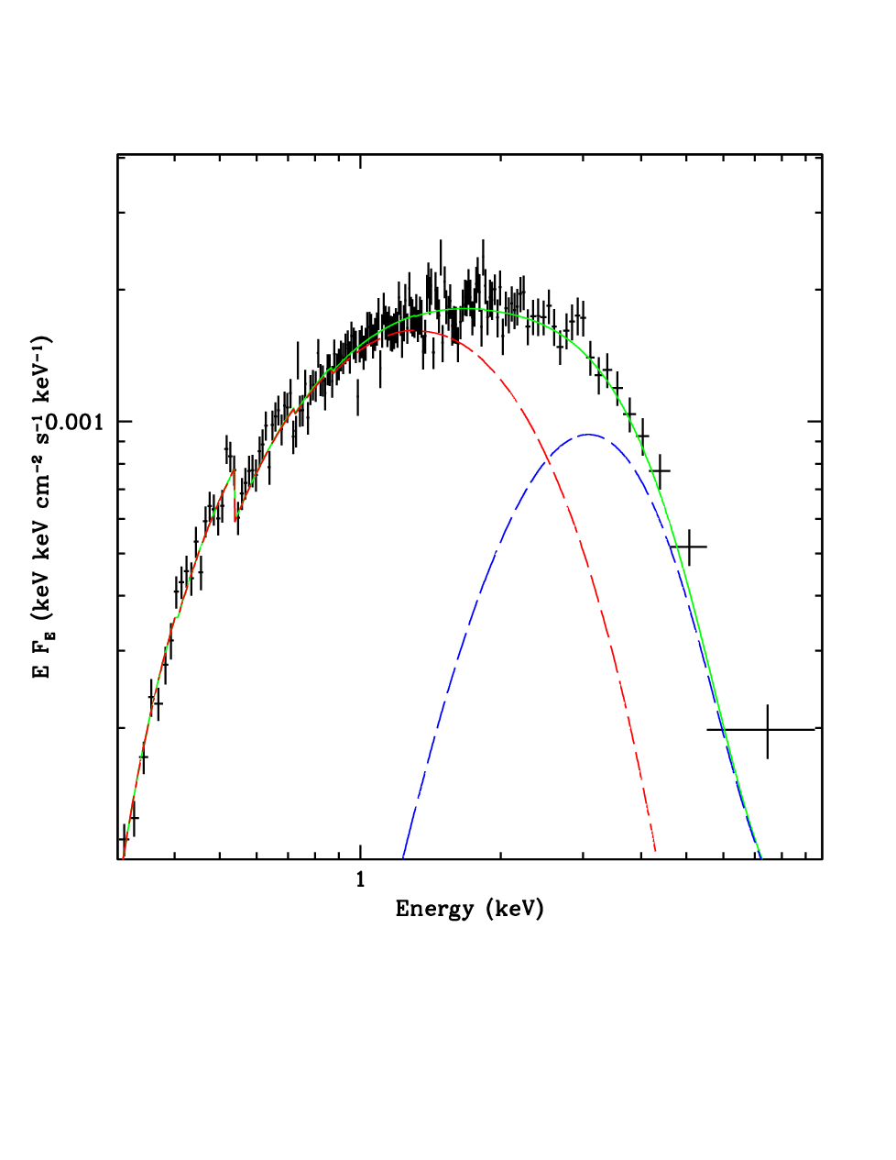
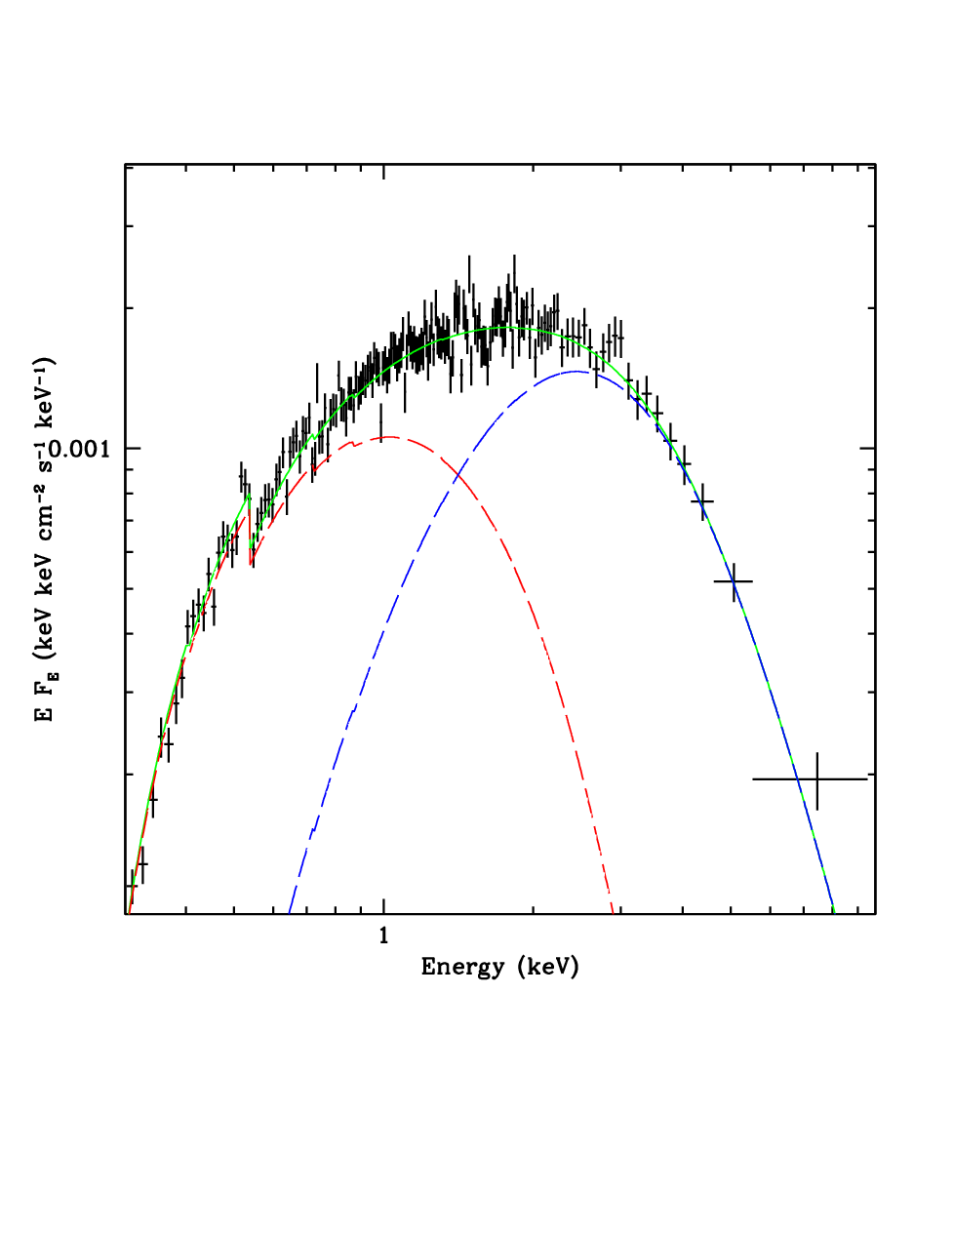
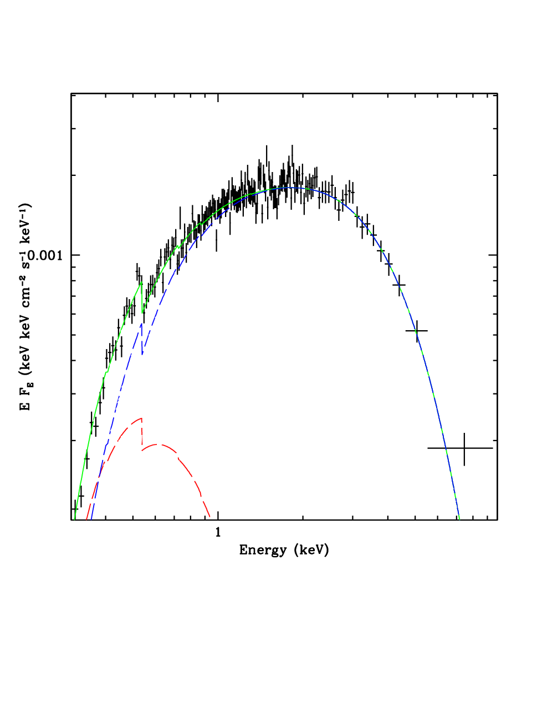
Spectral deconvolutions are sometimes degenerate!
The X-ray Universe 2011, Berlin Matthew Middleton

Slide 4
Need to discriminate using co-properties
L/Ledd | X-ray spectra | Variability
< a few % | Hard tail, cold disc | Tail highly variable (disc the source of variability: Uttley et al. 2011)
A few – tens % | Hotter disc with softer tail (<2.2) | Stable disc, tail can have residual variability
~tens % | Disc dominated | Stable on all but very long timescales
100% | Advection? Winds? | Extrinsic?
The X-ray Universe 2011, Berlin Matthew Middleton

Slide 5
Timing tools:
Fourier transform the lightcurve → power density spectrum (PDS)
Excess variance (rms) spectrum → break the lightcurve into different energy bands subtract white noise
Covariance → measure correlated variability relative to a reference band.
Lag spectra (see Phil Uttley’s talk Thursday 17:50)
For a single observation measuring its spectral shape and variability is useful but seeing the evolution of spectral shape and variability is powerful. ULXs are generally persistant!
The X-ray Universe 2011, Berlin Matthew Middleton

Slide 6
Treat ULXs as two populations, low luminosity and high luminosity
→ Low luminosity ULXs appear spectrally ‘broad’
→ High luminosity have clear breaks
Gladstone, Roberts & Done 2009
The X-ray Universe 2011, Berlin Matthew Middleton

Slide 7
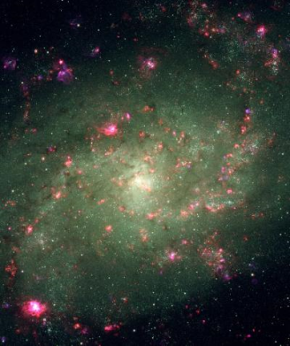
Example 1. M33 X-8
Weng et al. 2009
The X-ray Universe 2011, Berlin Matthew Middleton

Slide 8
LOW
MEDIUM
HIGH
Low : < 1.36x10³⁹ erg/s
Medium : 1.36-1.52x10³⁹ erg/s
High : > 1.52x10³⁹ erg/s
The X-ray Universe 2011, Berlin Matthew Middleton

Slide 9
IMBH argument: 100-10,000 solar masses
In ‘high’ bin, this would be at < 10% L/L_{edd}
Prediction: hard tail and highly variable (low state), or soft power-law tail out to >50keV (very high state).
Spectra inconsistent + no variability above 3keV
Disc only spectra (e.g. thermal dominant) do not fit and even relativistically smeared spectra are not broad enough:
Middleton, Sutton & Roberts 2011

Slide 10
If mass of M33 X-8 is ~10M_{solar} then mass accretion rate approaching or at Eddington in even the lowest bin
Predictions above Eddington:
1. Slim disc (Mineshige 2000): disc becomes thermally inefficient, dominated by advection processes
T_{in} α R_{in}^{-p} for a thin disc p = 0.75, advection dominated p=0.5
2. Winds(Poutanen et al. 2007): Radiation pressure drives material from the disc - spectrum becomes distorted
The X-ray Universe 2011, Berlin Matthew Middleton

Slide 11
Slim disc only:
Low → Medium
T_{in} = 1.90 +/- 0.1 T_{in} = 1.43 +/- 0.05
P = 0.52 +/- 0.01 p = 0.56 +/- 0.01
Luminosity has increased therefore mass accretion has increased
but T has decreased.
p has increased and so disc appears to be LESS advection dominated!
Inconsistent with advection dominated disc behaviour seen in other ULXs (Feng & Kaaret 2007).
Energy must be being lost somehow – include the effects of wind creation...
The X-ray Universe 2011, Berlin Matthew Middleton

Slide 12
Toy model:
R1
R2
ISCO
Middleton, Sutton & Roberts 2011
Advection dominated disc – cool component
Inner regions highly illuminated, disc loses energy in a photosphere/wind – hot component
As luminosity increases, radiation pressure increases, R2 moves outwards. Disc component gets cooler and less advection dominated.
The X-ray Universe 2011, Berlin Matthew Middleton

Slide 13
Fit significantly improved in all bins.
Middleton, Sutton & Roberts 2011
Consistency check, does our choice of bin affect the outcome?
No (actually constrains it further) plus all individual observations are well described by their flux binned spectral model.
The X-ray Universe 2011, Berlin Matthew Middleton

Slide 14
Example2: M31 ULX-1 (CXOM31 J004253.1+411422)
The X-ray Universe 2011, Berlin Matthew Middleton

Slide 15
Middleton et al. 2011 in prep
The X-ray Universe 2011, Berlin Matthew Middleton

Slide 16
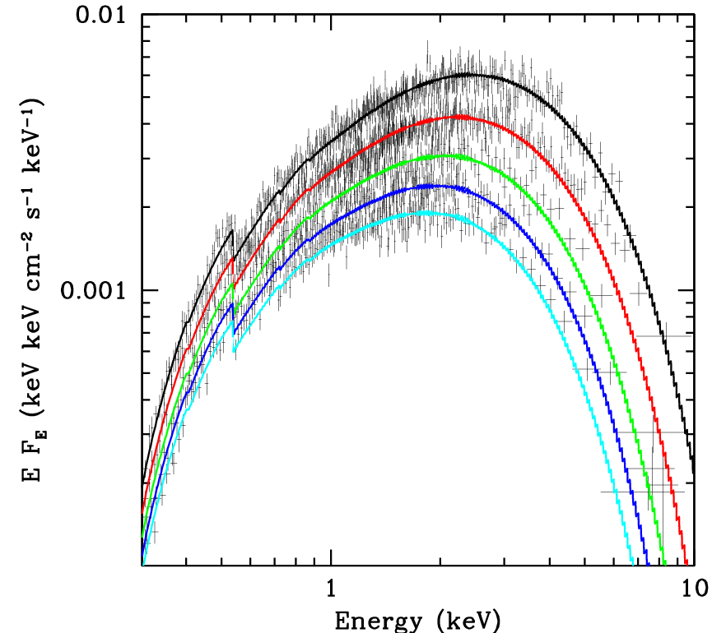
Just disc spectrum, mass of ~20 solar masses? Try BHSPEC across all simultaneously ensures T⁴ behaviour. Only good description if we use the smaller estimate of n_{H} (0.067 rather than 0.127x10²²cm⁻²)
The X-ray Universe 2011, Berlin Matthew Middleton

Slide 17
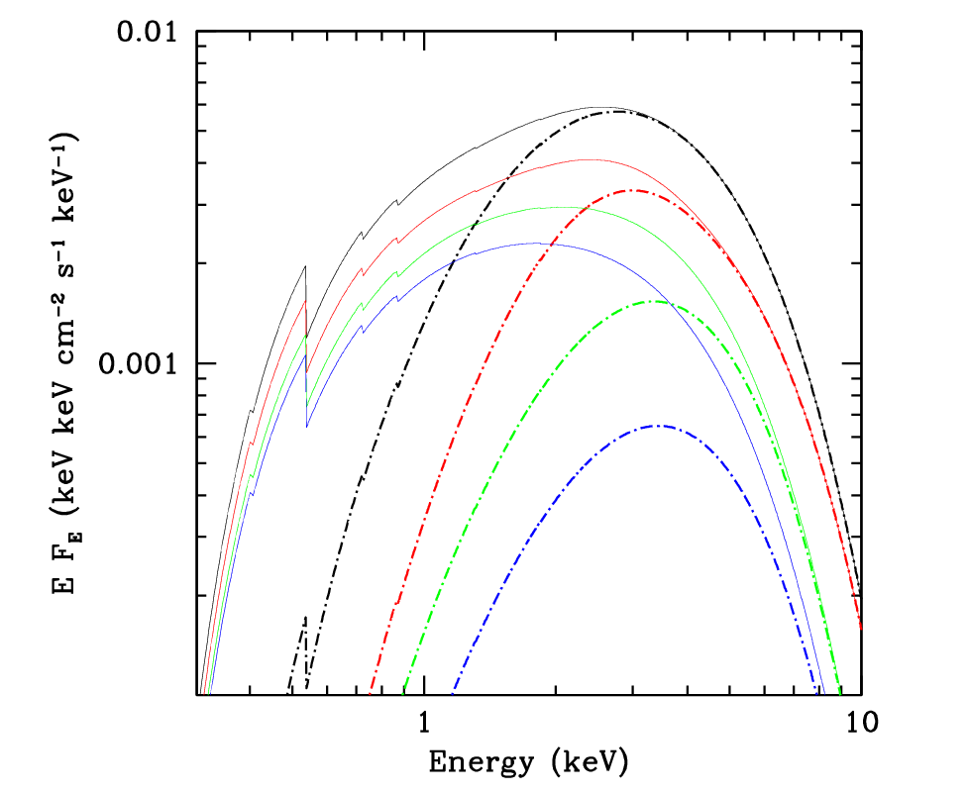
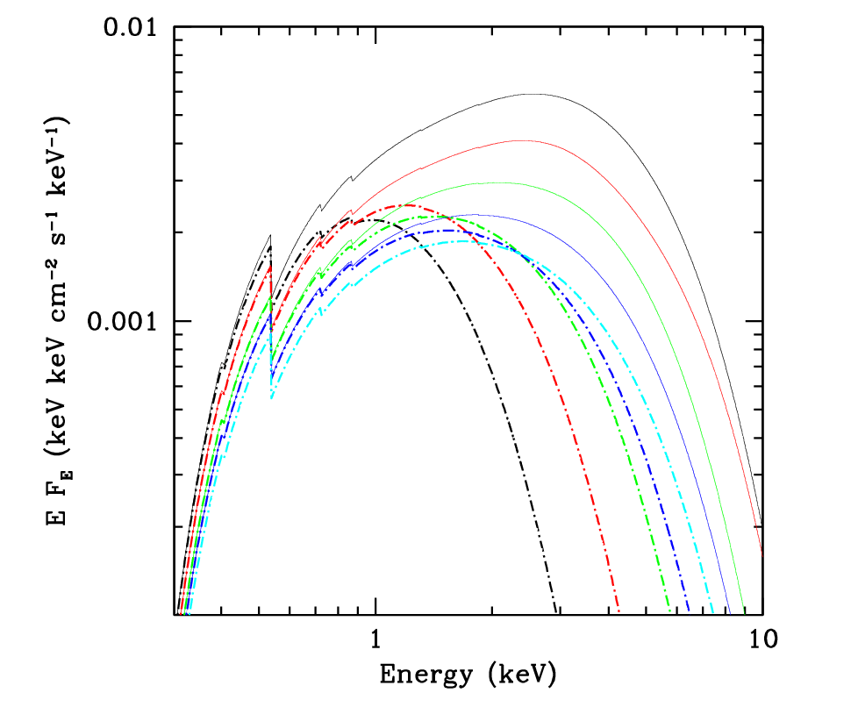
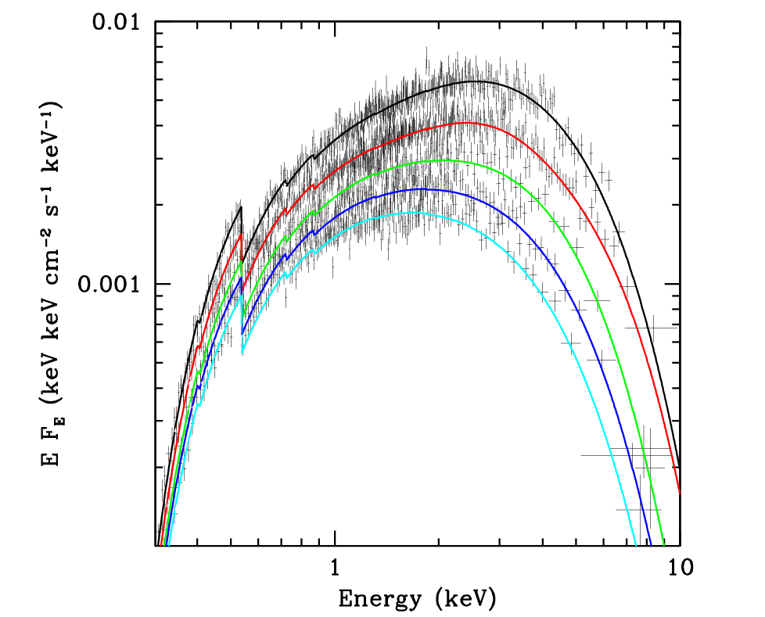
Smaller mass: ULX model – better fit for either of the two columns
With decreasing luminosity the disc gets hotter and more advection dominated, the ‘wind’ component gets hotter and less important
Middleton et al. 2011 in prep
The X-ray Universe 2011, Berlin Matthew Middleton

Slide 18
Fractional covariance: excess rms in a given energy band relative to a reference band, normalised to the mean count rate in each.
Middleton et al. 2011 in prep
The X-ray Universe 2011, Berlin Matthew Middleton

Slide 19
No correlated variability: how to make this in just a disc? Instability at ~Eddington that propagates inwards with dampening at all other radii? Contrived?
R1
R2
ISCO
Variability at the edge of the cool disc is a possibility if the expelled wind/photosphere is strong enough and intercepts the disc in the line-of-sight? Consistent with X-ray spectral models.
The X-ray Universe 2011, Berlin Matthew Middleton

Slide 20
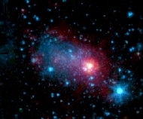
Higher luminosity ULXs?
NGC 5408 X-1 (see Dheeraj Pasham’s talk next)
The X-ray Universe 2011, Berlin Matthew Middleton

Slide 21
Middleton et al. 2011
Variability increases on all timescales – second component highly variable but does not look like sub-Eddington component......extrinsic? Also seen in other sources: see Andrew Sutton’s poster
The X-ray Universe 2011, Berlin Matthew Middleton

Slide 22
R1
R2
ISCO
Increasing mass accretion rate
R1
R2
Possible degeneracy in model via viewing angle.
The X-ray Universe 2011, Berlin Matthew Middleton

Slide 23
SUMMARY
Low luminosity ULXs are broad – can make spectral fitting difficult
We can use timing tools to strengthen our models
M33 X-8 appears to behave as an Eddington/Super-Eddington system with advection and wind effects important
M31 ULX-1 shows a linear decrease consistent with e-fold times of soft outburst sources
Spectral behavior matches our predictions as does the variability
Toy model might change at higher luminosities or be degenerate in viewing angle

