Slide 1
Investing Chandra and XMM time to detect the missing baryons in a WHIM
Current Evidence & Future Prospects

Slide 2
The Missing Baryons in a WHIM
Ω_{b}(BLA) + Ω_{b}(OVI^{WHIM}) ~ 10-20 % Missing Baryons
dN/dz(N_{OVII}>10¹⁵ cm⁻²) = 10

Slide 3
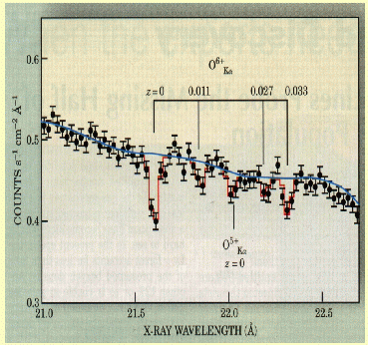
The WHIM in X-Rays: 80-90 % of the Missing Mass?
(Nicastro+05, Nature)
Controversial
We stand by our Result:
(Nicastro et al., 2008, Science)
XMM-Newton does *NOT* rule out Chandra detections (Rasmussen+07, ApJ)
Chances of falsely detecting the two systems are 0.05 % and < 0.01 %, *NOT* 40 % and 6 % (Kaastra+06, ApJ)

Slide 4
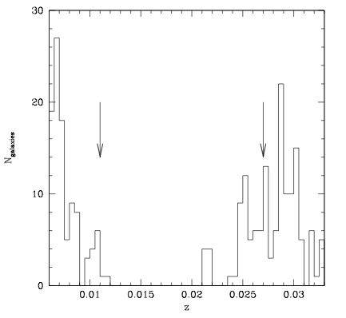
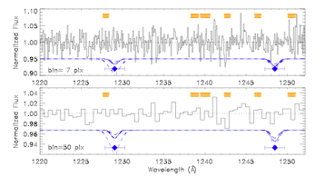
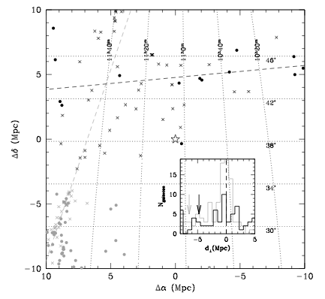
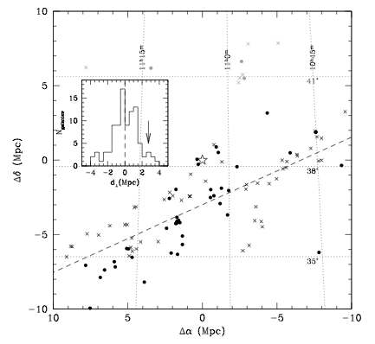
Conflicting Evidence
Portion of the 1-orbit COS Spectrum of Mkn 421
(courtesy of C. Danforth)
Williams et al., 2010
Danforth et al., 2011

Slide 5
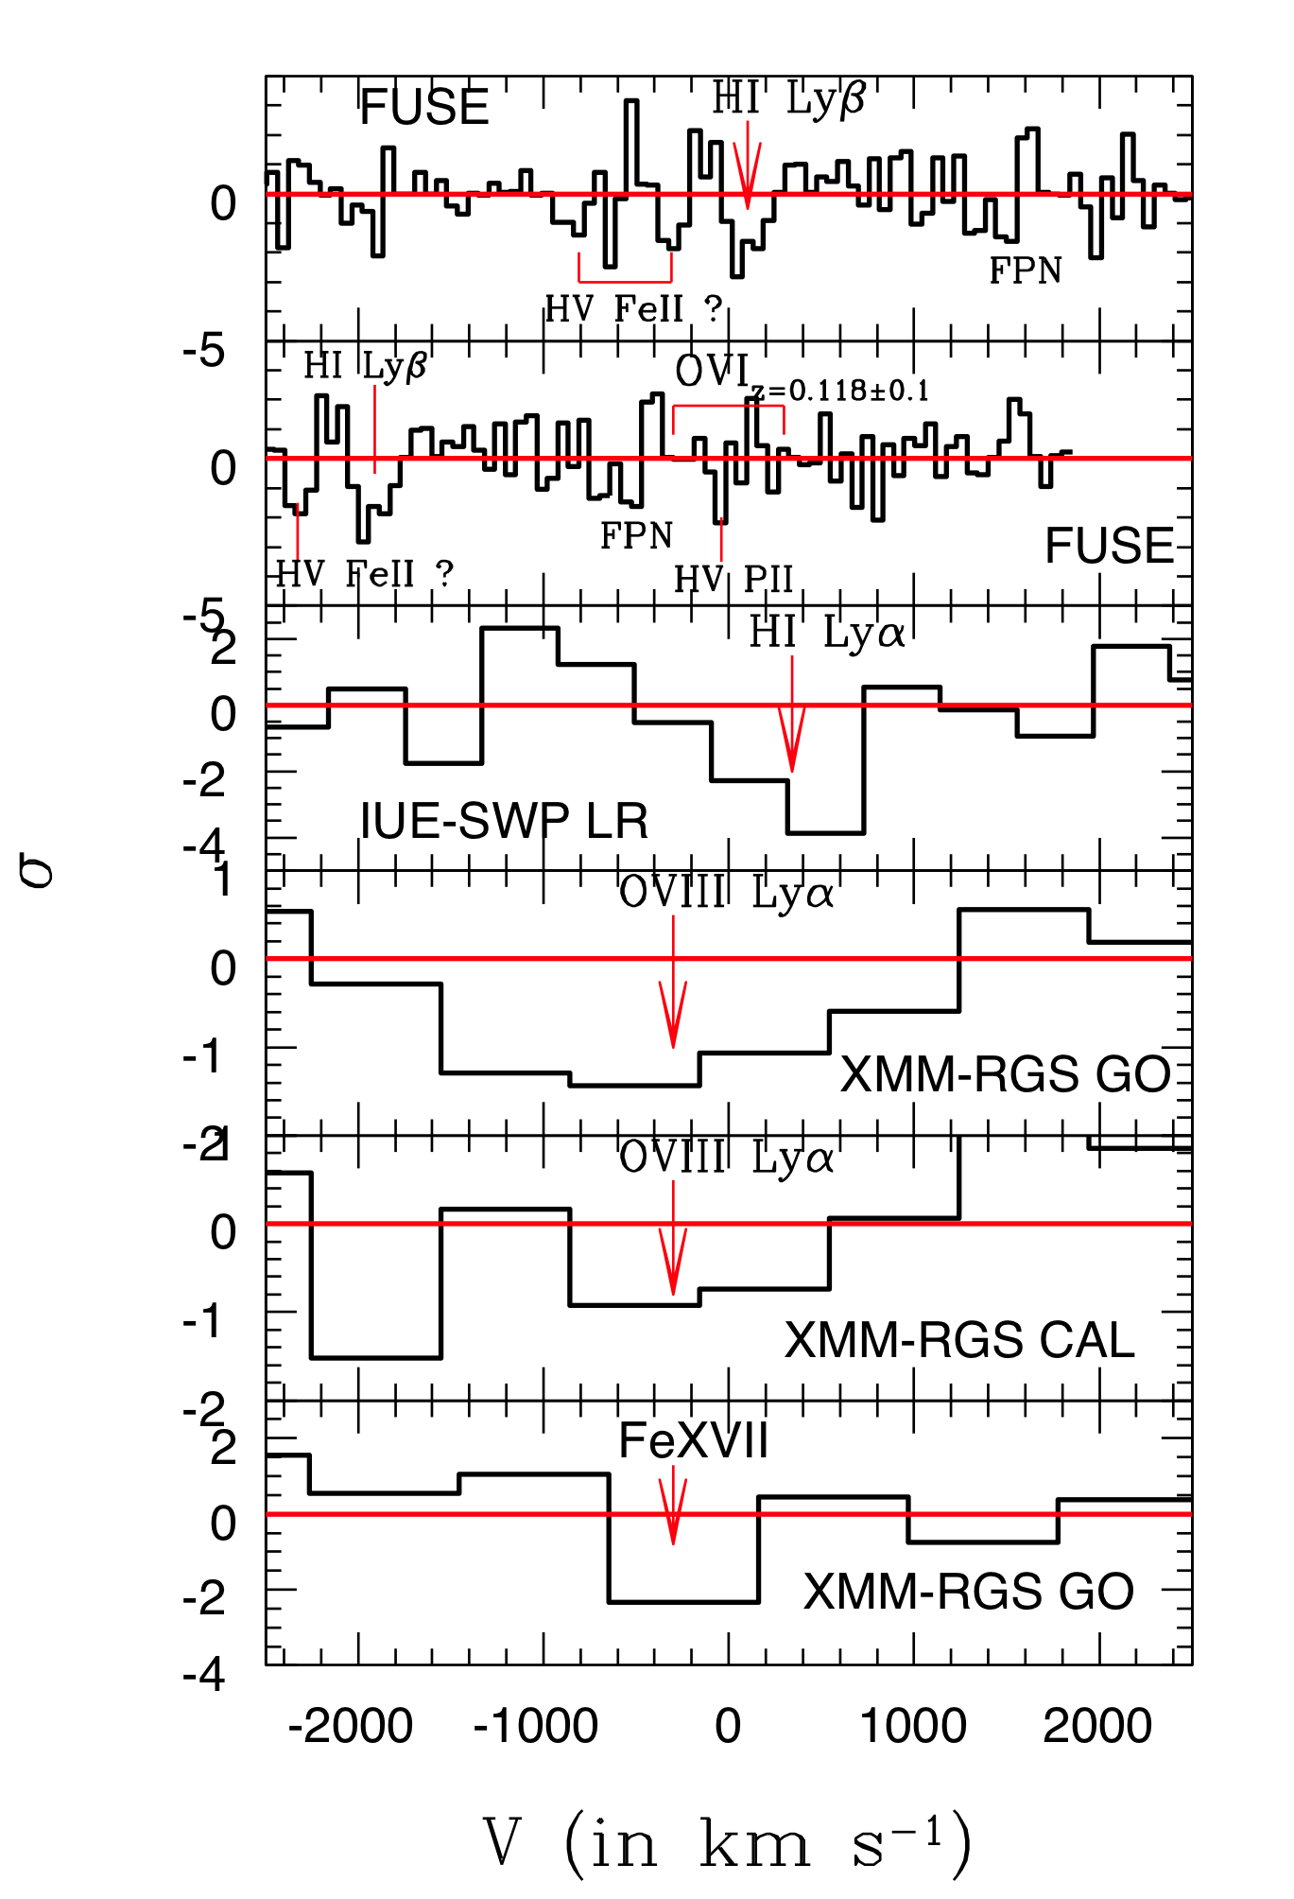
PKS 0558-504: an X-Ray/BLA Filament at z=0.118?
From X-rays ➔ logT < 6.75;
logN_{H} =21.5±0.3 (Z/Z_{0.01})⁻¹
From lack of OVI ➔ logT > 6.52
From HI and T ➔ Z = (1-4)% Z
From Z and T ➔ δ ≈ 300
and Theory
From δ and N_{H} ➔ D=4-7 Mpc
Combined Statistical Significance = 5.2σ
(5σ if FUSE systematics are included)
[Nicastro et al., 2010]

Slide 6
H 2356-309: a Galaxy-Rich Sightline
A ~ 10¹⁷ cm⁻² OVII Column!
…an OVII DLA Equivalent!
Zappacosta et al., in prep.
Fang+10
Zappacosta+10

Slide 7
A firm detection can and must be secured with current facilities
Chandra-LETG data of 1ES 1553+113: 340 ks
HST-COS G130M Data of 1ES~1553+113: 2 orb.
1ES 1553+115: the Best WHIM Target in the Universe!
Zappacosta et al., in prep.
z > 0.3
First 335 ks of our first 0.5 Ms
Chandra HRC-LETG:
Systems at z=0.042 and z=0.123: associated BLAs
OI at z=0.051: associated HI Lyα
Possible OVII at z=0.232 and z=0.297
Danforth et al., 2010
Takes 2 Ms with Chandra
Against the Brightest Target
at z> 0.3
GOAL: Reach 3 Ms Total Exposure.
Breaks 3 mA OVII Sensitivity Threshold

Slide 8
The Future…
Funding Agencies (ESA, NASA, JAXA) have hit their Funding Wall
The Era of Large (X-ray) Observatories has come to an end
<5% of post-doc offers are in X-rays (50% O-IR, 35%, Radio)
Co-pointing Gratings (0.1-1 keV), Calorimeters (1-10 keV), Hard-X-ray Optics (10-80 keV), extremely inefficient
…Size is not Everything!

Slide 9
NASA Astrophysics Funding Wall
US scenario
New Missions: $2.3B to 2020
J W S T
Chandra, HST, Fermi…
Development
HST de-orbit
Source: NASA October 2009 http://www.spacepolicyonline.com/pages/images/stories/Astro2010_NASA_Oct2009_v1.pdf
Notes:
Funding wedges always just about to open.
Assuming NO slips.

Slide 10
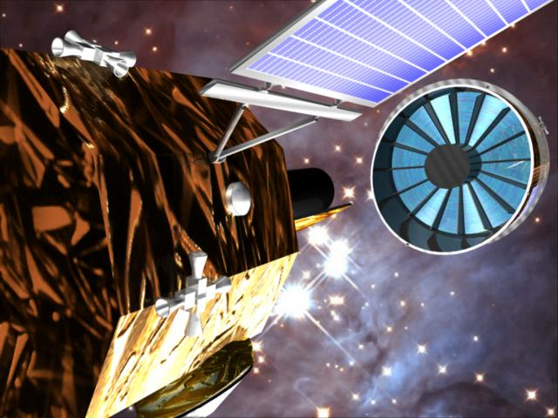
ESA Astrophysics Funding Wall 2004-2006: XEUS: 30 m² The X-ray Evolving Universe Spectrometer
2-Stage mission in formation flight
1st stage: 6 m², 35 m FL
2nd stage: exploit Space Station: 30 m² !!!!
Explores High-z Universe!
2007: XEUS: shrunk down to 5 m²
Selected as 1 of the 3 CV Ls; 1-Stage mission in formation flight
ESA mission-study establishes estimates were wrong….now it’s 3 m^{2;} Still….Explores High-z Universe!
08: IXO [International X-ray Observatory]: 2.5 m²
11: Athena: 1.1 m² (1 keV); 0.5 m² (6 keV)

Slide 11
Post-doc Demographic
From most recent AAS Job-list (total 35)

Slide 12
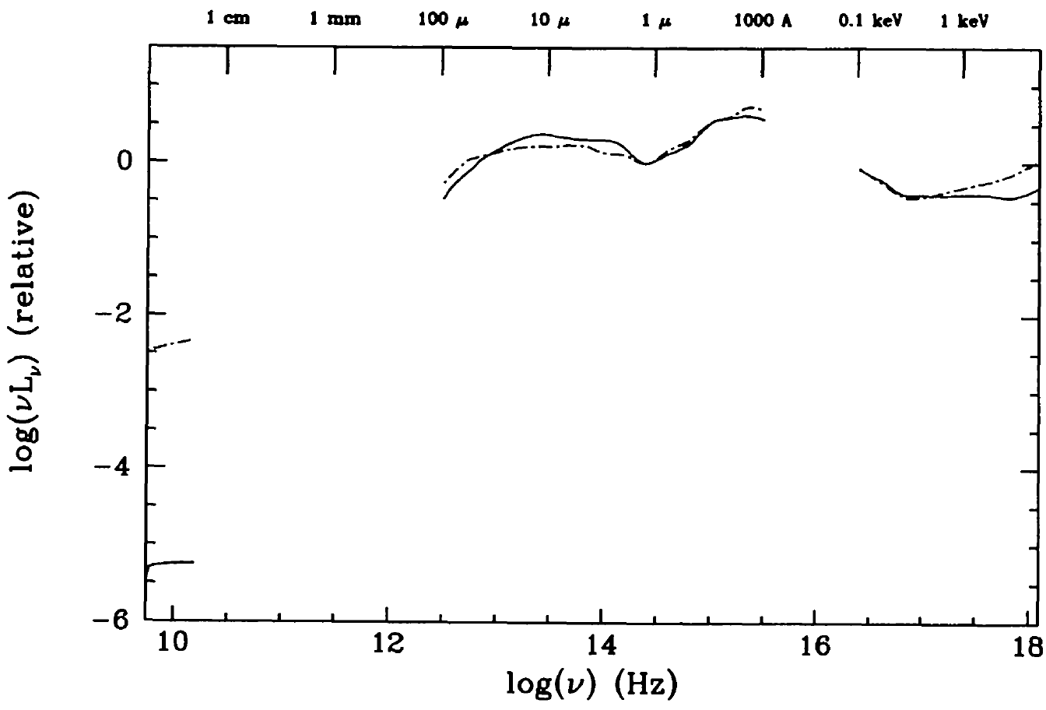
Overly broad scope?
In 2004 Con-X had 4 identical spacecraft
Co-pointing Gratings, Calorimeter, Hard-X-rays: inefficient
Would rarely co-point GALEX –blue/hot- and Spitzer – red/cold
Same ΔlogE as Con-X: 1 or 2 instruments mostly idle
10 keV
Quasar SED
Elvis et al, 1994
Spitzer
GALEX
Con-X
18
19

Slide 13
…could be Much Brighter…
#1: Calorimeter, optimized for >1keV. ~1arcmin OK
#2: Gratings + short focal length mirrors. ~10”
#3: Hard X-ray, optimized for >10keV. ~20”
#4: Best possible PSF: 1-2” ?? Area: whatever
Each US-Explorer-sized (250 M$ = 170 MEU!)
70% gain in instrument utilization
Do reference mission faster → more science
Harder to cut as each spacecraft is unique

Slide 14
NASA Explorers
• The schedule for the current round of NASA Explorer proposals is:
– Step 1 Selections announced (target) ............Sept 2011
– Phase A Concept Study Reports due (target) ....August 2012
– Down-selection for flight target)............February2013
• There are:
– 15 Astrophysics EX mission proposals - $250M including launch
– 11 Astrophysics Missions of Opportunity proposals - $55M
includes both Partner MOs and Small Complete Missions
• Proposed ESA member state participation:
– 7 (27%) have no ESA member state involvement
– 15 (58%) involve science-only contributions from ESA member states
– 4 (15%) involve ESA member state science contributions and in addition hardware or facility contributions valued at > $10M

Slide 15
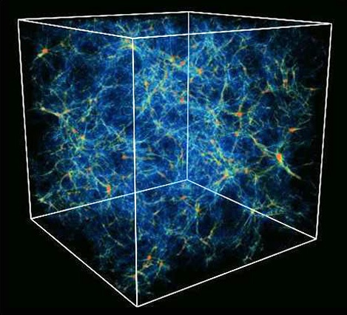
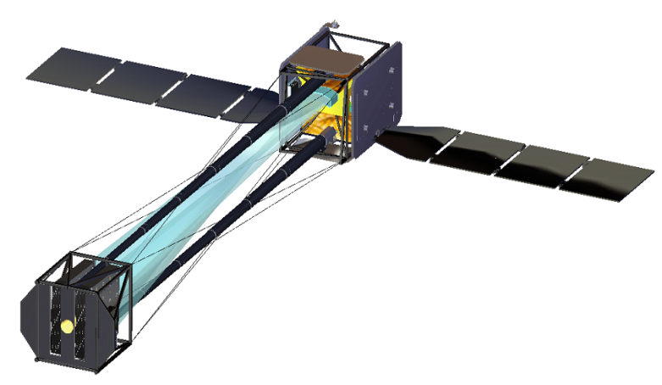
WHIMEX Doing High Resolution X-ray Spectroscopy Right Webster Cash and the WHIMEx Team

Slide 16
WHIMex
Athena

Slide 18
The WHIM: Future Prospects WHIM-Ex

Slide 19
Conclusions
The majority of the WHIM has probably already been detected in the X-rays.
Recent Chandra data of “The Best WHIM Target in the Universe” are promising: tentative detection of the metal counterparts to the two COS BLAs.
Longer integrations are needed to confirm this results and secure the first uncontroversial detection of the 80% of the Missing Baryons.
In the future a moderate throughput, high resolution soft X-ray spectrometer (e.g. WHIM-ex) will enable:
(a) the accurate (few %) measure of the Cosmological Mass Density of Baryons in the Universe
(b) the study of the interplay between galaxy and AGN outflows and the IGM (feedback)
(c) the understanding of the role of shocks in the formation of structures in the Universe
(d) the mapping of the Universe’s Dark-Matter concentrations

