Slide 1
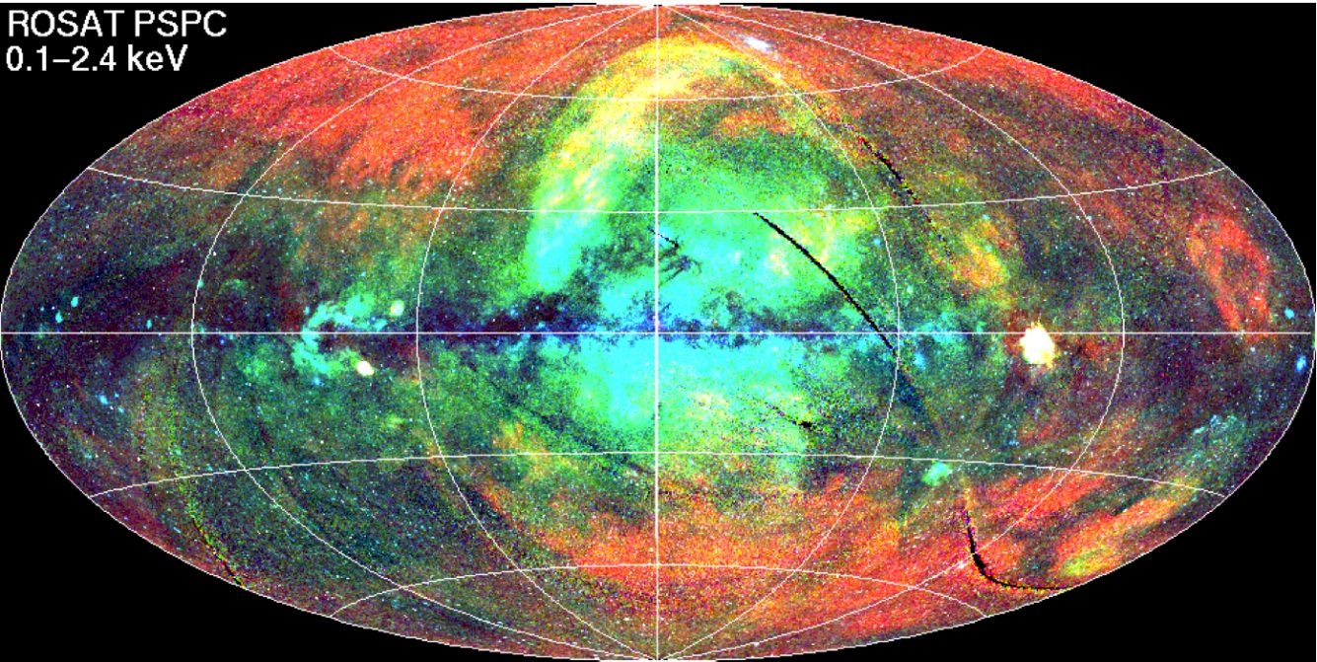
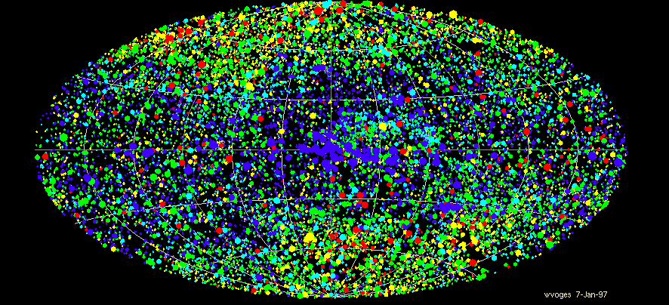

eROSITA
A new all-sky X-ray Survey
Peter Predehl
Max-Planck-Institut für extraterrestrische Physik

Slide 2
eROSITA Team
PI: Peter Predehl (MPE)
Project Scientist: Andrea Merloni
Co-Is: Hans Böhringer, Ulrich Briel, Hermann Brunner, Evgeniy Churazov, Michael Freyberg, Peter Friedrich, Günther Hasinger, Eckhard Kendziorra, Dieter Lutz, Josef Mohr, Norbert Meidinger, Kirpal Nandra, Mikhail Pavlinsky, Thomas Reiprich, Andrea Santangelo, Jürgen Schmitt, Axel Schwope, Matthias Steinmetz, Lothar Strüder, Rashid Sunyaev, Jörn Wilms
System Engineer: Josef Eder
Product Assurance: H. Bräuninger, M. Hengmith
Electronics Engineering: W. Bornemann, O. Hälker, S. Hermann, W. Kink, S. Müller, O. Hans, Z. Zhang, G. Plasoianu + Workshop
Mechanical Engineering: H. Huber, Chr. Rohé, L. Tiedemann, R. Schreib, B. Mican, H. Eibl, A. Schneider, F. Huber, K. Lehmann, + Workshop
Mirror System, PANTER: P. Friedrich, W. Burkert, M. Freyberg, B. Budau, , V. Burwitz
Cooling, Thermal Engineering: M. Fürmetz, E. Pfeffermann, A. Buron
CCD-Camera: N. Meidinger, G. Schächner, J. Elbs, S. Ebermayer, A. v. Kienlin
Attitude: A. Schwope
Calibration, Analysis: G. Hartner, K. Dennerl, R. Andritschke, Chr. Tenzer
Laboratory, PUMA, Tests: M. Vongehr, R. Gaida, K. Dittrich, Th. Burghart, T. Blasi, F. Schrey, K. Hartmann
Ground Software, Simulation, Science: H. Brunner, P. Guglielmetti, G. Lamer, M. Mühlegger, J. Wilms, I. Kreykenbohm, C. Schmid, M. Brusa, A. Finoguenov, M. Salvato
Mission Planning: J. Schmitt, J. Robrade
Scientific/Infrastructure Working Group Chairs: W. Becker, H. Böhringer, H. Brunner, K. Dennerl, M. Freyberg, F. Haberl, I. Kreykenbohm, J. Mohr, K. Nandra, T. Reiprich, J. Robrade, A. Santangelo, M. Sasaki, J. Schmitt, A. Schwope, J. Wilms
Institutes:
MPE, Garching/D
Universität Erlangen-Nürnberg/D
Universät Tübingen/D
Universität Hamburg/D
Astrophysikalisches Institut Potsdam/D
Max-Planck-Institut für Astrophysik/D
Space Research Institute IKI, Moscow/Ru
Argelander Institut, Universität Bonn
Universätssternwarte München (LMU)
Industry:
Media Lario/I Mirrors, Mandrels
Kayser-Threde/D Mirror Structures
Carl Zeiss/D ABRIXAS-Mandrels
Invent/D Telescope Structure
pnSensor/D CCDs
EHP/B Heatpipes
RUAG/A Mechanisms
HPS/D,P MLI
+ many small companies

Slide 3
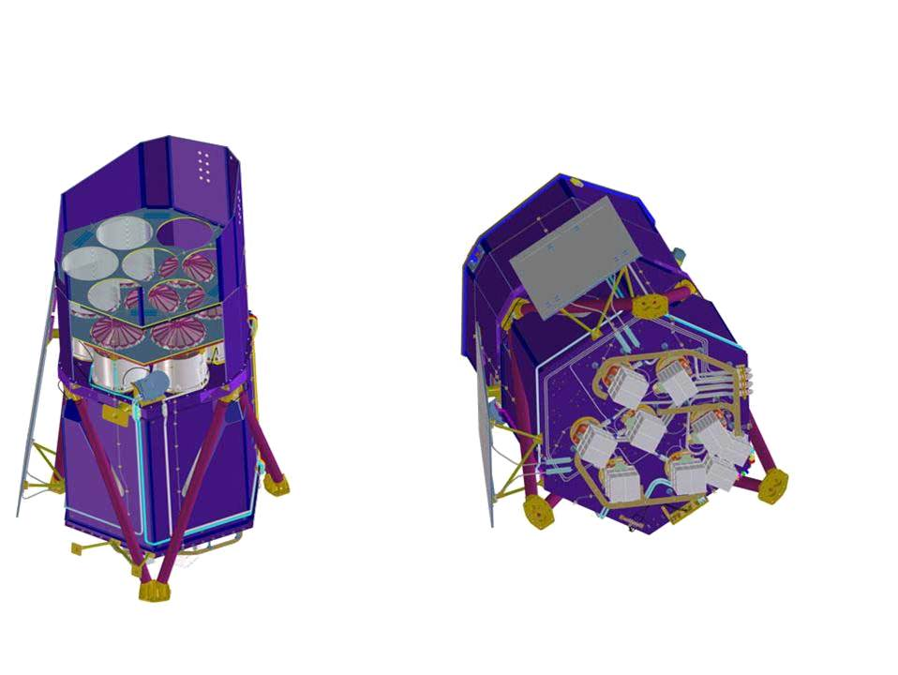
Instrument
Focal length 1,6 m
Field of View 1° Ø
7 identical Mirror Modules
54 nested Mirror Shells
Energy Range 0.5-10 keV
Energy Resolution 138 eV @ 6 keV
Dimensions 3,2m × 1,9m Ø
Weight 740 kg

Slide 4
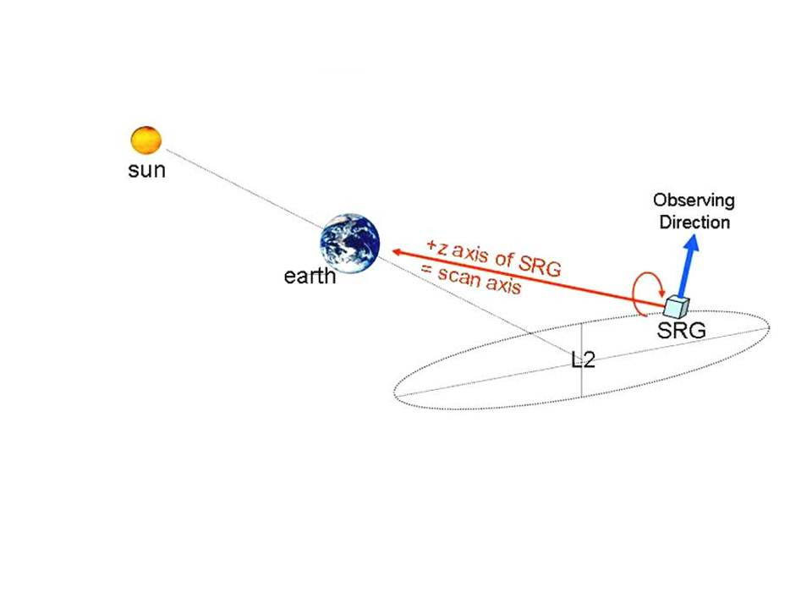
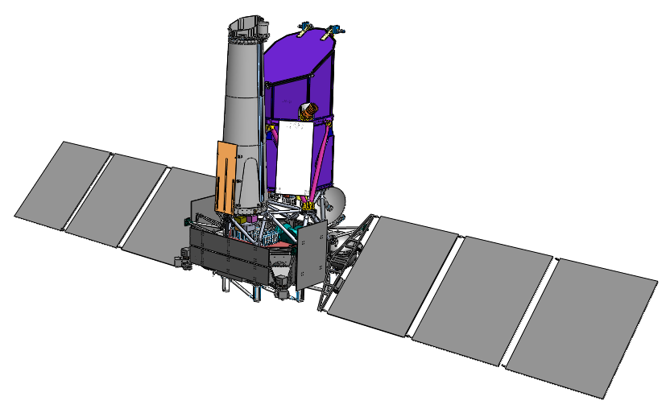
Spektrum-Rentgen-Gamma Mission
Prime Instrument:
ART-XC eROSITA (MPE)
(IKI)
Navigator
(Lavochkin)
Orbit around L2
Continously rotating S/C during Survey
~ 4 hours / revolution
4 years survey, 3 years pointing
Launch with Zenith-Fregat
from Baikonur 2013
Zenith/Fregat/Navigator-combination
already successfully flown (Elektro-L)

Slide 5
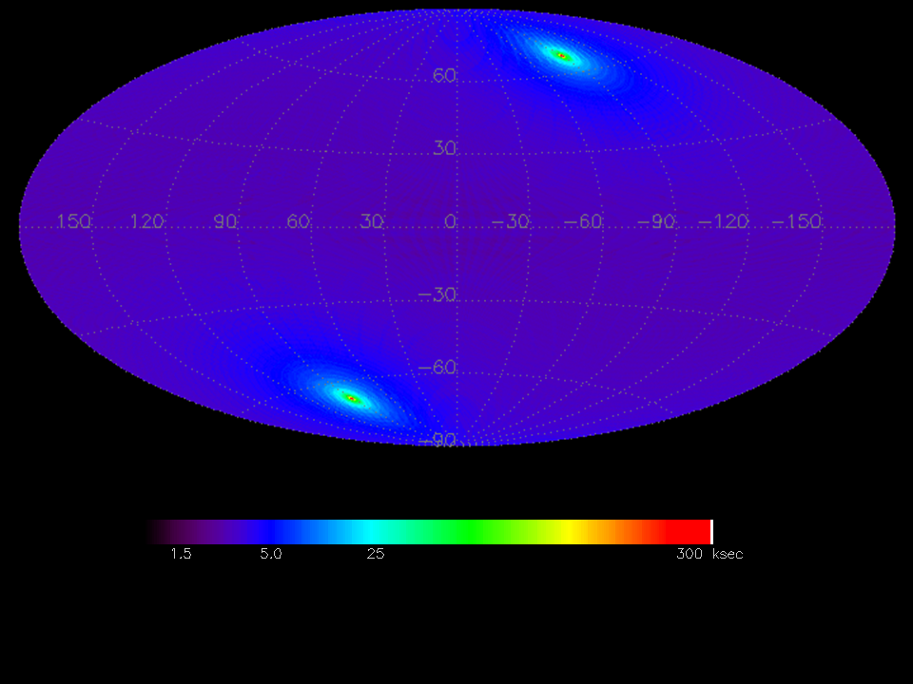
Exposure
(M. Fürmetz, MPE)

Slide 6
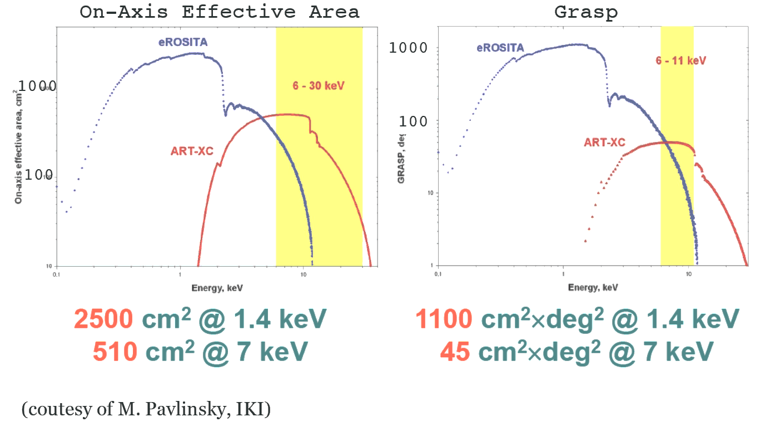
eROSITA & ART

Slide 7
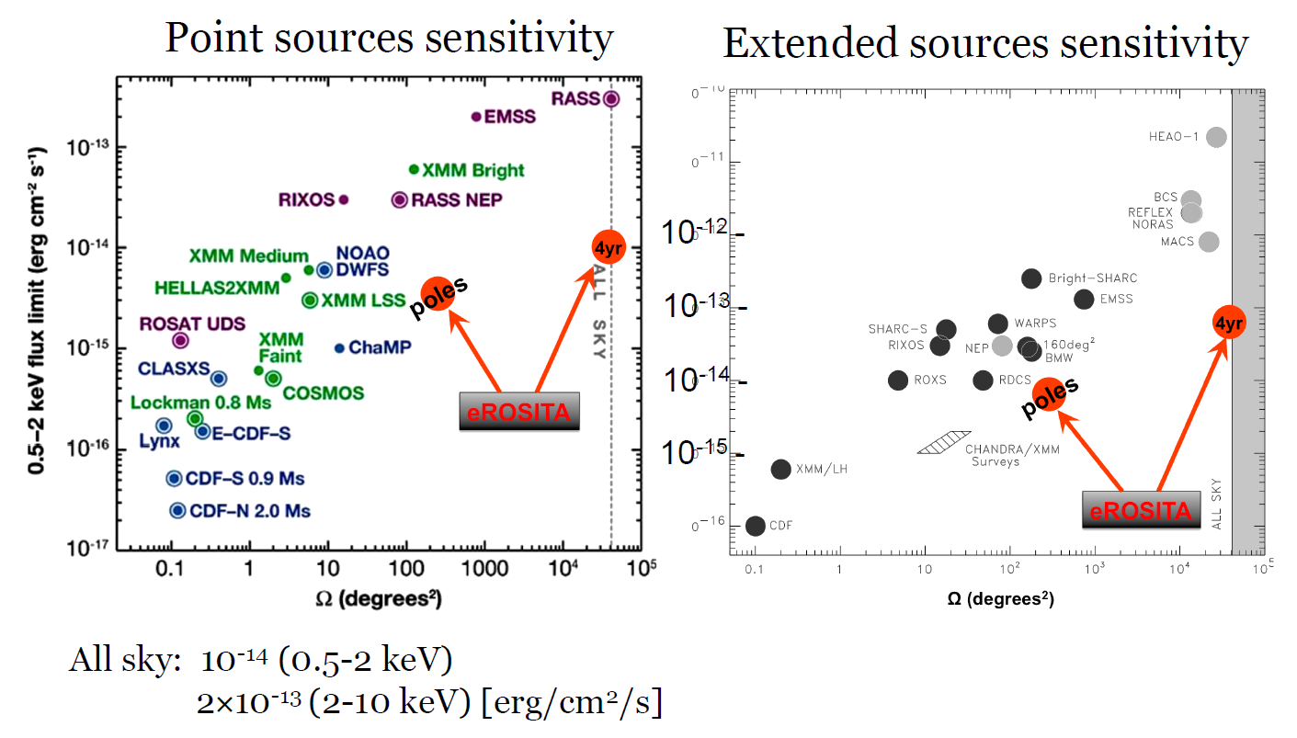
Comparison with other Surveys

Slide 8
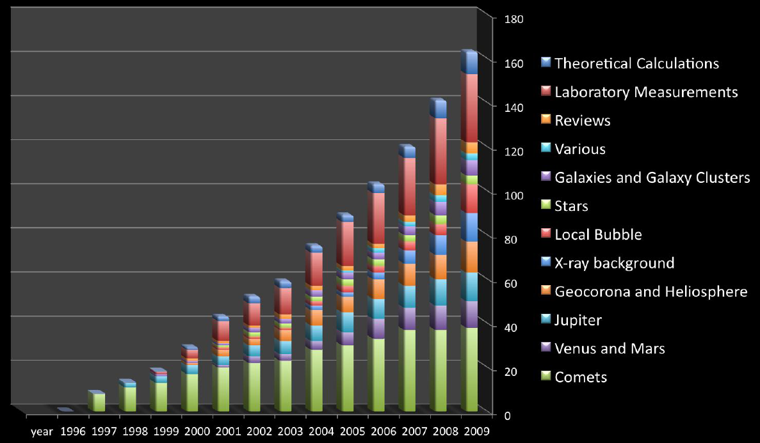
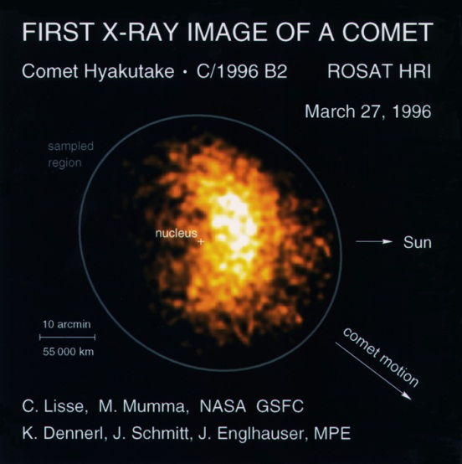
Comets & Charge Exchange
court. K. Dennerl

Slide 9
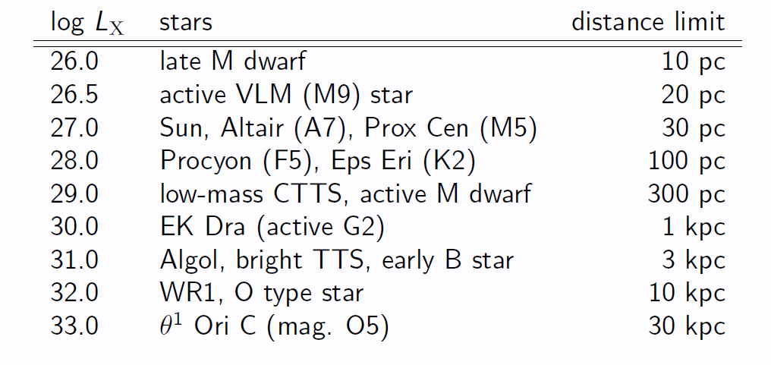
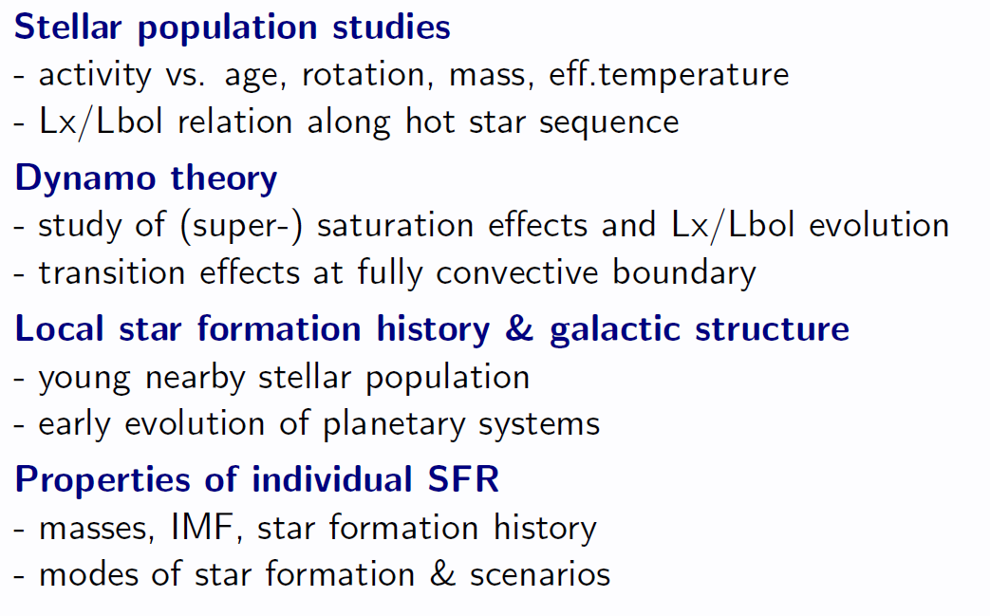
Stars
0.3 – 0.5 Mio. Stars in eRASS
Cool Stars (late A to late M-type, magnetic activity, coronae)
Hot Stars (O to early B-type incl. WR Stars, wind shocks)
other
court. J. Robrade

Slide 10
SNR + ISM
SNRs:
  Search for new SNR candidates (radio quiet / X-ray bright)
  Large SNRs in Milky Way
Hot Interstellar Medium:
  Globally (LMC, SMC)
  Particular Sources (superbubbles, SNR)
  Strong shocks, T, densitities, ionization stages, chem. abund., NE effects
  XMM-Newton and Chandra spectra show inconsistencies with collisional ionizing equilibrium
  and common non-equilibrium ionizing models
  Background:
    Local Hot Bubble (origin? state? CEI or NEI?, cooling curves?, etc.)
    Loop I (CE relevant?)
    Galactic Halo (by shadowing → 3d picture of contribution and properties)

Slide 11

Compact Objects
Accretion
  via RLOF (CVs, LMXBs, BHs…
  via stellar wind (HMXBs)
  via disk (BE)
  from ISM (INS, IBH)
Thermonuclear
  Novae, Bursts
Cooling, remnant heat
  WDs, NSs
Magnetic Fields
  AXPs, Magnetars
Spin-down
  Pulsars
Other
100 - 1000 INS
court. A. Schwope

Slide 12
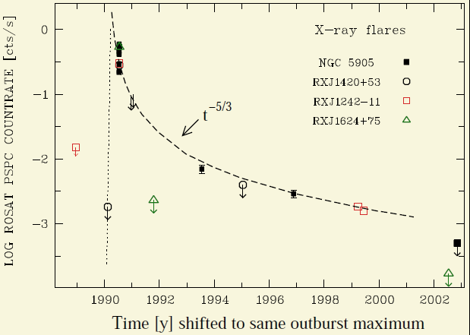
Time Domain Astrophysics
Variabilities:
Stellar Flares
NS and BH Outbursts
Long-Term Variability of AGN
Tidal Disruption Events
Gamma-ray Bursts
Komossa, 2004
Time Ranges:
Individual Scan ~ 30 sec (mCrab sensitivity)
Revolution ~ 4 hours
Visibility 1 Day
Sky Coverage 0.5 year
Survey Duration 4 years

Slide 13
AGN
3 Mio. AGN in eRASS
Accretion History: XLF, obscured vs. unobscured
LSS: AGN ACF, AGN/Galaxy CCF, AGN/Cluster CCF
AGN host Galaxies: Morphology, SFR, Obscuration
Sub-Populations:
  High Redshift (z>6)
  Extreme Luminosity
  Compton thick AGN
Spectra: Obscuration, Continuum, Soft Excess, Iron Lines
Variability: Var. vs. L, L/L_{edd}, z, Tidal Disruptions
→ e.g., K. Nandra; this conference

Slide 14
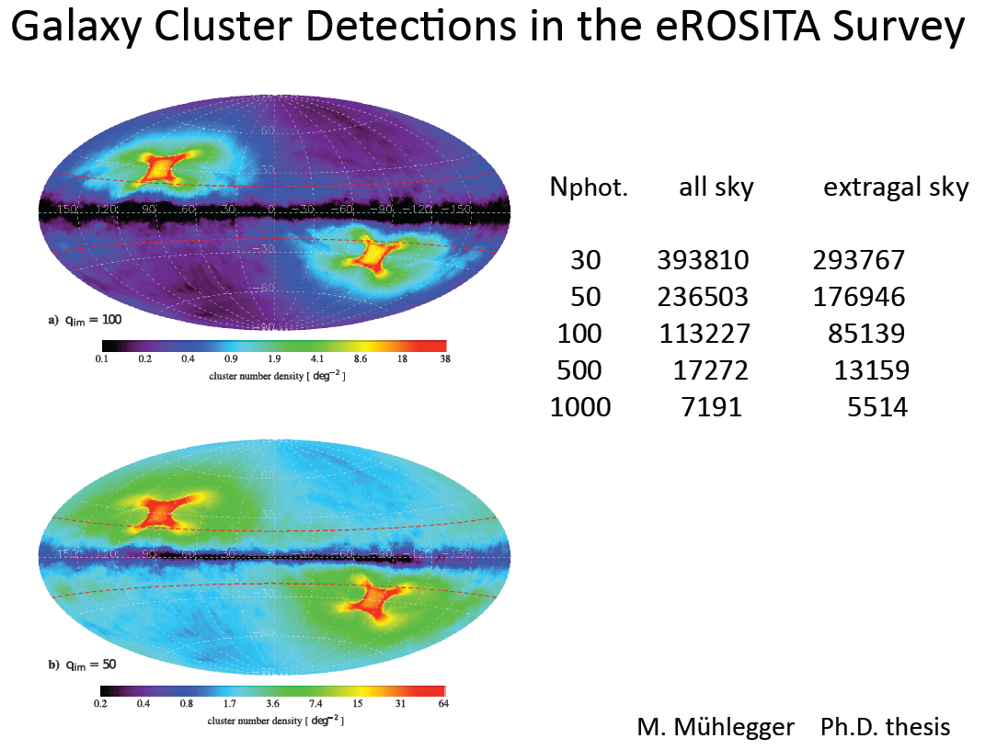
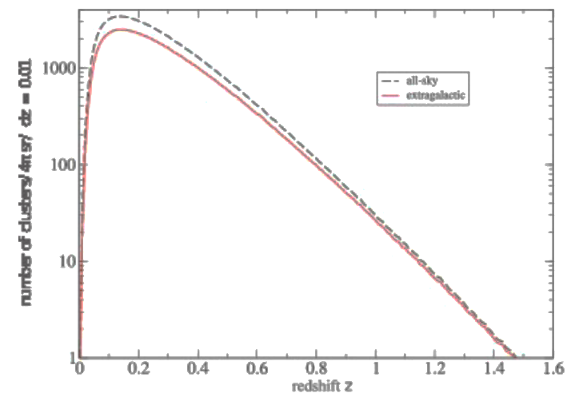
Clusters of Galaxies
100.000 GCs in eRASS
- Core Science of eROSITA -
Cluster mass function evolution with redshift for different cosmologies
→ constraints on Ω_{m}, Ω_{λ}, σ₈
→ e.g., Chon; Miyaji; Reiprich; Takey; Zhang; this conf.

Slide 15
Working Groups
„Science Working Groups“: Chairs
Clusters and Cosmology H. Boehringer, J. Mohr, T. Reiprich
AGN, Blazars K. Nandra
Normal Galaxies F. Haberl
Compact objects A. Schwope, A. Santangelo
Stars J. Robrade, J. Schmitt
Solar System K. Dennerl
Diffuse emission, SNR W. Becker, M. Freyberg, M. Sasaki
„Infrastructure Working Groups“:
Time Domain Astrophysics J. Wilms, I. Kreykenbohm
Data analysis, source extraction, catalogs H. Brunner
Multi-wavelength followup J. Mohr
Calibration K. Dennerl
Background M. Freyberg

Slide 16
Follow-up Observations
Needs for followup:
  Enabling studies of cosmology and cluster physics:
  Redshift: phot-z + spec-z, Mass Estim.: weak lens. + velocity disersions
  Evolution of AGN Population
  Redshift estim., phot-z, spec-z
  Galactic Sources
  Followup Context for eROSITA (List not complete!)
    Shallow Multiband OIR Surveys 2MASS, PanSTARRS, SDSS
    Deep Multiband OIR Surveys VISTA, DES
    Optical Spectroscopic Surveys SDSS, BOSS
    Proposed Optical Spectroscopic Surveys 4MOST, BigBOSS, WEAVE, Euclid
    Future OIR Imaging Surveys LSST, Euclid
    Radio, MM Surveys

Slide 17
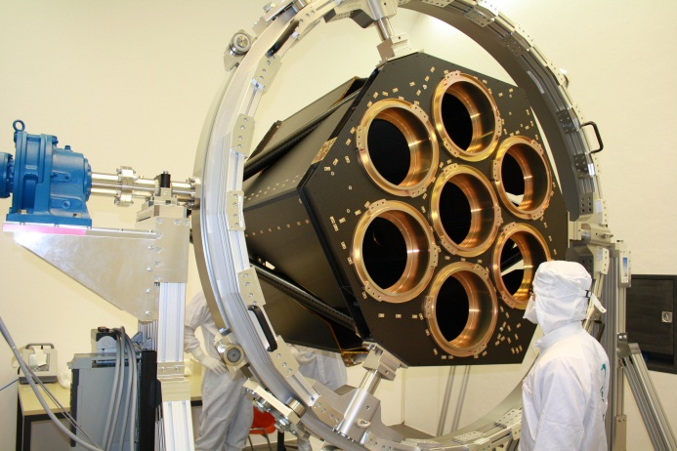
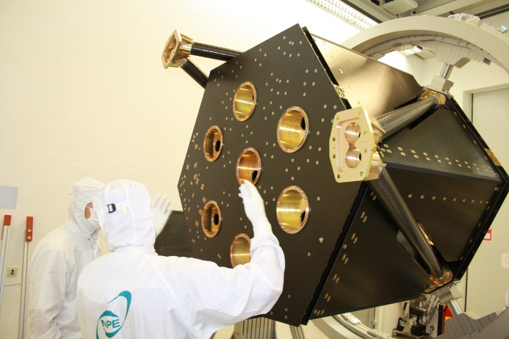
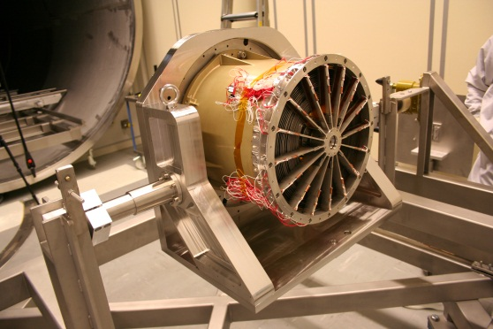
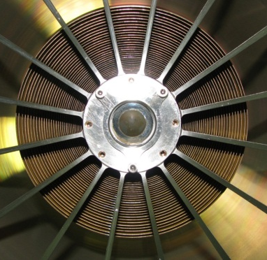
eROSITA Status
Telescope Structure
ready for integration of
subsystems and components
Mirror Modules
FM-production running
FM1 (31 shells) in spec.
FM2 (15 shells) in spec.
15 arcsec HEW, on-axis
→ P. Friedrich et al., this conference

Slide 18
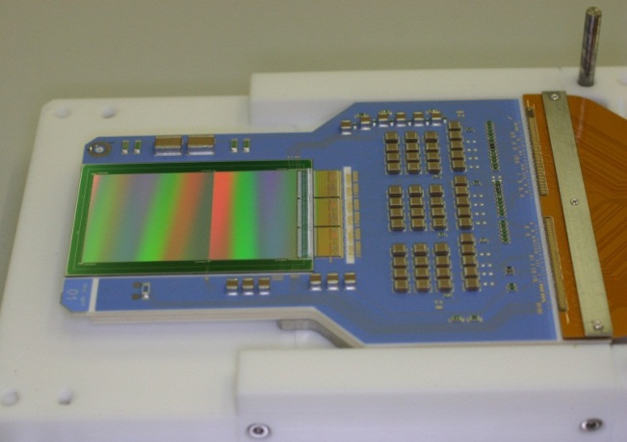
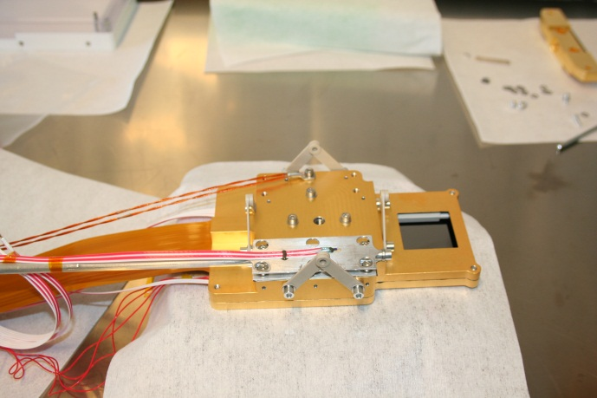
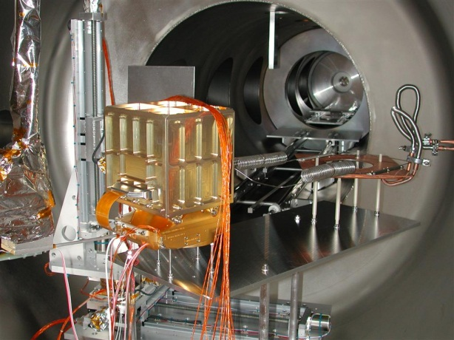
pnCCD-Camera
pnCCD Module working since 2010,
in spec
size: 384 × 384 pixels
= 28.8 × 28.8 mm²
cycle time: 50msec
energy resolution 138eV @ 6 keV

Slide 19
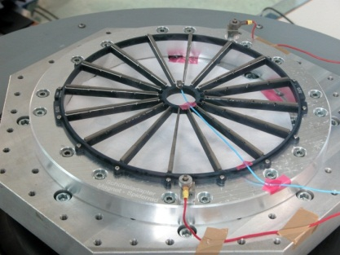
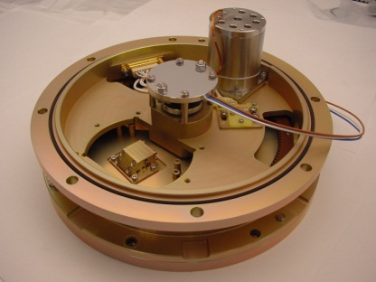
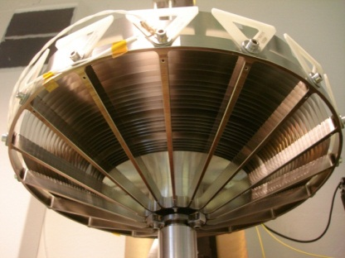
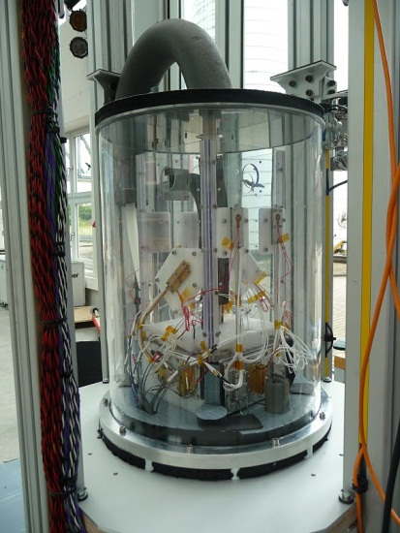
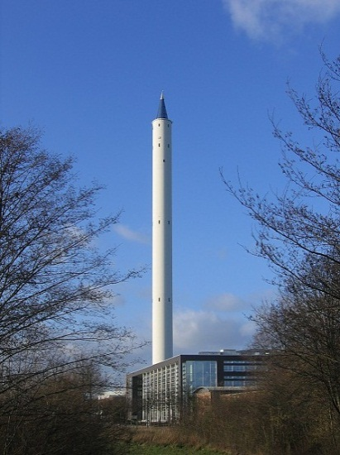
Miscellaneous
Magnetic Electron Deflector qualified
Filterwheel qualified
X-ray baffle qualified
cryogenic heatpipes just tested at the
Drop Tower in Bremen, 10sec µg

Slide 20
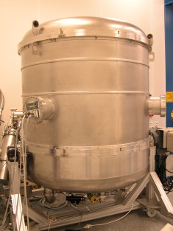
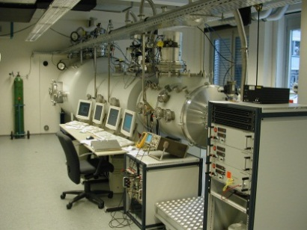
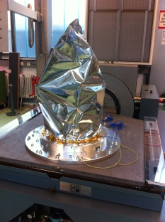
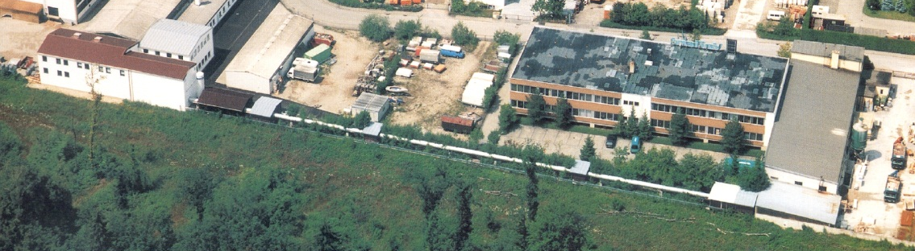
MPE Test Facilities
hundreds of individual tests to be conducted
9 vacuum chambers continuously in operation + shaker + other equipment

Slide 21
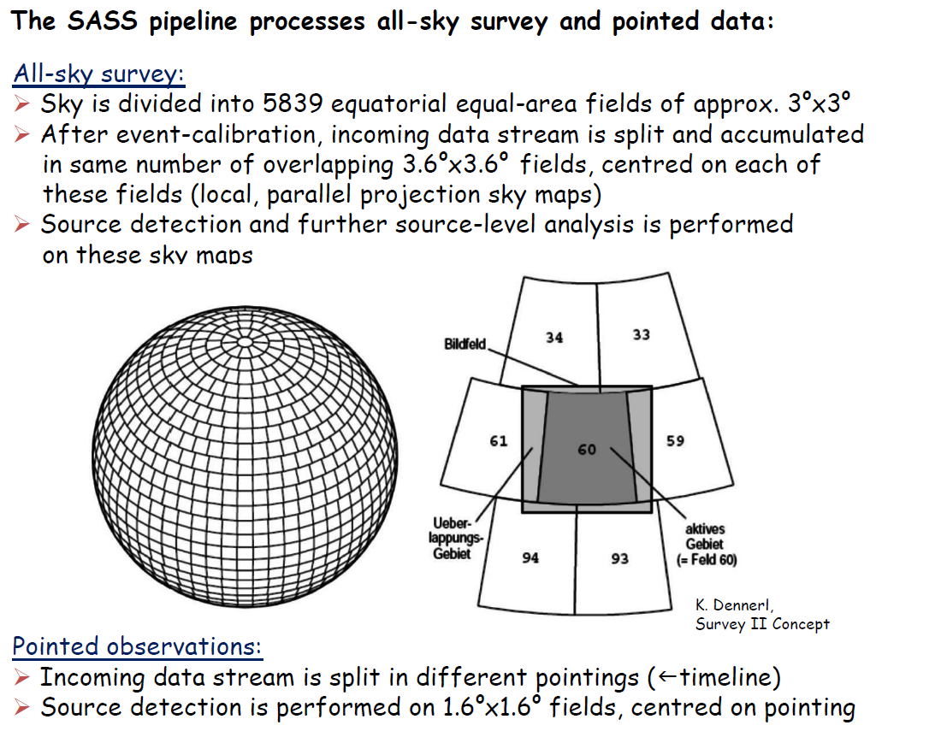
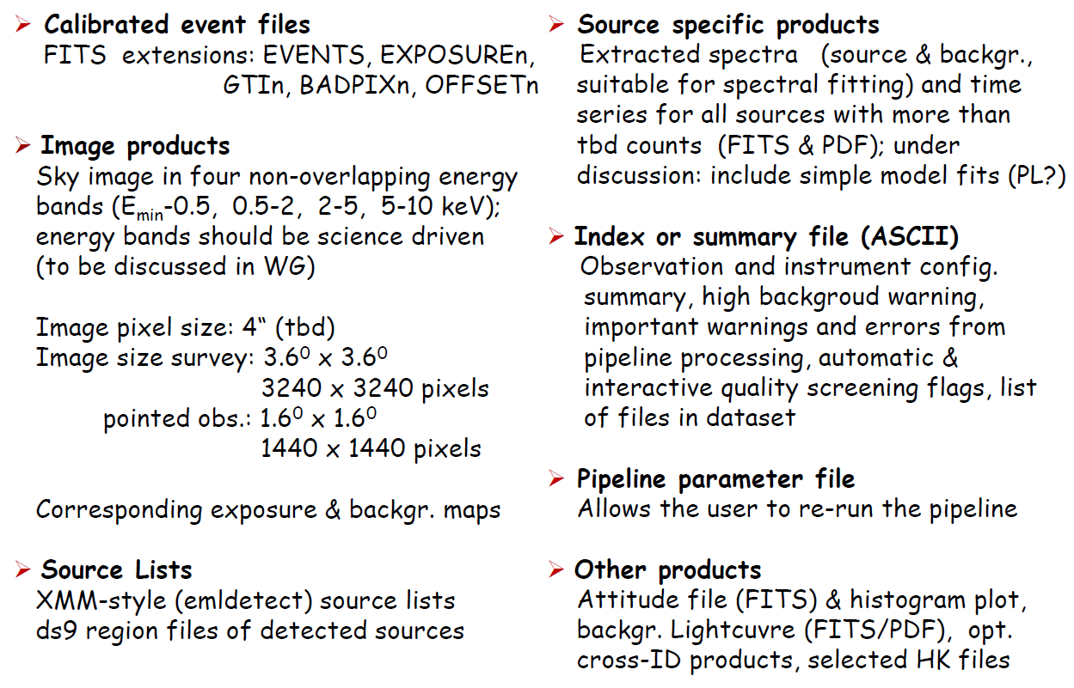
NRTA & SASS & Catalogues
NRTA (Near Real Time Analysis) work in progress (till mid 2012)
SASS (Standard Analysis Software System) work in progress (till mid 2012)
Tests of all software systems starts mid 2012
→ e.g., H. Brunner et al., this conference

Slide 22
Summary
HW: No major issues, „normal work“
eROSITA schedule compatible with delivery in December 2012
Open: Sky split between IKI and MPE
(due date July 1st = tomorrow)
Science Working Groups established & working
Discussions with potential collaborators

Slide 23
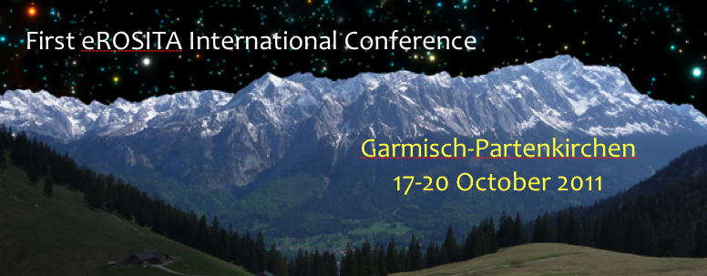
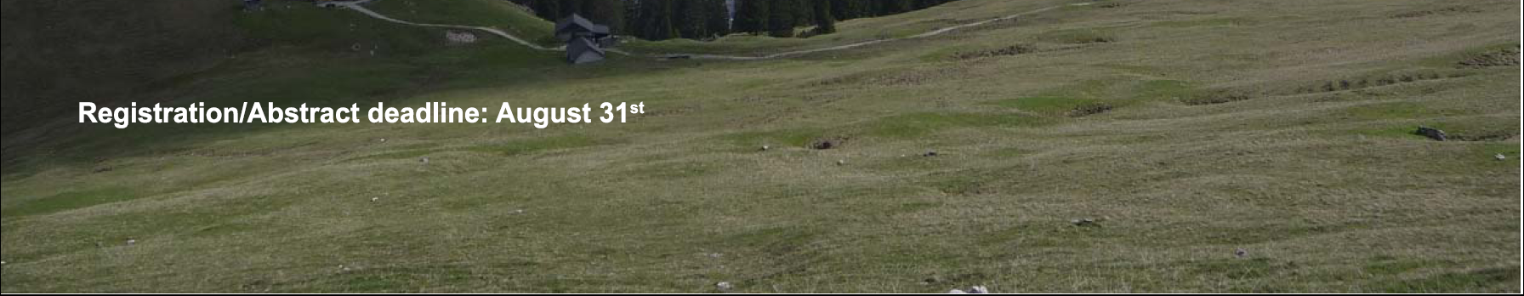
http://www.mpe.mpg.de/erosita/erosita2011/index.html

Slide 24
Simulations
Pointing Scan
Off-axis blurring of a Wolter-I telescope →
PSF has to be averaged over the FoV
15 arcsec on-axis → 28 arcsec averaged

Slide 25
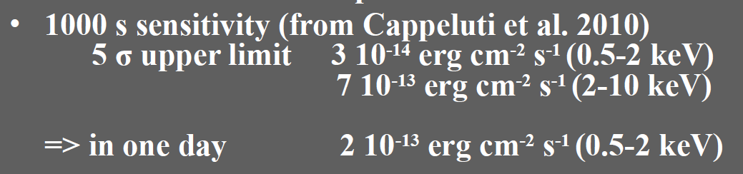
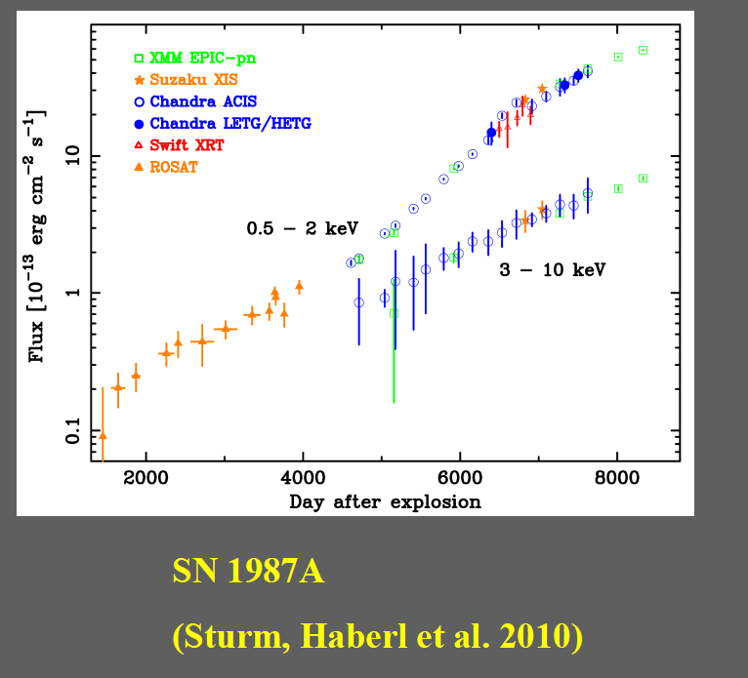
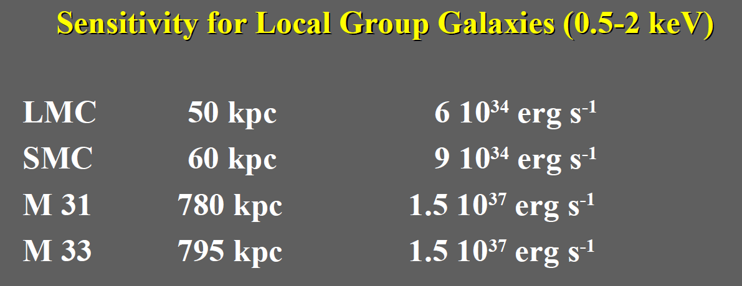
Nearby Galaxies
15 – 20.000 Galaxies in eRASS
Prokopenko & Gilfanov, 2009
→ e.g., F. Haberl, W. Pietsch, this conference

Slide 26
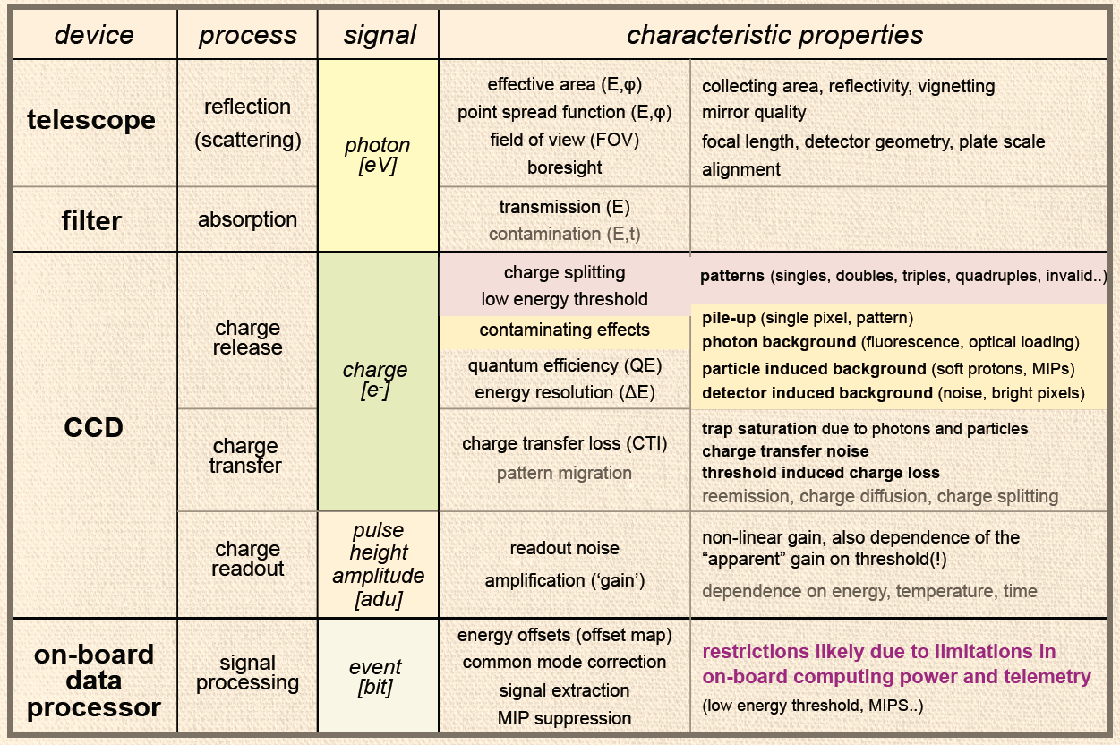
Calibration
court. K. Dennerl

Slide 27
Outline
Description of eROSITA
Science with eROSITA
Status of eROSITA

