Slide 1
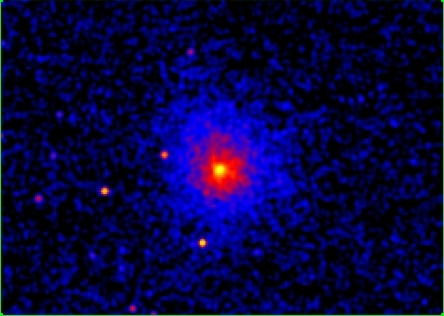
CHANDRA’s view of cool-core clusters at high-z Joana Santos (ESAC/ESA)
P. Tozzi (INAF-OATS), P. Rosati (ESO), H.Boehringer (MPE),
M. Nonino (INAF-OATS), G. Giovaninni (INAF-BO)
The X-ray Universe – Berlin 2011

Slide 2
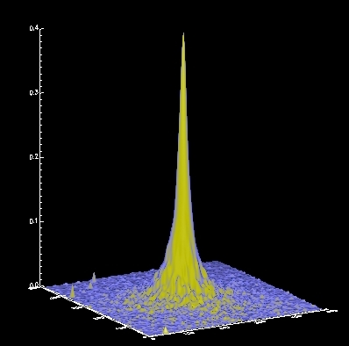
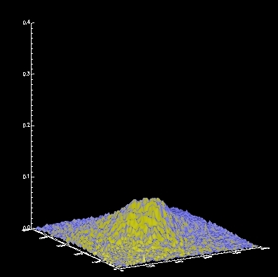
Cool-core clusters
CC
Non - CC
- Central surface brightness excess
- Central cooling time << t_{HUBBLE}
- Low central entropy (< 30 kev/cm2)
- Temperature drop: T_{c} ~ 1/3 T_{avg}
Complex physics:
heating counteracts cooling -> AGN energy injection
Feedback mechanisms between ICM and BCG
CC as the end stage of cluster virialization
Local universe is dominated by CC: 50-70% e.g. Hudson+2010
z<0.4 No evolution Bauer+2005
0.5<z<0.9 Strong evolution 400SD -> density cuspiness Vikhlinin+2007
0.7<z<1.4 Moderate evolution: most high-z clusters are moderate CC
RDCS -> surface brightness concentration Santos+2008
Notes:
Cc – cluster assembly process – formation and mass assembly scenarios

Slide 3
using Chandra data of 3 cluster samples at 0.1< z< 1.3 - c_{SB} , surface brightness concentration - central entropy - central cooling time Deep Chandra data of WARPJ1415 at z=1 JS, P.Tozzi, P.Rosati, M. Nonino, G. Giovaninni 2011 in prep
The evolution of cool-core clusters
JS, P.Tozzi, P.Rosati & H. Boehringer 2010 A&A
- surface brightness analysis
- spectroscopic analysis: temperature & metallicity profiles
- central cooling time & central entropy
- central radio source

Slide 4
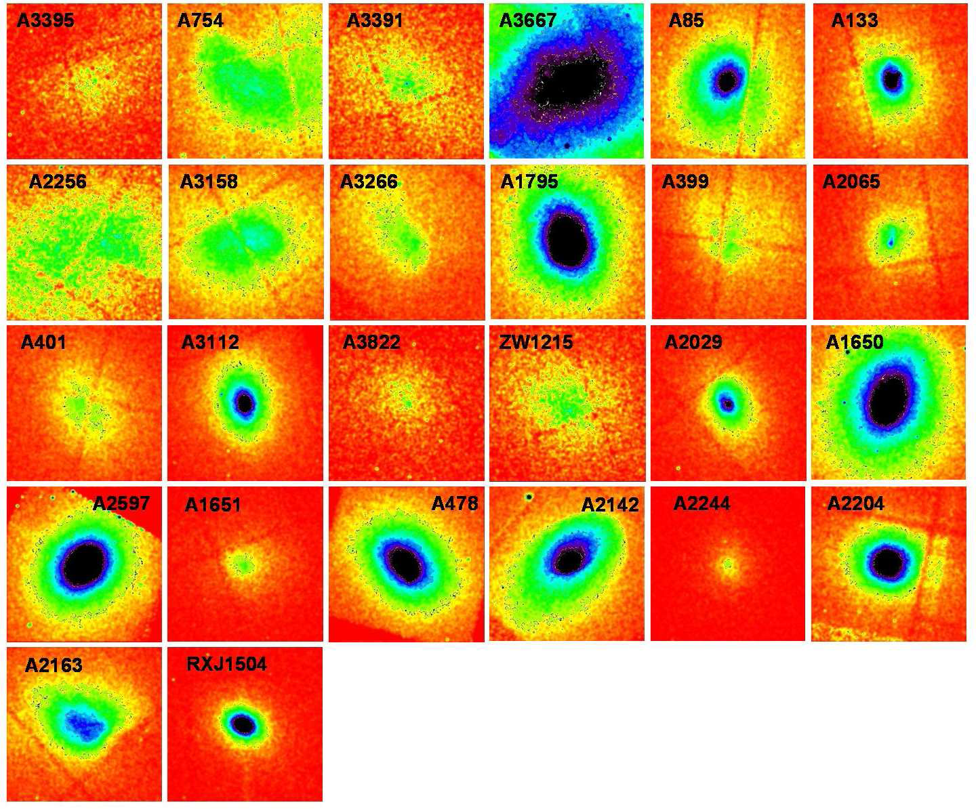
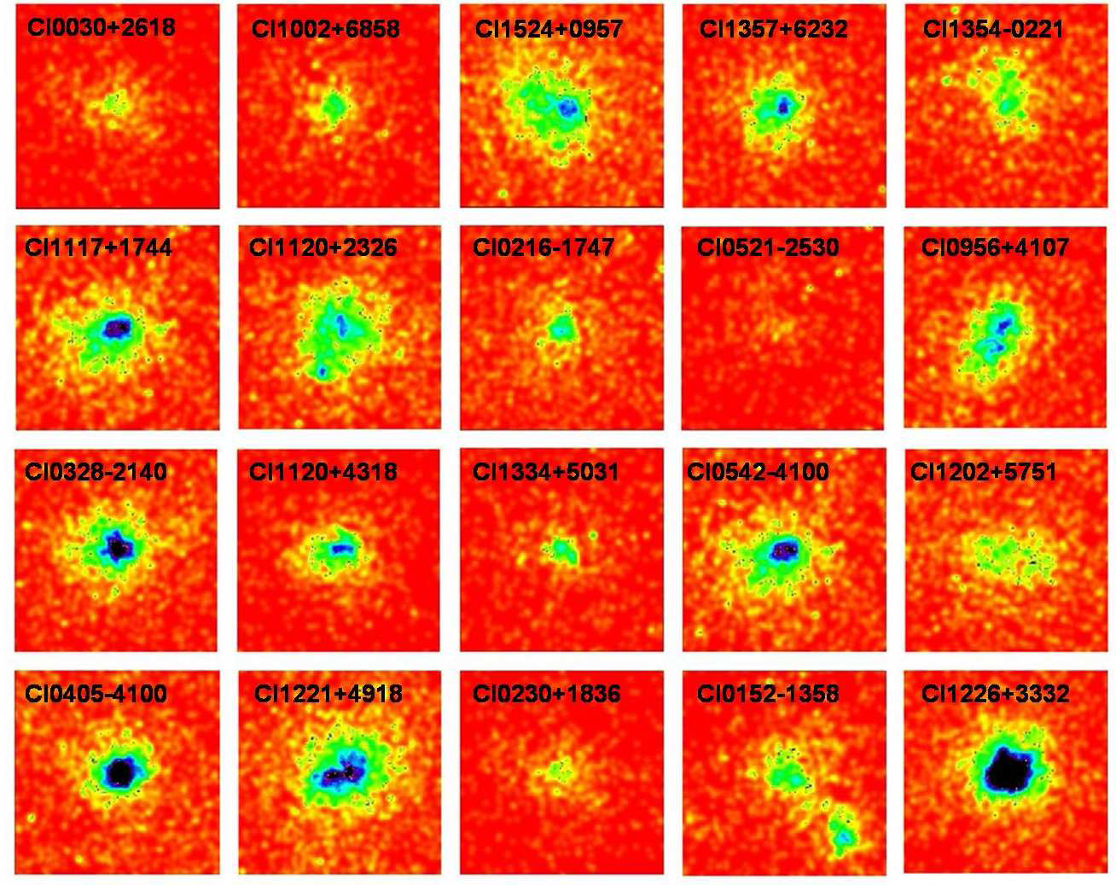
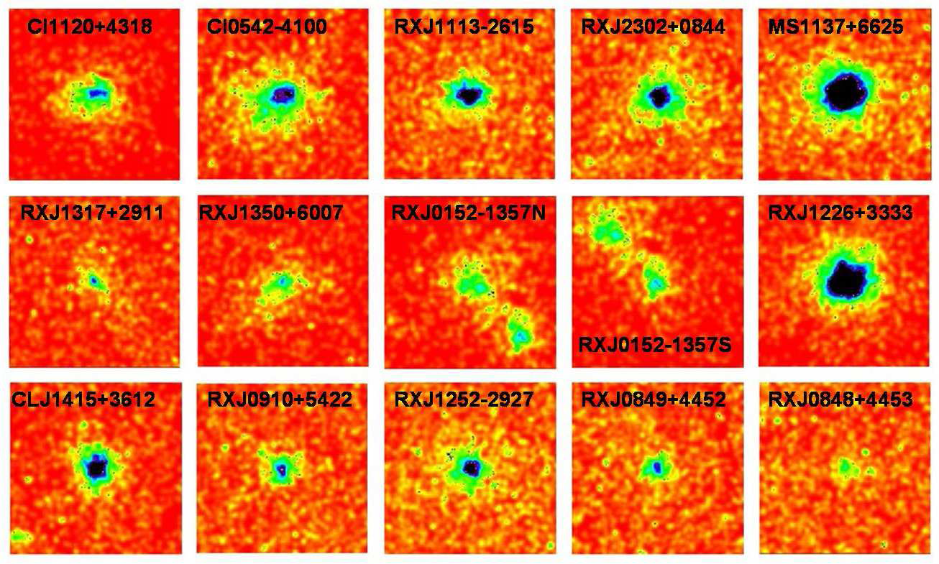
Chandra data of 3 cluster samples
26 clusters
400SD
0.1< z <0.2
20 clusters 400SD
0.5<z<0.9
15 clusters RDCS+WARPS 0.7< z <1.3

Slide 5
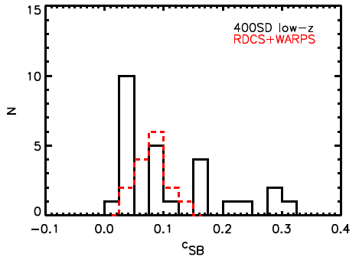
Surface brightness concentration
Santos et al. 2008
c_{SB} = SB (r< 40 kpc)
SB (r< 400 kpc)
Non cc
Strong cc
Most of high-z cluster in moderate cool core region

Slide 6
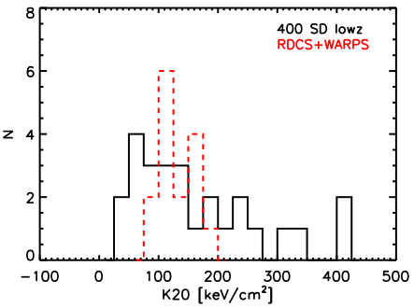
Central entropy r=20kpc
1 Temperature
Strong cc
Non cc
Ko < 30 keV/cm2
Cavagnolo+ 2008

Slide 7
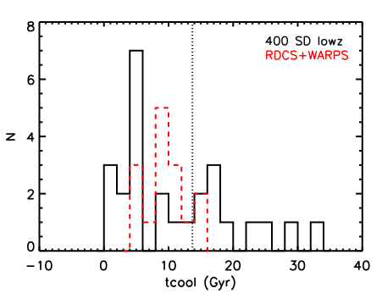
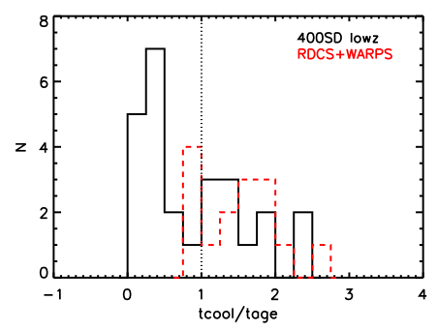
Central cooling time r=20kpc
1 Temperature
BUT we don’t know the
age of the clusters …!!

Slide 8
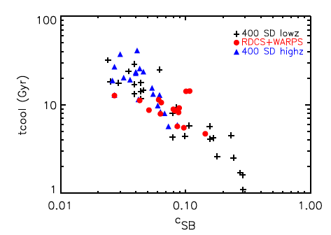
Correlation between t_{cool} and c_{SB}
c_{SB} shows very strong correlation with t_{cool}:
the best cooling estimator at high-z (Hudson + 2010)

Slide 9
Summary I
Moderate evolution of cool-core clusters up to z=1.3
- Lack of strong CC, but large fraction of high-z moderate CC
- No sign of cc/ncc bimodality
- 400SD-highz skewed to low concentrated clusters:
-> we used the RDCS+WARPS to measure evolution
- usefulness of a simple parameter, c_{SB}, as a CC estimator in low S/N data
-> Cool-cores must have formed at z > 1.4
-> Need more data: next-generation X-ray survey mission!
We chose the strongest high-z cc in our sample
to investigate the cc properties in detail :

Slide 10
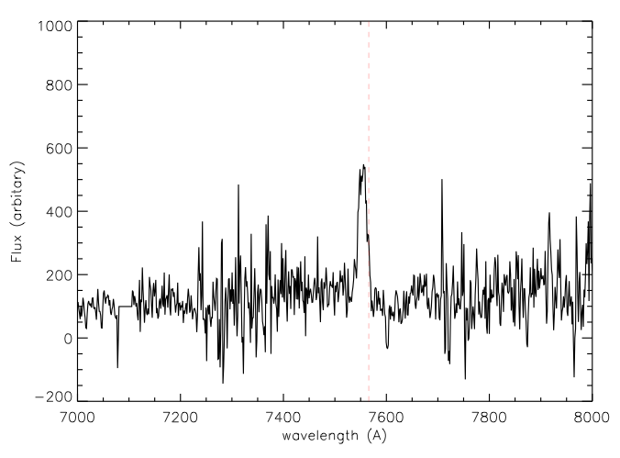
WARPJ1415 @ z=1, a CC in the distant Universe
ACS i775-z850
HST/ACS
90 ksec archival ACIS-I data:
T=7 keV
Lx[0.5-2.0]=4x10^44 ergs/s
t_{cool}=3.4 Gyr
c_{SB}= 0.145 (moderate/strong cc)
BCG - OII
GEMINI / GMOS
courtesy of A. Edge
Very bright, massive BCG
with OII emission
280 ksec ACIS-S Cycle 12
(PI JS))
~ 8000 net counts
8 bins spectroscopic analysis

Slide 11
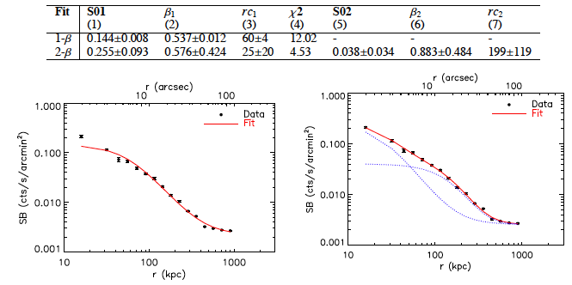
WARPJ1415: double beta model fit to surface brightness
LL _{core} ~ 4 L _{tot}l
ACS i775-z850
Notes:
Profile will be used for an accurate mass determination

Slide 12
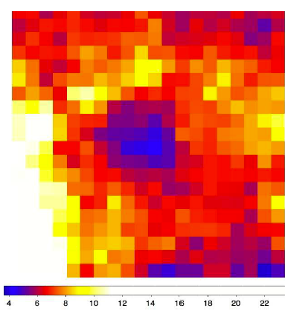
WARPJ1415: temperature profile & map
40” ~ 320 kpc
Temperature drop: T_{c}=4.7±0.4 keV
<T> ~ 6 keV
ACS i775-z850

Slide 13
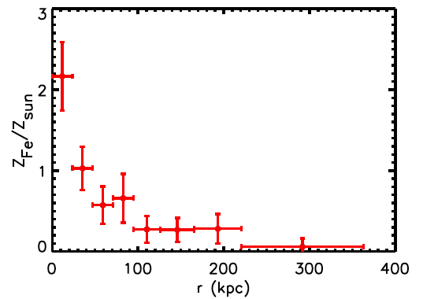
WARPJ1415: metallicity profile
Fe peak: Z_{fe, c}=2.1 ± 0.4 Z_{sun}
< Z_{fe}> ~ 0.2 Z_{sun}
We also detect Si, S, Ni at 2-σ
ACS i775-z850

Slide 14
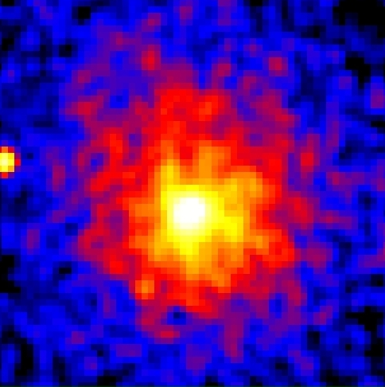
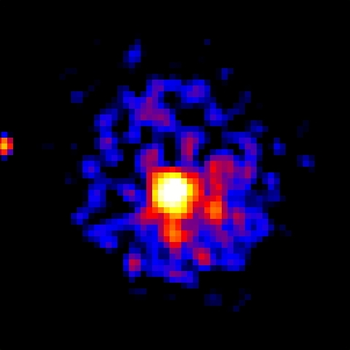
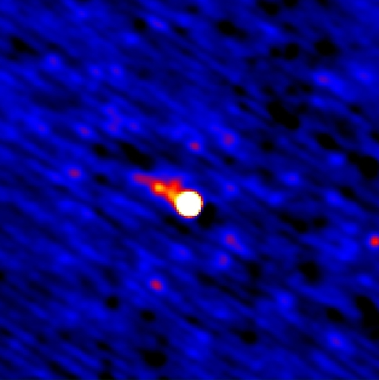
WARPJ1415: X-rays + radio interaction
Chandra Residual Radio VLA (res ~ 2”)
80 kpc
1’ (480 kpc)
Asymmetry in SB in
north part, 45°
Nuclear emission:
L_{1.4GHz} = 2.0x10^25 W/Hz
+ one sided jet/tail feature
1’
ACS i775-z850

Slide 15
WARPJ1415: cool core estimators
CC parameter | Archival 90 sec | Combined 370 ksec
T_{drop} | -- | 4.7 – 8.2 – 5.7 (keV)
Z_{fe,c} | -- | 2.1±0.4 Z_{sun}
c_{SB} | 0.144±0.016 | 0.150±0.007
t_{cool,c} | 3.4 Gyr | 0.7 Gyr
K0 | 80 keV/cm2 | 26 keV/cm2
The importance of deep data for high-z clusters!

Slide 16
Summary II
WARPJ1415 is a a cool-core cluster at z=1!
- using the deepest Chandra data of a high-z cluster (370 ksec)
we measure:
- SB profile: 2 β-model required (ongoing: X-ray mass profile)
- temperature drop similar to the ones in local cc clusters
- central cooling time < 1 Gyr, central entropy < 30 keV/cm2
- very high Fe peak -> clue to enrichment mechanisms & timescales
- radio source in the center + OII emission in the BCG
The X-ray properties of the cool-core in WARPJ1415 are
very similar to the ones of low-z cool-cores
Ideal high-z cluster to study the ICM-BCG feedback
mechanisms

