Slide 1
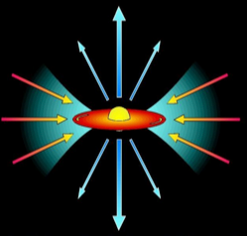
x
x
Stellar X-ray sources
x
Wolf-Rayet stars
x
x
FU Or outbursts
OB-stars
protostars
(Class 0; Class I)
HAeBe stars
x
Companions?
Winds,
magn.fields
Pre-main sequence stars
(= T Tauri stars) + young BDs
A(p)-stars
Accretion,
Jets, coronae
Solar-type stars
coronae
X-ray emission from stars
Recent advances
and future prospects
Beate Stelzer
(INAF – Osservatorio Astronomico di Palermo)
Very low-mass stars
+brown dwarfs
Coronae?

Slide 2
Topics of this talk:
Rotation-activity-age relation
X-rays from accretion in pre-MS stars + brown dwarfs
X-ray emission from pre-MS jets

Slide 3
Rotation-activity connection on the main-sequence
In main-sequence stars 3 regimes of rotation-activity relation:
correlation L_{x} and P_{rot} for slow rotation
“saturation” with L_{x} independent of P_{rot}
“super-saturation” (decreasing L_{x} for fastest rotators)
Origin of saturation:
Complete coverage of corona with active regions (filling factor=1) (Vilhu et al. 1984)
Centrifugal stripping of coronal loops (Jardine & Unruh 1999)
Origin of super-saturation:
A) Field dragged to pole (reduced filling factor) (Stepien et al. 2001)
B) Centrifugal stripping of coronal loops (Jardine & Unruh 1999)
Pizzolato et al. (2003)

Slide 4
Rotation-activity connection on the main-sequence
In main-sequence stars 3 regimes of rotation-activity relation:
correlation L_{x} and P_{rot} for slow rotation
“saturation” with L_{x} independent of P_{rot}
“super-saturation” (decreasing L_{x} for fastest rotators)
Pizzolato et al. (2003)
Better dynamo indicator:
Rossby number
directly related to dynamo number

Slide 5
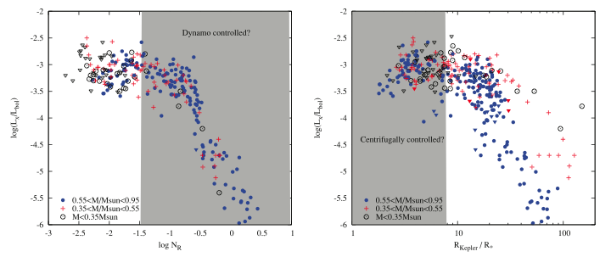
Rotation-activity connection on the main-sequence
Jeffries et al. (2011)
Regime of fast rotation:
Super-saturation for K- but not M-dwarfs;
Corotation radius controls activity:
Centrifugal stripping of coronal loops (Jardine & Unruh 1999)
Regime of slow rotation:
Little scatter for different masses;
Dynamo controls activity

Slide 6
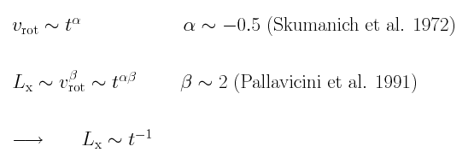
Rotation-activity-age connection on the main-sequence
Expected X-ray/age relation:
Measuring X-ray/age relation:
comparison of observed and predicted galactic star counts
direct comparison of age/X-ray luminosity
Problem:
Surveys either not deep enough (no old stars) or small area (few stars)
Problem:
Age of individual stars not known

Slide 7
Rotation-activity-age connection on the main-sequence
Expected X-ray/age relation:
Potential for future wide-area X-ray surveys (Rosita, Athena/WFI ?, … ):
high sensitivity + high number statistics
f_{lim} ~ 10⁻¹⁴ erg/cm²/s All-Sky Survey
A) comparison of observed and predicted galactic star counts
Stelzer et al., in prep.
Chandra/COSMOS 0.9 60 Wright et al., 2010
Poster N.Wright
β=-2.68
CDFN:
Expected decay law produces too many stars
→ Decline of X-ray luminosity with age must be faster
Feigelson et al. (2004)

Slide 8
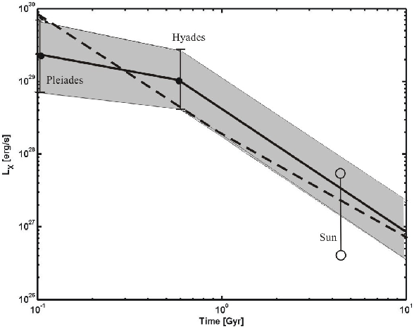
Rotation-activity-age connection on the main-sequence
Expected X-ray/age relation:
Scaling law
from XLF:
B) Direct comparison of age/X-ray luminosity
Fig. from Penz et al. (2008)
6 solar analogs
(“The Sun in time”; Ribas et al. 2005)

Slide 9
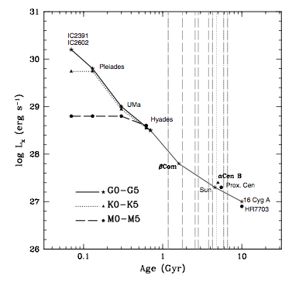
Rotation-activity-age connection on the main-sequence
Expected X-ray/age relation:
B) Direct comparison of age/X-ray luminosity
Ongoing Chandra + XMM-Newton program
(PI Ribas):
“Calibrating the time-evolution of the
high-energy emission of GKM stars”
…for GKM star companions to WDs
…concentrating on M-stars
M3.5 Chandra obs.
Garces et al. (2011)

Slide 10
Rotation-activity connection on the pre-MS
ONC / COUP
ONC -- Preibisch et al. (2005)
Open Clusters -- Pizzolato et al. (2003)
Sun -- Messina et al. (2003)
Preibisch et al. (2005)
Correlation between L_{x} /L_{bol} and P_{rot} (?), contrary to expectation
long convective timescales on pre-MS, all ONC stars are saturated or super-saturated

Slide 11
Rotation-activity connection on the pre-MS
Taurus / XEST
TMC non-accreting
TMC accreting
Open Clusters (Pizzolato)
ONC (Preibisch)
In contrast to MS stars
much larger scatter of
L_{x} /L_{bol} for given R₀:
Variability
Unresolved binaries
make up for <0.5 dex
C) accretion
Briggs et al. (2007)

Slide 12
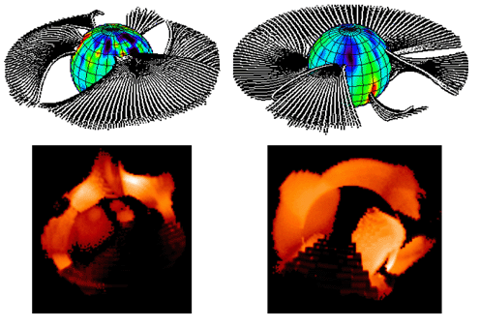
Accretion + X-ray luminosities in pre-MS stars:
Accretion suppresses X-rays ?
Potential of future X-ray missions:
time-resolved medium-resolution spectroscopy → variations in L_{x} and N_{H} related to accretion structure
Accretors have lower L_{x} than non-accretors.
Possible explanation:
Higher density → less efficient heating
Less efficient convection → weaker dynamo
X-ray emission obscured by accretion streams (Gregory et al. 2007)

Slide 13
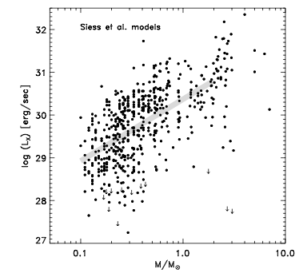
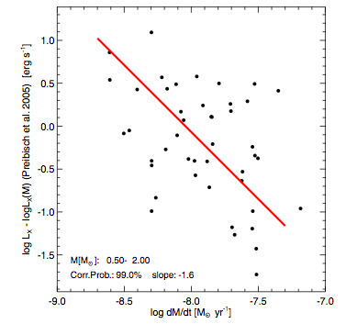
Accretion + X-ray luminosities in pre-MS stars:
X-rays shut off accretion ?
COUP ( = Chandra Orion Ultradeep Project) …. 850 ks Chandra
Preibisch et al. (2005a)
Drake et al. (2009)
Accretors have lower L_{x} than non-accretors.
Possible explanation:
Strong X-rays photoevaporate disks
→ Accretion ceases
Poster J.Drake

Slide 14
Rotation-activity connection for ultracool dwarfs ?
Ultracool dwarf = dwarf with SpT M7 and later
Origin of (super)saturation:
Negative feedback of dynamo (Kitchatinov et al. 1994)
Field dragged to pole (reduced filling factor) (Stepien et al. 2001)
Centrifugal stripping of coronal loops (Jardine & Unruh 1999)
But:
Centrifugal stripping requires R_{corona} > few R*
Berger et al. (2008b)
ultracool dwarfs ~ 1 dex less active at “saturation” (P~0.4…1 d)
most rapid rotators: A) evidence for super-saturation ? or B) reduced coronal heating ( due to high electrical resistivity at low T_{eff}) ?

Slide 15
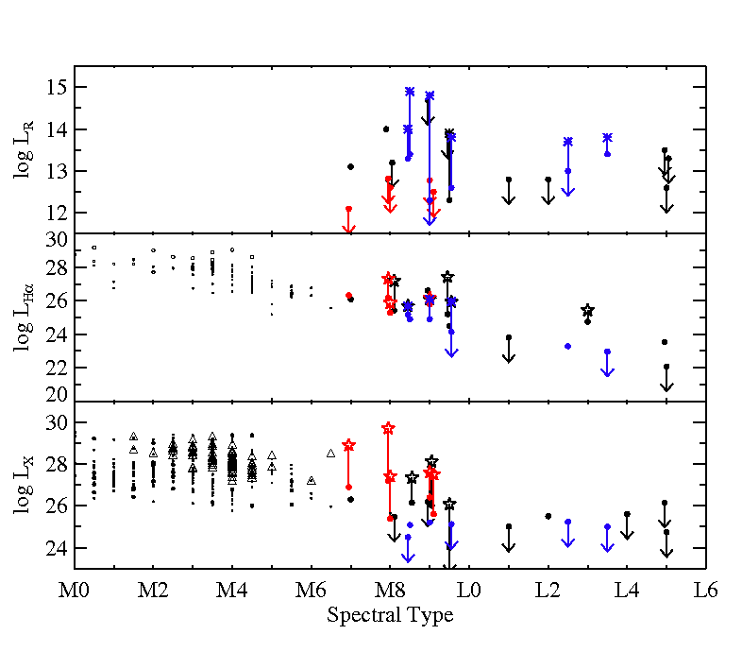
Coronal vs. chromospheric vs. transition region activity
fully convective
transition
AIM: compare heating mechanisms in different layers of atmosphere
Potential for future wide-area X-ray surveys (Rosita, Athena/WFI ?, … ):
X-ray properties of large sample of ultracool field dwarfs
d < 20 pc
Big effort in recent Hα surveys
but no new X-ray survey since ROSAT
Rough completeness of
X-ray detections for M stars:
7pc > 90 %
15pc ~ 75 %

Slide 16
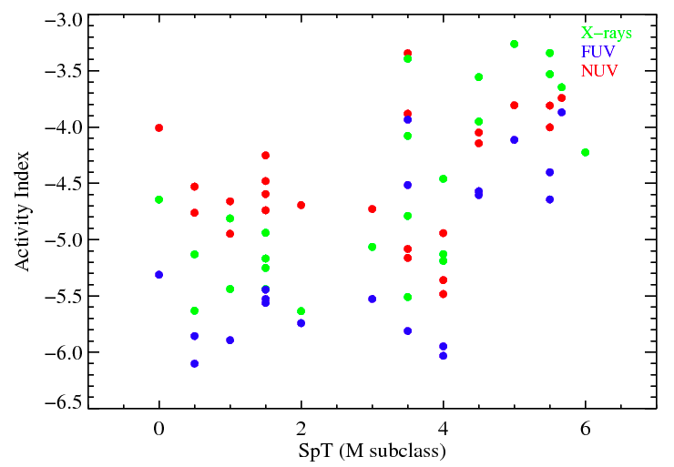
Coronal vs. chromospheric vs. transition region activity
fully convective
transition
AIM: compare heating mechanisms in different layers of atmosphere
X-ray and UV emission
show transition
at SpT M3…4
(Poster A.Marino)
d < 20 pc
Big effort in recent Hα surveys
but no new X-ray survey since ROSAT
Rough completeness of
X-ray detections for M stars:
7pc > 90 %
15pc ~ 75 %

Slide 17
Brown dwarfs:
X-rays from accretion shocks?
Chandra ACIS-S
Highest quality X-ray data
for a BD so far:
~ 600 cts for FUTauA
Stelzer et al. 2010
FUTauA is „peculiar“:
far above the evolutionary models in the HR diagram
→ Extreme youth or strong accretion or activity influencing L_{bol} and/or T_{eff} ?

Slide 18
Brown dwarfs:
X-rays from accretion shocks?
Highest quality X-ray data
for a BD so far:
~ 600 cts for FUTauA
Untypically low temperature (0.24 keV);
as in the prototype accreting TTS TW Hya !
X-rays from accretion
diagnosed by
Soft spectrum
High density
Stelzer et al. 2010
Athena can
* sample statistical numbers of low-res. spectra for BDs to determine X-ray temperature
* obtain first high-res. Spectrum of BD → density measurement

Slide 19
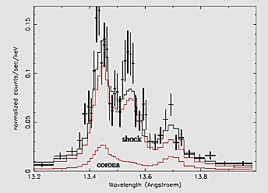
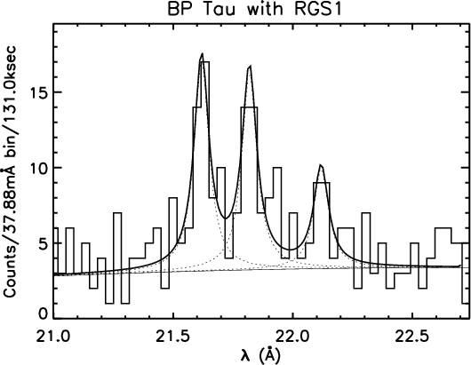
Origin of high-density X-ray emitting gas in cTTS
High density (~ 10¹² cm⁻³ ) in accretion shock;
1-d slab model for accretion column
TW Hya Guenther et al. (2007)
XMM/RGS Ne IX triplet
(corona + shock)
intercombination
resonance
forbidden
Steady state accretion shock
+ coronal contribution
explains triplet shapes
for TW Hya
Schmitt et al. (2005)
Few cTTS bright enough for Chandra/XMM gratings:
BP Tau, V4046 Sgr, CR Cha, T Tau

Slide 20
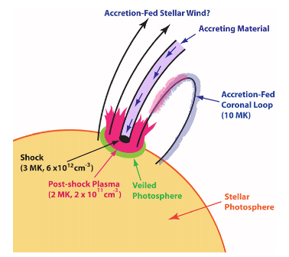
A picture of X-ray emission from TW Hya
High density (~ 10¹² cm⁻³ ) in accretion shock;
1-d slab model for accretion column
Brickhouse et al. 2010
TW Hya Guenther et al. (2007)
XMM/RGS Ne IX triplet
(corona + shock)
intercombination
resonance
forbidden
Steady state accretion shock
+ coronal contribution
explains triplet shapes
for TW Hya
500 ksec Chandra observation of TW Hya:
2-component shock model:
3 MK plasma with higher N_{H} than component B)
2 MK plasma with larger area than component A)
→ accretion-fed corona

Slide 21
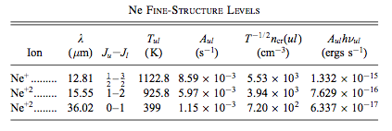
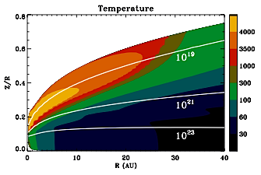
X-ray induced [Ne II] emission
K-shell ionization energy of Ne (0.9 keV) ~ peak of stellar X-ray spectrum → high photo-ionization cross-section for Ne by X-rays
fine-structure transitions of [Ne II] and [Ne III] by collisional excitation:
X-ray irradiation produces
warm disk atmosphere:
~ 4000 K
Glassgold et al. (2007)
Meijerink et al. (2007)

Slide 22
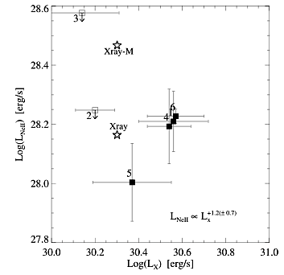
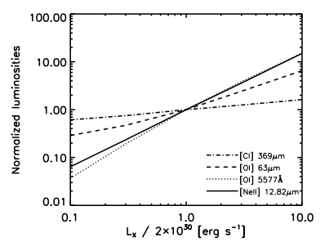
Correlation between [NeII] and X-ray emission ?
Observed relation for FEPS stars:
Flux calculations:
Meijerink et al. (2007)
Flux of [Ne III] 15.5 μm
~ factor 20 lower than [Ne II] 12.8μm
Pascucci et al. (2007)
X-rays from RASS, [NeII] from Spitzer/IRS
→ marginal evidence for correlation (?)

Slide 23
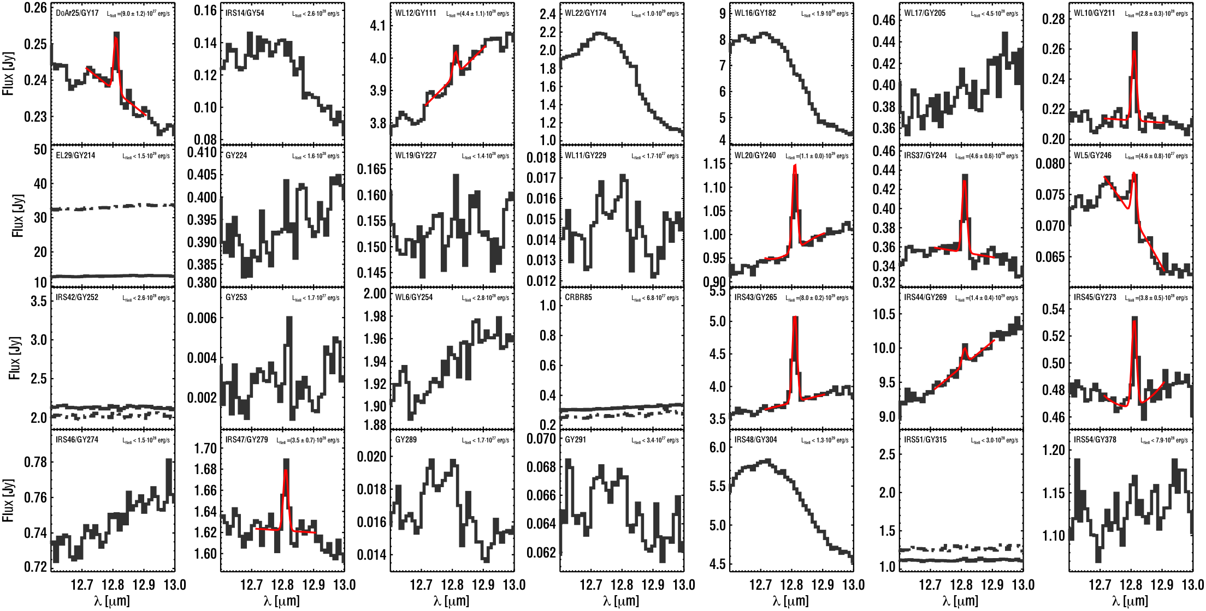
[NeII] emission of DROXO sources
28 Spitzer/IRS targets
in DROXO field: 10 [NeII] detections
22 X-ray detections All [NeII] detections are X-ray sources
Flaccomio et al. (2009)

Slide 24
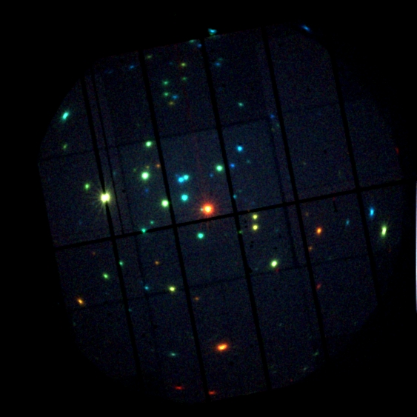
A correlation between [NeII] and X-ray emission ?
Protostars
Accreting T Tauri star
Non-accreting T Tauri star
500 ks XMM-Newton
in ρ Oph Core F
PI Sciortino
3 paper published,
others in prep.
no correlation between L_{x} and L_{NeII}
most L_{NeII} higher than model predictions
L_{NeII} related to evolutionary state?
(Class I have highest L_{NeII} ) --> possible role of inflow + outflow on [NeII] emission
Flaccomio et al. (2009)

Slide 25
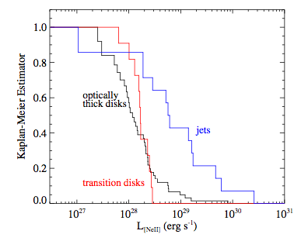
Origin of [Ne II] emission: disks or jets?
Jet driving T Tauri stars
have higher [NeII] luminosity
[Ne II] excitation in jets:
Jet shocks
Stellar X-rays
X-rays from jet
Guedel et al. (2010)

Slide 26
X-ray emission from pre-MS jets
Bonito et al. (2010)
Less than a dozen pre-MS jet shocks have been detected in X-rays.
Characteristics of X-rays from pre-MS jets:
soft emission
weak absorption
displacement of few arcsec to driving pre-MS star (few 100 – 1000 AU)

Slide 27
X-ray emission
from pre-MS jets:
Z CMa
0.2-1.0 keV
0.2-8.0 keV
In 2008:
Detection of an X-ray
source to the SW of ZCMa;
P.A. coincides
with optical jet
0.2-1.0 keV
0.2-8.0 keV
Poetzel et al. (1989)
Stelzer et al. (2009)

Slide 28
The X-ray jet of ZCMa
ORDER OF MAG ESTIMATES
FOR THE JET EMISSION:
1)
Observed X-ray temperature: 0.1-1 keV
v_shock ~ 300…900 km/s compare: v_jet < 600 km/s from optical forbidden lines
i.e. v_shock < v_jet (as expected)
2)
Comparison of displaced photon centroid in 2003 and 2008 Chandra images:
expanding shock front with v_sh ~ 900 km/s ? But: continuous extension of X-ray emission
to the SW in 2008 image suggests temporary radiative loss due to intermittent jet
0.2-1.0 keV
0.2-1.0 keV
Poetzel et al. (1989)
Stelzer et al. (2009)

Slide 29
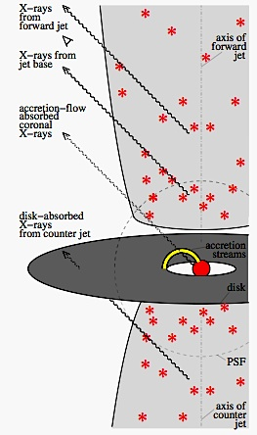
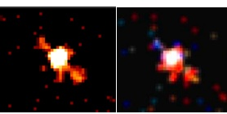
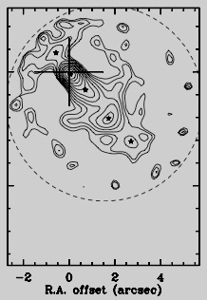
X-ray emission from pre-MS jets: DG Tau
0.6-1.7 keV ACIS-S: DG Tau + jets
4”
Smoothed
Color-coded
Guedel et al. (2008)
4 X-ray emitters in DG Tau system:
soft, weakly absorbed jet
soft, stronger absorbed counterjet
soft, weakly absorbed base of forward jet
hard stellar corona
[OI]6300A
Guedel et al. (2008)
LaValley et al. (1997)
Resolved with Chandra: sub-arcsec separation (Schneider & Schmitt 2008)

Slide 30
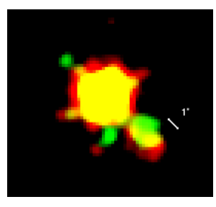
X-ray emission from pre-MS jets: DG Tau
0.6-1.7 keV ACIS-S: DG Tau + jets
4”
Smoothed
Color-coded
Guedel et al. (2008)
2005/2006
2010
4 X-ray emitters in DG Tau system:
soft, weakly absorbed jet
soft, stronger absorbed counterjet
soft, weakly absorbed base of forward jet
hard stellar corona
Guedel et al. (2011)
X-ray shock comoving
with optical jet
→ No stationary structure
Resolved with Chandra: sub-arcsec separation (Schneider & Schmitt 2008)

Slide 31
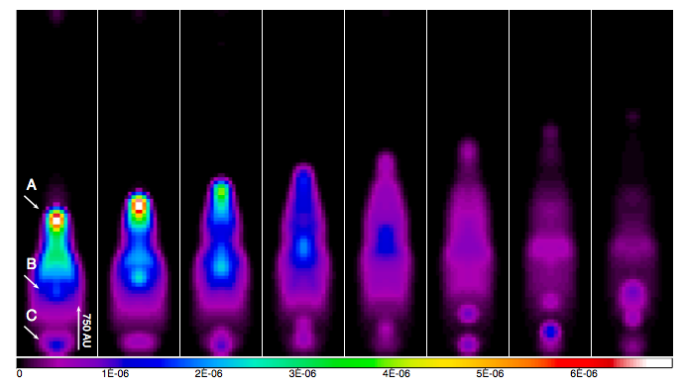
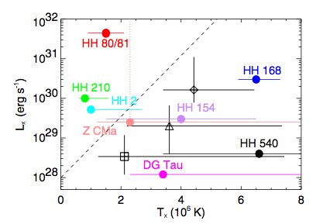
HD simulations of pre-MS jets
Bonito et al. (2010)
2d HD simulations of pulsed jet:
knotty structure
predicted X-ray emission ok for low-mass stars with small distance of X-ray knots to driving source
Bonito et al. (2010)
Huge errors
in observed L_{x} and T_{x} !
High-mass stars

Slide 32
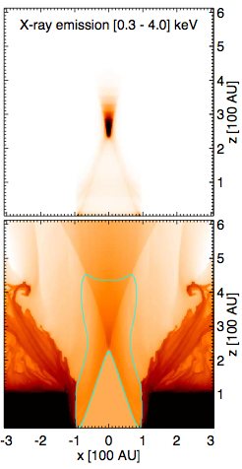
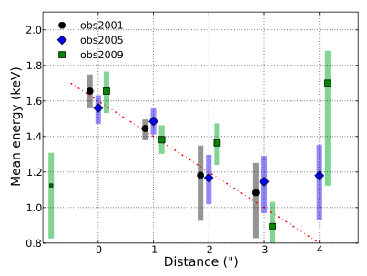
X-ray emission from pre-MS jets: HH 154
stationary
component
Elongated,
variable
component
Future X-ray missions: Not enough spatial resolution
Evidence for decrease of kT and N_{H}
with distance (Schneider et al. 2011)
Synthesized X-ray emission of pre-MS jet
passing thru a nozzle (Bonito et al. 2011)
Poster R. Bonito
Poster P. Schneider

Slide 33
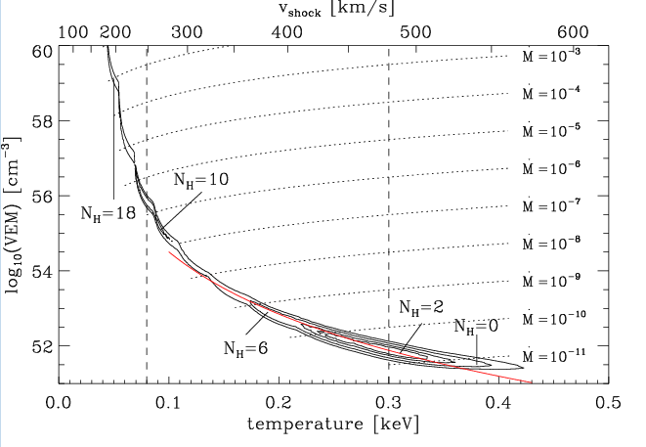
X-ray emission from pre-MS jets:
spectroscopy
Guedel et al. (2007)
TAX - source ( = Two – Absorber X-ray Source)
Potential for future X-ray spectroscopy instruments (Athena/WFI):
constraining soft component in TAX-sources
wabs * apec + wabs * apec
small kT higher kT
small N_{H} higher N_{H}
Soft (jet) component
poorly constrained
(Guenther et al. 2009)
Jet
Stellar corona

Slide 34
Rotation-activity-age-magnetic field
Different origin of “super-saturation” in solar-type stars and UCDs ?
L_{x} / age decay on the main-sequence? (implications for ang.momentum loss..)
X-ray emission from brown dwarfs
How do L_{x} and T_{x} evolve with age ? Does accretion play a role?
Fe Kα emission from pre-MS stars
Is it fluorescence from photo-excitation or electron impact ionization?
Is [NeII] emission from disks or jets?
X-ray emission from pre-MS jets
Is the plasma stationary or moving ? (continuous or pulsed jet?)
And: coronal abundances, flares, CP stars, hot stars, ….

