Slide 1
Populations of accreting X-ray sources in galaxies
Marat Gilfanov
MPA, GArching

Slide 2
Hans-Jakob Grimm
Pavel Shtykovskiy (IKI/MPA)
Rashid Sunyaev (MPA/IKI)
Rasmus Voss (MPA, MPE)
Akos Bogdan (MPA)
Igor Prokopenko (IKI)
Stefano Mineo (MPA)
Zhongli Zhang (MPA)

Slide 3
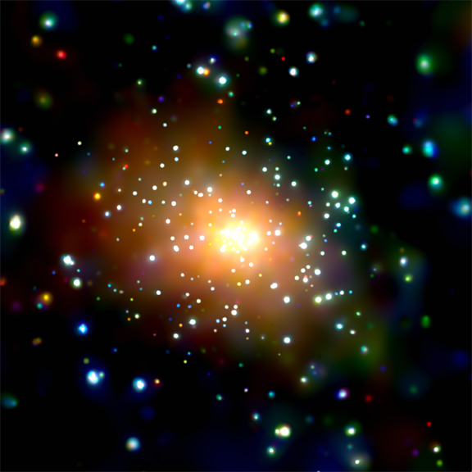
Images: 5
Andromeda galaxy (M31)
Chandra X-ray observatory - resolution 0.5”
~confusion free study of XRB population
in nearby galaxies

Slide 4
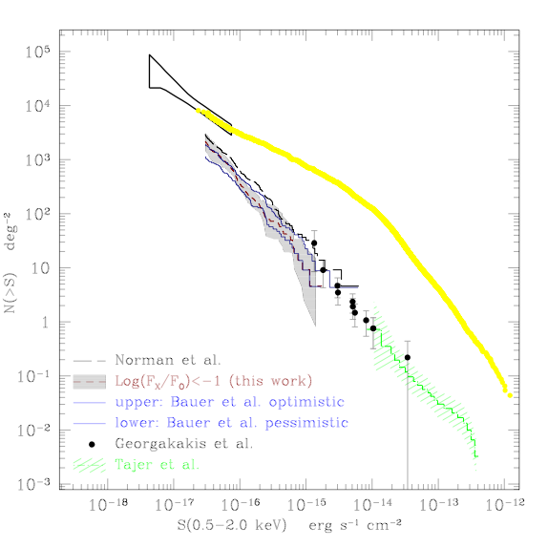
Why to study
X-ray emission from galaxies, properties of galaxies, a new stellar mass and SFR proxy
Normal galaxies dominate in number (but not in total flux)
Ranalli et al., 20006

Slide 5
Why to study
X-ray emission from galaxies, properties of galaxies, a new stellar mass and SFR proxy
Formation and evolution of X-ray binaries luminosity distributions specific frequency, per M* and per SFR

Slide 6
X-ray binaries
High mass companion
Low mass companion

Slide 7
X-ray binaries
High mass companion
Low mass companion

Slide 8
Evolutionary time scales
HMXB
t~10-50 Myrs
~ duration of star formation event
Star formation tracer
LMXB
t~1-10 Gyrs
~ live time of the host galaxy
Stellar mass tracer
Notes:
Explains the facts, which might look puzzling at the first glance.

Slide 9
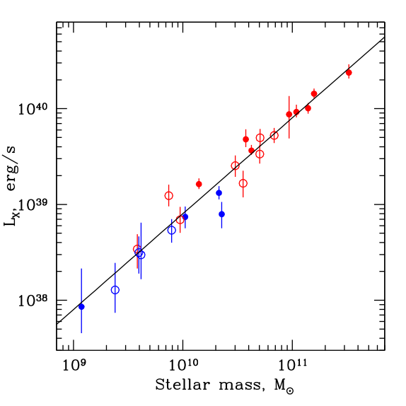
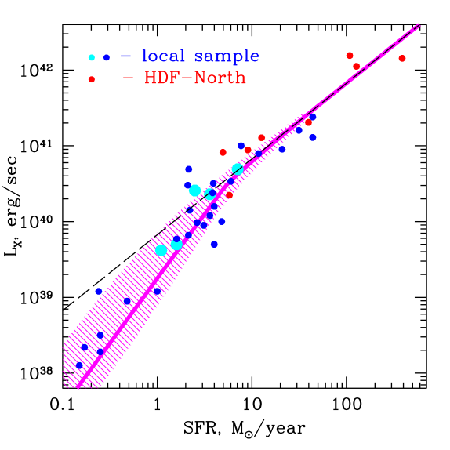
L_{x}, M* and SFR
LMXB
HMXB
Non-physical
effect of statistics
of small numbers
L_{tot}=ΣL_{k}

Slide 10
A new M* and SFR proxy?
LMXB
HMXB
Non-physical
effect of statistics
of small numbers
L_{tot}=ΣL_{k}

Slide 11
BUT: scatter and systematics
LMXB
HMXB
Non-physical
effect of statistics
of small numbers
L_{tot}=ΣL_{k}

Slide 12
A new Lx-SFR study (with Stefano Mineo)
uniform sample
no systematic effects
no data analysis issues
BUT: scatter remains
unlikely to be related to SFR inaccuracy
(almost) no physically meaningful correlations
the mean is consistent with Ranalli et al and Grimm et al.

Slide 13
Luminosity functions

Slide 14
Luminosity functions
HMXBs and LMXBs:
different shapes/slopes different accretion regimes:
wind accretion
Roche-lobe overflow

Slide 15
A new HMXB XLF
still a power law with slope of 1.6, fully consistent with Grimm et al.
still no feature at the L_{edd} for a neutron star
a possible feature at the L_{edd} for a black hole

Slide 16
HMXB XLF & IMF slope
accretion of radiation pressure driven stellar wind

Slide 17
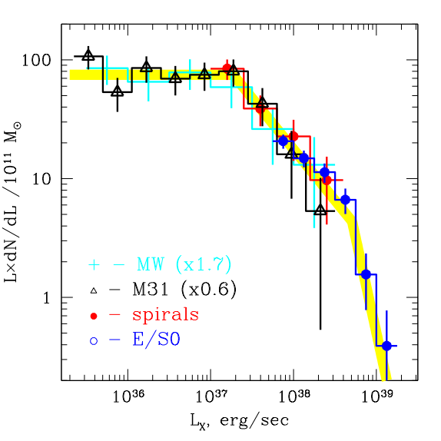
LMXB XLF
gravitational braking
in longer Porb systems
magnetic braking (Sco X-1 etc.)
Evolved companion and/or
Gravitational braking in
ultracompact binaries
NS+WD, Porb~10 min
short life-time problem
King, Bildsten,
Postnov and others

Slide 18
Total number and luminosity of X-ray binaries
L_{x} ~ 2•10³⁹SFR  1•10³⁹M*
N_{x}(L_{x}>10³⁷) ~ 7SFR  10M*
[SFR]= M/yr
[M*]=10¹⁰ M

Slide 19
How many black holes and neutron stars become X-ray sources?

Slide 20
number of HMXBs observed at any given time:
number
of HMXB
birth rate
of compact
objects
fraction
of comp.
objects
duration of
X-ray active
phase

Slide 21
Fraction of compact objects X-ray active once in their lifetime
Powered by accretion from:
high-mass companion (HMXB)
low-mass companion (LMXB)

Slide 22
Dynamical formation of LMXBs in dense stellar environments

Slide 23
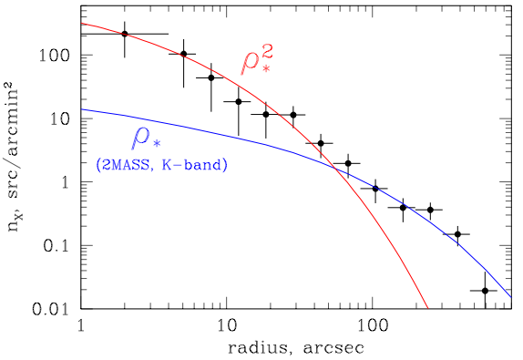
Specific frequencies of LMXBs in the Milky Way
 | total mass | N_{LMXB} | specific frequency
Globular clusters | ~10⁷ Msun | 13 | 1 per ~10⁶ M_{sun}
Galaxy | 5·10¹⁰ M_{sun} | ~200 | 1 per ~10⁸ M_{sun}
Surface density of X-ray binaries in Andromeda galaxy

Slide 24
Specific frequencies of LMXBs in the Milky Way
 | total mass | N_{LMXB} | specific frequency
Globular clusters | ~10⁷ Msun | 13 | 1 per ~10⁶ M_{sun}
Galaxy | 5·10¹⁰ M_{sun} | ~200 | 1 per ~10⁸ M_{sun}
2 stars involved ρ*² dependence on the stellar density
formation rate of LMXBs in the center of Andromeda galaxy: 100 LMXBs per 1 Gyr

Slide 25
Andromeda galaxy (M31)
image: Li & Wang

Slide 26
Luminosity functions (with Zhongli Zhang)
M31, M81, Cen A, Maffei 1, NGC3379, NGC4697, NGC4278, Milky Way
~200 GC LMXB
CXB subtracted incompleteness corrected
paucity of faint sources in GCs
no good explanation so far (He accretors – Voss et al)
field sources
GC sources

Slide 27
Faint field sources
number of sources
contribution to
total luminosity
~3%
Sazonov et al., 2006 Revnivtsev et al., 2006
Notes:
Geroicheskii trud Sergeya Sazonova!

Slide 28
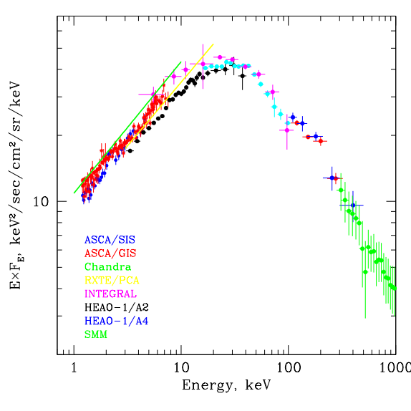
Cosmic X-ray background
CXB spectrum
Chandra Deep Field North (2 Msec)
~80-90% of CXB is resolved into emission of AGN and QSO

Slide 29
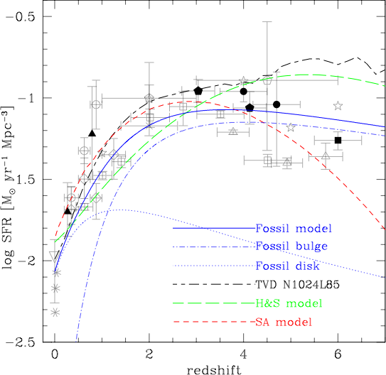
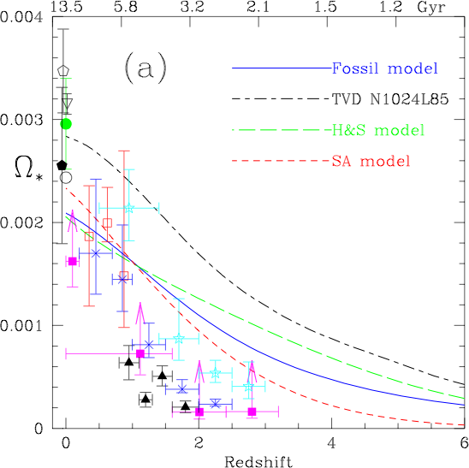
X-ray binaries and CXB
Cosmic star formation
stellar mass
(from Nagamine et al., 2006)

Slide 30
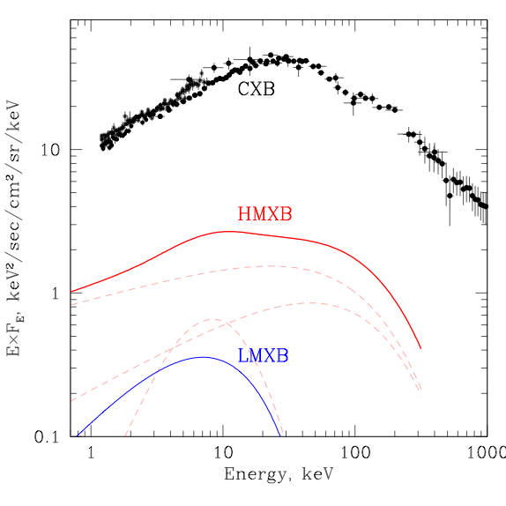
X-ray binaries and CXB
2-10 keV:
HMXB ~7-10%
LMXB <1-2%
<z_{HMXB}> ~ 1.5
<z_{LMXB}> ~ 0.5
HMXB contribution is dominated by ULXs

Slide 31
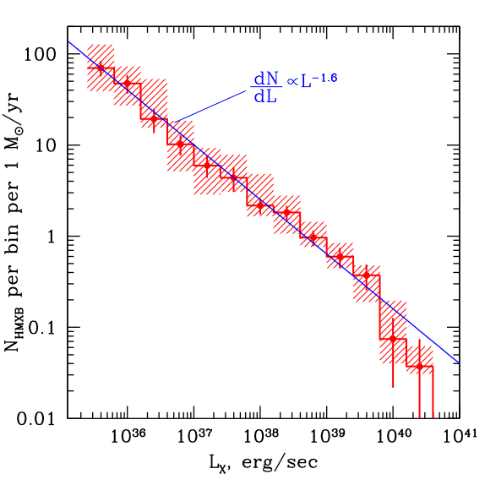
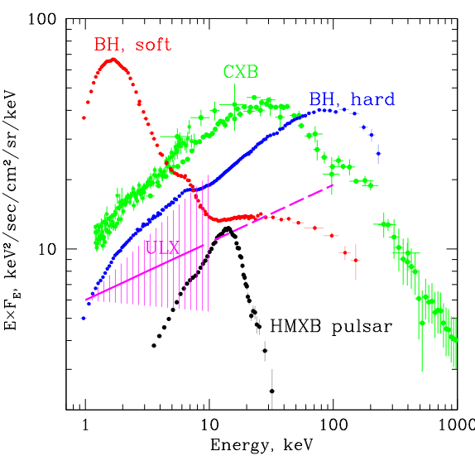
Contributions of different HMXB kinds
HMXB luminosity function
HMXB spectra
HMXB
pulsars
Black
holes
“ULX”
Swartz et al., 2004
10% HMXB pulsars + 20% BH +70% “ULX”

Slide 32
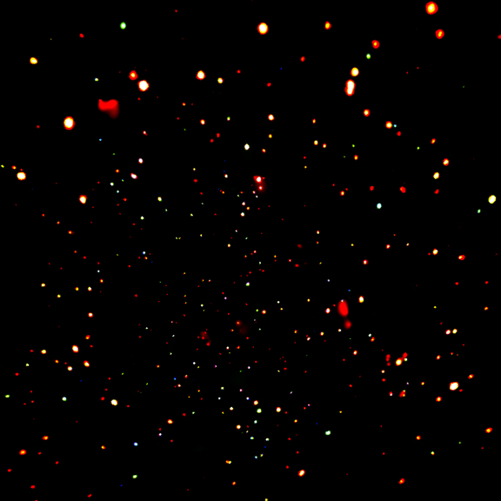
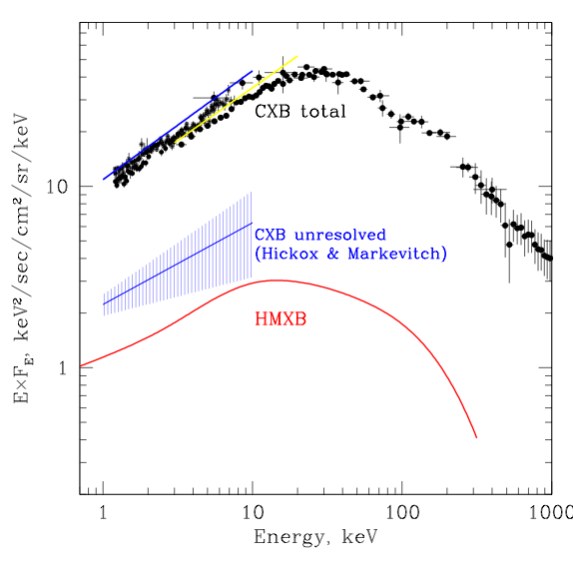
HMXBs & unresolved part of CXB
HMXB (ULX) contribution can explain ~50% of the unresolved part of the CXB (via contribution of faint normal galaxies)

Slide 33
Thank you!

Slide 34
Formation of binaries in close stellar encounters
tidal capture of a normal star by an NS/BH
collision of NS/BH with a red giant
exchange reactions
Clark, 1975; Fabian,Pringle & Rees, 1975; Press & Teukolsky, 1977; Hut & Bahcall, 1983; Lee &
Ostriker, 1986; Verbunt 1987; …

Slide 35
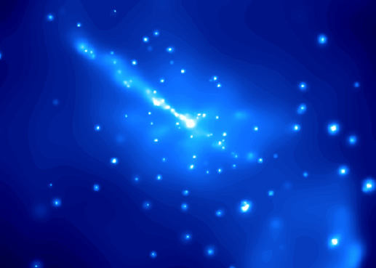
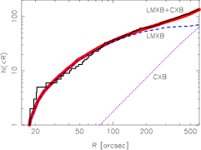
Centaurus A radial distribution of LMXBs
Chandra
point sources
2MASS

