Slide 1
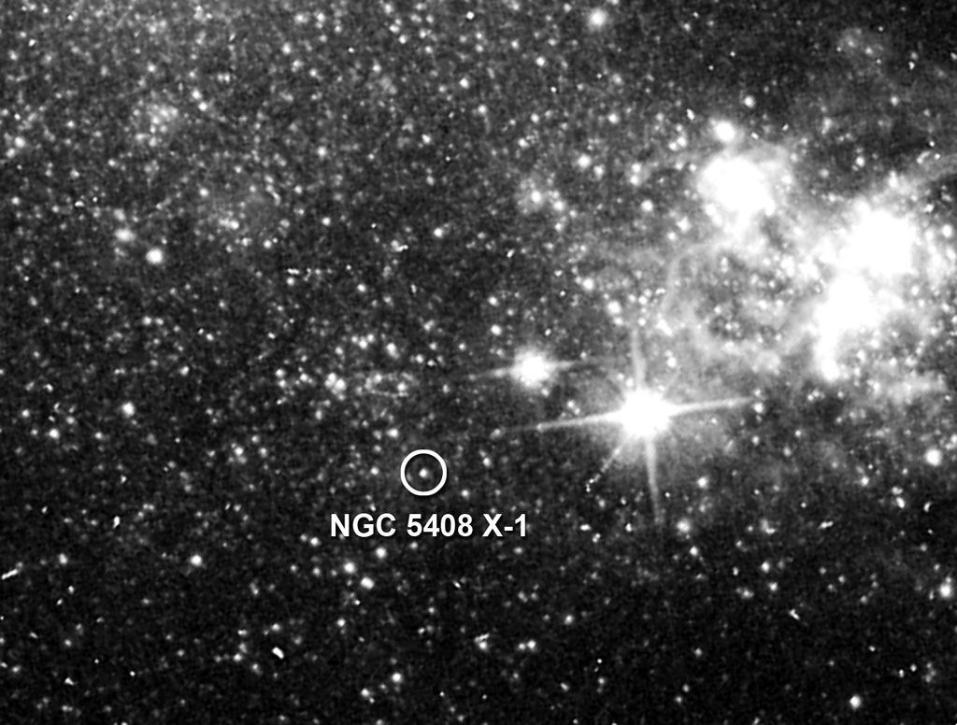
Challenging Times:
A re-analysis of...
Matthew Middleton, Tim Roberts, Chris Done, Floyd Jackson

Slide 2
X-ray spectra
Spectral analysis compresses timing information but ok for first order analysis.
Can fit 2 component model as for other accreting sources...
Disk component temperature suggests M ~ 10³⁻⁴M_{ʘ}

Slide 3
Mass estimate from disc should give sub-Eddington states.
Inconsistent – we see a break in high signal-to-noise spectra (Gladstone et al. 2009)
New model whereby corona is mass-loaded

Slide 4
Warning about spectral fitting, need to use physically motivated models and even then its just a convolution!
Frequency x Energy
Energy (keV)
Spectral fitting is degenerate : timing analysis can help!!

Slide 5
Power Density Spectrum: PDS
Square of Fourier transform of lightcurve
Frequency x Power
ν_{b}
ν_{h}
Frequency

Slide 6
Timing characteristics are species invariant (McHardy et al. 2006). Can use these features (QPOs) to estimate the mass of object.

Slide 7
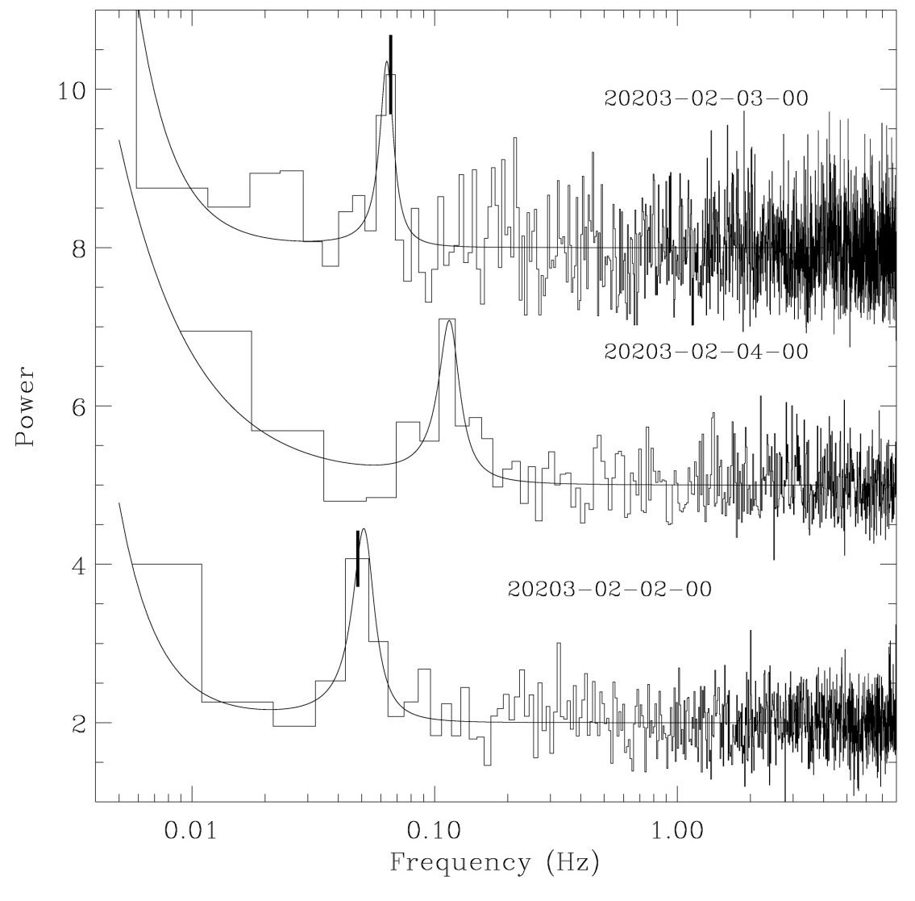
3 ULXs show QPOs:
M82

Slide 8
NGC 5408 X-1
The QPO in NGC 5408 X-1, can indicate the likely mass of the source by determining the likely GBH analogy. Done by Strohmayer & Mushotzky 2009 – type C LFQPO of GBHs.

Slide 9
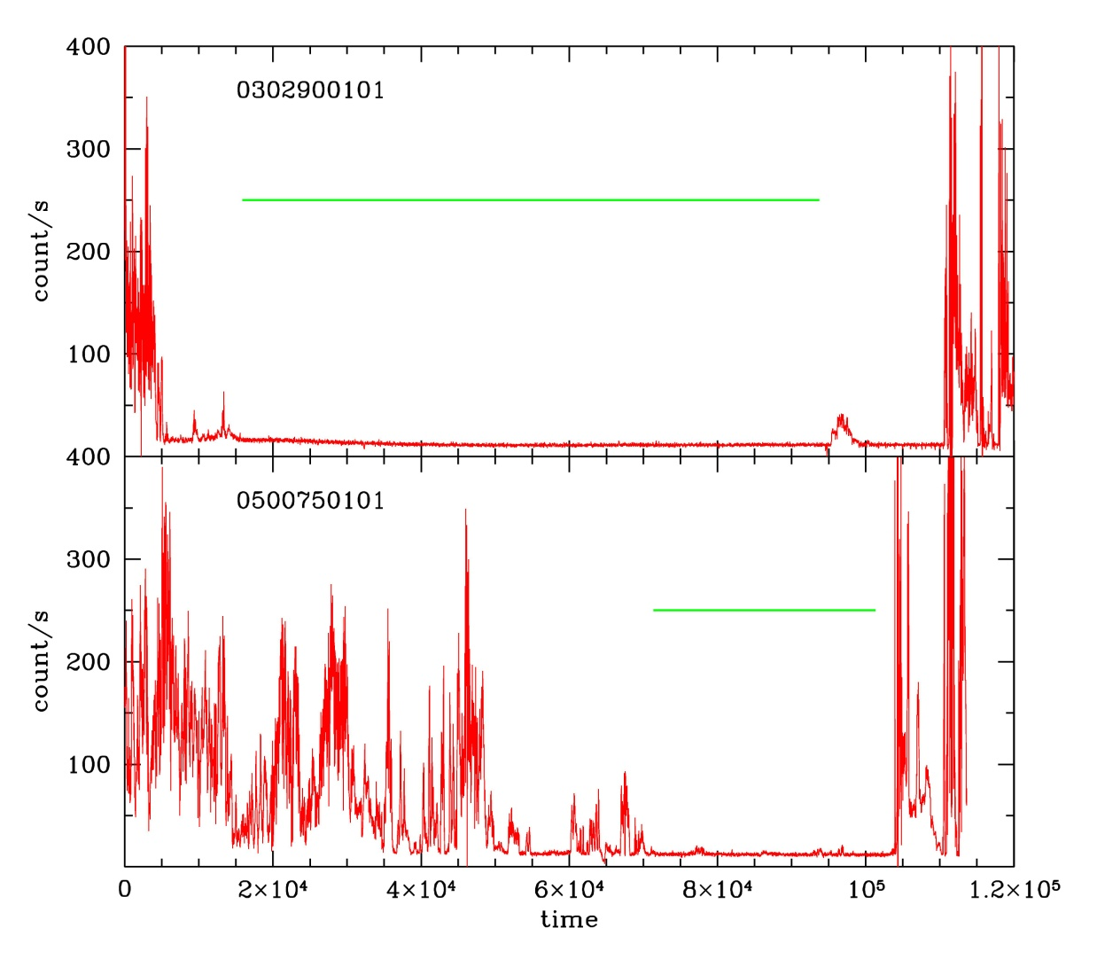
Problem!! SM09 used 70ks of data from Obs 2 - dominated by bgd flaring. Lets look at the observations again with more appropriate GTIs

Slide 10
Is there a break? F-test >95% significance

Slide 11
Soft features? Maybe...but data not great.
EPIC data improved by inclusion of MEKAL plasma. Probably too luminous to be associated with star formation.
Chandra diffuse emission ~2% of emission – features probably intrinsic – longer observation should constrain these.
Middleton & Roberts in prep

Slide 12
We still see the QPO in the same E-bands where detection is reported as strongest
Is this the type-C LFQPO of GBHs? Can this be tested?

Slide 13
This can be tested: does the position of the QPO obey:
Frequency x Power
ν_{b}
ν_{h}
Frequency

Slide 16
However, some sources deviate from the relation when the QPO approaches break.
Something fundamental is changing - can no longer rely on interpretation based on PDS alone.

Slide 17
What can it be? Lets look at the E-dependent variability on different timescales
F_{var} (Vaughan et al. 2003)
Can replicate the shape of the variability on all t-scales so two-component model is fine.
There is constrained E-dependent rapid variability – fluctuations on short t-scales?
Huge fractional variability!!

Slide 18
Level of power is huge: only matched by the most luminous, @Eddington or
> Eddington sources...
What could it be - wild speculation...
If its @Eddington then M~100M_{ʘ}.
We can make this from low-Z star see Mapelli et al. 2010 arXiv:1005.3548.

Slide 19
Attributed to rapid fluctuations (Belloni et al. 2000)
... see Middleton & Ingram in prep.
xte.mit.edu/~rr/new_67hz.mov

Slide 20
Summary
Timing characteristics can improve on spectral interpretations which may be degenerate.
Fractional variability suggests that the components vary in different ways as seen in AGN and GBHs.
The position of ν_{b} is determined from simulating the full PDS and indicates that the position of the QPO does not appear to agree with the tight correlation seen in binaries.
If the amount of variability (and X-ray spectrum) is indicative of Eddington/super-Eddington accretion then perhaps the QPO is analogous to the ULFQPO of GRS 1915+105?

