Slide 1
Exploring the Nature of the Brightest
Hyper-luminous X-ray Source
Sean Farrell
XMM-Newton Survey Science Centre
University of Leicester, UK
In collaboration with…
N. Webb, D. Barret, O. Godet & B. Plazolles – CESR, France
K. Wiersema– University of Leicester, UK
T. Maccarone – University of Southampton, UK
M. Servillat – Harvard-Smithsonian CfA, USA
S. Oates – MSSL, UK
I. Heywood – University of Oxford, UK

Slide 2
Overview
Overview
Discovery of ESO 243-49 HLX-1
Monitoring campaign with Swift
Triggered XMM-Newton observation
Multi-wavelength follow-up results:
Radio (ATCA)
Ultra-violet (Swift, GALEX)
Optical (VLT)
Conclusions

Slide 3
Discovery of ESO 243-49 HLX-1
HLX-1 coincident with edge-on S0a spiral galaxy ESO 243-49 at ~100 Mpc
At galaxy distance, unabsorbed L_{x} ~ 10⁴² erg/s in 0.2 – 10 keV band
Brightest ULXs prior to this discovery had L_{x} ~ 1 x 10⁴¹ erg/s (e.g. Cartwheel, M 82, NGC 2276 hyper-ULXs)
Observed luminosity ~400 times greater than Eddington limit for 20 M_{sun} BH
Farrell, Webb, Barret, Godet & Rodrigues, Nature, 2009, 460, 73

Slide 4
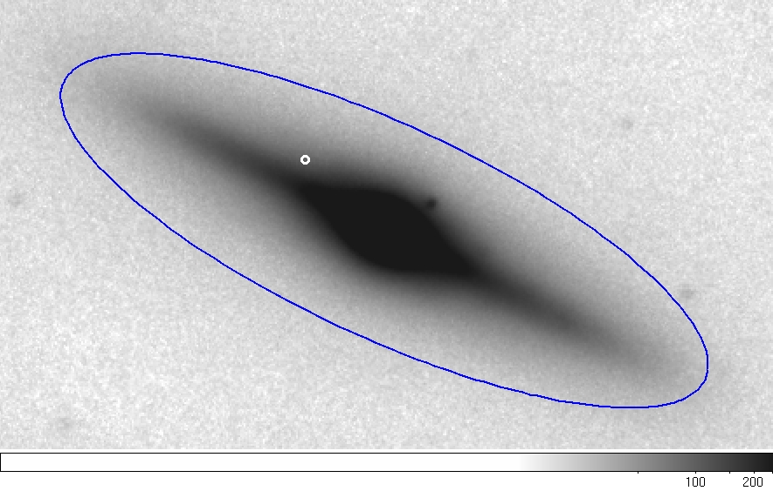
Discovery of ESO 243-49 HLX-1
Chandra position of HLX-1, error ~ 0.3”
Magellan J-band image of ESO 243-49

Slide 5
Discovery of ESO 243-49 HLX-1
Originally detected serendipitously in Nov 2004 during 20 ks XMM-Newton (XMM1) observation of galaxy cluster A 2877
Spectrum similar to (some) other ULXs i.e. fit by absorbed steep power law
N_{H} of (8 +/- 3) x 10²⁰ cm⁻² approx. four times Galactic value (~2 x 10²⁰ cm⁻²)
Power law photon index of 3.4 +/- 0.3 consistent with BH in very high state

Slide 6
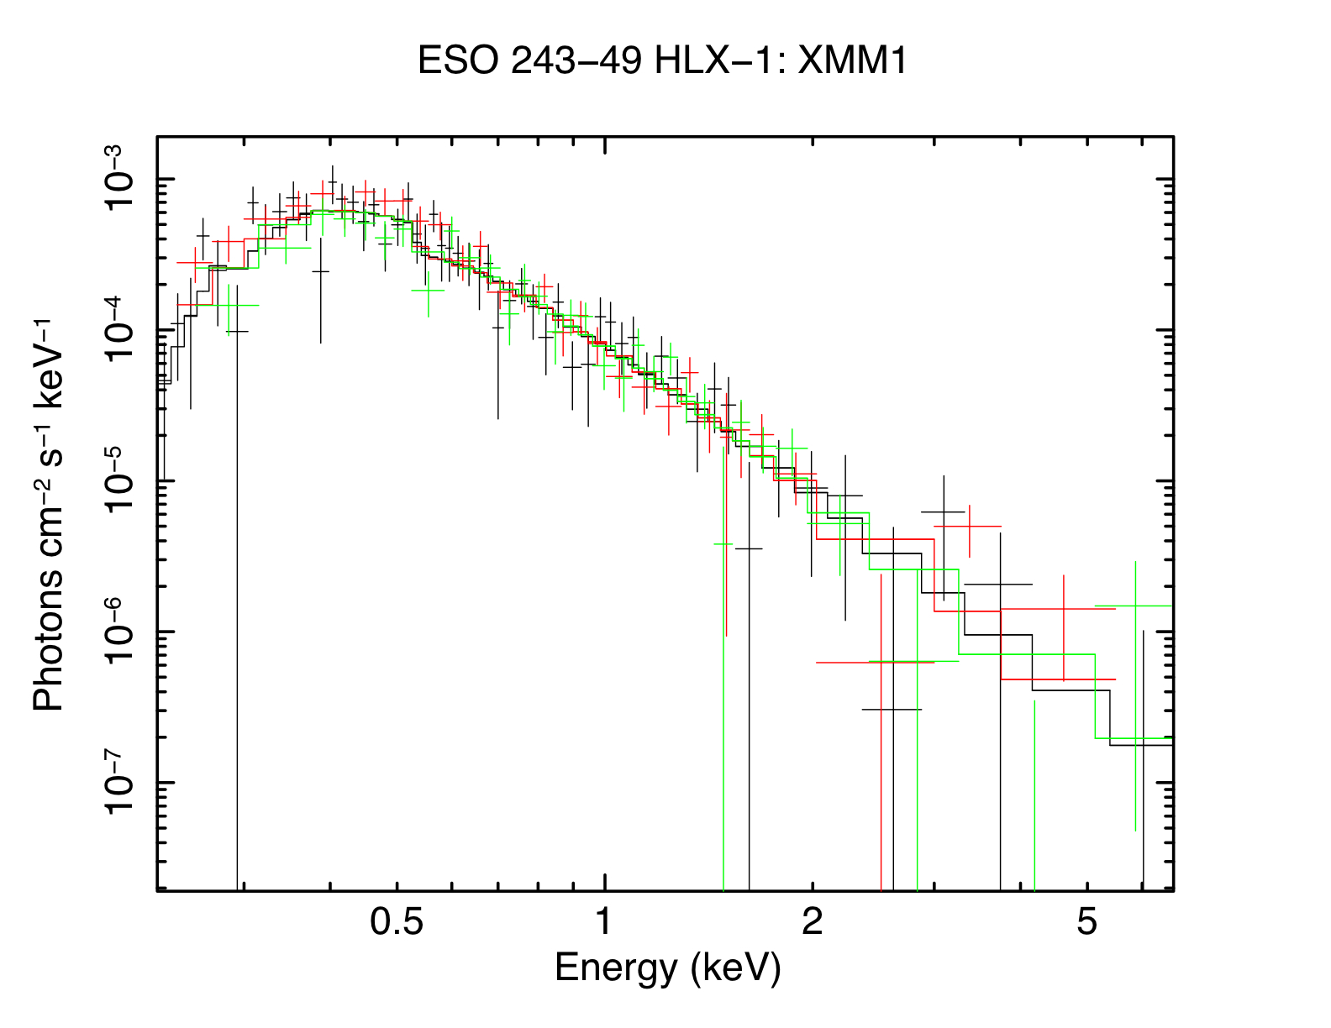
Discovery of ESO 243-49 HLX-1
2004-11-23

Slide 7
Discovery of ESO 243-49 HLX-1
Follow-up 50 ks XMM DDT obs. in Nov 2008 (XMM2) to search for variability
Spectrum dominated by kT = 0.18 +/- 0.01 keV disc black body component (~80% of total flux)
N_{H} = (4 +/- 1) x 10²⁰ cm⁻², photon index = 2.2 +/- 0.3
Spectrum of XMM2 obs. consistent with BH in high/soft state
Simulations indicated we should have detected disc black body in XMM1

Slide 8
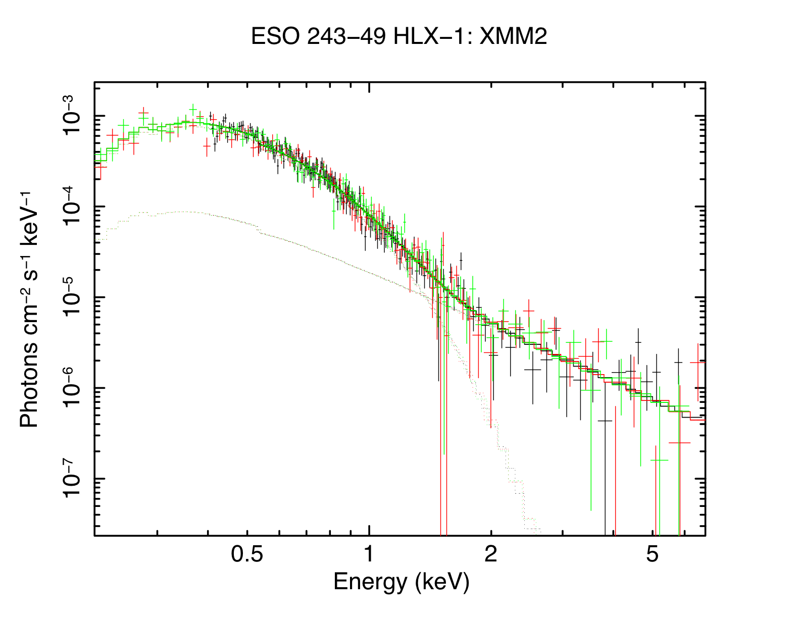
Discovery of ESO 243-49 HLX-1
2008-11-28

Slide 9
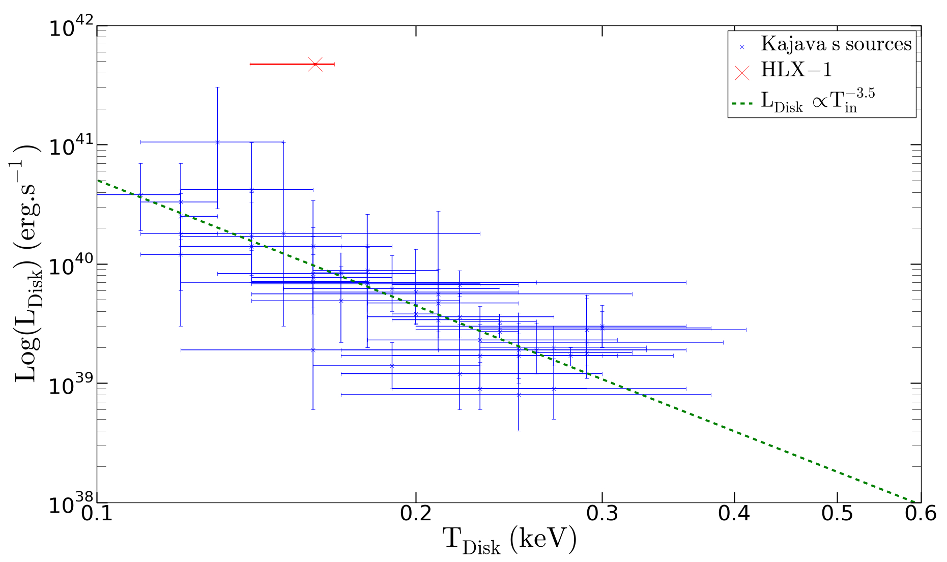
Discovery of ESO 243-49 HLX-1
XMM2
Blue points from Kajava & Poutanen (2009)

Slide 10
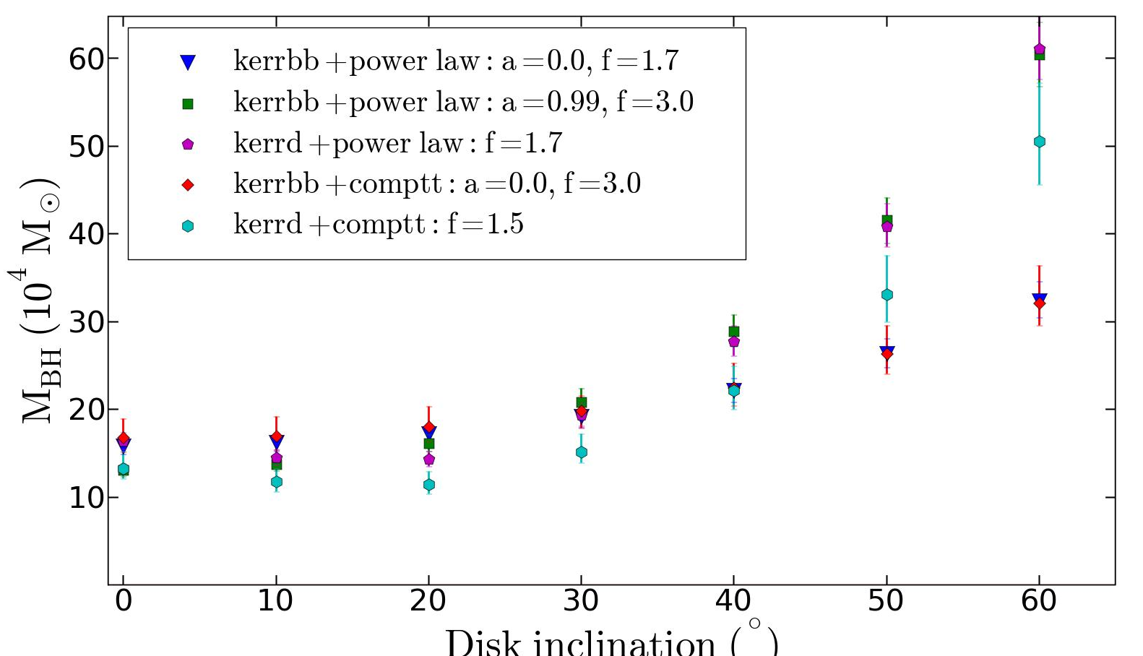
Discovery of ESO 243-49 HLX-1
a = 0.99
a = 0
Fits to XMM2 spectrum using Kerr black hole disc black body models gives masses between ~1 – 6 x 10⁵ M_{sun}

Slide 11
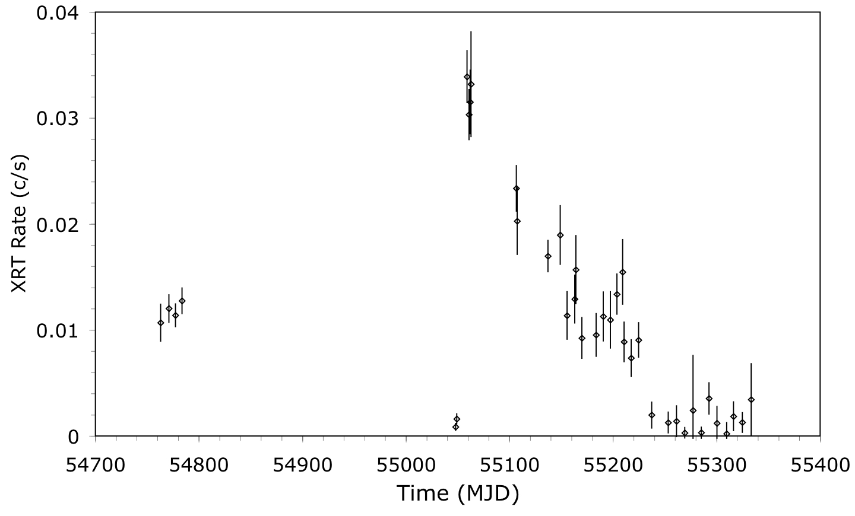
Swift Monitoring
C2
X1
X2
C1
X3

Slide 12
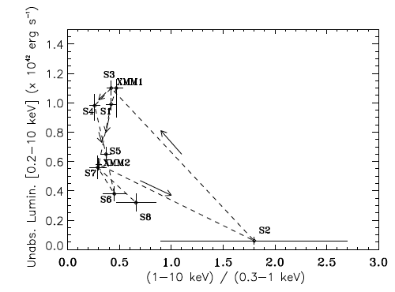
Swift Monitoring
Hardness intensity diagram showing spectral hysteresis
Very high
High/hard
Galactic black hole
X-ray binary spectral
hysteresis curve
High/soft
Low/hard
Godet, Barret, Webb, Farrell, Gehrels, 2009, ApJ, 705, L109

Slide 13
Triggered XMM Obs.
Last week 100 ks XMM observation triggered
HLX-1 was fainter than expected, so statistics are poor (even with 100 ks!)
Cannot constrain nH sufficiently, but if frozen at XMM2 value can constrain photon index to 2.3 +/- 0.2
Spectrum consistent with low/hard state (with some caveats)

Slide 14
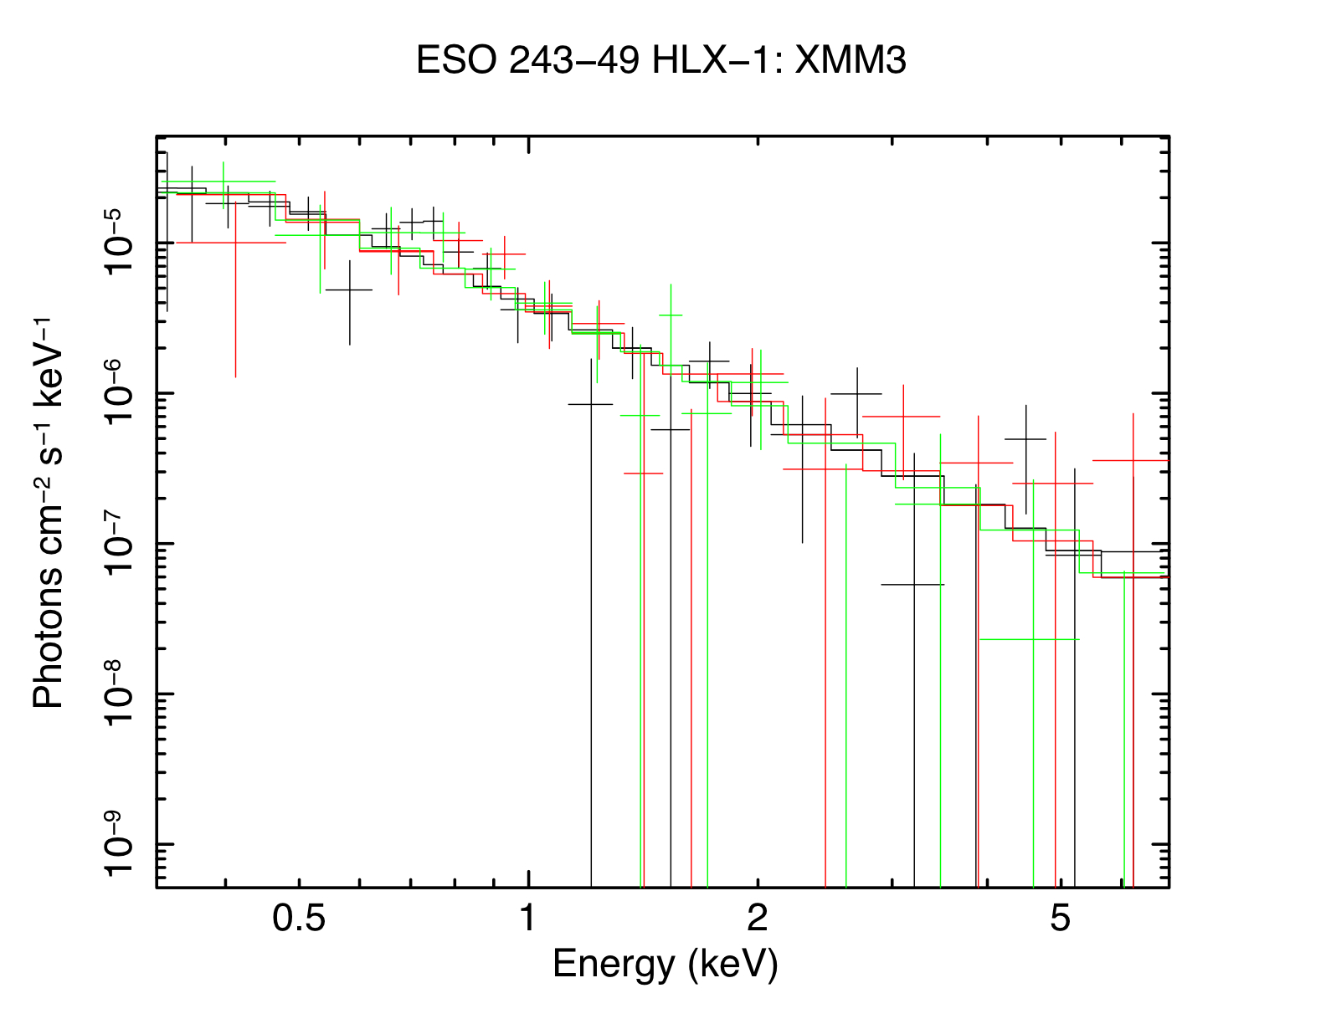
Triggered XMM Obs.
2010-05-14

Slide 15
Triggered XMM Obs.
2004-11-23
2008-11-28
2010-05-14

Slide 16
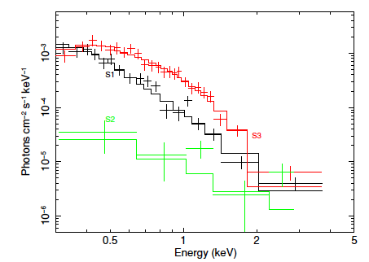
Triggered XMM Obs.
Swift XRT spectra

Slide 17
Radio
ATCA radio image of ESO 243-49 field (Webb et al. in prep.)
Radio detection of ESO 243-49 nucleus
(radius = 3σ error)
Chandra position of HLX-1 (radius = 3σ error)
ESO 243-49
Fdensity upper limit at HLX-1 position = 45 μJy
(3 x RMS noise)

Slide 18
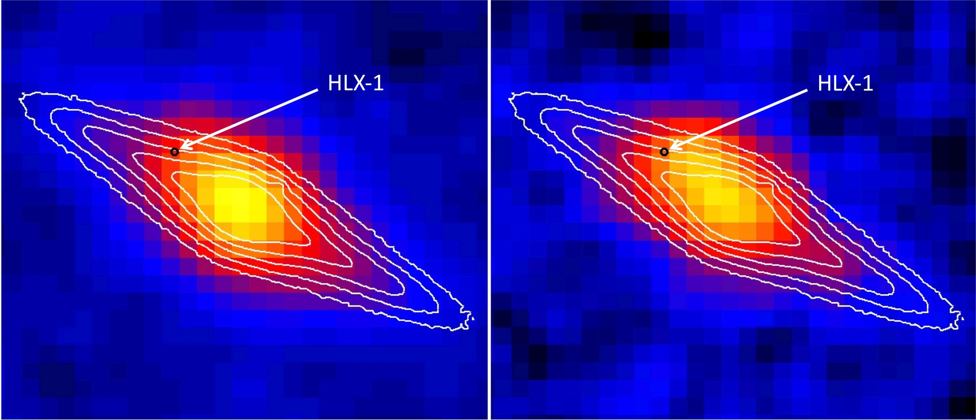
Ultra-violet
Extended UV emission recently detected, possibly associated with HLX-1
Indication of hot accretion disc around intermediate mass BH?
Evidence of star formation driven by galaxy interactions?
Need HST data to find out
GALEX near-UV
GALEX far-UV
Webb, Barret, Godet, Servillat, Farrell & Oates, 2010, ApJ, 712, L107

Slide 19
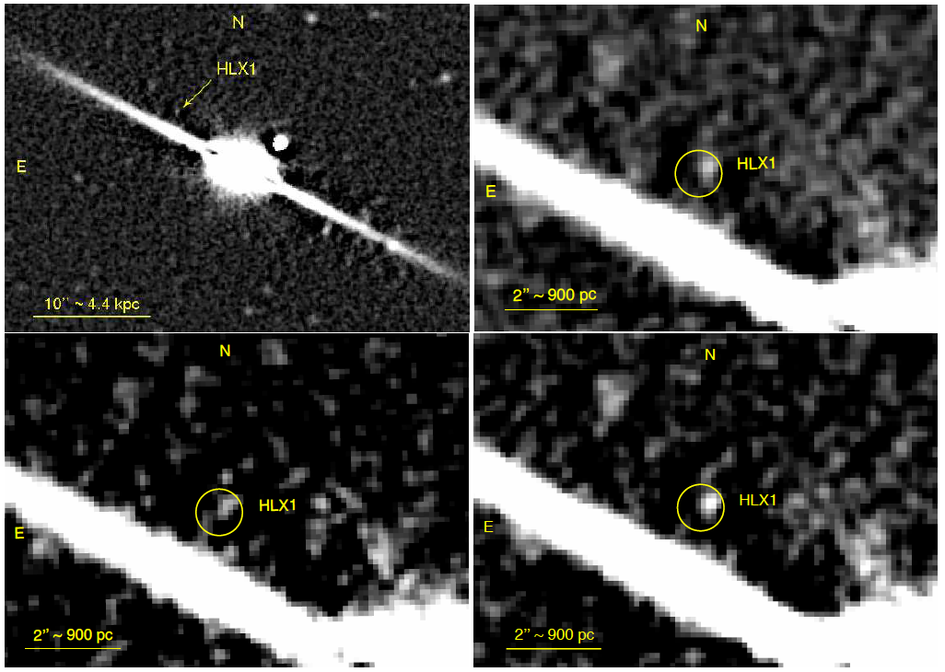
Optical
Faint (R = 23.8 mag) optical counterpart recently detected by Soria et al. (2010)
giving max Fx/Fopt ~1000. ULX or Galactic qNS at ~2.5 kpc?
Diffuse emission subtracted
R-band
Very high
High/hard
Galactic black hole
X-ray binary spectral
hysteresis curve
V-band
R+V
High/soft
Low/hard

Slide 20
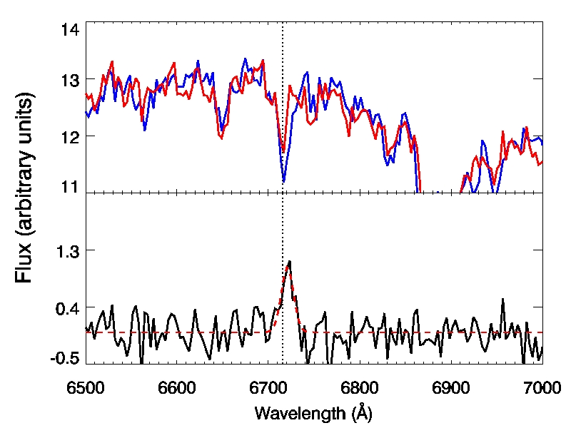
Optical
Follow-up VLT spectroscopy/imaging detected faint I-band counterpart
Spectrum is dominated by continuum emission with no obvious emission lines (expected for background galaxy or coronally active foreground star)
Hα absorption line apparent in spectrum of galaxy, with obvious rotation
Background subtracted HLX-1 spectrum detects 11.3σ emission line at 6721Å, consistent with Hα at galaxy redshift of z = 0.022
Definitely in ESO 243-49, so not a foreground or background object!
VT 2-D spectrum
After subtracting smoothed 2-D spectrum
HLX-1
Galaxy emission
Bkg subtracted
spectrum
Hα
HLX-1
z = 0.0223
Hα
VLT I-band image
After subtracting smoothed image
Farrell et al. 2010, ApJL, submitted
Farrell et al. 2010, ApJL, submitted

Slide 21
Conclusions
Redshift of Hα line consistent with ESO 243-49 → definitely in galaxy!
Max Lx of 10⁴² erg s⁻¹ confirmed → HLX-1 is most extreme ULX
L_{x} in low/hard state still ~10⁴⁰ erg s⁻¹!
Variability definitively rules out multiple lower luminosity sources
Can we explain luminosity entirely with beaming?
Left with super-Eddington accretion:
if maximum L_{x} = 10 x L_{Edd}, implies mass > 500 M_{sun} (e.g. Begelman 2002)
Width and luminosity of Hα line gives upper limit of 1500 M_{sun} (if Greene & Ho (2005) mass scaling relationship holds, big caveat!)
Compounding evidence continues to support IMBH

