Slide 1
Spectral Study of CAL87
Ken Ebisawa (JAXA/ISAS)
Dai Takei (Rikkyo University)
Thomas Rauch (University of Tuebinen)

Slide 2
CAL87
A super-soft source in LMC discovered by Einstein (“Columbia Astrophysics Laboratory” 87)
Optical and X-ray eclipses with an orbital period of 10.6 hour
Relatively “hard” spectrum with significant emission above > 0.5 keV

Slide 3
Optical light curve
Continuous monitoring four 4 years
B-band
Secondary dip
At φ=0.5
Primary dip
at φ=0
R-band
Indicates an accretion disk bulge with
a bright irradiated disk (details later)
Alcock et al. (1997) by product of MACHO
project

Slide 4
X-ray light curve with ROSAT
X-ray dips are shallower and broader compared to optical dips
No significant X-ray spectral variation
Accretion Disk Corona (ADC) model suggested
X-ray emitting corona is extended and only partially eclipsed (details later)
X-ray light curve
Optical light curve
X-ray spectral hardness
Schmidtke et al. (1993)

Slide 5
Precise modeling the optical light curve
White dwarf with 0.75 M , secondary star with 1.5M
Examined several cases to fit optical light curves
Accretion disk has an optically thick “spray”
Optical emission region is not localized, but distributed over the secondary star
The white dwarf is never directly observed due to the presence of spray
Spray
Spray
Optical
emission
Optical
emission
Schandl et al. (1997)

Slide 6
Precise modeling the optical light curve
disk and spray
secondary star
Optically thick accretion disk and “spray” produce most of the optical emission
At the primary minimum, secondary occults most of the emission from the disk and the spray
Secondary star has minor optical emission
At the secondary minimum, the spray partially occults the secondary star
White dwarf surface is always hidden from the line of sight
Schandl et al. (1997)

Slide 7
ASCA CCD observation
Strong absorption edge at 0.85 keV detected
Blend of strong OVIII edge (0.871 keV) and weak OVII edge(0.739 keV)
Optically thick atmospheric spectrum (Heise, van Teeseling and Kahabka 1994) suggested
Fit including edge
Residual without edge
Residual including edge
Asai et al. (1998)

Slide 8
ASCA with white-dwarf atmosphere LTE model
LTE model fit
Best-fit LTE model
Only kT is free parameter
Surface gravity
not constrained
kT=75 eV (log g=9)
kT=89 eV (log g=10)
Model by Heise, van Teeseling
and Kahabka (1994)
Ebisawa et al. (2001)

Slide 9
ASCA with white-dwarf atmosphere NLTE model
NLTE model fit
Best-fit NLTE model
Only kT is free parameter
Surface gravity
not constrained
kT=65eV (log g=9)
kT=79 eV (log g=10)
Model by Hartmann et al. (1999)
(not including absorption lines)
Ebisawa et al. (2001)

Slide 10
Interpretation of the ASCA spectrum
Solution
Luminosity is calculated from
the radius (mass) and T_{eff}
For a given mass
(gravity), T_{eff} is constrained
from the model fit
WD mass is from 0.8 to 1.2 M
Intrinsic luminosity is from 0.4-1.2x10³⁸erg/s
However, the observed luminosity is about an order of magnitude lower
We are observing the scattered emission with τ_{sct}~0.1
Consistent with the ADC model and the optical light curve result (WD is always hidden)
allowed range
(considering model uncertainty)
WD mass, radius and surface gravity
have almost unique relationship
Ebisawa et al. (2001)

Slide 11
Modeling the ASCA light curve
WD is permanently
blocked
X-ray emission from
extended ADC
Ebisawa et al. (2001)

Slide 12
XMM and Chandra grating observations
Numerous emission lines!!

Slide 13
XMM and Chandra grating observations
LETG spectrum explained with
optically thin emission
(photoionized plasma)
Greiner et al. (2004)

Slide 14
No optically thick component?
“Discovery” of numerous emission lines
Not noticeable with CCD spectral resolution
Emission lines are expected from photoionized accretion disk corona
Gratings are insensitive above ~0.9 keV
Not sensitive to weak continuum emission
Difficult to recognize the OVIII edge at 0.871 keV
Optically thick component exists, as well as the optically thin component

Slide 15
XMM, Chandra, ASCA simultaneous fit
Eight spectra fitted simultaneously
XMM RGS1, RGS2, EPIC, MOS1, MOS2
Chandra LETG
ASCA SIS0, SIS1
Includes both optically thick and thin components

Slide 16
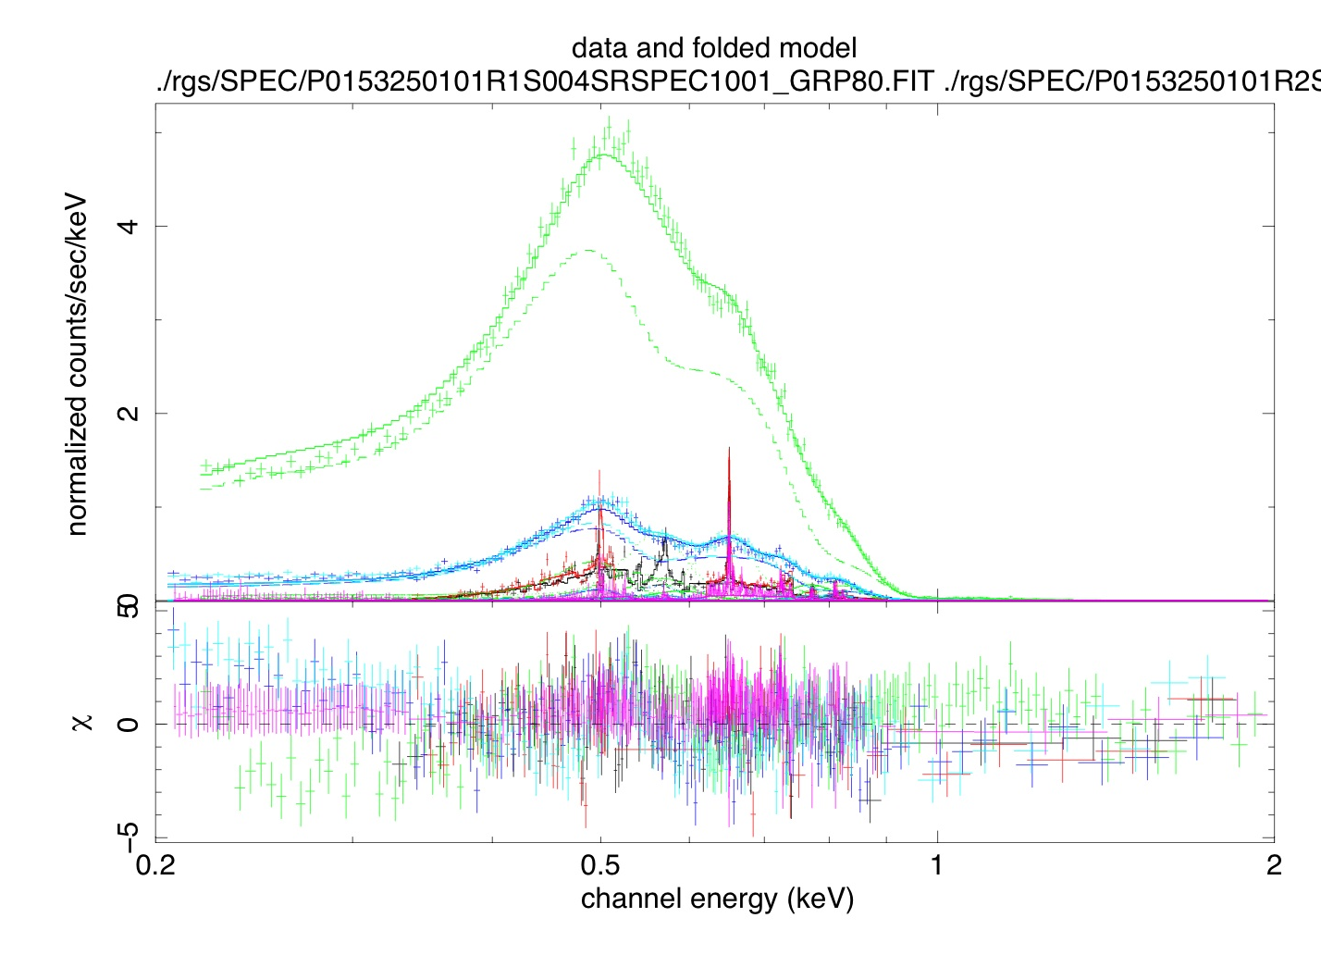
linear scale
Blackbody+two edges
+emission lines

Slide 17
log scale
Blackbody+two edges
+emission lines
EPIC
MOS
RGS
LETG
ASCA

Slide 18
linear scale
Best-fit model:
Blackbody+two edges
+emission lines

Slide 19
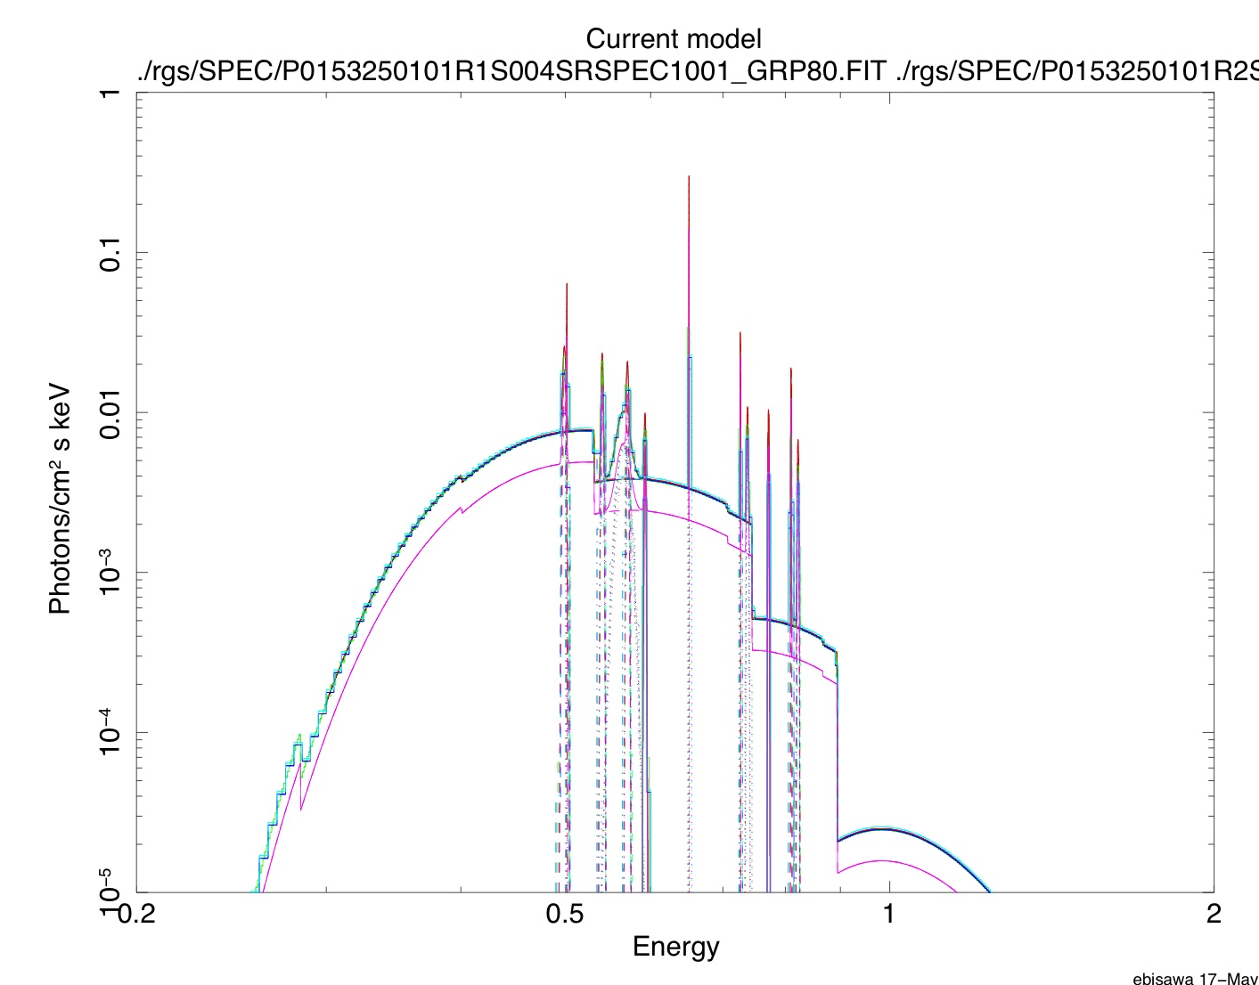
log scale
Best-fit model:
Blackbody+two edges
+emission lines

Slide 20
Application of the state of the art WD NLTE model
Rauch 2009
private communication
800,000 K
OVIII
log g=9
LMC abundance
OVIII
1,000,000 K
900,000 K

Slide 21
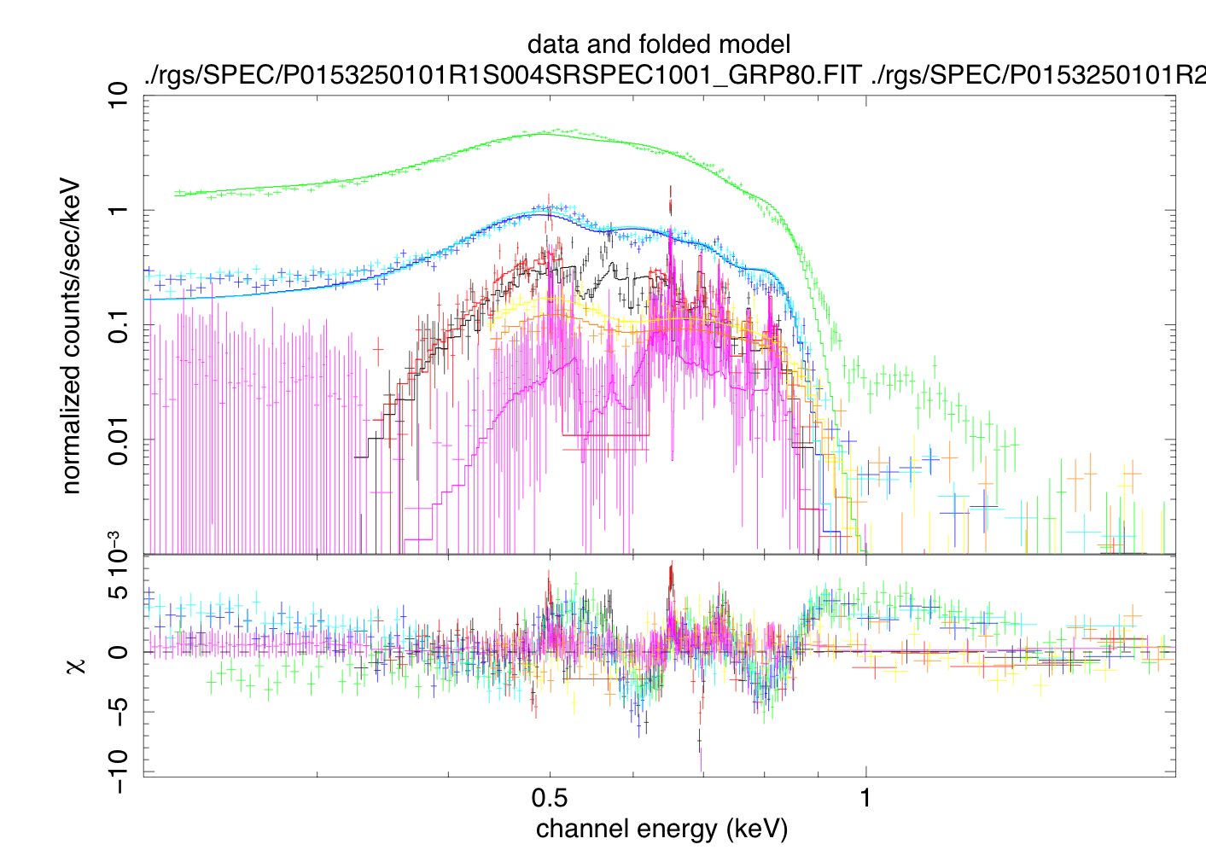
Rauch NLTE model
+ emission lines
T=800,000 K
Need improvement,
But manageable

Slide 22
The best-fit model
(NLTE + emission lines)
Absorption edges,
absorption lines and
emission lines

Slide 23
Conclusion
We presented spectral model of CAL87 observed with XMM-Newton and Chandra, following the provisional study using ASCA.
We confirmed both the WD surface emission (with absorption edges and lines) and the Accretion Disk Corona emission (emission lines).
Presence of both optically thick and thin spectral components makes the SSS study formidable, but we are establishing a plausible model.

