Slide 1
SSS in young stellar populations: progenitors of the “prompt” Sne Ia?
Thomas Nelson
NASA Goddard Space Flight Center
University of Maryland – Baltimore County

Slide 2
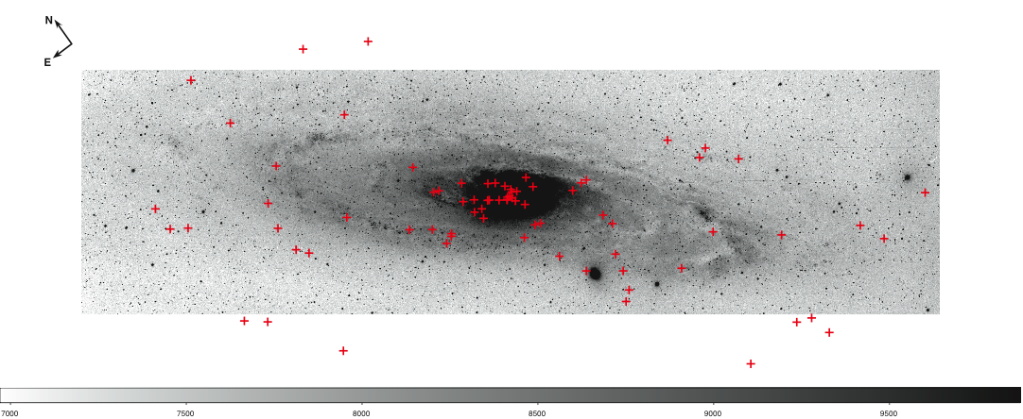
SSS in M31
Cluster of sources in bulge
Fraction of systems seem to trace spiral arms

Slide 3
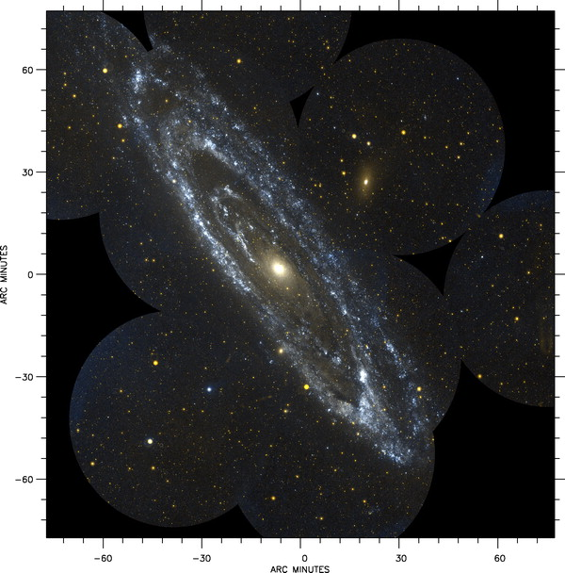
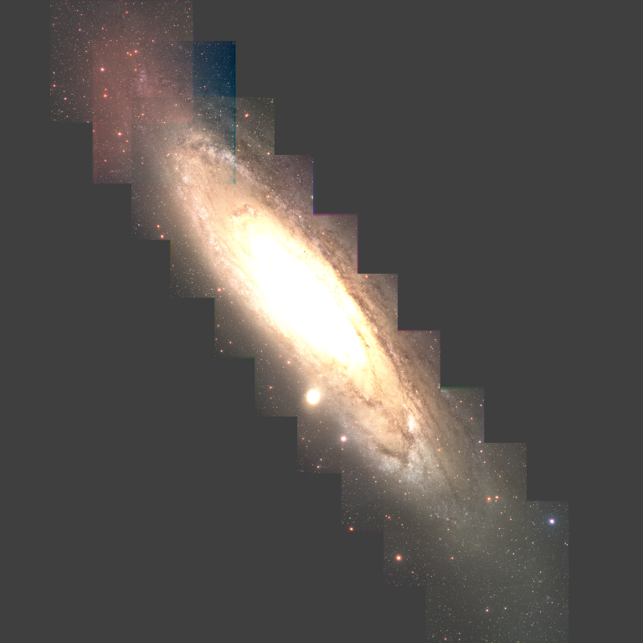
Searching for Optical/UV counterparts
We used GALEX surveys of M31 to search for UV counterparts
For optical, we used the U,B,V,R,I LGS M31 data
Avoided inner 5’ because of source confusion
Thilker at al., 2006, also Bianchi et al. 2007
Massey et al., 2006

Slide 4
What did we find?
Included 50 sources in counterpart search
Only 16 have a UV source in the error circle
Mainly ROSAT sources, with large error circle
Most not resolved due to 5” GALEX resolution
All UV “detected” SSS are in spiral arms – UV sources are young, massive stars in M31
LGS useful in determining sources of UV light…

Slide 5
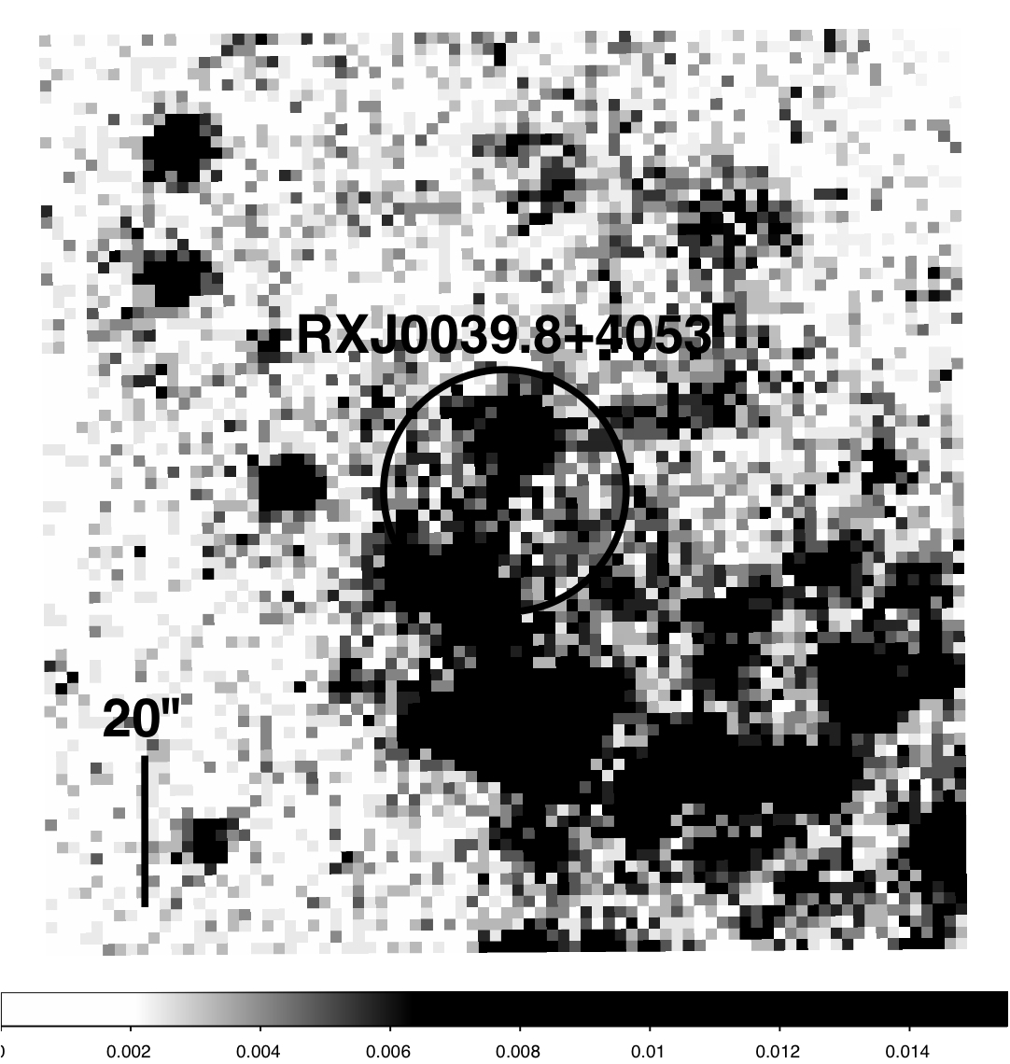
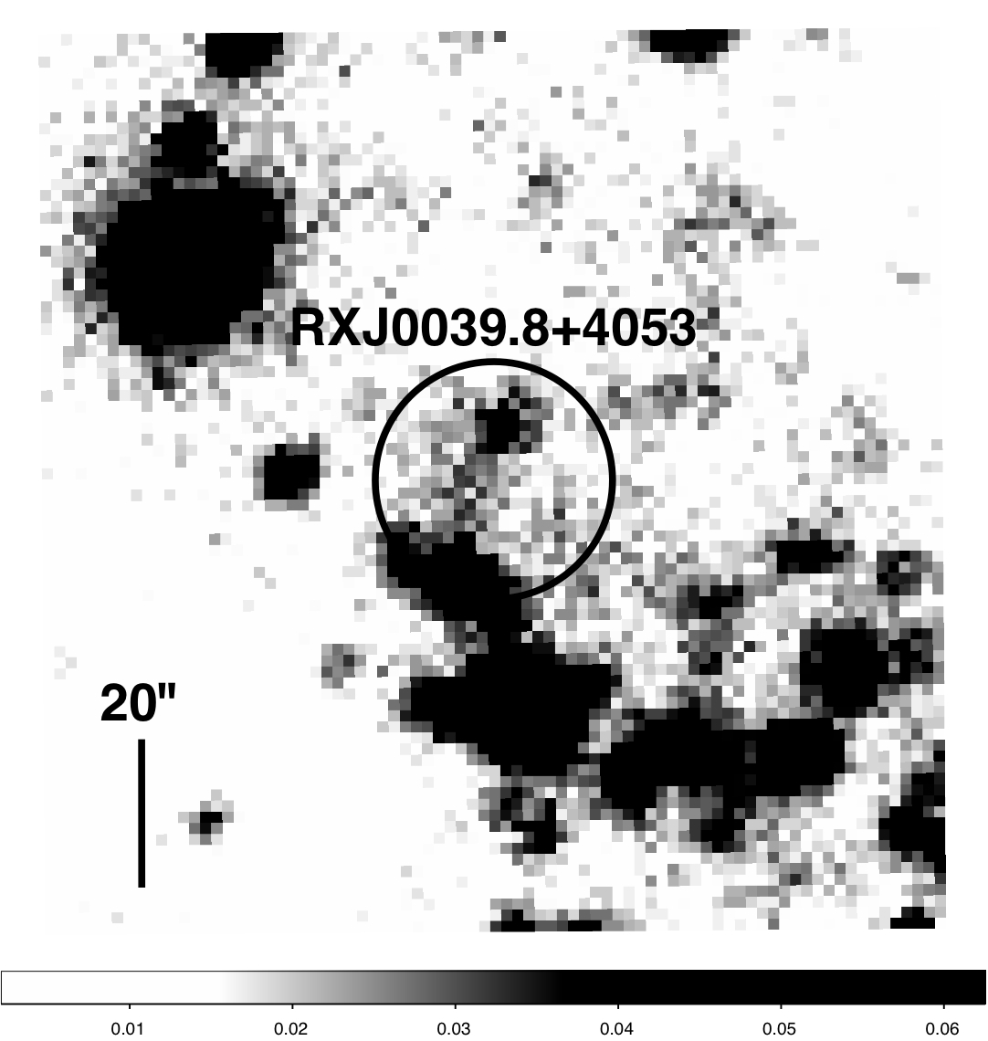
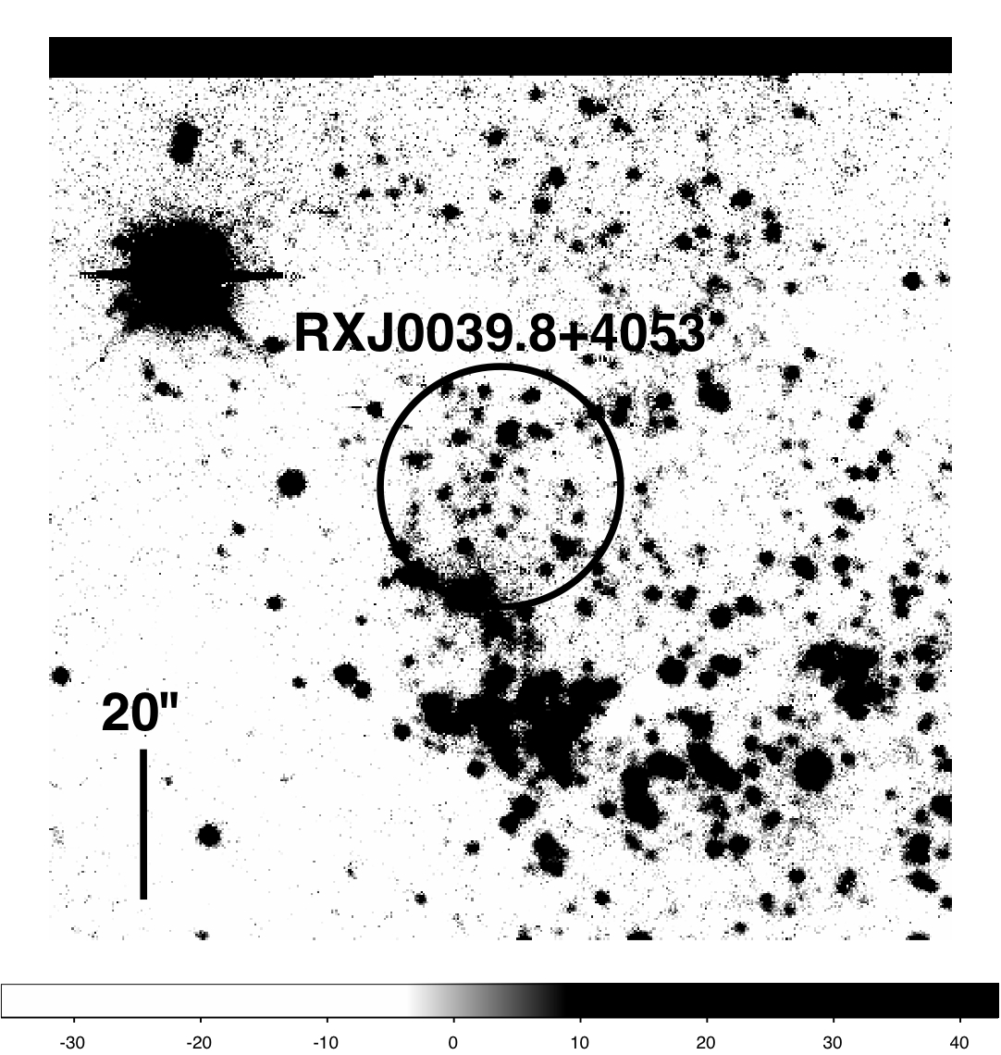
Example – RX J0039.8+4053
GALEX FUV, NUV and LGS U Band images
2 sigma positional error circle
Multiple sources in error circle – identifying a single counterpart is difficult!

Slide 6
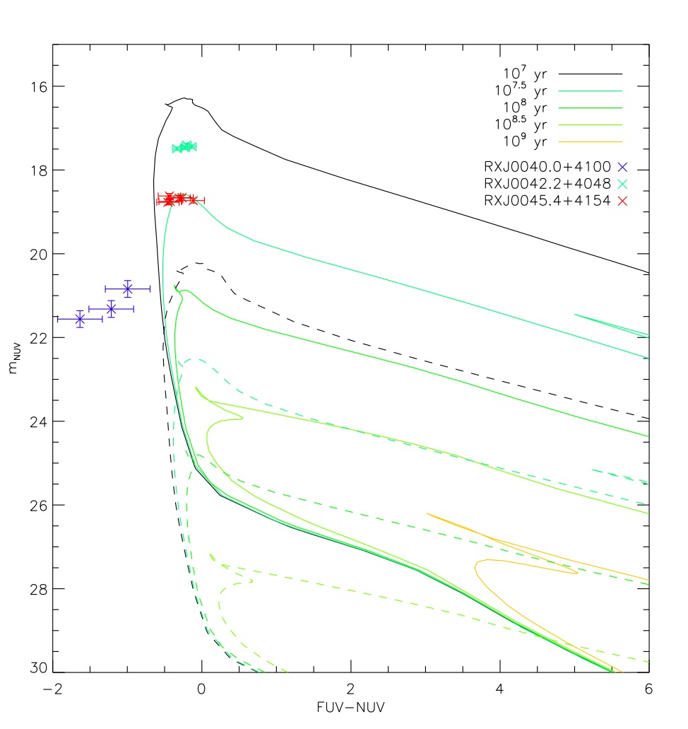
GALEX photometry
Photometry only possible in three cases
Two sources appear to be slightly evolved massive stars
Third source, RX J0040.0+4100 too hot for models – could be due to presence of irradiated disk?

Slide 7
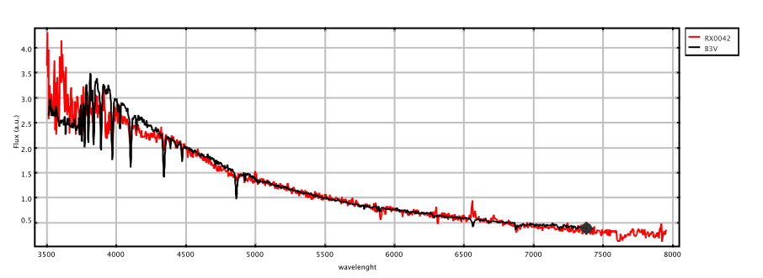
RX J0042.2+4048
Persistent X-ray source, position refined to within 2” with Chandra
Spectrum consistent with early B star, although refined fitting needs to be done

Slide 8
New SSS – XMMU J003910.8+404521
Discovered in EPIC-pn observation of July 06
Faded Dec 06 through July 07
Lx < 10³⁶ erg s⁻¹ with Swift in May 08
Similar duty cycle to ROSAT SSS
All photons below 0.7 keV
Optical counterpart identified, photometry consistent with B (or possibly Be star) with mass > 5 Msol (although reddening dependent)

Slide 9
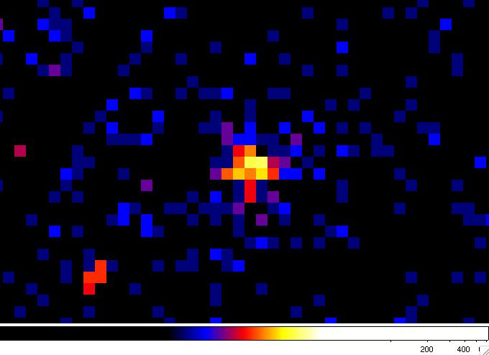
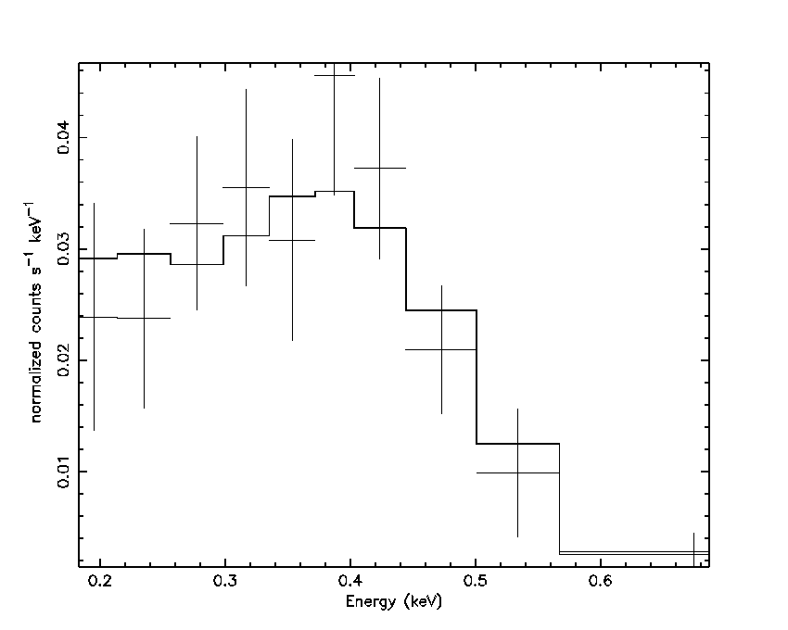
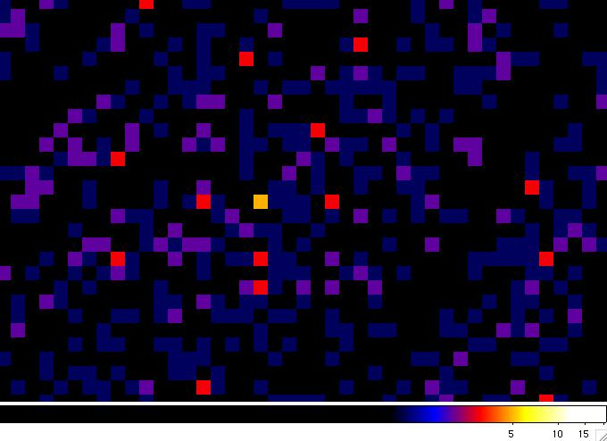
XMMU J003910.4+404521 cont.
0.2 – 10 keV
Epic-PN spectrum with wabs+bb fit
T_{bb} 5-6 x 10⁵ K
N(H) 0.7-1.5 x 10²¹ cm⁻²
L_{x} 4 x 10³⁷ – 10³⁸ erg s-1
1 – 10 keV : no source deteted

Slide 10
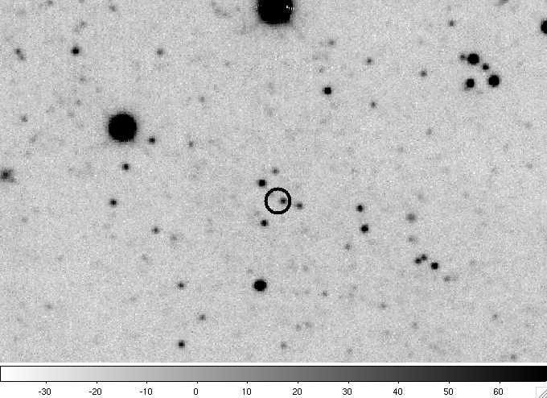
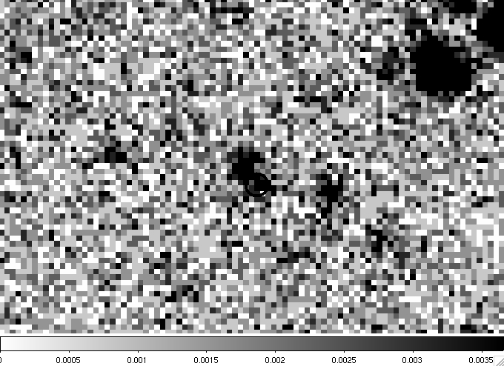
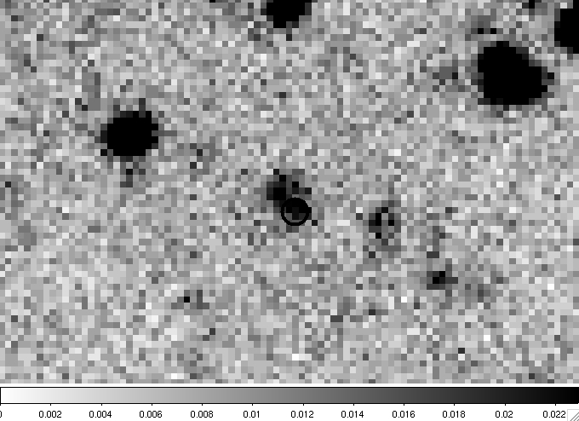
Optical/UV Counterpart
U
FUV
NUV
V = 21.827
B-V = -0.33
U-B = -0.705
V-R = 0.151
R-I = -0.17

Slide 11
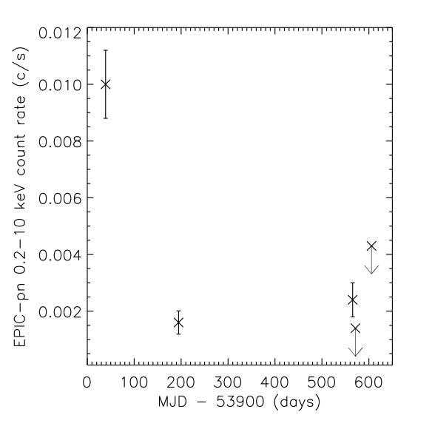
Source properties
X-ray light curve reminiscent of a nova
Other (transient) SSS have been identified as B or Be stars
XMMU J052016.0-692505 in LMC (Kahabka et al. 2006): B0-3e star, duty cycle unknown
Suzaku J0105-72 in SMC (Takei et al. 2008, this conference): B0 star? similar duty cycle, optical ID less certain
Similar temperatures and luminosities
Similar duty cycles to ROSAT sources also in arms
What could be going on in these sources?
EPIC-pn lightcurve. Arrows indicate
3 sigma upper limit

Slide 12
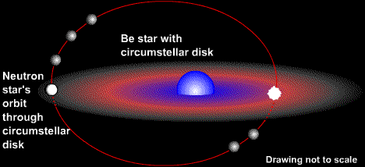
Be/WD binaries
Be stars are non-giant B stars which show emission lines in their spectra
Are known to be rapidly rotating, at 70-90% of breakup velocity (Townsend et al., 2004)
Emission lines believed to arise in decretion disk which forms due to massive rotation
Evidence that rapid rotation is due to CBE (e.g. existence of Be/NS binaries)

Slide 13
Population synthesis studies of Be evolution
Models predict nature and number of compact companion to post CBE Be stars
Pols et al. (1991) – explored possible range of q, degree of conservatism in mass transfer
Raguzova (2001) added effects of tidal synchronsim
Concentrate on Raguzova study…

Slide 14
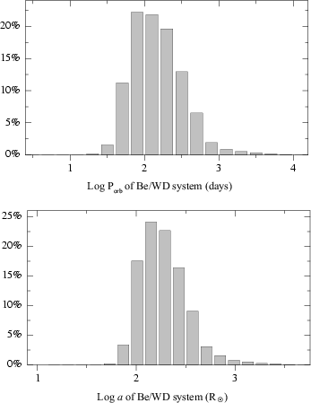
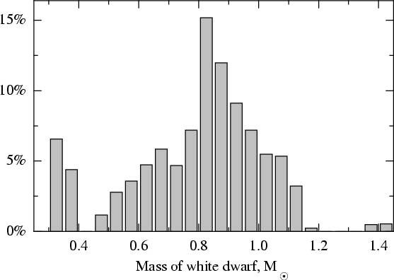
50% of systems with MWD > 0.8 Msol
Predicted orbital parameters: Porb peaking
around few 100 days, a around few 100 Rsol

Slide 15
Summary of Raguzova (2001) results
70% of Be stars formed by CBE will have WD
58% of these WD will be CO
Be disks are of similar scale to orbital separation
Orbits should be circular (and coplanar?)
So, WD will generally orbit inside Be disk – accretion from Be outflow?
Star forming regions will start producing Be/CO binaries in approx. 5 x 10^7 years

Slide 16
Connection to prompt SNe Ia
SSS in these systems could be TNR on white dwarf once it accretes critical mass from Be disk
WDs could experience accretion and outburst cycles like in novae, and possible gain in mass with time
WDs initially massive, so require less mass to reach M_{Ch}
Mass accretion can be more efficient if binary orbit and disk are coplanar
Models predict CO white dwarfs within 5 x 10⁷ yrs. Depending on WD mass and accretion efficiency, could explode in uder 10⁸ yrs

Slide 17
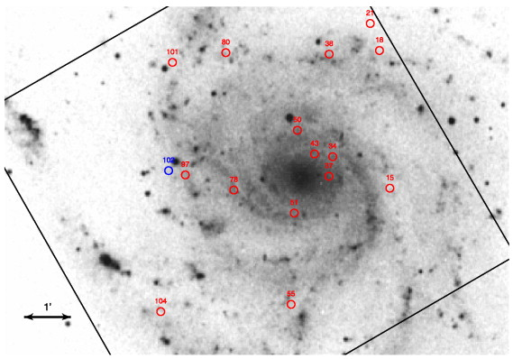
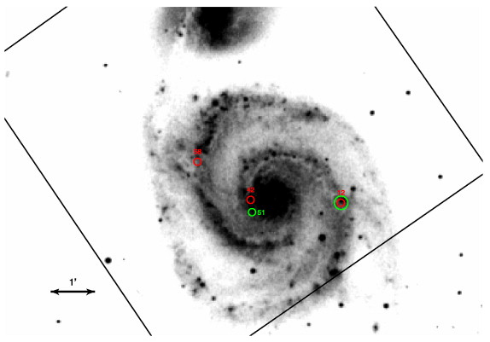
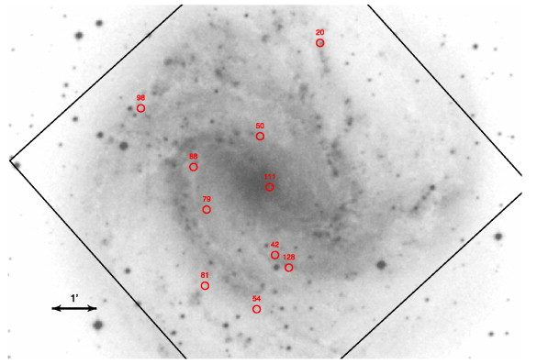
SSS distribution in external galaxies
SSS in other external galaxies also trace the arms (Di Stefano & Kong 2003)
Could this model be the explanation?

