Slide 1
International Asteroid Warning Network
(IAWN) Update
Kelly Fast
IAWN Coordinating Officer
Near-Earth Object Observations Program Manager
NASA Planetary Defense Coordination Office
IAWN Administration team at the University of Maryland/Planetary Data System Small Bodies Node (Bauer, Reddy, Spahr, Warner, et al.)
Update to IAWN Steering Committee and Signatories
31 January 2024

Slide 2
IAWN Steering Committee
IAWN Steering Committee
Sergio Camacho, INAOE
Paul Chodas, JPL/CNEOS
Alan Harris, DLR
Lindley Johnson, NASA
Patrick Michel, OCA
Richard Moissl, ESA
Giovoanni Valsecchi, INAF
Boris Shustov, INASAN
IAWN Coordinating Officer
Kelly Fast, NASA
IAWN Permanent Observers
Space Mission Planning Advisory Group
(SMPAG)
Detlef Koschny, Chair for ESA
United Nations Office for Outer Space Affairs
(UNOOSA)
Romana Kofler
International Astronomical Union (IAU)
Gonzalo Tancredi, Univ. del Uruguay

Slide 3
IAWN Administration supporting NASA’s organizing role for IAWN
NASA Planetary Data System Small Bodies Node
at the University of Maryland
Tim Spahr IAWN Manager - membership (leave of absence)
Vishnu Reddy IAWN Coordinator – campaigns, meetings, membership,
Elizabeth Warner IAWN Webmaster - website, meetings, membership
J. “Gerbs” Bauer IAWN Administration supervisor
NASA Planetary Defense Coordination Office
Lindley Johnson Lead for NASA’s IAWN organization role
Kelly Fast Coordinating Officer for the IAWN Steering Committee
Mike Kelley NASA lead for IAWN Campaigns
Josh Handal NASA support for IAWN

Slide 4
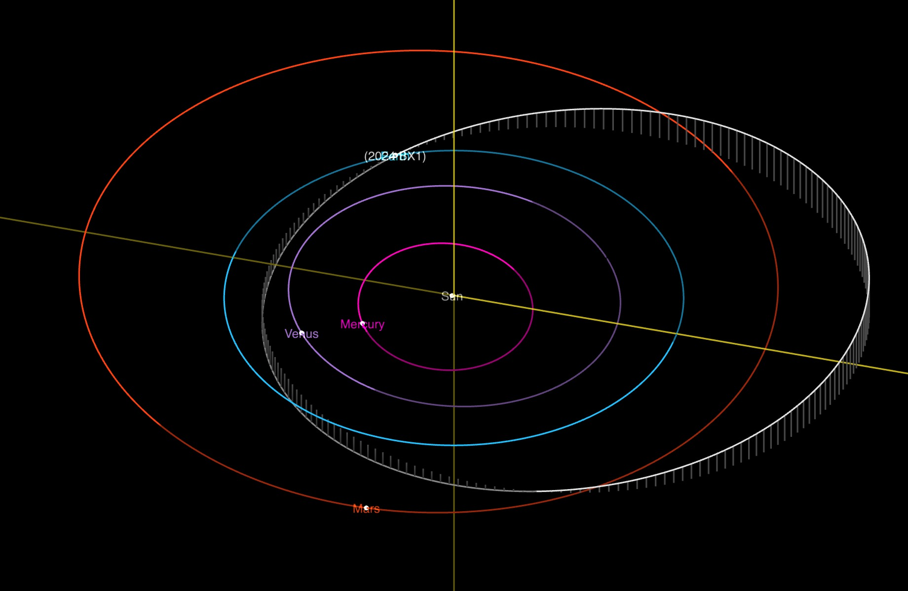
Impact of small asteroid 2024 BX1 on January 21, 2024
* The impact was over Germany on 1/21/24 at 1:32am CET, which was 1/20/24 at 7:32pm EST.
Notes:
Kelly Q: We heard from Lindley that nothing big is coming our way anytime soon, but I know small asteroids actually do impact Earth quite often, as was the case with asteroid 2023 CX1, which impacted Earth on Saturday January 20! If small asteroids hit Earth often, why was this specific asteroid so interesting to the Planetary Defense community?
This was a good chance to test the systems that look for NEOs and calculate Earth impacts
2024 BX1 was first observed by Hungarian observatory GINOP-KHK (K88) and reported to the Minor Planet Center (K88 also discovered impactor 2022 EB5 and 2023 CX1)
JPL Scout system identified a potential impact and informed PDCO
ESA’s NEO Coordination Centre similarly identified a potential impact
The worldwide community submitted observations to the MPC and narrowed down the region of uncertainty

Slide 5
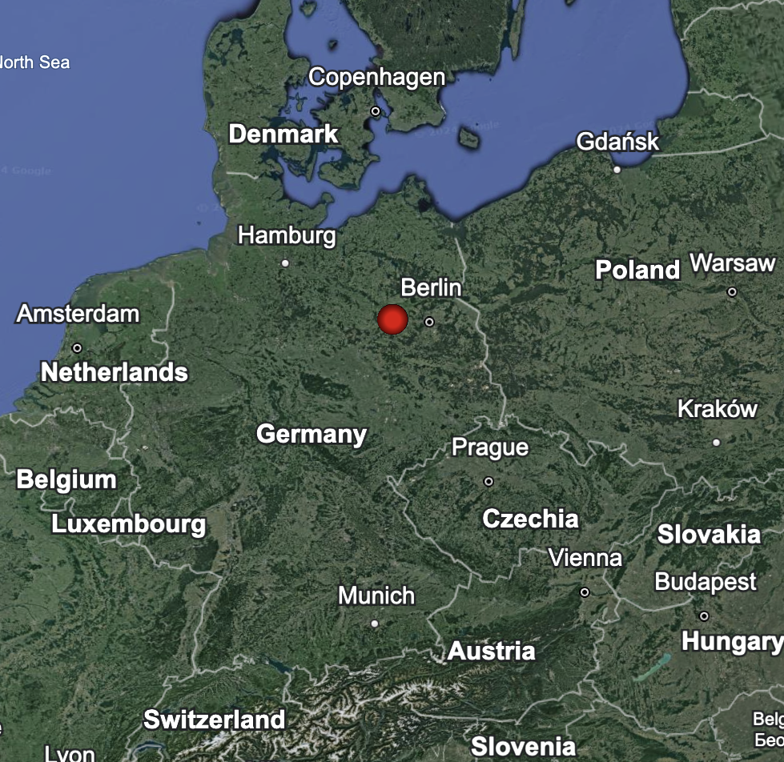
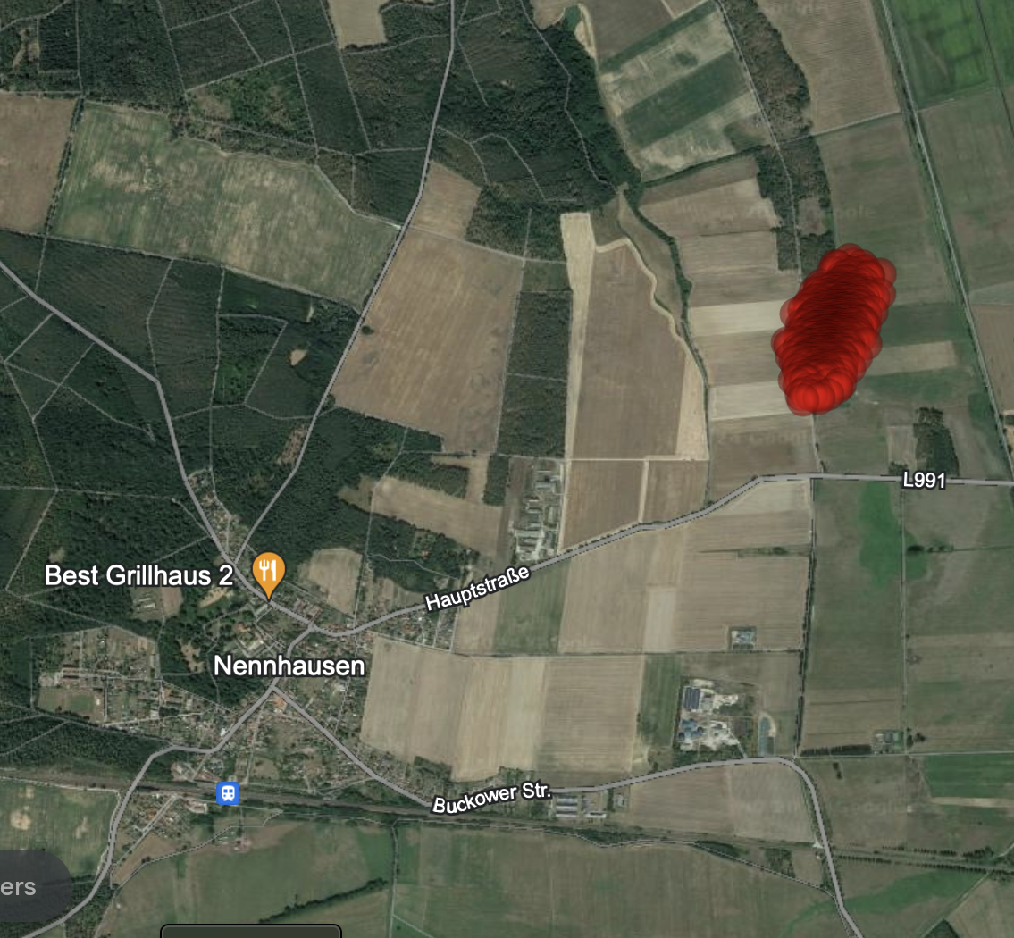
Impact of small asteroid 2024 BX1 on January 21, 2024
NASA JPL’s Center for Near-Earth Object Studies (CNEOS) issued an alert 2 hours before impact based on observations sent to the Minor Planet Center by Krisztián Sárneczky at Konkoly Observatory (Piszkéstető), Hungary.
Follow-up from observatories throughout Europe allowed CNEOS to quickly refine the impact prediction to west of Berlin, Germany. ESA NEOCC made a similar prediction.
Notes:
Kelly Q: When you say the area of uncertainty was narrowed, what does that mean exactly?
The uncertainty region for the impact narrowed as additional observations helped CNEOS and NEOCC refine their orbit calculations
You can see here in the hours leading to impact how the area of where 2024 BX1 was going to impact shrank as more data was submitted
Eventually at T-1 hour we narrowed the impact site down to Germany
The object disintegrated as a meteor to the west of Berlin over Nennhausen, Germany

Slide 6
Impact of small asteroid 2024 BX1 on January 21, 2024
The asteroid posed no threat since it was so small at ~1 meter in size
It was an excellent demonstration of planetary defense capabilities: find, track and accurately predict impact location
NASA (@AsteroridWatch) and ESA (Moissl-@Richard_M_F) notified the public on social media channels
Many watched the impact as it happened or caught the view on Berlin-area webcams
https://twitter.com/michaelaye/status/1748874235269853494
https://twitter.com/meteordoc/status/1748868373033746881

Slide 7
UN Office of Outer Space Affairs
Committee on Peaceful Uses of Outer Space
Overview for NEO Threat Response
United Nations
COPUOS/OOSA
Inform in case of
credible threat
Parent Government
Delegates
Determine Impact time, location and severity
Potential deflection mission plans
International Asteroid Warning Network (IAWN)
www.iawn.net
Space Missions Planning Advisory Group (SMPAG)
www.smpag.net
Coordinated by NASA
Chaired by ESA
Observers, analysts, modelers…
Space agencies and offices
Notes:
Note: SMPAG is the group that recommends space mission options - it will be the focus in the second part of this session

Slide 8
International Asteroid Warning Network (IAWN)
A worldwide collaboration of asteroid observers and modelers recommended by the United Nations
Newest signatories to IAWN include:
Australia | Univ. New South Wales, Canberra
Australia | Univ. Western Australia
Czech Republic | Klet Observatory
Japan | JAXA
France | K19-PASTIS
Italy | ABObservatory L90 *
Italy | K78 Iota Scorpii
Italy | Montagna Pistoiese 104 *
Italy | Virtual Telescope Project
Kazakhstan | Fesenkov Astrophysical Institute
Slovakia | Kysuce Observatory G02
United States | Mind's Eye Observatory
IAWN includes
56 signatories
from over 25 countries
(January 2024)
*Since last meeting

Slide 9
Notification by IAWN - Threshold
IAWN shall warn of predicted impacts exceeding a probability of 1% for all objects characterized to be greater than 10 meters in size*
*Roughly equivalent to absolute magnitude of 28 if only brightness data can be collected.
Reference: Report SMPAG-RP-003 on Recommended Criteria & Thresholds for Action for Potential NEO Impact Threat (led by IAWN) at smpag.net
UNCOPUOS conference paper A/AC.105/C.1/2017/CRP.25
Notes:
Rationale: Impact probabilities greater than 1 per cent are rare yet warrant awareness of possible effects. Most objects greater than 10 meters in size could have some effects (air blast and pieces) that could reach the Earth’s surface. IAWN is compelled to warn populations if bodies will have effects that reach the ground. Setting threshold at 1 per cent is a compromise between not being overly alarmist and not warning too late for necessary action to be initiated. It is a probability figure that individuals and governments can comprehend. An alert such as this demonstrates that the IAWN is functioning. Further, it ensures the flow of communications from IAWN to the public and the United Nations.

Slide 10
Notification by IAWN – Who?
The IAWN Coordinating Officer or a member of the IAWN Steering Committee will notify:
Chair, Space Mission Planning Advisory Group (SMPAG)
United Nations Office of Outer Space Affairs (UNOOSA)
UNOOSA will notify UN Member States
IAWN signatories would also notify and work with their own governments according to their own national policies, as applicable.

Slide 11
Last IAWN Meeting
26 October 2023 - Full meeting of the IAWN Signatories
Reports from various IAWN Signatories including new Signatories
Report by SMPAG
Update by the Minor Planet Center
IAWN Observing Campaign Summary: 2023 DZ2
Community discussions on best practices for the network such as timing, reporting astrometric uncertainties, image stacking, coordinating astrometric follow-up

Slide 12
Peer-Reviewed Publications
A 2023 DZ2 characterization campaign paper is under review
The Second International Asteroid Warning Network Timing Campaign: 2005 LW3
Davide Farnocchia et al 2023 Planet. Sci. J. 4 203 https://doi.org/10.3847/PSJ/acfd22
International Asteroid Warning Network Timing Campaign: 2019 XS
Davide Farnocchia et al 2022 Planet. Sci. J. 3 156 https://doi.org/10.3847/PSJ/ac7224
Apophis Planetary Defense Campaign
Vishnu Reddy et al 2022 Planet. Sci. J. 3 123 https://doi.org/10.3847/PSJ/ac66eb
Near-earth asteroid (66391) Moshup (1999 KW4) observing campaign: Results from a global planetary defense characterization exercise
Vishnu Reddy et al 2022 Icarus 374 114790 https://doi.org/10.1016/j.icarus.2021.114790
Near-Earth asteroid 2012 TC4 observing campaign: Results from a global planetary defense exercise
Vishnu Reddy et al 2019 Icarus 326 133 https://doi.org/10.1016/j.icarus.2019.02.018

Slide 13
Latest Updates
The IAWN Steering Committee held its first meeting in January 2014
This is the 10th anniversary of the first IAWN meeting
IAWN Steering Committee Meeting – 30 January 2024
This executive session addressed the future of the IAWN Steering Committee by detailing, for the Terms of Reference, the core IAWN capabilities to be represented by a geographically and organizationally diverse representation from among IAWN signatories
This will be communicated to IAWN signatories for additional or expanded applications
The next IAWN meeting is tentatively being planned for the week of 7 October 2024 as an IAWN Steering Committee workshop on NEO threat notification followed by a full hybrid meeting of IAWN signatories

Slide 14
BACKUP

Slide 15
IAWN Background
IAWN is a worldwide collaboration of asteroid observers and modelers that was recommended by the United Nations
From the IAWN Statement of Intent:
“The intent of the International Asteroid Warning Network (IAWN) is to establish a worldwide effort to detect, track, and physically characterize near-Earth objects (NEOs) to determine those that are potential impact threats to Earth. This network is comprised of a partnership of scientific institutions, observatories, and other interested parties performing observations, orbit computation, modeling, and other scientific research related to the impact potential and effects of asteroids.”

