Slide 1
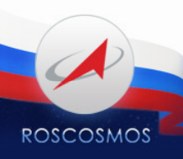

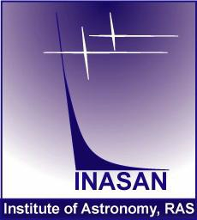

Slide 2
Roscosmos and RAS expressed their wish to integrate issues of NEO and space debris in the Federal Program.
Project proposed for
Russian Federal Space Program for 2016-2025
ECOZOND
NEBOSVOD
APOTHIS

Slide 3
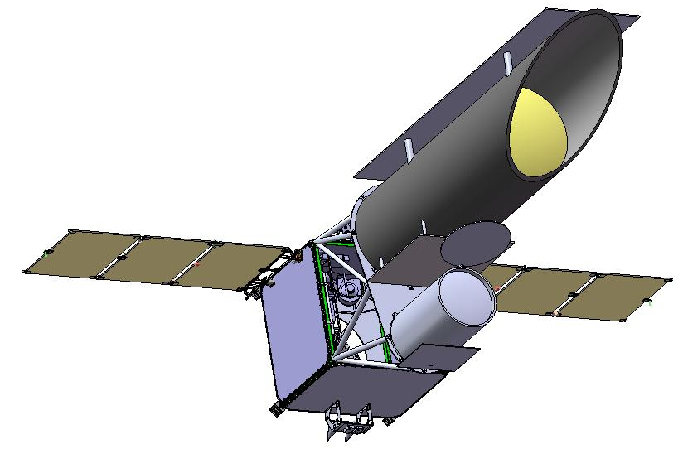
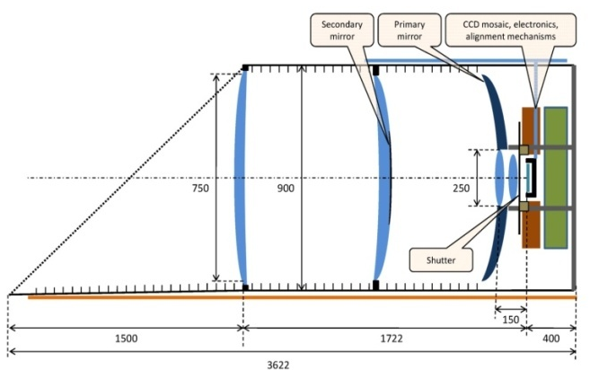
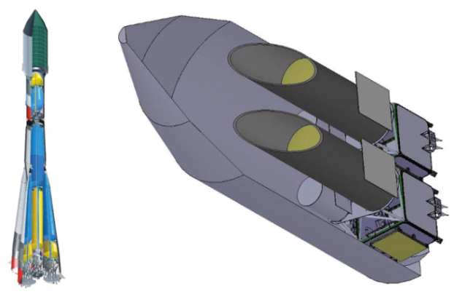
EKOZONT
Project of space survey telescope for the detection NEOs
EKOZONT is a concept of cost-effective space system designed for the detection of NEOs down to size of 100 m not later than 15-25 days before the possible collision with the Earth.
The space system consists of one or two spacecrafts at low orbit.
In addition to the detection of NEOs, the system will be capable to detect space debris and to carry out some scientific research programs.
EKOZONT spacecraft layout with a main VT-77 telescope and auxiliary 40 cm telescope.
• The main 75 cm telescope with 7º FoV will be focused to search the weakest and the most distant NEOs.
• 40 cm telescope will be effective to discover the nearest bright NEOs and space debris.
Layout of two EKOZONT satellites for “Soyuz” launcher.
VT-77 telescope layout.
3
Notes:
3

Slide 4
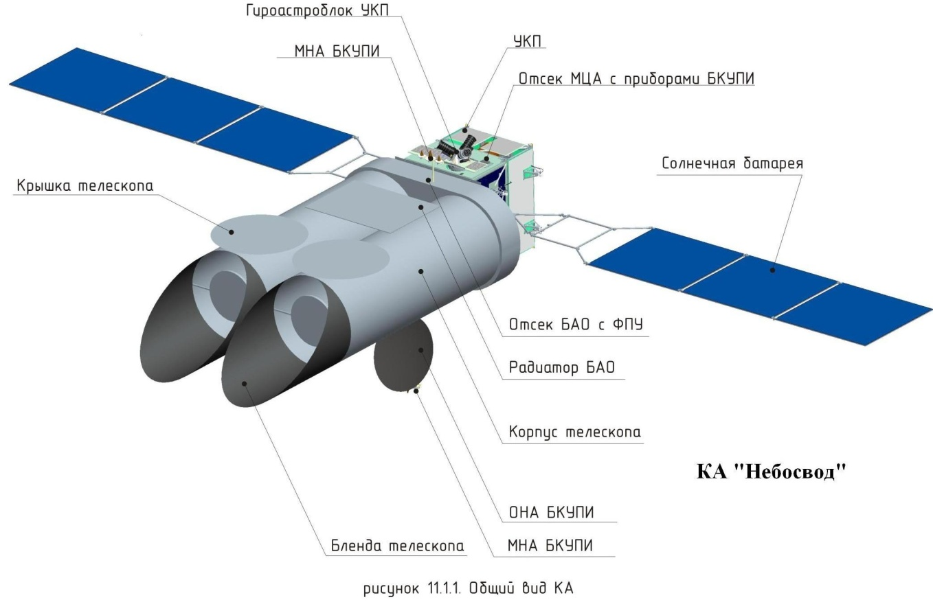
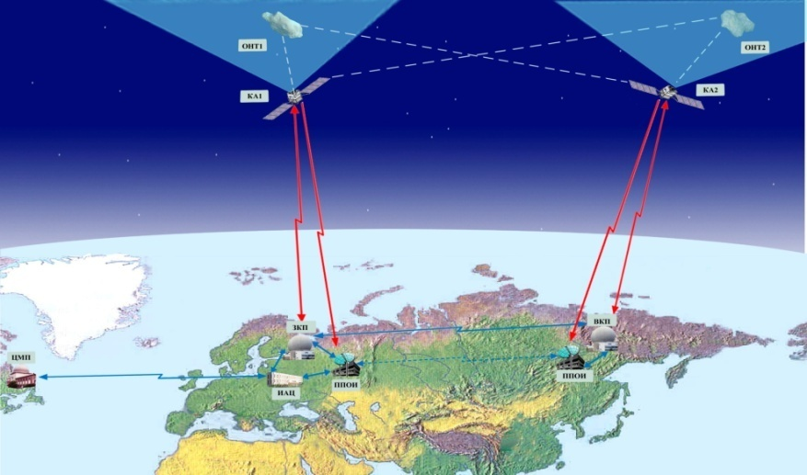
NEBOSVOD
Space survey telescope for the detection of most distant NEOs
NEBOSVOD is a concept of high-sensitivity space system designed for the detection of most distance and small NEOs down to size of 50 m not later than 30-45 days before the possible collision with the Earth.
The space system consists of two spacecrafts at GSO orbit.
The main system parameters are:
Telescopes aperture: 1.5 m
Field of view: 8°× 4°
Limiting sensitivity 25^{m}
Observing mode TDI
Survey rate: 20000 sq.deg/day
4
Notes:
4

Slide 5
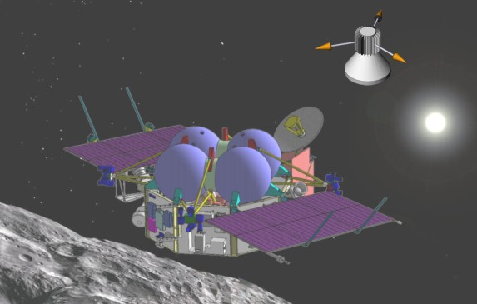
Space mission “Apophis”
Apophis is a automated mission to an asteroid. The major goals of the mission preliminary named “Apophis” are:
to carry out a study of physical and chemical properties;
to put a special radio beacon into circum-asteroid orbit aimed for precise determination of the asteroid’s orbital parameters.
The period 2018-2022 seems to be the most reasonable window for the launch. The total mass of payload is about 800 kg. Both distant and contact (if a lander option will be included) modes of study are considered.
5
Notes:
5

Slide 6
National NEO program and international cooperation
A national NEO program is under preparation in Russia.
Its implementation will allow Russia to participate effectively in the international cooperation on the issue.
As an example cooperation of development that has been established during joint efforts on the Russian-American RAMOS program can be used to in the international asteroid hazard programs.
6
Notes:
6

Slide 7
