Slide 1


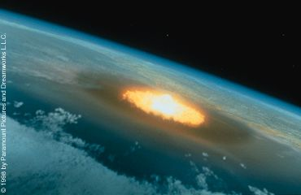
Austrian Update to the Hypothetical Threat Exercise of SMPG
Rudolf Albrecht
Austrian Space Forum
Christian Koeberl
Department of Lithospheric Research
University of Vienna, Austria

Slide 2
Status October 2023
- Austria, like many other countries, does not, at this point in time, have a detailed plan to be enacted in the case on a possible asteroid threat.
- An analysis on the national level of possible actions in response to various natural disasters has been initiated. Target date for completion is January 2024. It is thus not possible to provide specific information before that date.
- Coordination is through the Ministry for Climate Action (BMK; Mr. Andreas Herndler) and the Ministry of the Interior (BMI; Ms. Nieves Kautny)
- The asteroid threat is classified as a low probability/high impact event. Consequently, it has not received the highest attention.
- It is obvious that some actions required in the case of an asteroid threat, will be similar to actions required for other natural disasters, such as earthquakes or floods.
- Depending on the nature of the disaster, relevant national and international experts will be consulted. Extensive collaboration at the level of the European Union is hoped for.

Slide 3
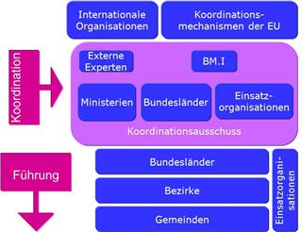
Status, cont’d
Austria has a national civil protection mechanism in place, which covers large events of a catastrophic nature (https://www.bmi.gv.at/204/start.aspx). This mechanism involves the civil protection agencies, medical facilities, law enforcement and the armed forces. It has been invoked numerous times for flooding and for winter storms. It is designed to also cover earthquakes and aviation accidents.
The National Crisis- and Disaster Management (Staatliches Krisen- und Katastrophenmanagement, SKKM; https://www.bmi.gv.at/204/skkm/start.aspx ) will be activated. This group will assess the situation and develop options.

Slide 4
Plans and Considerations
- An overview of the current disaster management scenario in Austria, including guidelines, is in https://www.bmi.gv.at/204/start.aspx#uebersicht
- The Ministry of the Interior is maintaining a web site with information on the possible mitigation of various disasters, like fires, flooding, snow, evacuation. https://www.bmi.gv.at/204/Download/start.aspx
- The Austrian Red Cross has developed guidelines for disaster management https://www.roteskreuz.at/fileadmin/user_upload/PDF/Vorschriften_und_Richtlinien/Rahmenvorschrift_Grosseinsatzmanagement_2017.pdf
- Starting Jan 2024 the Krisensicherheitsgesetz (Crisis Protection Law) will be enacted. It will establish administrative structures and responsibilities for possible crises https://www.parlament.gv.at/dokument/XXVII/I/2084/fname_1569325.pdf
- A hardened Situation Room is being installed underneath a “Flakturm” (Anti Aircraft gun tower) in Vienna (Stiftskaserne). For of these towers were left over from WWII. They resisted all attempts to remove them. Some of them have been re-purposed.

