Slide 1
APOPHIS 2029
Preliminary results of a CNES feasibility study
Jean-Yves Prado CNES/DSP
SMPAG, Vienna June 2014

Slide 2
Contents
APOPHIS reminder
Mission objectives
Strawman minimum payload
Mission analysis
Next steps

Slide 3
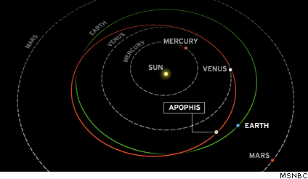
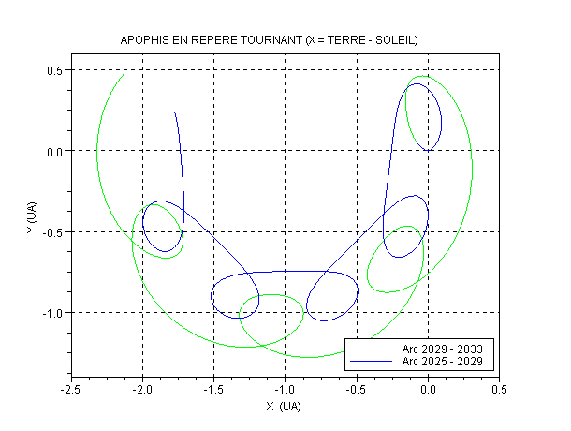
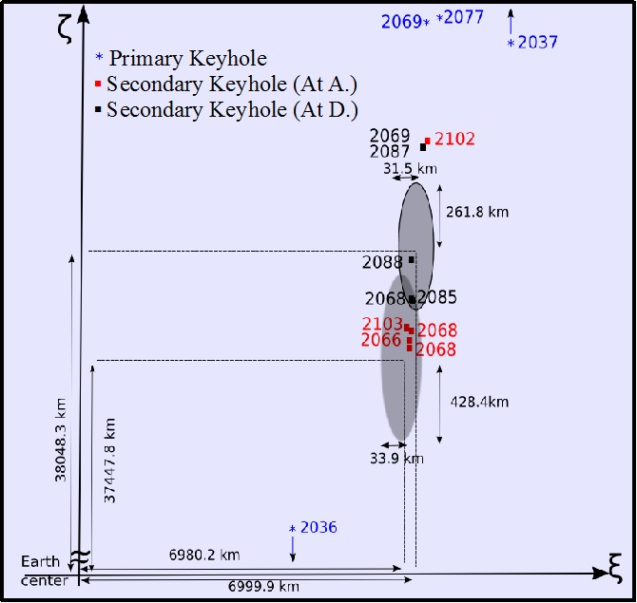
APOPHIS
Discovered in June 2004
Close approach to the Earth on April 13, 2029
Tumbling spin state with a period ~ 30 hours
Diameter ~ 330 meters (from Herschell IR observations)
Next observation window from the Earth in 2020-2021

Slide 4
Rationale of the CNES study
Is there a significative advantage to plan for a space mission where a probe would accompany Apophis during its 2029 pass ?
Assumptions:
- first mission to Apophis
- priority to the mitigation preparation objectives
- scientific objectives not excluded but secondary
Main mission objective
provide informations about Apophis that would be requested for designing a future mitigation mission, if needed
=> Internal structure characterization
=> Observation of its possible changes induced by the close approach

Slide 5
Mission objectives
Impact risk assessment
Mitigation mission
Reentry modeling
Non gravitational forces modeling
Long term orbit propagation
Mass, inertia,
Rotation, gravitational field
Porosity, cohesion
Rubble pile/monolith
Rifts
High accuracy orbit determination Flyby geometry
Thermal modeling of the regolith
Surface
Subsurface and internal structure modeling
3D modeling

Slide 6
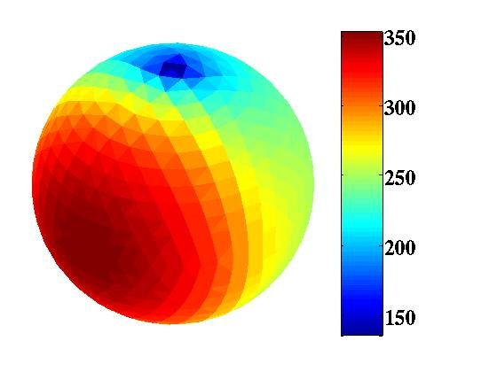
Strawman Payload
General features (shape, mass, rotation, gravity)
Wide Angle and Narrow Angle cameras in VIS and near IR
Radio science
Surface analysis
NAC and WAC in VIS and Near IR
Spectroscopie in VIS and IR large spectrum
Sub-surface analysis
High Frequency radar
Options:
  Sismometers
  Artificial craterisation
Sounding
Low Frequency Radar tomography
Option: sismometers
Long term tracking:
Radio and/or laser reflector to be assessed
Thermal map of Apophis from Herschel observations
at 70, 100 and 160 microns
© Esa, Herschel, Mach-11, T. Müller, MPE

Slide 7
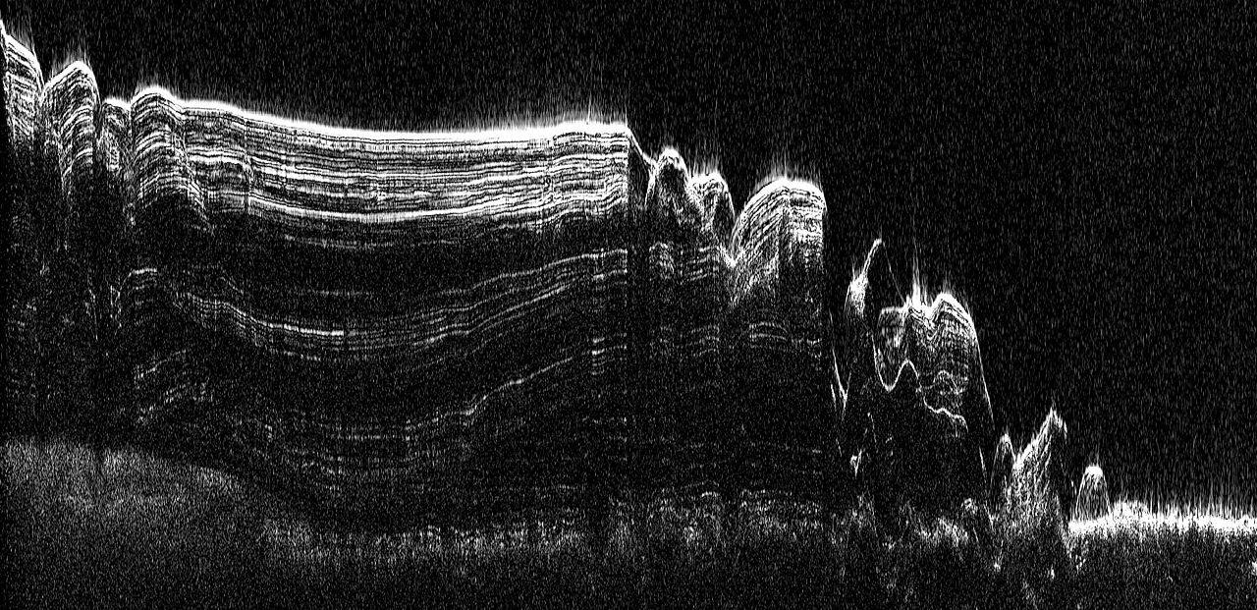
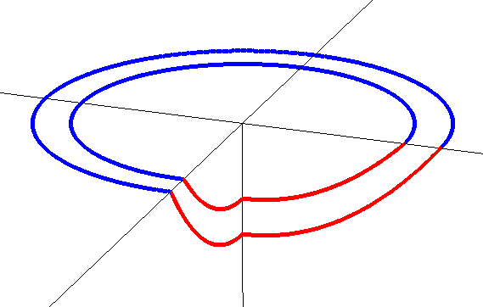
Radars
  Low frequency radar for tomography
    Tomography in Reflection
      RF wave propagation (~20 MHz)
      Orbiter only (Marsis-like)
    Deep interior profiles : Interfaces, layers and voids
    Heritage Sharad, Marsis
  High frequency radar for regolith characterisation
    300 MHz-1GHz
    10 cm resolution @10 m depth
    Can be used in an altimeter mode and contribute to the gravitational field determination
    Used in the range 500 m -2500 m
    Heritage Wisdom/EXOMARS
This image shows a cross-section of a portion of the north polar ice cap of Mars, derived from data acquired by the Mars Reconnaissance Orbiter's Shallow Radar (SHARAD

Slide 8
Instrumentation / Objectives
Impact risk assessment
Mitigation mission
Reentry modeling
Non gravitational forces modeling
Long term orbit propagation
Mass, inertia,
Rotation, gravitational field
Porosity, cohesion
Rubble pile/monolith
Rifts
High accuracy orbit determination Flyby geometry
Thermal modeling of the regolith
Surface
Subsurface and internal structure modeling
3D modeling
Ranging and doppler
Radar tomography
Ground penetrating radar
Seismometers
IR mapping
Cameras
Radio tracking
Laser altimeter

Slide 9
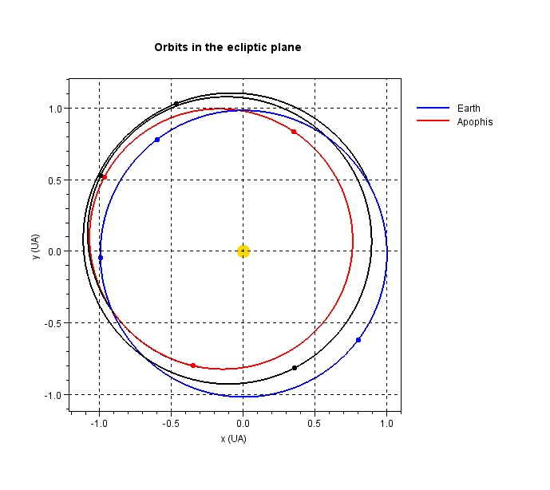
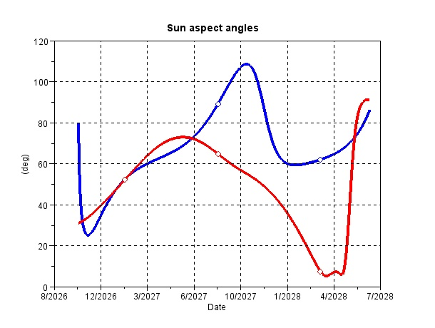
Mission analysis example
Departure : 22/10/2026
Arrival : 11/07/2028
Δt = 629 d
Δv = 2.14 km/s
Δm = 44.1 kg
Ion Thruster NSTAR
Isp = 3080 s
P = 1500 W
T = 53 mN
Thrust : 306 d
01/02/2027 – 08/05/2027
11/12/2027 – 08/07/2028
1
2
Departure
3
3
1
2
Arrival
Sun-S/C-Earth
Sun-S/C-Apophis

Slide 10
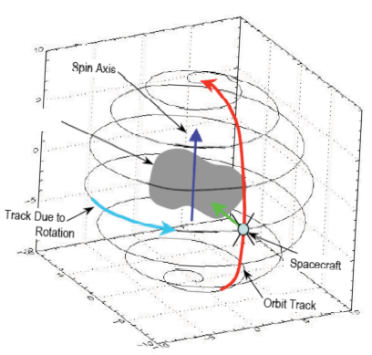
  Operational scheme
Rendez-vous to a waiting position 200 km in the sun direction (mid July 2028)
Approach to 20 km controled from the ground using NAC (1m@10km)
VIS and IR science between 20 km and 3km
Radio science between 300 m and 3km
About 6 months for the programme before April 13
Spacecraft ahead of Apophis for the flyby
High accuracy geometry determination of the F/B
from ranging/doppler between G/S and S/C (eg from KRU)
Same observation programme after the flyby
to identify possible changes

Slide 11
Main outcomes
Compatibility with a SOYOUZ launch from French Guyana Space Center
Electric propulsion required
Affordable fuel budget (~50 kg)
Mitigation objectives can be achieved through VIS and IR cameras and 2 radars
The mitigation objectives can be satisfied without landing any device
The 2029 timeframe is a unique opportunity to study Apophis, its internal structure, the possible changes due to the gravitational effects from the Earth and determine the exact geometry of its flyby

Slide 12
Next steps
For this ‘minimal’ scenario
orbit stability and risk assessment for the navigation phase within the Apophis sphere of influence
instrument specification follow on
study of possible options: sismometers, passive tracking devices
Consideration of additional scientific objectives such as drilling, sample return…
The APOPHIS 2029 science group is presently very busy in the ROSETTA mission
A second study phase can start in early 2015
Association with SMPAG members is welcome

Slide 13
Acknowledgement
Science mission group
P. Michel, A. Barrucci, D. Hestroffer, A. Herique, O. Groussin, H. Rème, R. Garcia, D. Mimoun, J.L. Vérant, W. Thuillot
CNES PASO Team
E. Hinglais, L. Lopes, T. Martin, M. Delpech, E. Canalias, J. Laurent-Varin, J.J. Berthon,
N. Taglang, R. Rodriguez Suquet, J.C. Lalaurie, C. Loisel

