Slide 1
UK Activities:
NEO Characterisation
Simon F. Green
Planetary and Space Sciences
Department of Physical Sciences
The Open University
SMPAG, Vienna, 12-13 June 2014
Notes:
Apologies for the very brief abstract.
Will briefly review the evidence for grain fragmentation and outline its possible consequences for Rosetta.

Slide 2
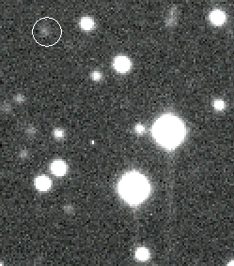
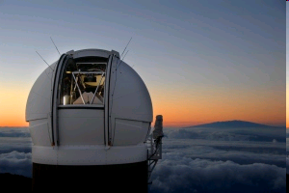
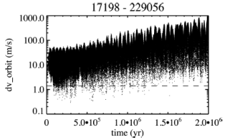
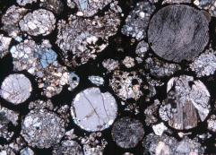
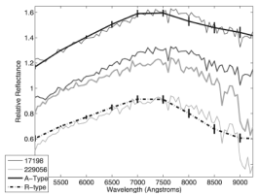
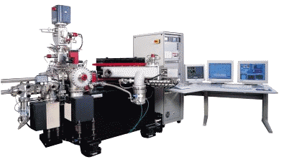
Dynamics
Surveys/Astrometry
Queen’s Belfast
Pan-STARRS1 asteroid science co-lead Cometary activity, collisions
LSST data products UK proposal lead
Dynamical modelling
Armagh, Queen Mary London
Long-term evolution, Yarkovsky effect
Composition
Remote sensing
Queen’s Belfast, Kent, Oxford
Vis/NIR & mid-IR spectroscopy
Returned samples/meteorites
Open Univ., Imperial, Manchester, NHM, UCL/Birkbeck, Leicester, Oxford, Bristol, Glasgow, Kent, Edinburgh
UK Cosmochemistry Analysis Network

Slide 3
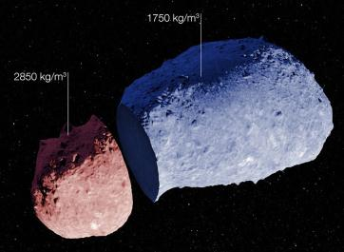
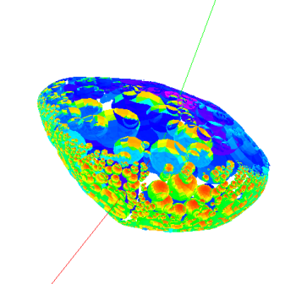
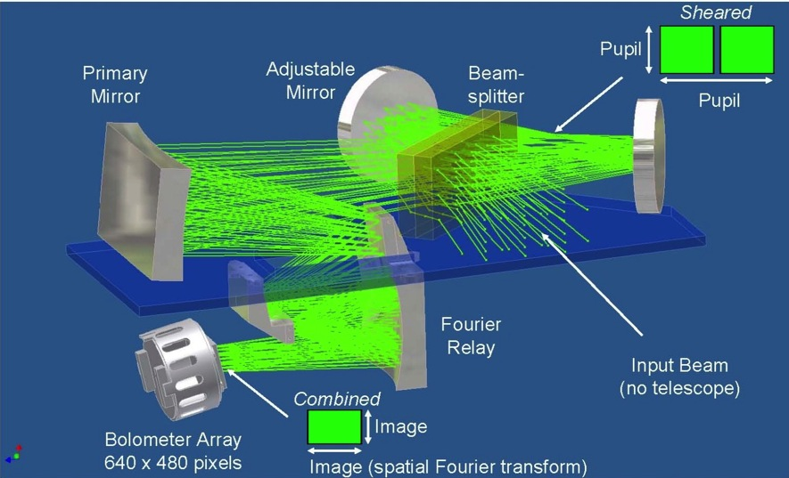
Physical Properties
Shapes and Spin
Kent, Queen’s Belfast, Open Univ.
Shape, spin rate & axis orientation from light curve observation & inversion
Spin/obliquity changes from observations & thermophysical modelling
Thermophysical properties
Open Univ., Oxford
Albedo, Diameter, Temperature, thermal inertia, surface roughness from IR observation & thermal models.
YORP/Yarkovsky effect, density
Instruments for missions
Oxford: IR spectrometer, electrical charging
MSSL/UCL: Cameras
Open Univ.: Mass spectrometer
Leicester: X-ray spectrometer
Imperial: Magnetometer

