Slide 1
Space Mission Planning Advisory Group
Report to STSC 2016
Gerhard Drolshagen
ESA
Technical Directorate and SSA Programme
(Chair of SMPAG)
16 February 2016

Slide 2
SMPAG purpose and membership
The purpose of the SMPAG is to prepare for an international response to a NEO impact threat through the exchange of information, development of options for collaborative research and mission opportunities and NEO threat mitigation planning activities.
Membership is open to all national space agencies or governmental or inter-governmental entities that coordinate and fund space activities and are capable of contribution to or carrying out a space based NEO mitigation campaign.

Slide 3
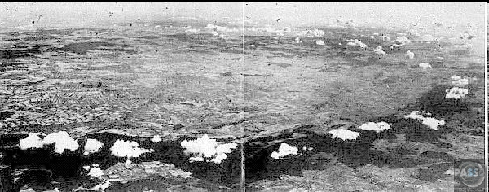
Impact crater
Nördlinger Ries
25 km, 15 Mio Jahre
Meteor Crater in Arizona
1.2 km, 50 000 Jahre

Slide 4
SMPAG formation and status
The SMPAG was officially established in February 2014
SMPAG Terms of References were finalized in June 2014
SMPAG has established a work plan in November 2015 which is a living document
SMPAG works in close coordination with IAWN

Slide 5
SMPAG Membership (Status 16 February 2016)
Official members with nominated delegations:
AEM (Mexico) ESA
ASI (Italy) NASA (USA)
Belspo (Belgium) ROSA (Romania)
CNES (France) ROSCOSMOS (Russian Federation)
DLR (Germany) SSAU (Ukraine)
IAWN (ex officio) SUPARCO (Pakistan)
ISA (Israel) UKSA (UK)
JAXA (Japan)
Official Application received:
South Korea
Intention of Membership indicated:
CSA (Canada)
China

Slide 6
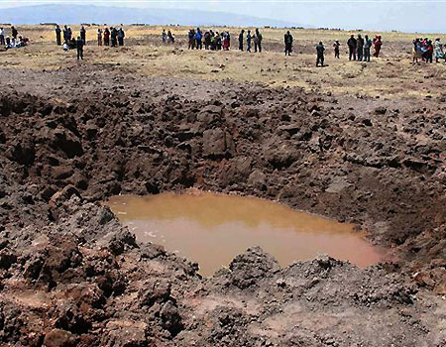
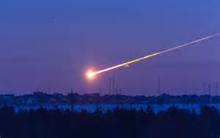
Threshold criteria
Chelyabinsk impact event (NEO size: 20-m)
Crater with 14-m diameter formed by impact from space in 2007 in Carancas, Peru (NEO size : few m)

Slide 7
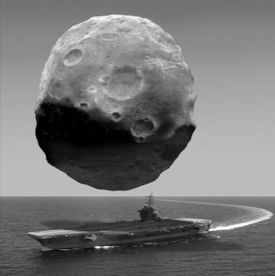
Comparison of sizes
Asteroid 2005 YU 55
Diameter ≈ 300 m
Passed within Lunar distance in November 2011.
(rom SWF Report 2012, illustration by Michael Carrol)

Slide 8
SMPAG work plan
A list of 11 activities has been identified by SMPAG:
Criteria and thresholds for impact threat response actions. (Lead: NASA)
Mitigation Mission Types and technologies to be considered (Lead: UKSA)
Mapping of threat scenarios to mission types (Lead: ESA)
Reference missions for different NEO threat scenarios (Lead: ASI)
A plan for SMPAG action in case of a credible threat (Lead: NASA/IAA)

Slide 9
SMPAG work plan, cont.
Communication guidelines in case of a credible threat (Lead: NASA)
Produce a ‘road map’ for future work on planetary defense (Lead: DLR)
Consequences, including failure, of NEO mitigation space missions (Lead: TBD)
Criteria for deflection targeting (Lead: TBD)
Study the nuclear device option (Lead TBD)
Toolbox for a characterization payload (Lead: CNES)

Slide 10
Possible NEO deflection strategies (Illustrationen von L. Cano, Deimos)

Slide 11
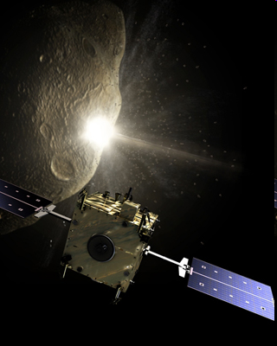
NEO deflection
The kinetic impactor is the most advanced method
Illustration: ESA

Slide 12
IAWN/SMPAG Open Forum
A joint IAWN/SMPAG Open Forum will be held:
on
Thursday, 18 February 2016, starting at 13:30
in
Board Room D, 4th floor (Room for STSC plenary sessions)
Brief overview presentations by IAWN and SMPAG will be followed by an open discussion.
All persons on site are invited to attend.

