Slide 1
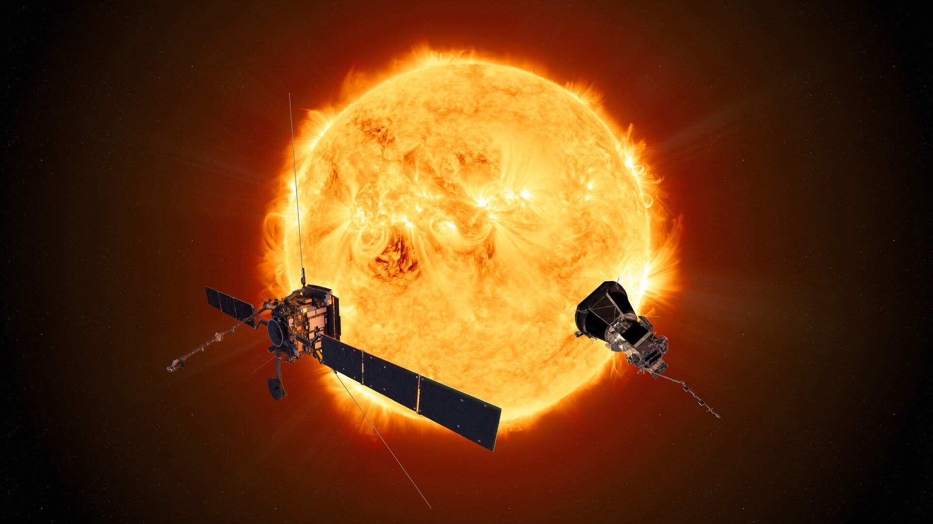
ECLIPSE Conference Testing the expansion factor - solar wind speed relation with SolO data.
J-B Dakeyo, Alexis Rouillard,
Milan Maksimovic, Victor Réville,
Pascal Démoulin, Philippe Louarn

Slide 2
Context and Objectives :
Better understand solar wind acceleration mechanisms with its source characteristics :
Connecting In-situ (vp, Tp, np) to remote sensing observations (magnetograms)
→ Testing the v-f correlation

Slide 3
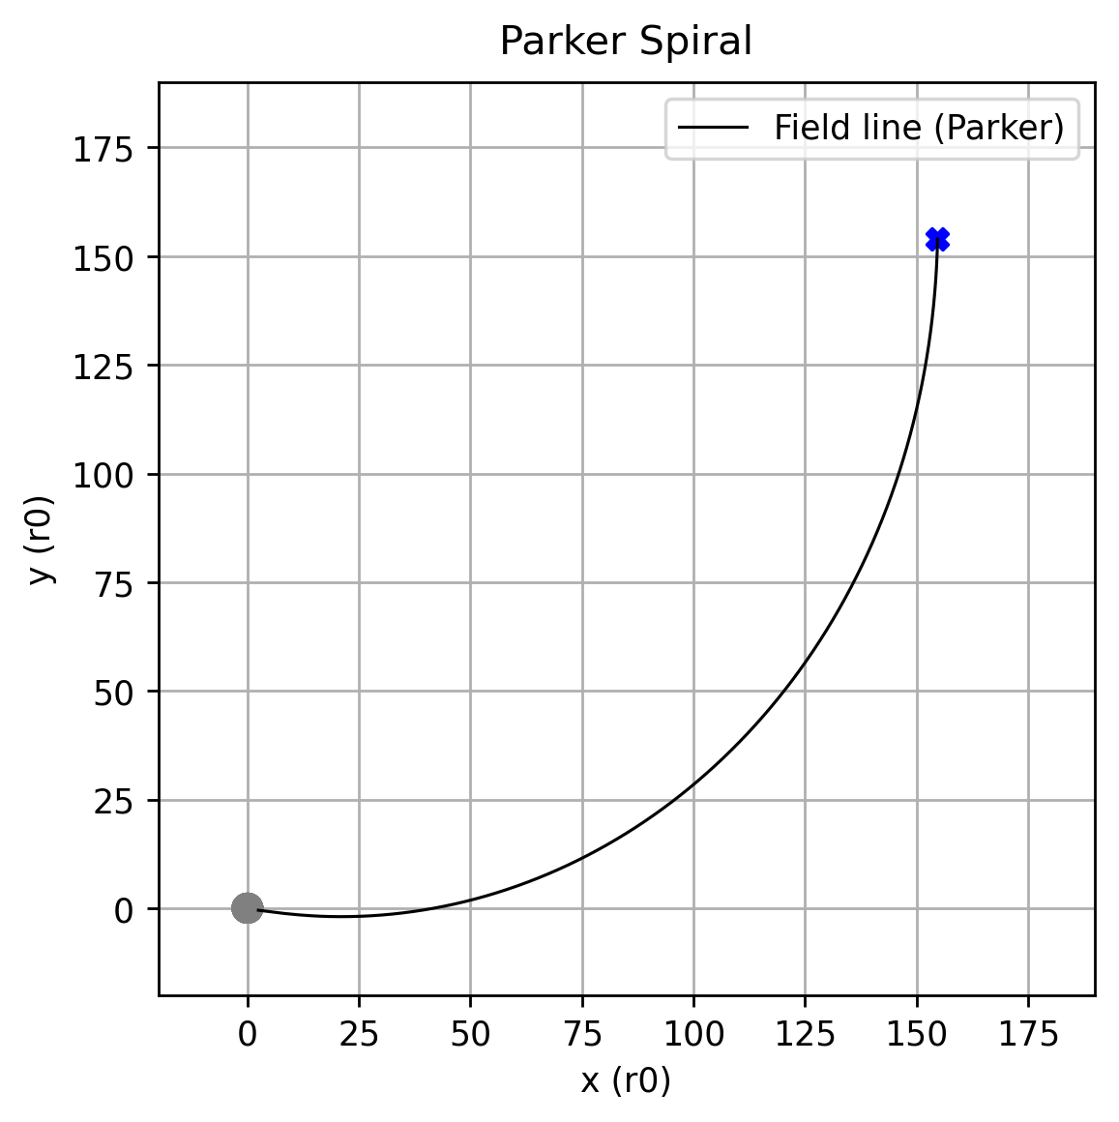
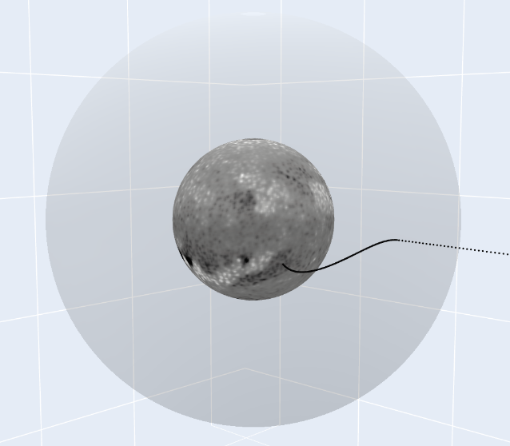
Magnetic Connectivity on Solar Orbiter
« Freeze in » property of the plasma
Field line = Trajectory
Close to the Sun : PFSS reconstruction
Far from the Sun : Streamline tracing (Parker’s like spiral)
$$r_{ss}$$
Solar Orbiter
Parker Spiral
($B_{r}$ in-situ)
Sun
PFSS
reconstruction
($B_{r}$magnetogram)

Slide 4
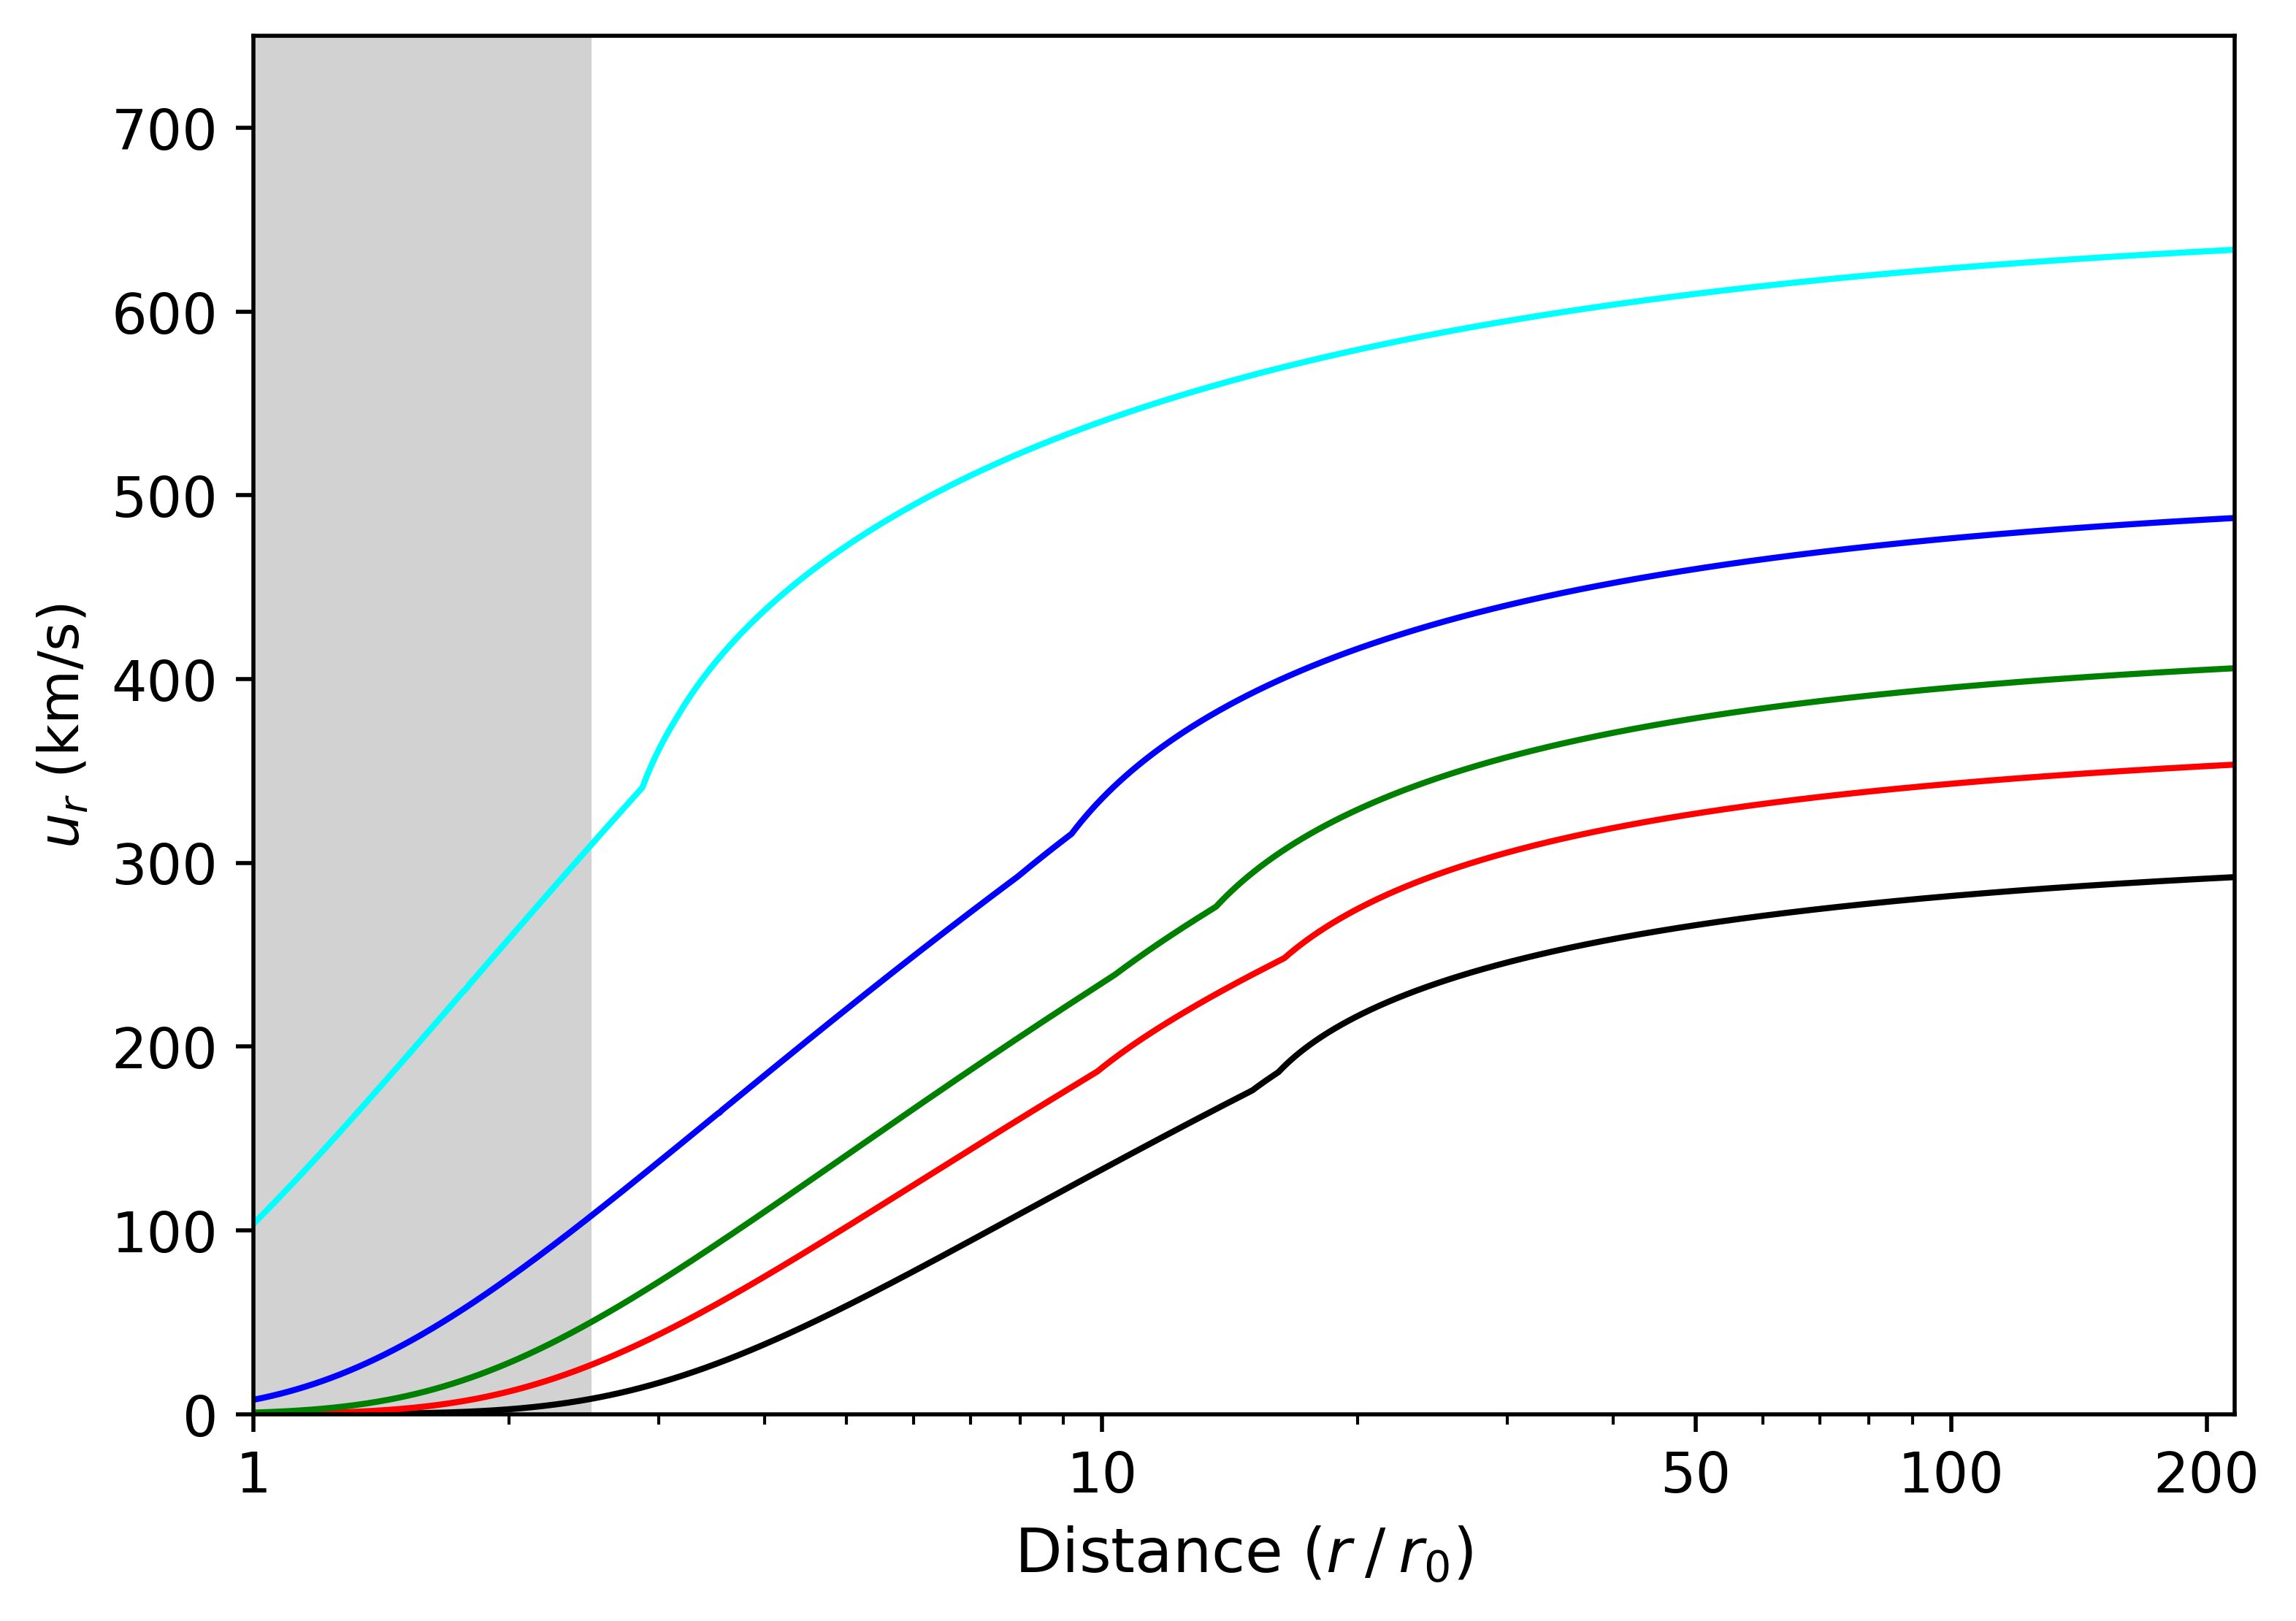
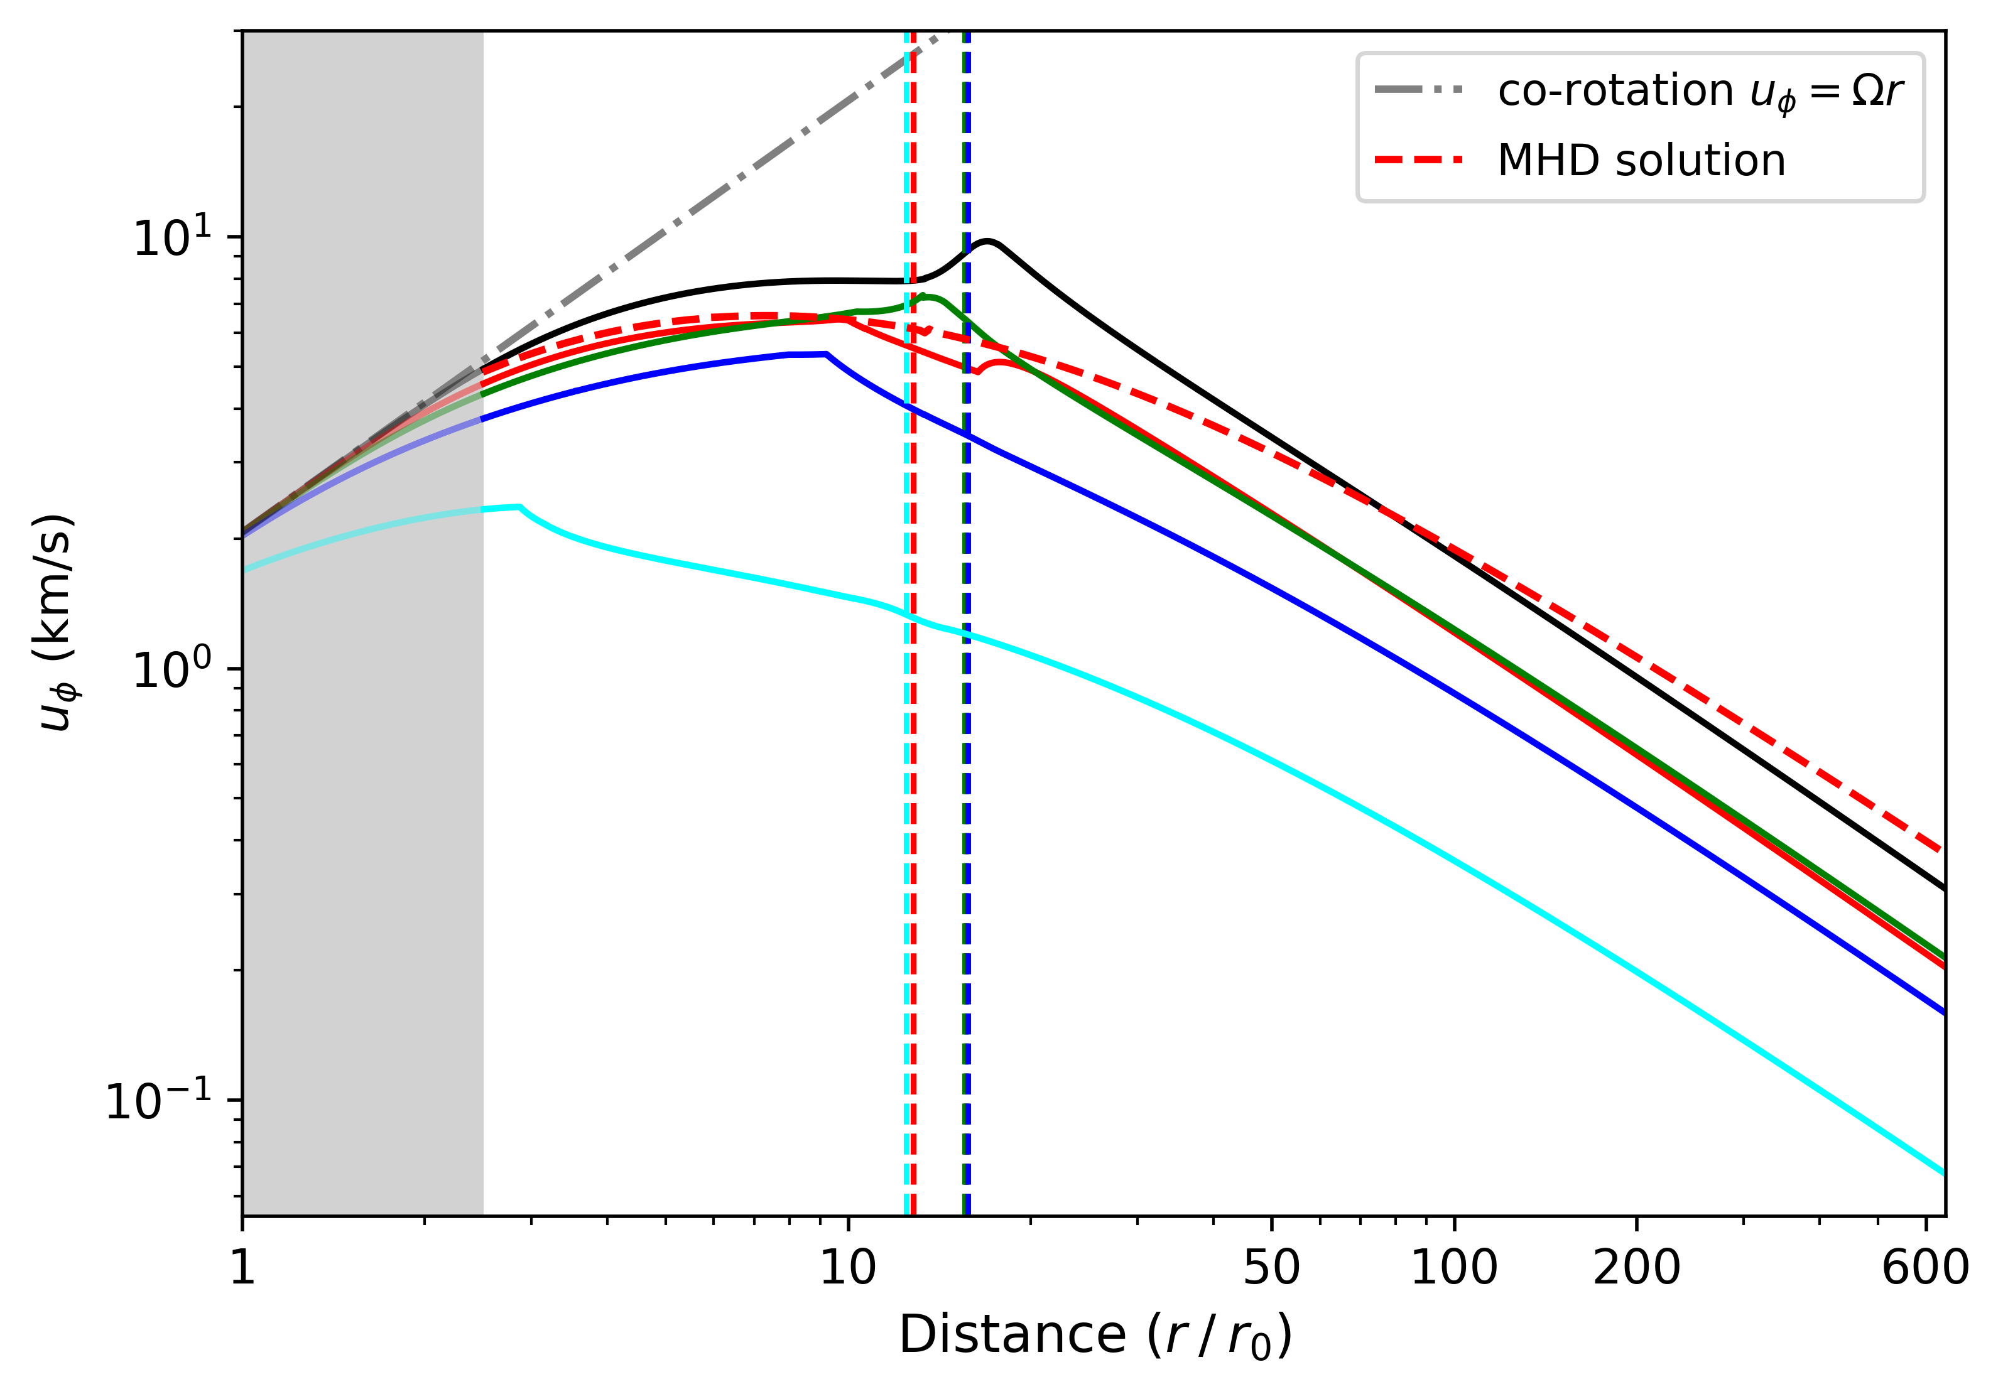
Far from the Sun : Streamline tracing improuvment
Isopoly streamline tracing:
$u_{r}$ radial isopoly profiles
$u_{φ}$ from corotational effects
Streamline Spiral with non constant $u_{r}$ and $u_{φ}$
(Dakeyo et al. 2022)
(Weber & Davis 1967)
Radial evolution
Corotational
effetcs
(Dakeyo et al. 2022)
(Dakeyo et al. 2024a)

Slide 5
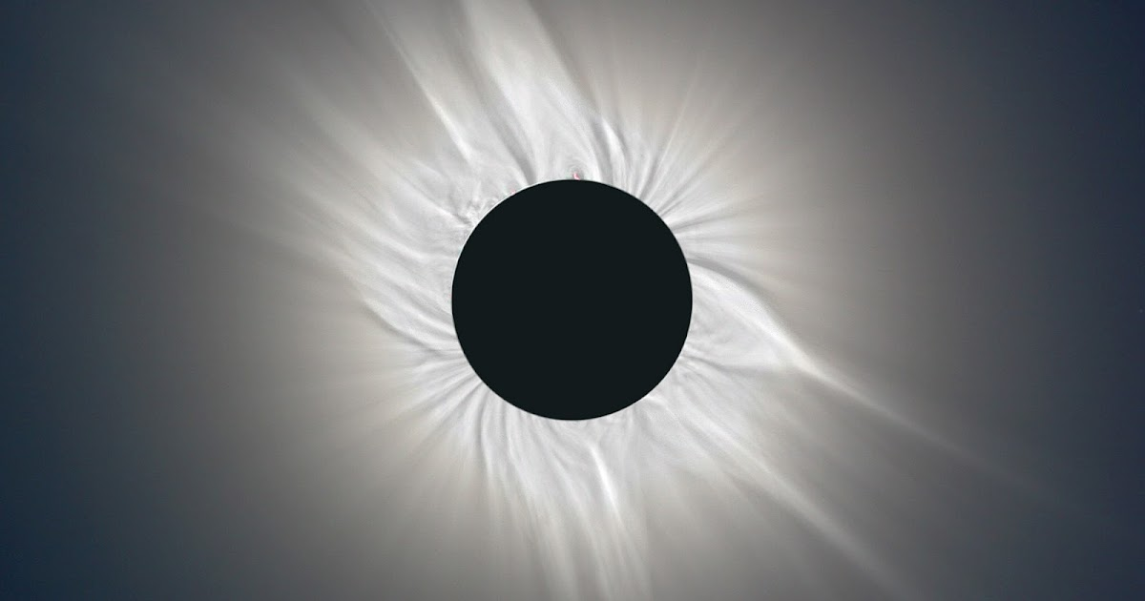
Super radial expansion : Expansion factor

Slide 6
Flux tubes are in super expansion near the Sun
What influence on the wind ?

Slide 7
Magnetic Flux Tube Expansion : Expansion factor $f$
$$f= \frac{B_{r}\left(r_{ss}\right)}{B_{r}\left(r_{0}\right)}{ \left(\frac{r_{ss}}{r_{0}}\right)}^{2}$$
Describe the deviation to a spherical expansion in 1/ $r^{2}$ of $B_{r}$ between the top of transition region ($r_{0}$) and source surface ($r_{ss}$)
Super-radial
expansion
Super-radial
expansion
$$r_{ss}$$
$$r_{ss}$$
Spherical expansion
Spherical expansion
Large f associated to slow solar wind
Low f associated to fast solar wind
(Wang & Sheeley 1990,
Arge 2000)
Flux tube
$$r_{0}$$
$$r_{0}$$

Slide 8
Magnetic Flux Tube Expansion : Heating and expansion relation
$$H_{heating}∝1/\frac{{du}_{A}\left(r\right)}{dr}∝1/\frac{{dB}_{r}\left(r\right)}{dr}$$
→ $H_{heating}∝1/f$
For Alfven waves heating processes, the heating scale height is limited by $B_{r}$gradient with altitude
(Wang 1993, Verdini 2007, Pinto & Rouillard 2016)
Low altitude heating → increase mass flux (+), accelerate(+)
High altitude heating → accelerate(++)
$$r_{ss}$$
$$r_{ss}$$
Large f associated to slow solar wind
Low f associated to fast solar wind
Large $B_{r}$ gradient
→ Waves do not propagates at high altitude
Low $B_{r}$ gradient
→ Waves propagates also at high altitude
(Wang & Sheeley 1990,
Arge 2000)
$$r_{0}$$
$$r_{0}$$

Slide 9
Ready to analyze magnetic connectivity results

Slide 10
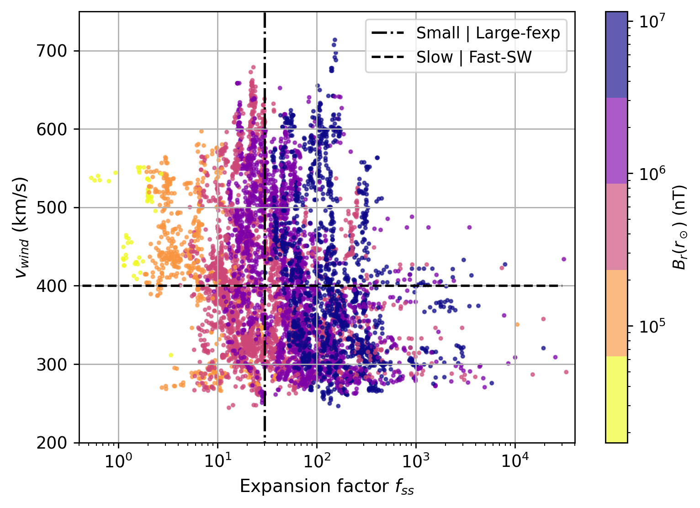
Magnetic connectivity from 08/2020 to 03/2022 on Solar Orbiter (Minimal solar activity period)
From litterature knowledges we would expect :
→ A global anticorrelation v-f

Slide 11
Magnetic connectivity from 08/2020 to 03/2022 on Solar Orbiter (Minimal solar activity period)
From litterature knowledges we would expect :
→ A global anticorrelation v-f

Slide 12
Magnetic connectivity from 08/2020 to 03/2022 on Solar Orbiter (Minimal solar activity period)
Correlation coefficient of the v-f distribution = - 0,27 → No evident anti-correlation
One speed value is not directly related to a single $f_{ss}$ value

Slide 13
Fast solar wind (low $B_{0}$)
Fast solar wind
(high $B_{0}$)
i) What about accordance with previous studies ?
ii) Physical explanations ?
Slow solar wind
(low $B_{0}$)
Slow solar wind (high $B_{0}$)

Slide 14
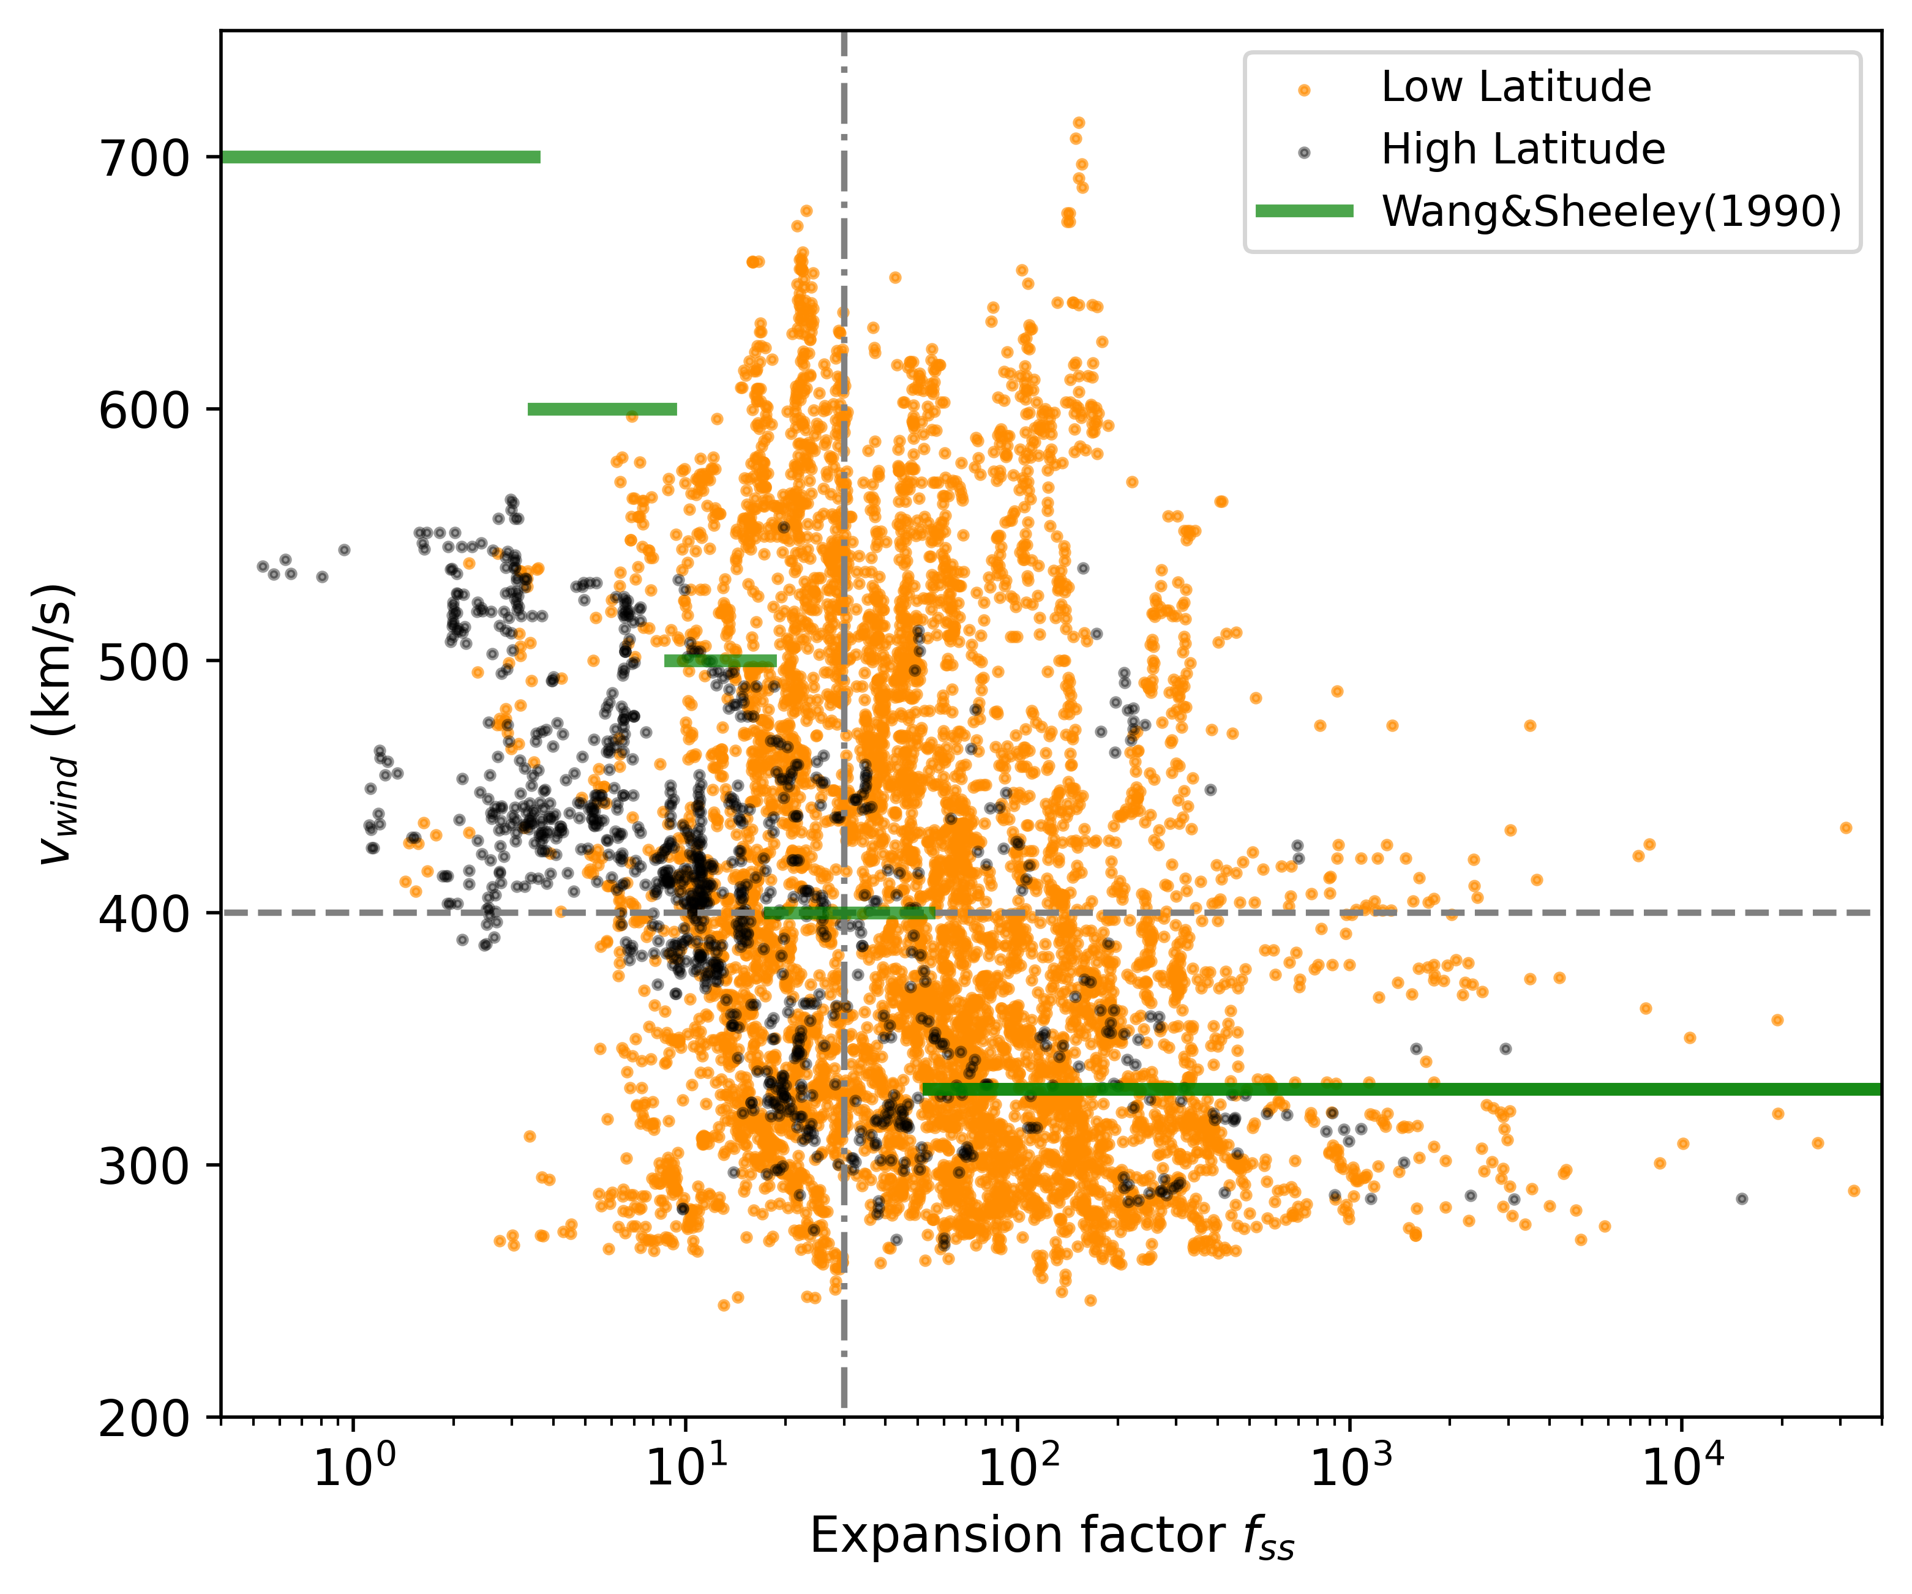
Accordance with large scale v-f studies ?
Global correlation coeff : - 0,27
W&S (1990) :
No magnetic connectivy
v-f anti-correlation set as an initial assumption, not a consequence
Involuntary filtering effect → low resolution magnetograms, long time average
→ Remaining large scale and long term structures i.e. coronal holes
Classification by latitude

Slide 15
Accordance with large scale v-f studies ?
Global correlation coeff : - 0,27
High lat correlation coeff : - 0,51
In accordance with
v-f coronal holes relation (W&S1990, Arge2000)
W&S (1990) :
No magnetic connectivy
v-f anti-correlation set as an initial assumption, not a consequence
Involuntary filtering effect → low resolution magnetograms, long time average
→ Remaining large scale and long term structures i.e. coronal holes
Low lat correlation coeff : - 0,24
Classification by latitude

Slide 16
$H_{heating}∝1/f$ (Wang 1993)
Fast solar wind
with large f
Physical
explanations ?

Slide 17
DeLaval Nozzle effect (Hugoniot equations)
Diverging flow
Converging flow
Deceleration
Acceleration
Subsonic flow
Correlation / Anti-correlation:
Expansion - flow speed
Acceleration
Deceleration
Supersonic flow

Slide 18
What about physical explanations ? : Hugoniot equations
Two super-radial expansion solutions for wind models
Kopp & Holzer 1976
From an empirical expansion profil
→ Varying $f_{m}$ value
‘‘f-supersonic’’
$$A=f_{K} r^{2}$$
with
$$c_{s}$$
Fast wind with large $f_{m}$
theoretically exists (depends also on $σ_{e}$, $r_{e})$
‘‘f-subsonic’’
Easier to model fast wind with large $f_{m}$

Slide 19
What about observations modeling ? : New set of isopoly equations
→ Kopp & Holzer $f_{K}(r)$ mainly represent coronal holes like expansion
What about super expansion of f(r) profiles from PFSS ?
Isopoly equation with super expansion
Same wind isopoly input parameters + f(r)
Dakeyo et al. 2024b (in prep)
→ identify if observations are modeled by f-subsonic or f-supersonic solutions ?

Slide 20
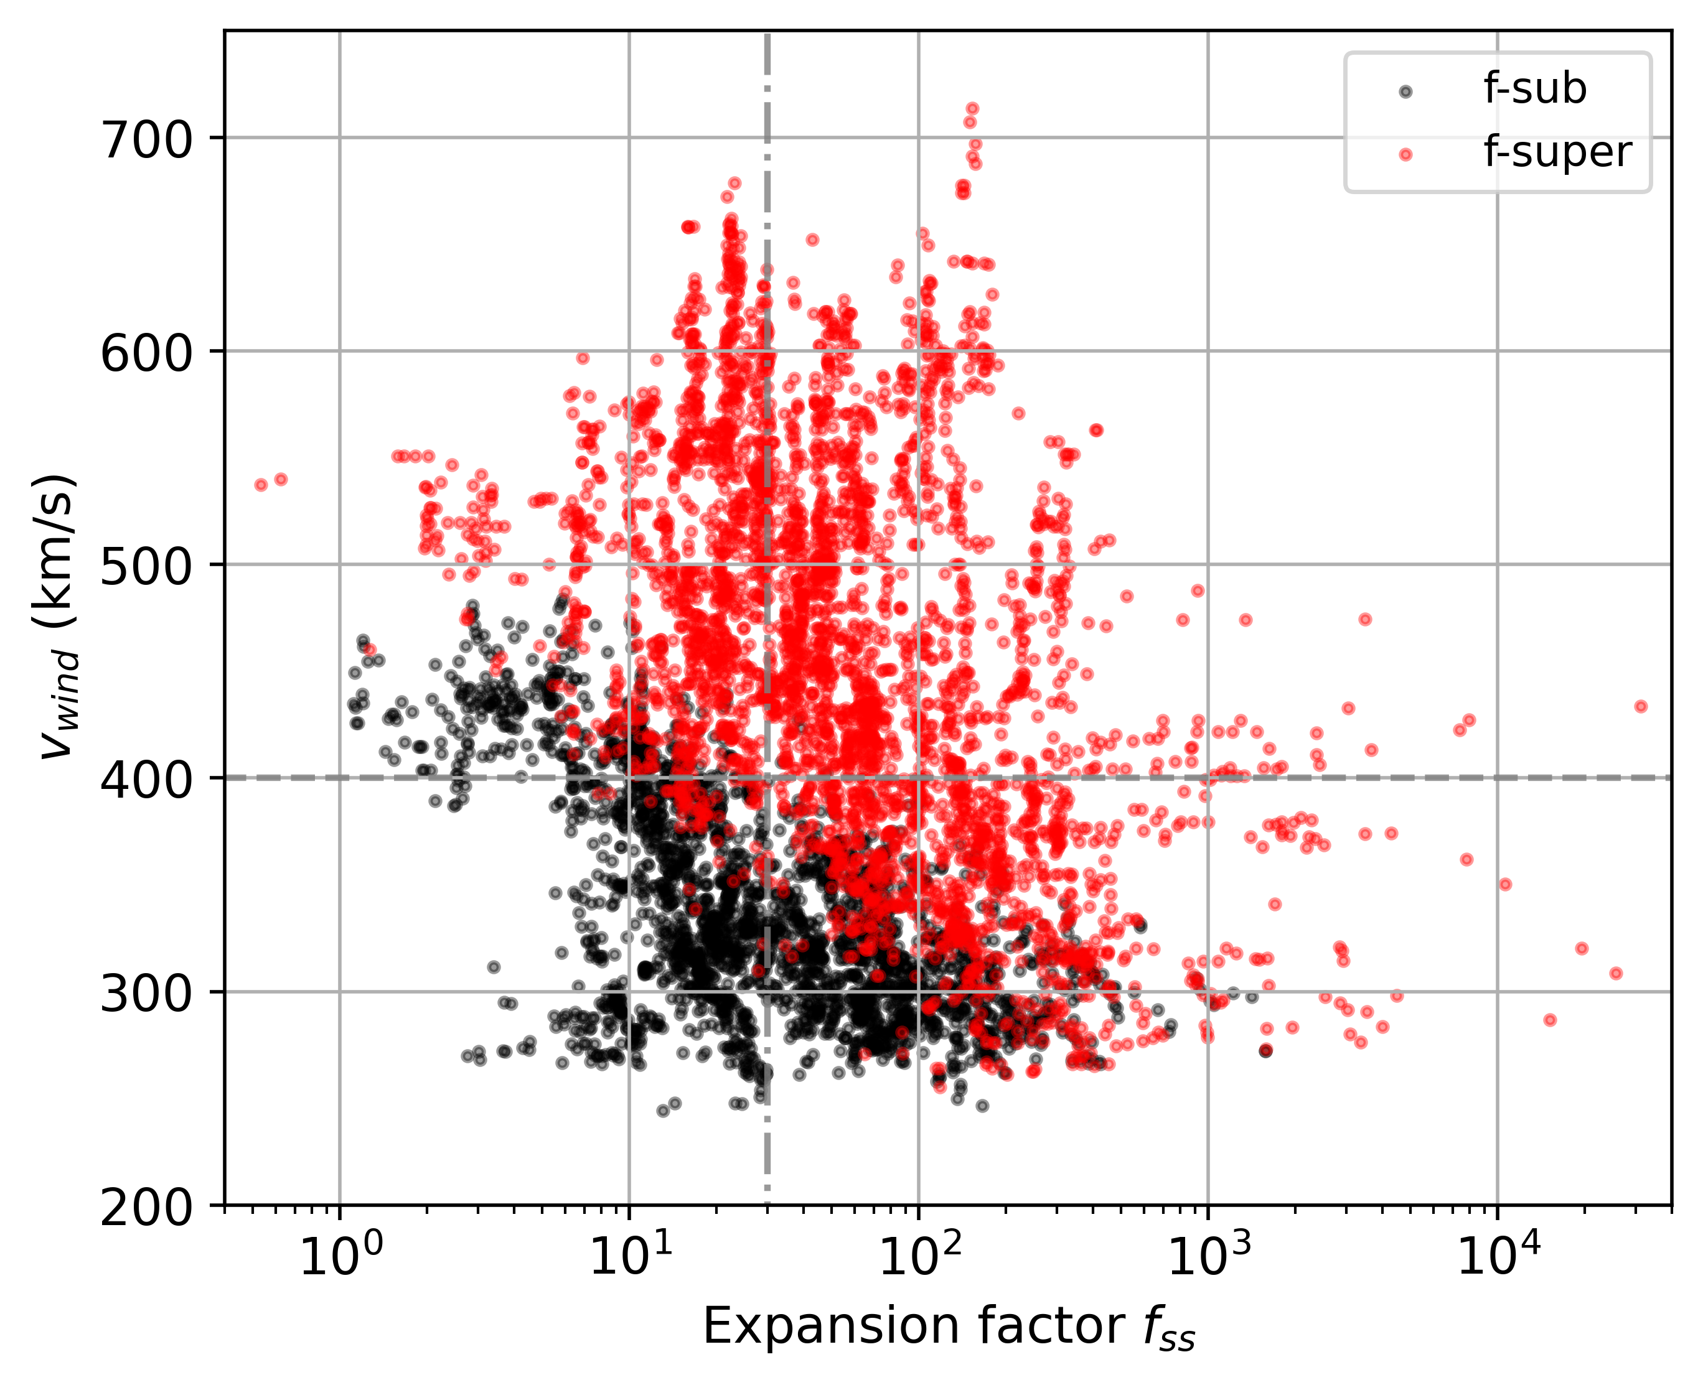
Isopoly models including f(r) of PFSS
More than half of the observations are assumed f-supersonic
f-subsonic → mainly slow wind
f-supersonic → mainly fast wind
Separtion between both solution type vary with v and f
Differences on f-subsonic and f-supersonic expansion profiles ?

Slide 21
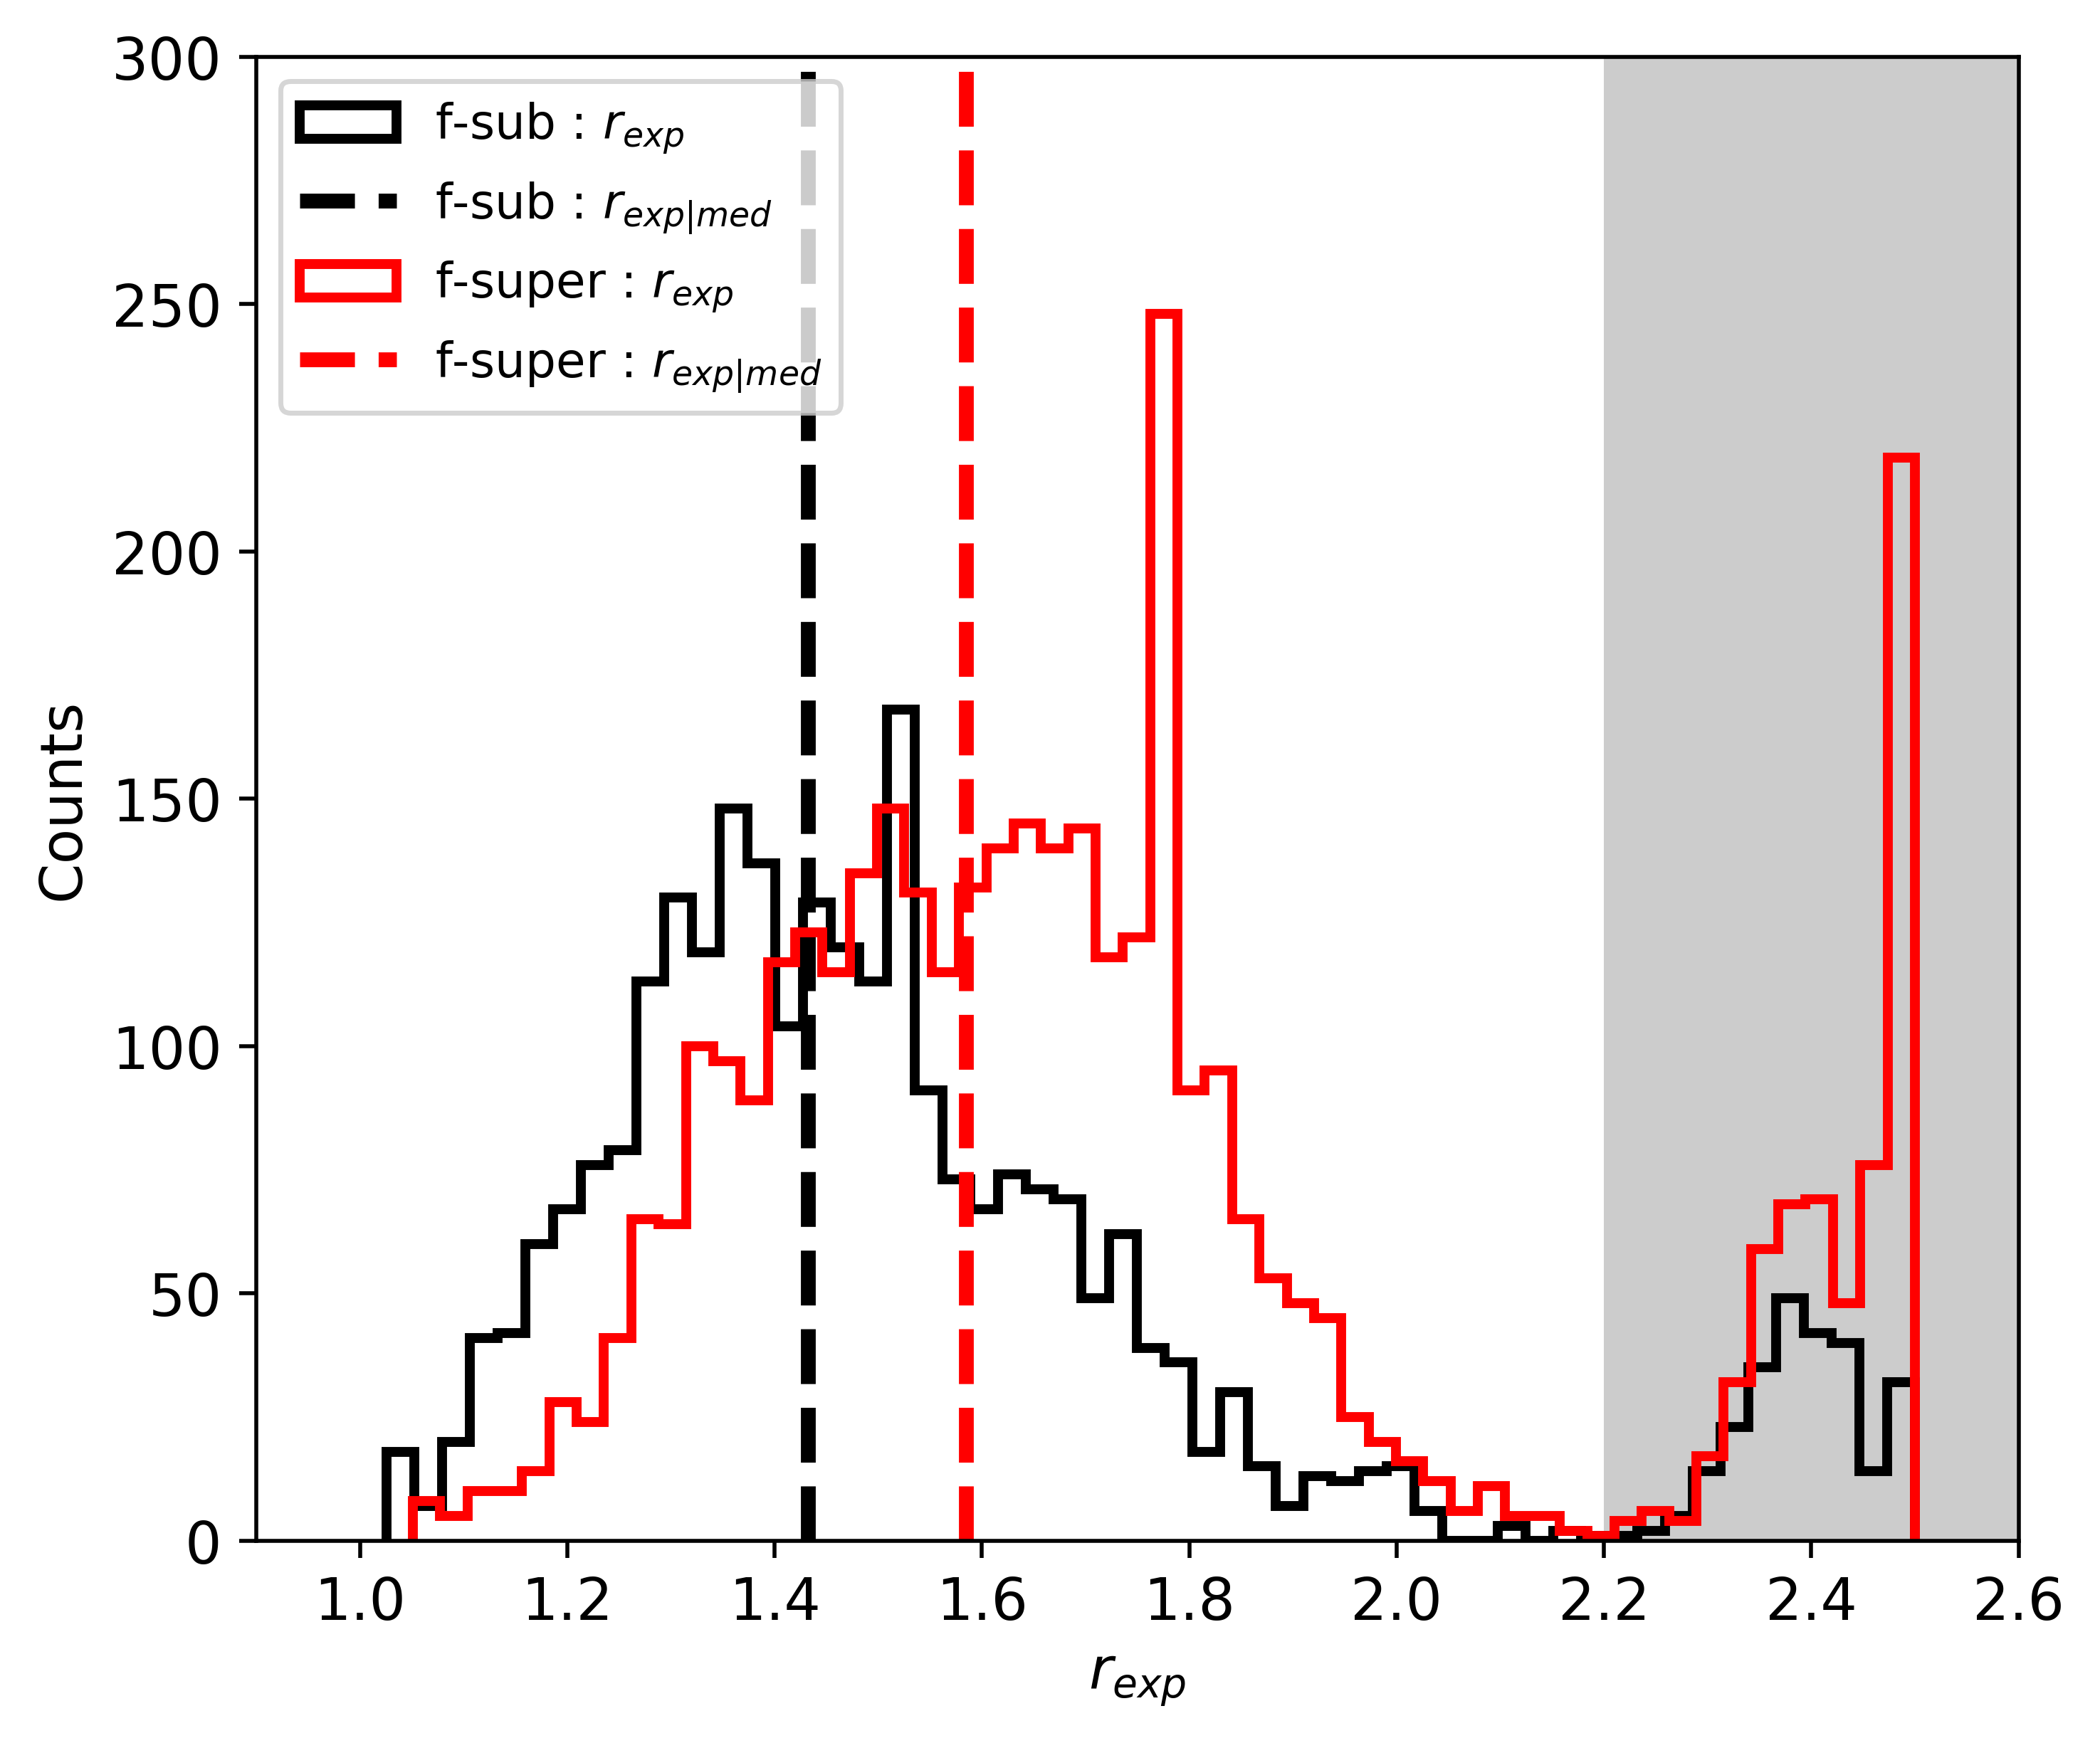
Difference on f-subsonic and f-supersonic expansion profiles ? YES
Possible HCS and PFSS modeling discrepancies
We define the expansion radius $r_{exp}$ for a given $f\left(r\right)$ profile :
$r_{exp}=r$ where $f^{′}′$(r) = 0
as the radius at the inflection point.
$$r_{exp|f−sub}<r_{exp|f−super}$$

Slide 22
Conclusion on the v-f study :
There is no global clear anti-correlation $v | f$ → But $v | f$ anti-correlation for high latitude sources (i.e. coronal holes like in solar minimum)
Existence of fast solar wind with large expansion factor (statistically well represented) originating from low latitudes
The global v-f correlation could be blurred by the superposition of the two super-radial expansion solutions (f-subsonic and f-supersonic solutions) → a single $f_{ss}$ value is not appropriate to relate a wind speed → need to consider expansion radius $r_{exp}$
f-supersonic solutions for large $f_{ss}$ should be more seriously considered for the fast solar wind modeling
→ allow to reach higher speeds

Slide 24
Parametric study of the influence of the flow super expansion
Super-radial expansion modeling
Isopoly equation with super expansion
$$A=f_{K} r^{2}$$
with
Kopp & Holzer 1976
Dakeyo et al. 2024b (in prep)
Testing f-subsonic and f-supersonic isopoly solutions
$f_{m}$ → Expansion amplitude
$r_{e}$ → Expansion radius
$σ_{e}$ → Expansion length
Expansion parameters effetc ?

Slide 25
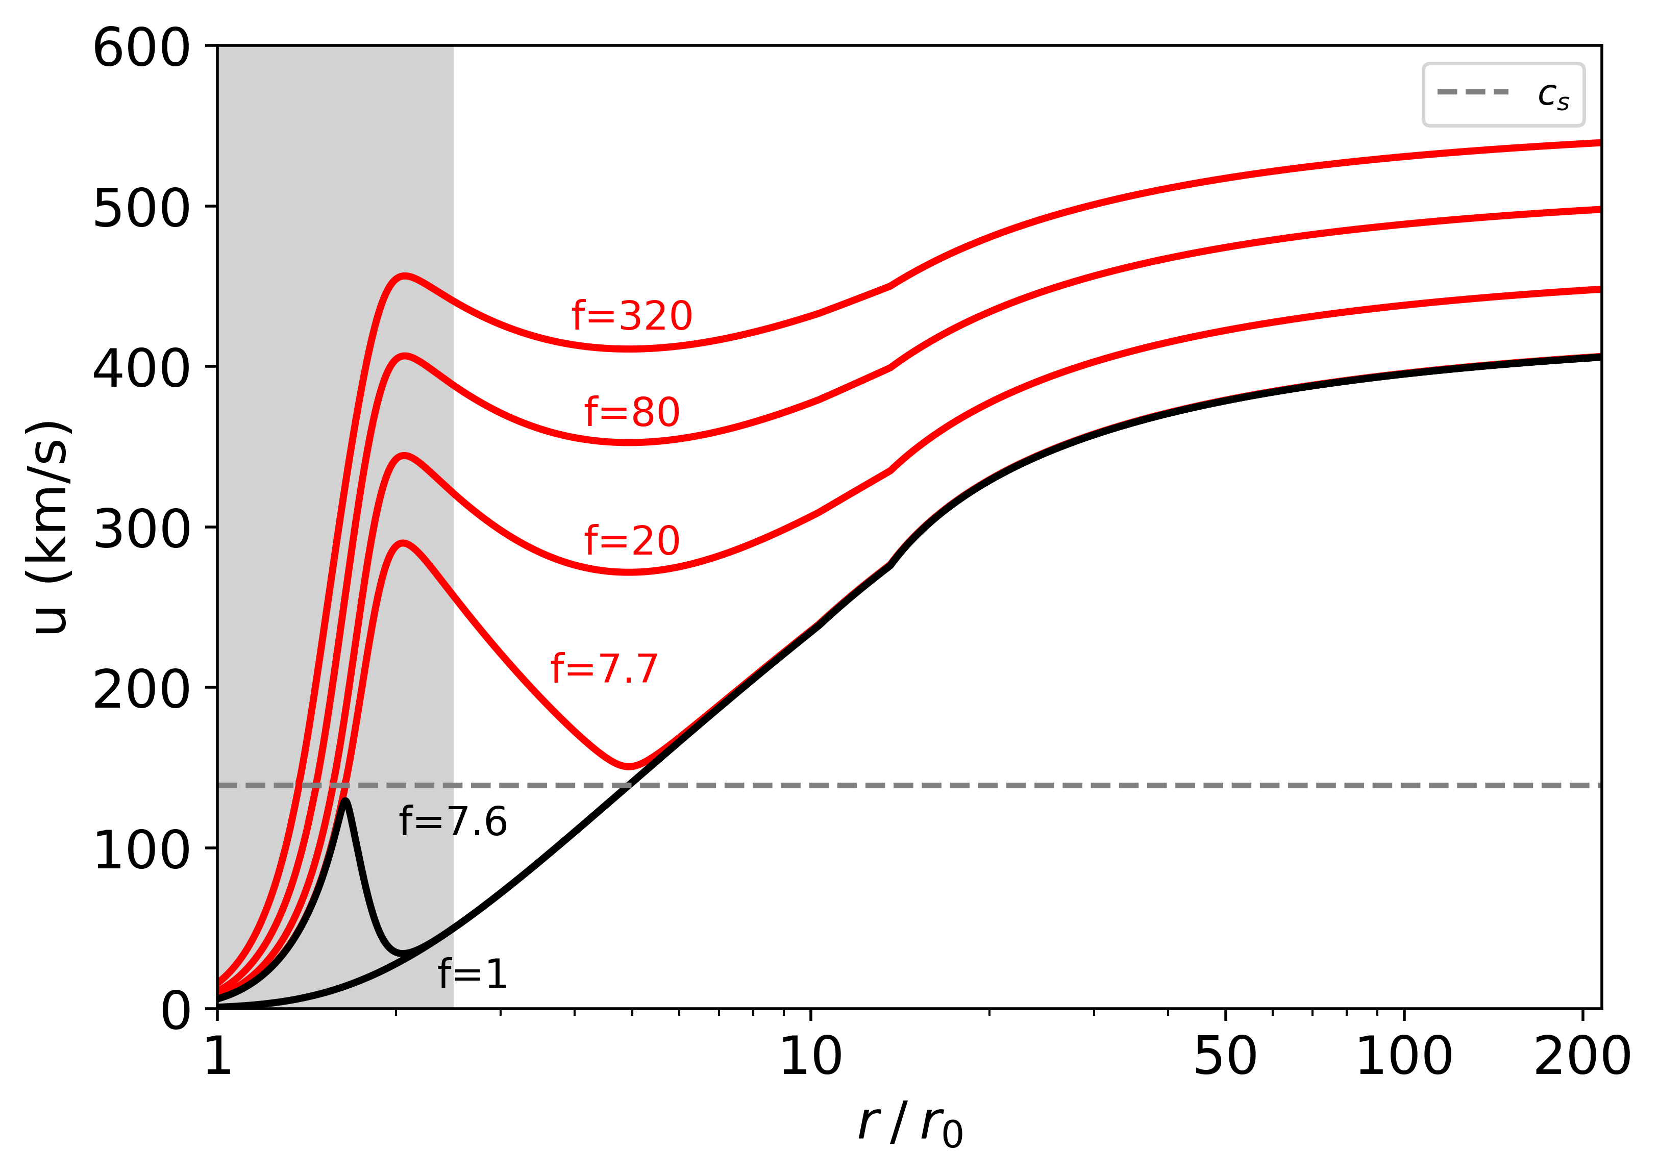
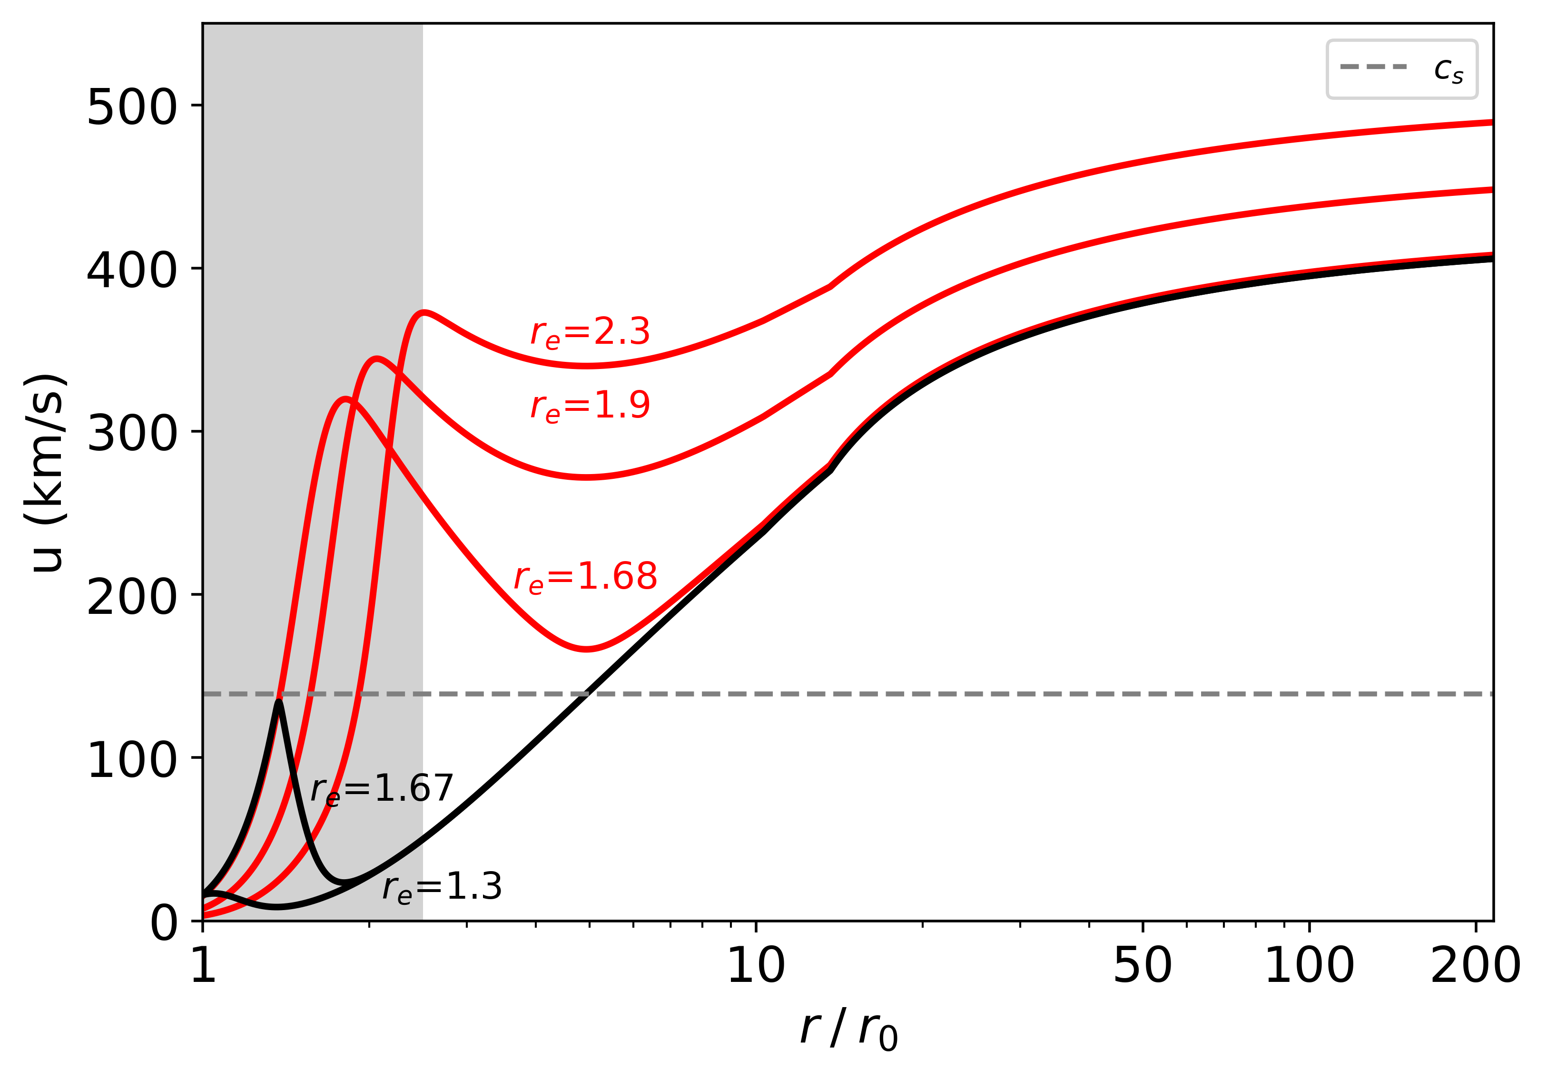
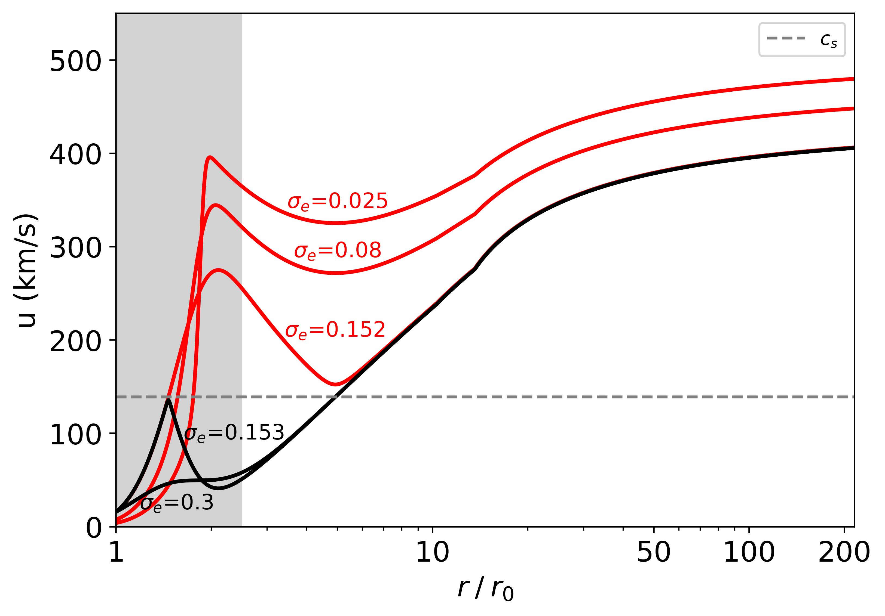
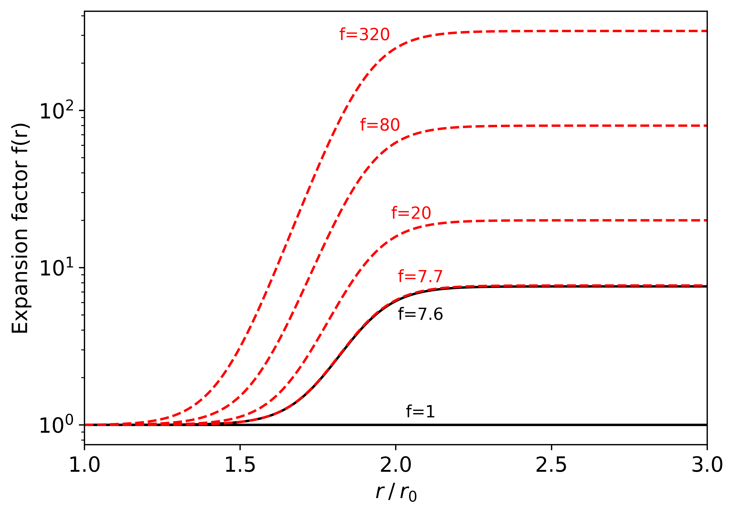
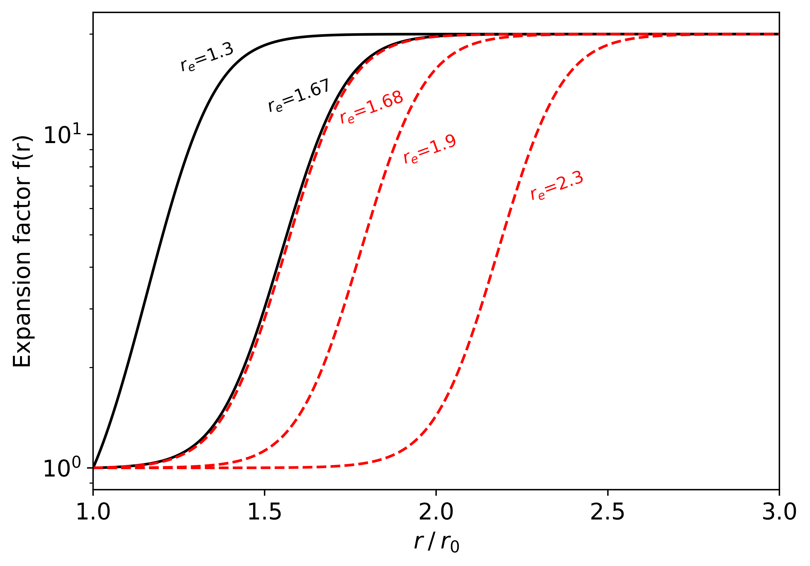
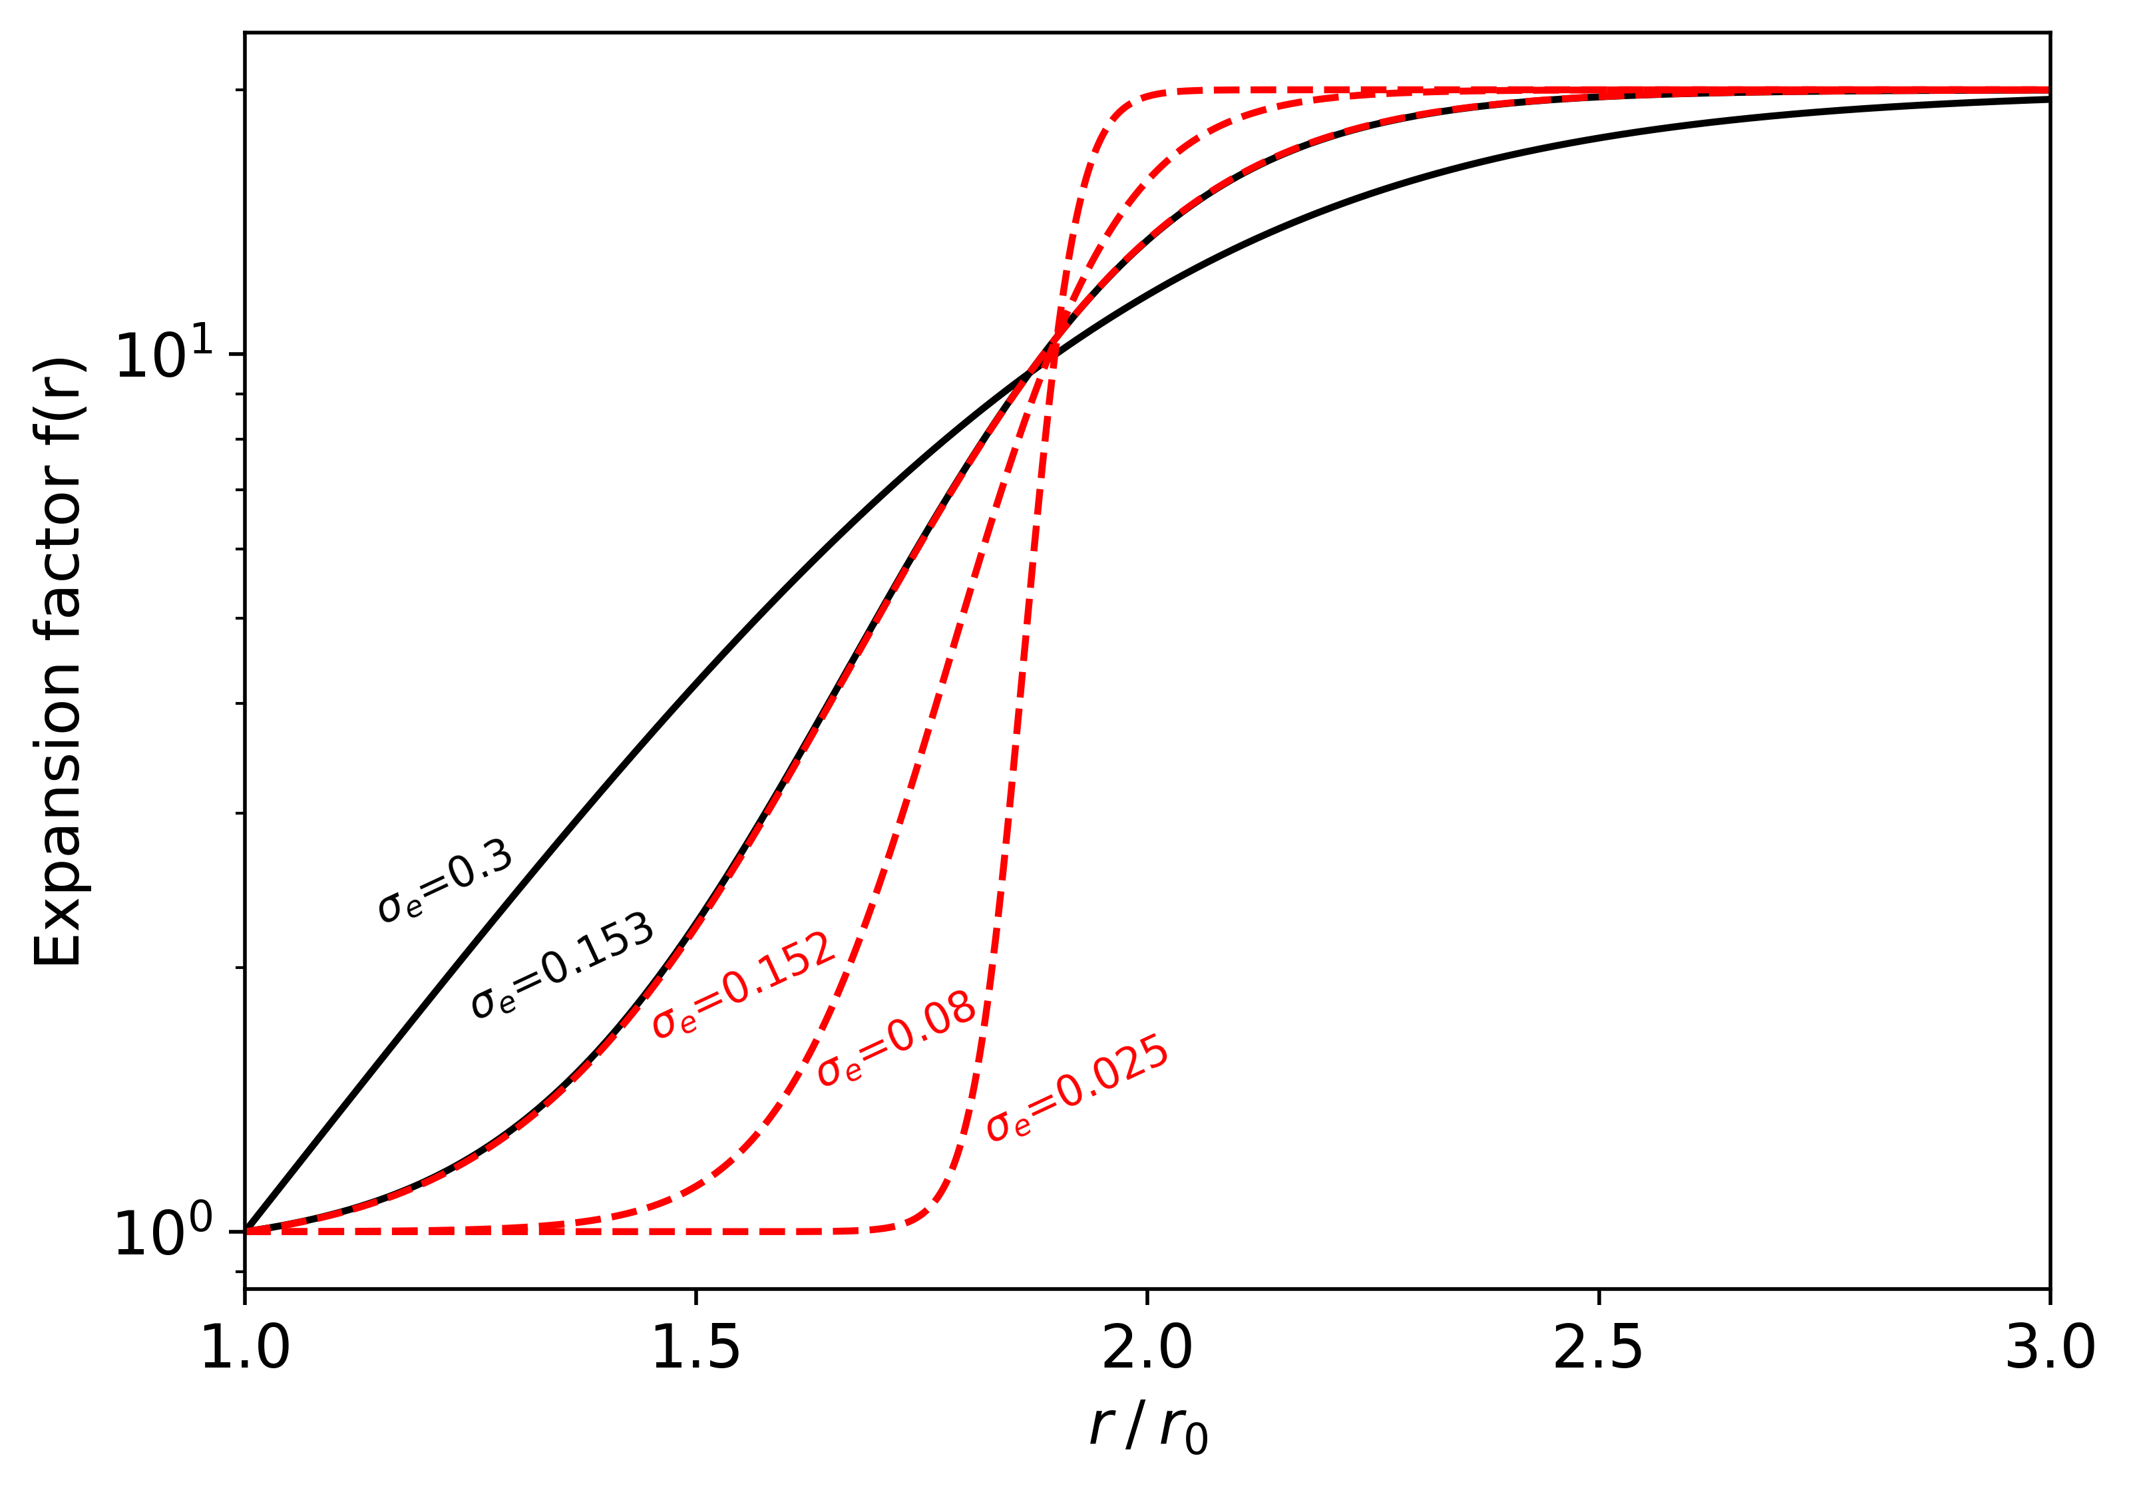
Isopoly parametric study with $f_{K}$ profile (Kopp & Holzer 1976)
For same 1au speed : f-supersonic solutions may require lower ($T_{p0}, T_{e0}$)
Expansion parameters :$f_{m}, r_{e}, σ_{e}$
Influence of $f_{m}$
Influence of $r_{e}$
Influence of $σ_{e}$
Expansion amplitude
Expansion radius
Expansion length

Slide 26
Far from the Sun : Streamline tracing improuvment
Streamline Spiral
$$φ=\frac{u_{φ|Sun}}{u_{r|Sun}}= ω_{sun} \frac{\left(r −Rss\right)}{u_{r}}$$
« Standard method » (Ballistic mapping)
Constant radial speed $u_{r}=u_{wind}$
No tangential speed $u_{φ}=0$
Results in several mapping bias compared to considering $u_{r}≠$ $cst$ and $u_{φ}=0$ (Dakeyo et al. 2024a)
Streamline deviation
→ Travel time underestimation

Slide 27
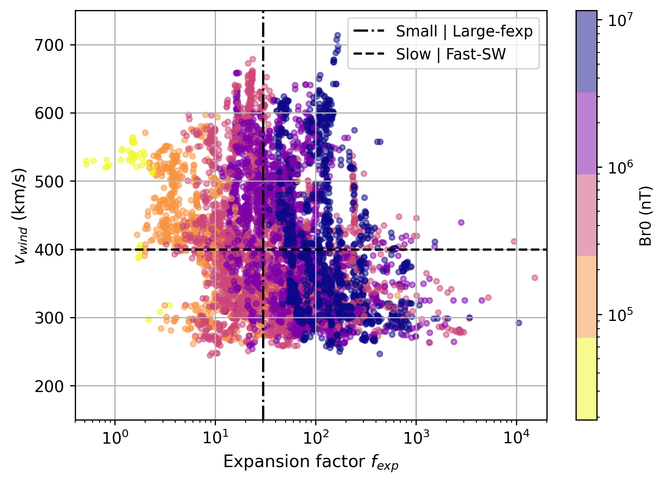
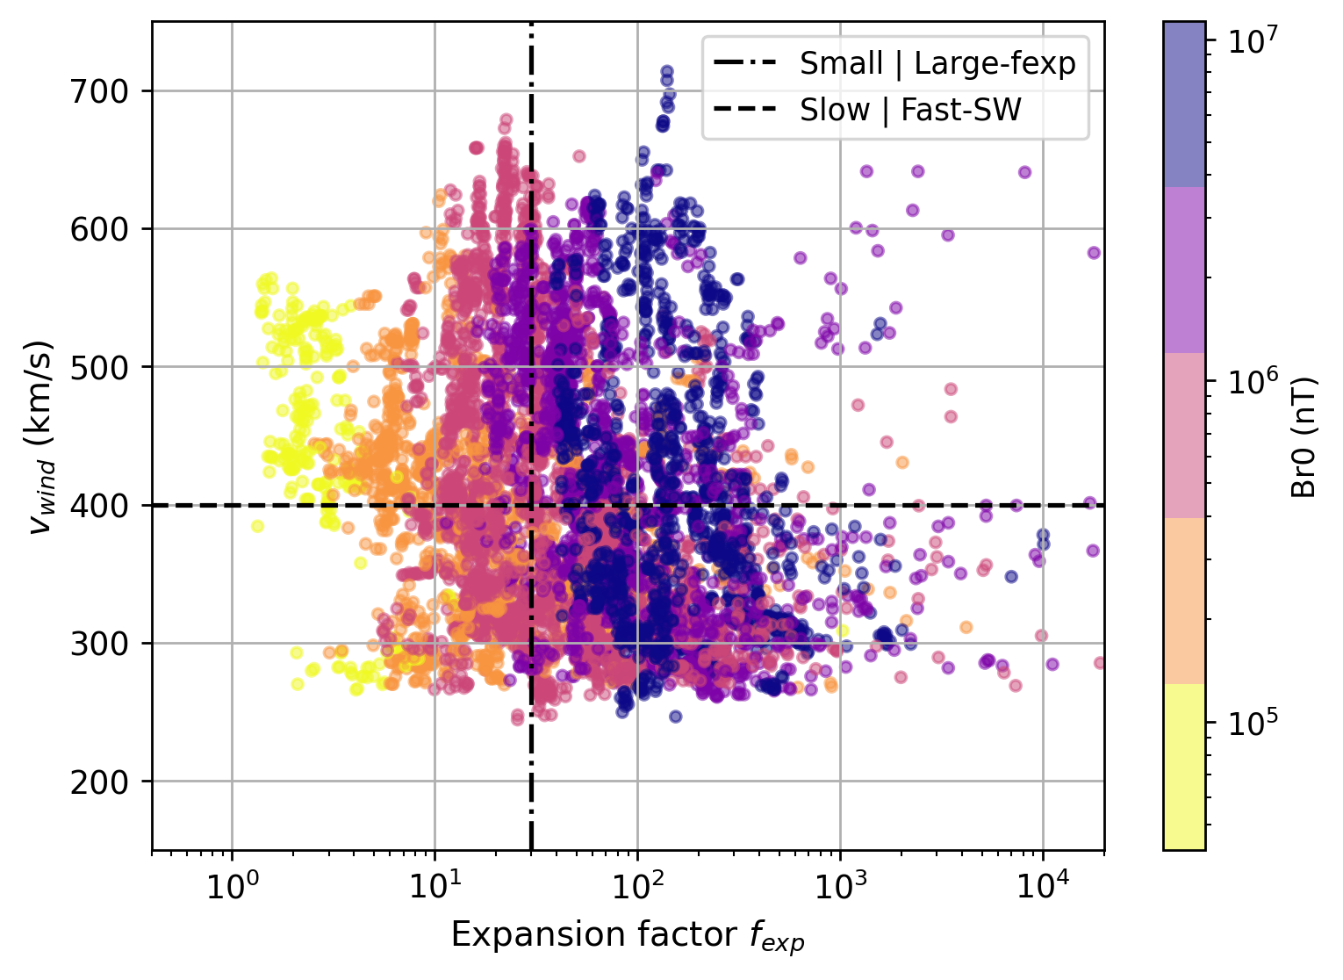
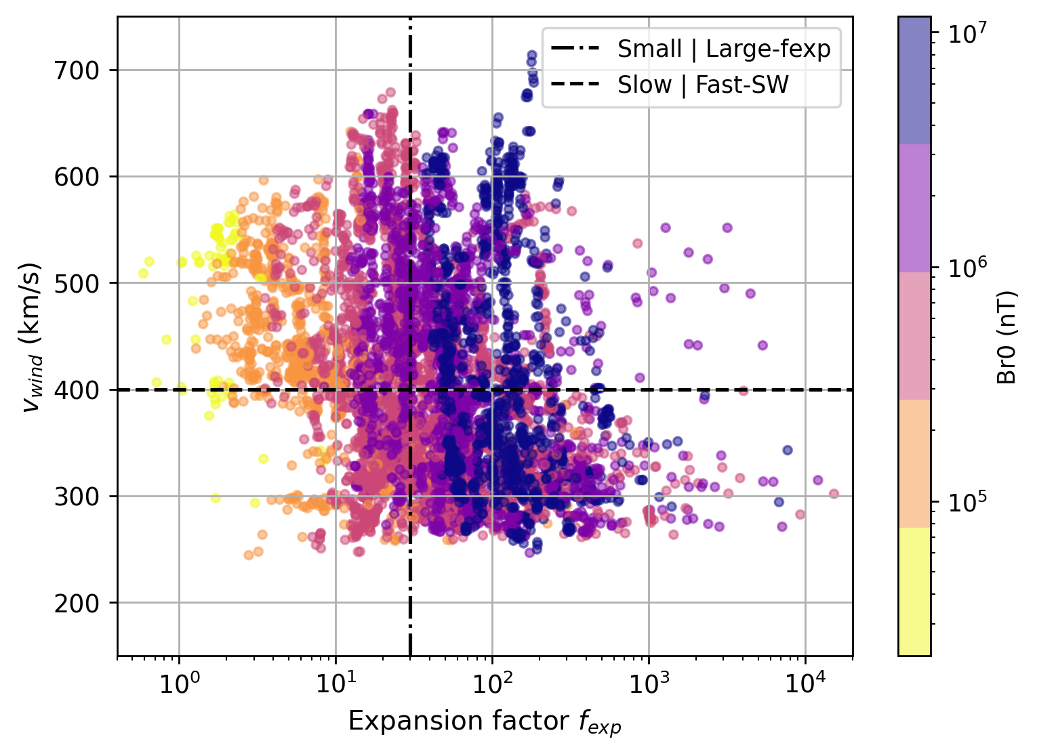
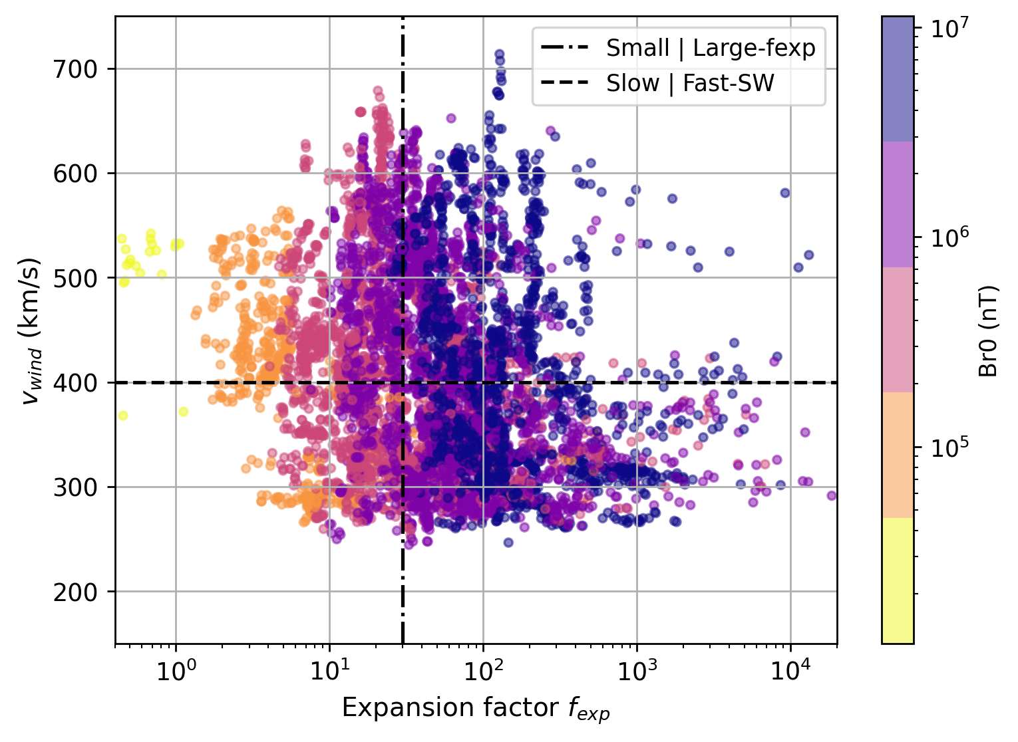
+5°
-5°
Artifical mapping variability
Mapping reliability → OK
+10°
-10°

Slide 28
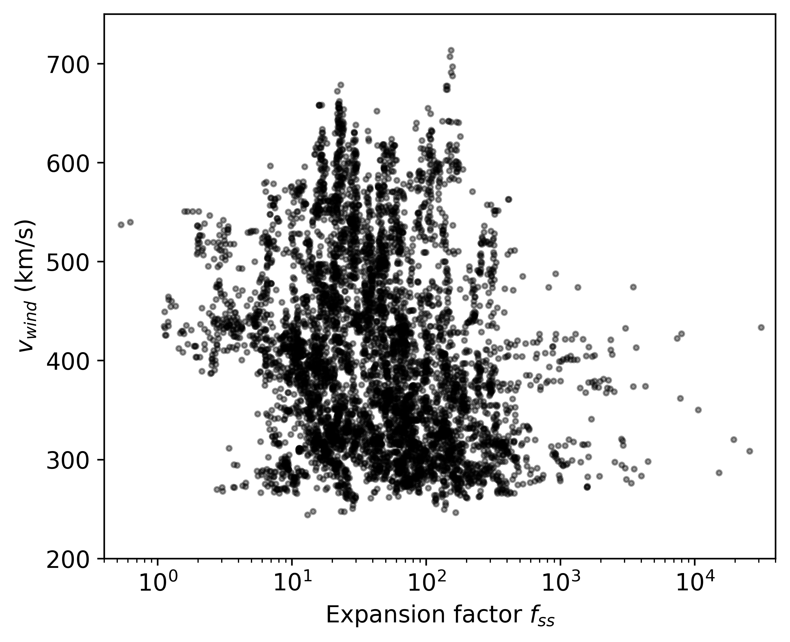
Data compartimenting
→ Mean parameter estimated on each quadrant for a given mediam $f(r)$ profile
6 bins for $f_{ss}$
5 bins in speed
→ 30 isopoly median models in total

Slide 29
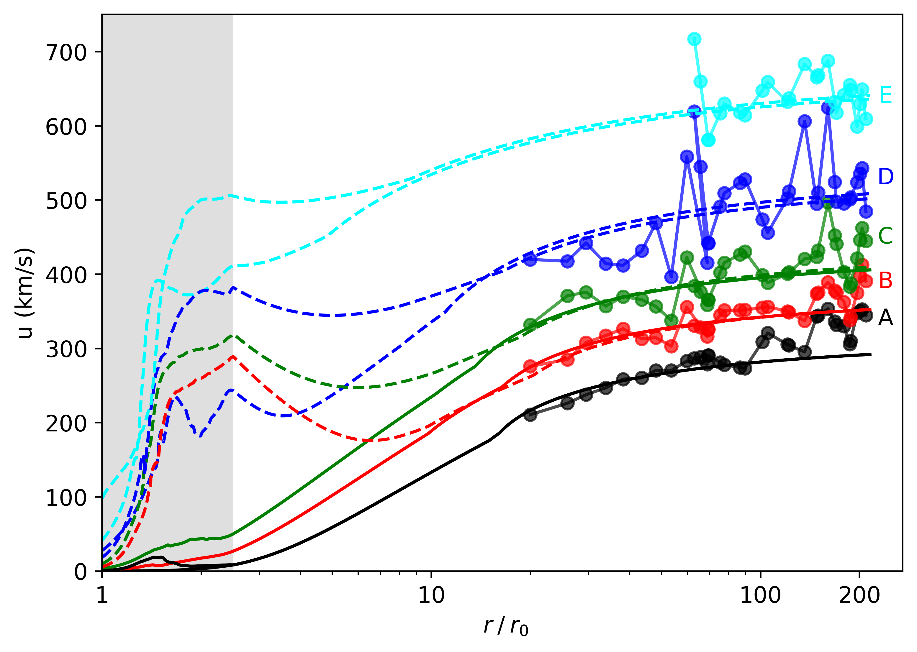
Typical isopoly speed profile with super radial expansion modeling
From Dakeyo et al. 2022
$$T_{p0}=[0.65 , 1.1, 1.63, 2.51, 5.61]$$
f(r) modeling low down $T_{p0}$ from 5.61MK until 2.21 MK
$$T_{e0}∼0.7 − 0.9 MK$$
Wind type | A | B | C | D | E
$$T_{p0} (MK)$$ | 0.65 | 0.9 – 1.1 | 1.08 – 1.63 | 1.56 – 2.51 | 2.21 – 3.61
$r_{iso|p} (r_{0})$ | 16.1 | 16.4 – 19.9 | 13.6 – 19.9 | 9.2 – 15.2 | 2.9 – 8.9
Speed at 1au (km/s) | 292 | 352 - 370 | 406 - 416 | 492 - 527 | 623 - 645
Bi-fluid mean $T_{0}=\frac{T_{p0 }+ T_{e0}}{2} (MK)$ | 0.72 | 0.86 – 0.96 | 0.9 – 1.17 | 1.16 – 1.63 | 1.55 – 2.25

Slide 30
Typical isopoly speed profile with super radial expansion modeling
From Dakeyo et al. 2022
$$T_{p0}=[0.65 , 1.1, 1.63, 2.51, 5.61]$$
f(r) modeling low down $T_{p0}$ from 5.61MK until 2.21 MK
Mean temperature $T_{0}<2.25$MK ($≡$ available energy in the corona)
Wind speed populations profiles could overlap each other below $∼10 r_{0}$
$$T_{e0}∼0.7 − 0.9 MK$$
Wind type | A | B | C | D | E
$$T_{p0} (MK)$$ | 0.65 | 0.9 – 1.1 | 1.08 – 1.63 | 1.56 – 2.51 | 2.21 – 3.61
$r_{iso|p} (r_{0})$ | 16.1 | 16.4 – 19.9 | 13.6 – 19.9 | 9.2 – 15.2 | 2.9 – 8.9
Speed at 1au (km/s) | 292 | 352 - 370 | 406 - 416 | 492 - 527 | 623 - 645
Bi-fluid mean $T_{0}=\frac{T_{p0 }+ T_{e0}}{2} (MK)$ | 0.72 | 0.86 – 0.96 | 0.9 – 1.17 | 1.16 – 1.63 | 1.55 – 2.25

Slide 31
Conclusion on the v-f study :
There is no global clear anti-correlation $v | f$ , mixing all the type of solar wind sources → But anti-correlation $v | f$ is visible for high latitude sources and angular extented sources (i.e. coronal holes like sources)
We observationally assume the existence of fast solar wind with large expansion factor (statistically well represented) originating from low latitudes
The global v-f correlation could be blurred by the superposition of the two super-radial expansion solutions (f-subsonic and f-supersonic solutions) → $f_{ss}$ single value (between $r_{0}$ and $r_{ss}$) is not appropriate to describe flux tube expansion→ need to define other(s) indicator(s) as typical height expansion for instance (in progress)
For a given asymptotic speed, required temperature and heating rate in solar wind might strongly depends on the super expansion flow regime in near Sun region
Isopoly fast wind solution ($∼620−650$km/s) can be modeled with bi-fluid mean temperature of $∼1,55$ MK at the base of the corona → f-supersnonic solutions great track to follow for fast wind acceleration modeling

Slide 32
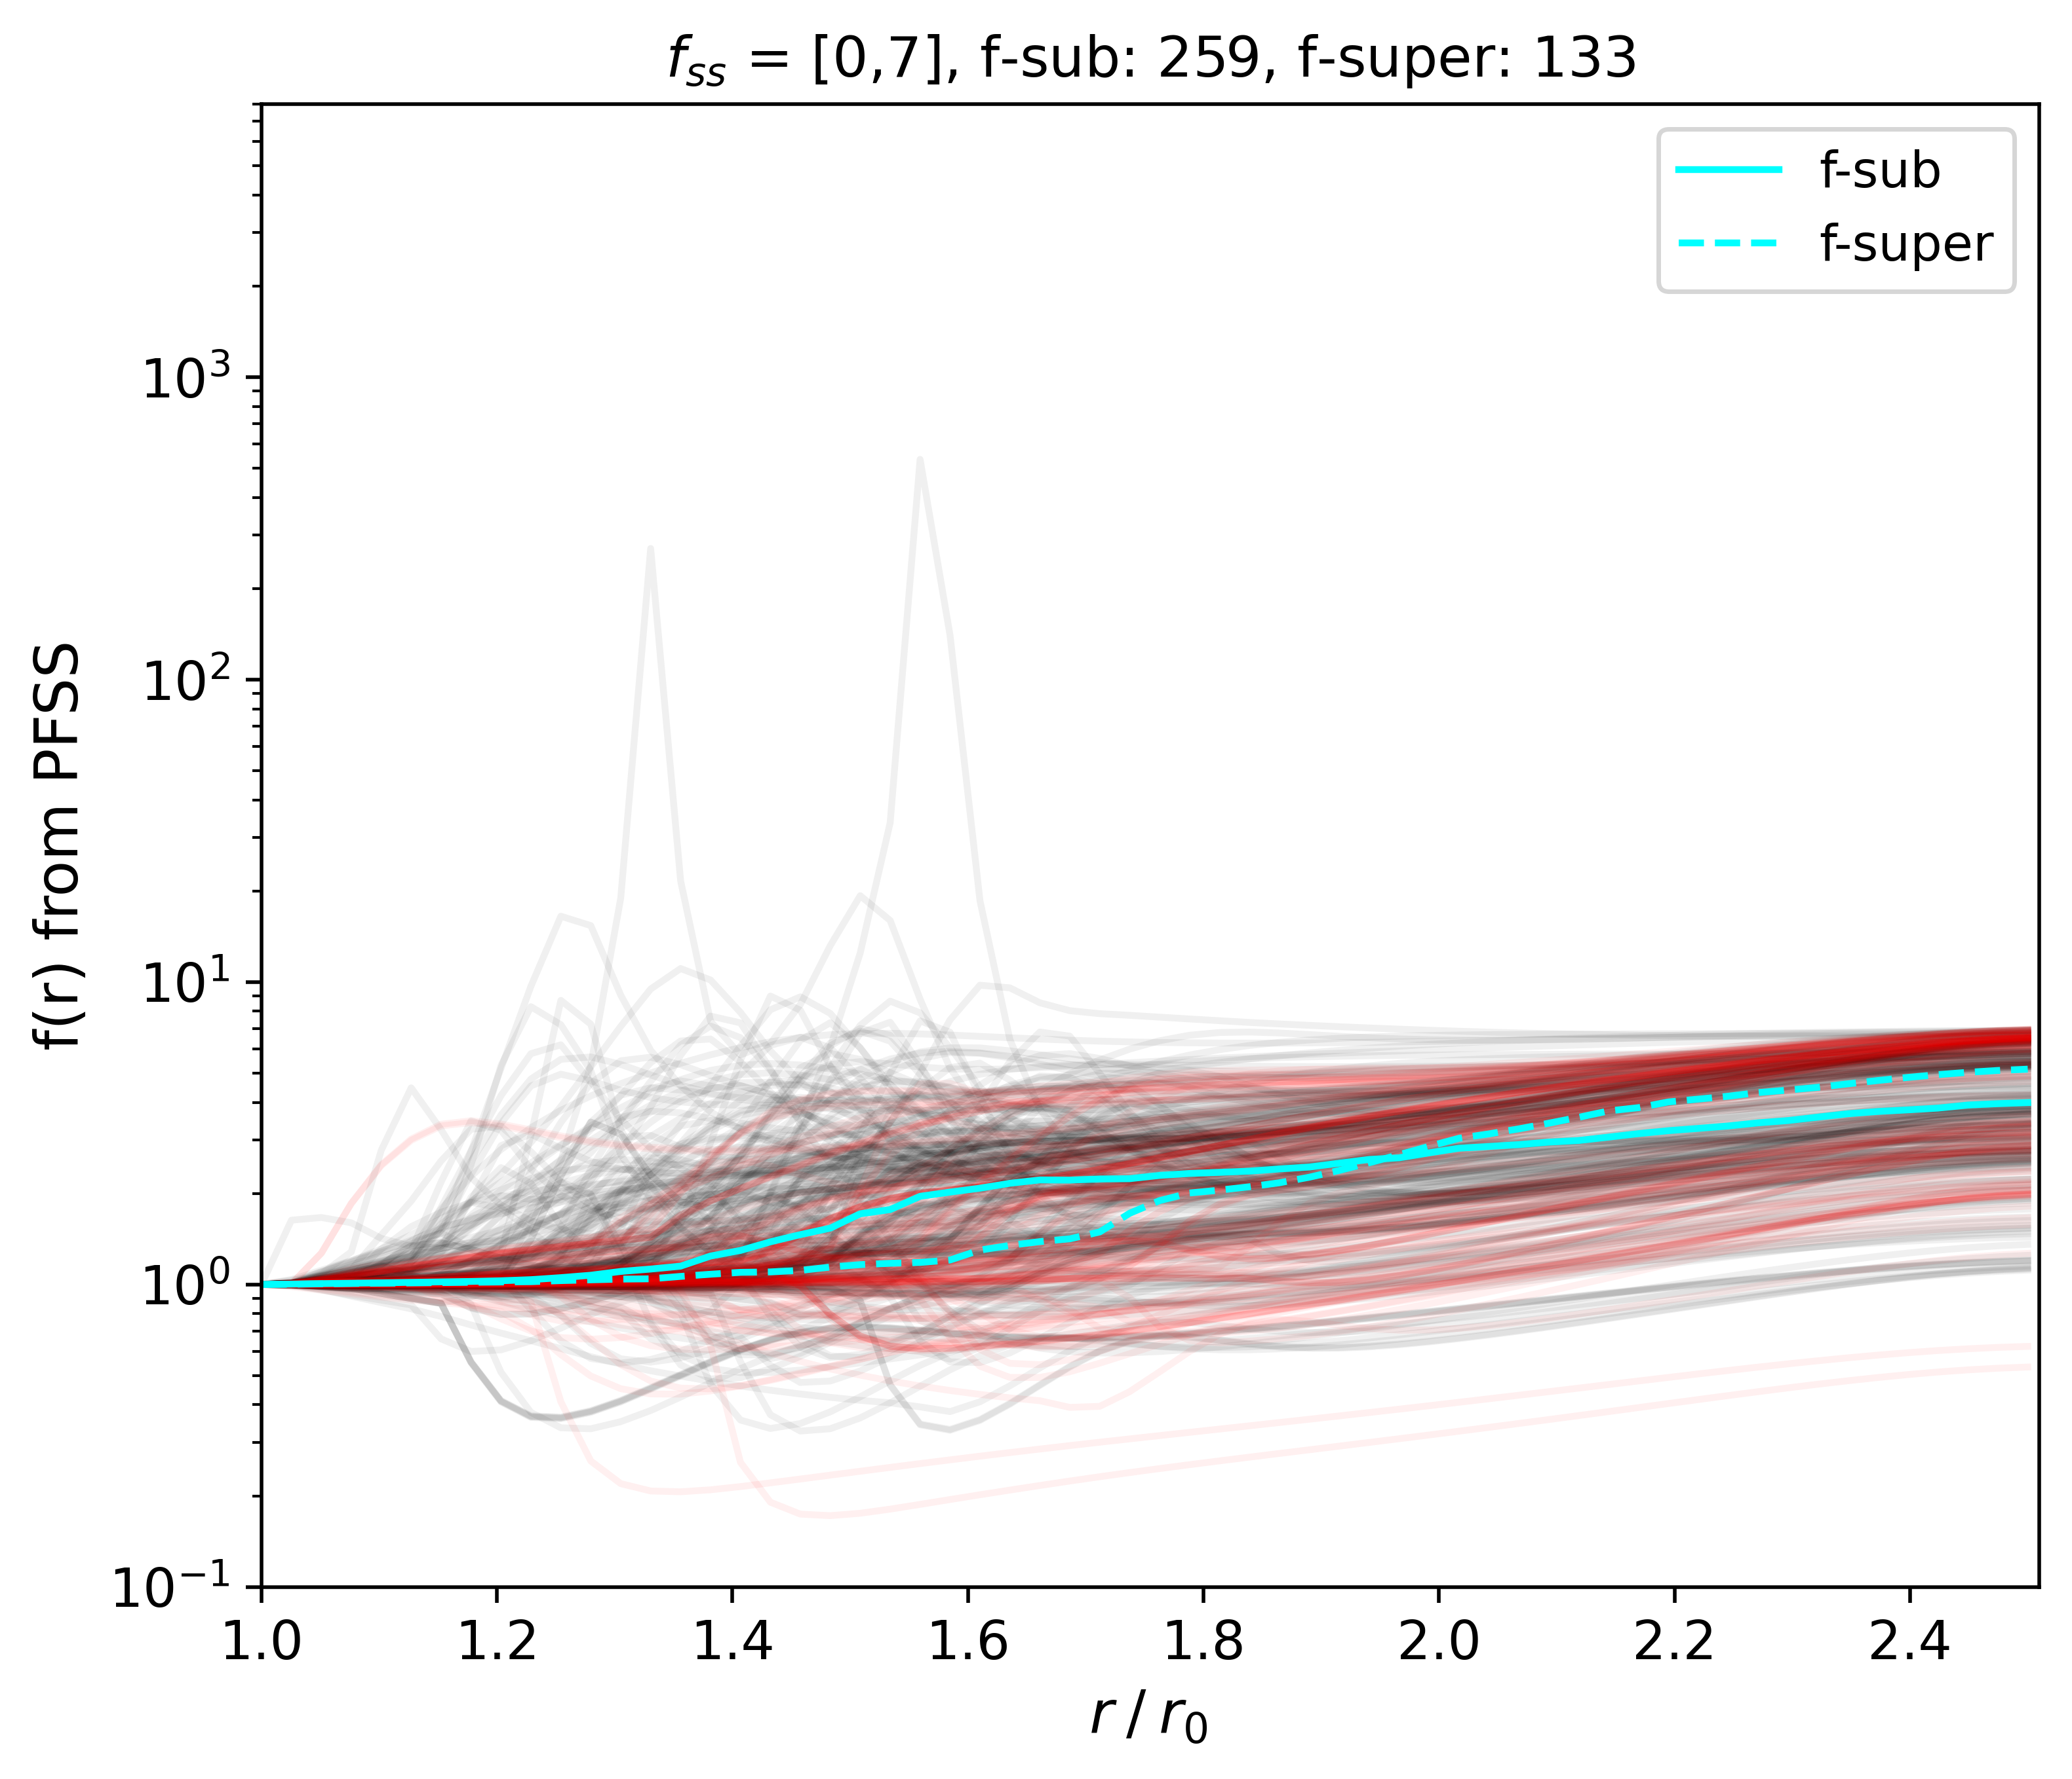
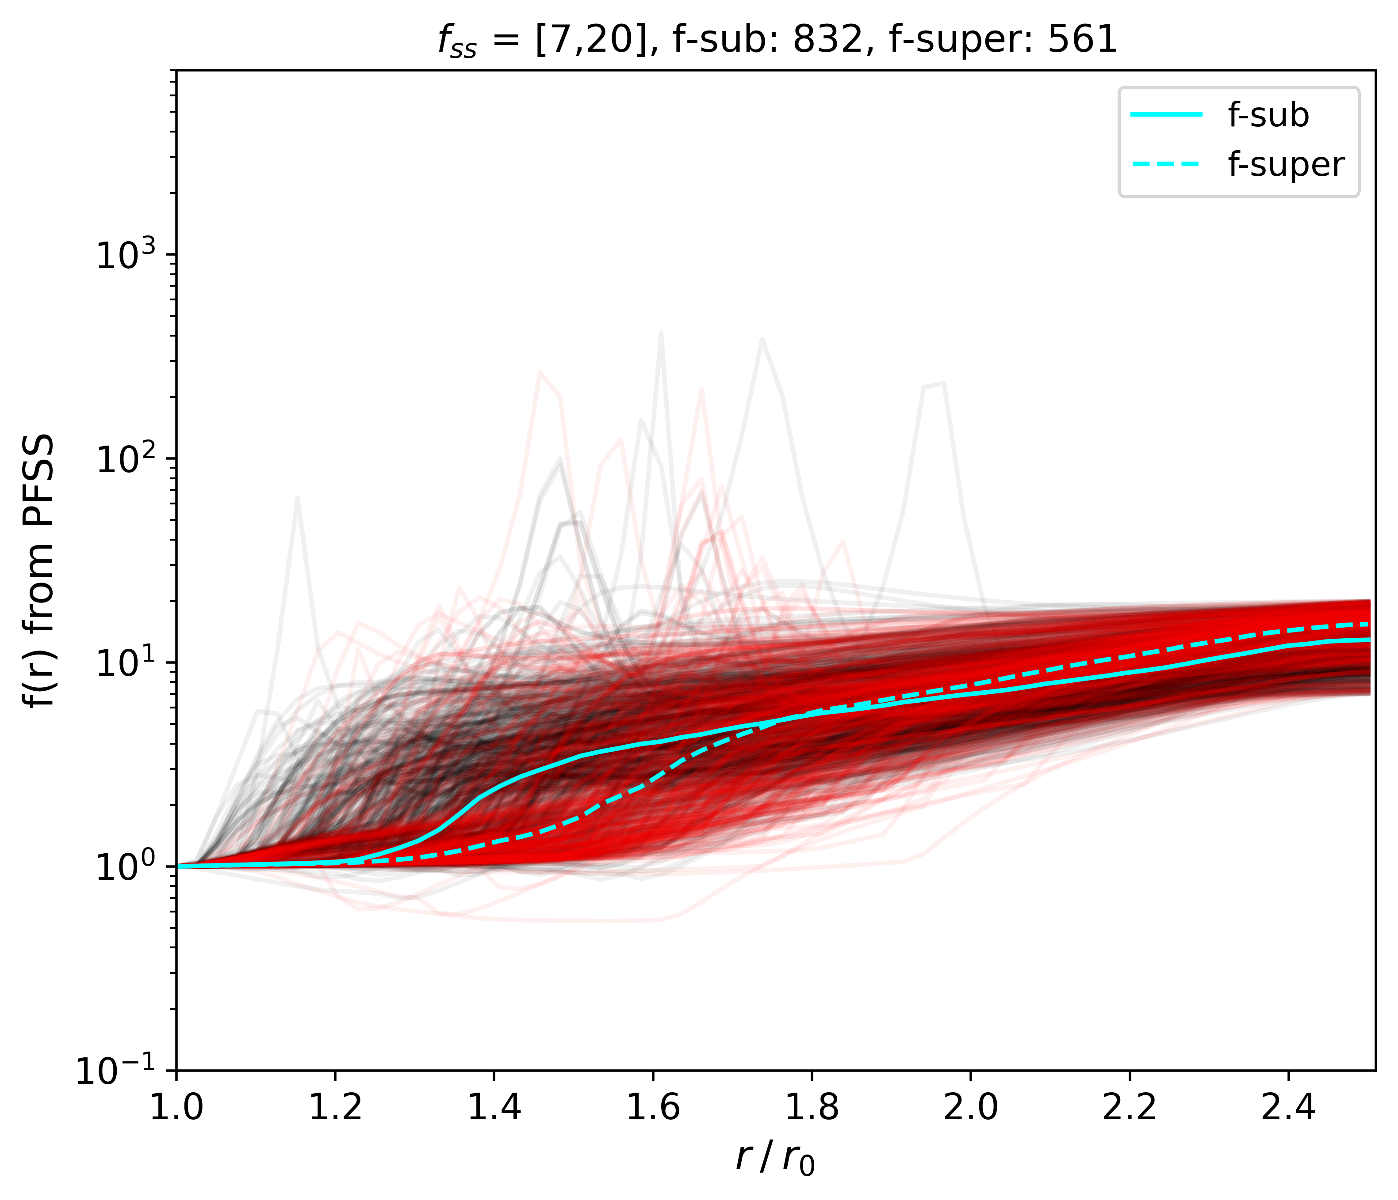
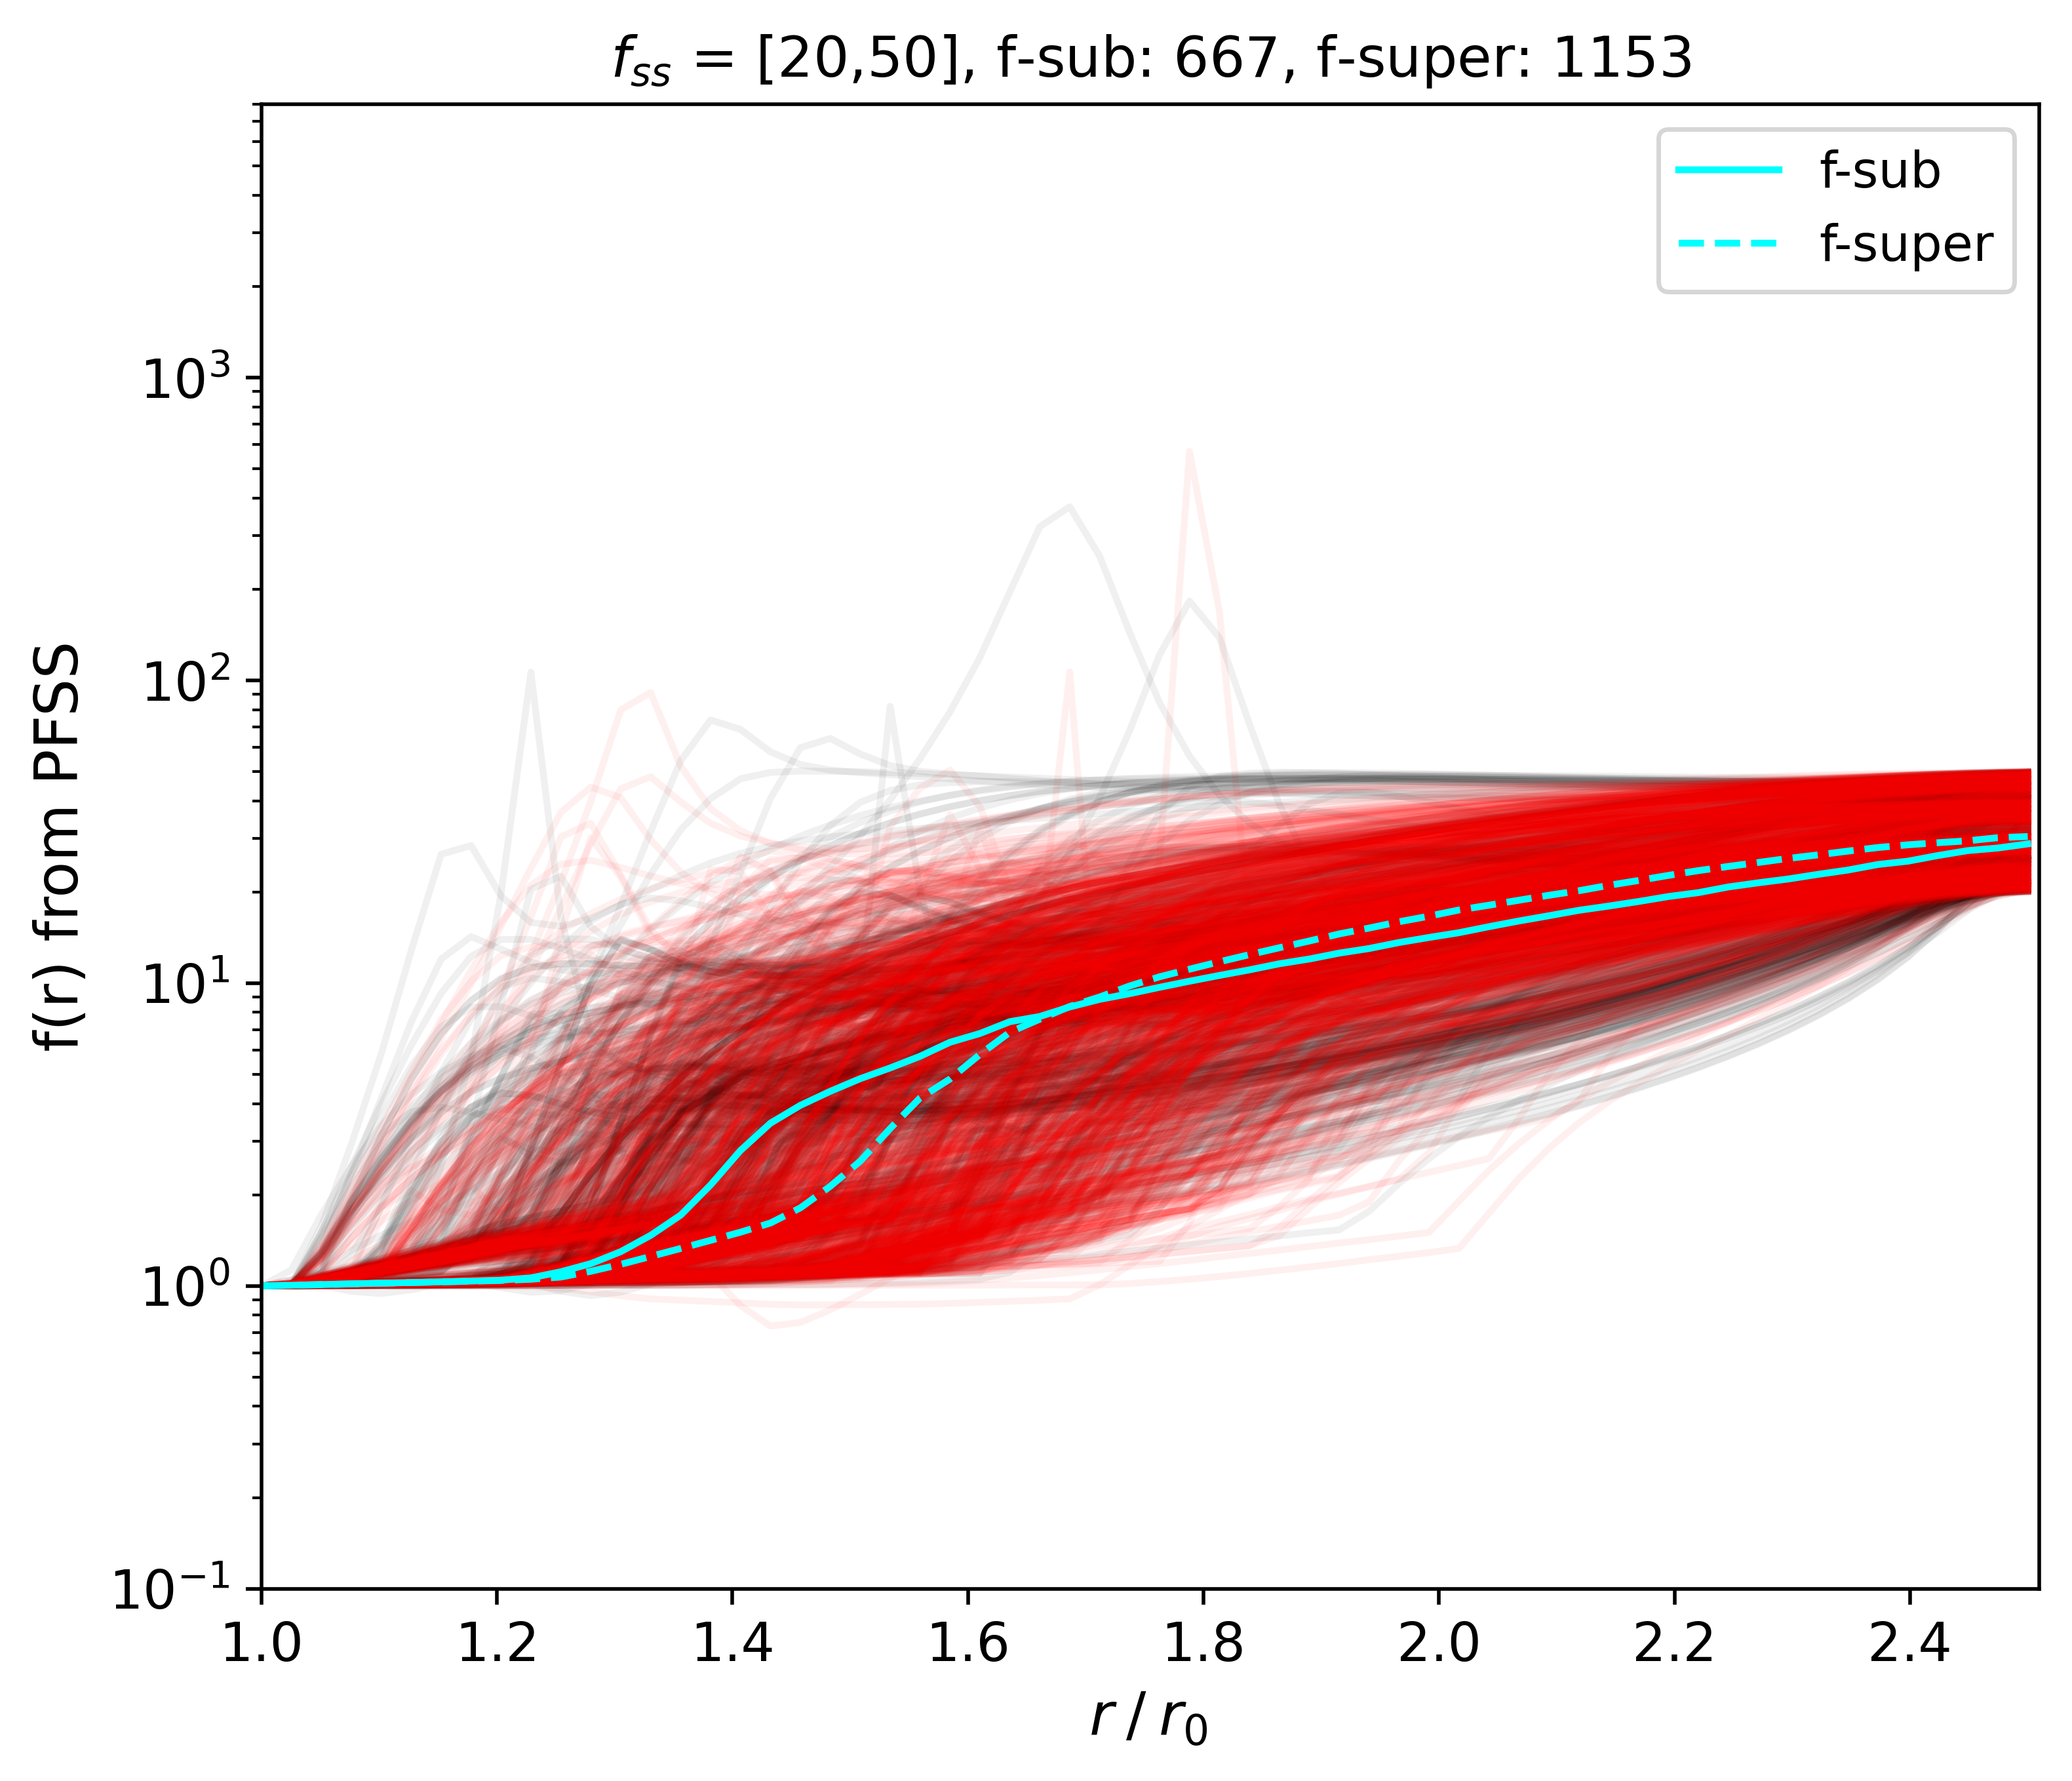
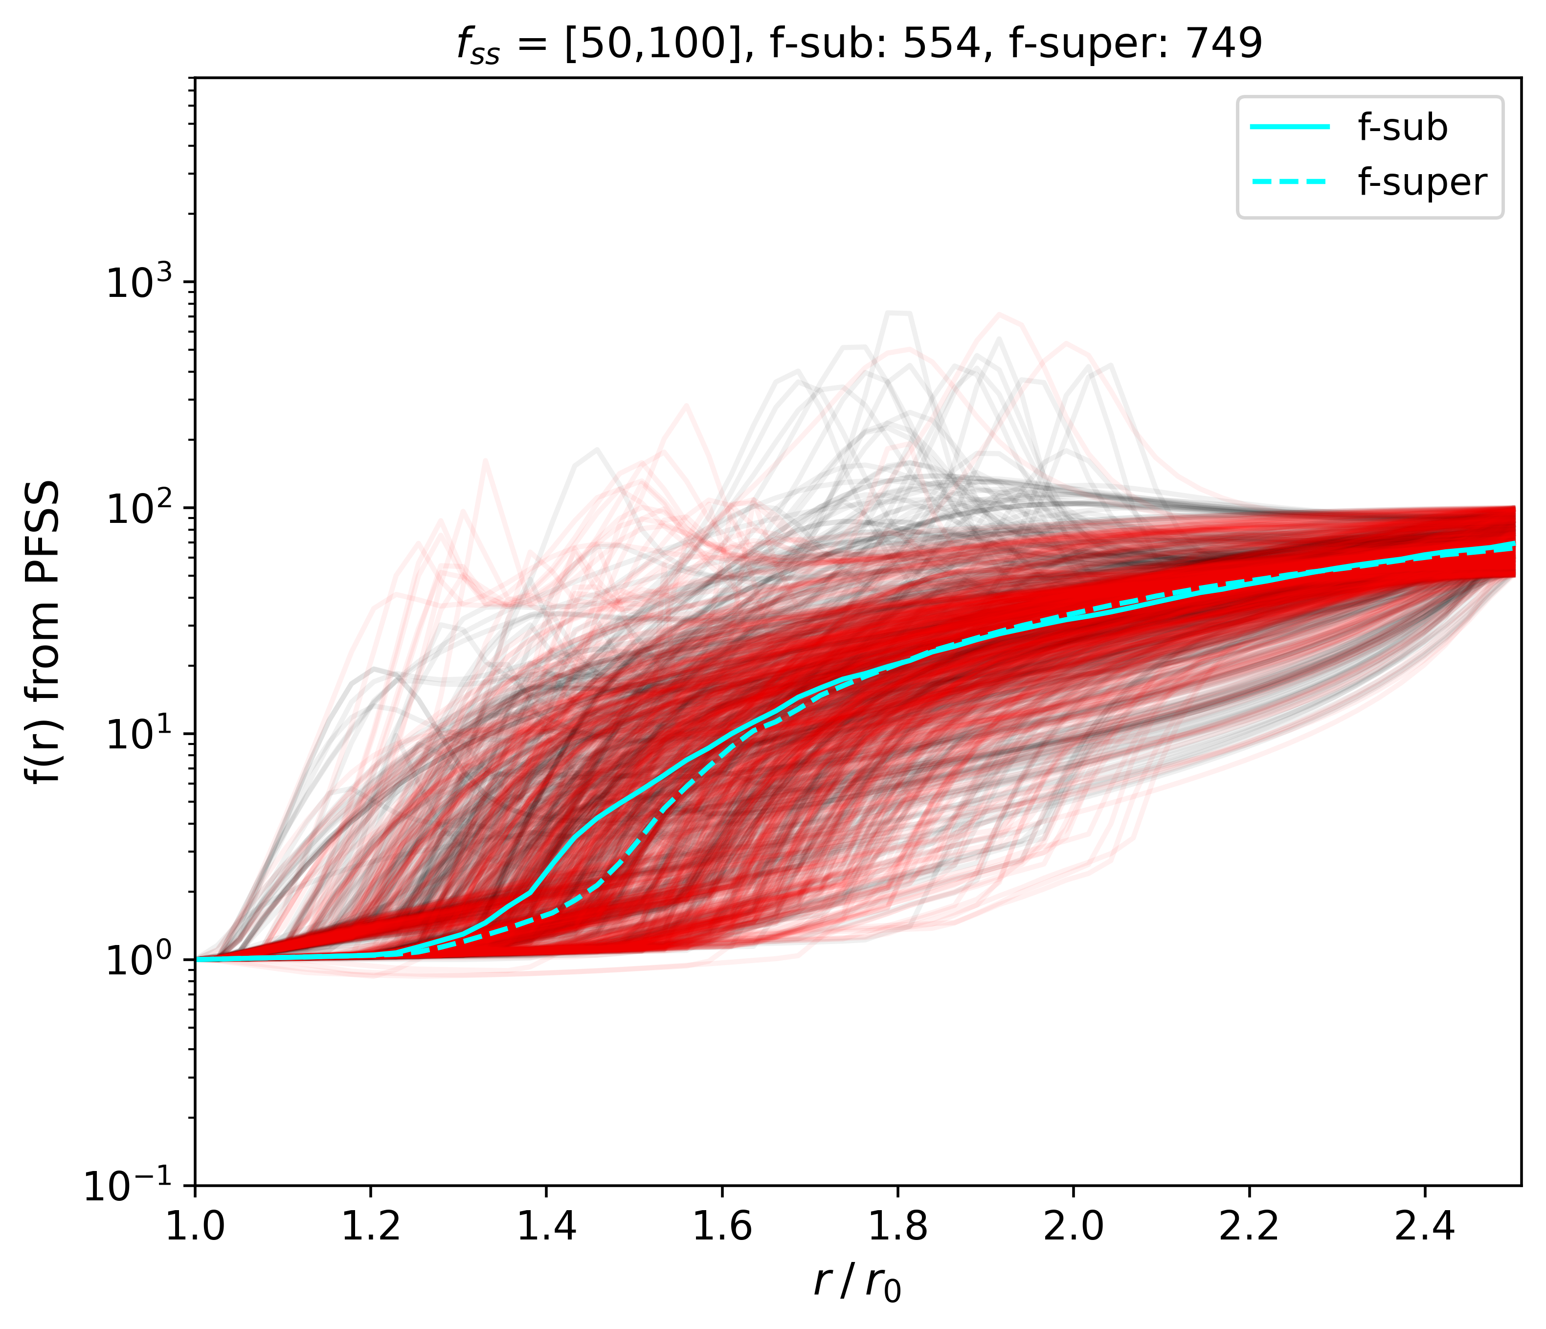
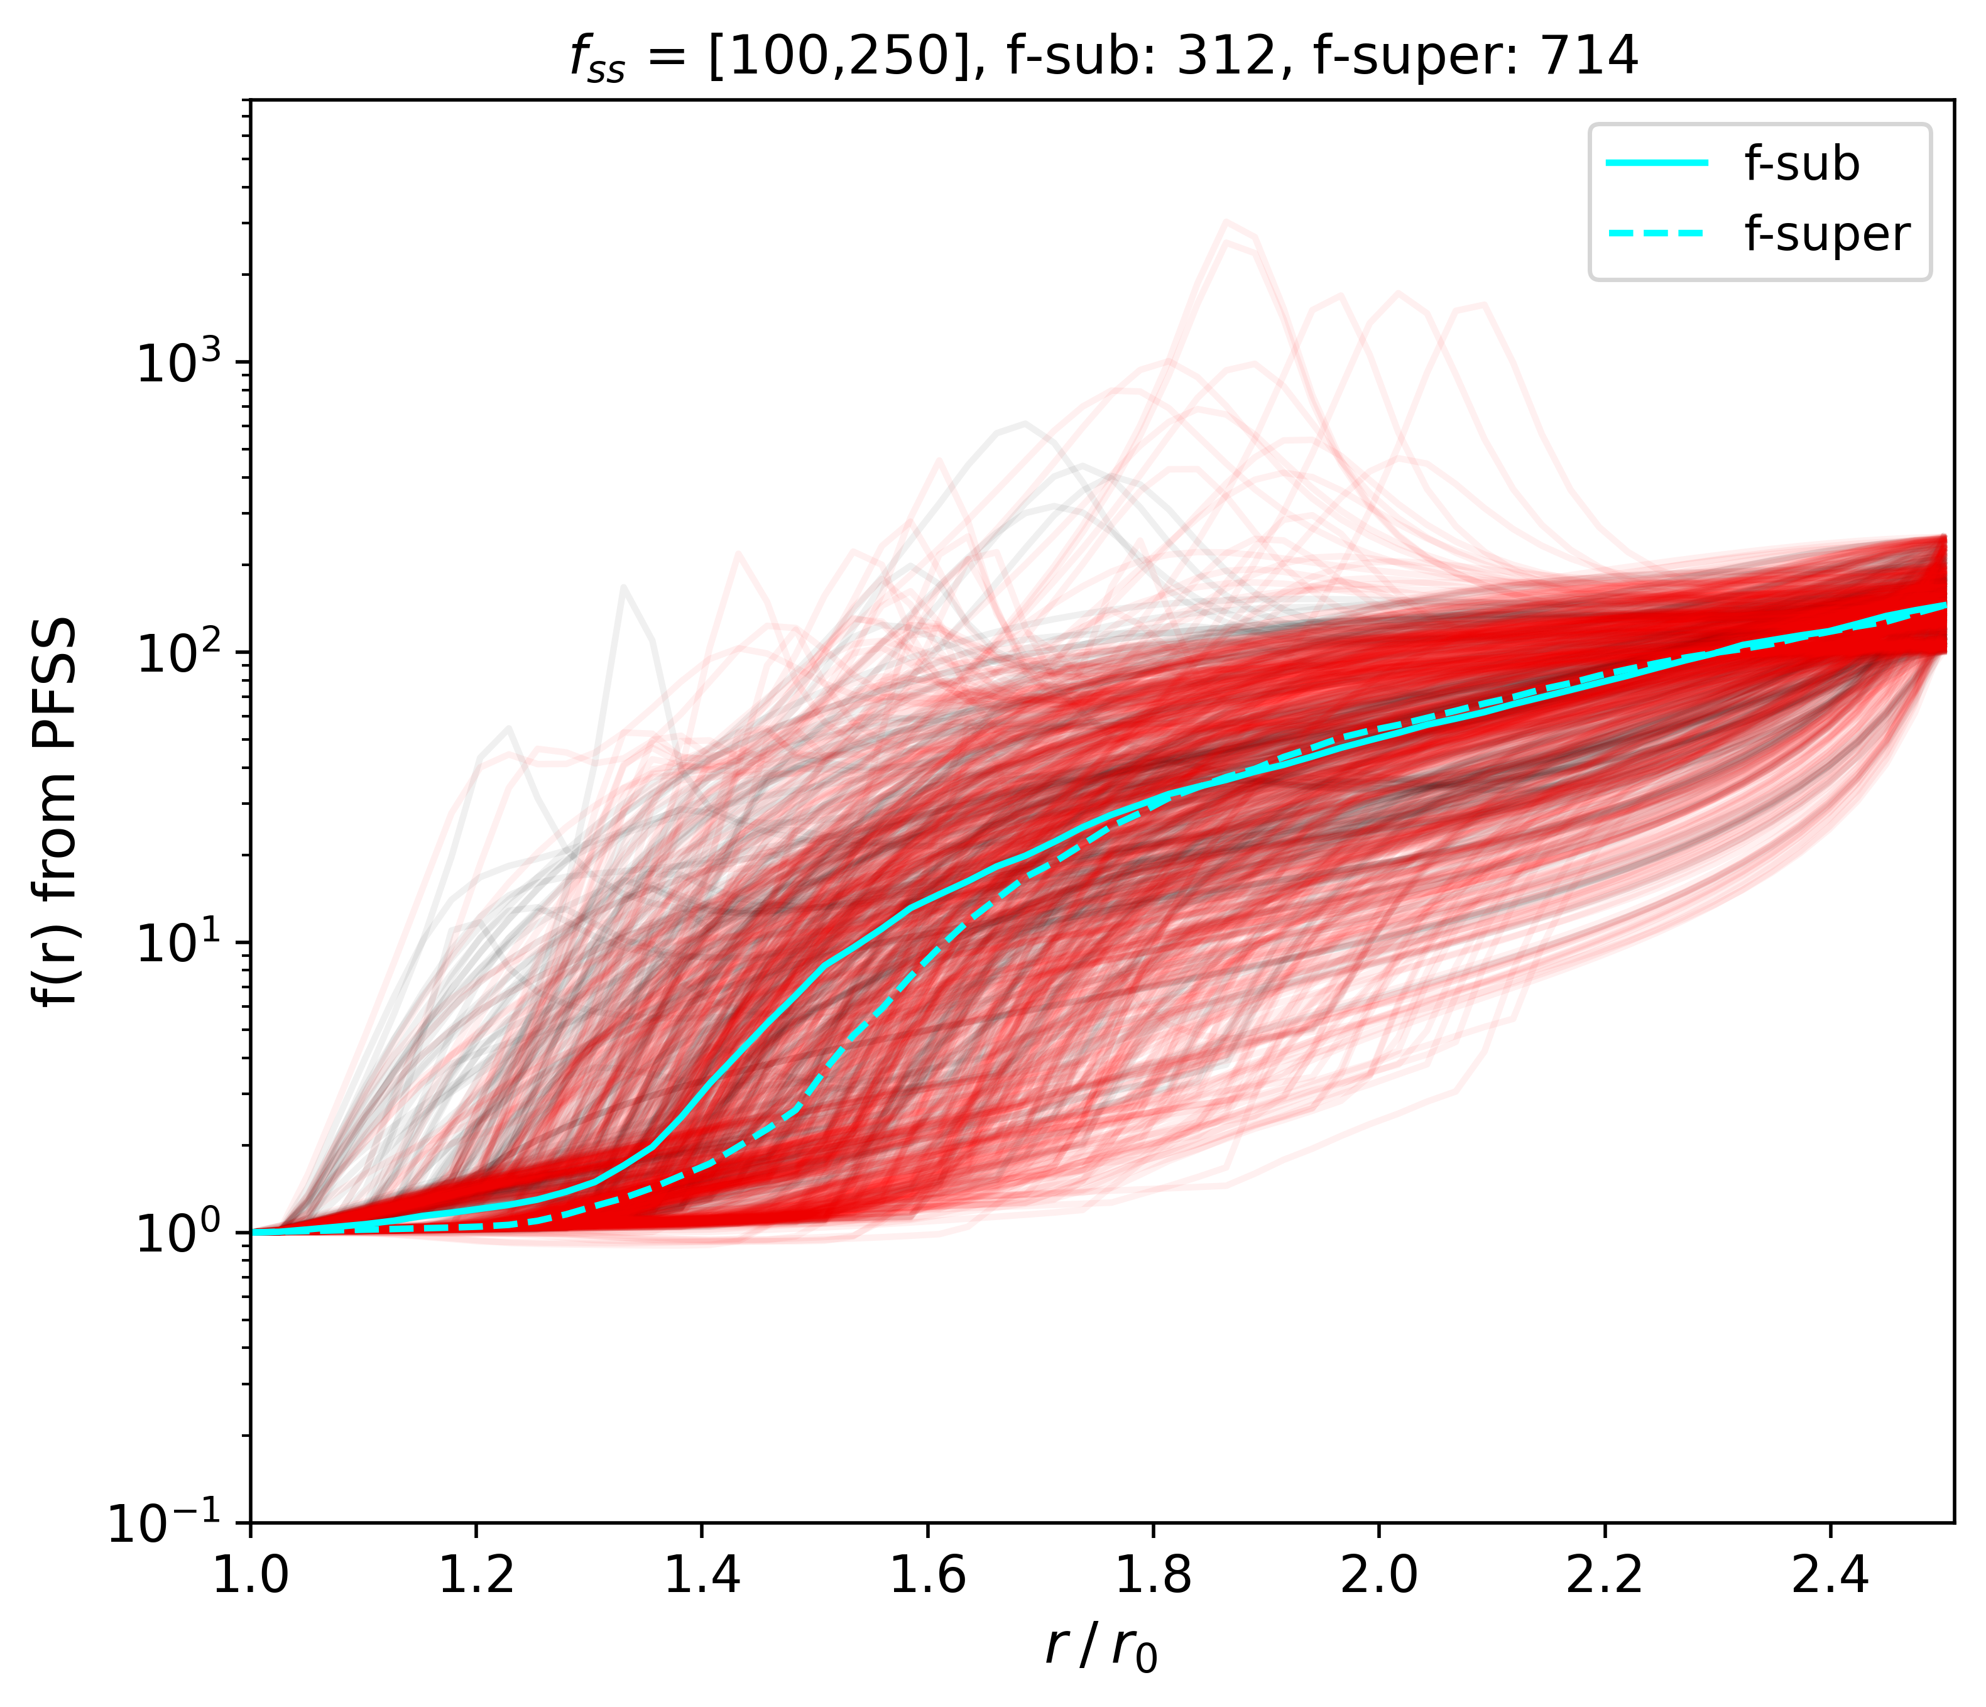
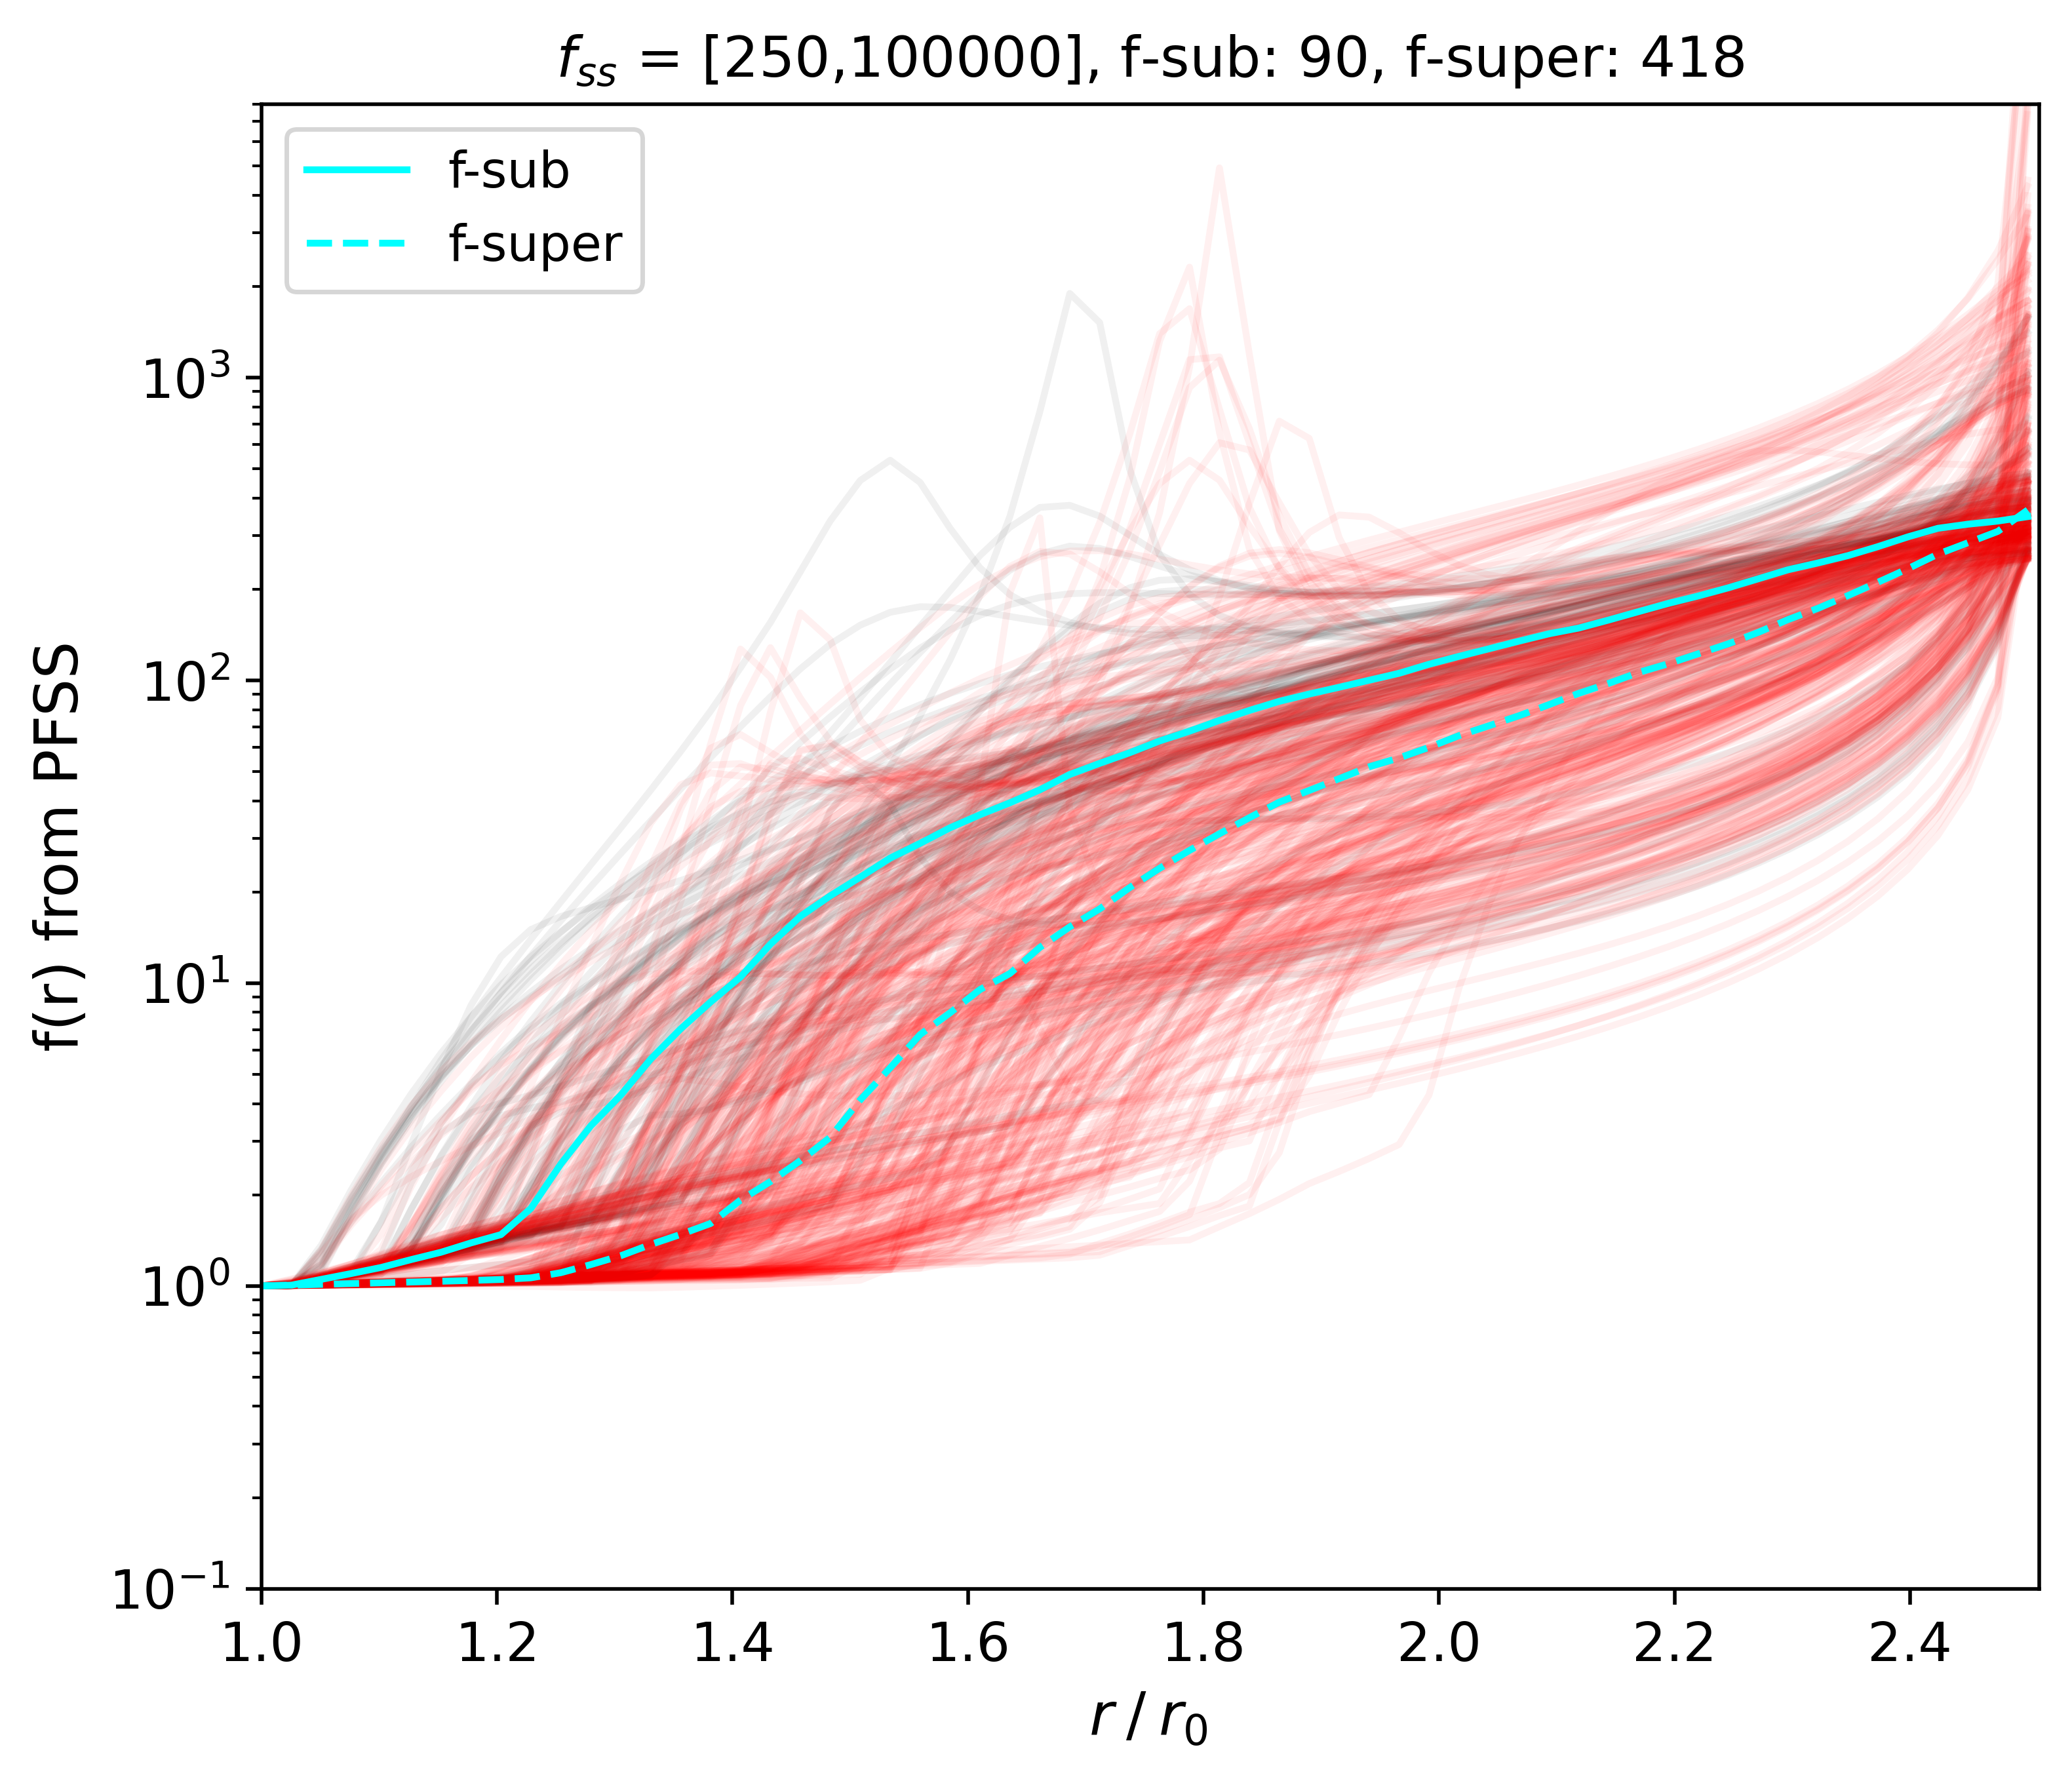
f-supersonic starts their super expansion at higher altitude than f-subsonic

Slide 33
Angular extension of a given source
Expansion factor
$$f= \frac{B_{r}\left(r_{ss}\right)}{B_{r}\left(r_{0}\right)}{ \left(\frac{r_{ss}}{r_{0}}\right)}^{2}$$
$$α_{ss}$$
Angular spreading factor
Flux tube
$$Q_{ss}=\frac{α_{ss}}{α_{0}}$$
Source angular extension
It’s not a mean $f_{ss}$ of all the flux tube → more likely an angular spreading of the field lines coordinates between $r_{0}$ and $r_{ss}$ (i.e. angular spread of the flux tube centroid)
$$α_{0}$$
Footpoint

Slide 34
Angular extension of a given source
$$Q_{ss}>1$$
Wind originating narrow magnetic structure (likely coridors)
$Q_{ss}≤1$
Wind originating wide magnetic structure (likely coronal holes)
$$α_{ss}$$
$$α_{0}$$
$$α_{0}$$

Slide 35
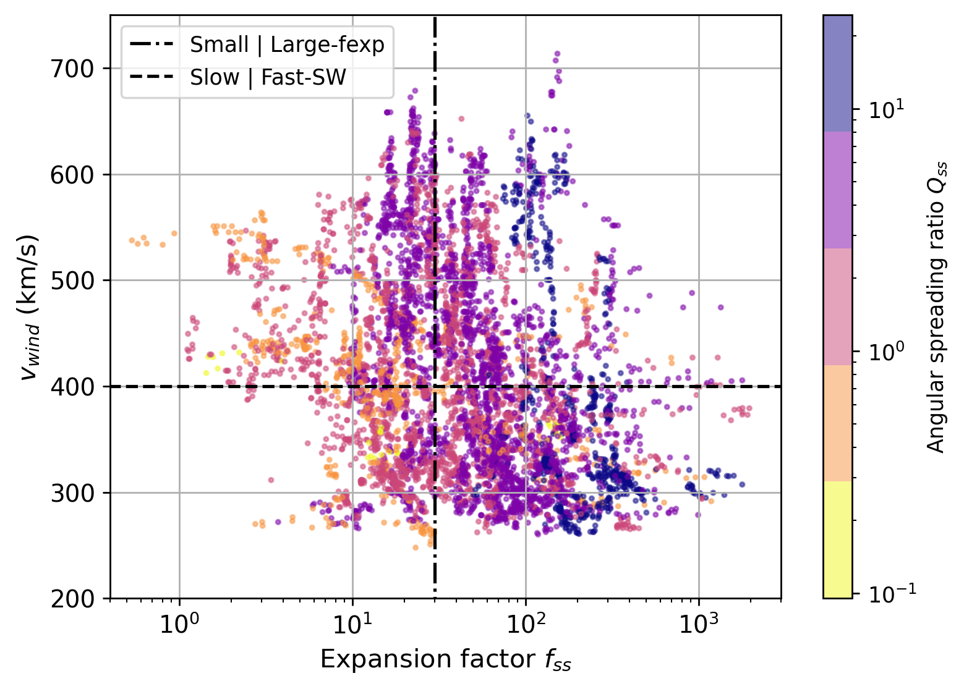

Slide 36
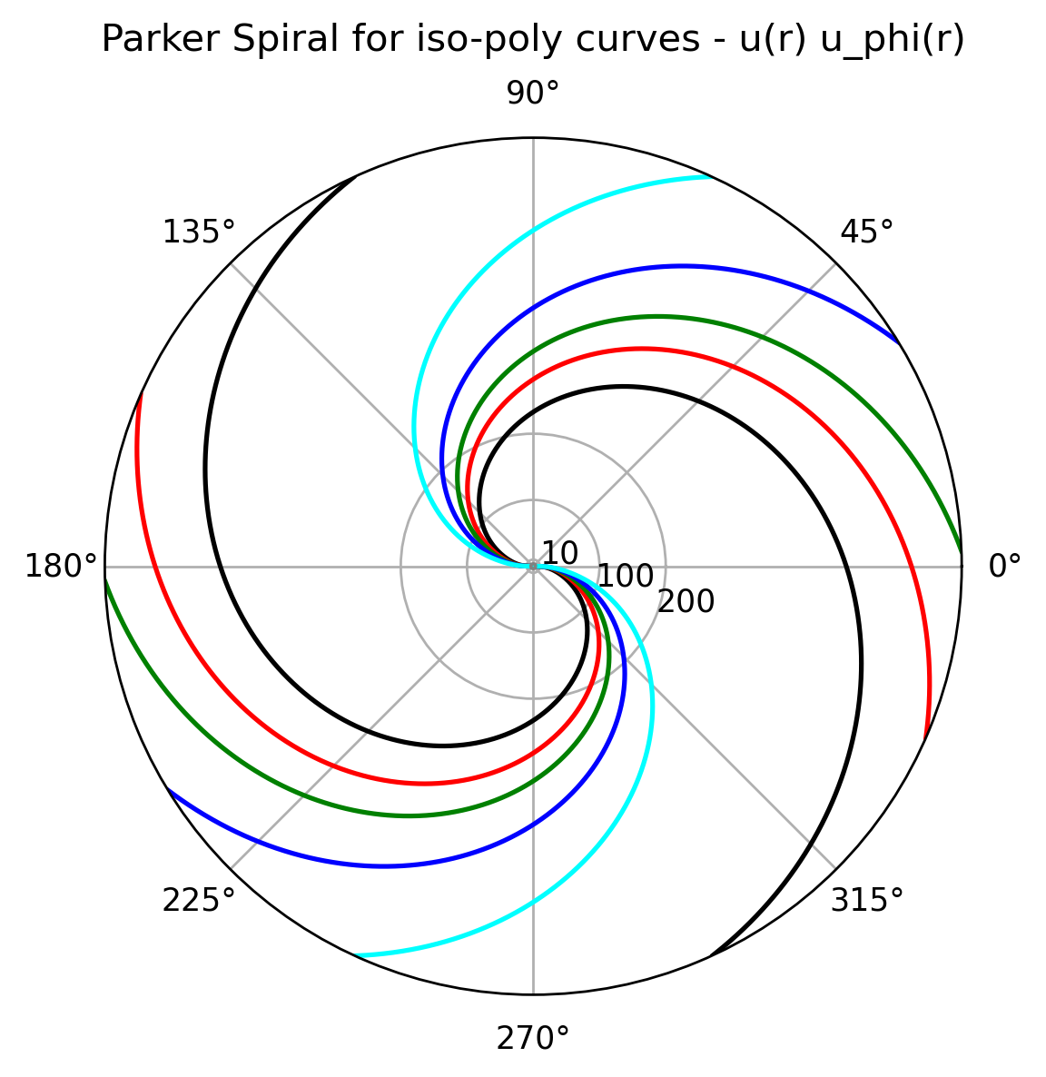
Magnetic Connectivity on Solar Orbiter
→ Far from the Sun : Parker’s like spiral
Fast
Wind modeling :
Isopoly models : isothermal close to the Sun, polytropic farther away, wind speed dependent (Dakeyo et al 2022)
Streamline modeling :
Parker’s like spiral with radial acceleration and corotational effects (Dakeyo et al 2024a)
Slow
Ready to compute magnetic connectivity on Solar Orbiter
What do we expect to observe ?

Slide 38
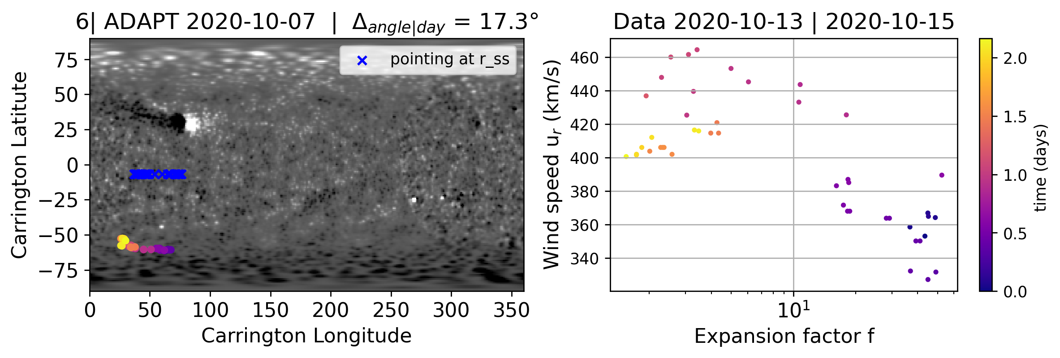
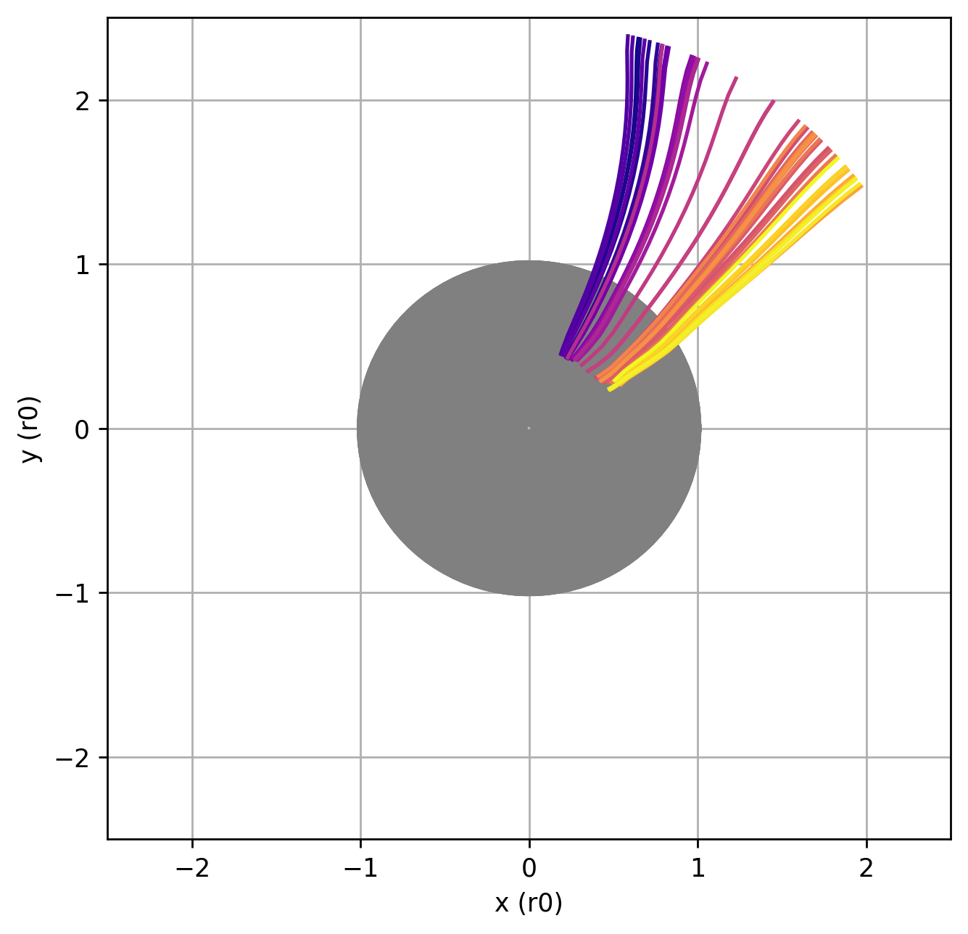
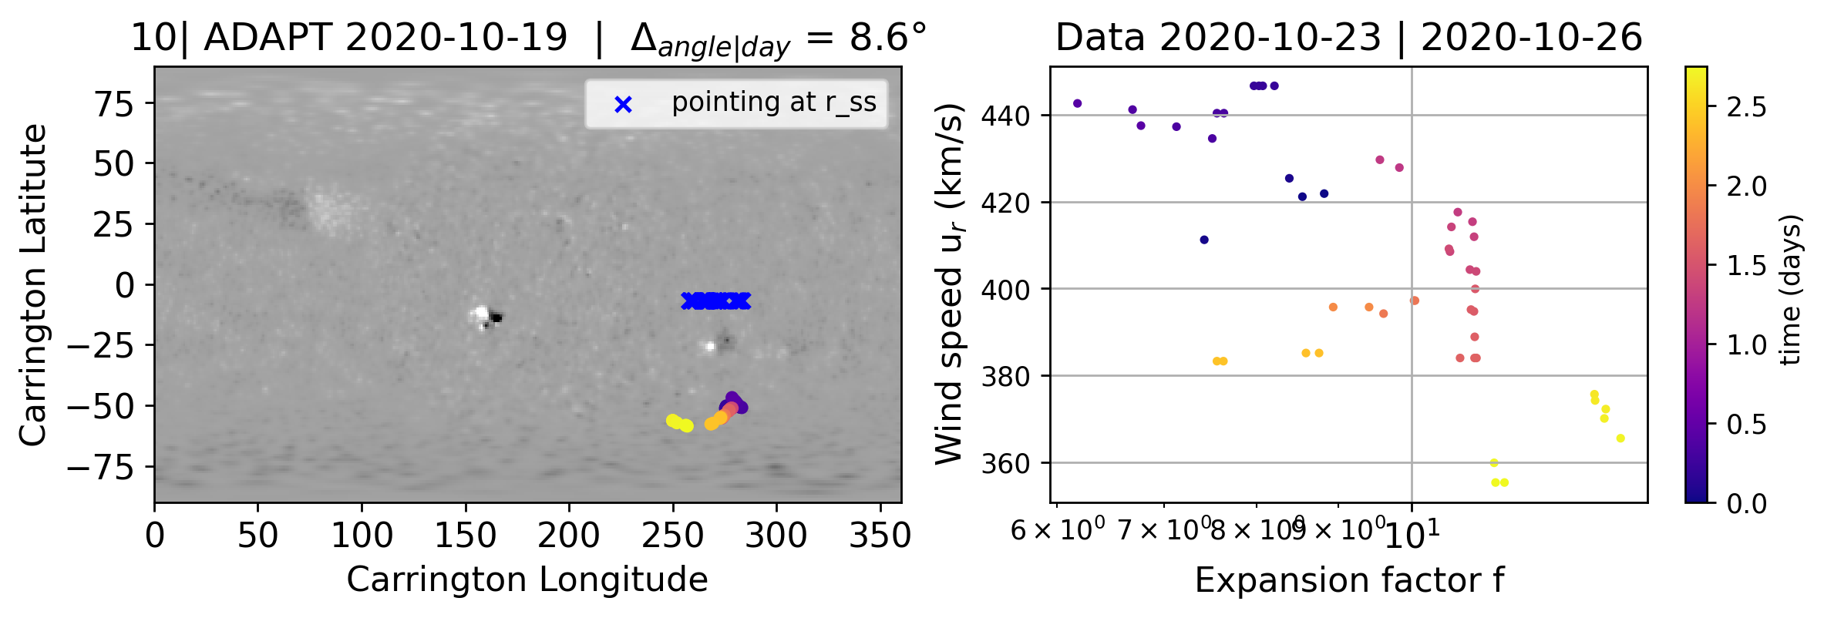
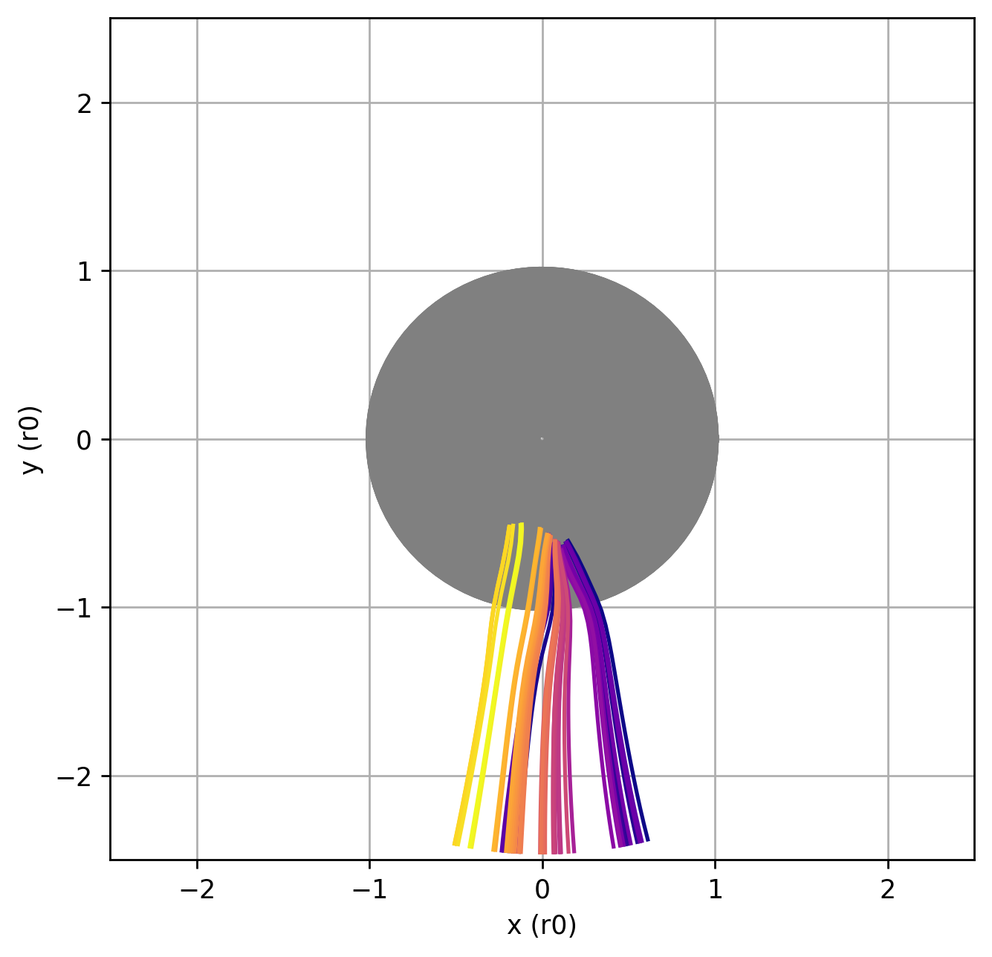
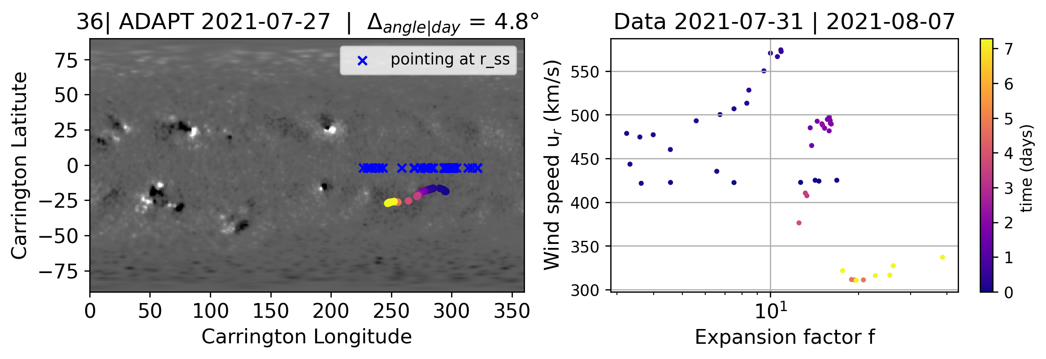
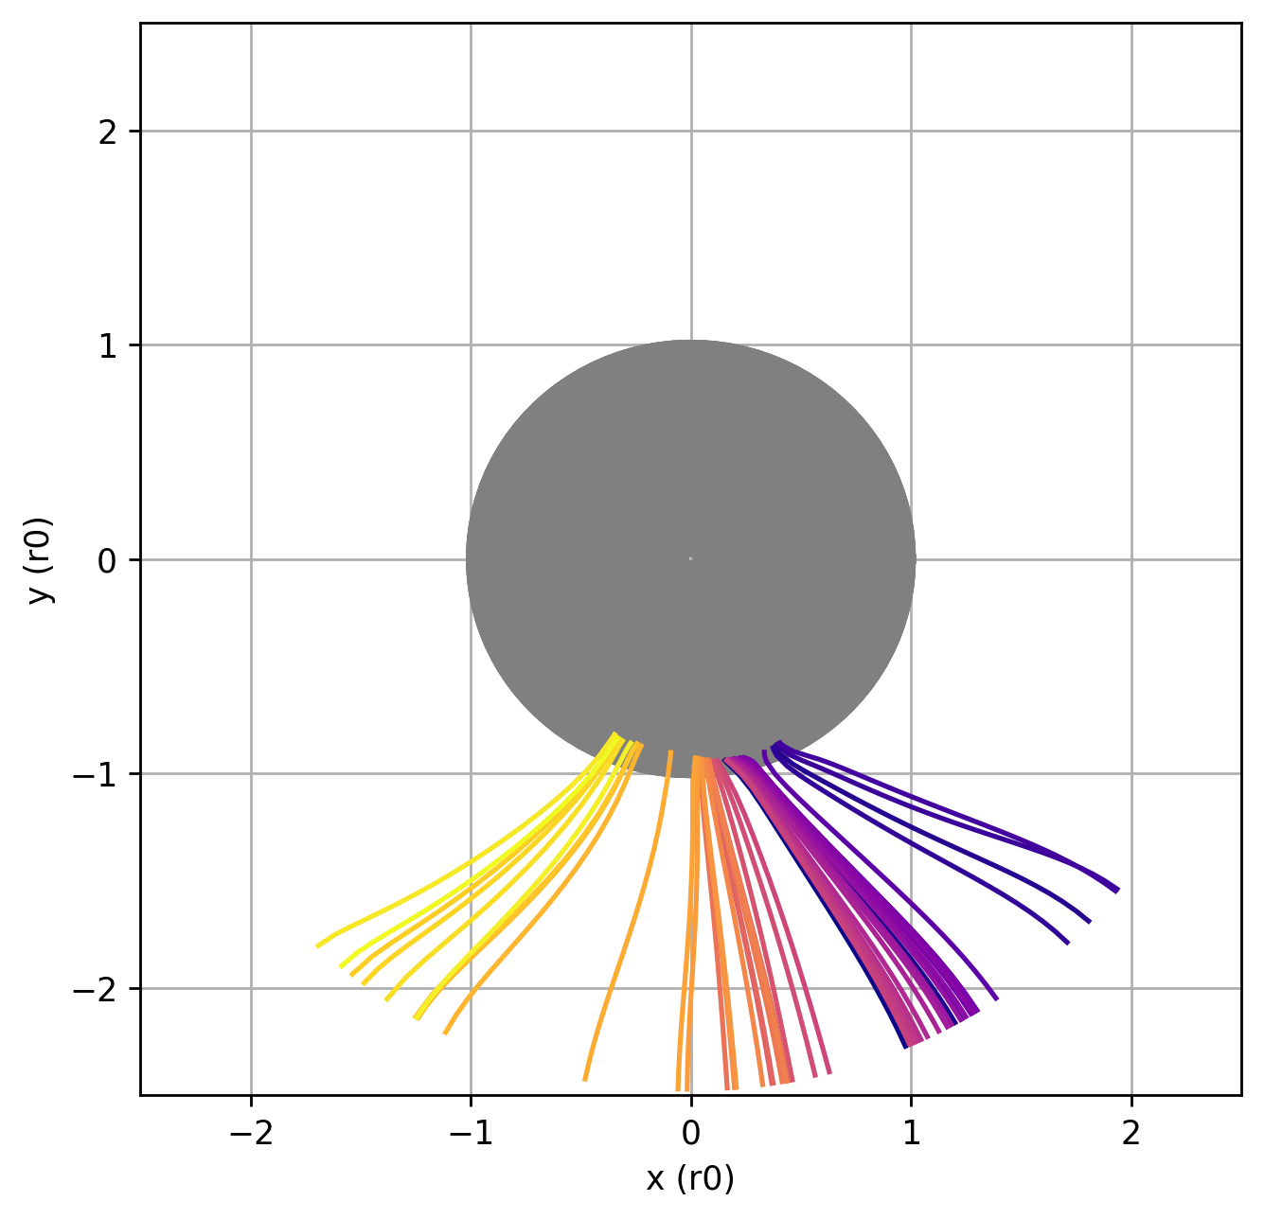
Cases with a good match with EUV images to Coronal Holes structures
Coronal Hole
Large/relatively large angular source
Coronal Hole
More or less clear
anti-correlation
Coronal Hole

Slide 39
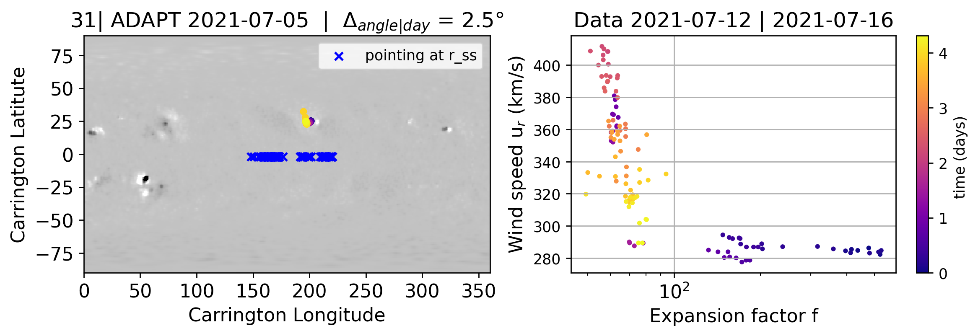
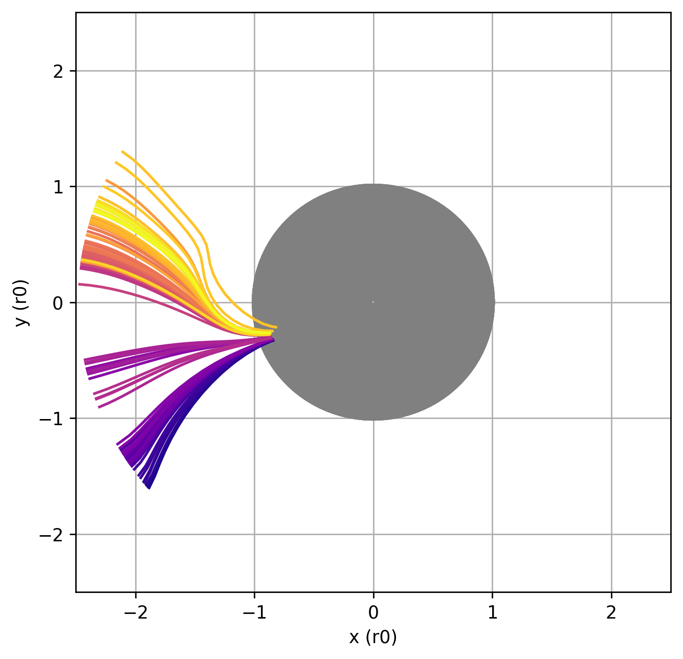
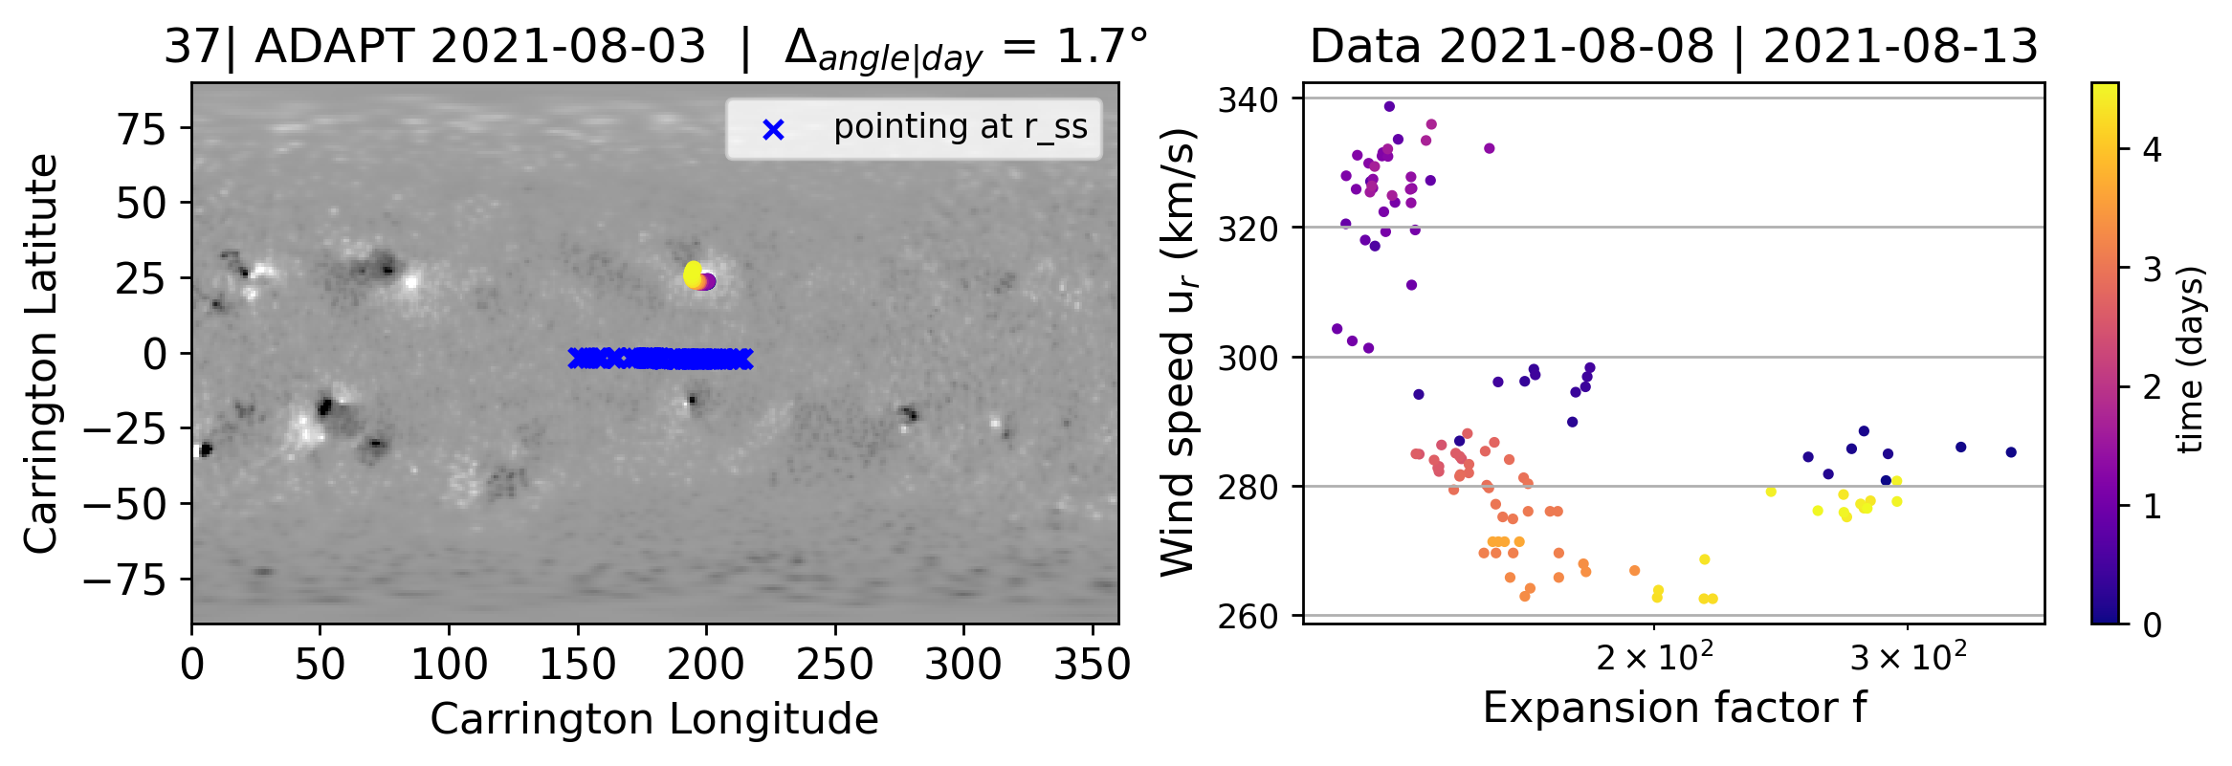
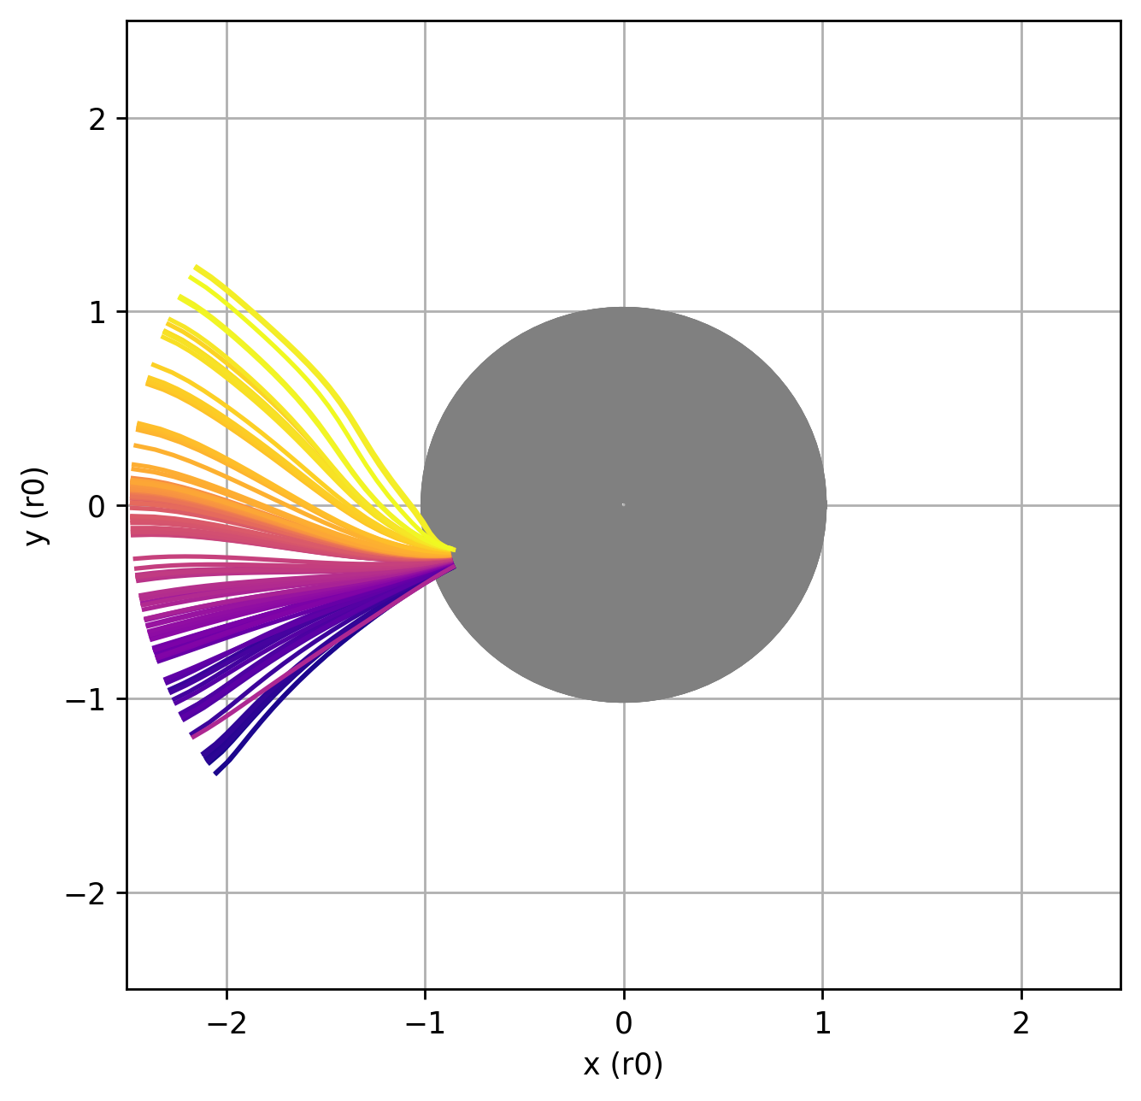
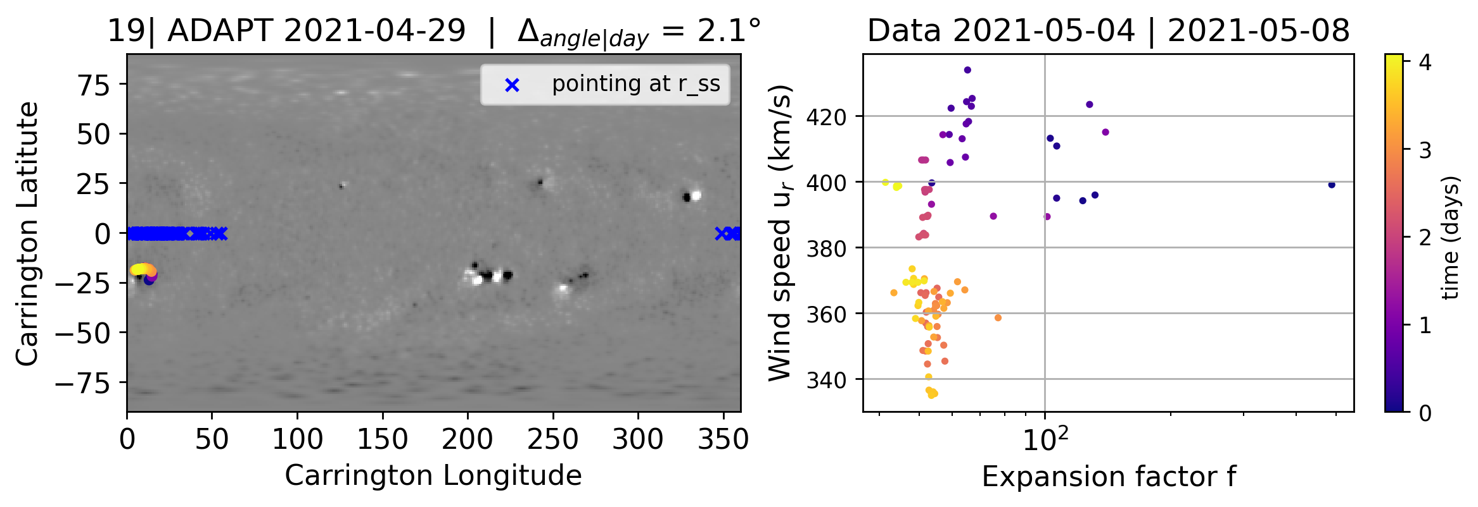
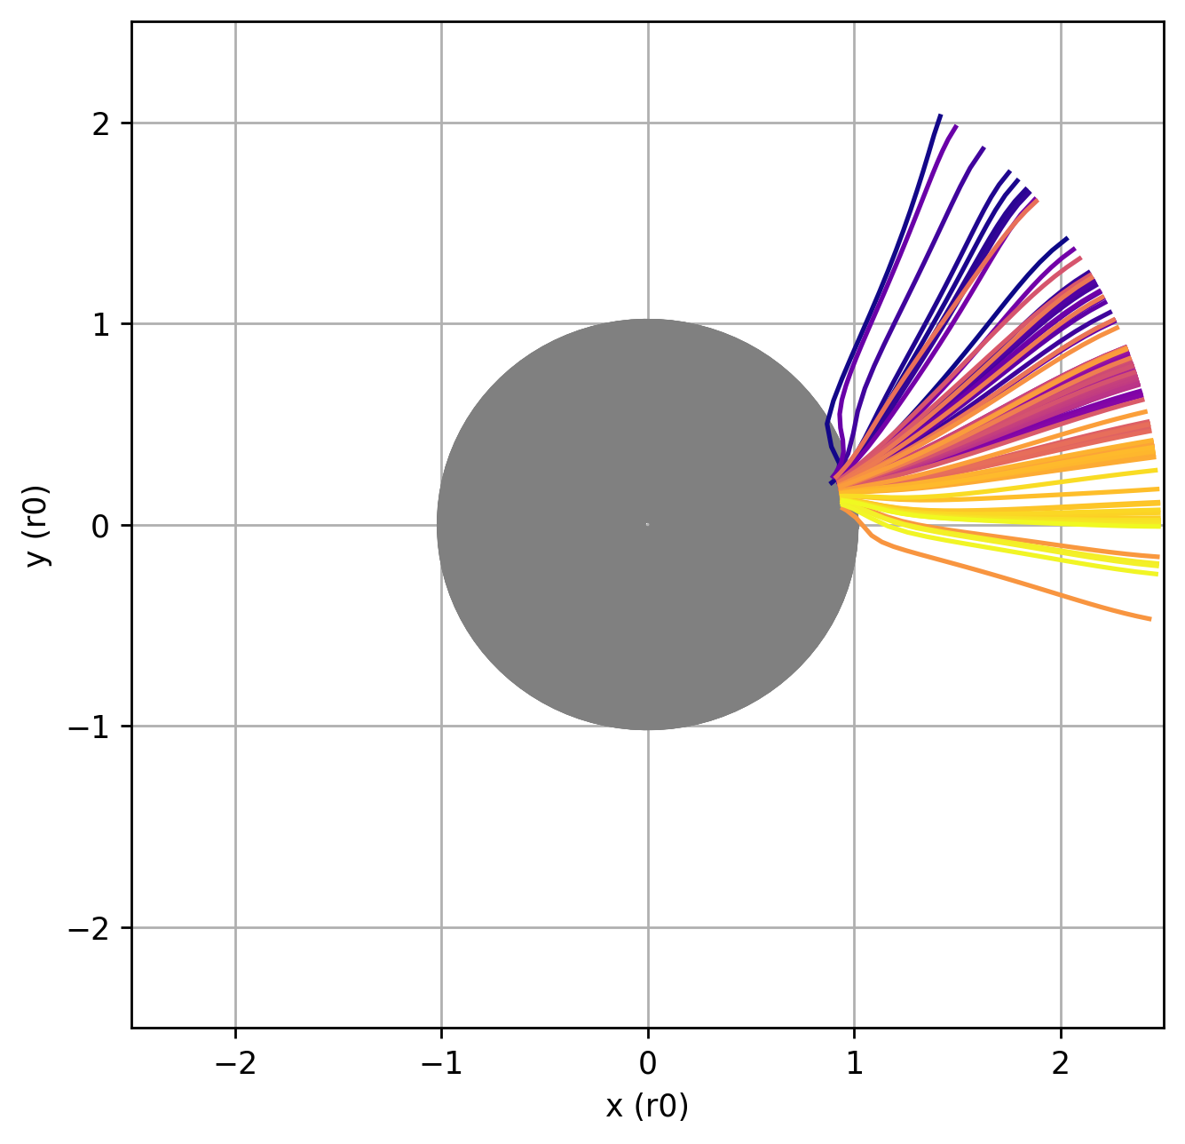
Cases with a good match with EUV images to Border of Active region structures
Active Region Border
Narrow angular sources
Partial or no
anti-correlation
Active Region Border
Active Region Border

Slide 40
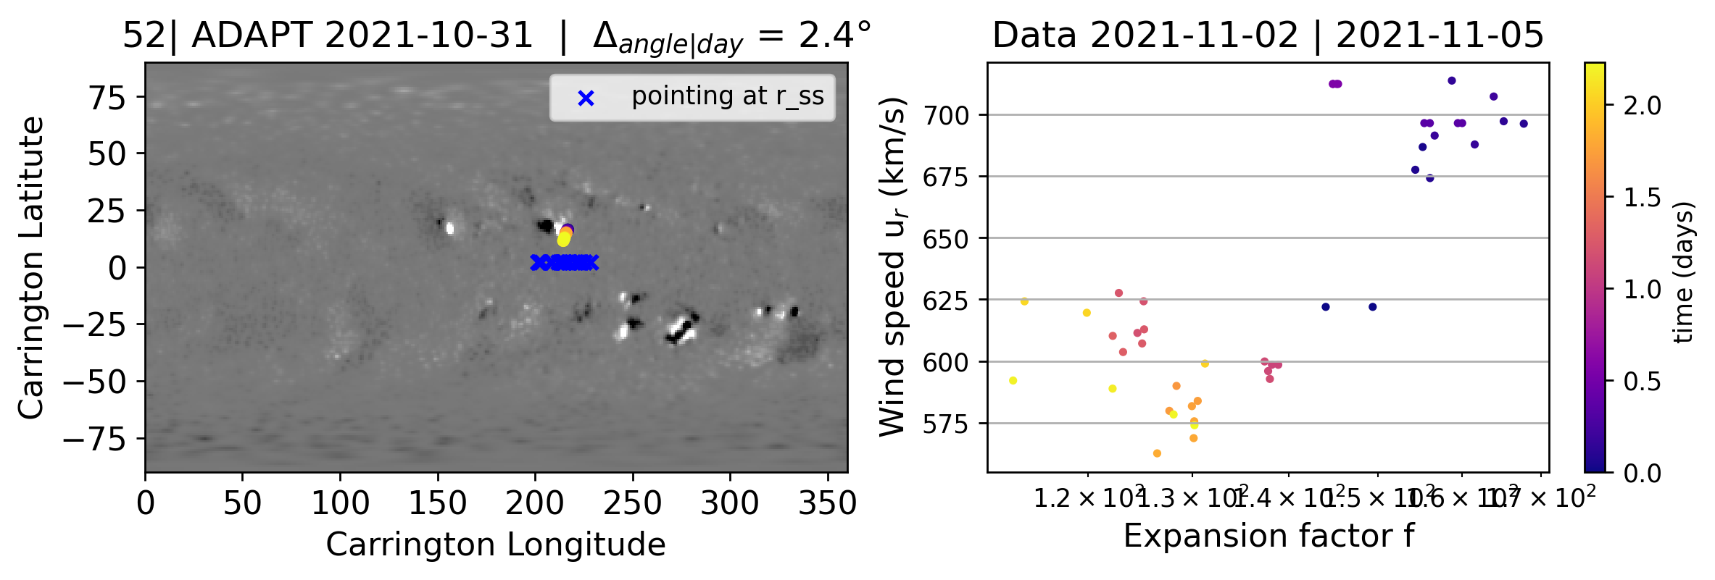
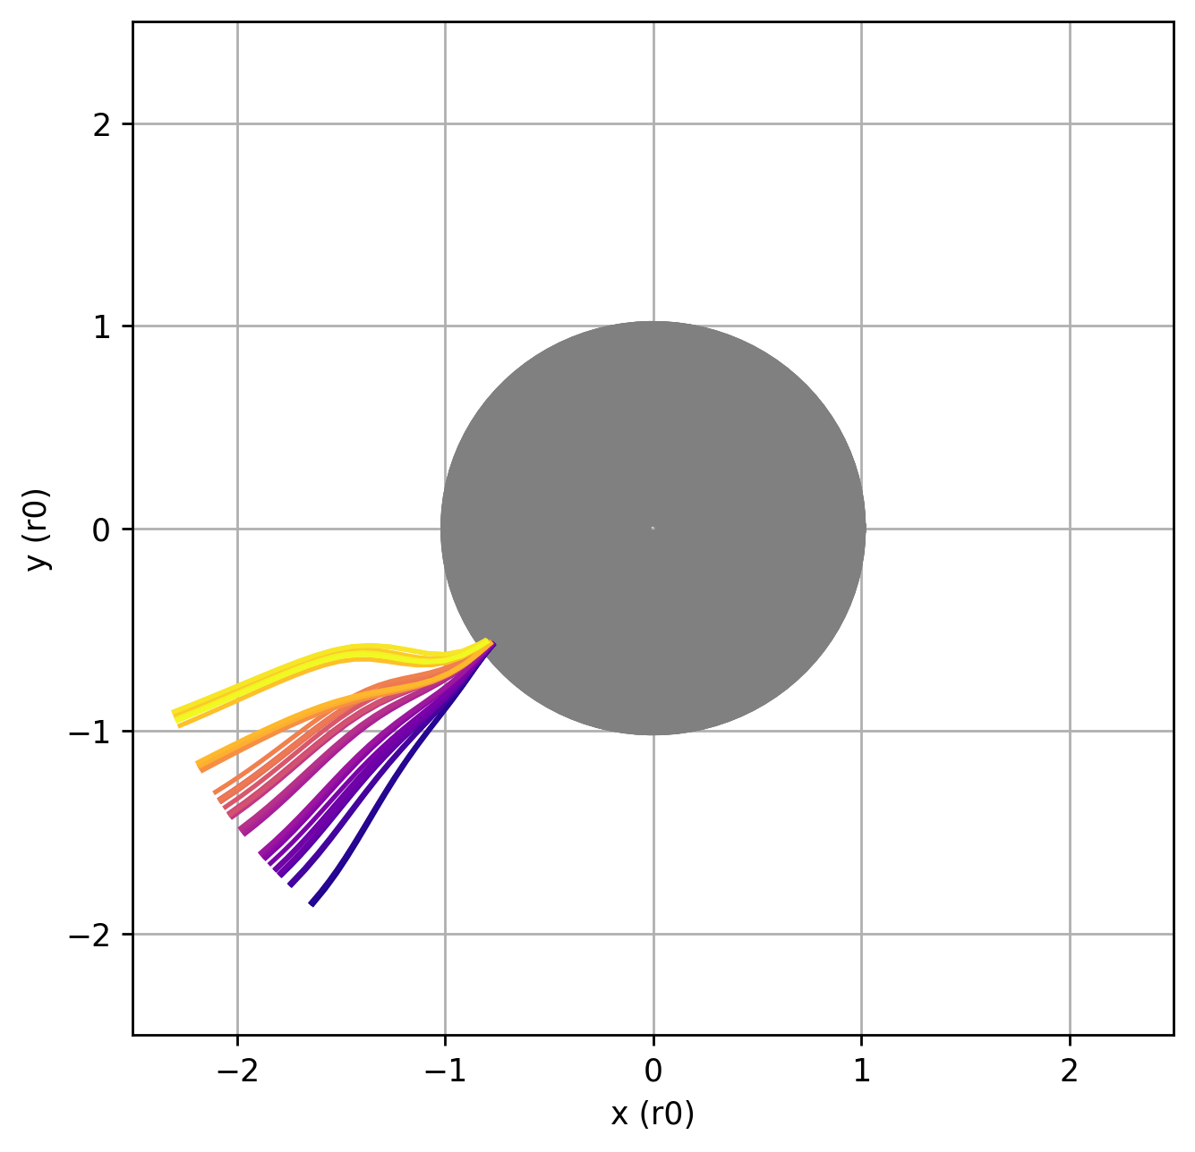
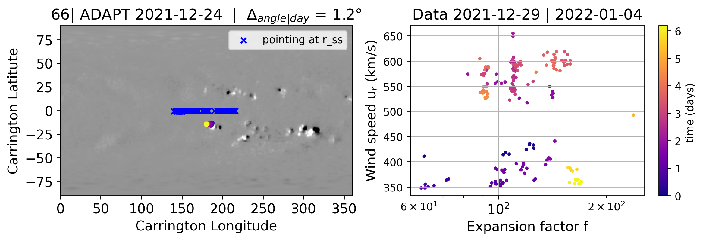
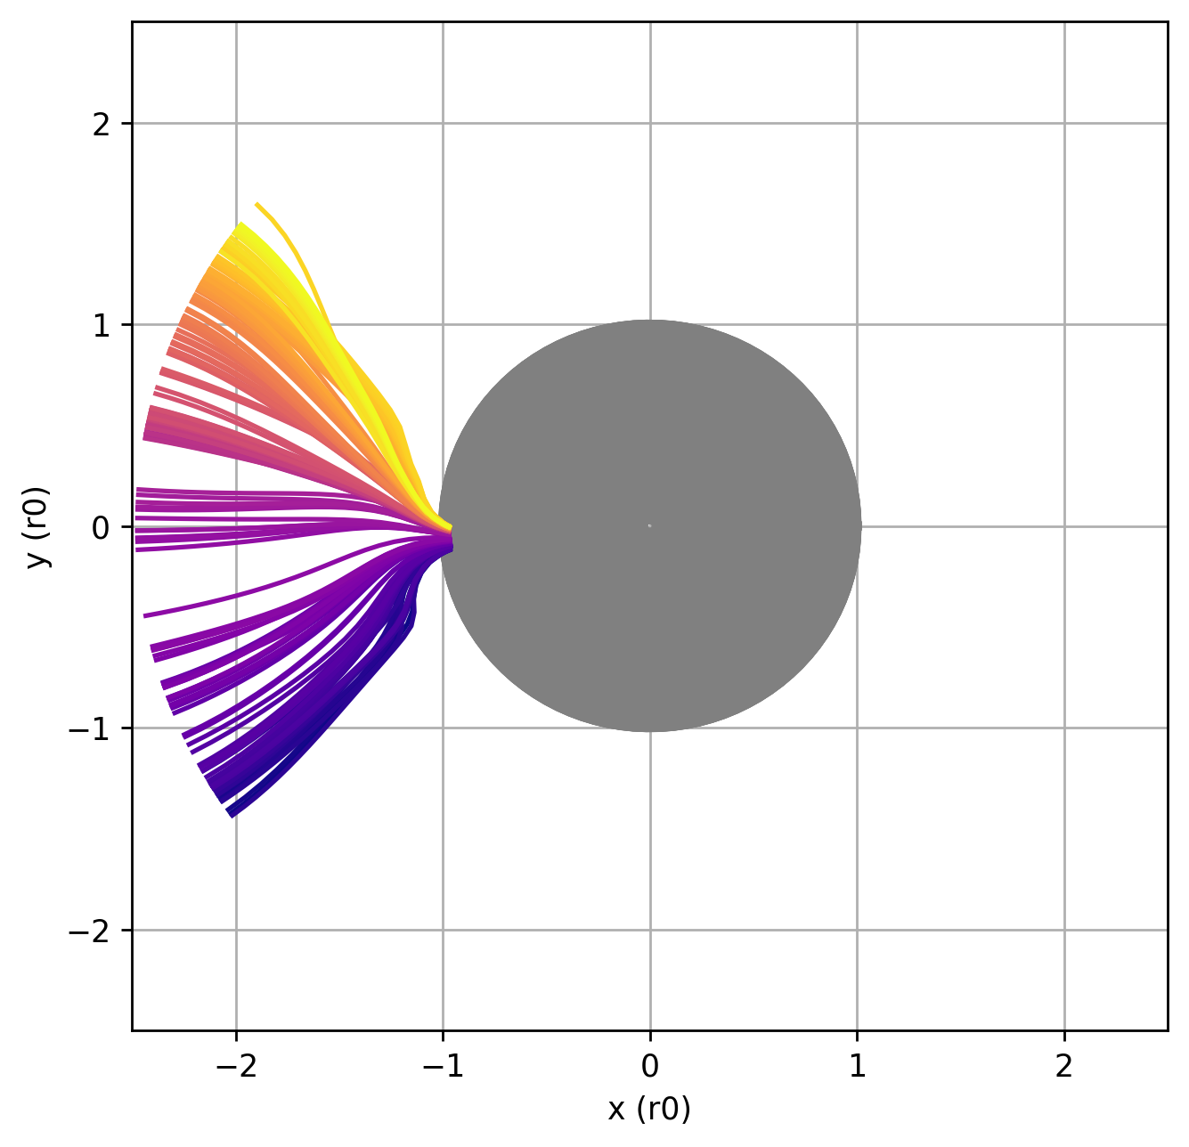
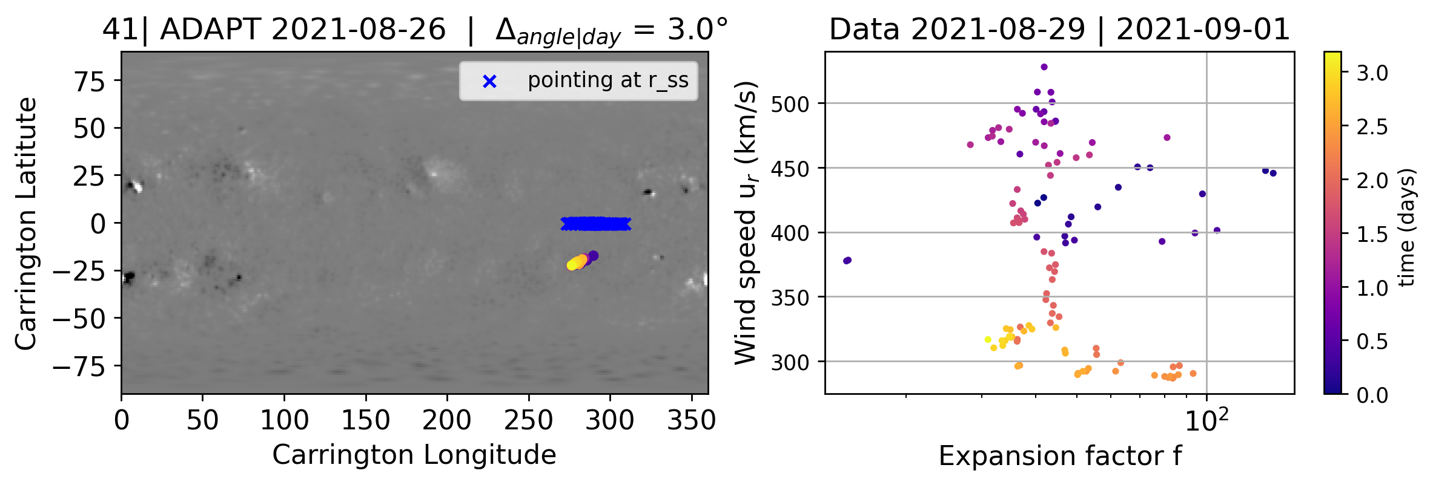
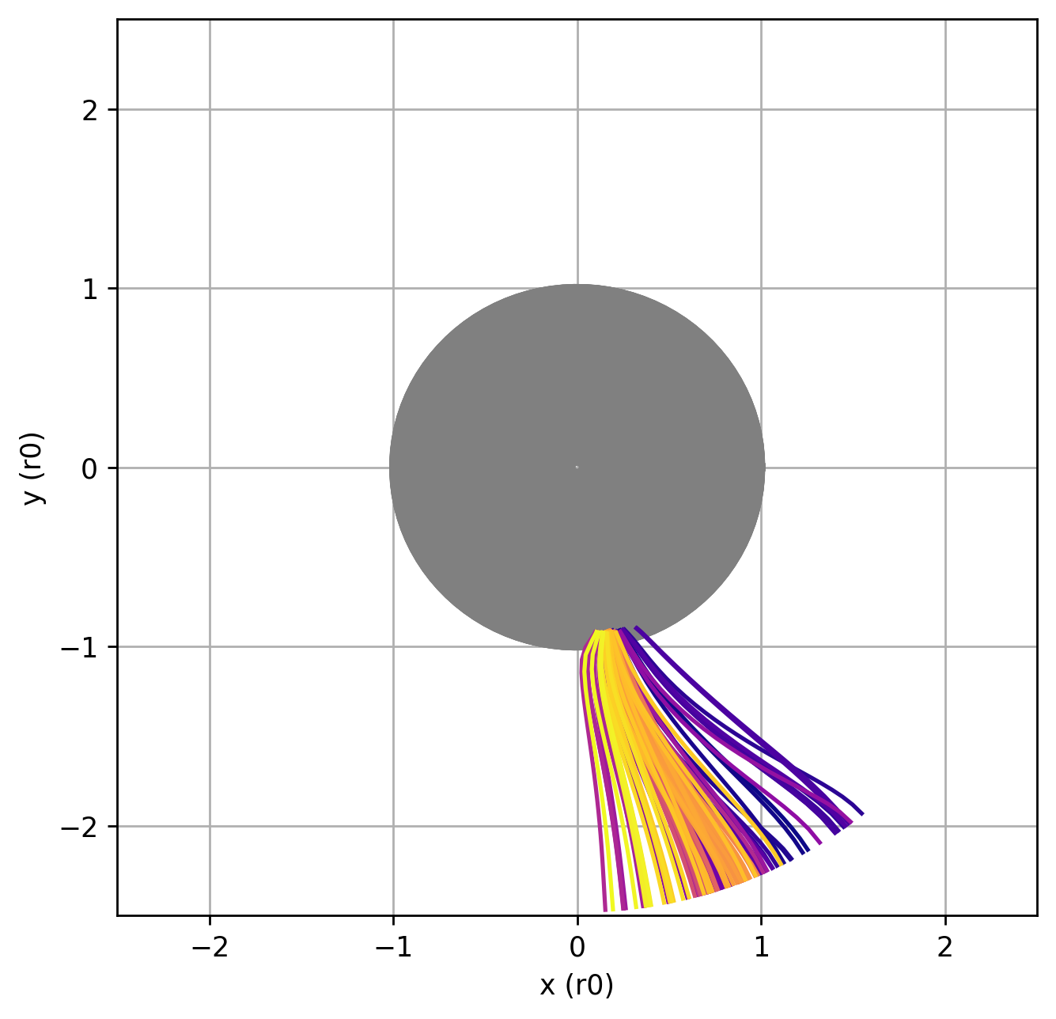
Pseudo Streamer ?
Narrow angular sources
No
anti-correlation
Pseudo-Streamer
Coronal Hole dissapearing ?

