Slide 1
Software For Automatically Detecting Meteorite Falls In Doppler Weather Radar
Mike Hankey - Meteoroids 2016 - Noordwijk, the Netherlands

Slide 2
NEXRAD Meteorite Recovery
Process discovered and pioneered by Jeffrey Fries, Marc Fries & Rob Matson
10 Meteorite Recoveries since 2009 West Texas, Mifflin, Sutters Mill, Battle Mountain, Novato, Addison, Stanfield, Creston, Osceola, Lubock Texas
Radar found on 7+ historic falls dating back to 1997

Slide 3
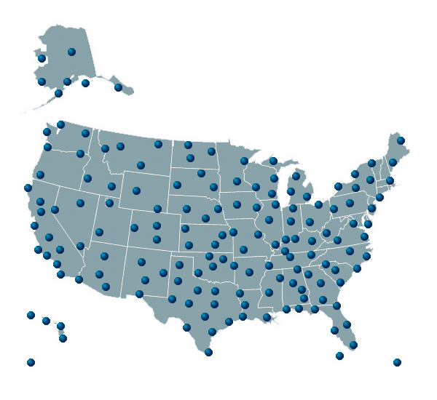
NEXRAD Basics
Data stored in multiple files per station
Each file contains 1 full rotation containing 720 rays for each elevation angle of the radar (7-16)
Each ray contains 1000s of ‘gates’ or pixels (.25km resolution)
Data files are published within minutes of recording
Each file holds millions of pixels each containing numerous values
Network of 160 Doppler Radar stations run by NWS, NOAA & USAF

Slide 4
How it works (manually)
Know when and where fireball happened
Identify radar stations near the place of the fireball and download data files for 1 hour around the fall time (6 files each)
Using NOAA viewer software & Google Earth look for transient clouds near the time and place of the fall
How to tell a meteorite cloud from a normal cloud?
Coincidence
Transient – sudden & short lived
Altitudes / Velocity
Size
Multiple hits on different stations and sweeps
Labor intensive, manual process requiring trained visual examination of up to 126+ images (3 * 7 * 6) – can take hours per event to detect, fully analyze and prepare KML report

Slide 5
Automation Opportunity
AMS Fireball System (RESTFull API)
NOAA NEXRAD Data now on AWS (cloud)
Pyart Python Library / API for reading and plotting radar data files

Slide 6
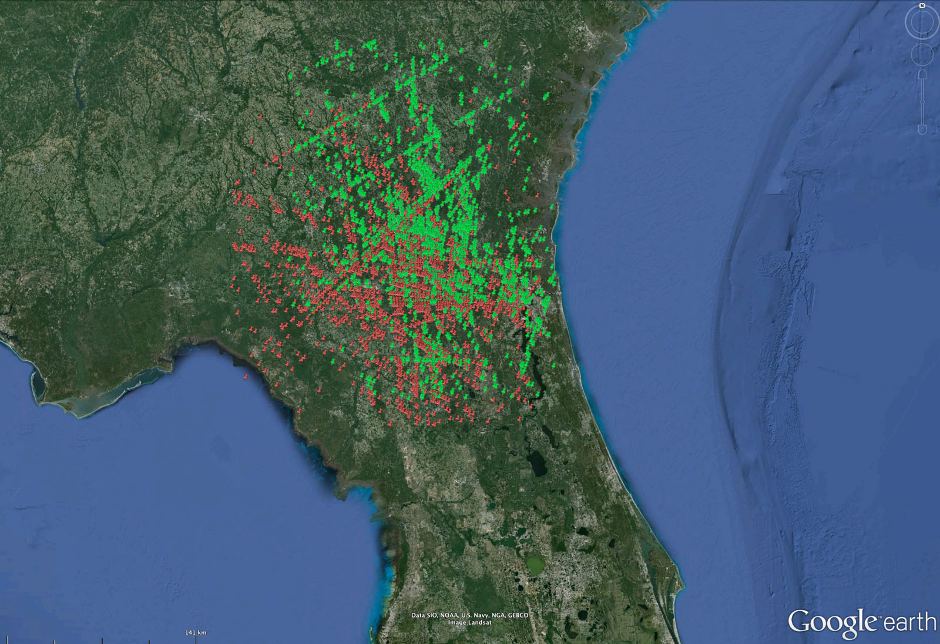
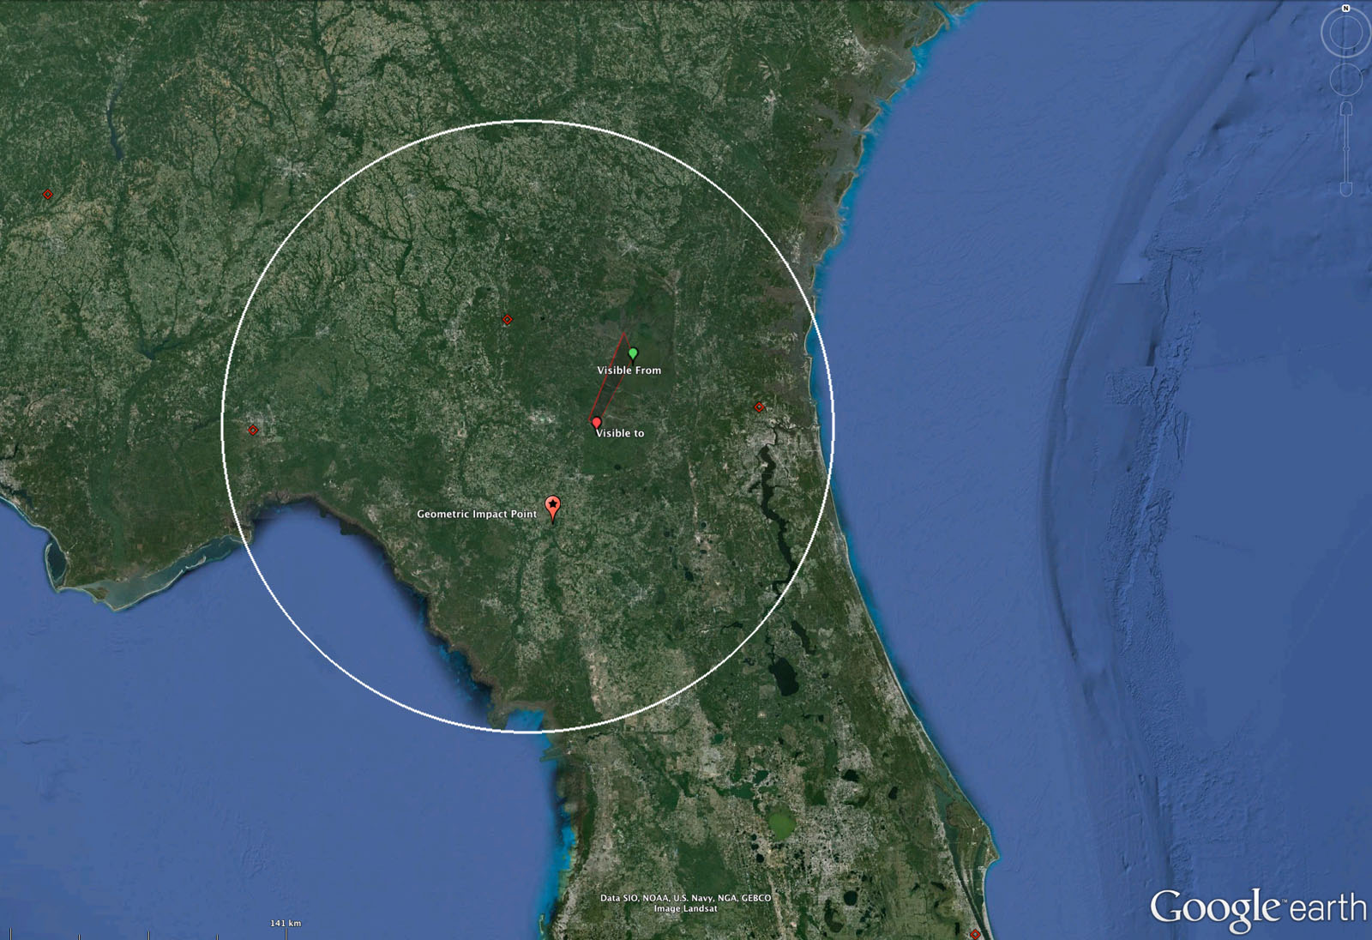
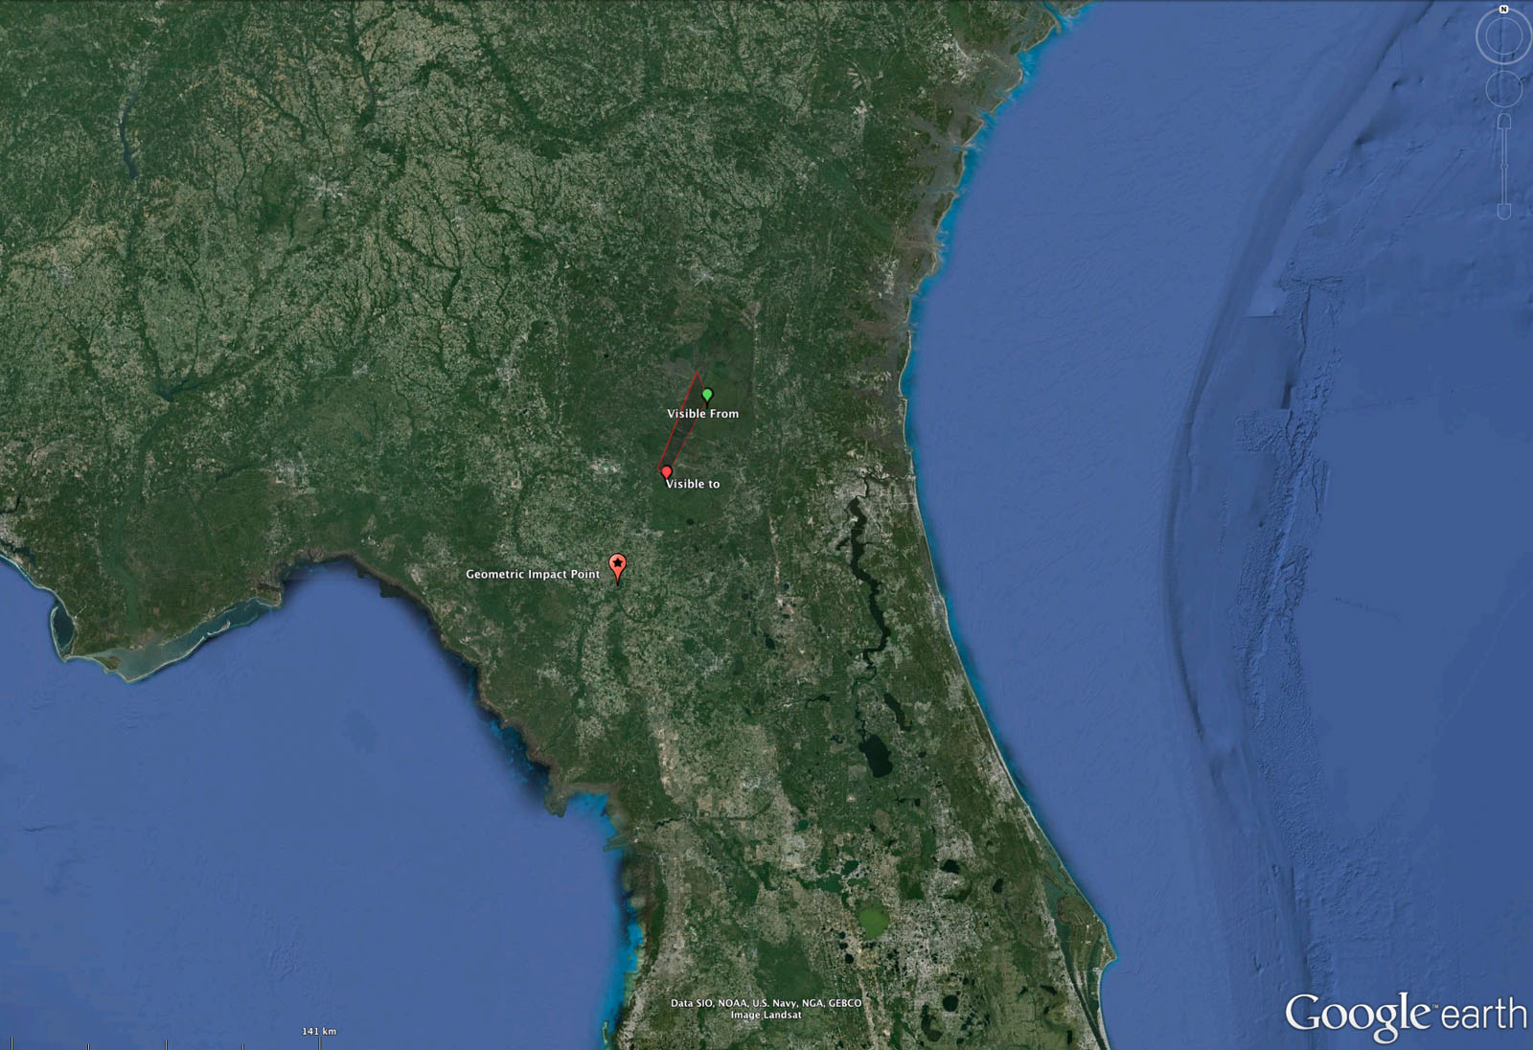
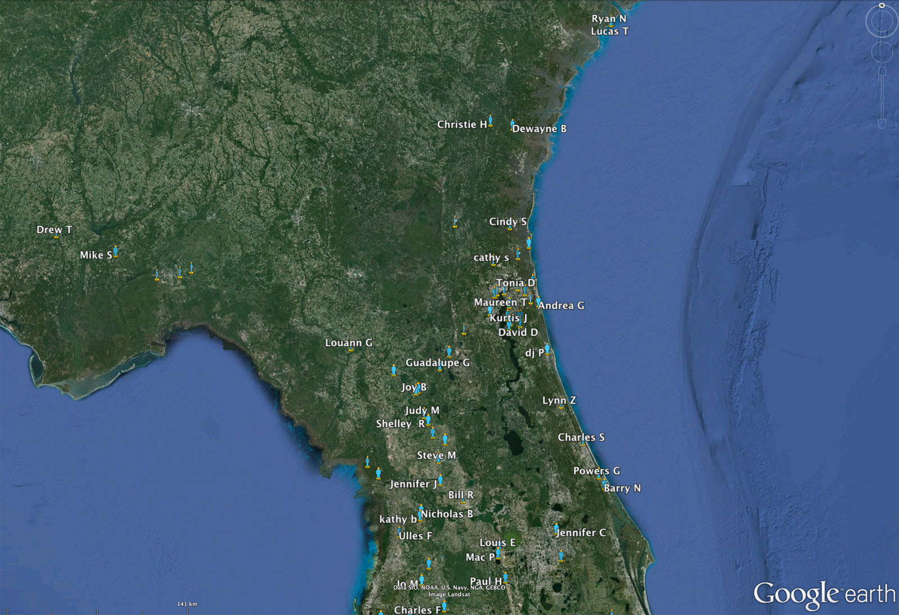
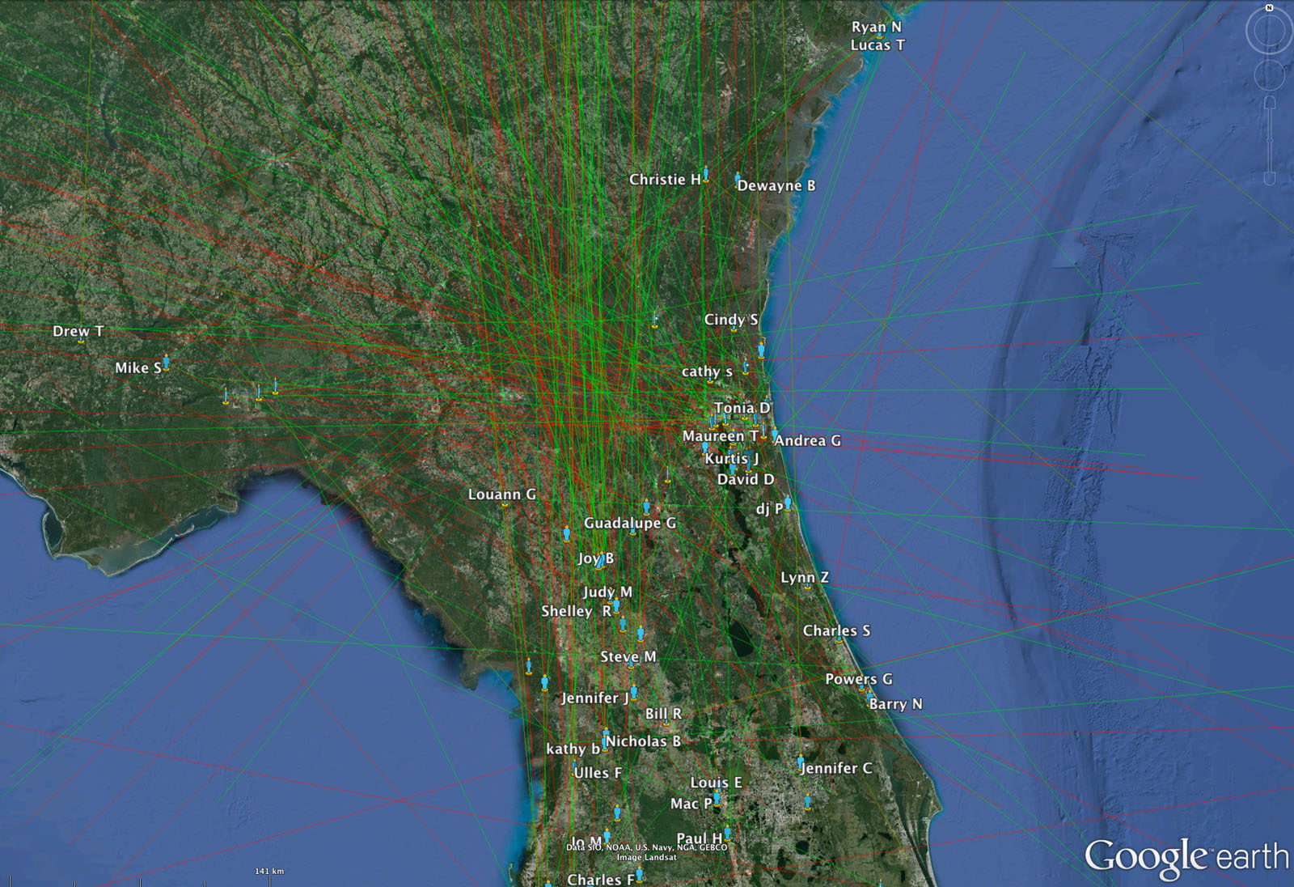
Automated Process – step 1
Witnesses
Plot Lines
Intersections
Trajectory
Radar Files

Slide 7
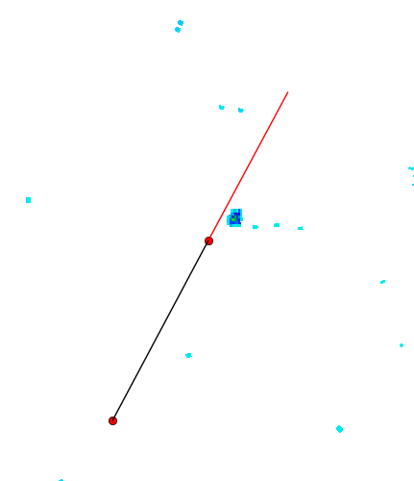
Automated Process – step 2
For each file, for each sweep:
Draw wide map of radar for visual review
Arrange files in simple overview page
Create KML Overlays

Slide 8
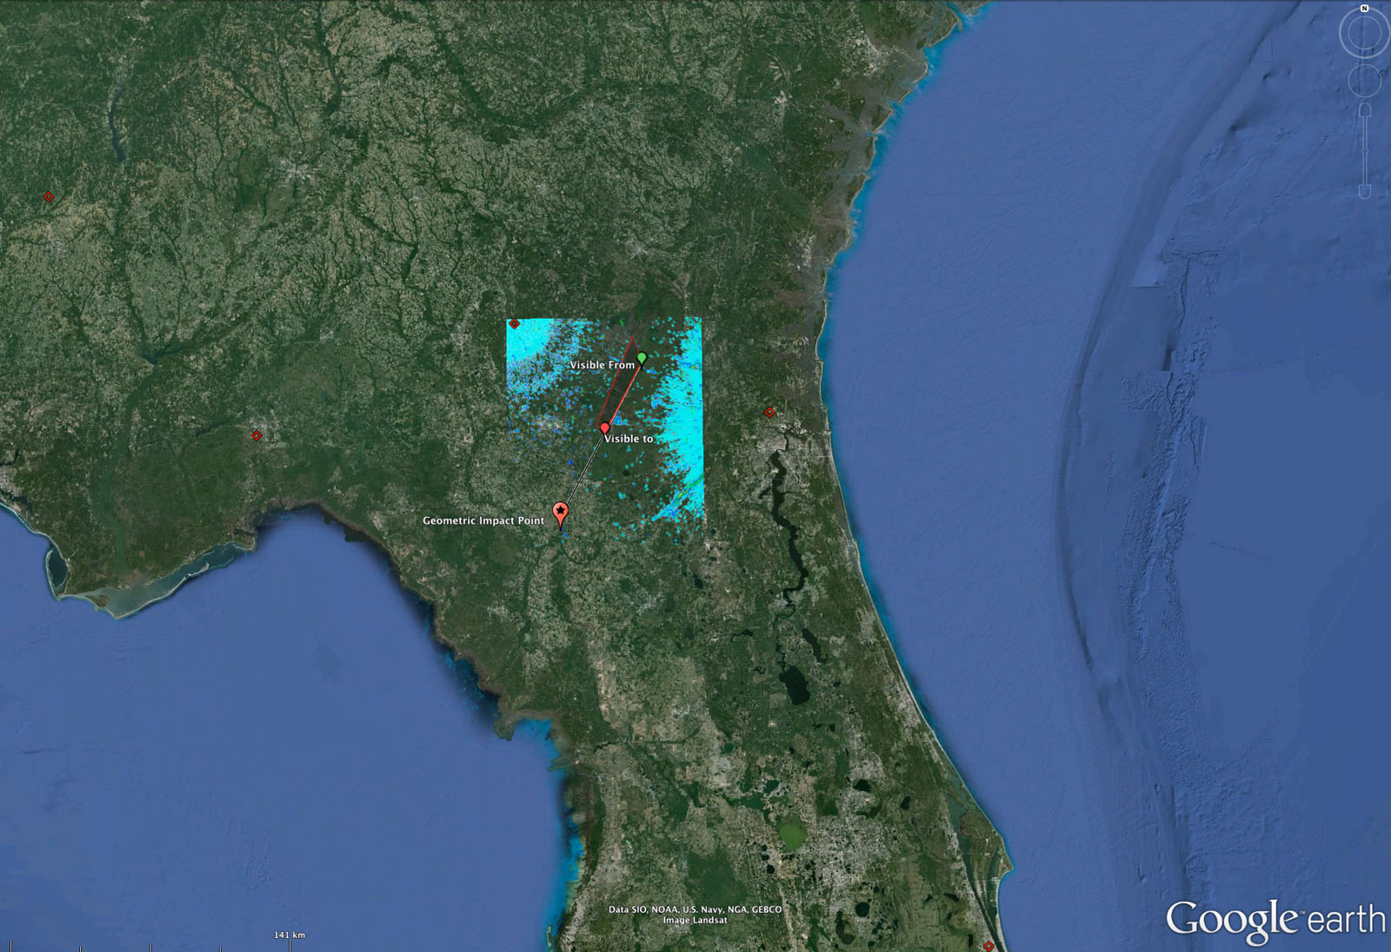
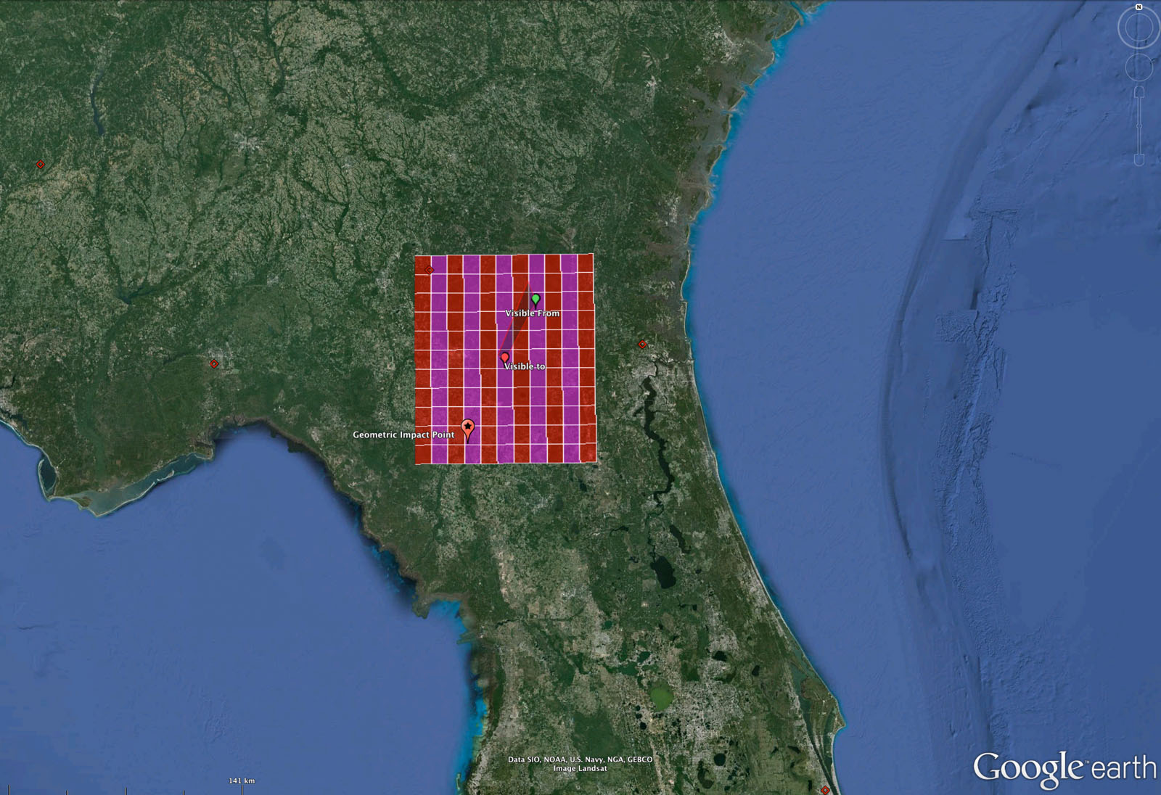
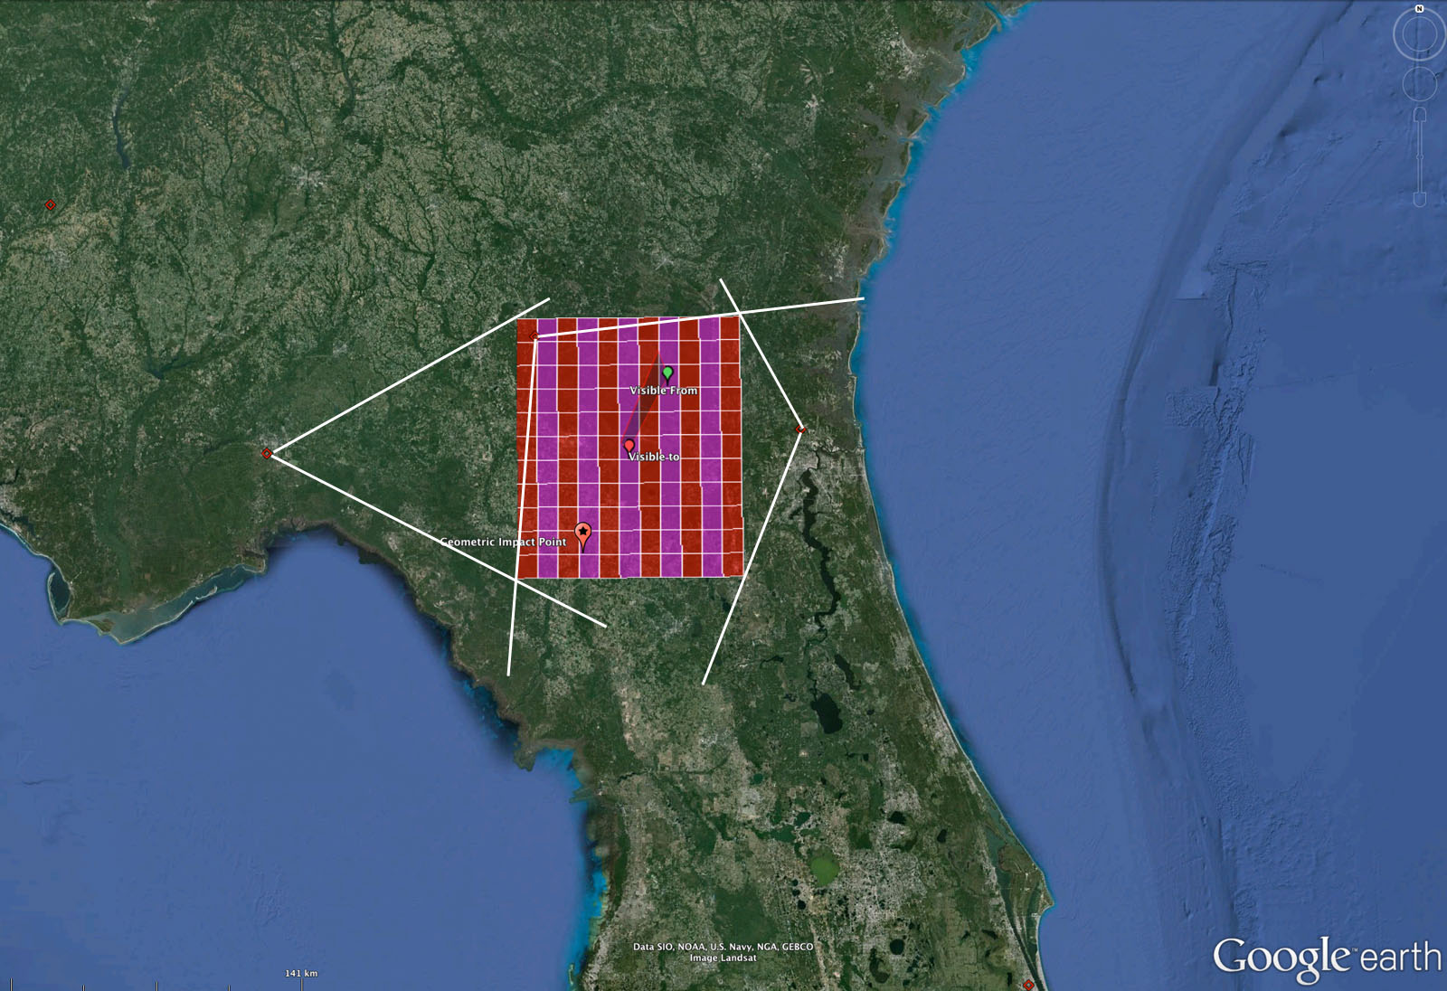
Automated Process – step 3
Calculate bounding box and cut into 10x10km sectors
Extract raw data inside BBOX (file, sweep, ray, gate)
Structure and load data into SQL database

Slide 9
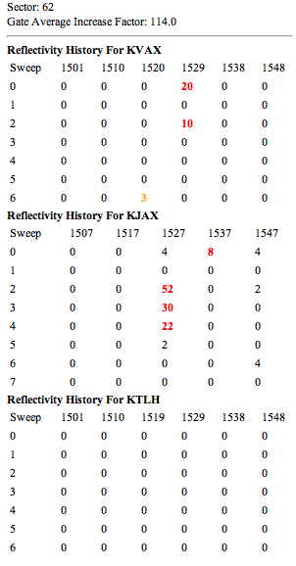
Automated Process – step 4
For each radar, for each sweep, for each time interval -- Determine total reflective gates per sector
On per radar, sweep and sector basis, determine average reflectivity for entire time period
Determine change to reflectivity per station, sweep, sector & time interval with average (avg factor)
Calculate and average additional fields and values per radar, sweep, time & sector (reflectivity +/-, differential reflectivity +/-, velocity +/-, spectrum width, cross correlation ratio, differential phase)

Slide 10
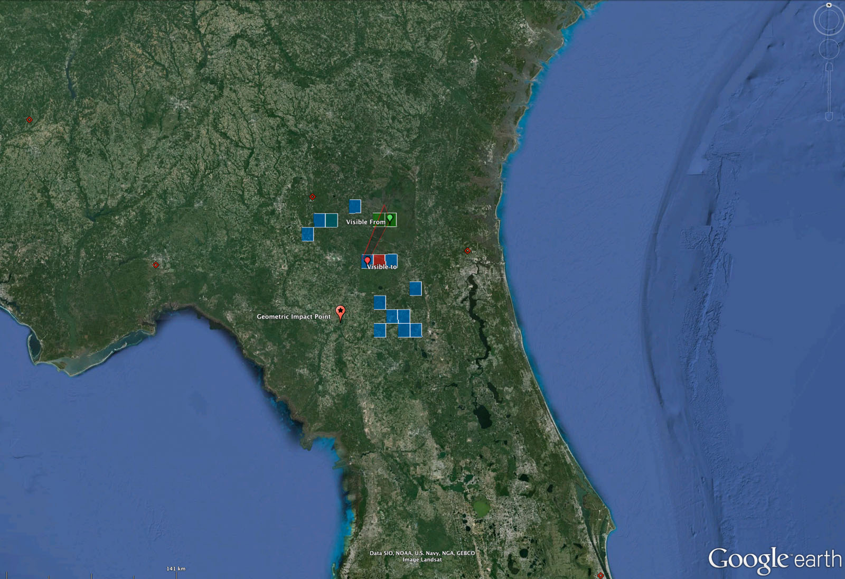
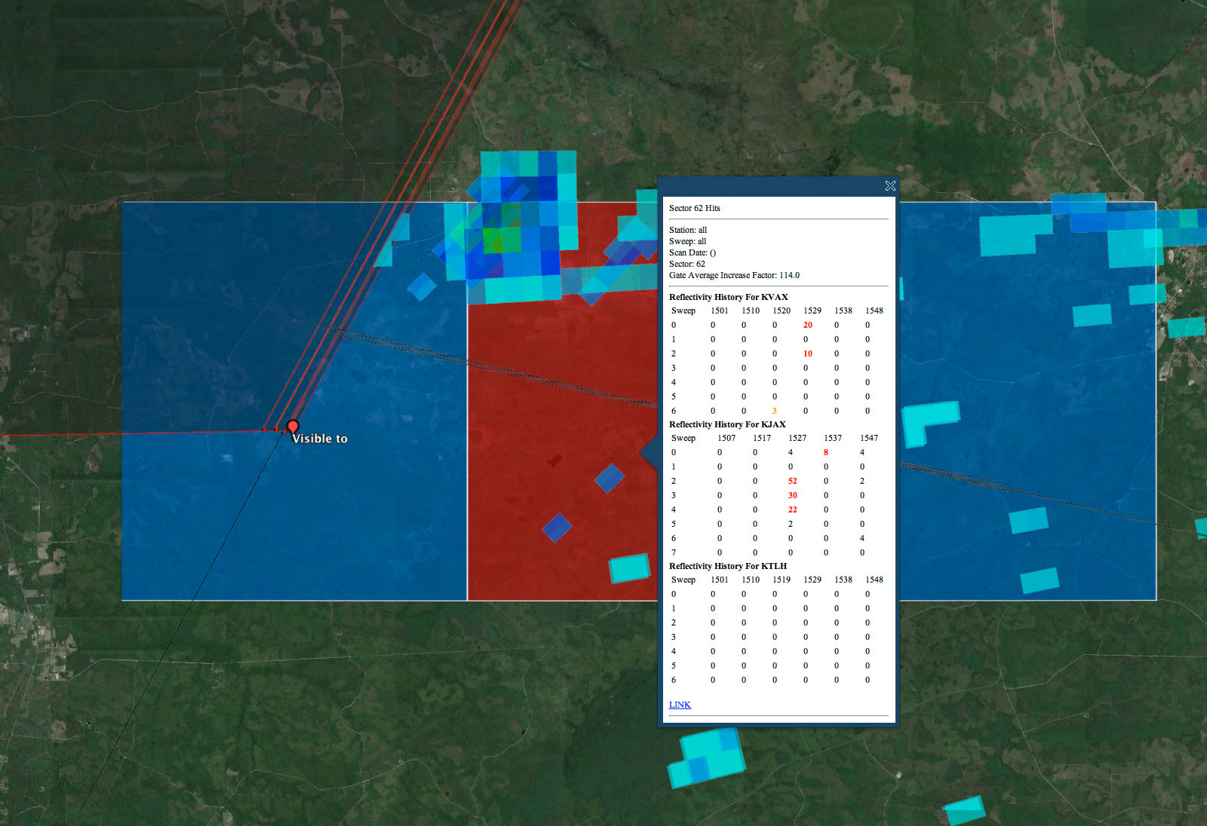
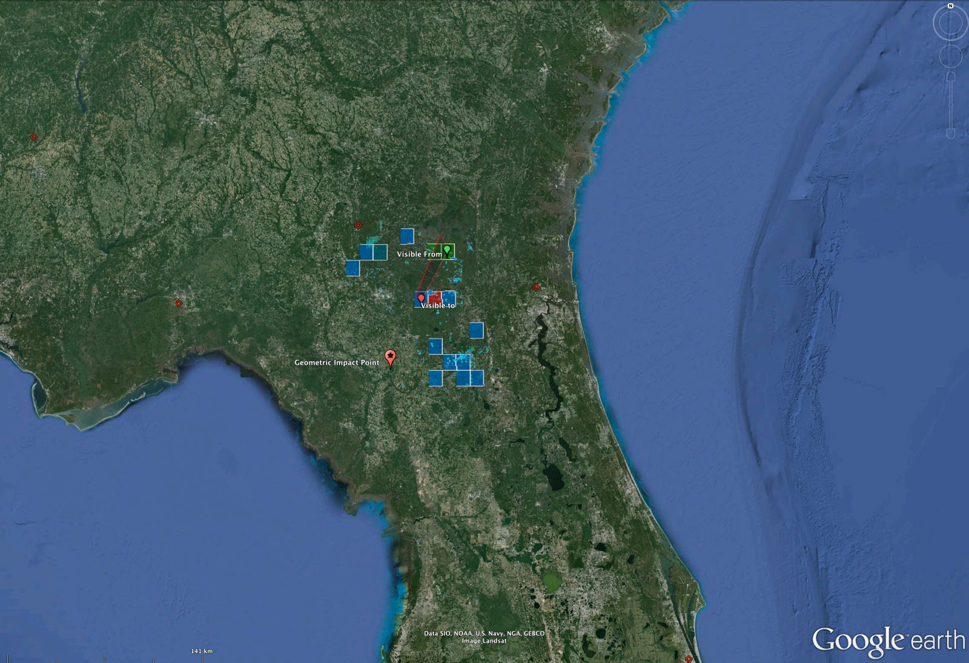
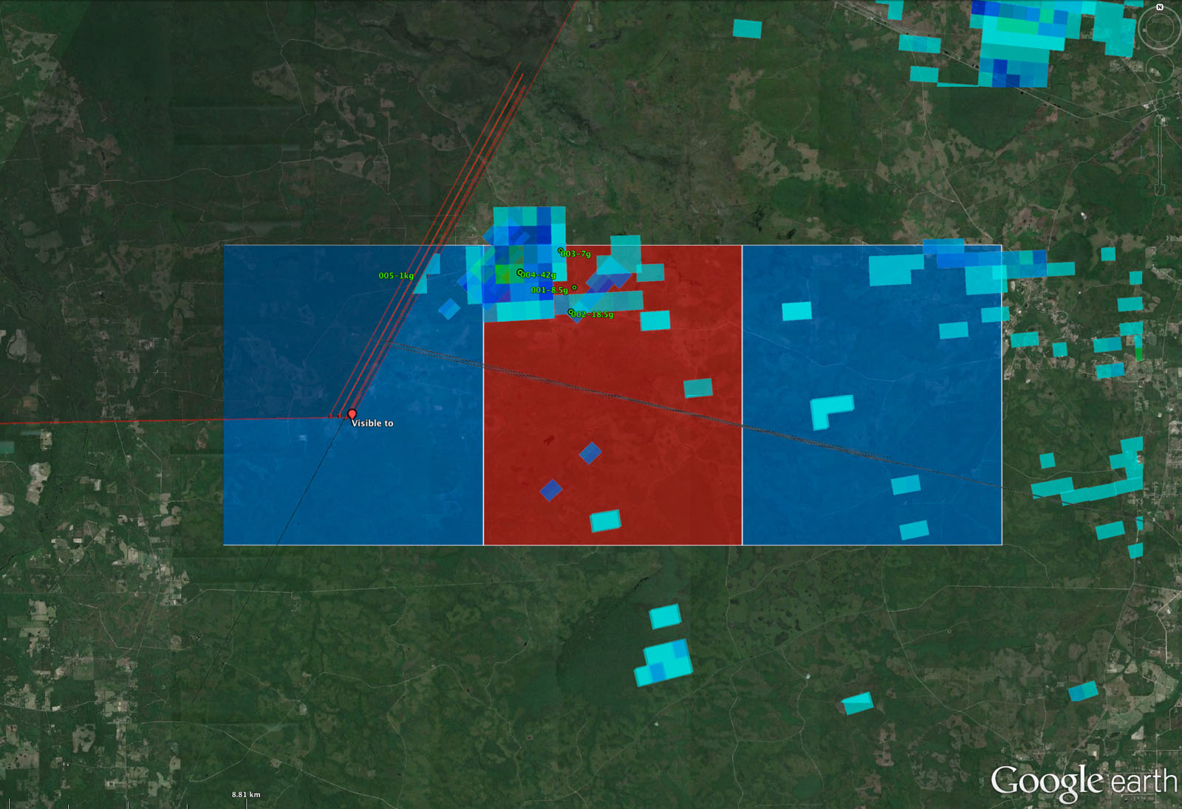
Automated Process – step 5
Calculate detections
Overlay Radar
Make Final KML

Slide 11
Detection Method
Expedited Manual / Visual
Sector Average Factor Detect
Sector Velocity Factor Detect
Signature Detect

Slide 12
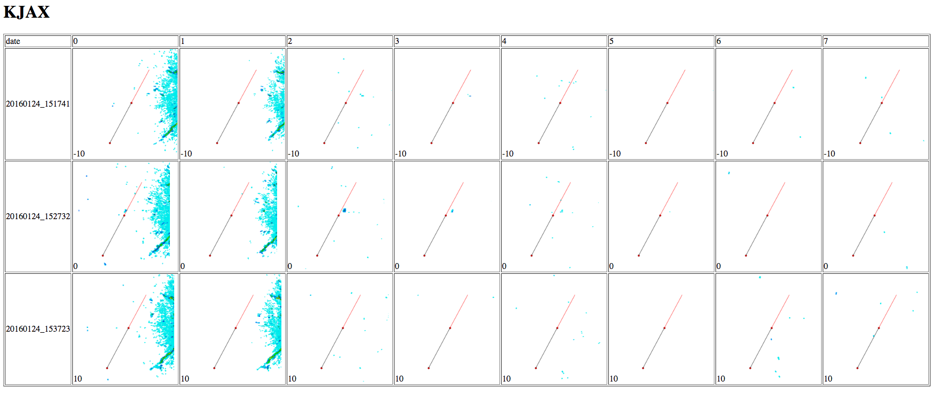
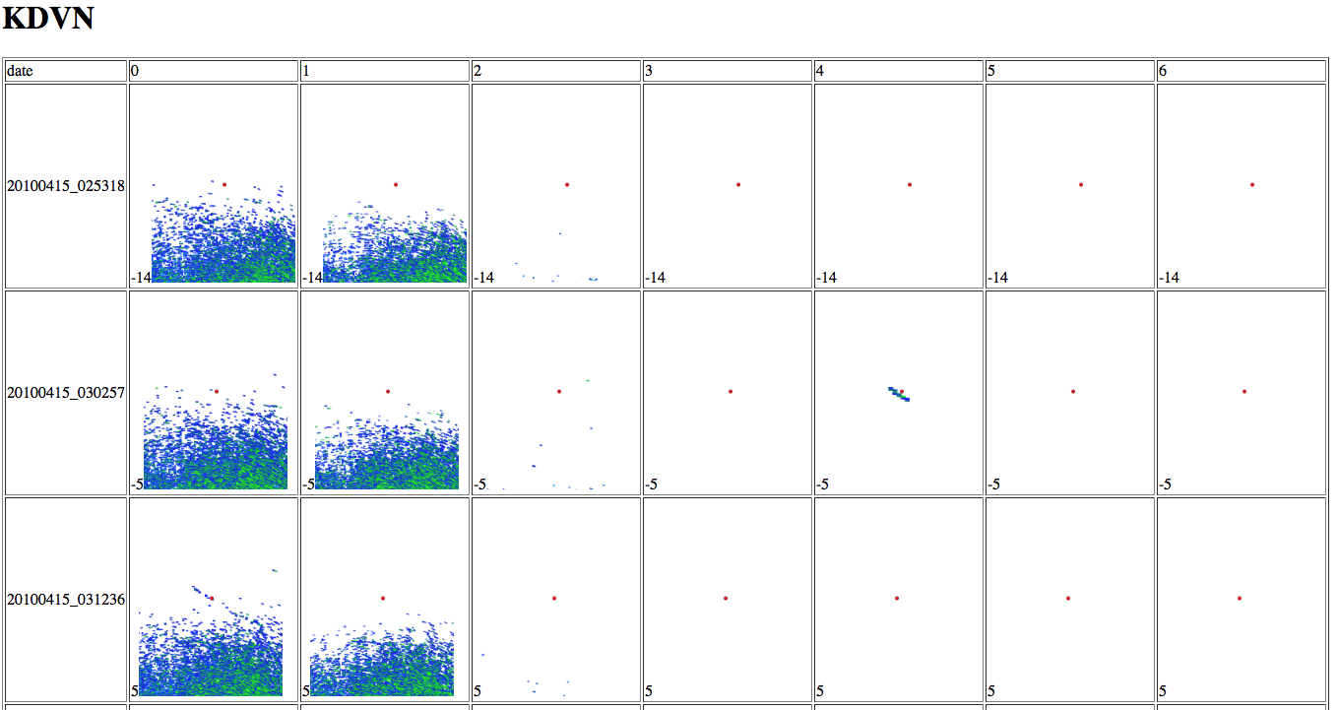
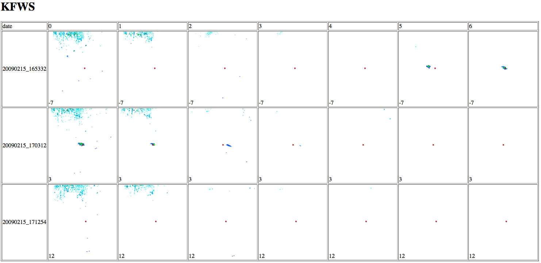
Expedited Visual Detection
Create radar image 200x200km around fireball end point for each radar, sweep and date
Sort images into easily viewable display table
Create KML overlay with folder for each station, sweep, time.
Images are ready to go as soon as researcher starts (saves 1 hour of manual work to review images and create overlays)
DetectionExpedited Image Analysis or non detection can be accomplished in seconds to minutes.

Slide 13
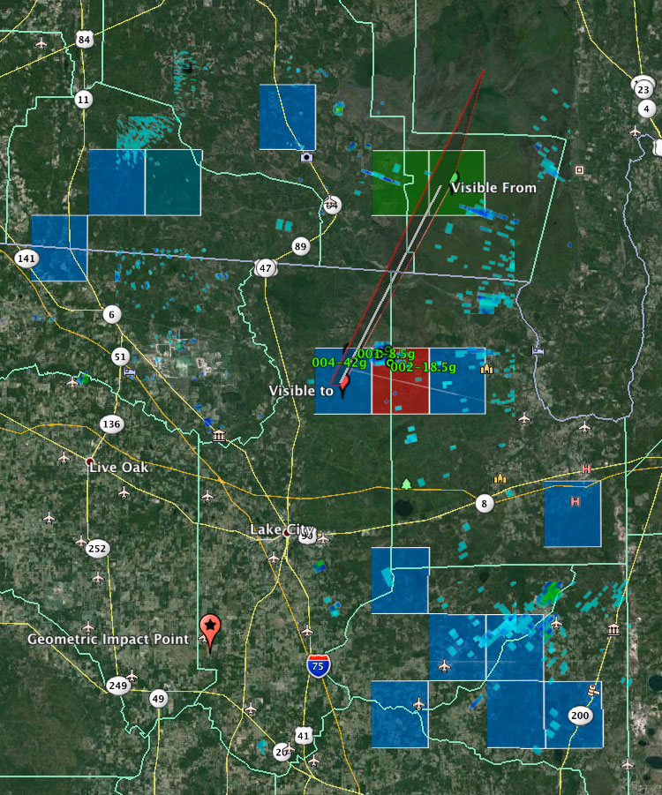
Sector Detector
Select sectors with highest cumulative average change within 20 minutes of fireball (-5 / + 15)
Create color coded KML for highest changers
Create KML Overlay with radar images
Capable of detecting anomalous weather patterns over wide area

Slide 14
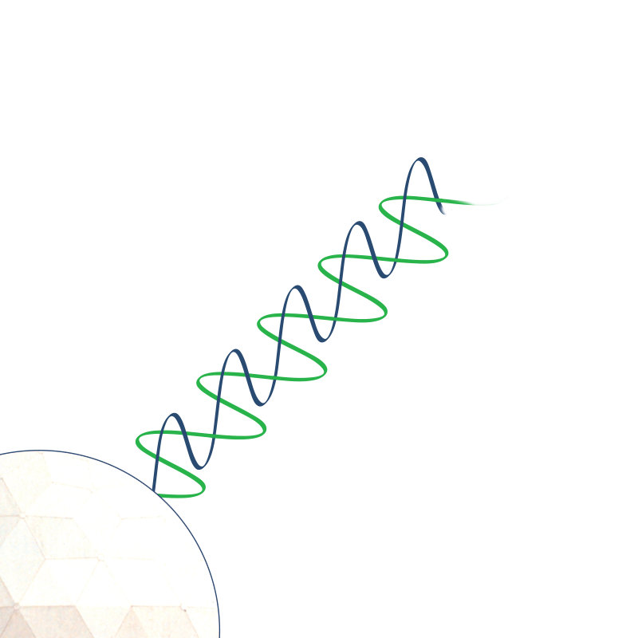
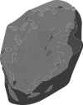
Signature Detection
Snow
Study known falls and find data similarities common with meteorites…
Rain
Meteorites
Hail
+/- Reflectivity
Correlation Coefficient
Altitude
Ray Scan Time
+/- Radial Velocity
Spectrum Width
Differential Phase
Correlation Coefficient
+/- Differential Reflectivity
Compare
Roll Fwd & Back
Density
Average
Distance

Slide 15
End Product
Automatic and near instant detection of newly created meteorite strewn fields and their exact locations delivered to email or text
Image Maps and animations
Histograms / Other Plots
KML Files & Overlays
Overlays Everything Sorted (client tool)
Overlays Detects Only
Sector Detections & Information
Signature Points & Data Pins
Trajectory & Witness Data
Raw Data -> Research
Meteorite Recovery -> More Research

Slide 16
Next Steps
Statistical Comparison of field values common in meteorite returns – reflectivity, differential reflectivity etc.
Detailed analysis of gate data closest to recovered meteorites
Batch run of historic AMS events
Final setup / auto-run automation

Slide 17
Some examples
AMS/NEXRAD Falls
Historic Meteorite Falls
DOD Falls

Slide 19
Thank You Dank Je Merci Danke Gracias Dakujem Hvala Dekuji Dziękuję Ci ありがとうございました
Спасибо
Sağol
Tack
Mulțumesc

