Slide 1
Hypervelocity Impact Measurements and Simulations
Meteoroids 2016
Andrew Nuttall and Sigrid Close
June 6th, 2016

Slide 2
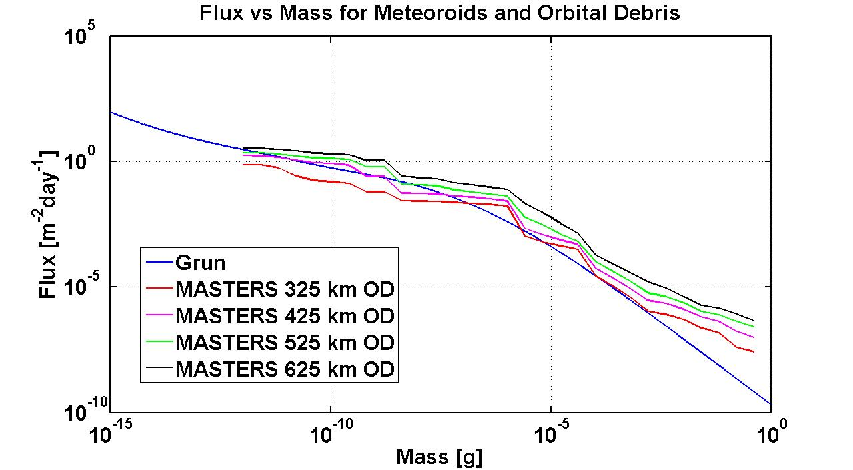
Space Environment
Space Debris
Radiation
Spacecraft Charging
Drag
Meteoroids
  Primary concern from more massive meteoroids is mechanical damage.
  Primary concern from less massive meteoroids is electrical damage.
~ 1 ng-sized particle will impact 1 m² spacecraft once per day
Gurnett, D. and Team, C. 2004. Initial results from the Cassini radio and plasma wave science investigation at Saturn. 35 p. 1895.
2

Slide 3
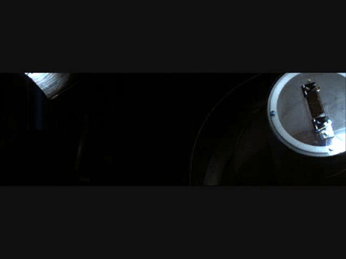
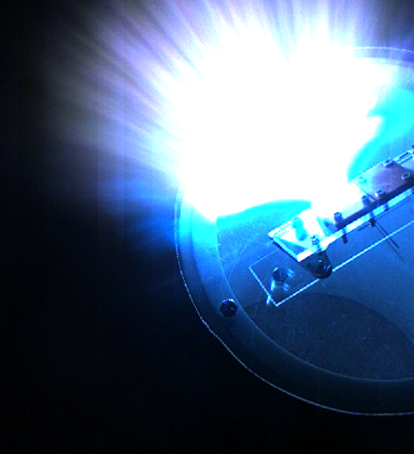
Impact Plasma Generation

Slide 4
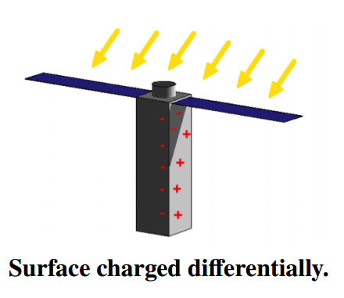
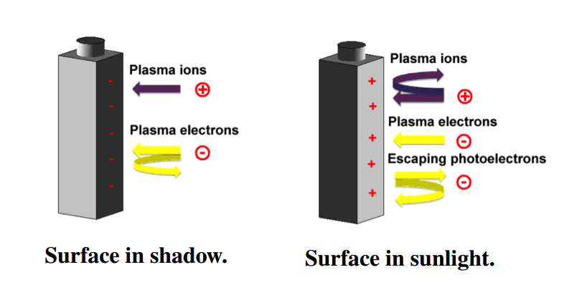
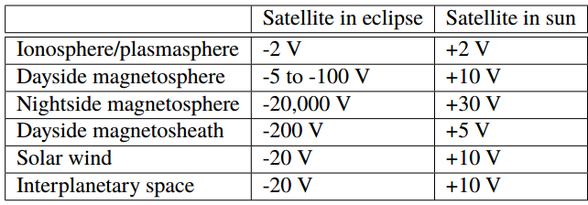
Spacecraft Charging

Slide 5
Research Goal
Spacecraft are routinely impacted by hypervelocity particles with possibility of damage
  Mechanical: “well-known”, larger, rare
  Electrical: “unknown”, smaller, more numerous
    Electrostatic Discharge (ESD)
    Electromagnetic Pulse (EMP)
Goal: characterize plasma and potential radio frequency (RF) emission from hypervelocity impacts to assess possibility of spacecraft damage

Slide 6
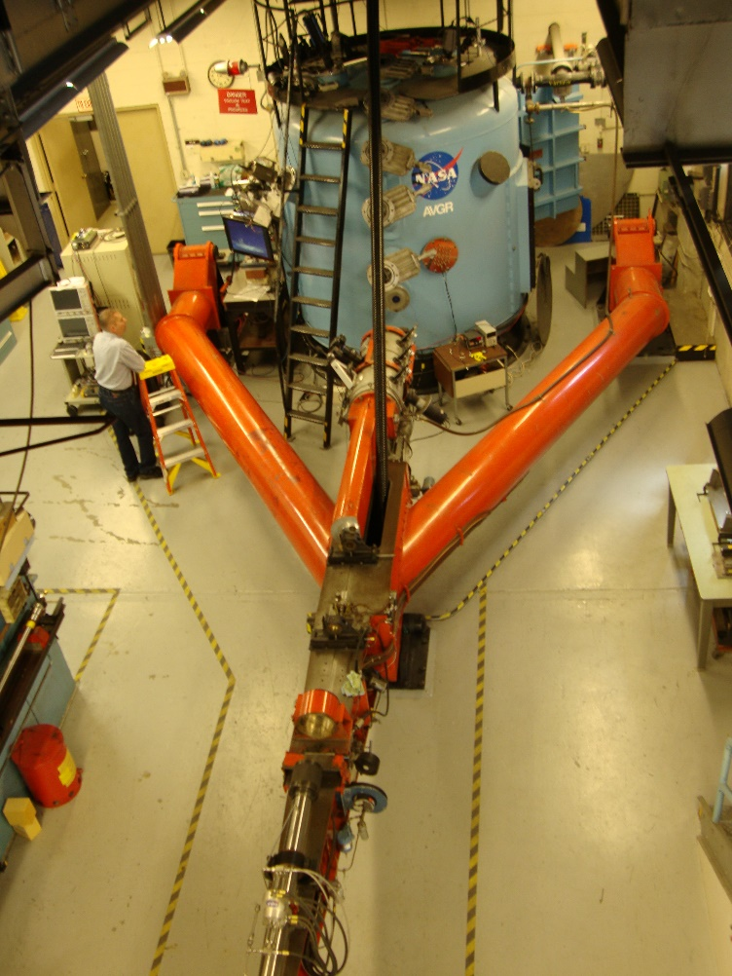
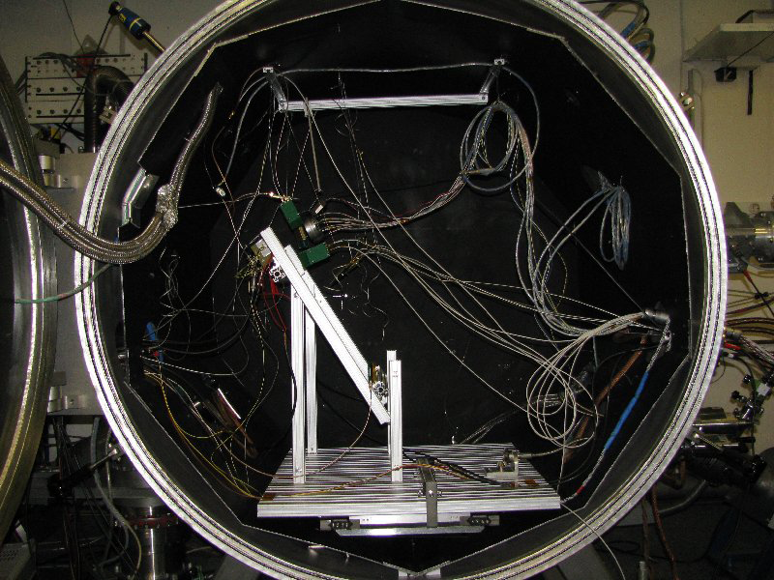
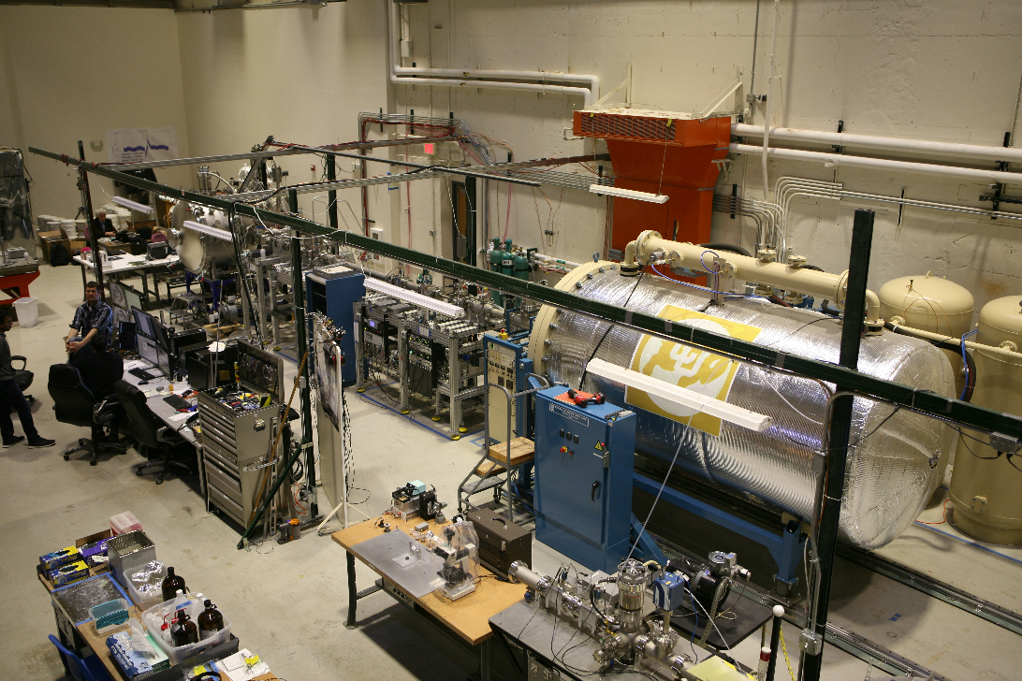
Ground Based Testing
To better understand the impact event series of ground based tests were conducted.
Ames Vertical Gun Range
Max Planck Institute
IMPACT

Slide 7
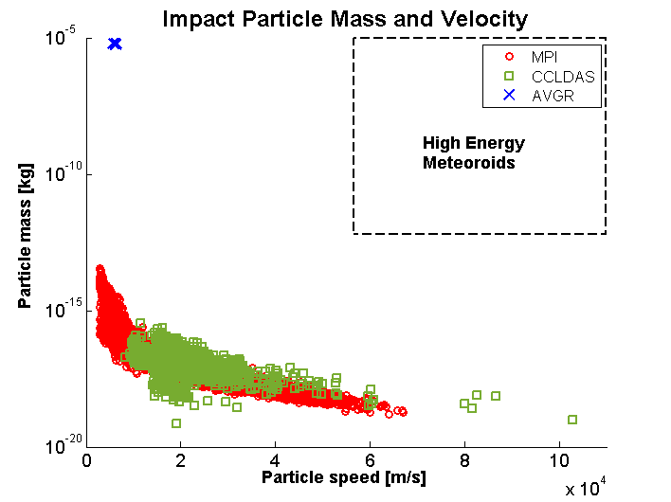
Impactor Configuration and Scaling
Meteoroids can achieve a wide range of masses and velocities
Available Ground Based Tests
Electrostatic – MPI/CCLDAS
  Mass: ~ 10⁻¹⁶ - 10⁻²⁰ kg
  Velocity: 5 – 100 km/s
Light Gas Gun – AVGR
  Mass: ~milligram
  Velocity: ~5 km/s

Slide 8
Multi-Physics Sensor Suite
Simultaneous measurements of multiple key parameters provides strong basis for impact plasma characterization.
Measurements:
Plasma
Optical Emissions
RF Emissions

Slide 9
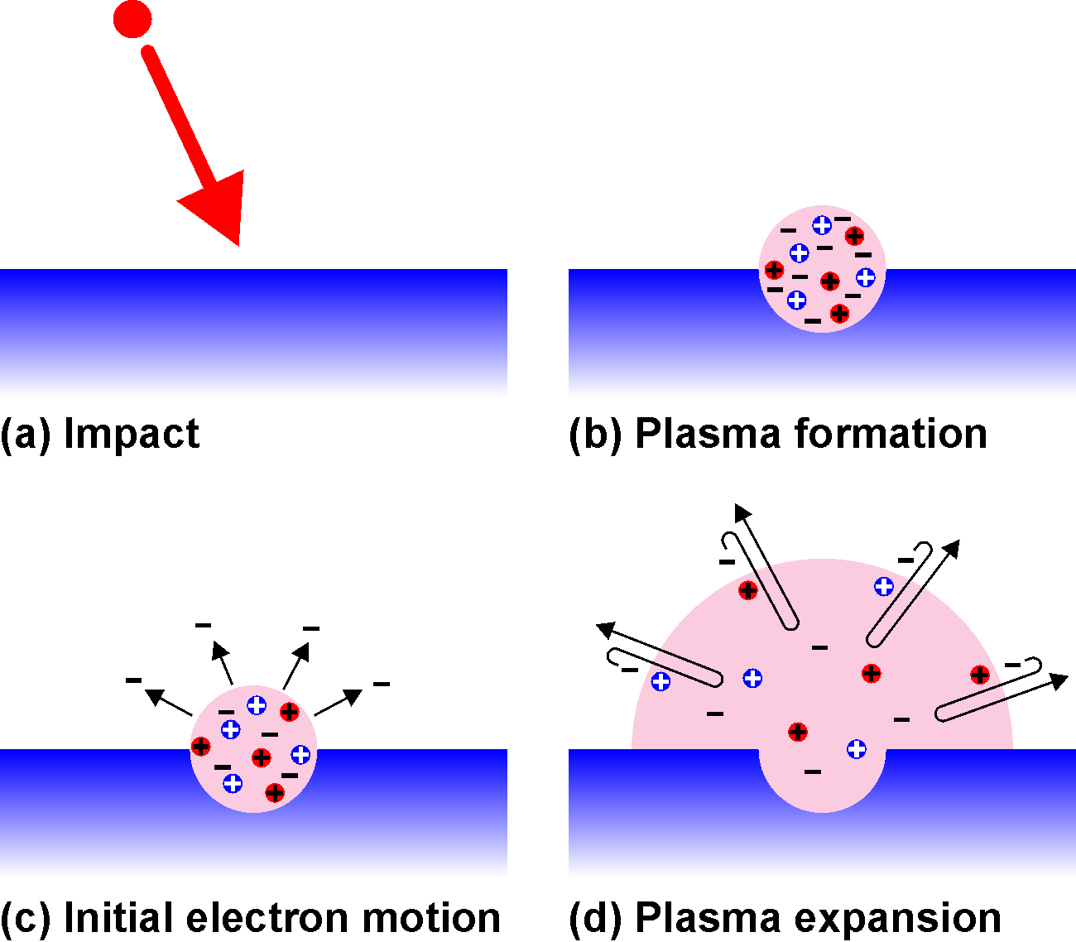
Grounded Satellite Emission Mechanism

Slide 10
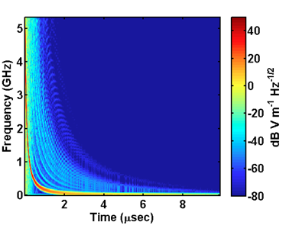
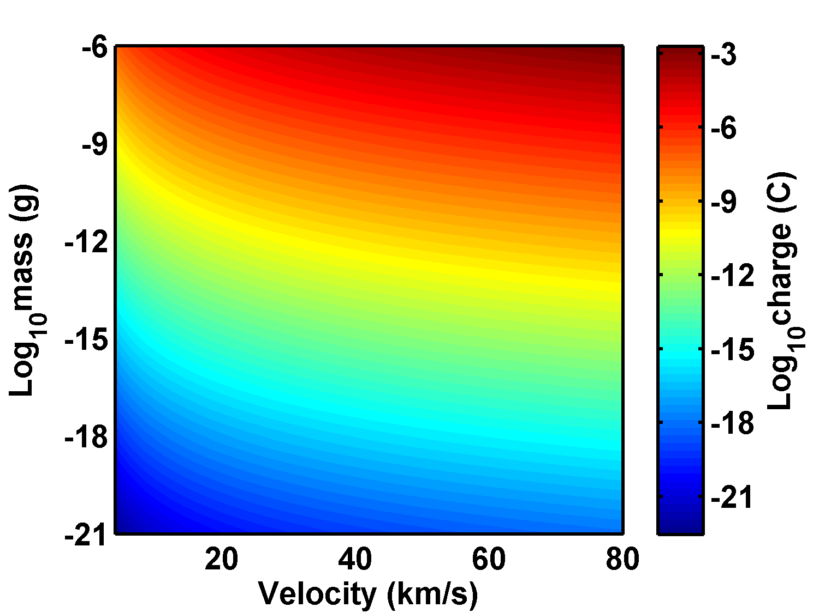

Oscillating Plasma Sheath
$$Q=0.1m{\left(\frac{m}{{10}^{−11}}\right)}^{0.02}{\left(\frac{v}{5}\right)}^{3.48}$$
McBride, N. and McDonnell, J. A. M. (1999). Meteoroid impacts on spacecraft: sporadics, streams, and the 1999 Leonids. Planet. Space Sci., pages 1005-1013

Slide 11
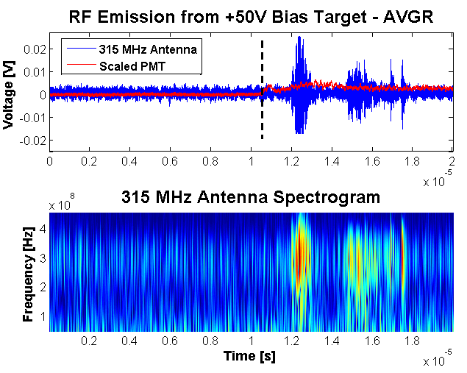
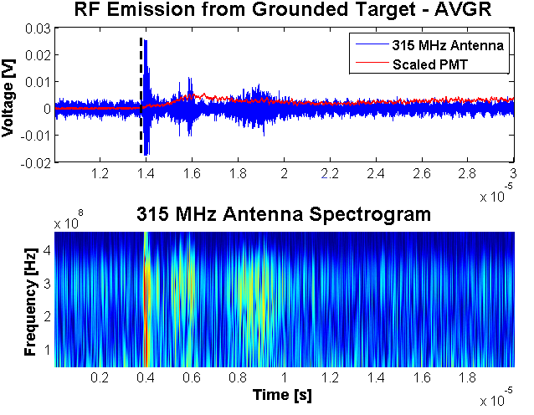
Grounded Target Emissions

Slide 12

RF Emission from Bulk Electron Acceleration
Biased Target
RF emission power scales according to Larmor formula for bulk electron acceleration.
Negatively biased targets accelerate liberated electrons in impact plasma.
RF emissions scale with the amount of impact plasma and target bias.

Slide 13
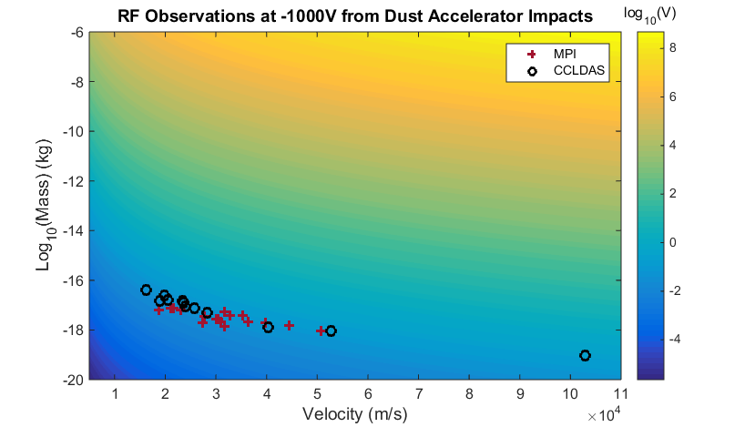


-1000V RF Emission Scaling
Scaling Analysis was conducted and error bounds were generated using a Monte Carlo simulation
Nominal:
Error:
$$RF=Am^{0.71}v^{3.33}$$
$$RF=Am^{0.9±0.6}v^{3.9±1.5}$$

Slide 14
Conclusions
Dust-sized meteoroids can impact satellites on a daily basis.
Spacecraft charging state sets the boundary conditions for hypervelocity impact plasma.
Different RF generation mechanisms are present for different spacecraft charge states.
Experiments were conducted a both light gas gun and electrostatic accelerator facilities.
RF emissions were observed with the potential to scale to disruptive levels.

Slide 15

Questions

Slide 16
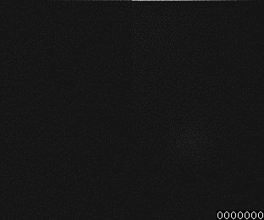
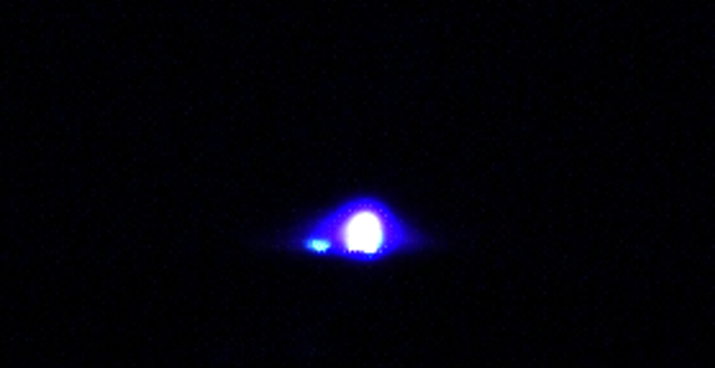
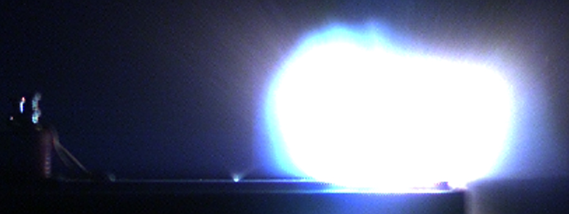
Arc Discharge

Slide 17
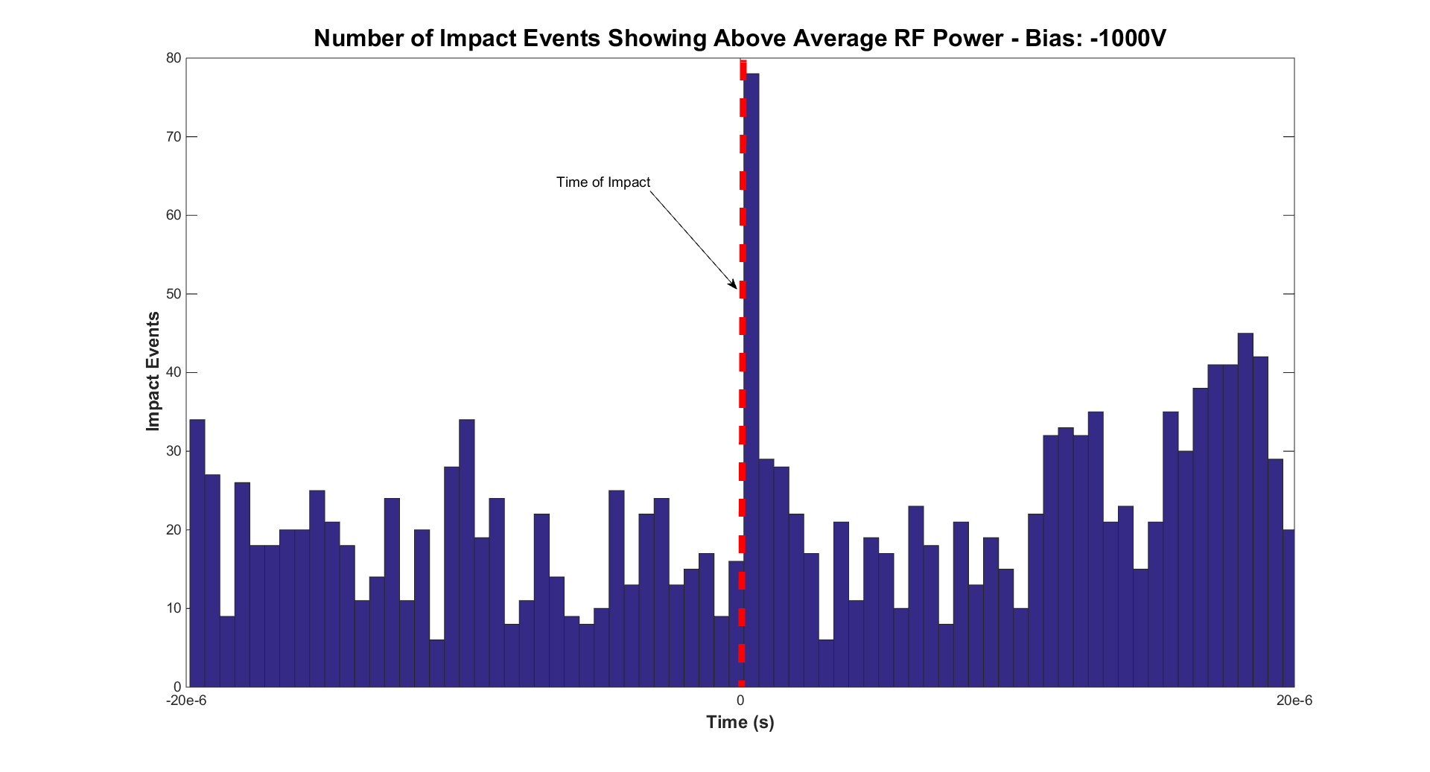
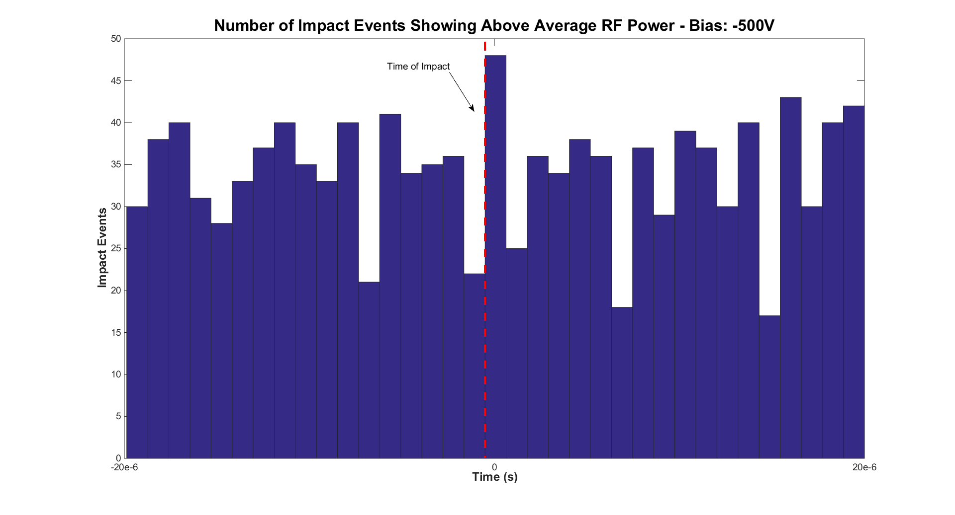
Effects of Bias Potential
Bias -1 kV
Bias -0.5 kV

