Slide 1
The Toroidal Sporadic Source: Understanding Temporal Variations
Pokorny p., Brown P. G., Moorhead A. V., Wiegert P.
Meteoroids 2016, 06-10 June

Slide 2
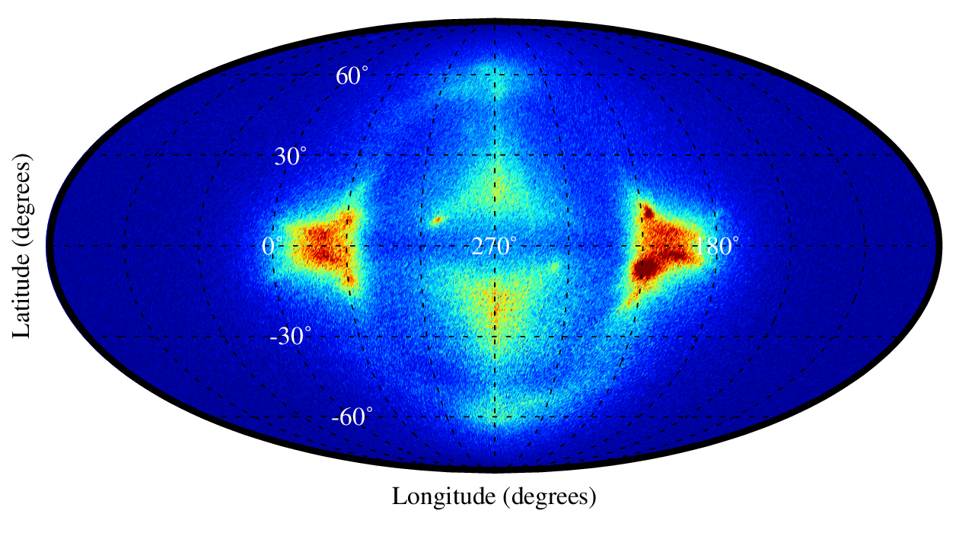
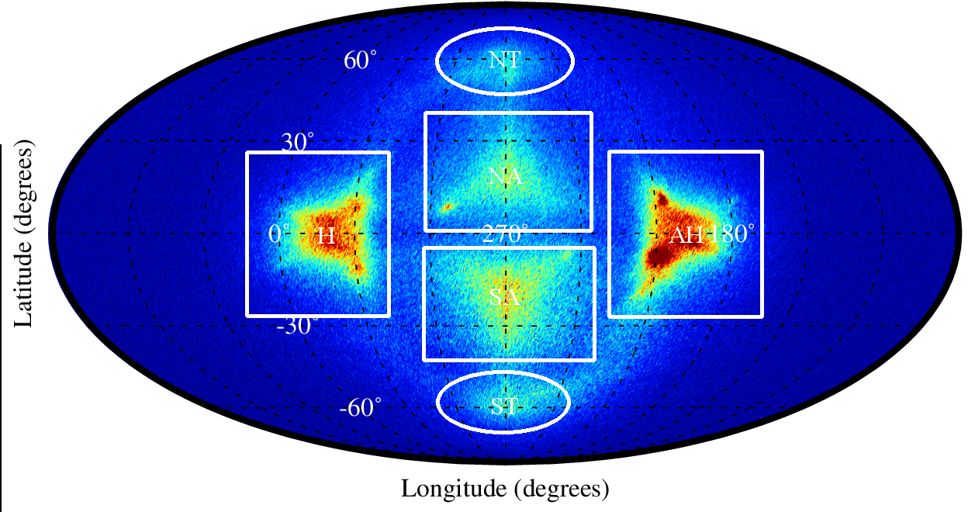
Meteoroid Environment at the Earth

Slide 3
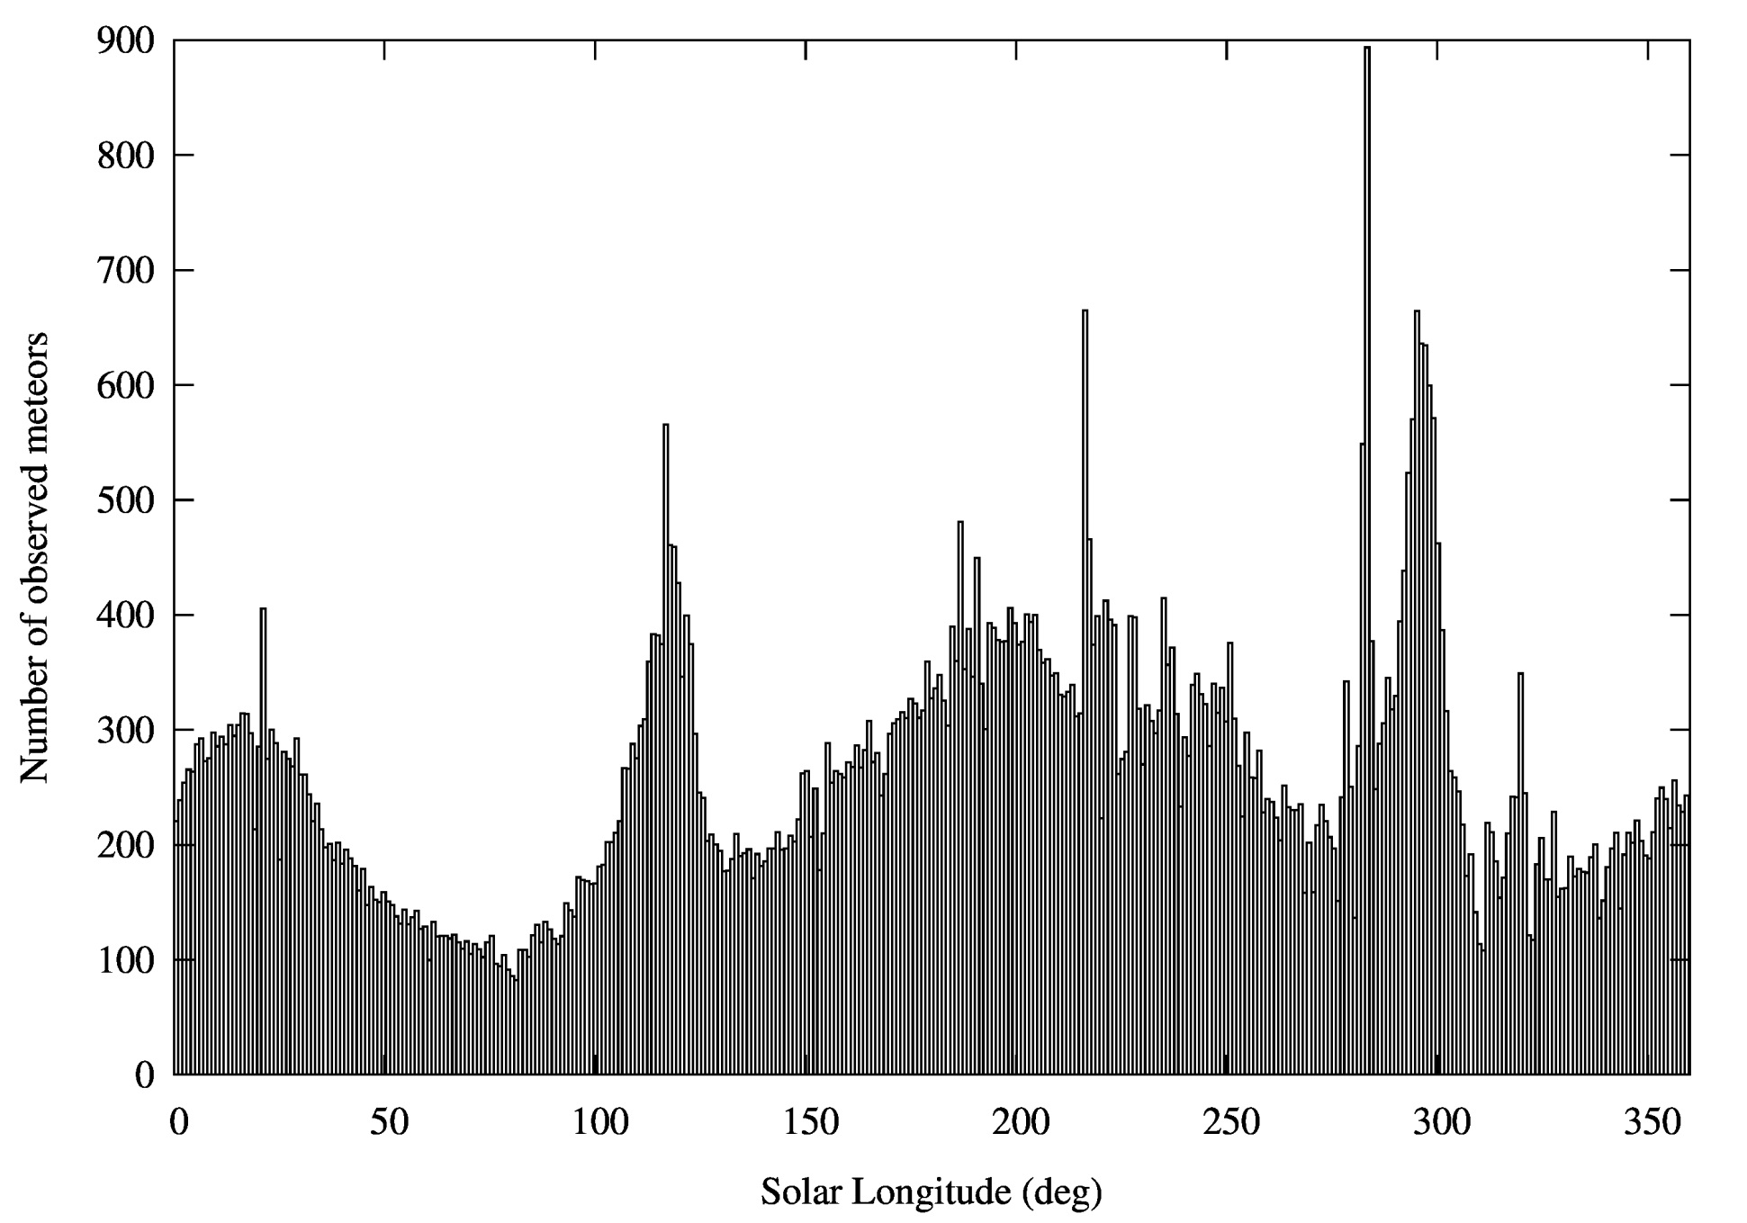
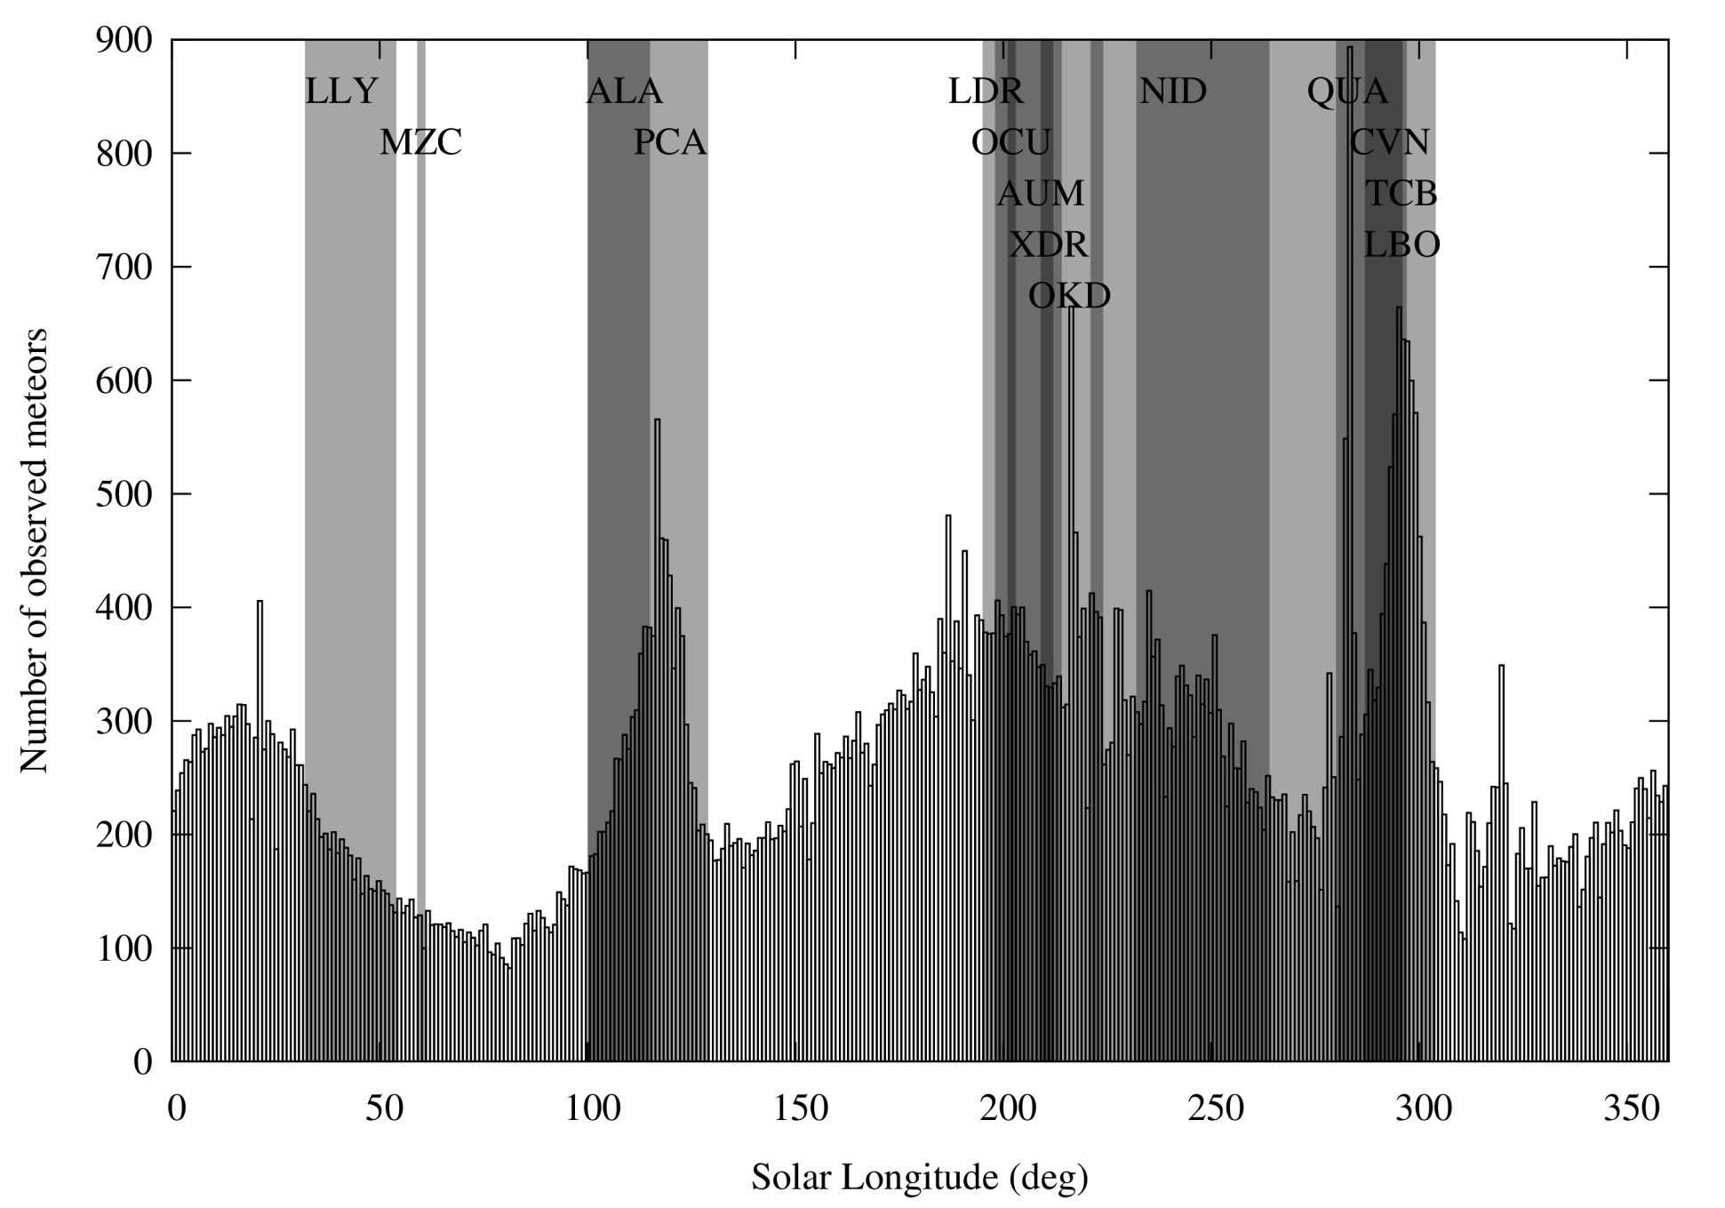
North Toroidal Source - cMOR

Slide 4
North Toroidal Showers
Name | ID | Solar. Lon | V_{g} [km/s] | Parent Body
Lambda Lyrids | LLY | 41.0 | 33.4
May Zeta Cyginids | MZC | 60.0 | 29.2
Alpha Lacertids | ALA | 105.5 | 38.3
Psi Cassiopeiids | PCY | 117.5 | 44.0
Lambda Draconids | LDR | 196.0 | 37.5
October Ursae Majorids | OCU | 204.7 | 52.0
Alpha Ursae Majorids | AUM | 209.0 | 35.6
Xi Draconids | XDR | 210.8 | 35.8
October Kappa Draconids | OKD | 216.0 | 37.3
November I Draconids | NID | 241.0 | 43.0 | 2009 WN25
Quadrantids | QUA | 283.5 | 41.7 | 2003 EH1/96P
Canum Venaticids | CVN | 293.0 | 52.6
Lambda Bootids | LBO | 295.5 | 41.0
Theta Coronae Borealids | TCB | 296.0 | 37.7
?

Slide 5

North toroidal source
The sporadic background

Slide 6
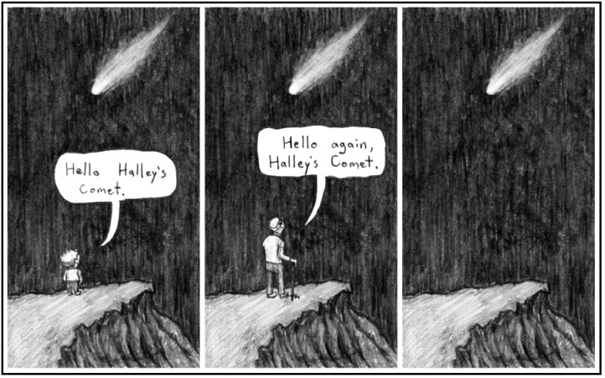
North Toroidal Source
The sporadic background – Halley-type comets (Pokorny et al. 2014)

Slide 7

North Toroidal Source
The sporadic background – Halley-type comets (Pokorny et al. 2013)
The vast majority of observed showers – unknown parent body

Slide 8
North Toroidal Source
The sporadic background – Halley-type comets (Pokorny et al. 2013)
The vast majority of observed showers – unknown parent body
Highly inclined showers – Kozai oscillations

Slide 9
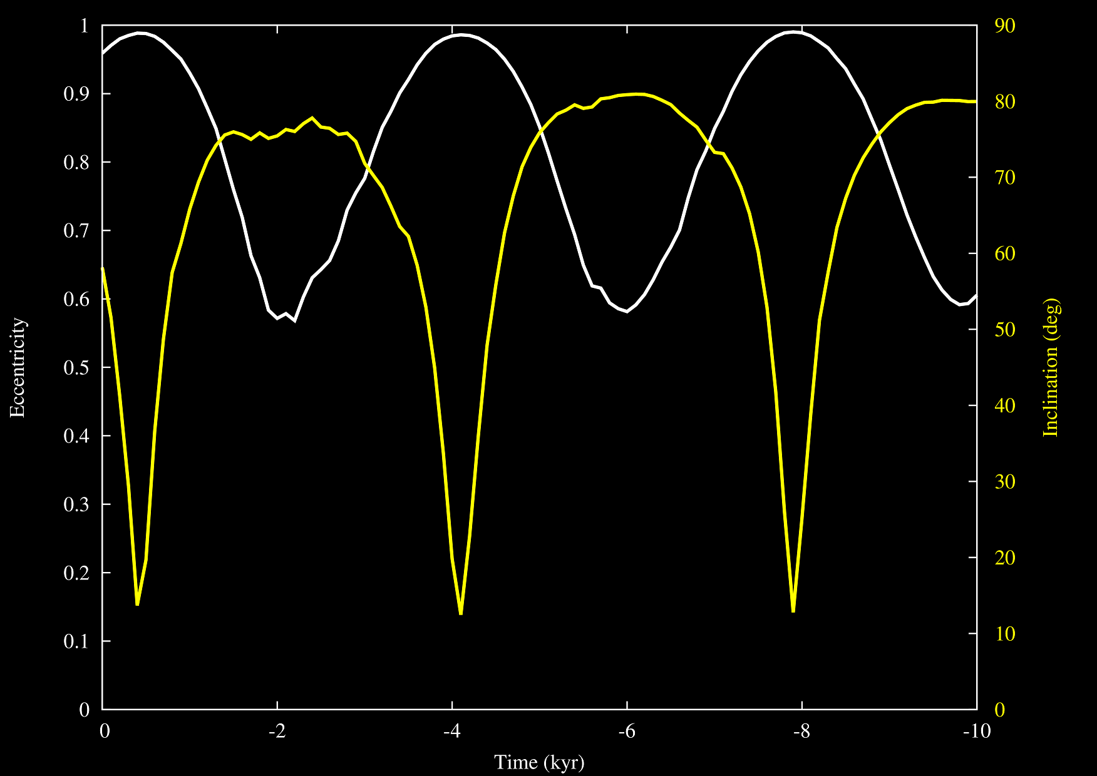
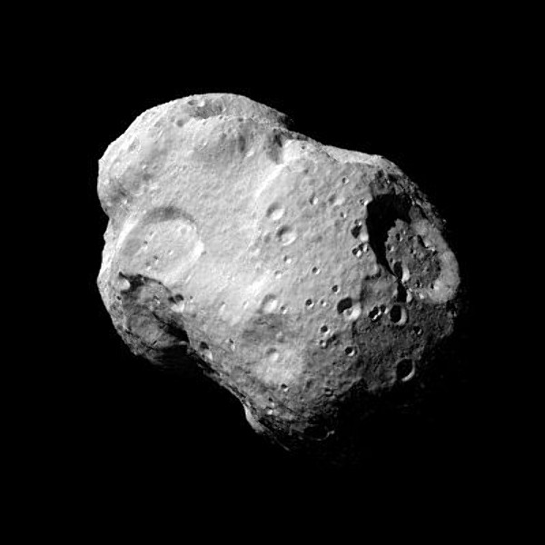

Kozai Oscillations
$I_{crit}\sim 39,2°$ $c=\sqrt{1−e^{2}} cos I$

Slide 10
The Solution
Idea: Use these oscillations as a constraint for the parent body population

Slide 11

The Solution
Idea: Use these oscillations as a constraint for the parent body population
Result: 169 potential parent bodies (out of $∼$ 600,000 bodies)

Slide 12
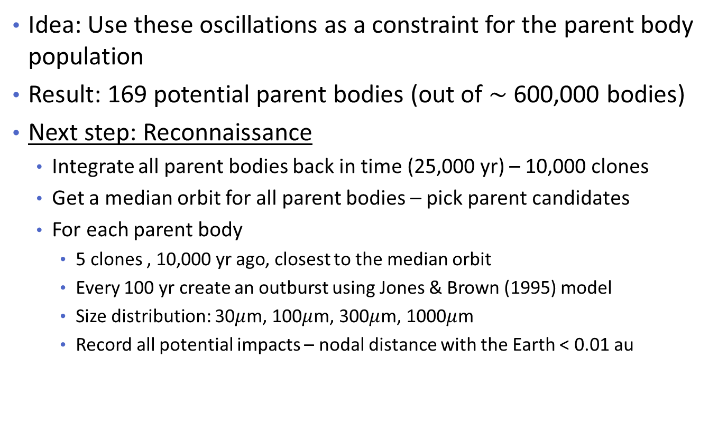
The Solution
Idea: Use these oscillations as a constraint for the parent body population
Result: 169 potential parent bodies (out of $∼$ 600,000 bodies)
Next step: Reconnaissance
  Integrate all parent bodies back in time (25,000 yr) – 10,000 clones
  Get a median orbit for all parent bodies – pick parent candidates
  For each parent body
    5 clones , 10,000 yr ago, closest to the median orbit
    Every 100 yr create an outburst using Jones & Brown (1995) model
    Size distribution: 30$μ$m, 100$μ$m, 300$μ$m, 1000$μ$m
    Record all potential impacts – nodal distance with the Earth < 0.01 au

Slide 13
The Solution
Idea: Use these oscillations as a constraint for the parent body population
Result: 169 potential parent bodies (out of $∼$ 600,000 bodies)
Next step: Reconnaissance
  Integrate all parent bodies back in time (25,000 yr) – 10,000 clones
  Get a median orbit for all parent bodies – pick parent candidates
  For each parent body
    5 clones , 10,000 yr ago, closest to the median orbit
    Every 100 yr create an outburst using Jones & Brown (1995) model
    Size distribution: 30$μ$m, 100$μ$m, 300$μ$m, 1000$μ$m
    Record all potential impacts – nodal distance with the Earth < 0.01 au

Slide 14
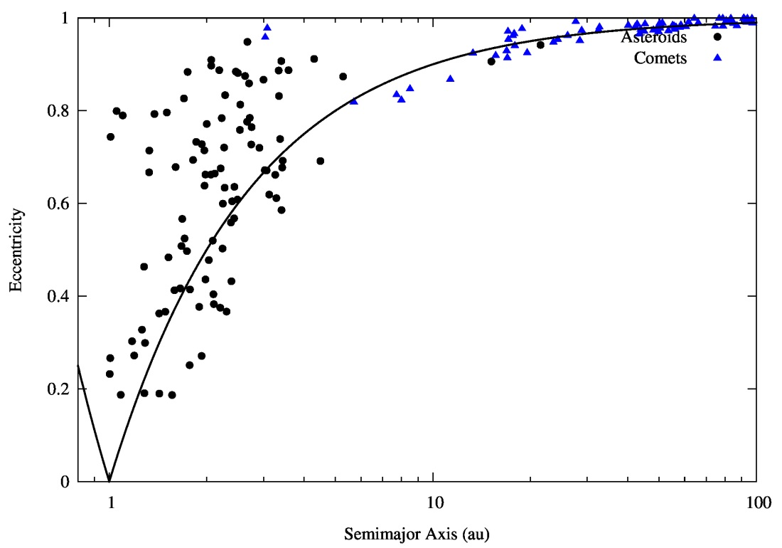
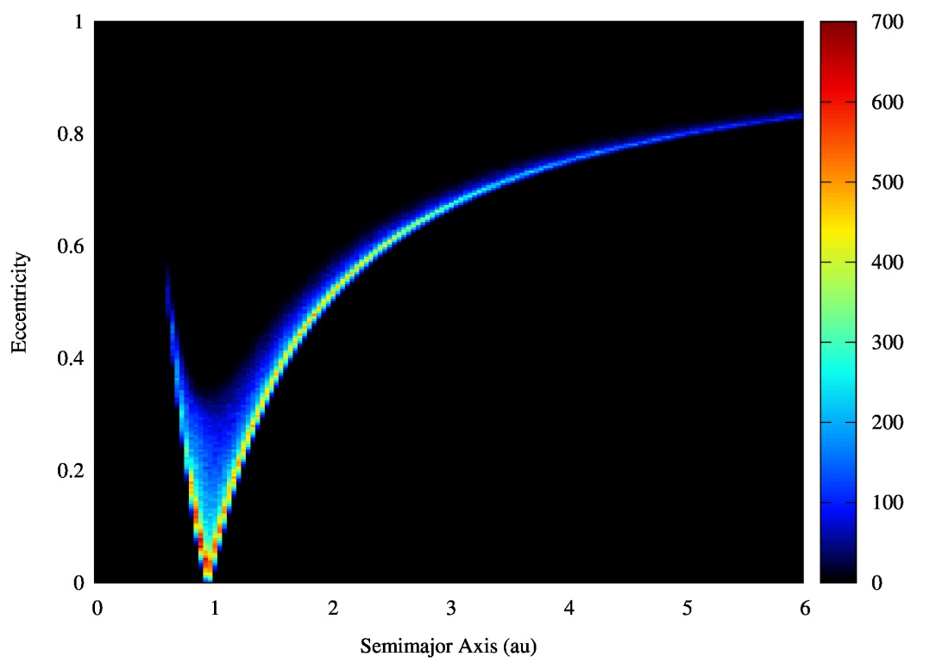
North toroidal source - more
Parent body candidates
Radar meteors

Slide 15
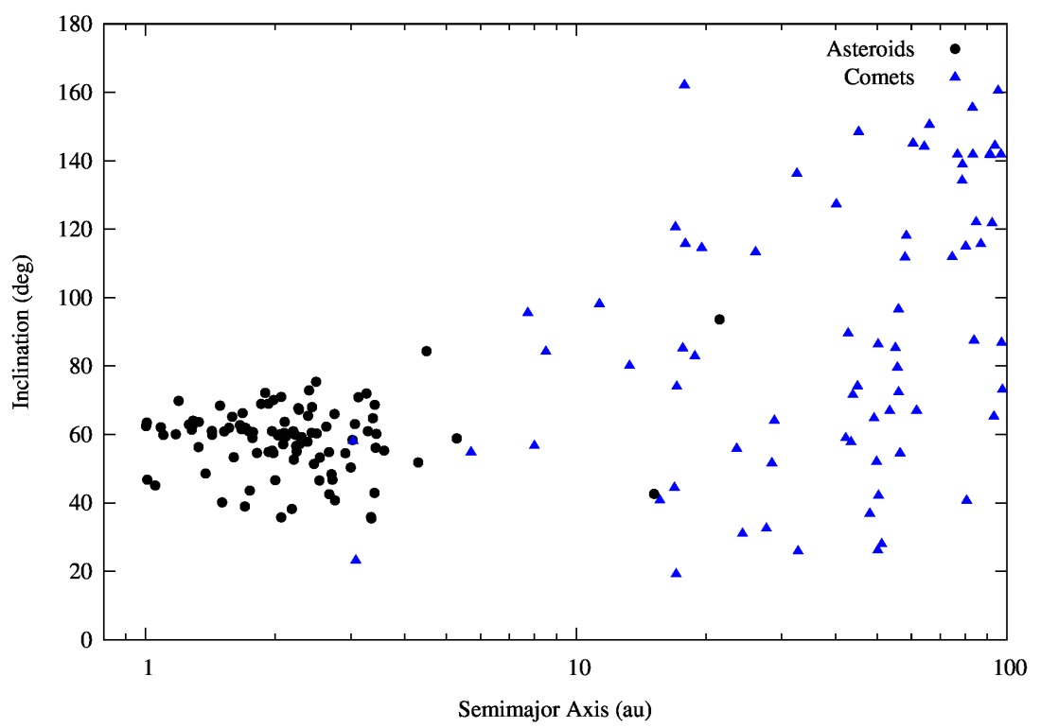
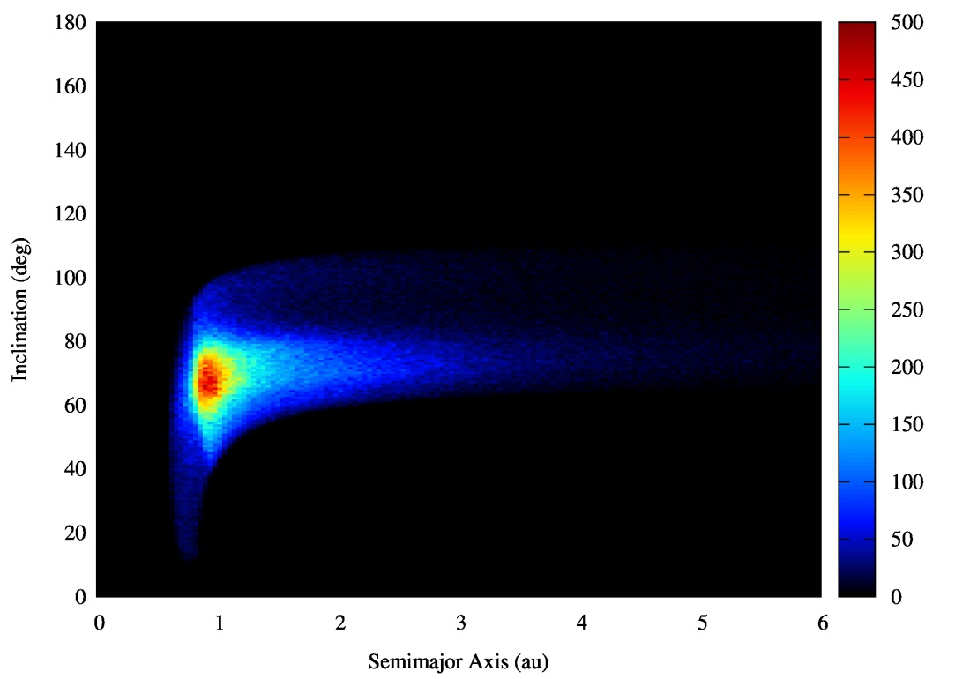
North toroidal source - more
Parent body candidates
Radar meteors

Slide 16
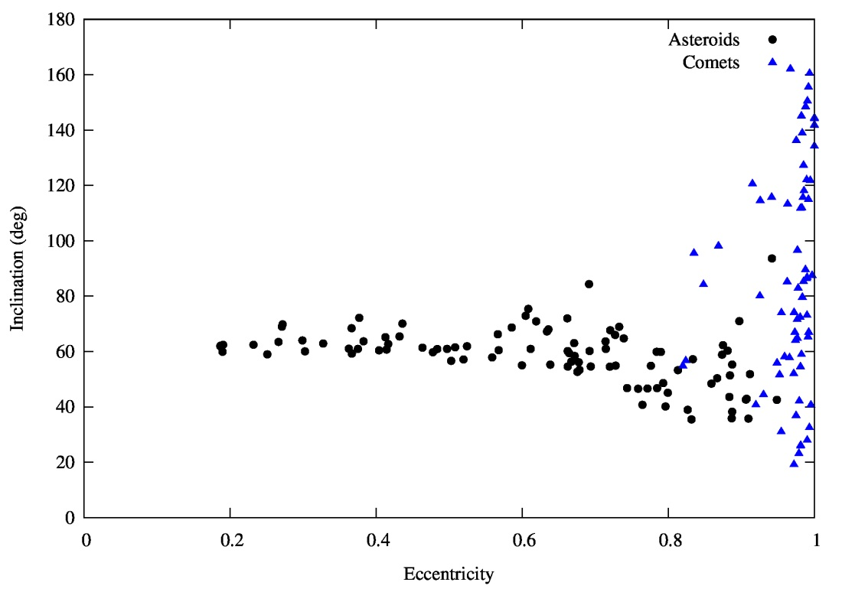
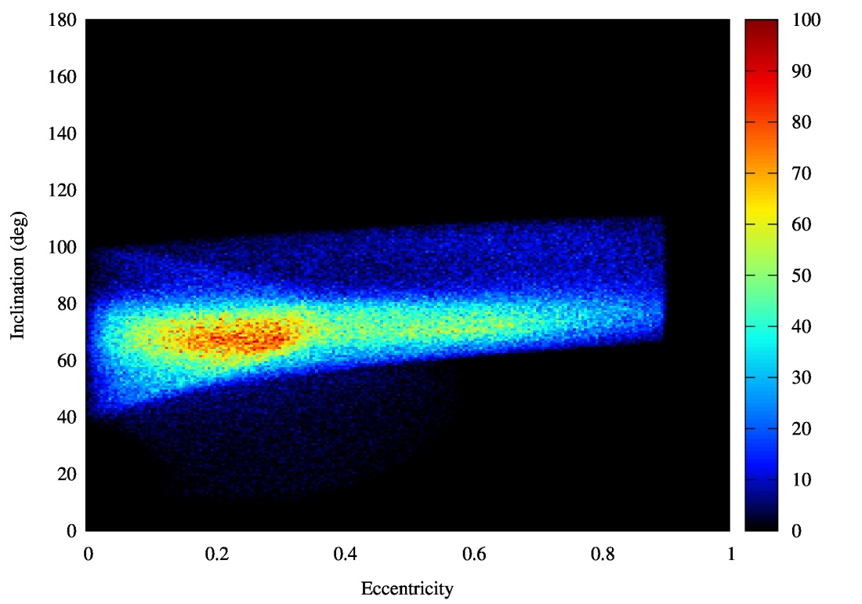
North toroidal source - more
Parent body candidates
Radar meteors

Slide 17
Shower association
All meteors closer than 0.01 au during 1975 – 2025

Slide 18
Shower association
All meteors closer than 0.01 au during 1975 – 2025
Using their orbital elements we get the solar longitude, the ecliptic longitude and latitude, and the geocentric velocity

Slide 19
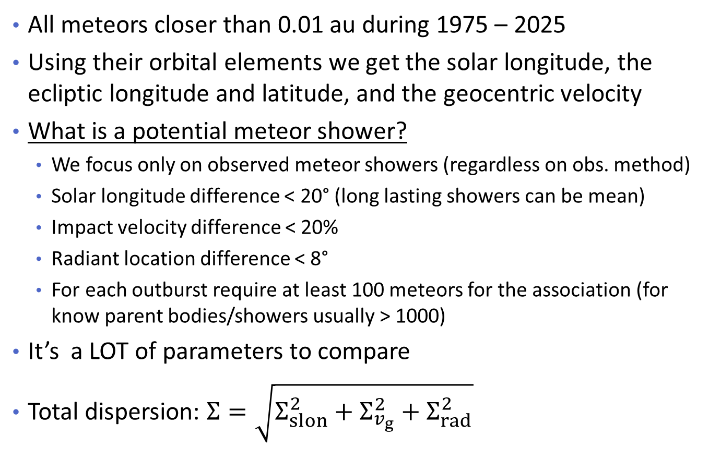
Shower association
All meteors closer than 0.01 au during 1975 – 2025
Using their orbital elements we get the solar longitude, the ecliptic longitude and latitude, and the geocentric velocity
What is a potential meteor shower?
  We focus only on observed meteor showers (regardless on obs. method)
  Solar longitude difference < 20° (long lasting showers can be mean)
  Impact velocity difference < 20%
  Radiant location difference < 8°
  For each outburst require at least 100 meteors for the association (for know parent bodies/showers usually > 1000)
It’s a LOT of parameters to compare
Total dispersion: $Σ=\sqrt{Σ_{slon}^{2}+Σ_{v_{g}}^{2}+Σ_{rad}^{2}}$

Slide 20
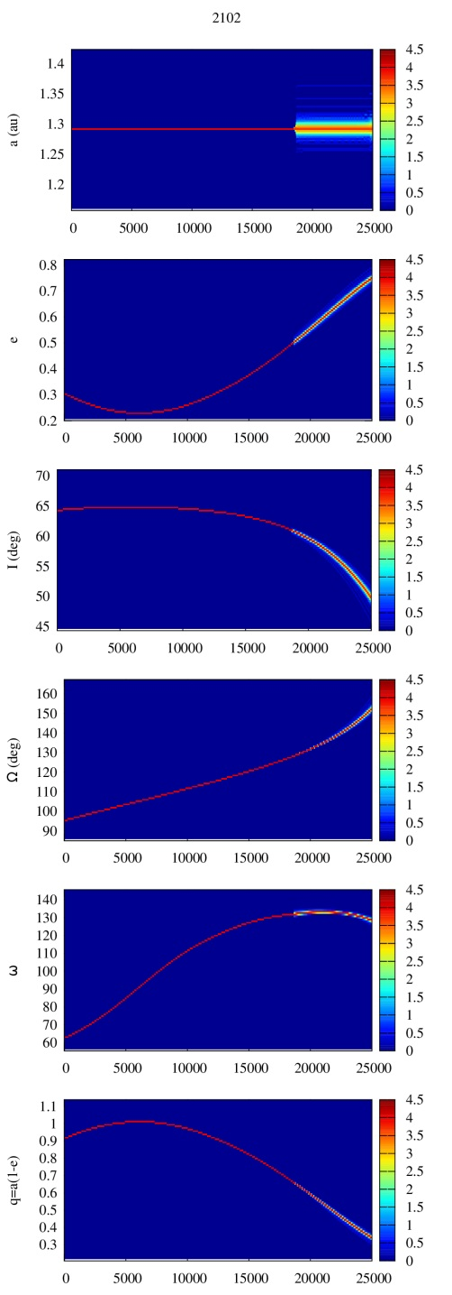

(2102) Tantalus (1975 YA)
NEO, very close approaches to the Earth ~ 0.05 AU, $H={16}^{m}$
Element | Value | Uncertainty (1σ) | Units
e | .29915 | 6.2315e-08
a | 1.2900 | 1.0412e-09 | AU
q | .90411 | 8.013e-08 | AU
i | 64.006 | 1.6762e-05 | deg
node | 94.370 | 6.8383e-06 | deg
peri | 61.552 | 1.7615e-05 | deg

Slide 21
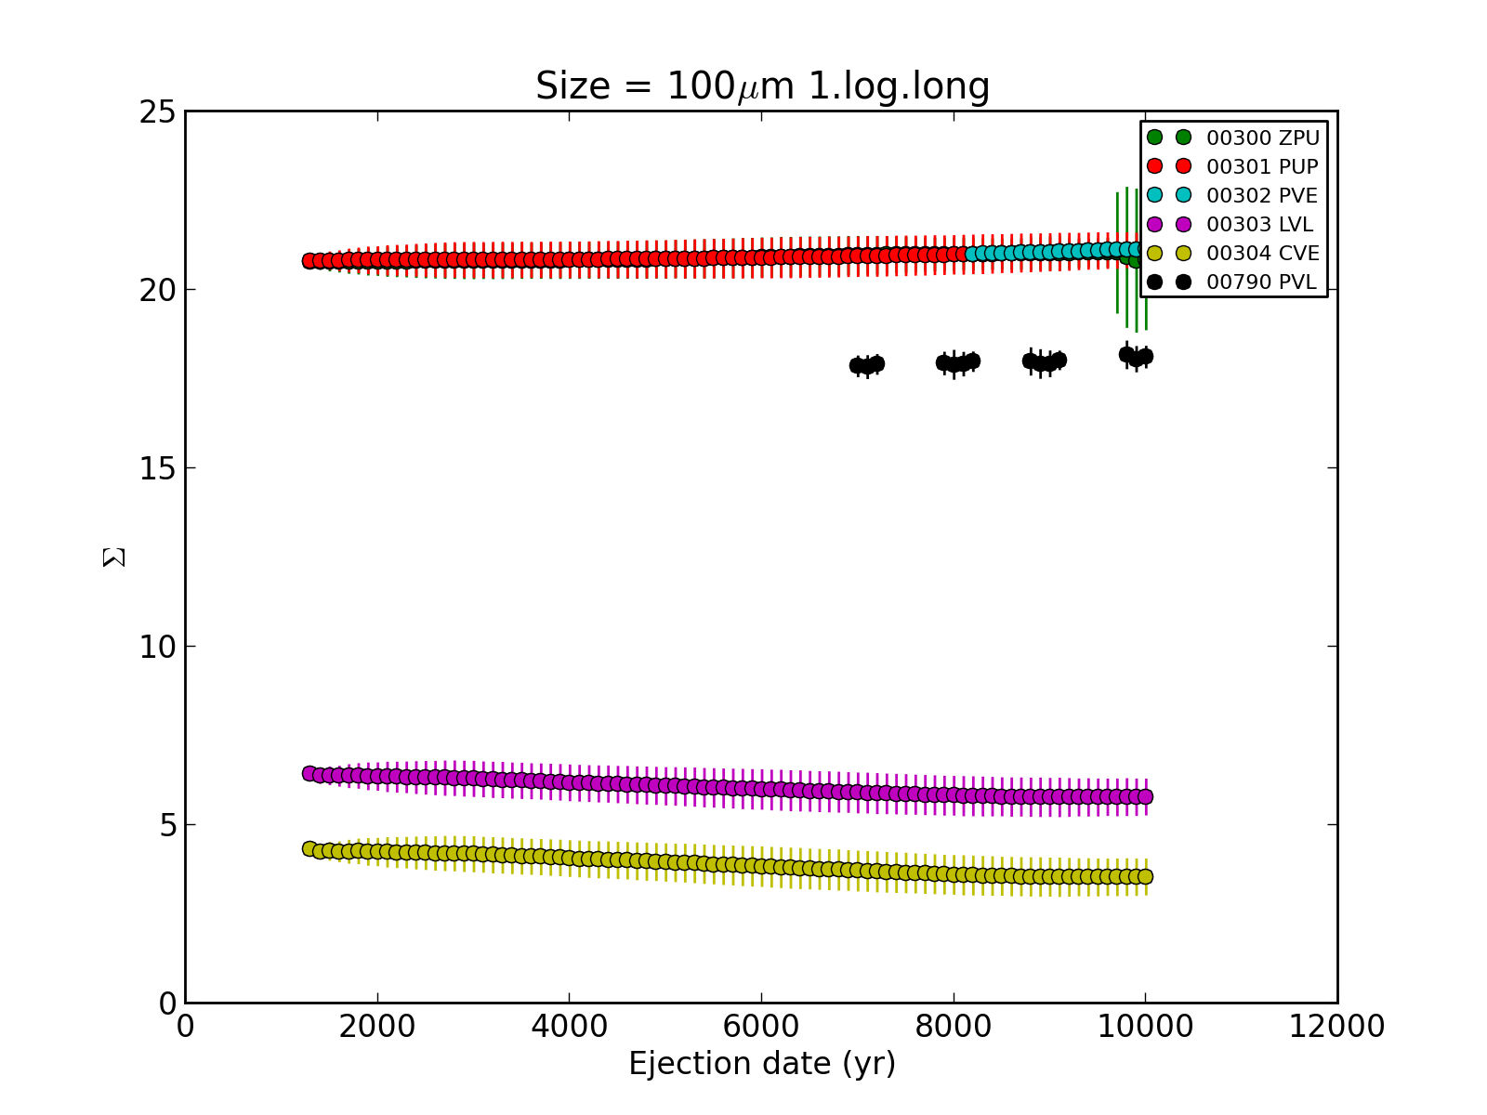
(2102) Tantalus (1975 YA)

Slide 22
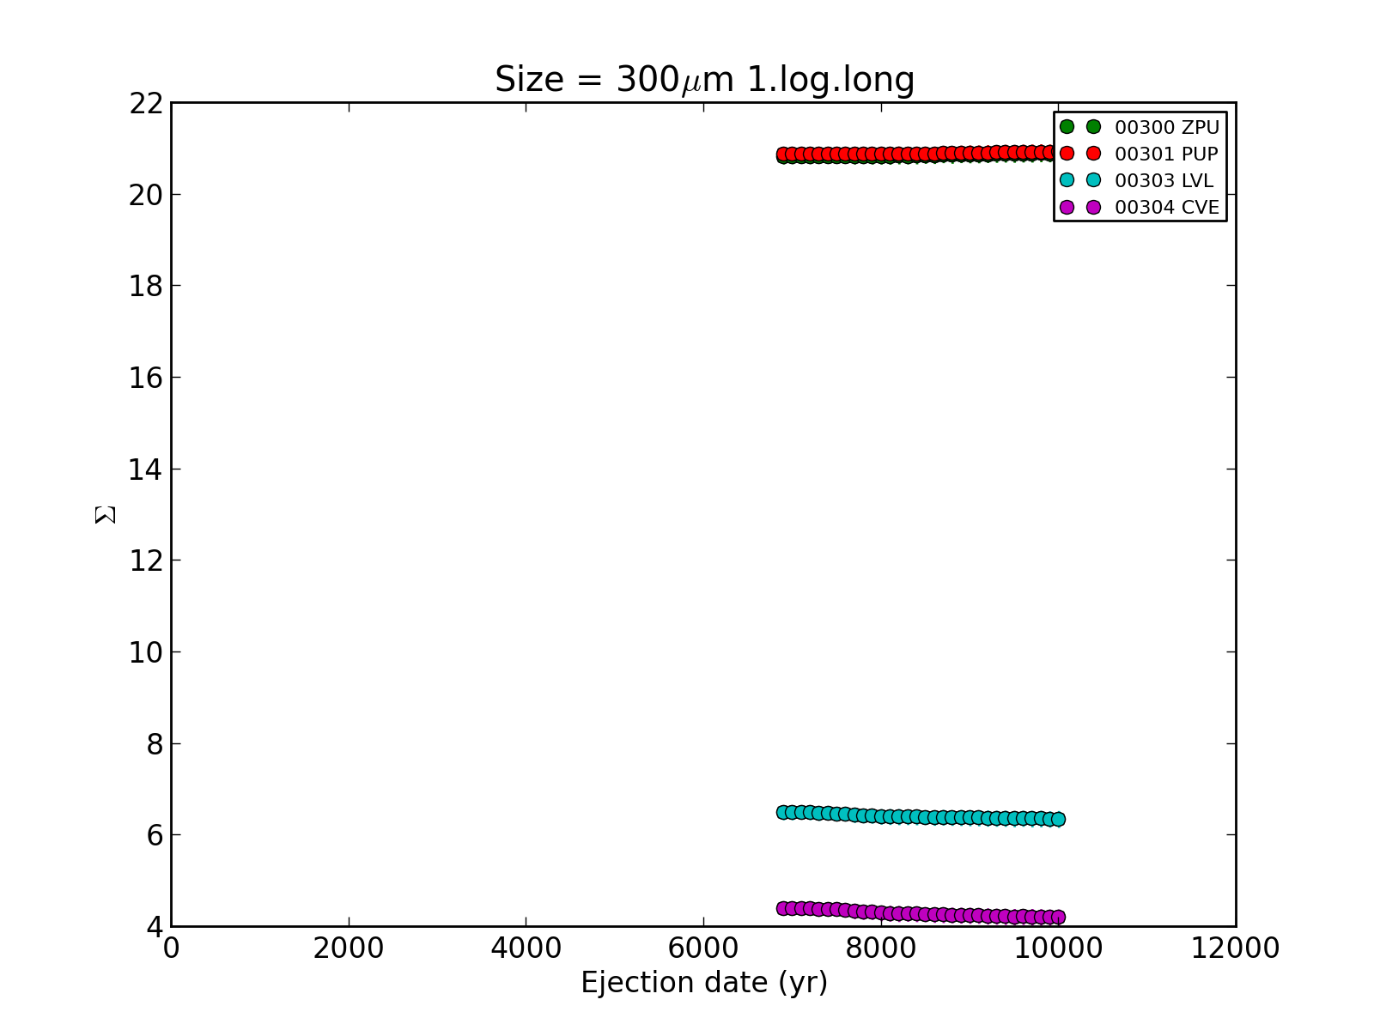
(2102) Tantalus (1975 YA)

Slide 23
North toroidal showers
Name | ID | Solar Lon | Vg [km/s] | Parent Body
Lambda Lyrids | LLY | 41.0 | 33.4
May Zeta Cyginids | MZC | 60.0 | 29.2
Alpha Lacertids | ALA | 105.5 | 38.3
Psi Cassiopeiids | PCY | 117.5 | 44.0
Lambda Draconids | LDR | 196.0 | 37.5
October Ursae Majorids | OCU | 204.7 | 52.0
Alpha Ursae Majorids | AUM | 209.0 | 35.6
Xi Draconids | XDR | 210.8 | 35.8
October Kappa Draconids | OKD | 216.0 | 37.3
November I Draconids | NID | 241.0 | 43.0 | 2009 WN25
Quadrantids | QUA | 283.5 | 41.7 | 2003 EH1
Canum Venaticids | CVN | 293.0 | 52.6
Lambda Bootids | LBO | 295.5 | 41.0
Theta Coronae Borealids | TCB | 296.0 | 37.7

Slide 24
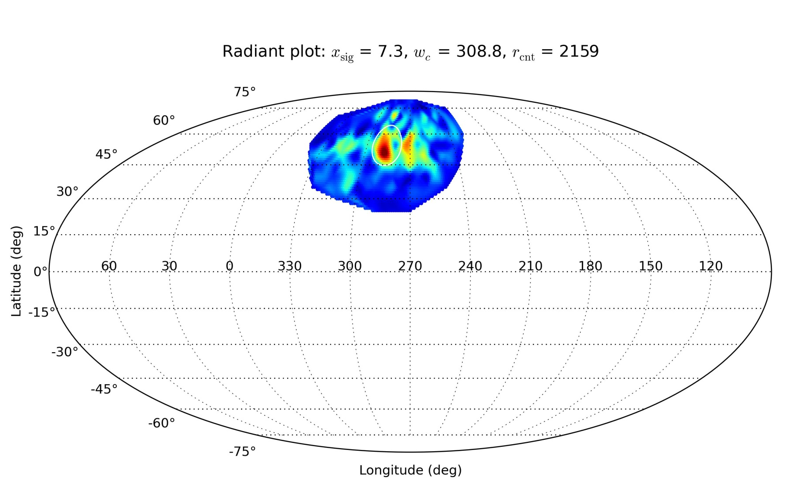
Lambda draconids (LDR)
Shower lasts for 18 days (CMOR)

Slide 25
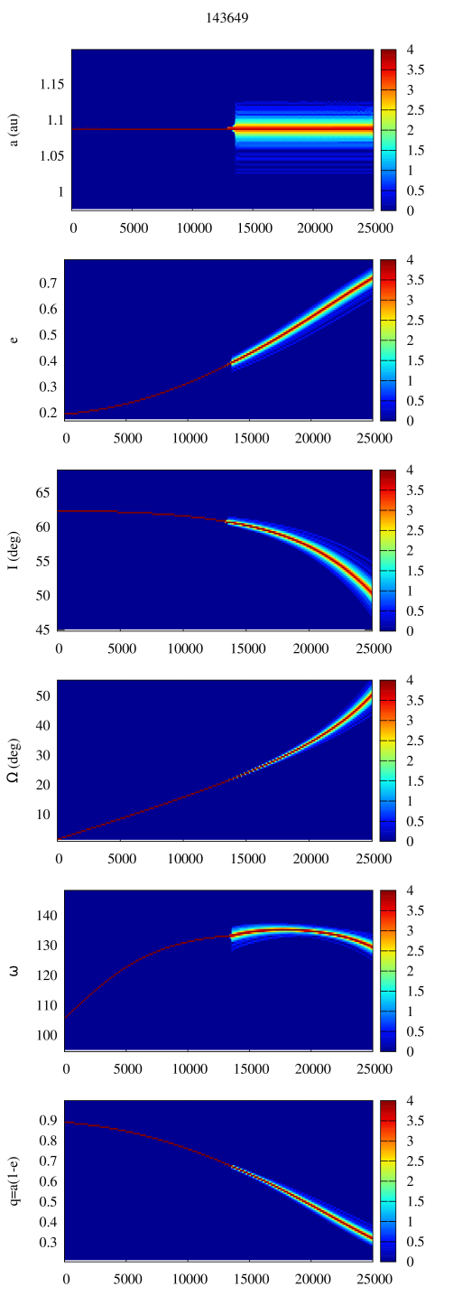
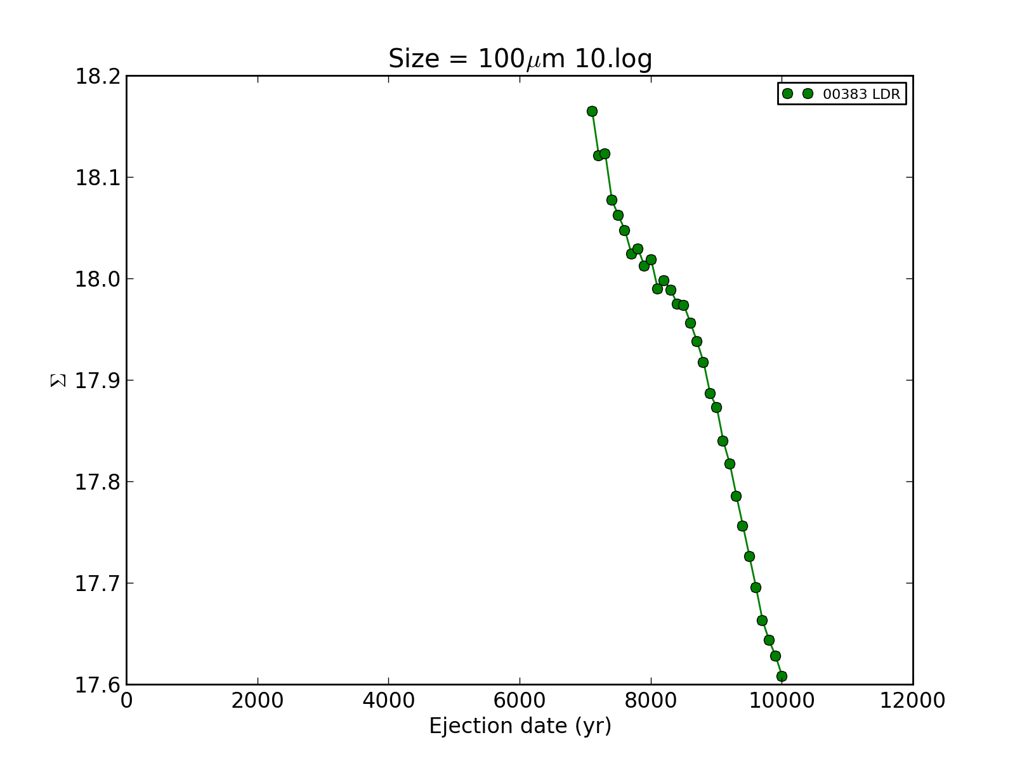
Lambda draconids (LDR)
Potential parent body:143649 (2003 QQ47)

Slide 26
North toroidal showers
Name | ID | Solar Lon | Vg [km/s] | Parent Body
Lambda Lyrids | LLY | 41.0 | 33.4
May Zeta Cyginids | MZC | 60.0 | 29.2
Alpha Lacertids | ALA | 105.5 | 38.3
Psi Cassiopeiids | PCY | 117.5 | 44.0
Lambda Draconids | LDR | 196.0 | 37.5 | 2003 QQ47
October Ursae Majorids | OCU | 204.7 | 52.0
Alpha Ursae Majorids | AUM | 209.0 | 35.6
Xi Draconids | XDR | 210.8 | 35.8
October Kappa Draconids | OKD | 216.0 | 37.3
November I Draconids | NID | 241.0 | 43.0 | 2009 WN25
Quadrantids | QUA | 283.5 | 41.7 | 2003 EH1
Canum Venaticids | CVN | 293.0 | 52.6
Lambda Bootids | LBO | 295.5 | 41.0
Theta Coronae Borealids | TCB | 296.0 | 37.7

Slide 27
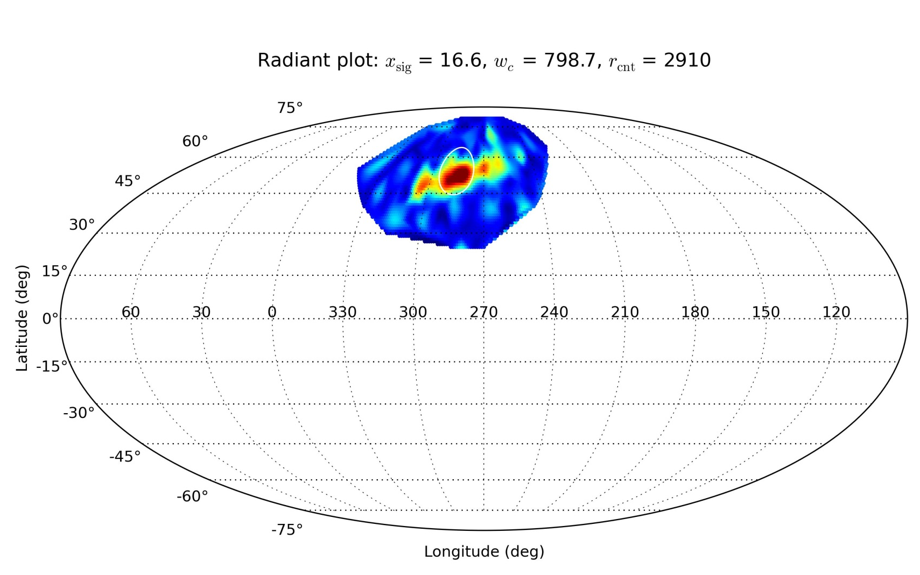
Alpha Ursae Majorids (AUM)
Shower lasts for 17 days (CMOR)

Slide 28
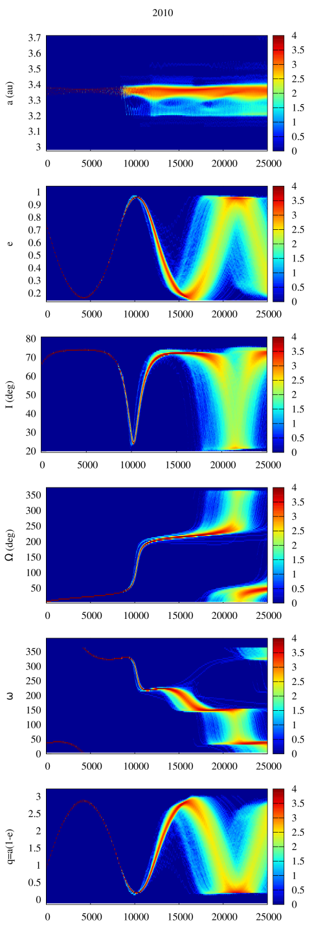
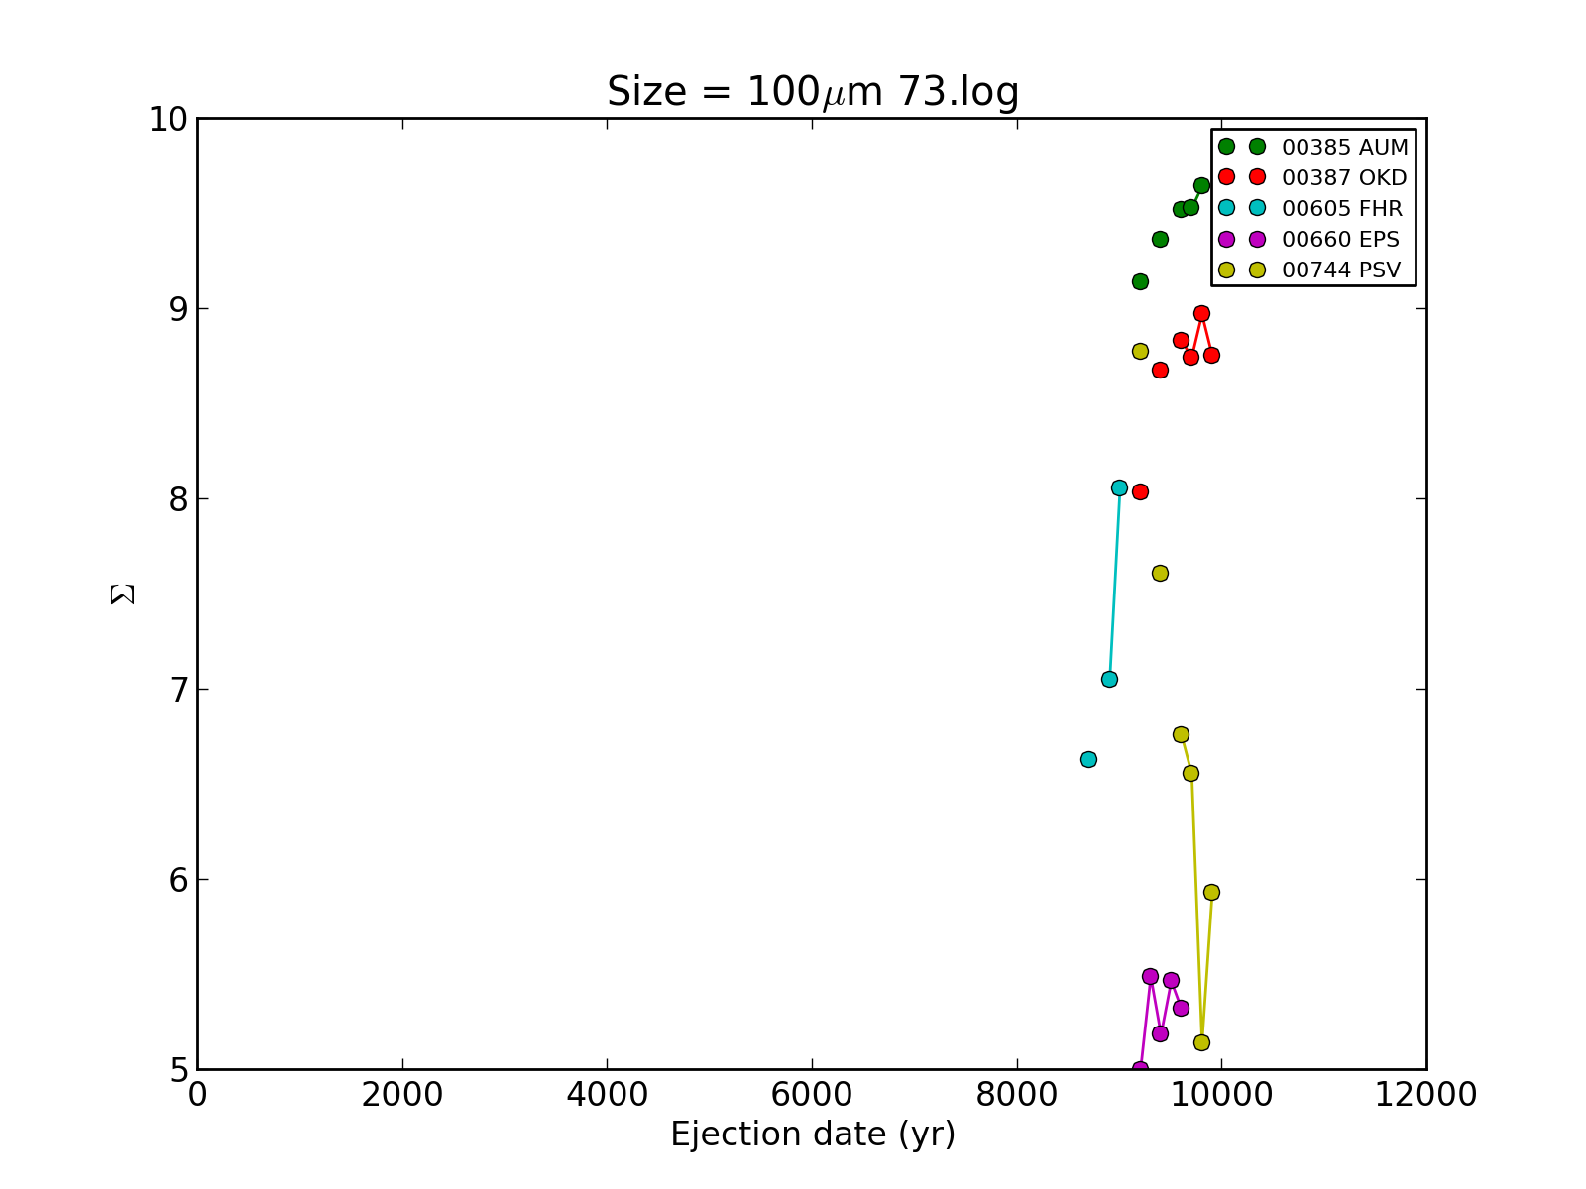
Alpha Ursae Majorids (AUM)
Potential parent body:(2010 QE2)

Slide 29
North toroidal showers
Name | ID | Solar Lon | Vg [km/s] | Parent Body
Lambda Lyrids | LLY | 41.0 | 33.4
May Zeta Cyginids | MZC | 60.0 | 29.2
Alpha Lacertids | ALA | 105.5 | 38.3
Psi Cassiopeiids | PCY | 117.5 | 44.0
Lambda Draconids | LDR | 196.0 | 37.5 | 2003 QQ47
October Ursae Majorids | OCU | 204.7 | 52.0
Alpha Ursae Majorids | AUM | 209.0 | 35.6 | 2010 QE2
Xi Draconids | XDR | 210.8 | 35.8
October Kappa Draconids | OKD | 216.0 | 37.3
November I Draconids | NID | 241.0 | 43.0 | 2009 WN25
Quadrantids | QUA | 283.5 | 41.7 | 2003 EH1
Canum Venaticids | CVN | 293.0 | 52.6
Lambda Bootids | LBO | 295.5 | 41.0
Theta Coronae Borealids | TCB | 296.0 | 37.7

Slide 30
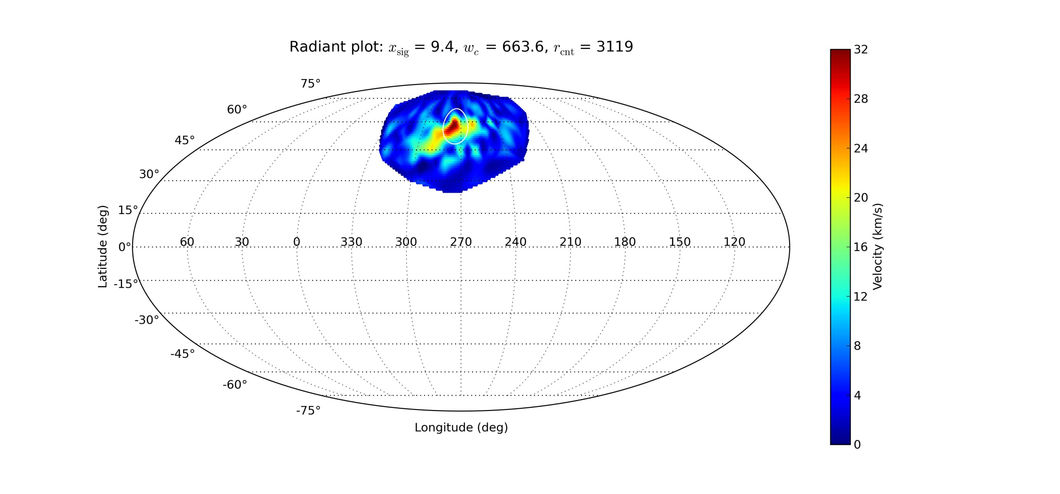
XI draconids (XDR)
Shower lasts for 7 days (CMOR)

Slide 31
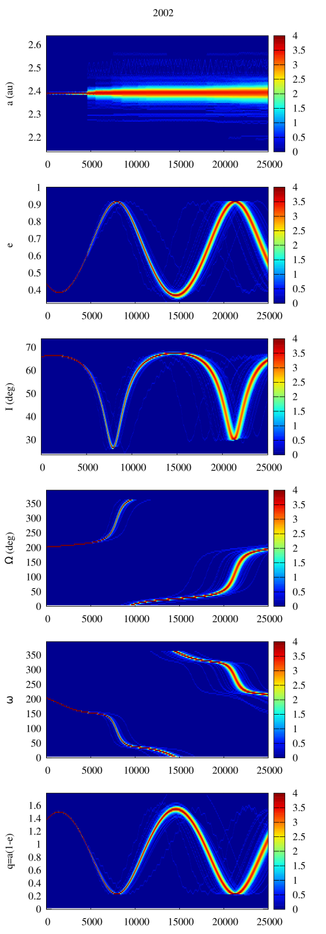
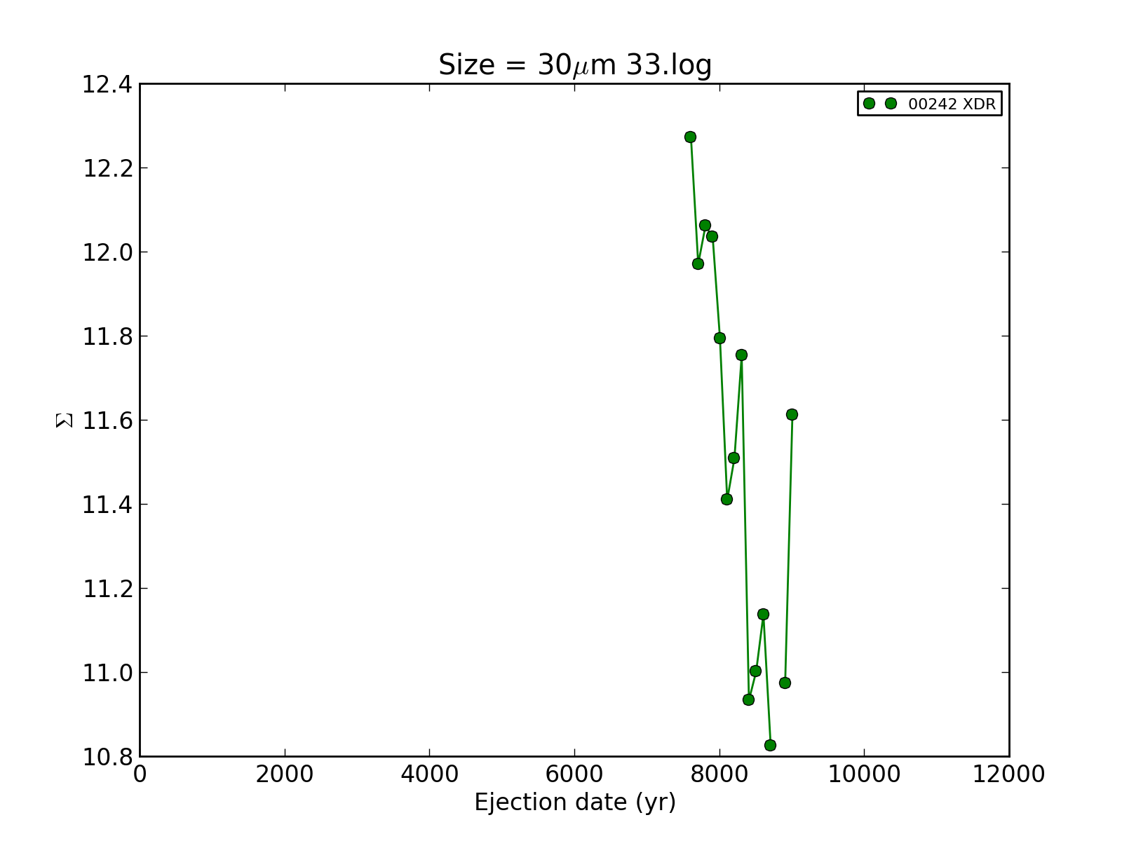
XI Draconids (XDR)
Potential parent body: (2002 SU)

Slide 32
North toroidal showers
Name | ID | Solar Lon | Vg [km/s] | Parent Body
Lambda Lyrids | LLY | 41.0 | 33.4
May Zeta Cyginids | MZC | 60.0 | 29.2
Alpha Lacertids | ALA | 105.5 | 38.3
Psi Cassiopeiids | PCY | 117.5 | 44.0
Lambda Draconids | LDR | 196.0 | 37.5 | 2003 QQ47
October Ursae Majorids | OCU | 204.7 | 52.0
Alpha Ursae Majorids | AUM | 209.0 | 35.6 | 2010 QE2
Xi Draconids | XDR | 210.8 | 35.8 | 2002 SU
October Kappa Draconids | OKD | 216.0 | 37.3
November I Draconids | NID | 241.0 | 43.0 | 2009 WN25
Quadrantids | QUA | 283.5 | 41.7 | 2003 EH1
Canum Venaticids | CVN | 293.0 | 52.6
Lambda Bootids | LBO | 295.5 | 41.0
Theta Coronae Borealids | TCB | 296.0 | 37.7

Slide 33
October kappa draconids (okd)
Shower lasts for 10 days (CMOR)

Slide 34
October kappa Draconids (OKD)
Potential parent bodies: (2010 QE2)

Slide 35
North toroidal showers
Name | ID | Solar Lon | Vg [km/s] | Parent Body
Lambda Lyrids | LLY | 41.0 | 33.4
May Zeta Cyginids | MZC | 60.0 | 29.2
Alpha Lacertids | ALA | 105.5 | 38.3
Psi Cassiopeiids | PCY | 117.5 | 44.0
Lambda Draconids | LDR | 196.0 | 37.5
October Ursae Majorids | OCU | 204.7 | 52.0
Alpha Ursae Majorids | AUM | 209.0 | 35.6
Xi Draconids | XDR | 210.8 | 35.8
October Kappa Draconids | OKD | 216.0 | 37.3
November I Draconids | NID | 241.0 | 43.0 | 2009 WN25
Quadrantids | QUA | 283.5 | 41.7 | 2003 EH1
Canum Venaticids | CVN | 293.0 | 52.6
Lambda Bootids | LBO | 295.5 | 41.0
Theta Coronae Borealids | TCB | 296.0 | 37.7

Slide 36
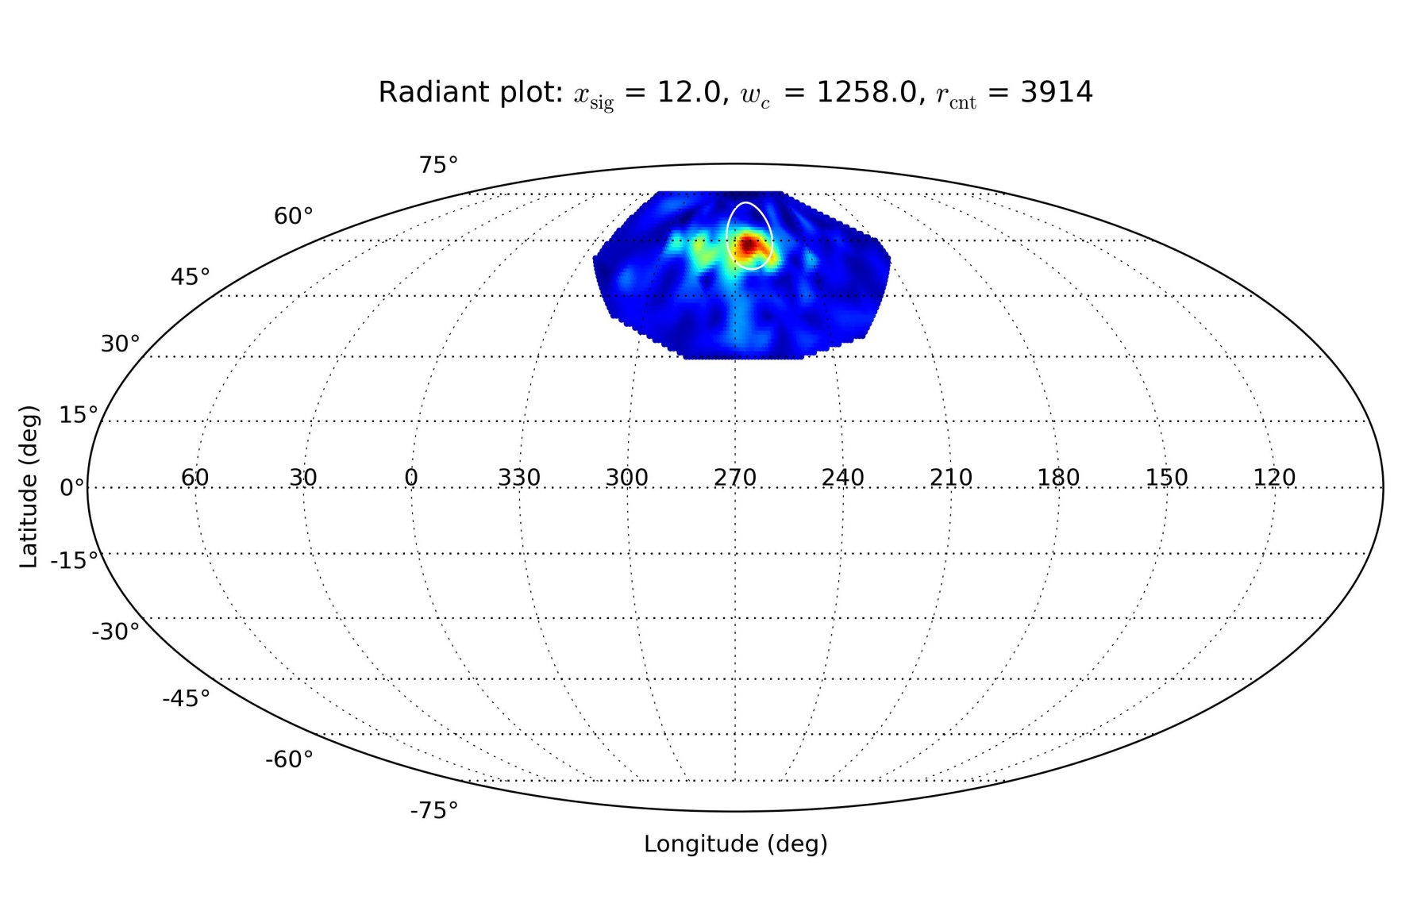
November I draconids (NID)
Shower lasts for 44 days (CMOR)

Slide 37
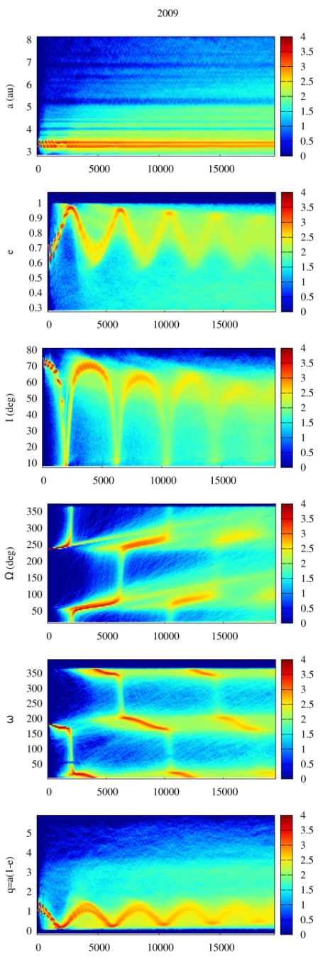
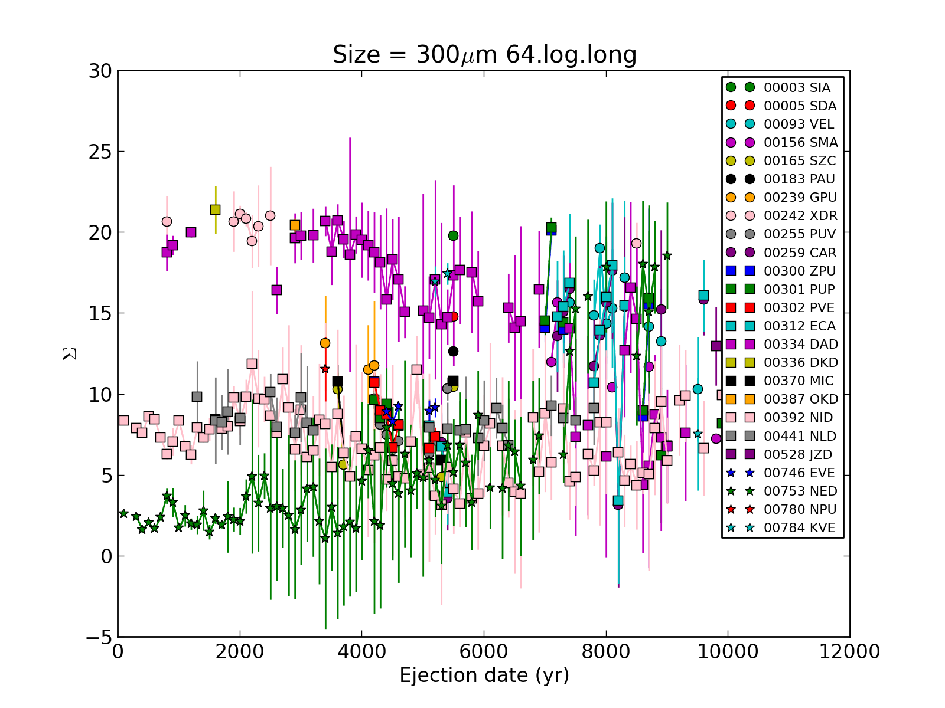
November I draconids (NID)
Two potential parent bodies: (2009 WN25)

Slide 38
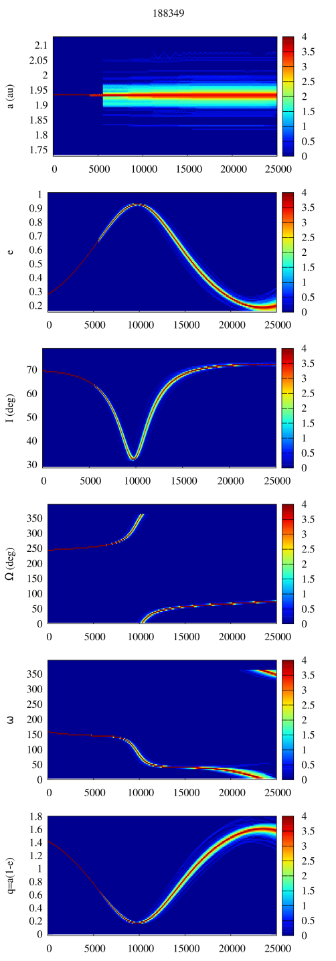
November I draconids (NID)
Two potential parent bodies: (2009 WN25)
188349 (2003 TS9)
Only several outbursts of 30 μm particles approx. 9 ka produce meteors
Very stable orbit, now on a Mars-crossing orbit => meteoroids need a lot of time to get on the Earth-crossing orbits – longer simulations needed

Slide 39
North toroidal showers
Name | ID | Solar Lon | Vg [km/s] | Parent Body
Lambda Lyrids | LLY | 41.0 | 33.4
May Zeta Cyginids | MZC | 60.0 | 29.2
Alpha Lacertids | ALA | 105.5 | 38.3
Psi Cassiopeiids | PCY | 117.5 | 44.0
Lambda Draconids | LDR | 196.0 | 37.5
October Ursae Majorids | OCU | 204.7 | 52.0
Alpha Ursae Majorids | AUM | 209.0 | 35.6
Xi Draconids | XDR | 210.8 | 35.8
October Kappa Draconids | OKD | 216.0 | 37.3
November I Draconids | NID | 241.0 | 43.0 | 2009 WN25
Quadrantids | QUA | 283.5 | 41.7 | 2003 EH1
Canum Venaticids | CVN | 293.0 | 52.6
Lambda Bootids | LBO | 295.5 | 41.0
Theta Coronae Borealids | TCB | 296.0 | 37.7

Slide 40
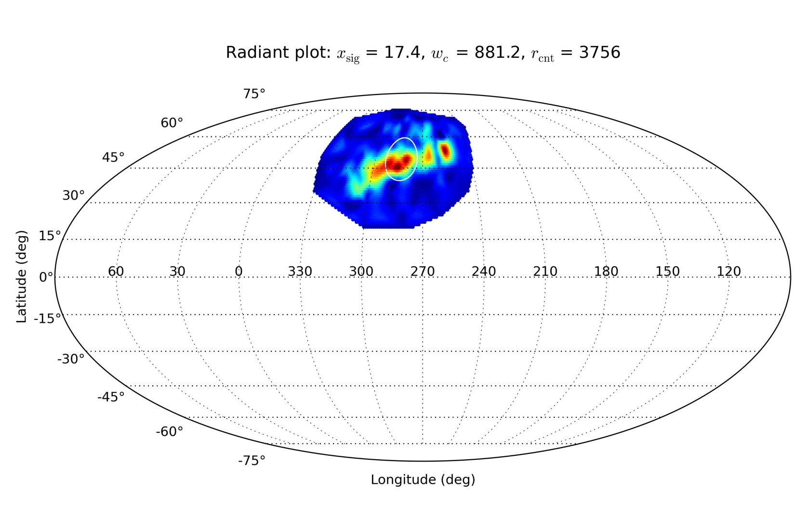
Theta coronae borealids (TBC)
Shower lasts for 18 days (CMOR)

Slide 41
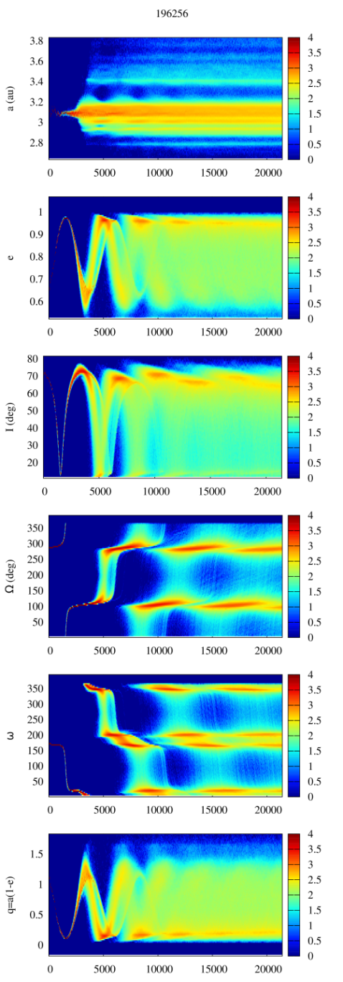
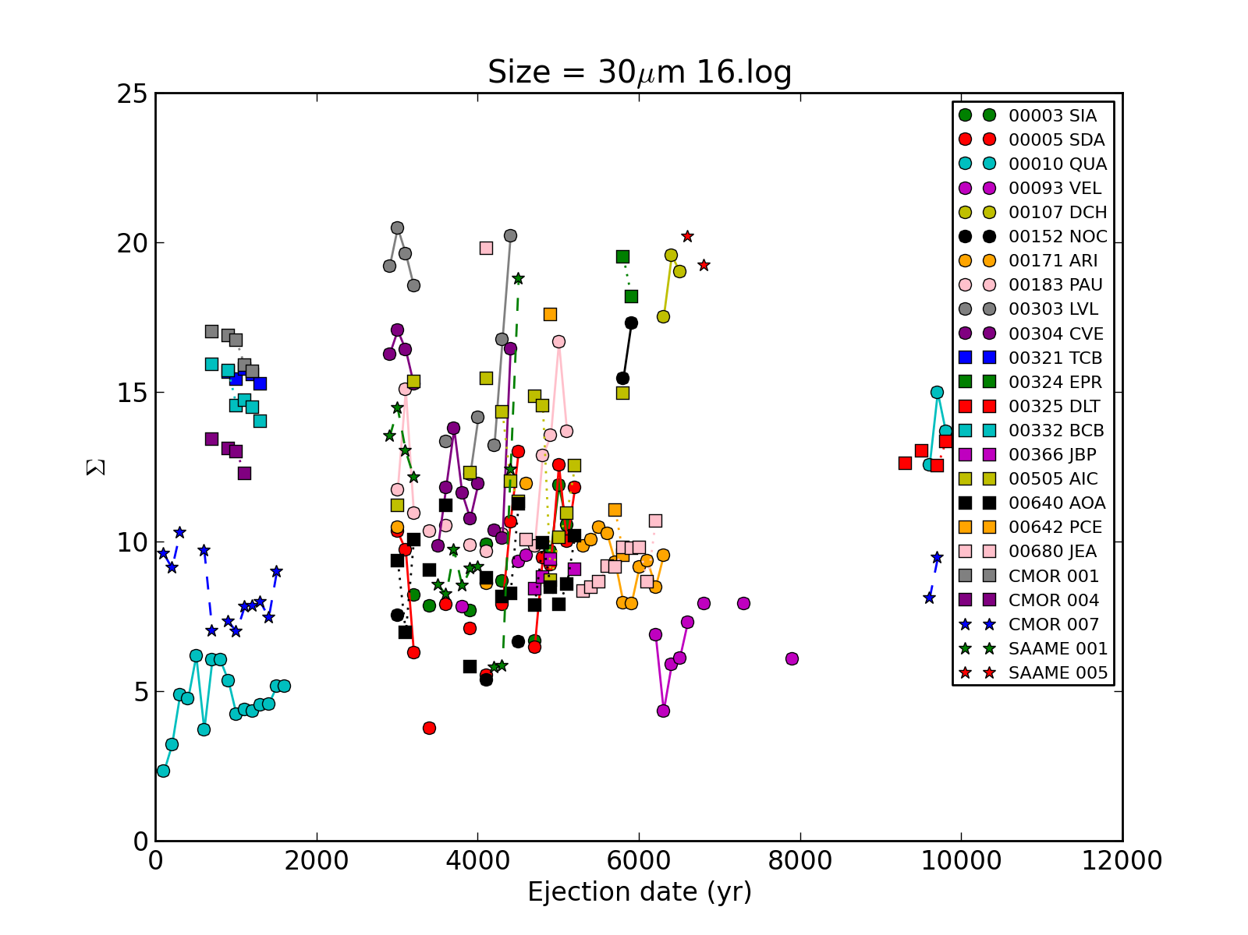
Theta coronae borealids (TBC)
Two potential parent bodies: (2003 EH1)
A body with a slightly different orbit from the same complex might be the solution

Slide 42
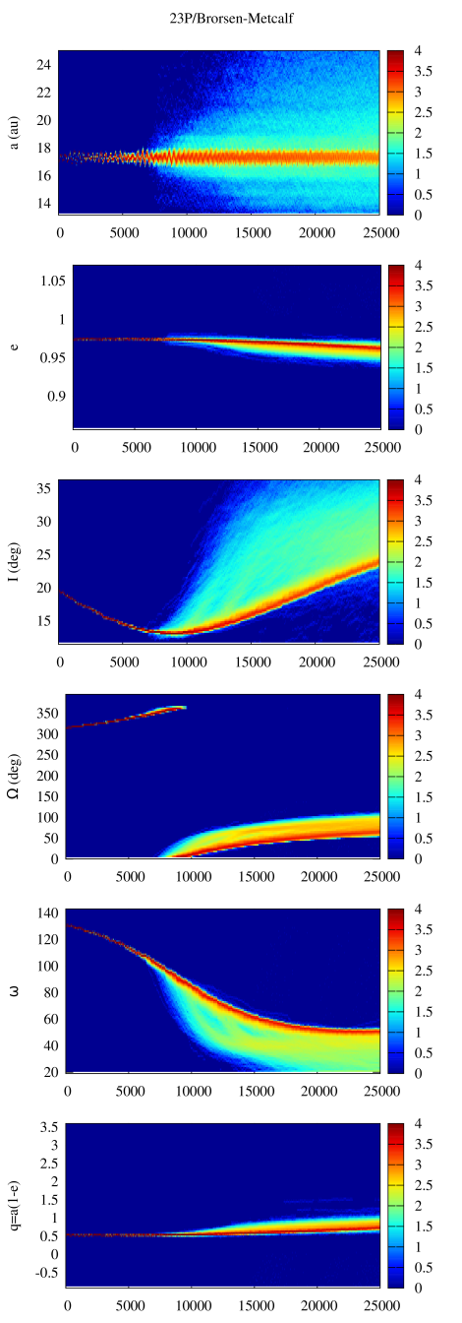

Theta coronae borealids (TBC)
Two potential parent bodies: (2003 EH1)
23P/Brorsen-Metcalf
Only one outburst created a shower ($∼$9,000 yr)
Needs to be traced further back in time
70 yr orbital period

Slide 43
North toroidal showers
Name | ID | Solar Lon | Vg [km/s] | Parent Body
Lambda Lyrids | LLY | 41.0 | 33.4
May Zeta Cyginids | MZC | 60.0 | 29.2
Alpha Lacertids | ALA | 105.5 | 38.3
Psi Cassiopeiids | PCY | 117.5 | 44.0
Lambda Draconids | LDR | 196.0 | 37.5 | 2003 QQ47
October Ursae Majorids | OCU | 204.7 | 52.0
Alpha Ursae Majorids | AUM | 209.0 | 35.6 | 2010 QE2
Xi Draconids | XDR | 210.8 | 35.8 | 2002 SU
October Kappa Draconids | OKD | 216.0 | 37.3 | 2010 QE2
November I Draconids | NID | 241.0 | 43.0 | 2009 WN25
Quadrantids | QUA | 283.5 | 41.7 | 2003 EH1
Canum Venaticids | CVN | 293.0 | 52.6
Lambda Bootids | LBO | 295.5 | 41.0
Theta Coronae Borealids | TCB | 296.0 | 37.7 | (2003 EH1)/23P

Slide 44
North toroidal showers
Name | ID | Solar Lon | Vg [km/s] | Parent Body
Lambda Lyrids | LLY | 41.0 | 33.4
May Zeta Cyginids | MZC | 60.0 | 29.2 | (2008 KP/2013 JA36)
Alpha Lacertids | ALA | 105.5 | 38.3
Psi Cassiopeiids | PCY | 117.5 | 44.0
Lambda Draconids | LDR | 196.0 | 37.5 | 2003 QQ47
October Ursae Majorids | OCU | 204.7 | 52.0 | (C/1975 T2 - SSM)
Alpha Ursae Majorids | AUM | 209.0 | 35.6 | 2010 QE2
Xi Draconids | XDR | 210.8 | 35.8 | 2002 SU
October Kappa Draconids | OKD | 216.0 | 37.3 | 2010 QE2
November I Draconids | NID | 241.0 | 43.0 | 2009 WN25
Quadrantids | QUA | 283.5 | 41.7 | 2003 EH1
Canum Venaticids | CVN | 293.0 | 52.6
Lambda Bootids | LBO | 295.5 | 41.0
Theta Coronae Borealids | TCB | 296.0 | 37.7 | 2003 EH1/23P

Slide 45
Conclusions
Out of 169 potential parent bodies only 9% is contributing to the north toroidal source

Slide 46

Conclusions
Out of 169 potential parent bodies only 9% is contributing to the north toroidal source
Age of many north toroidal streams for radar sized meteors is $≫$ 10 000 yr

Slide 47
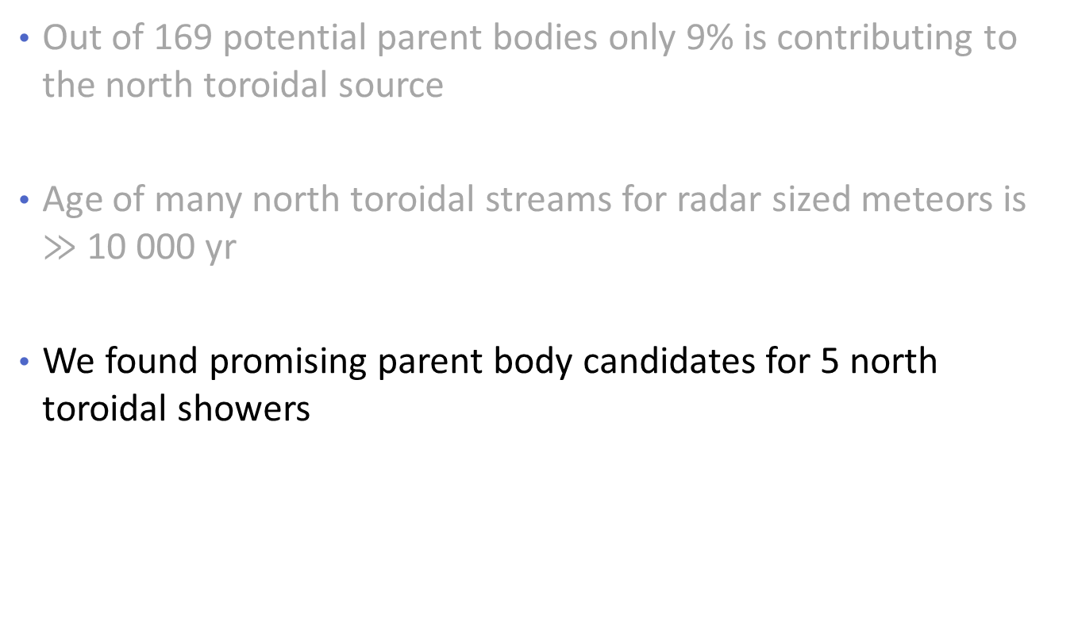
Conclusions
Out of 169 potential parent bodies only 9% is contributing to the north toroidal source
Age of many north toroidal streams for radar sized meteors is $≫$ 10 000 yr
We found promising parent body candidates for 5 north toroidal showers

Slide 48
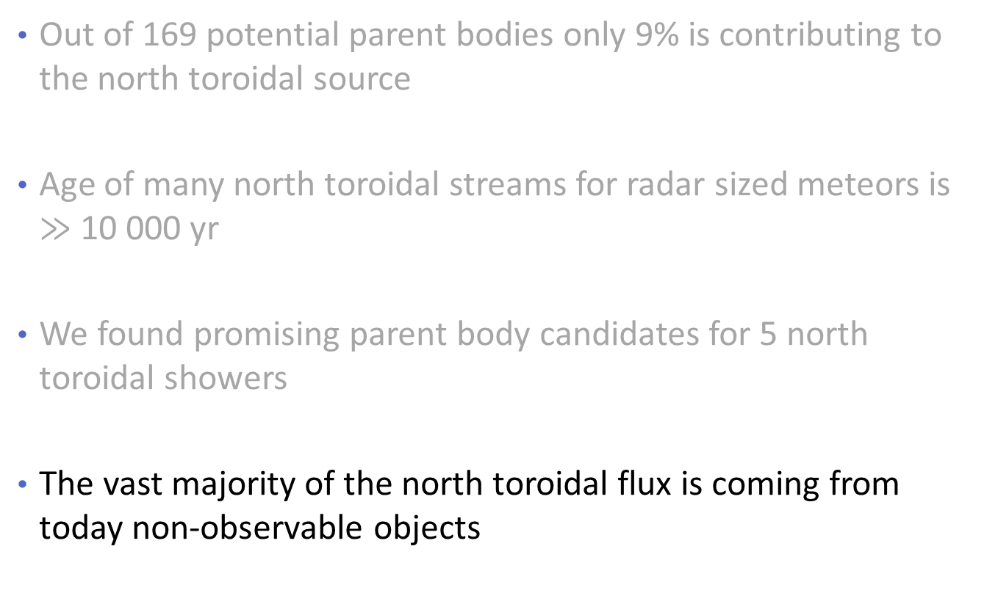
Conclusions
Out of 169 potential parent bodies only 9% is contributing to the north toroidal source
Age of many north toroidal streams for radar sized meteors is $≫$ 10 000 yr
We found promising parent body candidates for 5 north toroidal showers
The vast majority of the north toroidal flux is coming from today non-observable objects

Slide 49
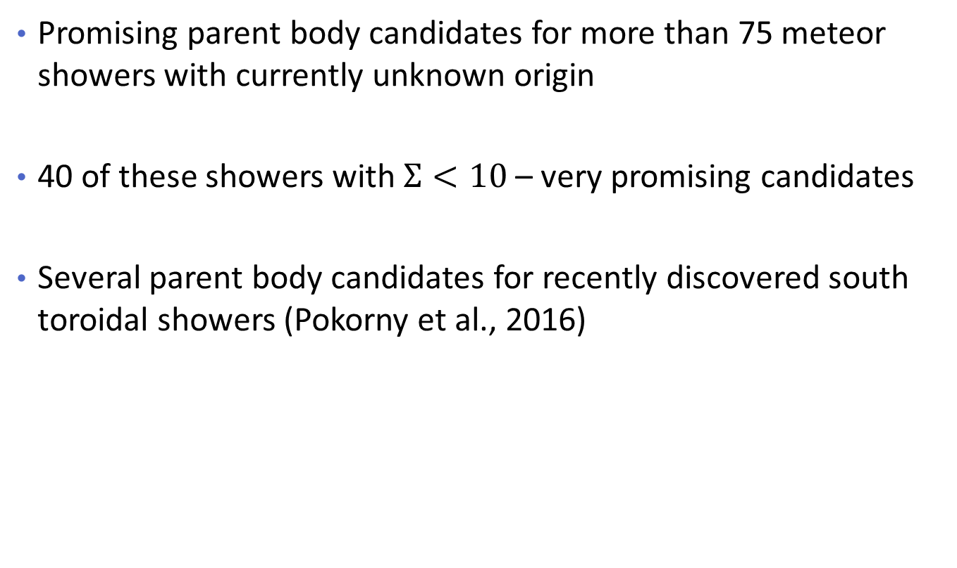
Other pleasant by-products
Promising parent body candidates for more than 75 meteor showers with currently unknown origin
40 of these showers with $Σ<10$ – very promising candidates
Several parent body candidates for recently discovered south toroidal showers (Pokorny et al., 2016)

