Slide 1
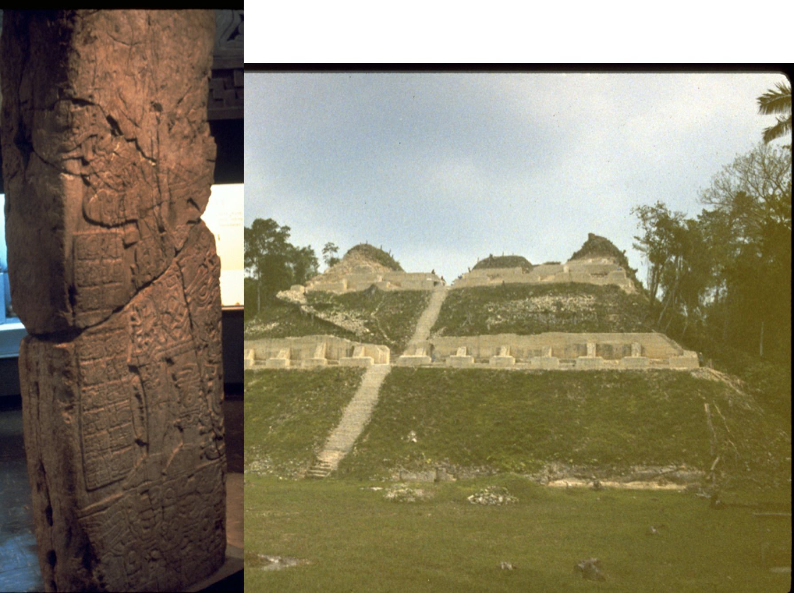
Evidence of Eta Aquariid Outbursts Recorded in the Classic Maya Hieroglyphic Script Using
Orbital Integrations
J.H. Kinsman (jhkinsman@gatech.edu)
D.J. Asher (dja@arm.ac.uk)
Caana, “Sky Place” Caracol, Belize
Population: > 100,000 (AD 650)
Stela 3
Notes:
Good morning ladies and gentlemen. My name is Hutch Kinsman. Ancient maya had a written ancient script –30 seconds. Using orbital integrations, David Asher and I decided to investigate the possibility that the Maya recorded Eta Aquariid outbursts in the Classic Maya hieroglyphic script. Previously there had been no scientific attempts to correlate any ancient Maya dates with any meteor outbursts from any meteoroid stream.

Slide 2
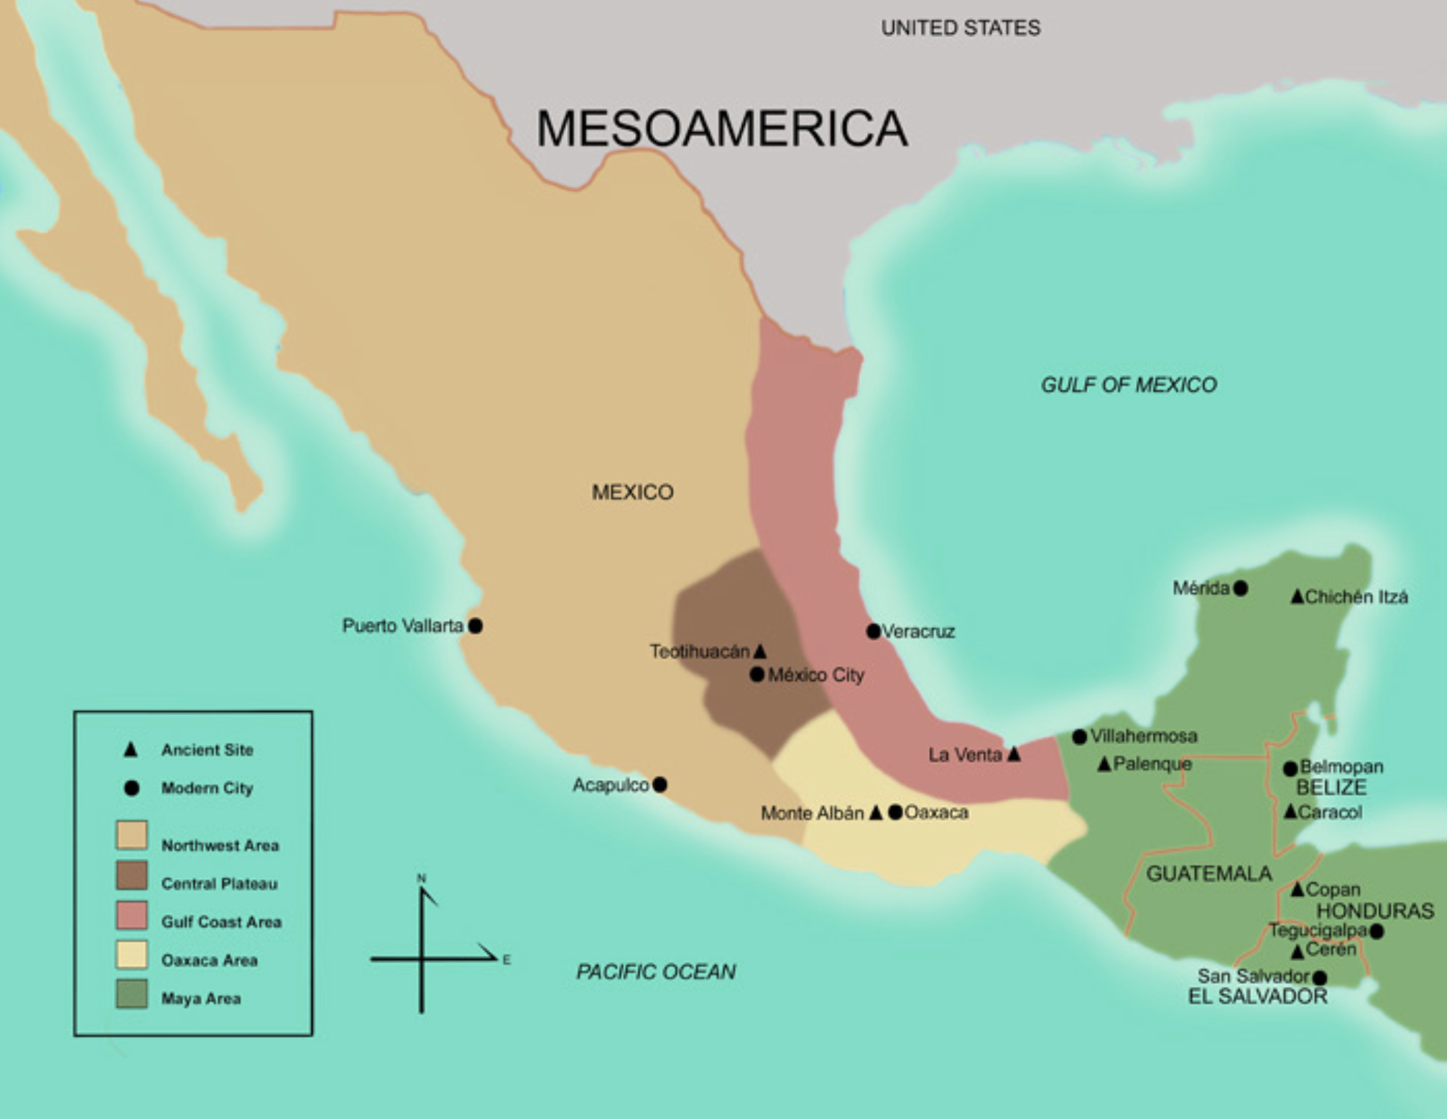
Chicxulub Crater
Notes:
The maya area is located on the south side of the gulf of mexico and contains the site of the Chicxulub crater.

Slide 3
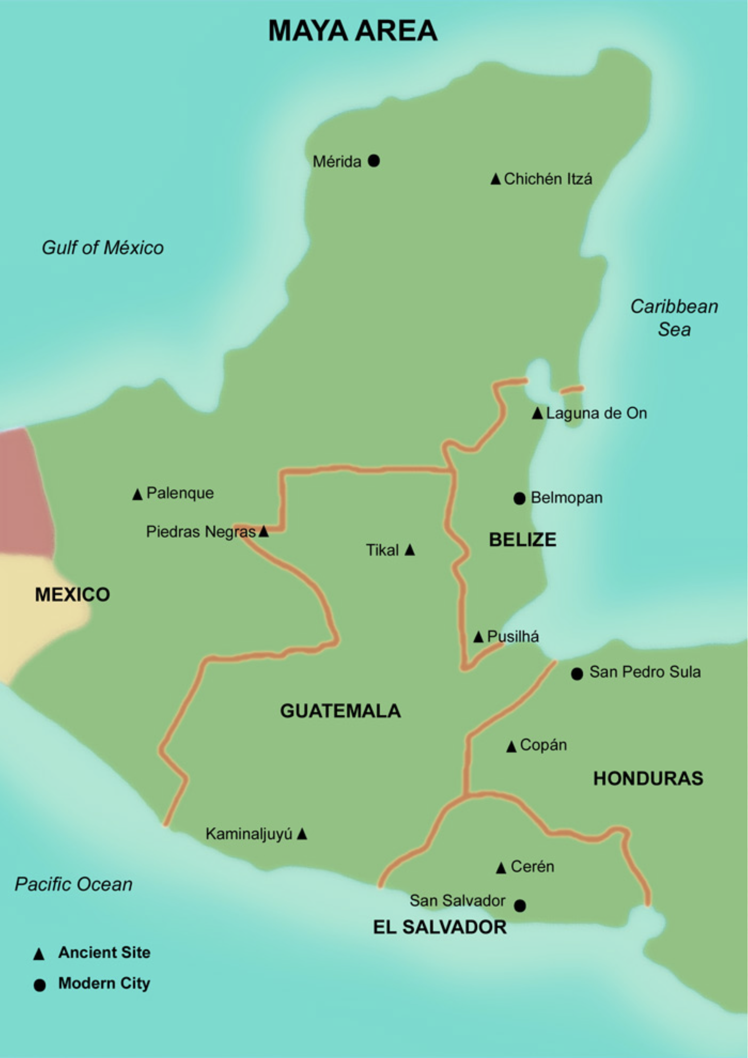
21.5º N
Maya Classic Period
AD 250-909
~ 2000 Dates
Eta Aquariid radiant visible in the east
~ 08:00 – 11:15 UT
(half hour prior to sunrise)
Naranjo
Caracol
Yaxchilan
La Corona
14º N
93º W
87º W
Notes:
And is located between 87 to 93 degrees west longitude and 14 to 21 and a half degrees north latitude. The radiant would have been visible in the east from about 08:00 to 11:15 just prior to morning twilight. The maya classic period covers the years from AD 250 until 909. Caracol, a site in Belize that we will talk about later, is located here.

Slide 4
Comet Halley ~ AD 500
Halley:
pre-perihelion
Halley
post-perihelion
~ 0.3 au
Eta Aquariids
Orionids
Notes:
One of the reasons we chose the eta aquariids is because the orbit of the parent body comet halley was closest to the earth’s orbit at its post-perihelion position in AD 500.

Slide 5
Criteria for Outburst
Δa₀ ≡ a₀ − a_{c}
a₀ = semi-major axis of particle at ejection time
a_{c} = semi-major axis of comet at ejection time
f_{a}(Δa₀) depends on initial distribution of particles as a function of Δa₀
f_{M} ‘mean anomaly factor’
f_{M} = along trail stretching as trail evolves
Cluster of Particles
Solar Longitude λ
|
(Desired) mean anomaly
M = 0
(when particles reach the descending node)
r_{E}
r_{D}
Δr ≡ r_{E} − r_{D}
r_{E} = heliocentric distance of the
Earth at the encounter
r_{D} = heliocentric distance of descending node of the
trail of particles
f_{r} density profile that increases
toward the center of the trail
Maximum density (peak ZHR) for outburst:
f_{r} (r_{E} − r_{D}) f_{a} (Δa₀) f_{M}
Notes:
f_{a} is the initial distribution of particles resulting from particle ejection and f_{M} is a term known as the mean anomaly factor. Mean anomaly factor basically describes the gradual stretching out over time of the particles in their orbital stream and thus becoming less dense in progressive revolutions. “These are the parameters used in “dust trail” calculations by McNaught and Asher and Sato and Watanabe.” (from David, may 14, 2016). Density of particles along the trail is a function of the product of f_{a}(Δa₀) and f_{M} . When you factor in delta r, you get the maximum density (peak zhr) for the outburst. delta r is the spacing between the earth and the meteoroid trail at the time of encounter.

Slide 6
Comet Halley ~ AD 500
Particle ejections in positive and negative tangential directions at comet perihelion.
P
q
Halley
post-perihelion
Eta Aquariids
Particle radius, s: 0.1 cm – 0.5 cm
Particle density, ρ: 1 g/cc
Comet Halley radius: 4 km
Halley in 240 BC, a_{c} = 18.06
q = 0.5854 v(q) = 54.6 kms⁻¹
Δa = 0.040 au/ms⁻¹
S = 0.1 cm, v_{ej} = 75.5 ms⁻¹
Δa₀ = ± 3.03 au
S = 0.5 cm, v_{ej} = 33.7 ms⁻¹
Δa₀ = ± 1.35 au
Notes:
These calculations do not include effects of solar radiation pressure. various parameters determine what is a physically realistic range of delta a 0, in our case plus or minus 3 au, depending on particle size.

Slide 7
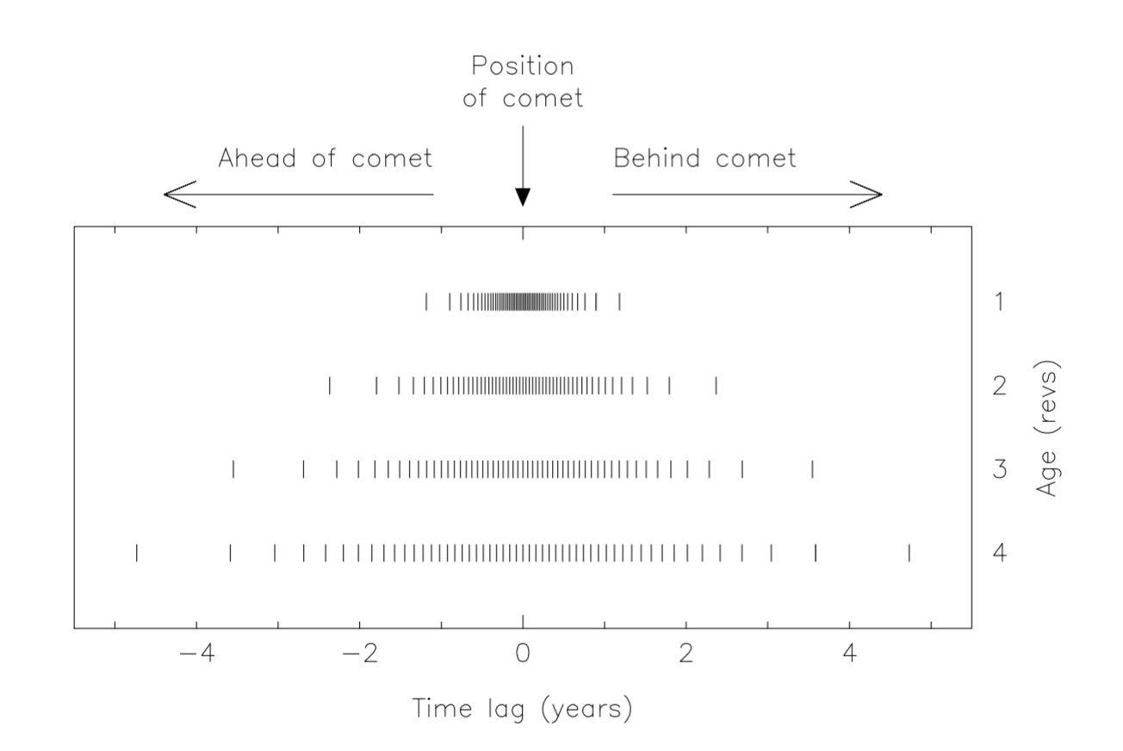
Particle dispersion in sequential orbital revolutions
without the effects of solar radiation pressure (Asher, 1999)
To a first approximation, the trail stretches linearly with time, ΔT ≈ n (3/2) a₀ ^{½} Δa₀
= constant x n x Δa₀ and therefore f_{M} = 1/n
Notes:
(On slide}

Slide 8
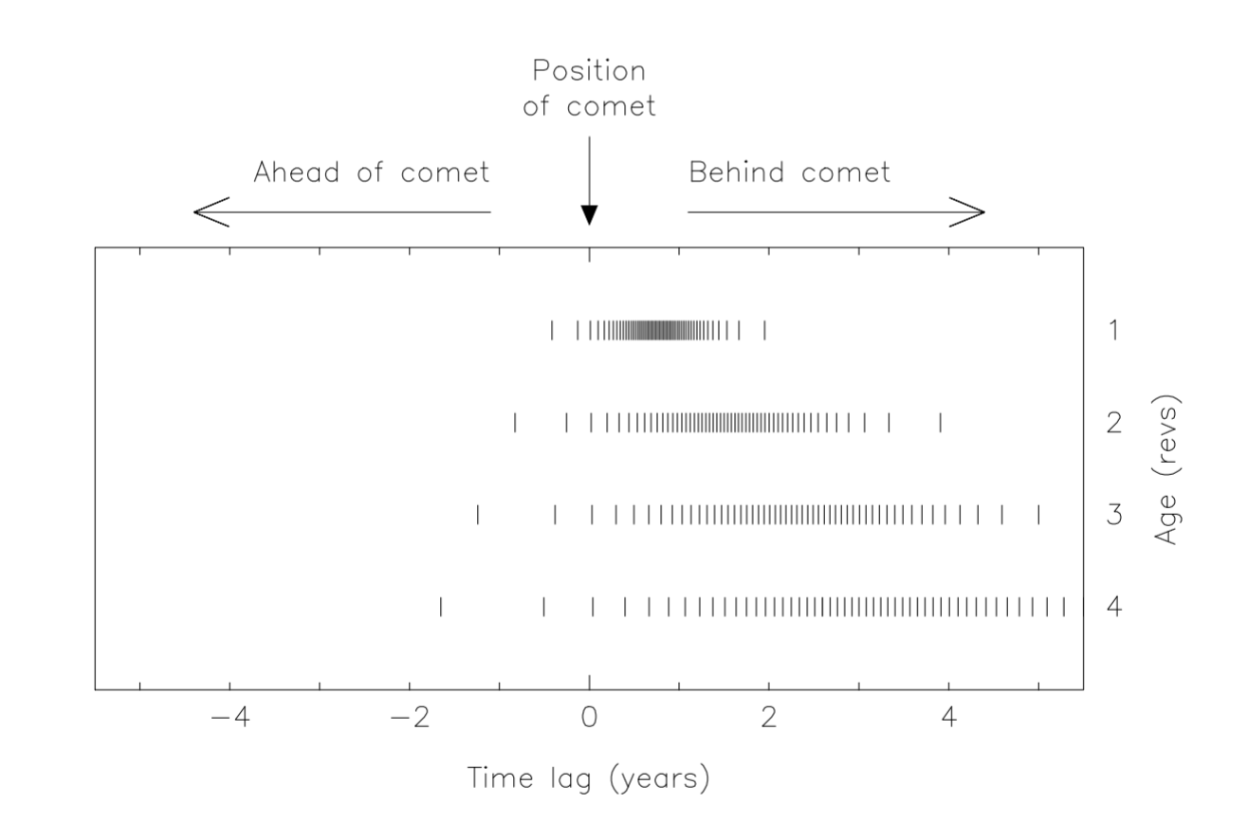
Particle dispersion in sequential orbital revolutions
with the effects of solar radiation pressure (Asher, 1999)
In our model, the effect of solar radiation pressure was to add about 1 au to the range of integration, i.e.,
radiation pressure increases the orbital period.
Notes:
How particles disperse as the number of revolutions increase.

Slide 9
Methodology: We used Everhart’s RADAU algorithm as implemented in the Mercury Integrator package (Chambers, J.E., 1999:793-799) using gravitational effects of all
8 planets and solar radiation pressure.
• Integrations carried out over a range of 16 – 22 au
(Halley’s semi-major axis a_{c} = 18 ± 3 au, adjusted by + 1 au for solar radiation pressure (as noted above),
• For each subject year initially integrated 400-600 particles with a typical particle spacing of 0.01 au, beginning with the one revolution trail and increasing to Halley passages as early as 1404 BC.
Once a solution was suspected the integrations were continued decreasing the
spacing down to 0.00001 au. Iterations were continued until the particles converged and solutions were determined according to time of outburst and:
Δr, Δa₀ and f_{M}
NOTE: Accurate comet data required! – parameters at perihelion passage: (Yeomans and Kiang, 1981), close back through 240 BC and close enough back to 1404 BC (0.04 au close approach). Data on 8 planets at each Halley perihelion: (Horizons, NASA website).
Notes:
“Data on 8 planets” could read “8 planetary state vectors” (David, may 14, 2016). search the 16-22 au semi-major axis range for solutions in these 3 key parameters that produce an encounter during the maya classic period.

Slide 10
The Eta Aquariids occurred during approximately April 9-14 during the Maya Classic Period. Therefore, to insure full coverage of possible events related to an Eta outburst, dates occurring throughout the entire month of April were analyzed:
• 54 dates back to and including 240 BC out of 63 total dates.
44 of these 54 analyzed back to at least including 616 BC
29 of these back to 1404 BC.
★ Results included 18 possible outbursts out of those 54 dates.
2 of these met criteria for a strong outburst:
⬥ AD 531 -- caused by previous recent revolutions of Comet Halley.
⬥ AD 849 -- caused by particles released at the 466 BC perihelion passage of Halley and trapped into a 2:13 Jovian resonance.
Notes:
leave out 54 dates back to….1404 bc. we tested a lot of possibilities with a LOT OF INTEGRATIONS

Slide 11
Yr Solar Date Julian Moon Trail Δr Δa₀ f_{M} ± Time S
Long. (UT) age rise or Year Rev (r_{E} − r_{D}) (au) from
λ (d) set (au) vis range
531 | 42.018º | Apr 10.494 11:52 | 7.8 | s06:54 | 451 | 1 | + 0.00081 | + 0.075 | + 1.008 | +0h 39m | H
 | 41.939º | Apr 10.413 09:55 | 7.7 | s06:54 | 374 | 2 | - 0.00089 | + 0.052 | + 0.759 | vis range | H
 | 41.955º | Apr 10.429 10:18 | 7.7 | s06:54 | 295 | 3 | - 0.00155 | + 0.048 | + 0.666 | vis range | H
Table 1. Results for 1, 2 and 3 revolution trails for AD 531. Approximate time of radiant visibility: 08:00 − 11:13 UT (sunrise at 11:43). S = strength of outburst (H = high).
Most intense outburst in Maya Classic Period
Jenniskens Table 5e post-dicts ZHR = 900 (2006:666)
(reported as “Not observed”).
Notes:
Note decreasing values of f_{M} as revolutions increase.

Slide 12
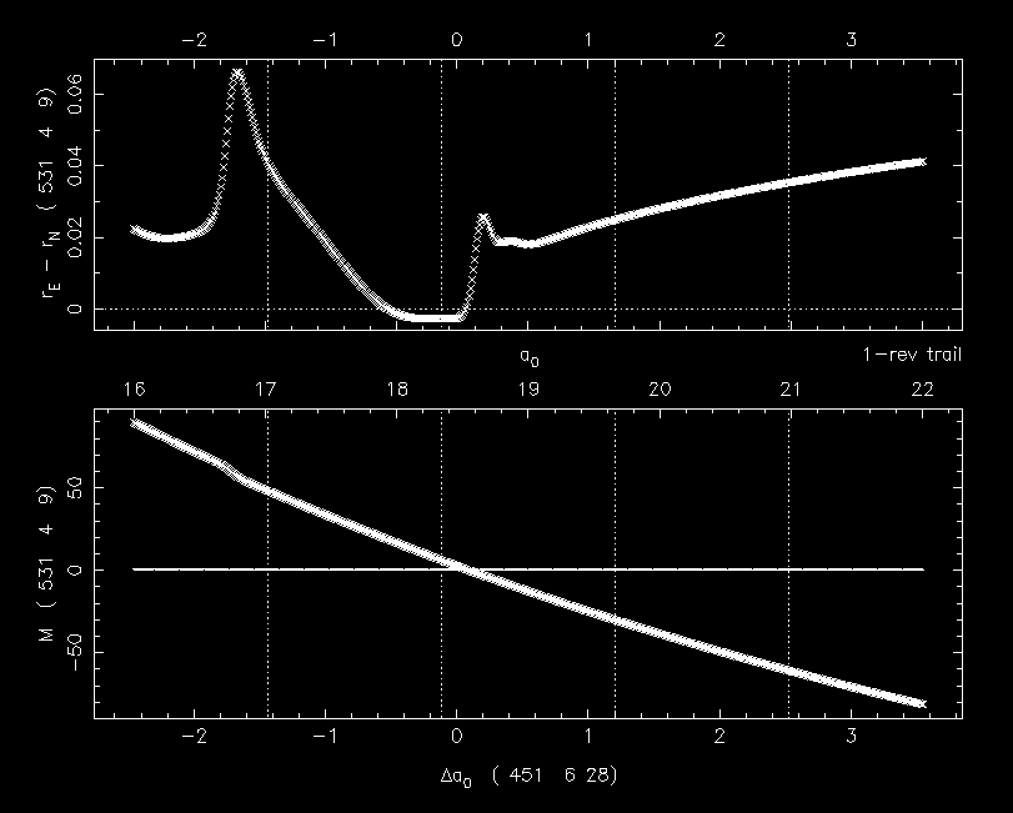
Notes:
Effects of gravitational perturbations can be seen when sequencing from the 451 trail to the 295 trail. Y-axis for M is nodal crossing time. “Time when particles reach the descending node.”

Slide 13
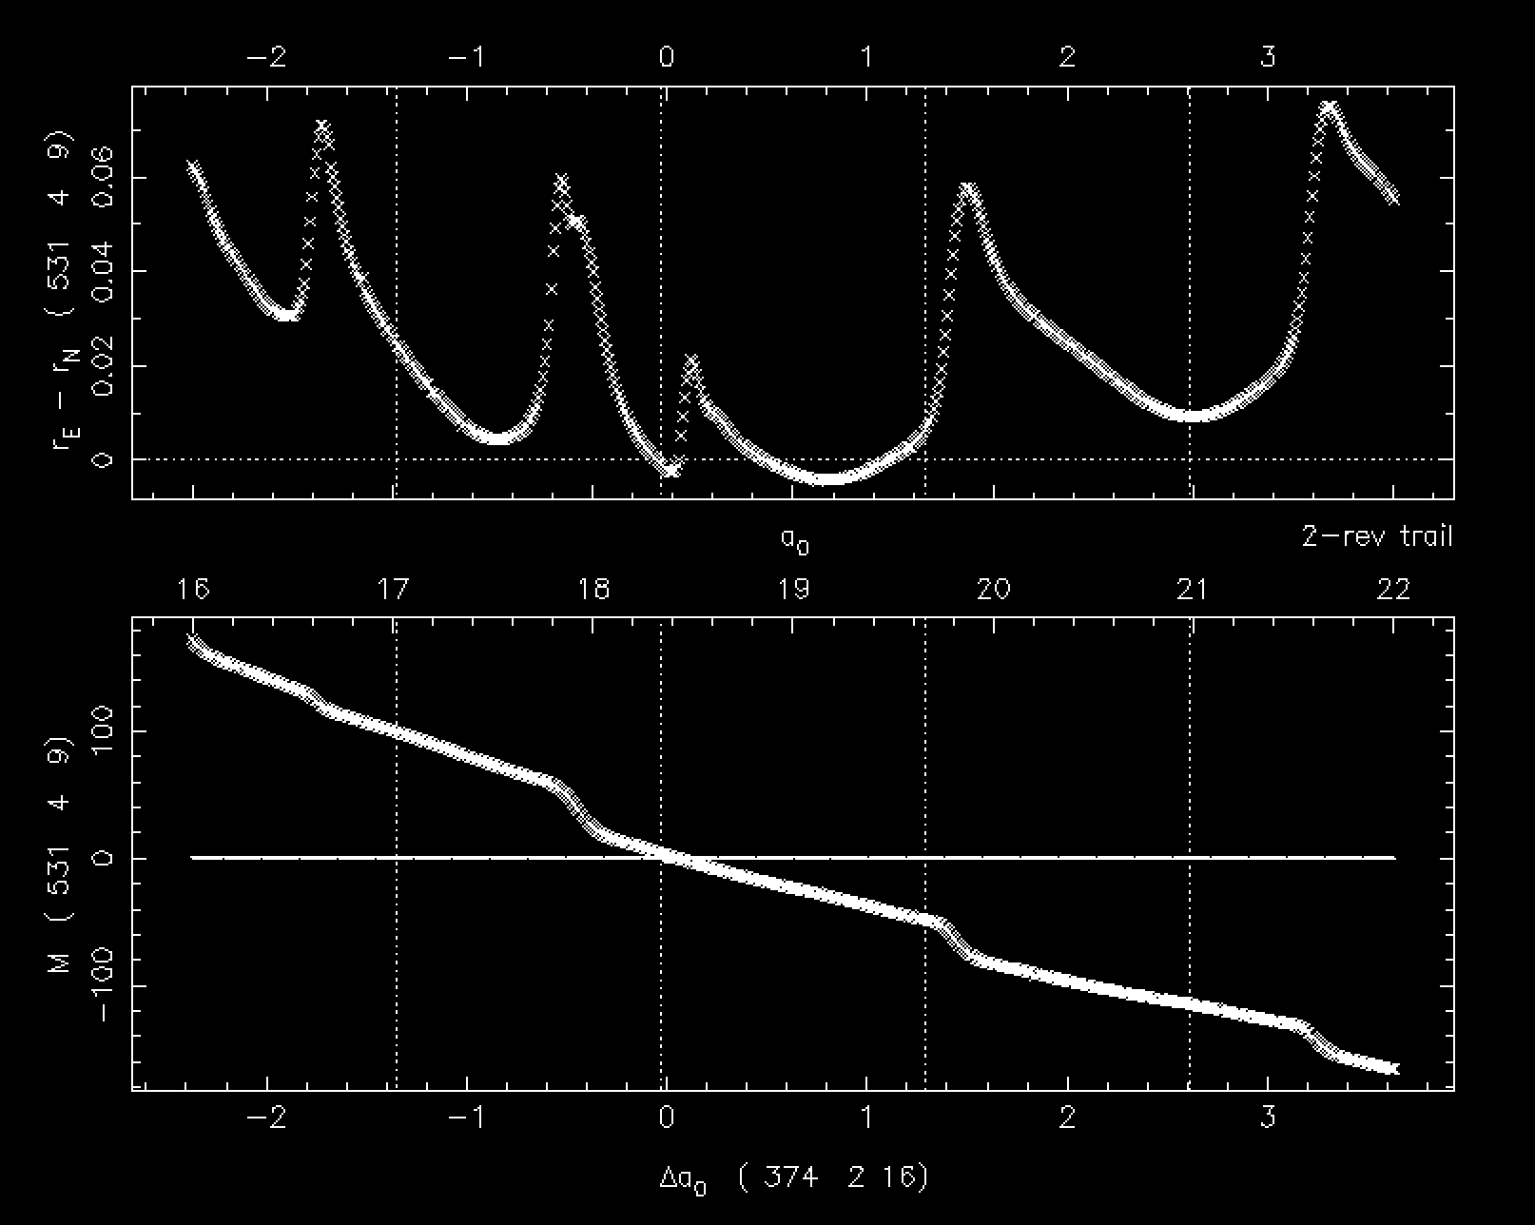
Notes:
Y axis for M mean anomaly is nodal crossing time—”Time when particles reach the descending node”

Slide 14
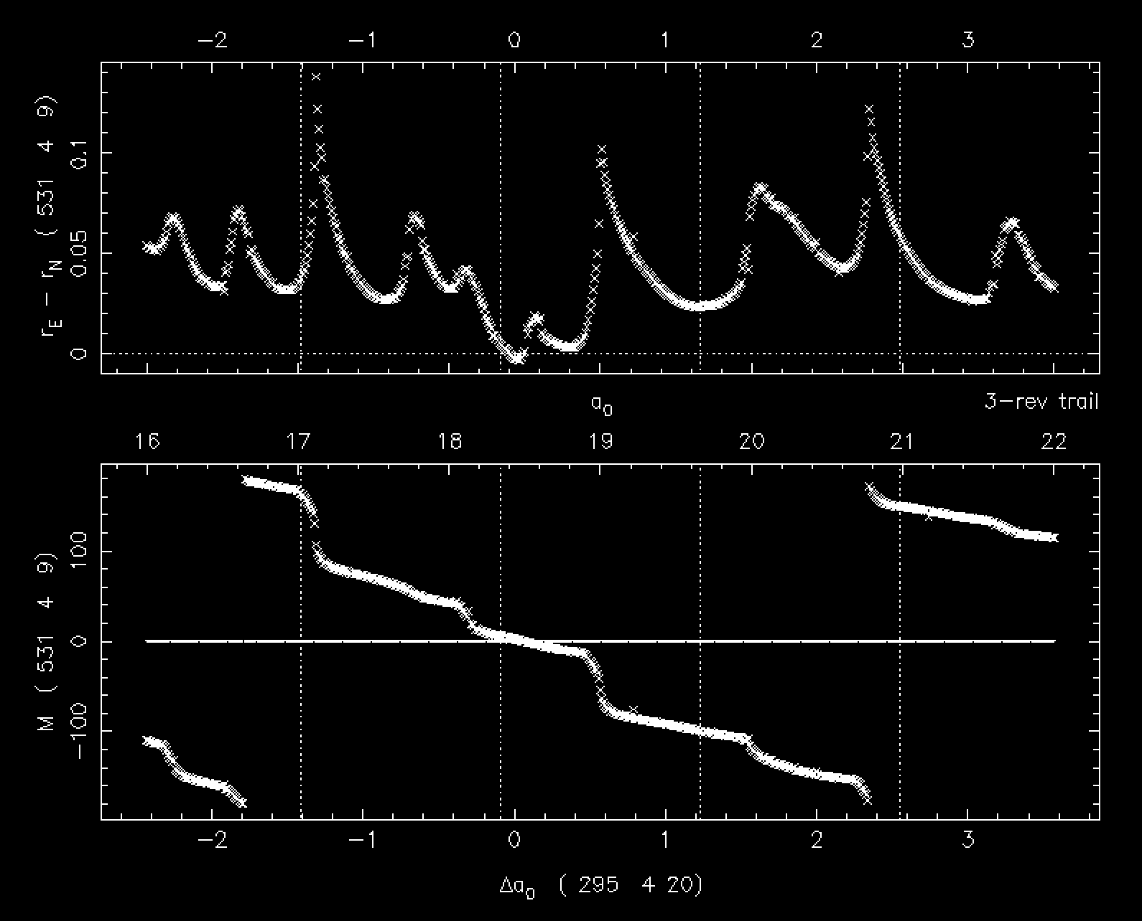
Notes:
Y axis M, “Time when particles reach the descending node.”

Slide 15
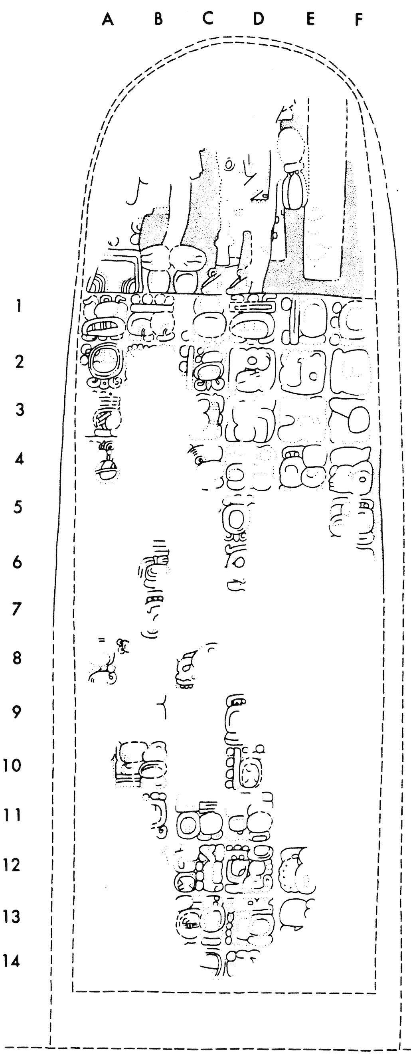
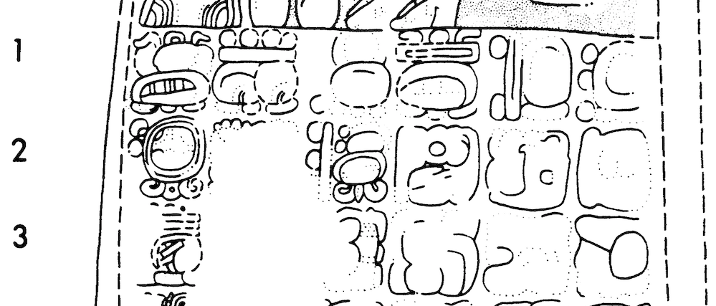
“8 days since the moon arrived”
Maya Long Count 9.4.16.13.3 Moon age 11.8 days
(Event [presumed]: ruler takes the royal throne [K’an I])
531 April 14 (+/- one day) 12:00 UT
Outburst: April 10, 09:55—11:52 UT Moon age 7.7 days
Solar Longitudes: 41.955º, 41.956º, 42.018º
Monument and location:
Stela 15, Caracol [Belize] (Drawing from Beetz and Satterthwaite, 1981)
Notes:
Moon age seems to note the date of the occurrence. Currently thought of as errors in lunar information.

Slide 16
Yr Solar Date Julian Moon Trail Δr Δa₀ f_{M} ± Time S
Long. (UT) age rise or Year Rev (r_{E} − r_{D}) (au) from
λ (d) set (au) vis range
849 | 44.327º | Apr 14.426 10:14 | 17.5 | s13:47 | -465 | 17 | - 0.00027 | + 0.638 | - 0.022 | vis range | H
 | 44.303º | Apr 14.401 09:38 | 17.5 | s13:47 | -465 | 17 | - 0.00040 | + 0.638 | + 0.022 | vis range | H
Table 1. Results for 17 revolution trail for AD 849. Approximate time of radiant visibility:
07:48 − 11:08 UT (sunrise at 11:38). S = strength of outburst (H = high). Moon light possibly a factor—moon is in Scorpius/Ophiuchus, sets at 13:47 UT.

Slide 17
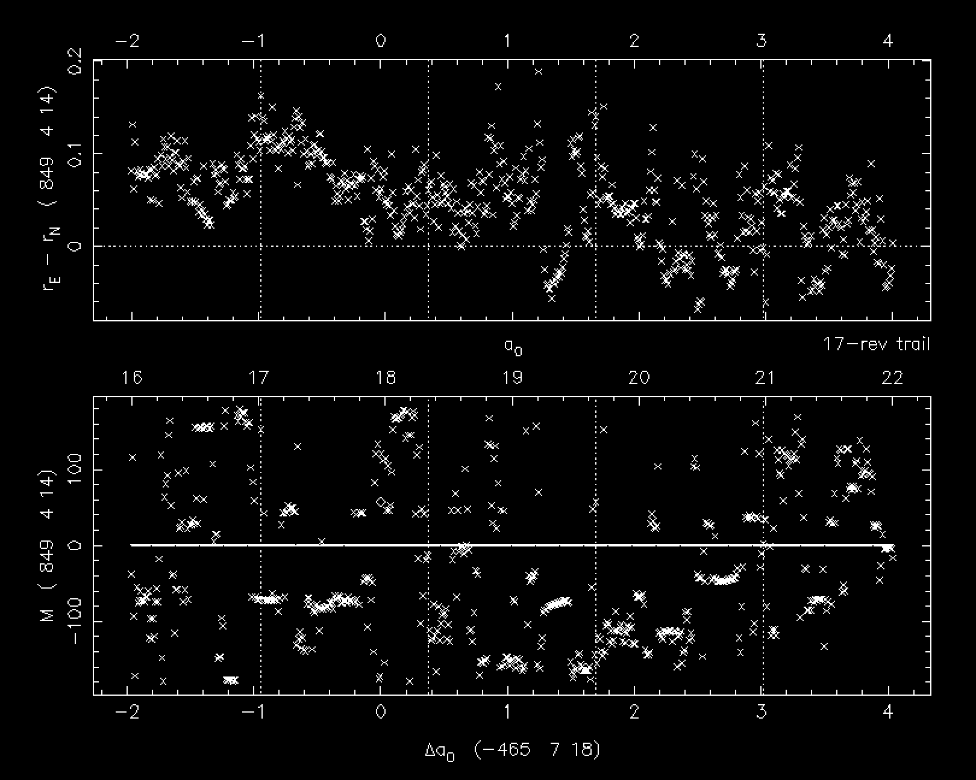
Notes:
Small area of possible resonance located at nodal crossing point, corresponds to small delta r.

Slide 18
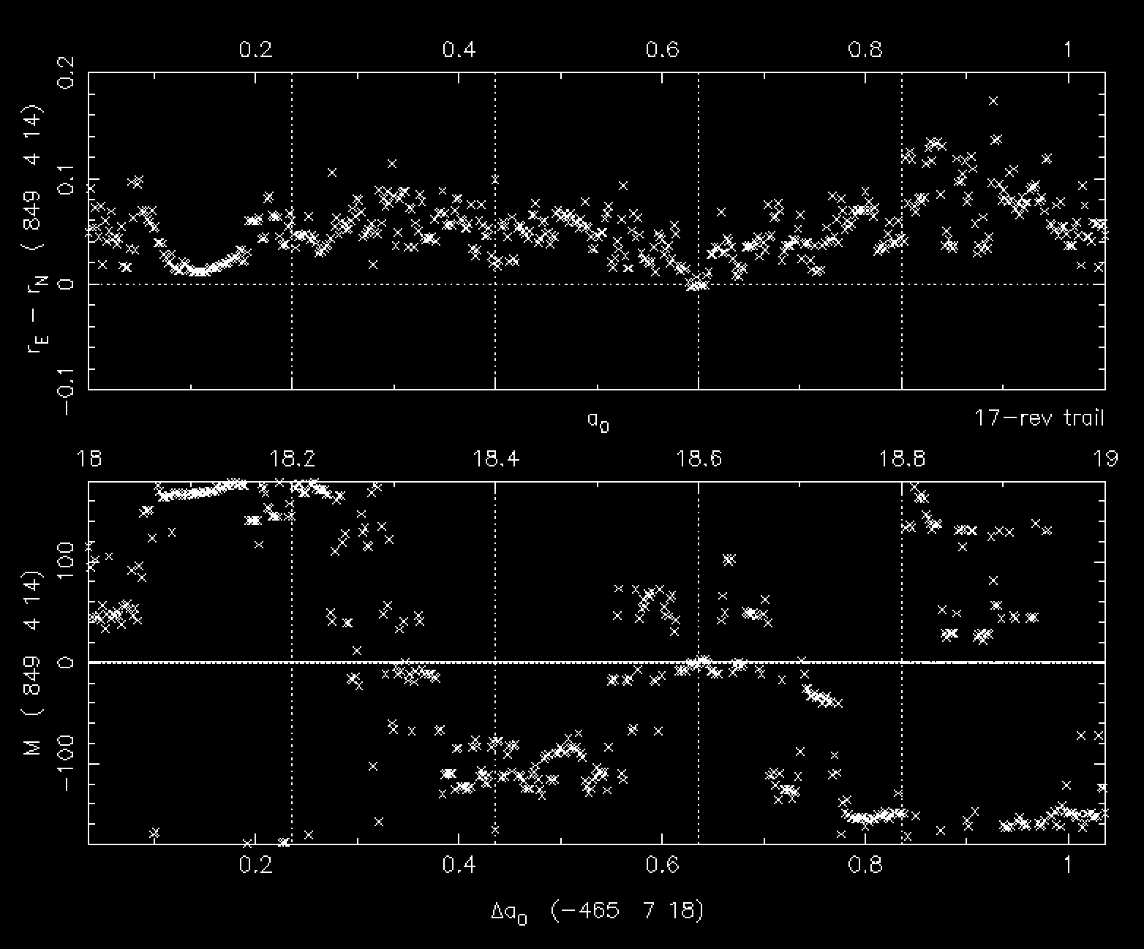
Notes:
Zoomed in shot of particles trapped in resonance

Slide 19
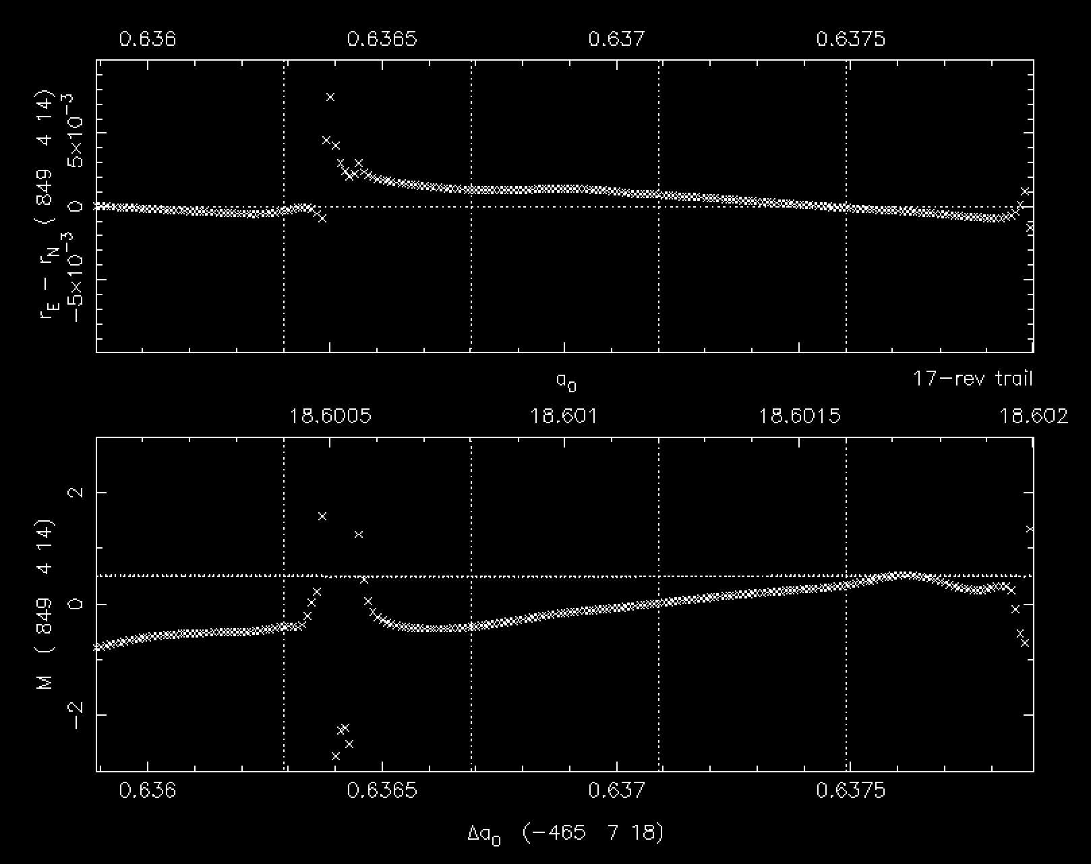
Notes:
Importance of resonance in keeping a compact grouping of particles to produce an outburst well into the future of the ejection year. Two points of the curve at the nodal crossing point.

Slide 20
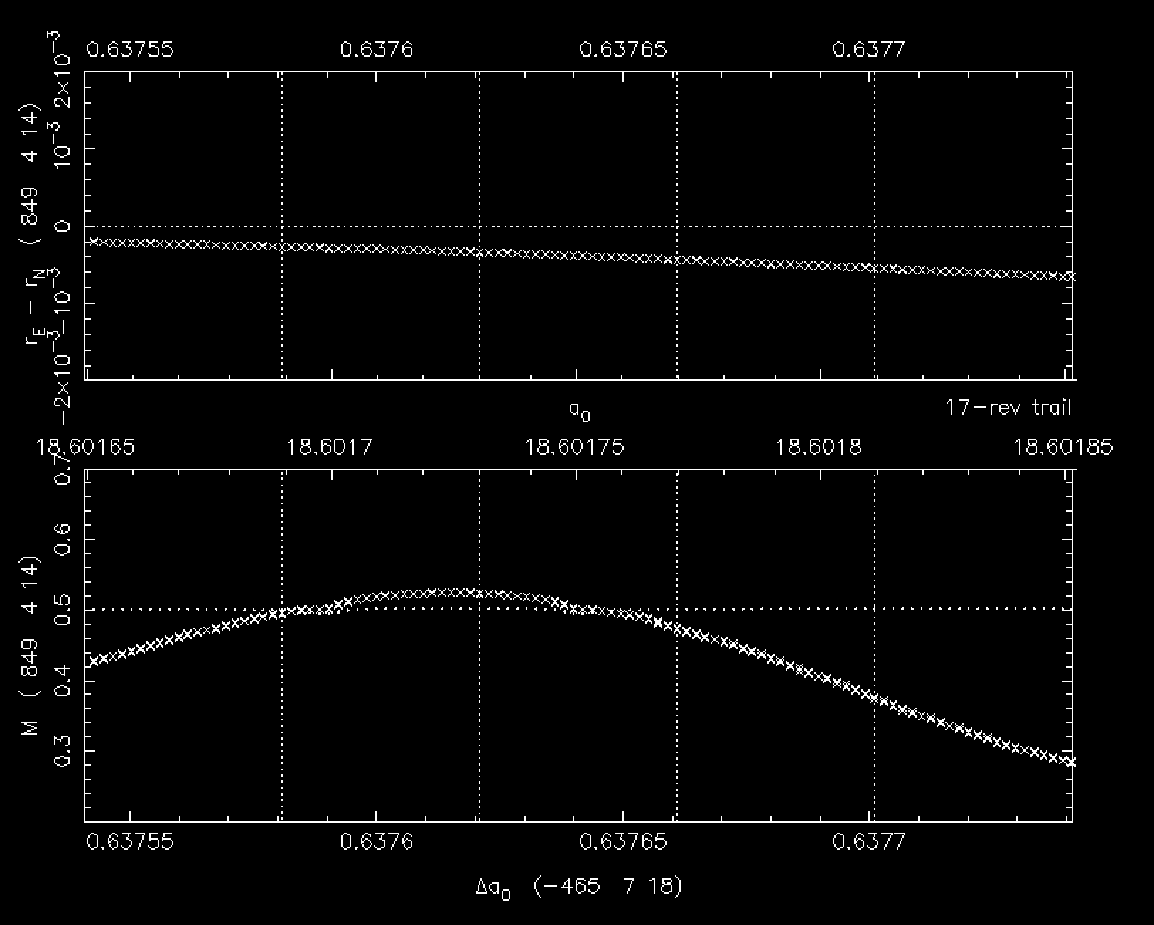
Δr = r_{E} − r_{D} = − 0.00027 au
Δr = r_{E} − r_{D} = − 0.00040 au
f_{M} = − 0.022
f_{M} = + 0.022
10:14 UT
09:38 UT
April 14
Δa₀ ~ 0.638
Notes:
With mean anomaly ≤ 0.02 throughout Δa₀ there may have been a continuous shower between.

Slide 21
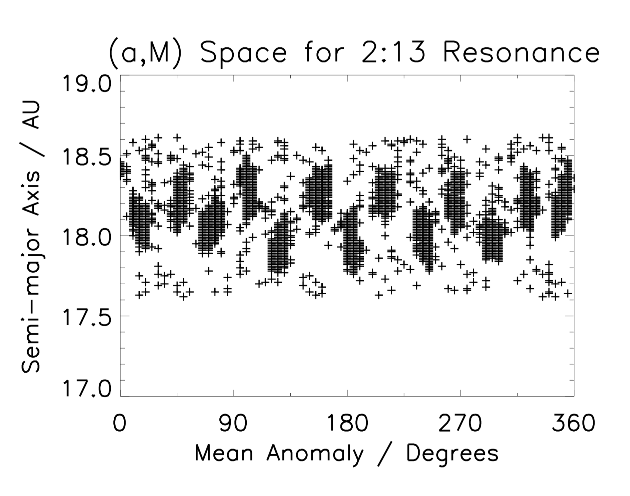
Sekhar and Asher (2013) showed that Comet Halley was in a 2:13 Jovian resonance from 240 BC until 1700, noting, “When the comet itself is resonant, there are more chances for the ejected meteoroid particles to get trapped in resonance which in turn would enhance the chances for meteor outbursts in future years.” ...We found this to be the case in the outburst of 849.
Notes:
Sekhar and Asher showed that comet Halley was in a 2:13 Jovian resonance from 240 BC until 1700 AD. A particle will stay within one of these clouds when in resonance as shown in the following slide, as indicated by the angle called the resonant argument (the angle you can plot to see if a particle is resonant). Our plotting program uses k₁ = 11, others zero, in practice makes virtually no difference. ASHWIN SHEKHAR

Slide 22
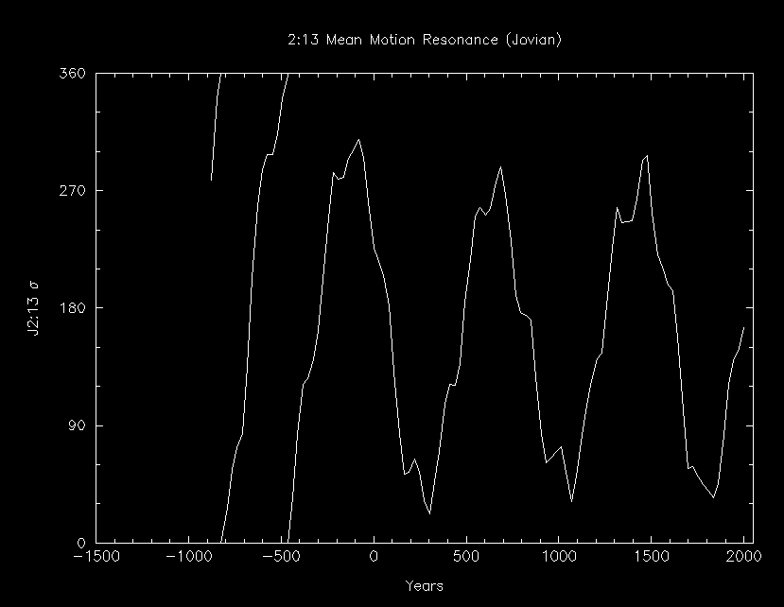
PParticle Rebounds to Stay in Resonance
~ 100 BC
Particle enters resonance
between
466 BC and
100 BC
466 BC
PParticle Rebounds to Stay in Resonance
Notes:
If a particle rebounds like this in sigma it corresponds to staying within one of the clouds in slide 22.

Slide 23
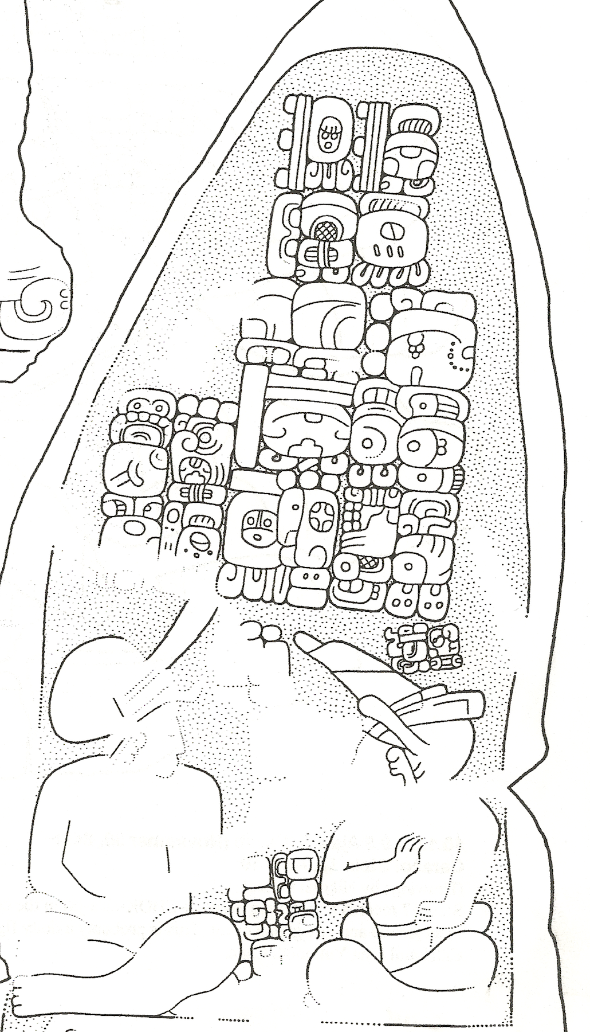
Maya Long Count 10.0.19.6.14
(non-standard Calendar Round date)
(Event: “He/she/it forms the Earth”?)
849 April 15, (+/- one day) 12:00 UT
Outburst: 849 April 14, 09:38, 10:14
Solar longitudes: 44.303º, 44.327º
Monuments and location:
Stela 17 and Altar 10, Caracol [Belize]
(Drawing by Nikolai Grube).
“Pre-creation” event:
3298 BC Mar 17/18
Post-dicted Eta Aquariid outburst?
(Solar longitude 43.0º)
Notes:
849 april 15, 12:00 UT, is the 584286 correlation; April 14 is the 584285 correlation.

Slide 24
Conclusions
The Maya likely recognized and noted the Eta Aquariid meteor shower.
Two of the most intense Eta outbursts (AD 531 and 849) during the Classic Period seem to have been associated with specific dates and events in the Maya record.
Outbursts were caused both by particle ejections from recent revolutions of Comet Halley and by earlier trails where clusters of particles were trapped in resonance.
The AD 531 outburst was likely the most intense Eta Aquariid that the Maya experienced during the Classic Period and was caused by recent revolutions of Halley in AD 451, 374 and 295. A post-dicted outburst in 531 of an estimated 900 ZHR had previously been noted as “not observed” by Jenniskens (2006:666, Table 5e).
The AD 849 outburst was caused by particles ejected during the 466 BC Halley perihelion passage. Those particles were trapped in a 2:13 Jovian resonance no earlier than 466 BC and no later than approximately 100 BC; most of those particles remained trapped in resonance until at least approximately 1700.
Notes:
recent revolutions where the particles haven’t had time to disperse and by earlier trails where the resonance has stopped the particles from dispersing.

Slide 25
Future Objectives
Perform similar numerical integrations on suspect dates for the Orionid and Perseid meteor showers.
Correlate specific events recorded by the Maya in the hieroglyphic script to specific outburst dates.

Slide 26
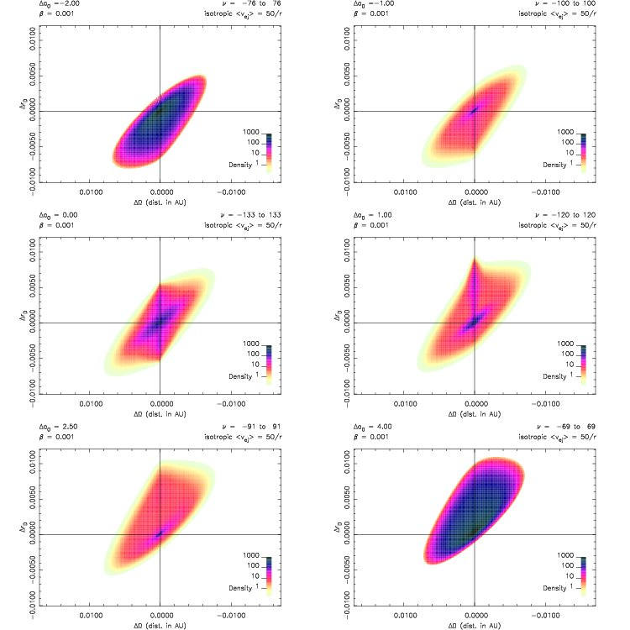

Slide 27
