Slide 1
Characteristics of meteor plasma distributions from radar head echoes
Meteoroids 2016
Noordwijk, NL
June 7, 2016
Robert A. Marshall¹
Sigrid Close²
Peter Brown³
Yakov Dimant⁴
Aerospace Engineering Sciences, University of Colorado Boulder, Boulder, CO, USA
Aeronautics and Astronautics, Stanford University, Stanford, CA, USA
Physics, University of Western Ontario, London, ON, Canada
Center for Space Physics, Boston University, Boston, MA, USA

Slide 2
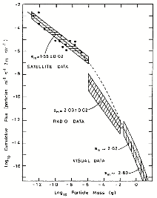
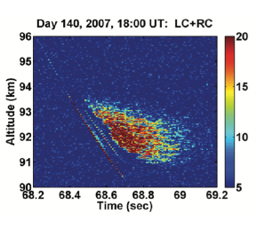
The Meteoroid Mass Flux
from Plane [2012]
from von Zahn et al [2005]
I am using meteor radar
head echoes to look at mass
from Close et al [2004]

Slide 3
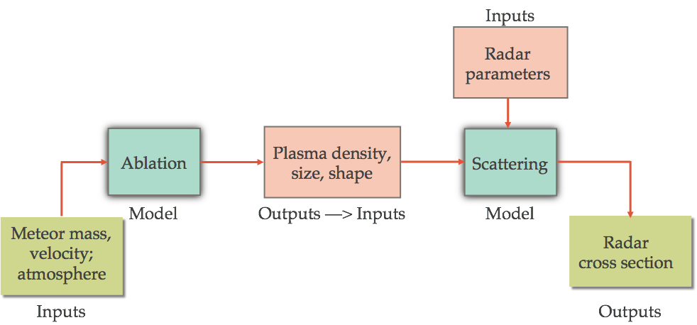
Goal: Determine parent meteoroid mass
Question:
Can we determine meteoroid mass and composition
From radar RCS, velocity, and other measurements?

Slide 4
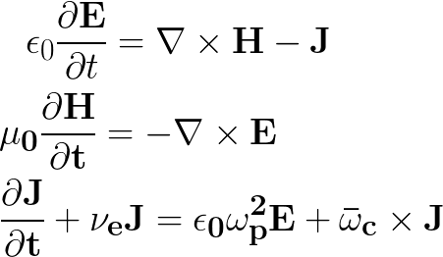
FDTD Modeling of Meteor Scattering
Forward model to calculate RCS from any meteor plasma distribution
FDTD is best when scattering object size r ~ wavelength λ
Meteor head plasma ~0.1 — 10 m; wavelength 0.5 — 10 m (600 MHz — 30 MHz)
Other advantages: arbitrary plasma distribution, arbitrary radar pulse shape, polarization, etc.
Model solves Maxwell’s equations and Langevin equation on a 3D cartesian grid
cold, collisional, magnetized plasma
Standard Yee [1966] grid with Lee & Kalluri [1999] plasma method (soon to be replaced)

Slide 5
Example Simulation: underdense
ωp,max/ω0 = 0.5; meteor radius = 1.5 m

Slide 6
Example Simulation: overdense
ωp,max/ω0 = 3; meteor radius = 1.5 m

Slide 7
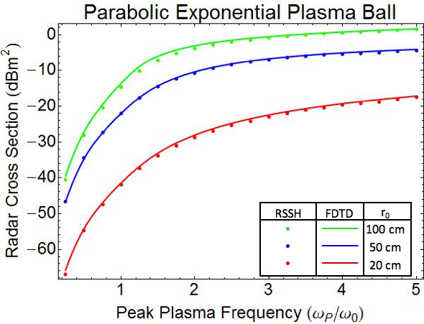
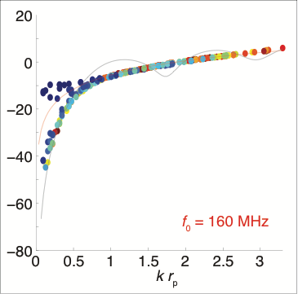
RCS dependence on size and density
Comparison with WIPL-D MOM computation
(Paul Bernhardt)
Reduced to one independent parameter:
overdense radius
*RSSH = Radially Stratified
Spherical Harmonic
Color coded by
ωp,max/ω0
For overdense meteor head echoes, the RCS is given by the overdense area
— overdense radius

Slide 8
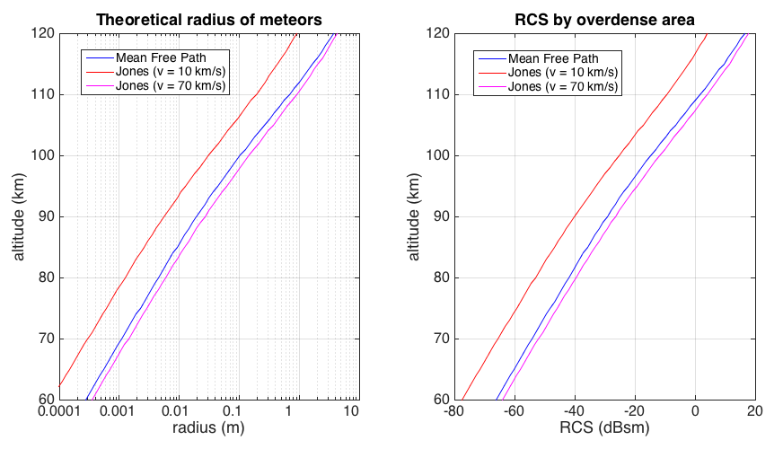
Implications: Expected RCS for overdense meteors
Very small RCS (less than -80 dBsm) likely due to underdense meteors
This is only if r0 = rp

Slide 9
Application to Data
CMOR (Canadian Meteor Orbit Radar) radar observations of head echoes
Data from Peter Brown; measurements made in Ontario, Canada
17.45, 29.85, and 38.15 MHz simultaneously
Also observed in optical, telescopic: verified minimal fragmentation
Locations from interferometry; beam patterns then give calibrated RCS

Slide 10
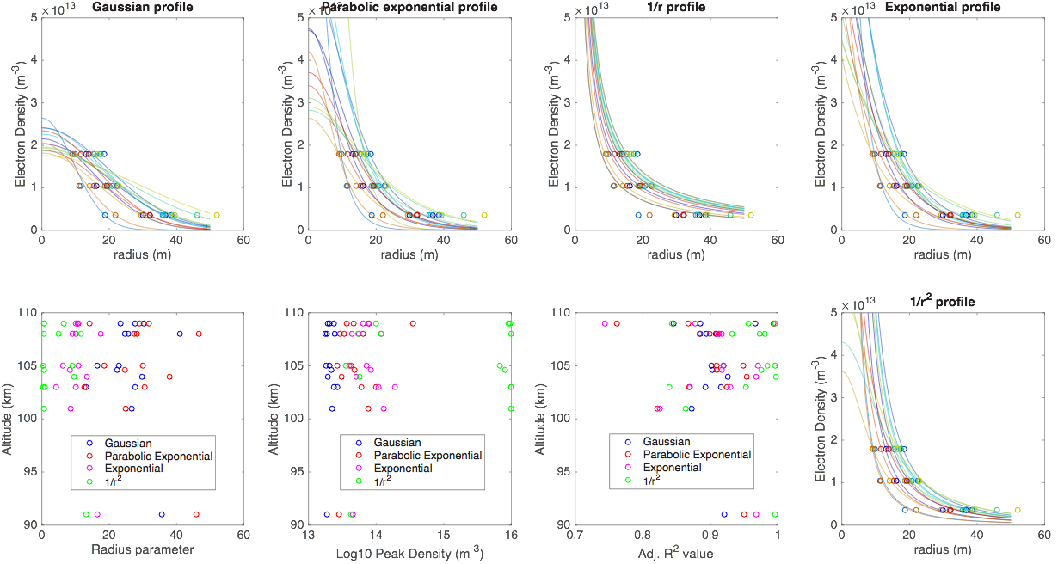
CMOR data fitting
1/r² distribution is best fit for most of these observations

Slide 11
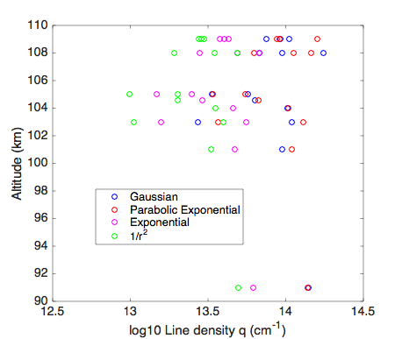
From ne profile to line density q
From density profile we can easily estimate line density q, which in turn determines mass [Close et al, 2004]:
How important is choice of fit to line density estimate?
Gaussian and Par. Exp. typically within 10% of each other
Exponential gives about 0.5 of that
1/r² gives about 0.25
1/r (not shown) gives 0.01!
Inversion to plasma parameters depends heavily on choice of distribution

Slide 12
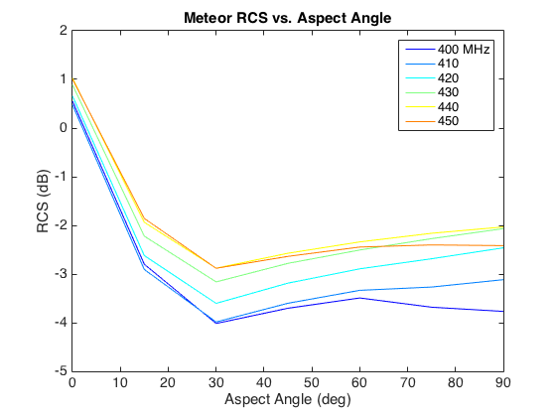
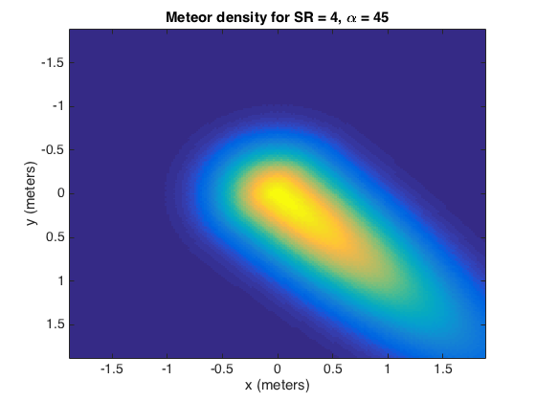
Aspect Angle sensitivity
RCS simulations for “elongated“ meteor
RCS is maximum for head-on scattering, reduced by ~3 dB for angles above ~15 degrees
Implications for q estimates!
SR = size ratio
RCS depends on aspect angle (if meteor is not spherically symmetric)

Slide 13
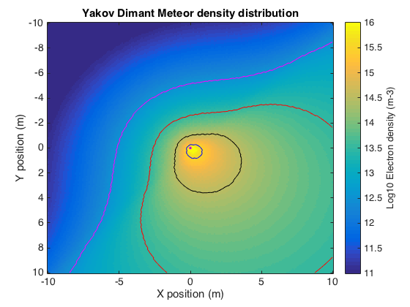
Multistatic Head Echoes
Recent experiments at EISCAT — data under analysis
Future experiments with other multistatic meteor radars (e.g. MMARIA, MARSSY, CMOR)
Monostatic RCS
Bistatic RCS x 2
With 3+ measurements, can get peak density, size, and shape from MMR
Not possible with monostatic, even with multiple f0
Ideal: MMR + multi-f0

Slide 14
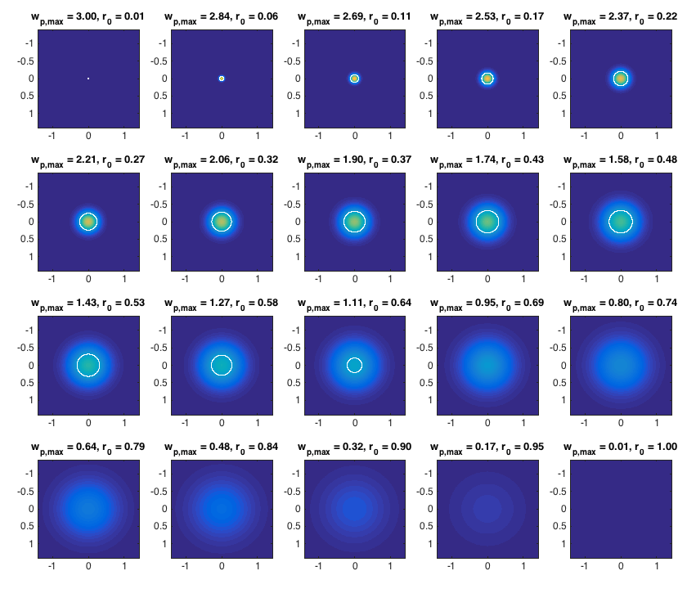
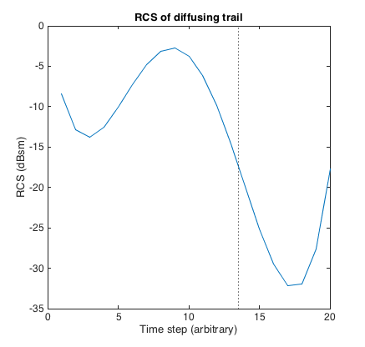
Bonus: Trail Modeling
Oscillations!
Bad model fitting

Slide 15
Summary / Ongoing work
For overdense meteors, RCS is given by “overdense area” of meteor plasma
For underdense meteors, need numerical model
Plasma distribution dramatically affects estimate of line density q and thus mass
Aspect angle affects RCS / q estimates
Ongoing:
Extension of RCS calculation to multistatic case (hard)
Comparison of RCS using Dimant distribution (almost done)
Scattering from meteor trails: 2D version of the model
Application to more data — multifrequency and/or multistatic

