Slide 1

Meteor trail lengths
Edward Stokan [estokan@uwo.ca]
Margaret Campbell-Brown
Meteoroids 2016 | June 8, 2016

Slide 2
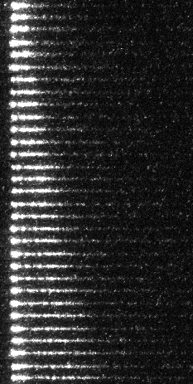
76.2 km
N
74.7 km
m
approx. 150 m

Slide 3
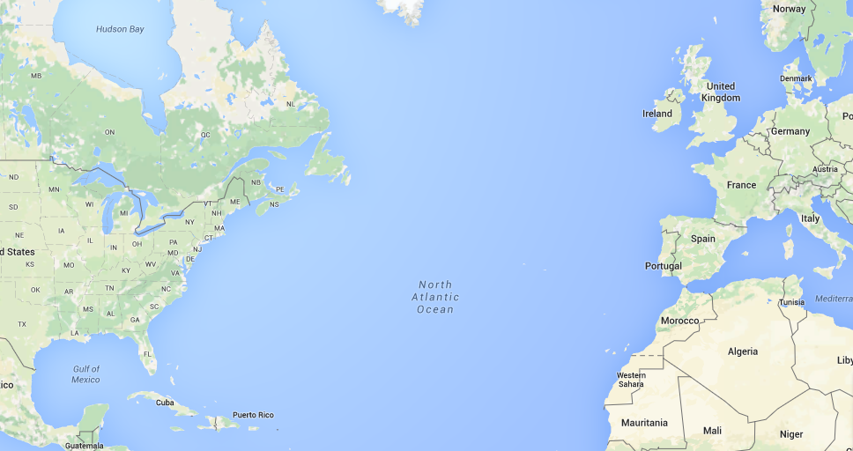
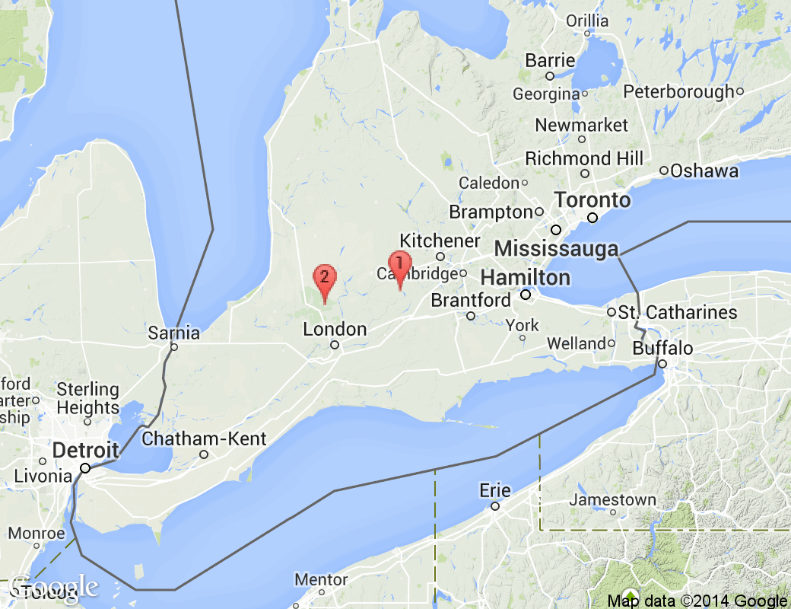
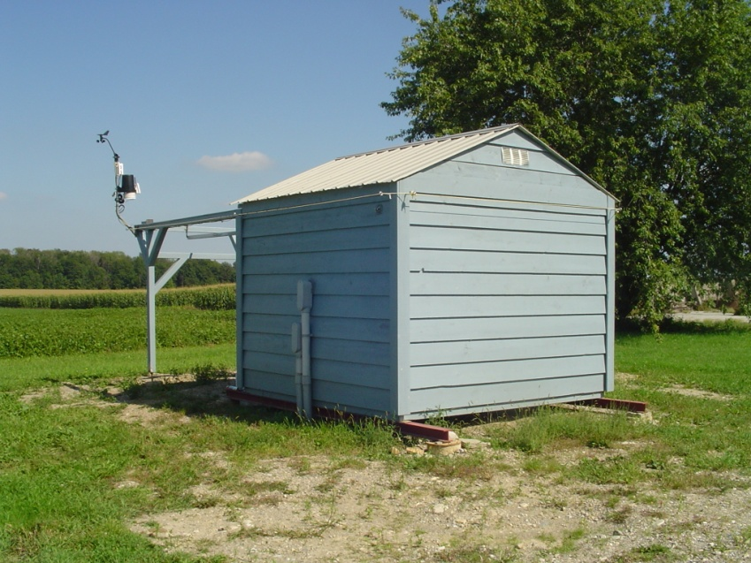
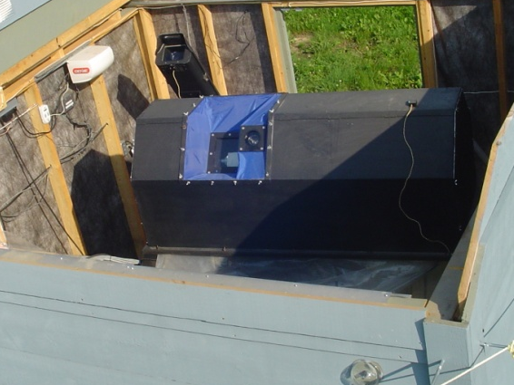
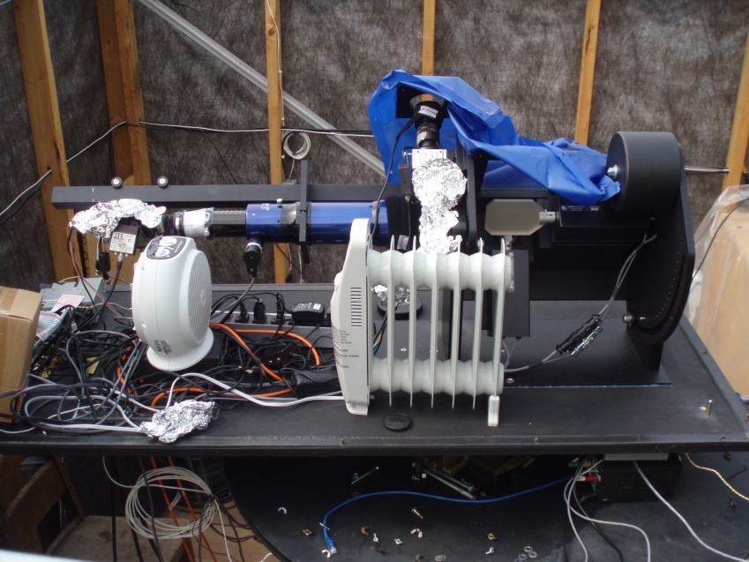
Canadian Automated Meteor Obs. (CAMO)
influx
wide field
narrow
field
50 km
wide field
mirrors
narrow field

Slide 4
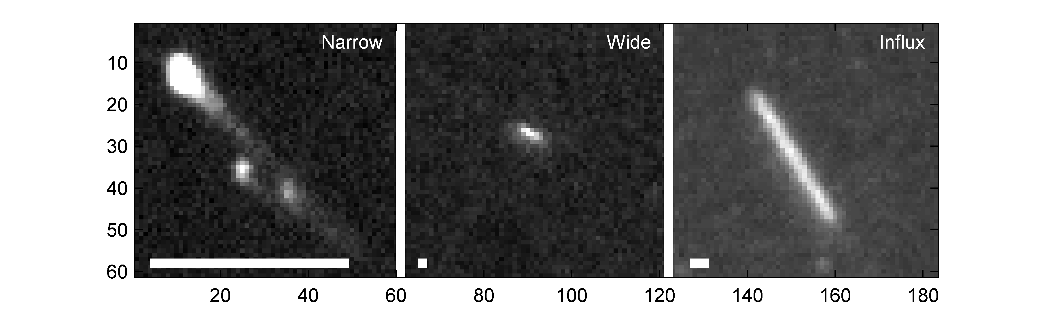
180 m
4.3 m
  1.5° tracking
110 fps
96 m
  28°
60 – 110 fps
  5 mag.
46 m
  21°
20 fps
  7.5 mag.

Slide 5
Approach
> Look at how far two fragments separate before one dies out
> Single-body ablation + narrow field photometry
> Fragment masses, densities
Planet. Space Sci. 48 (2000), 911 – 920

Slide 6


Perhaps the simplest example
∼3.2 km across

Slide 7
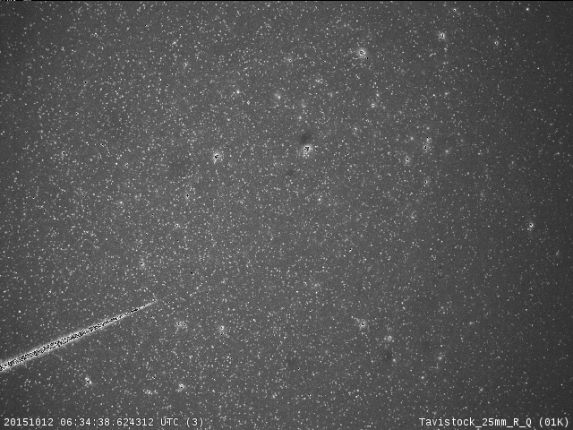
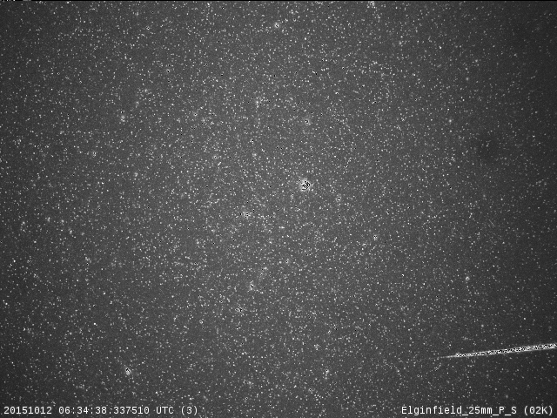
20151012_063438
T_{j} ∼ 3.5 – preliminary STA
v_{i} = 30.3 km s⁻¹ @ 95 km
v_{frag} ∼ 29.7 km s⁻¹ @ 81 km
∼3.2 km

Slide 8
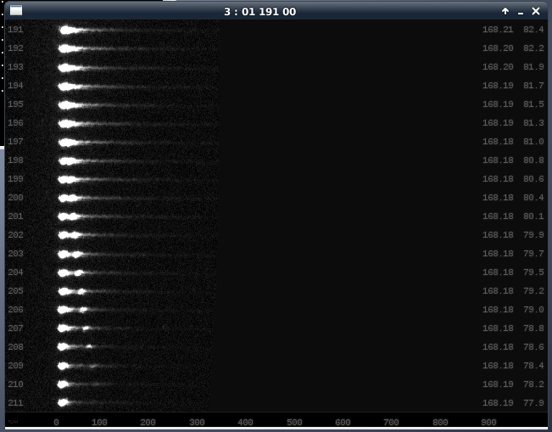
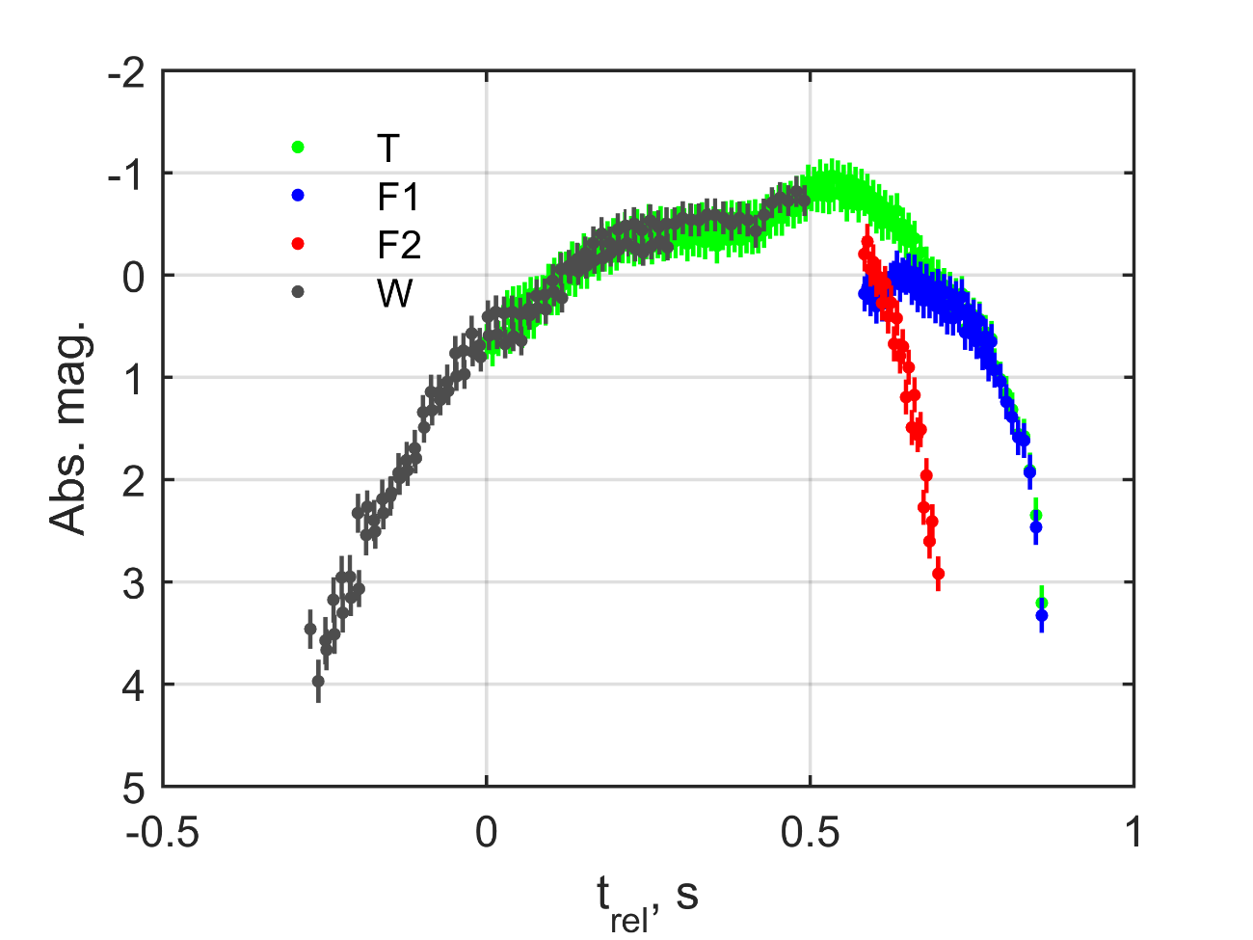
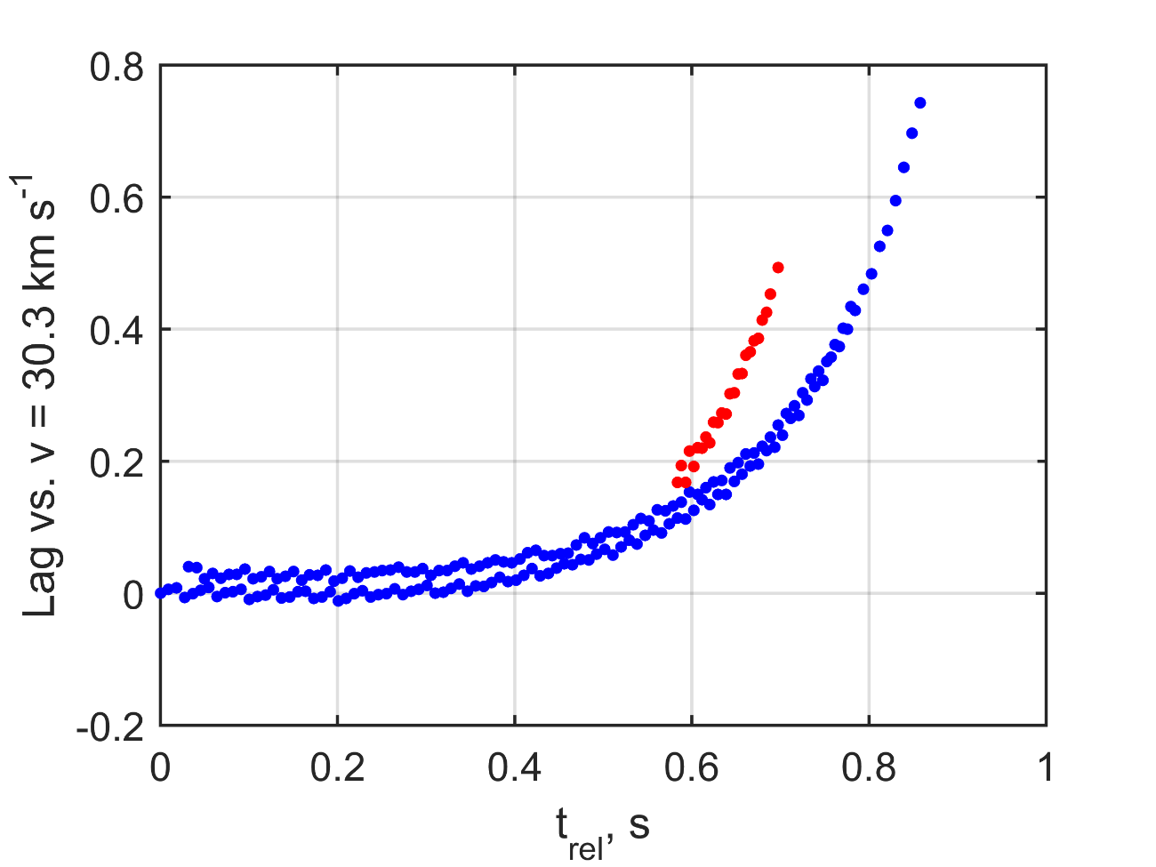
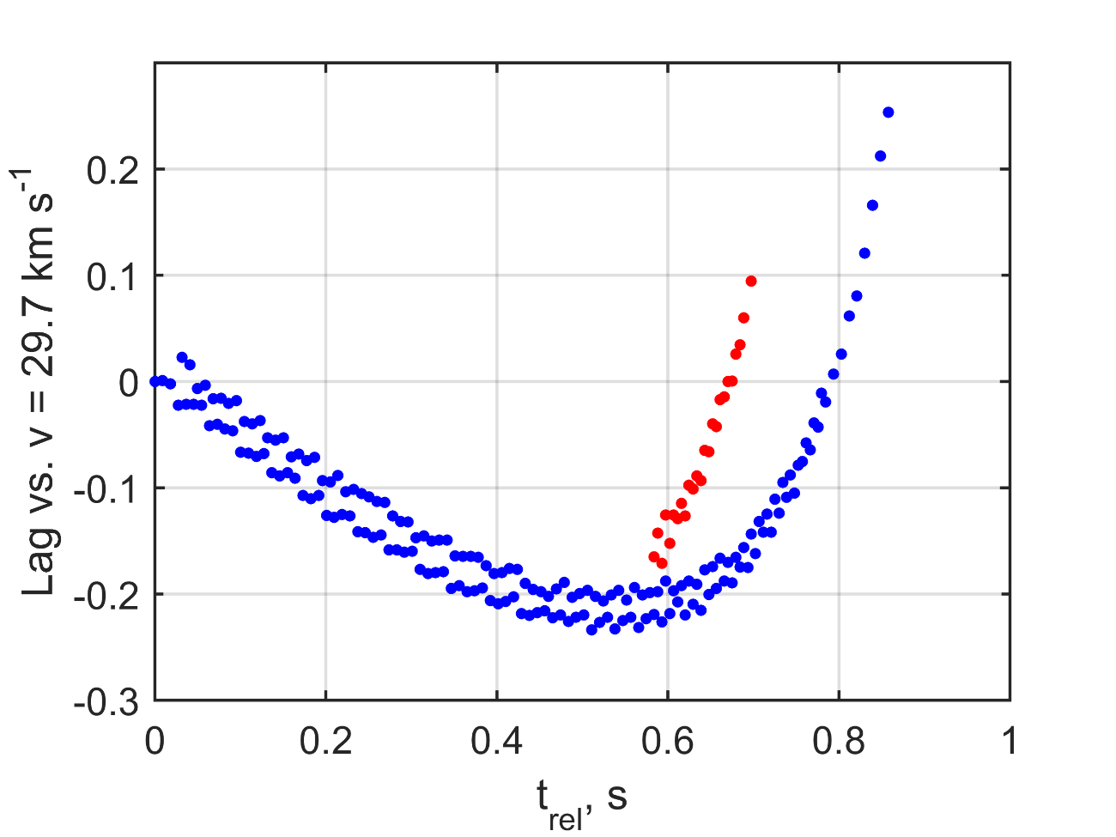
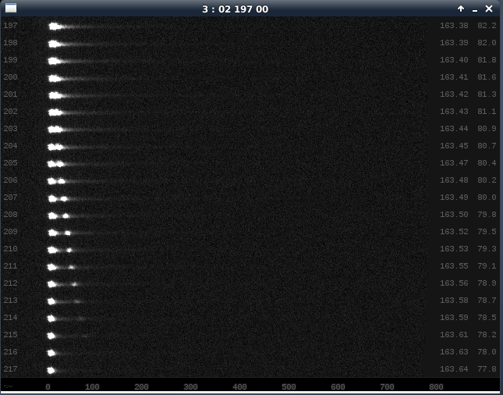
Δmag ∼ ±0.2
RMS resid. ∼ 2 m, max(resid.) = ±5 m

Slide 9
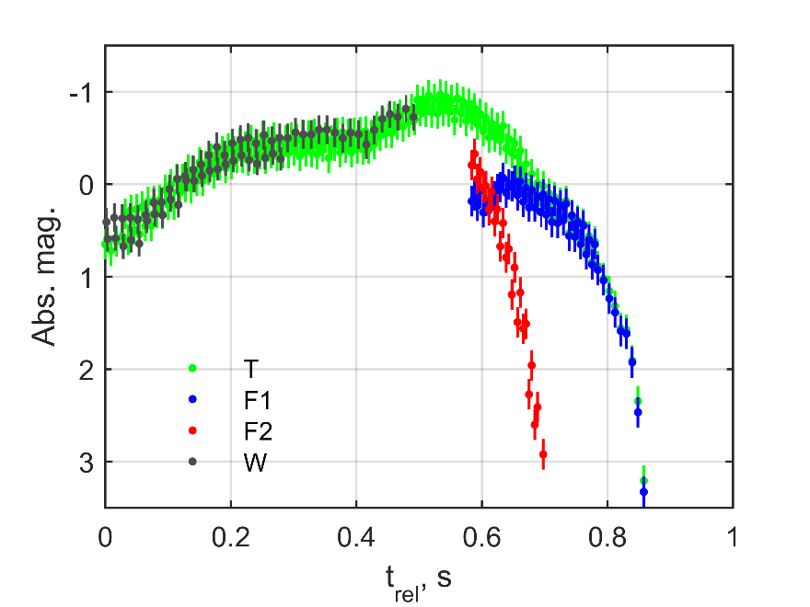

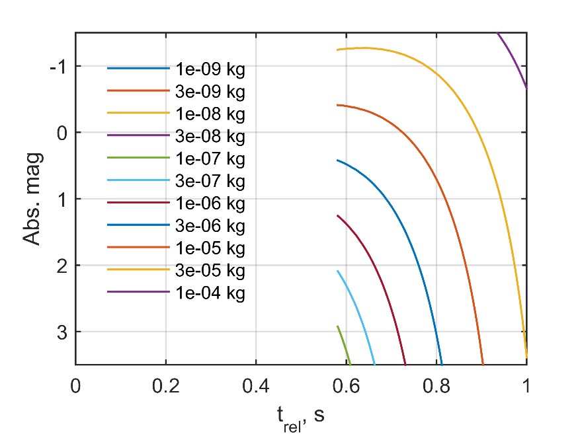
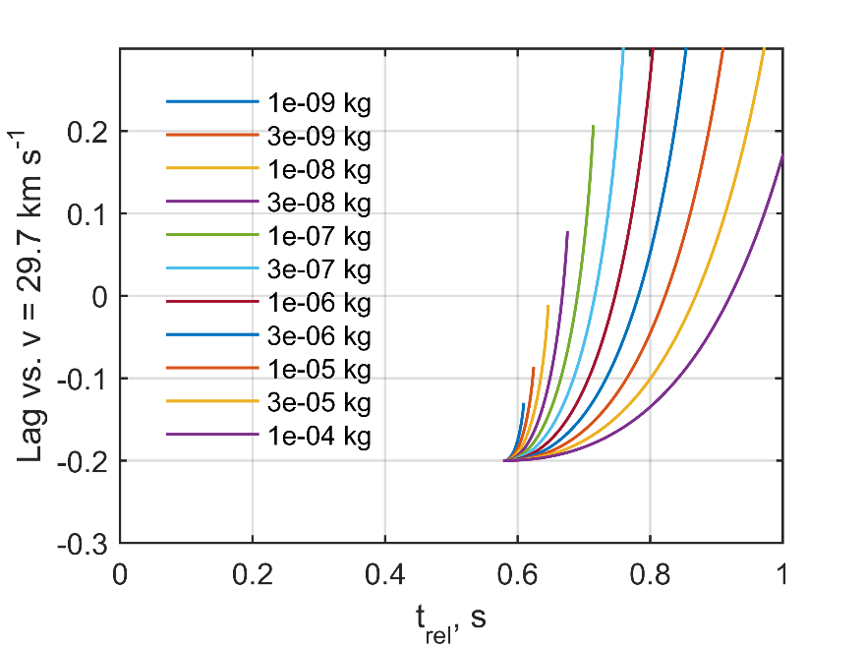
m = 3 – 10 mg
ρ_{met} = 2000 kg m⁻³

Slide 10
m = 0.01 – 0.1 mg
ρ_{met} = 2000 kg m⁻³

Slide 11
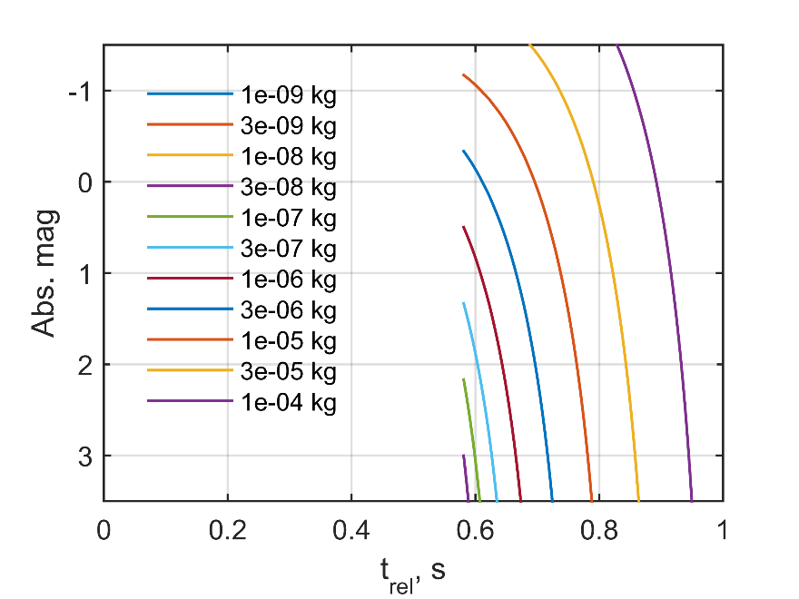
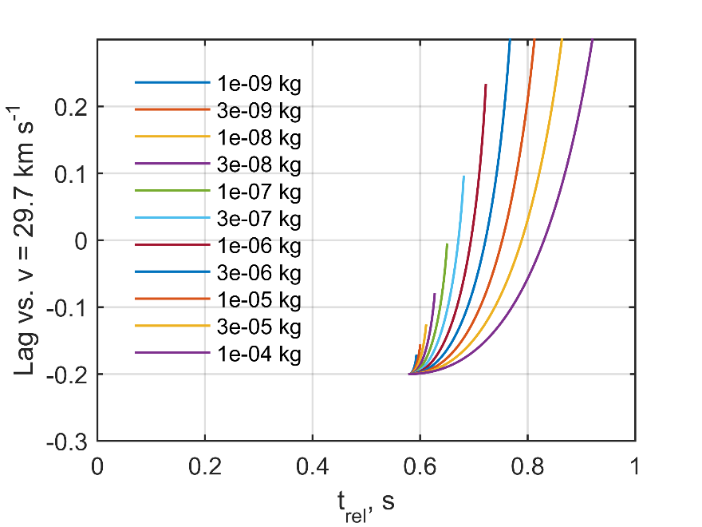
m = 0.3 – 1 mg
ρ_{met} = 700 kg m⁻³

Slide 12
Comments + to do
STA… Encke?
reasonable?
F1: 3 – 10 mg | ρ = 2000 kg m⁻³
F2: 0.3 – 1 mg | ρ < 700 kg m⁻³
Uncertainties
Alternate method for binary fragments
Actual trail length calculations

Slide 13
Thank you
Edward Stokan (estokan@uwo.ca)

