Slide 1


A preliminary comparison of MAARSY head echo measurements simultaneously detected with optical instrumentation
P. Brown¹, G. Stober², C. Schult², Z. Krzeminski¹, W.Cooke³, and J.L. Chau²
¹ Meteor Physics Group, Dept. of Physics and Astronomy, Univ Western Ontario,
London, Canada
² Leibniz Institute of Atmospheric Physics, Rostock University
Kuhlungsborn, Germany
³ NASA Meteoroid Environment Office, EV44,
Marshall Space Flight Center, Huntsville, AL, USA

Slide 2
Simultaneous radar/video observations
Radars and optical instruments are valuable tools for studying meteoroids, but suffer from (different) observing biases.
Simultaneous observations with radar and video can help constrain the true masses being detected
Fragmentation a key issue.

Slide 3
Meteoroid radiation and deceleration
I – light intensity, τ - luminous efficiency, A – shape factor,
Γ-drag coefficient, ρ_{m,} ρ_{a} - meteoroid and atmospheric densities
Based on light production photometric mass is determined (for small meteors neglecting deceleration)
M_{ph}
Problem:
poorly known luminous efficiency
If deceleration is measured
dynamic mass may be estimated
M_{d}
Problem:
fragmentation
To determine mass from optical observational data alone –
Need absolute luminous efficiency in your bandpass or figure out fragmentation

Slide 4
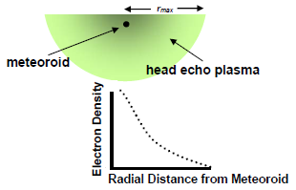
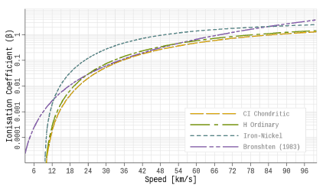
Head Echo Ionization Mass
Based on received radar power from head echo, an equivalent RCS can be measured for each returned pulse
M_{I}
Problem:
Need to convert RCS to total electron content, assuming some scattering model and radial size of electron cloud and distribution of electrons.
Ionization coefficient (electron production per ablated meteoric atom) also uncertain
Close (2004)
Weryk (2012)

Slide 5
MAARSY – Optical Campaign Goals
Compare speeds, begin/end heights and radiants measured by MAARSY and two station optical solutions for both bright (wide-field) events and fainter meteors
Compare photometric and dynamic mass with RCS-derived masses
  Goal – relative intercalibration of mass scales
Put all metric, photometric and ionization estimates together to try and self-consistently model specific events

Slide 6
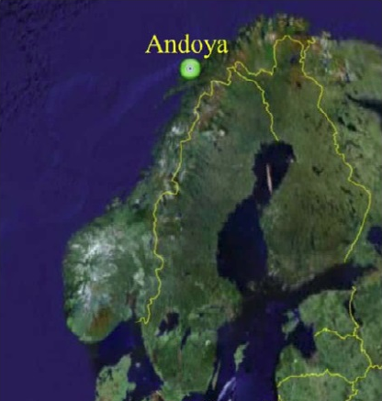
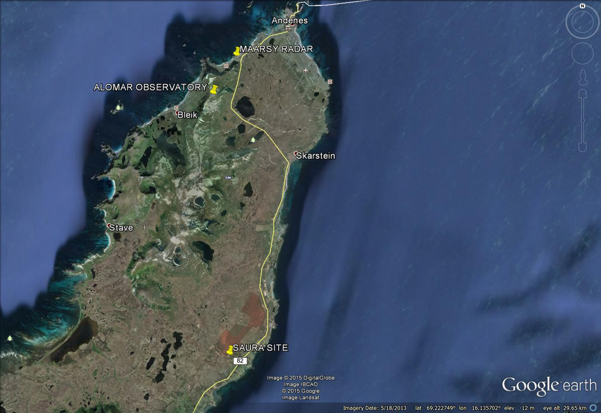
15 km
10 km

Slide 7
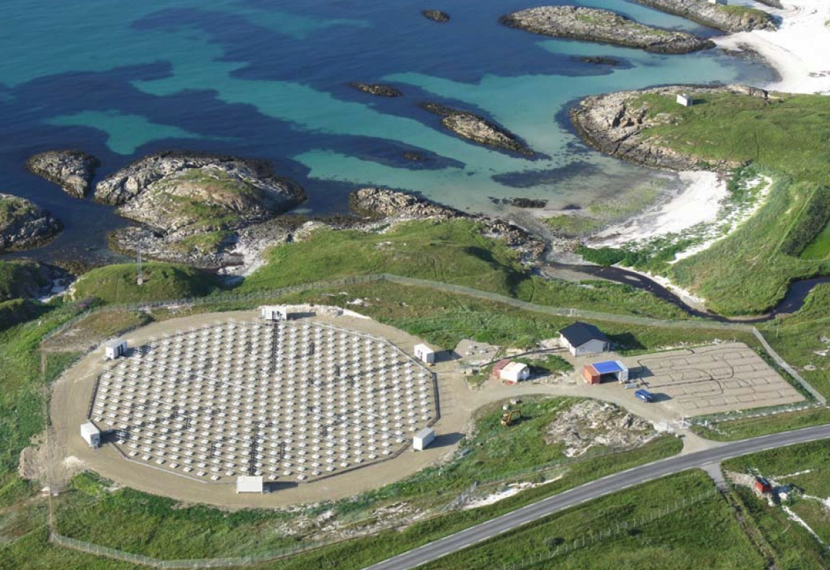
Middle Atmosphere Alomar Radar System-MAARSY
Experiment Specification
Pulse Repetition Freq. | 1000 Hz
Pulse coding | 16-bit complementary
Pulse length | 4.8 km (160 μs)
Duty Cycle | 3.2%
Range Resolution | 300 m
Start Range | 49800 m
End Range | 134700 m
Beam direction | Vertical (zenith pointing)
Hardware Specification
Frequency | 53.5 MHz
Transceiver-modules | 433
Power | ~866 kW
Antennas | 433 3-element (crossed) Yagi Antennas
Gain | 33.7 dBi
Aperture | ~6300 m²
Beam width | 3.6°
Beam steering capabilities | freely steerable with 35° off-zenith
Receiver channels | 16
Notes:
MAARSY
- active phased array antenna
- each antenna freely adjustable in frequency, power and phase
multi-channel reciever system for high flexibility on reception

Slide 8
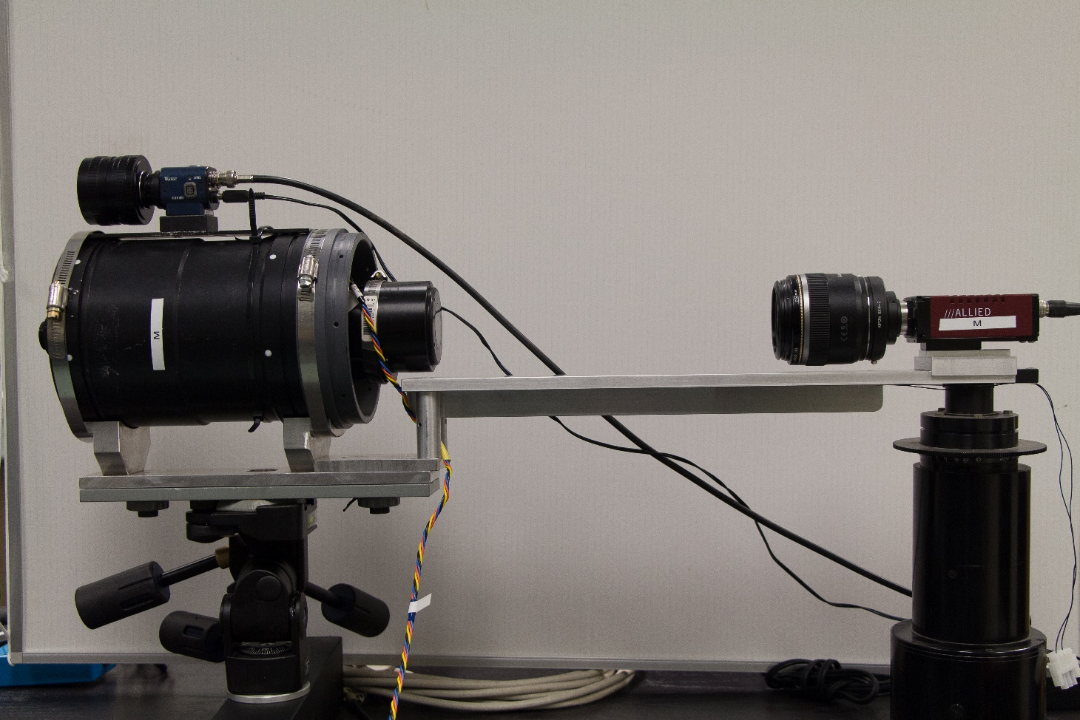
Optical System at each site
Narrow field (Gige) intensified systems have a 6° diameter field of view
50 fps
1k x 1k 12 bit
Limiting peak meteor magnitude +7 - +8^{M}
Limiting stellar magnitude +10^{M}
Median meteoroid mass ~10⁻⁷ kg
WATEC Ultimate H2
155mm f1.2 Catadioptric Lens
AVT Prosillica GX1050 Digital Camera
Gen II intensifier
Macro Lens
WATEC FOV 14° x 11° with 25mm f0.85 Fujinon lens
30 fps
640x480 8-bit
Limiting peak meteor magnitude +4
Limiting stellar magnitude +6^{M}
Median meteoroid mass ~10⁻⁶ kg

Slide 9
Data collection in 2014-2015
Cameras and radar observed simultaneously from Oct 3, 2014 – Apr 14, 2015
Total “clear” and dark (no LIDAR) skies in this interval
  Alomar 73 hours
  Saura 116 hours
236 multi-station meteors detected automatically with WATEC
108 WATEC events also detected by MAARSY

Slide 10
Data collection in 2015-2016
Cameras and radar observed simultaneously from Sep 15, 2015 – Apr 08, 2016
Total “clear” and dark (no LIDAR) skies in this interval
  Alomar 242 hours
  Saura 368.8 hours
  Including 2016 Quadrantid peak (multiple optical-HE Quadrantids detected)
140 multi-station meteors detected with WATEC and detected by MAARSY. This includes:
- 14 four camera detection (2 WATEC and 2Gige )
- 18 three camera (2 WATEC and 1 Gige)

Slide 11
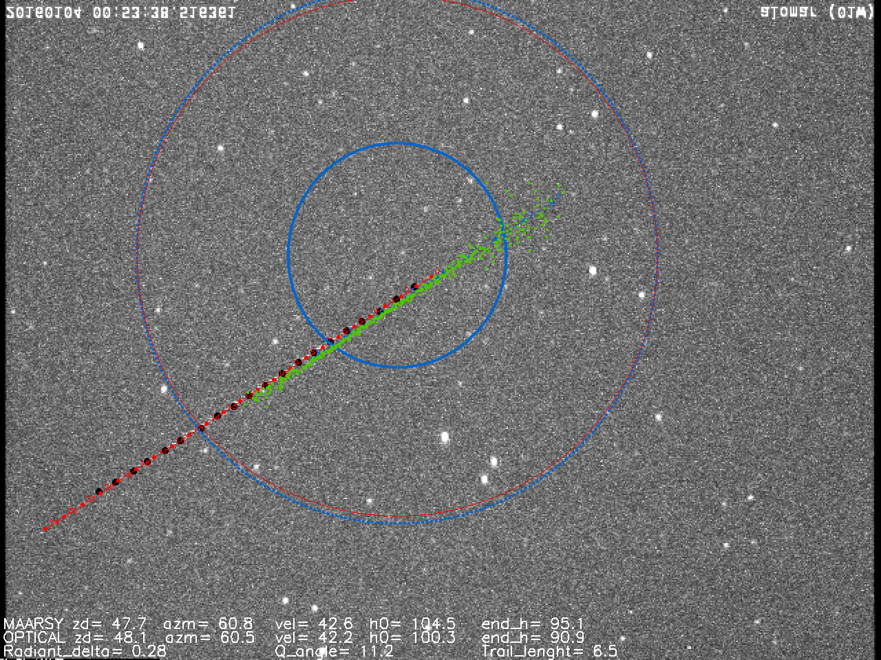
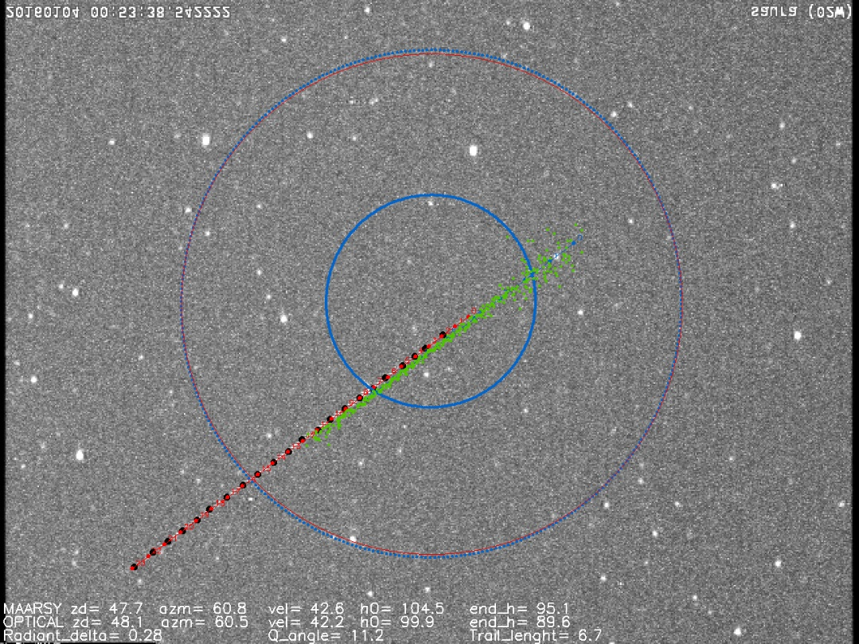
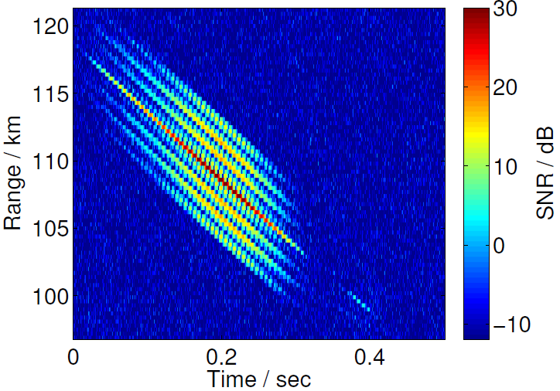
20160104_00h53m38s

Slide 12
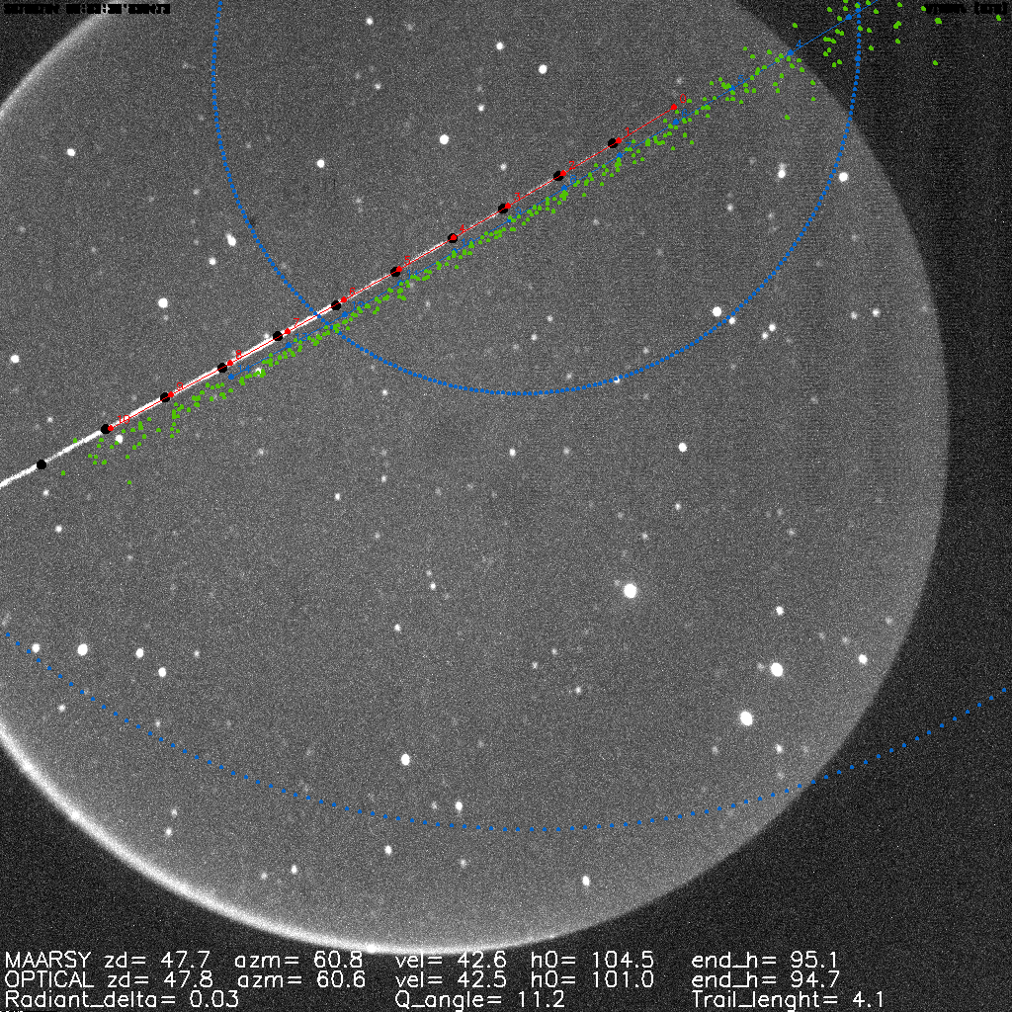
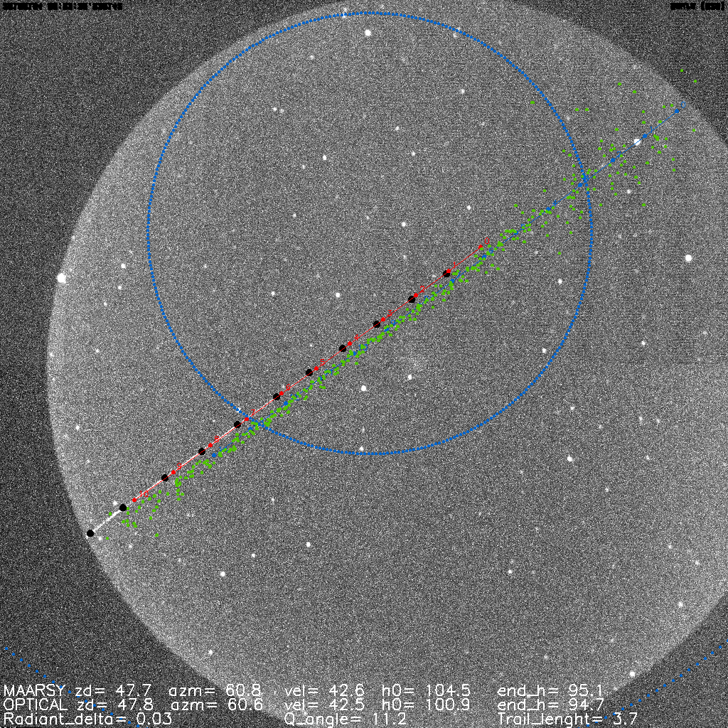
Gige Camera (Image Intensified)
Alomar Saura
20160104_00h53m38s

Slide 13
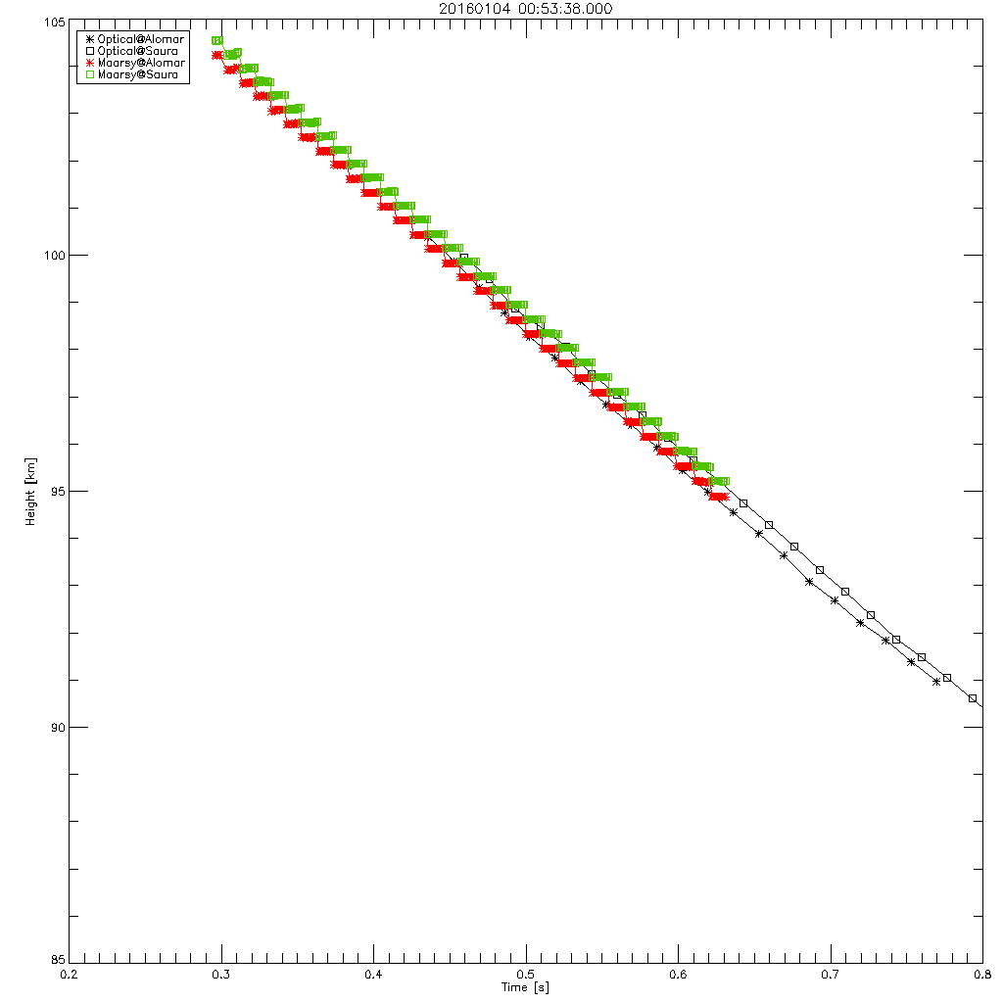
Watec Camera
Radiant Angular Deviation = 0.28 degs
Optical – Radar = 42.2 – 42.6 km/s= -0.4 km/s
V_{Saura} = 42.3 km/s
V_{Alomar}= 42.1 km/s
Peak_Mag = +3.3

Slide 14
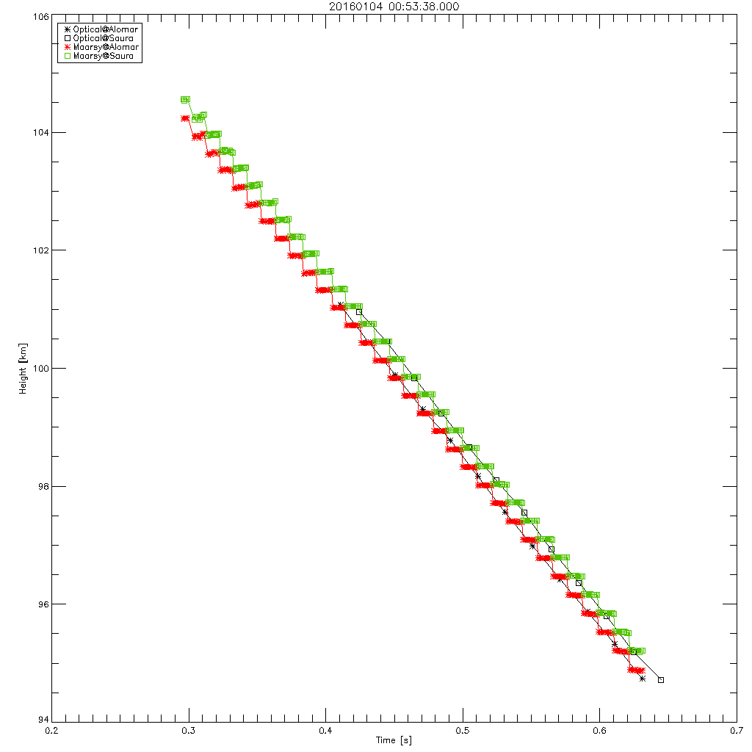
Gige Camera (Image Intensified)
Radiant Angular Deviation = 0.03 degs
Optical – Radar = 42.5 – 42.6 km/s= -0.1 km/s
V_{Saura} = 42.5 km/s
V_{Alomar}= 42.5 km/s
Peak_Mag = +3.6

Slide 15
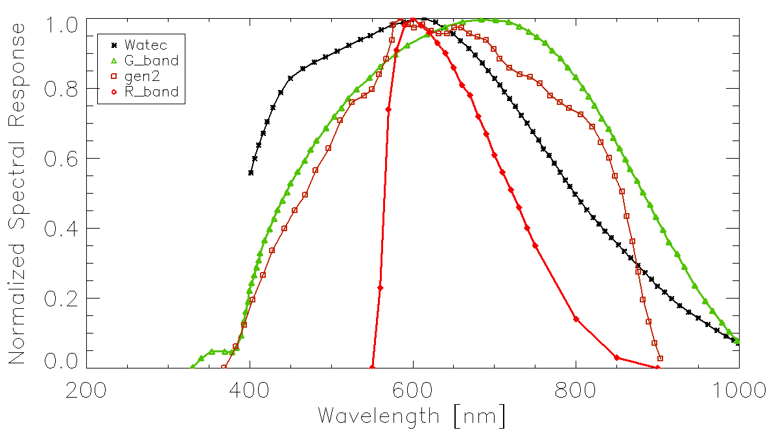
Use IGSL3 Gaia (G-band) magnitudes

Slide 16
Example RCS-lightcurve mass estimate
Find head echo mass using:
Find G-band mass using:
IG₀=1010W
τ =6% (Weryk and Brown, 2012)
4.6×10⁻⁷ kg
Campbell-Brown et al (2012)
Jones (1997)
3.6×10⁻⁷ kg
Watec
Gige

Slide 17
Results to end of 2016 campaign
Watec – MAARSY quality events (Q>3°, rad dev < 10°) [94 total events]
Gige – MAARSY quality events [12 total]
All differences are optical - radar
Dataset |  | Δh_{beg} | ΔHend | ΔVel | Δrad
Watec | Mean | -2.3 ± 0.5 | -1.4± 0.4 | -0.9± 0.2 | 1.9 ± 0.2
 | Median | -1.9 | -1.0 | -0.7 | 1.4
Gige | Mean | -2.4 ± 1.2 | -0.4± 0.9 | -1.5± 0.7 | 2.9 ± 0.9
 | Median | -3 | -0.6 | -1 | 1.6

Slide 18
Conclusions
MAARSY and optical two station solutions show comparable trajectories and speeds
MAARSY detects meteors higher and earlier than optical
Some bright optical events at low speeds passing through the beam are not detected by MAARSY
  Need to quantify this better
Gaia band magnitudes appropriate for Gige and Watec
Initial mass comparisons show consistent results
  Need better RCS model for mass and characterize uncertainties in luminous efficiency
For more details see Poster #33 (Stober et al) “Preliminary modelling results combining MAARSY meteor head echo observations and optical instrumentation to obtain meteoroid properties”

