Slide 1
Experimentation and numerical simulation of meteoroid ablation
Meteoroid 2016
Lorenzo Limonta, Sigrid Close
Space Environment and Satellite Systems Lab

Slide 2
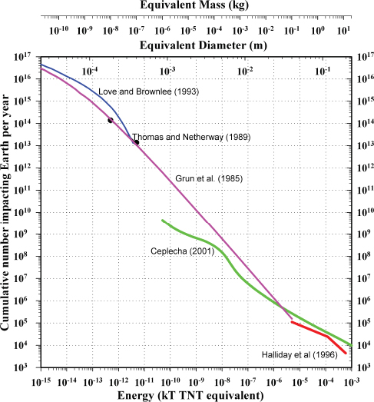
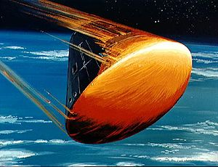
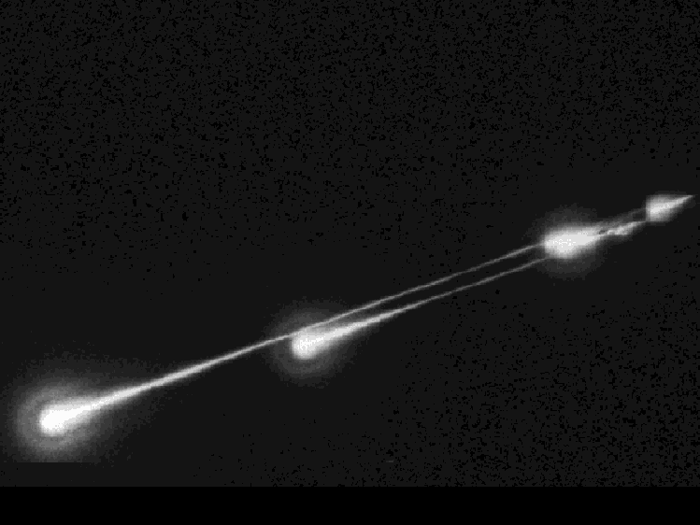
Motivation

Slide 3
Overview
Questions:
  What is the global distribution of meteoroid masses entering Earth’s atmosphere?
  How are meteor size, mass, and velocity related to measurable parameters?
  Can we better constrain
    Composition
    Luminous efficiency τ
    Ionization probability β
Methods:
  Simultaneous optical and radar detection
  Modeling
    Ablation model: from mass and velocity to plasma size, density, and brightness
    Scattering model: from plasma size and density to radar cross section

Slide 4
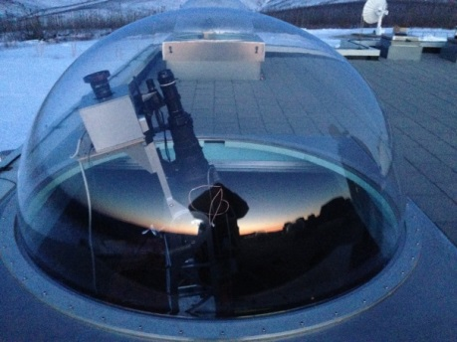
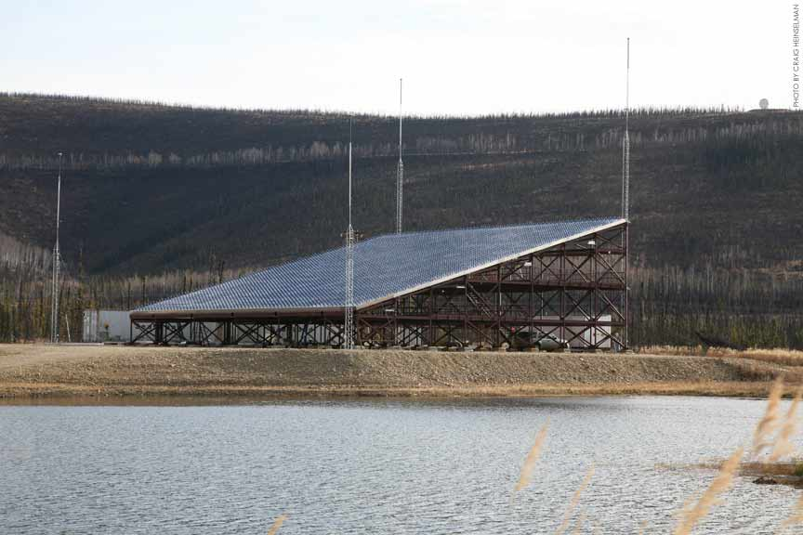
Data collection
  Joint optical and radar experiment conducted at PFISR spring 2014
  Two sensitive CMOS cameras, one with a long pass filter (λ > 475 nm)
  High power PFISR radar capable of detecting meteor head echoes
  Pointing 75deg elevation, 15 deg azimuth
  Field of fiew ~9x9 deg

Slide 5
Collected data
 | 03/30/2014 | 03/31/2014 | 04/01/2014 | 04/02/2014
Identified Objects | 49 | 95 | 136 | 59
True positive | 43 | 88 | 94 | 55
False Positive | 6 | 7 | 42 | 4
False Negative | N/A | N/A | N/A | N/A
Common Events | 13 | 11 | N/A | N/A

Slide 6
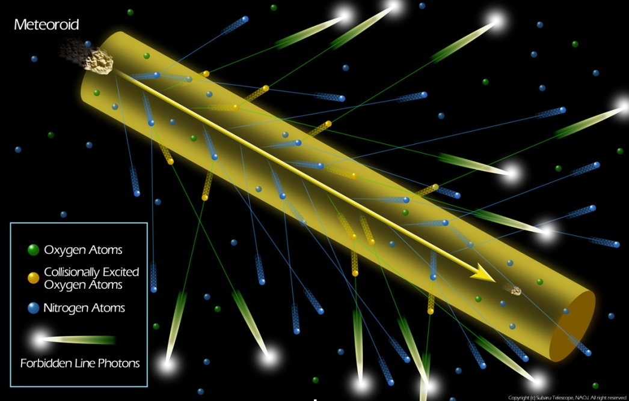
Ablation process
Courtesy of National Astronomical Observatory of Japan

Slide 7
Ablation process
Mass loss models:
Optical:
  If dv/dt small, v ~ constant → τ(v) ~ constant → I ∝ dm/dt
Radar:
  Under same assumptions: q/β ∝ dm/dt → Radar relation more complicated

Slide 8
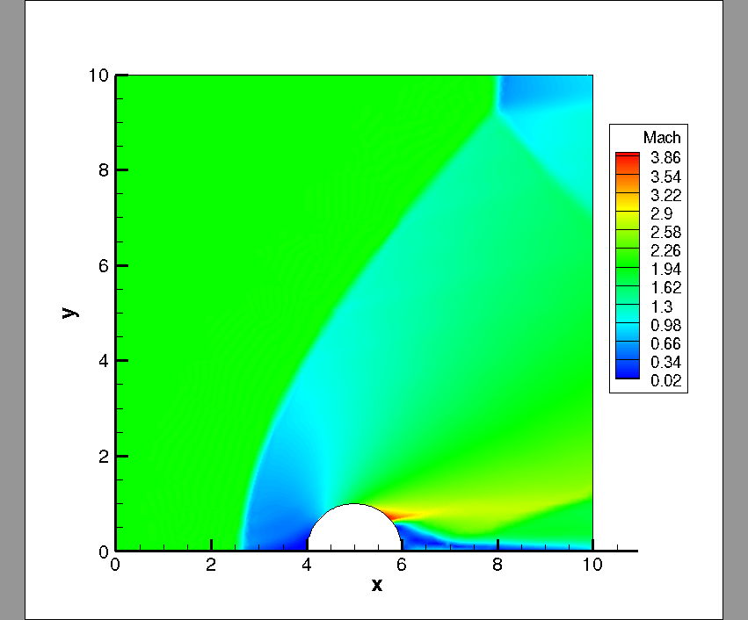
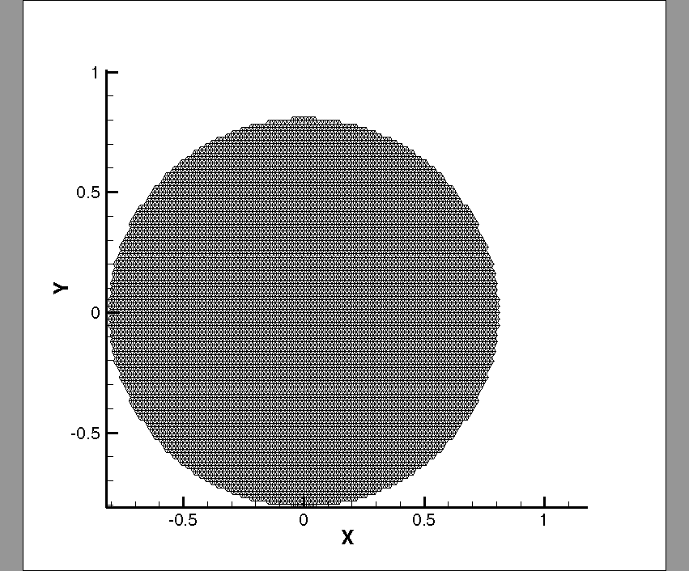
Theoretical framework
Need solving 2-d coupled equations:
  Fluid solver gives boundary conditions for ablation solver
  Ablation solver modifies fluid mesh
Fluid solver simplification:
  Hypersonic flow for stagnation point
  Similarity solution from 2-D Euler to map
  distributions of variables from stagnation point
  Restrict to events below 90 km of altitude
  Restrict to event with magnitude below 5

Slide 9

Theoretical Framework
  Ablation:
  Extreme conditions
  Unknown parameters
  Multispeces → different ablation rates
  Governing equations:
  Internal energy balance:
  Specific Heat:

Slide 10
Event of interest

Slide 11
Conclusions
Conclusions:
  Working model for a simplified 2-d numerical simulation
  Shown effects of shelled-multi-composition meteoroid models on mass loss
    Not sufficient to completely capture what detected
  Shown effects of rotation on mass loss
Future work:
  Crack propagation and fragmentation model (in collaboration with prof. Chiaramonte of Princeton University)
  Plasma PIC

