Slide 1
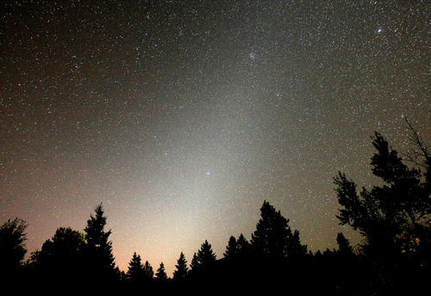
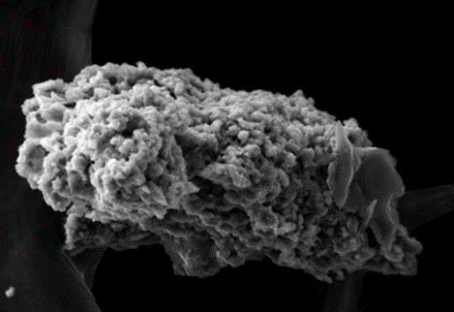
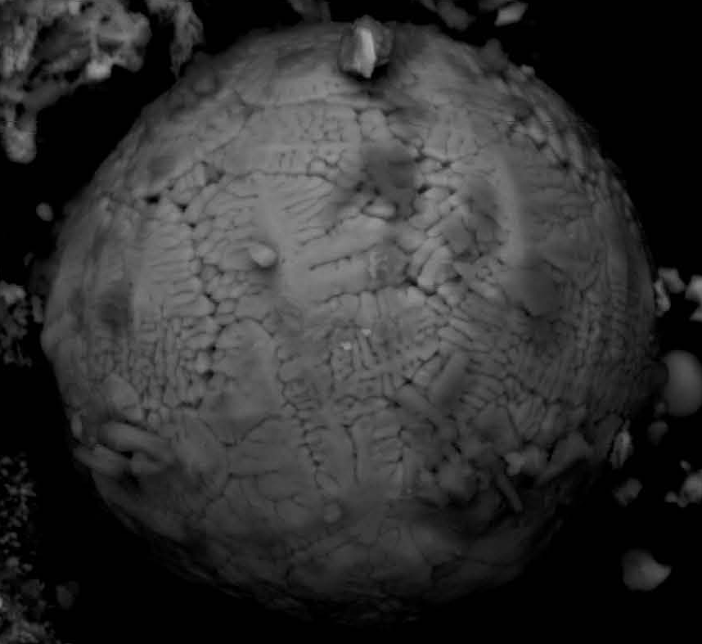


Experimental simulation of the atmospheric ablation of Interplanetary Dust Particles
J. C. Gómez Martín, D. Bones, J. D. Carrillo Sánchez, A. James, J. M. Trigo-Rodríguez, B. Fegley, J.M.C. Plane
School of Chemistry
FACULTY OF MATHEMATICS AND PHYSICAL SCIENCES

Slide 2

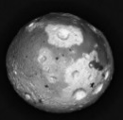
IDPs: ablation and impact on planetary atmospheres
IDPs
Taylor et al. (2012)
(CI and CM like fine grained aggregates)
Taylor et al. (2012)
Mesopause: H=85-100 km, T~170K, P~0.1Pa
Atmospheric
Constituents
Metal ion and neutral layers
Sputtering by air molecules
Na , K
Na⁺, K⁺
1800 K
Fe, Mg, Si
MSPs
Fe⁺, Mg⁺, Si⁺
CCN
H₂SO₄ removal
Aerosol Chemistry
2000 K
Ca, Al, Ti
Unmelted Micrometeorites
2400 K
Venus ~120 km Mars ~80 km Titan ~500 km
Cosmic
Spherules
Scoriaceous Micrometeorites

Slide 3
IDP mass input
Zodiacal Cloud observations
Mass and entry speed distributions
LDEF
Radar meteor head echoes
Chemical
Ablation
Model
Metal layers (diff. ablation)
Individual
IDP input estimates
(2 orders of magnitude)
MSP optical extinction
Unified
IDP input
estimate (reduced uncertainty)
WACCM
Micrometeorites
Metals in ice cores and seep sea sediments
Notes:
Uncertainty in the mass input of Interplanetary Dust:
Velocity and mass distribution derived from astronomical observations and orbital impactors depend on models.
Earth-based observations are “biased” by atmospheric entry, circulation and weathering.
A chemical ablation model (CABMOD) is used to connect extra-terrestrial and terrestrial observations to find a mass input estimate consistent with all observations.
CABMOD is based in well stablished thermodynamics, but it depends in a number of working assumptions:
particle composition, mineralogy and structure.
evaporation rate same as in equilibrium: Langmuir
Experimental validation/improvement of the model is required

Slide 4
CABMOD (Vondrak et al, 2008)
Isothermal particles
Temperature profile according to momentum and energy balance equations
Langmuir evaporation:
The rate of evaporation into a vacuum is equal to the rate of evaporation needed to
balance the rate of uptake in a closed system.
Equilibrium vapour pressures from upgraded MAGMA chemical equilibrium model (B. Fegley)
Monolithic particle, Fo₅₀ olivine, CI elemental composition.
Same T onset for evaporation of all components.
Onset should be consistent with the phase diagram of olivine.

Slide 5
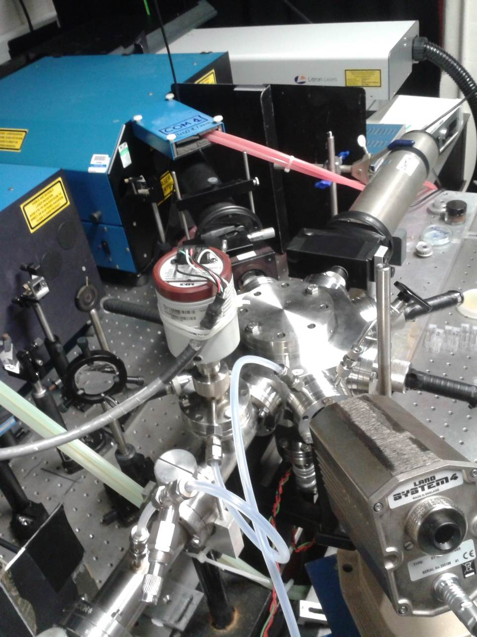
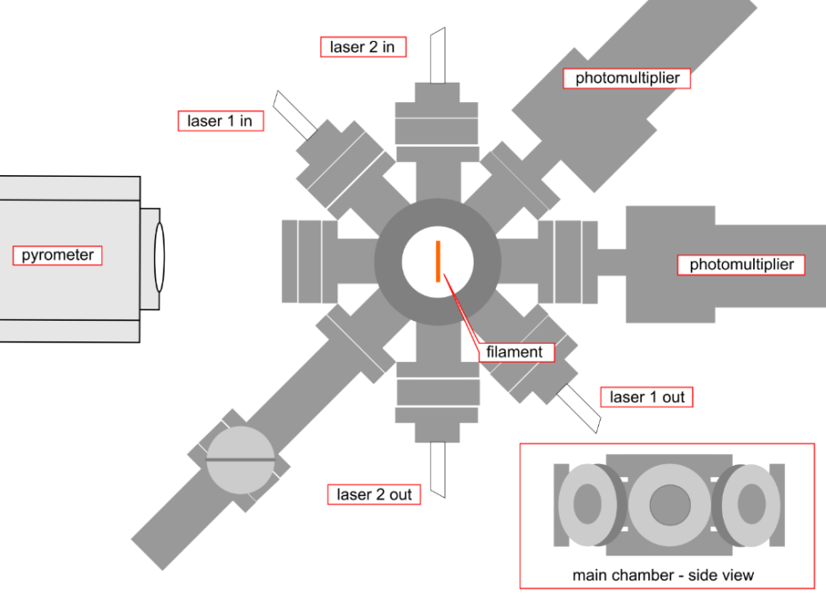
Meteor Ablation Simulator (MASI)
Nd:YAG LASER
Dye LASER
PMT
P HEAD
CHAMBER
PYROMETER
Perform a time-resolved simulation of micrometeoroid entry over a range of velocities and masses.
Resistively heated tungsten filament in vacuum chamber (0.1 hPa N₂) on which IDP analogues are deposited.
Filament current from a programmable power supply.
TO PUMP
Temperature measured/controlled by a pyrometer camera.
Ablation products measured by Laser Induced Fluorescence
Notes:
Particles placed on a filament ribbon
Filament flash heated
Filament temperature recorded using pyrometer.
Simulate the time-resolved temperature profile of meteoroid entry over a range of velocities and masses
Resulting ablation products (metal atoms and oxides) will be monitored by time-resolved laser induced fluorescence
Evaporation from the particle-coated filament will take place into an inert gas (N₂) at pressures of 100 mTorr to avoid suppressing the evaporation rate but avoiding coating the windows with metal
Measure the relative rates of evaporation of two species chosen from Na, Fe, Mg, Ca and SiO
CABMOD will be tested against the measured evaporation rates to measure the evaporation coefficients

Slide 6
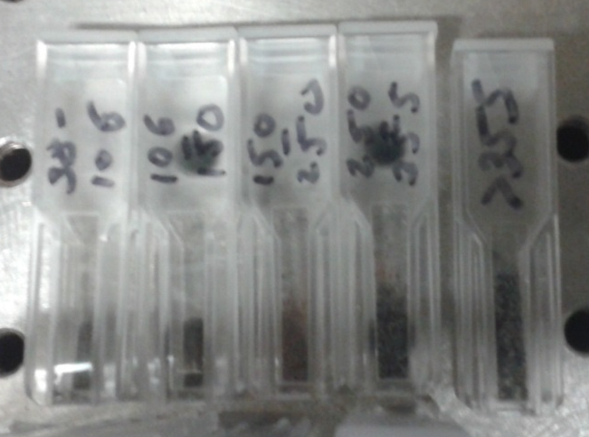
IPD Analogues: meteorites, minerals
Chergach (OC, H5): Compact aggregates
Mechanical size segregation by
a set of stacked test sieves.
Mass Influx Peak Diameter
less than 10% of IDPs are like this
Allende (CV3): Porous Aggregates
Allende (CV3): Coarse grains
75% of IDPs are like this, but finer-grained
10% of IDPs are like this

Slide 7
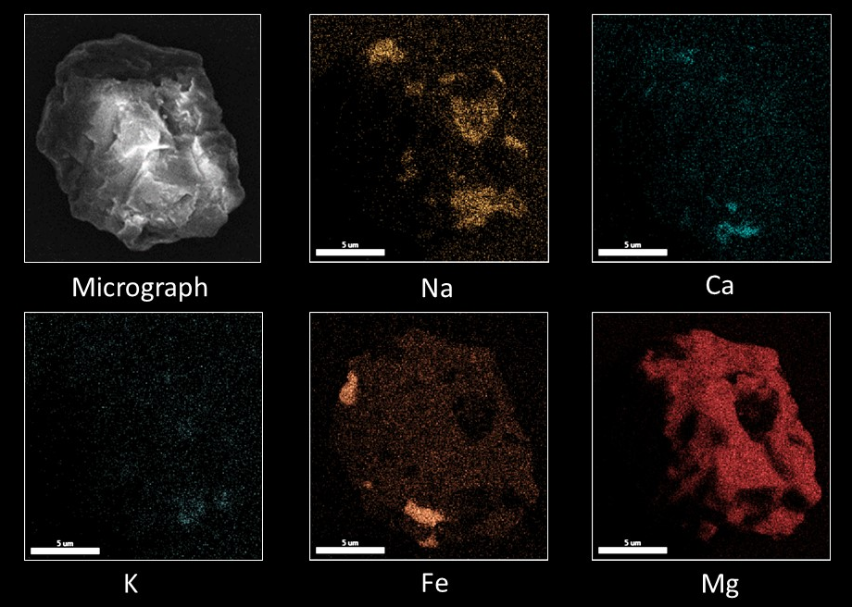
IPD Analogues: meteorites, minerals
Chergach(H5)

Slide 8
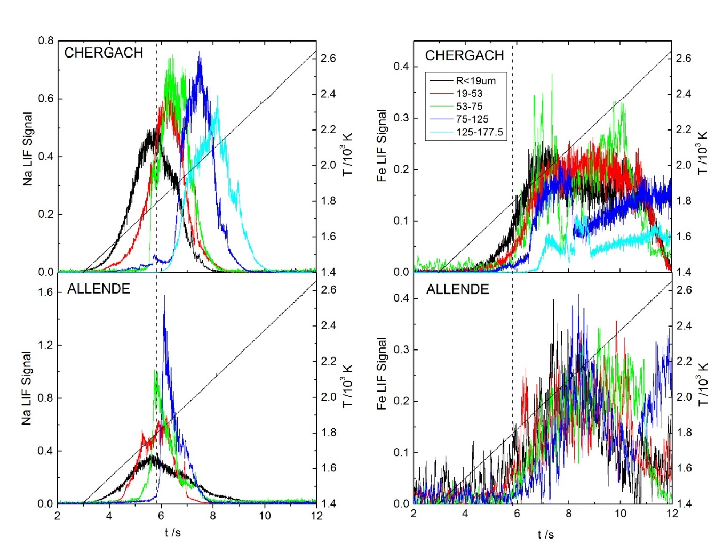
MASI: Results
Linear Heating Ramp
Na onset T (1400-1500 K) is much lower than for Fe.
The Na pulse is broad (300 K) and Gaussian for H5, irregular for CV3
Onset and peak Na shift to higher temperature for larger particles.
Temp.
Temp.
The Fe threshold shows a weak dependence on T
Melting temperature lower than Fo₈₀
The Fe pulse is very broad, non-Gaussian and shows discontinuities.
Na
Fe
Temp.
Temp.
Na
Fe
time /s
time /s
Notes:
Meteorites (IDPs) are complex mineral assemblages.
Low T onsets: Na → Albite, Sodalite; Fe → metallic Fe
Na contained in 20 µm crystalline grains, fine grained matrix
The Na onset dependence on particle size can be explained by delayed release of Na present in inner pockets.
Similar for metallic Fe (metallic Fe domains embedded in larger silicate domains).

Slide 9

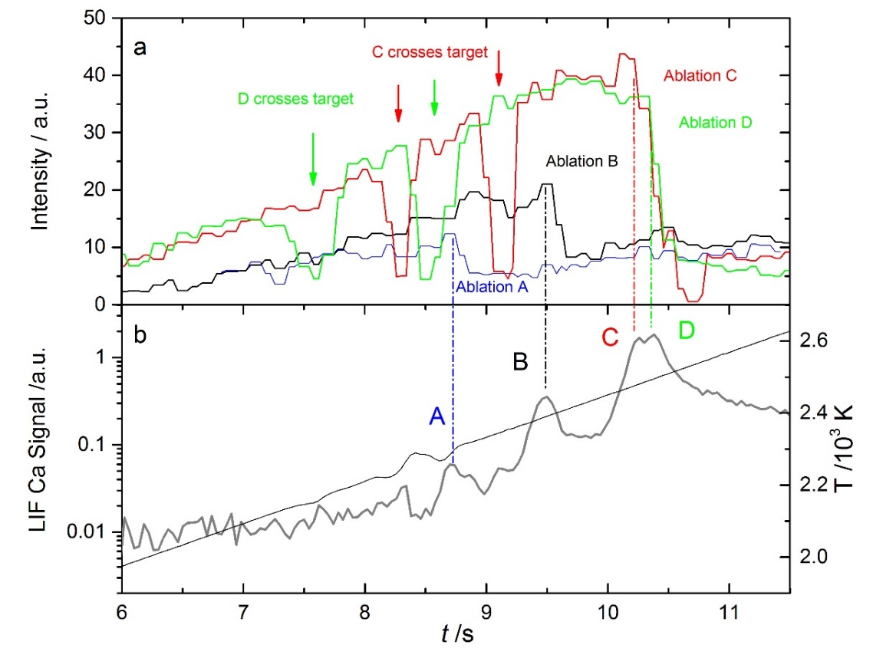
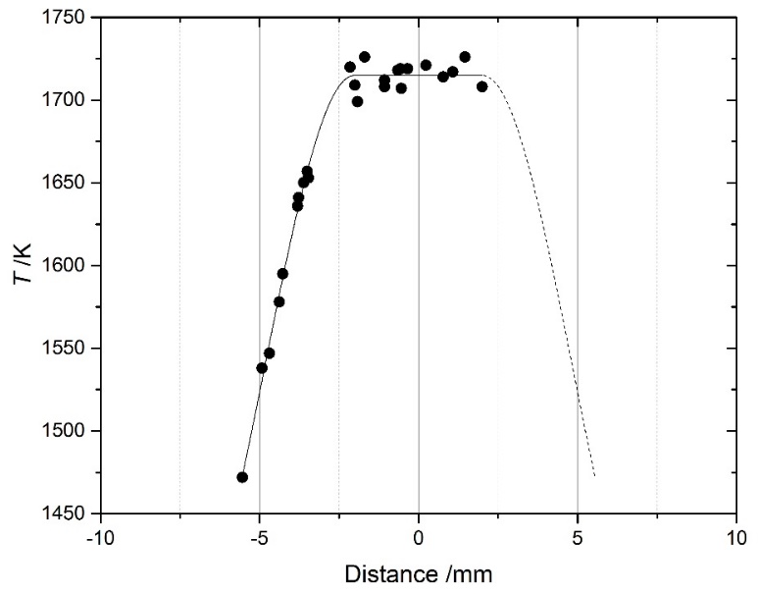
MASI: Results
Video starts
Calcium
Particles are tracked with a video camera
Valid runs are those where ablation is observed within the region of constant temperature of the filament
Electromigration mitigated by roughening of surface

Slide 10
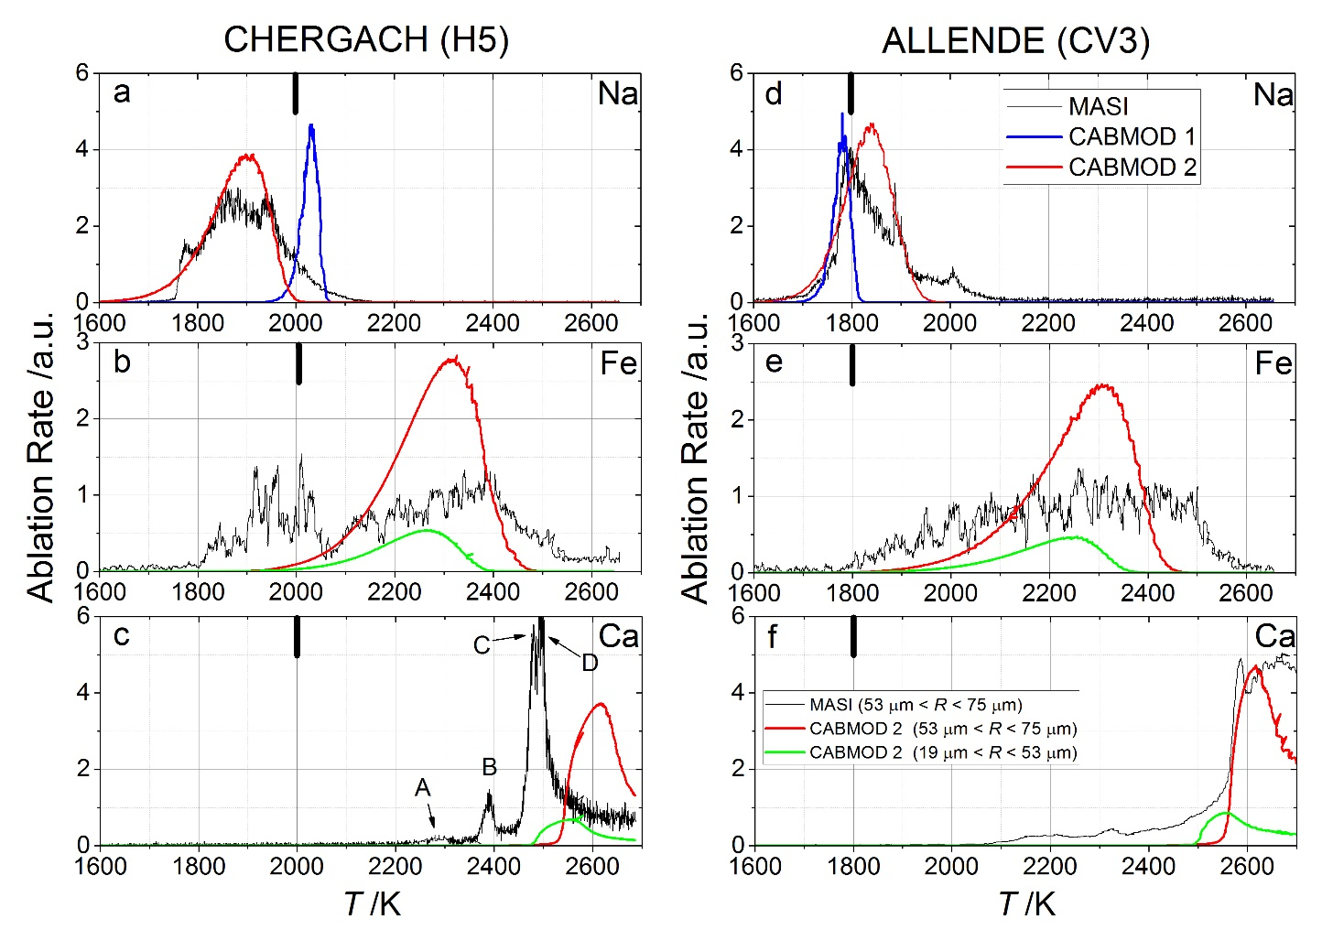
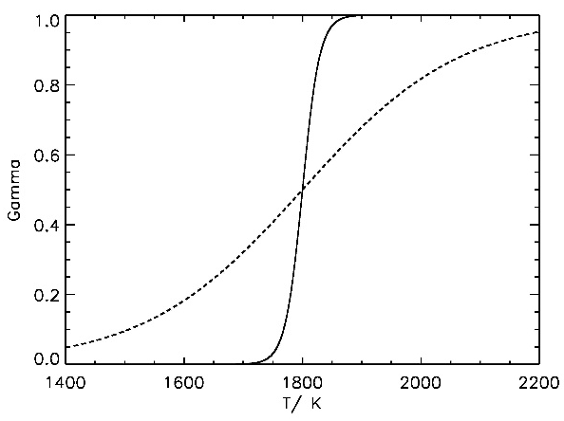
MASI: Results
Linear Heating Ramp
Metallic Fe
Metallic Fe
Modelling multi-phase aggregates with a single phase homogeneous particle!
An empirical approach is adopted to model Na: sticking coefficient
Two Fe phases: metal (+sulphide) and silicate
Ca release controlled by MgO and SiO₂ abundance in the melt

Slide 11
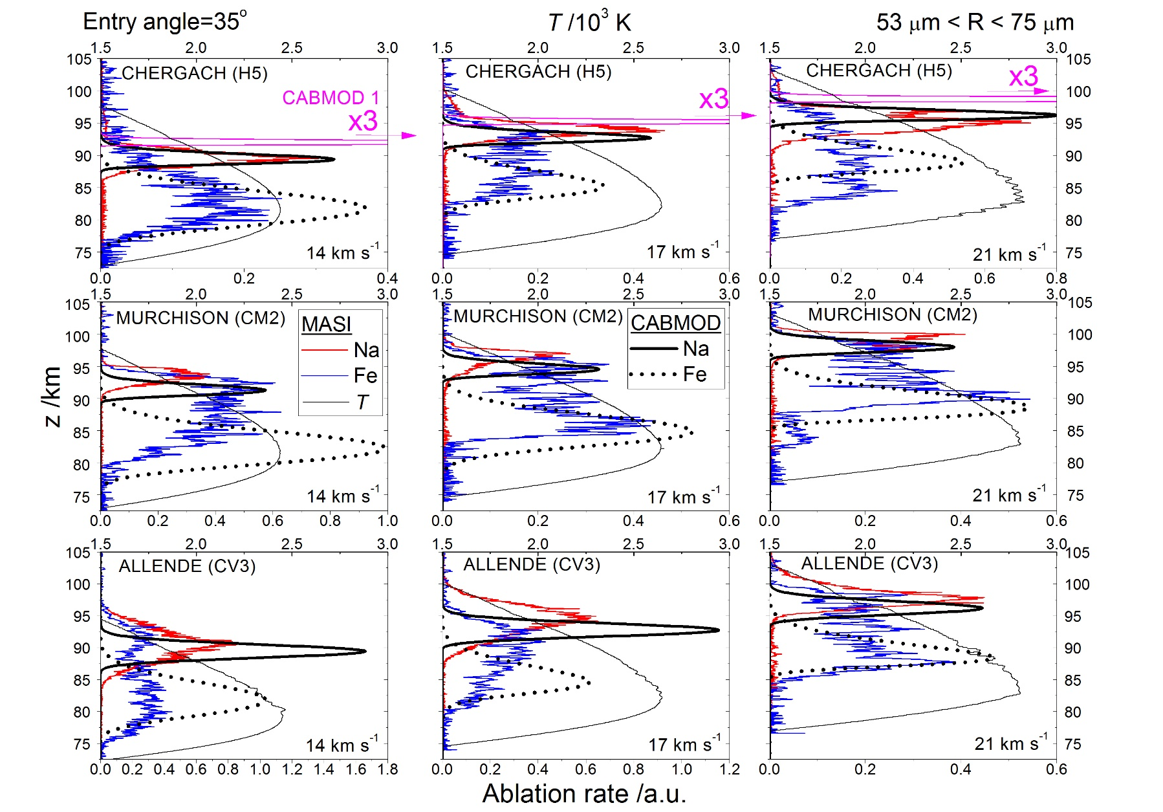
MASI: Results
Realistic atmospheric entry heating profiles
Entry velocity 1
Entry velocity 2
Entry velocity 3
SIZE
IDP analogue 1
IDP analogue 2
IDP analogue 3

Slide 12
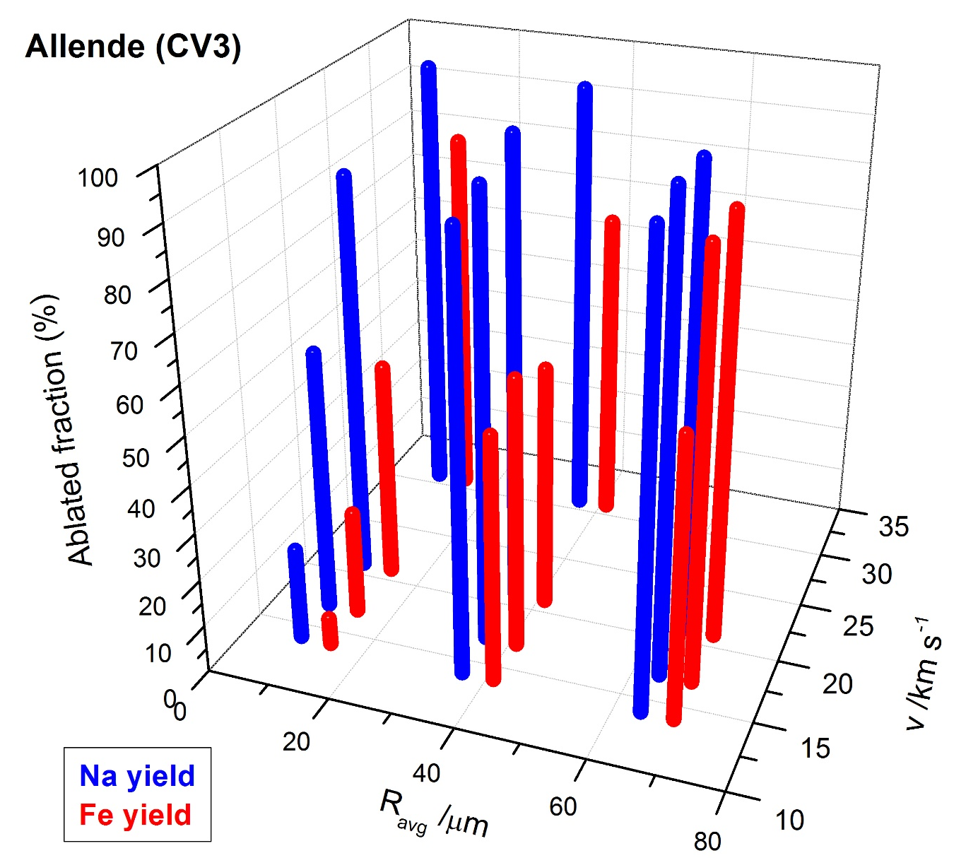
MASI: Results
Atmospheric yields
Weight each (v, M) combination with v and M distribution
Derive input for each element from the total input function.
Calculate average differential ablation coefficient and compare to metal layer observations.
35°

Slide 13
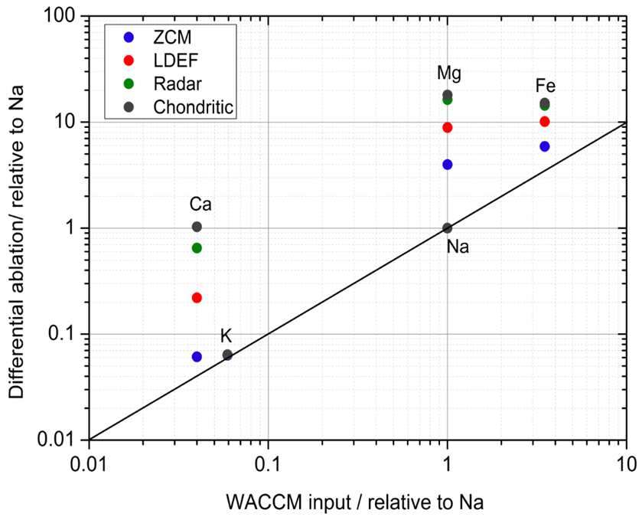

MASI: Results
CONCLUSIONS
Differential Ablation metal layers
$${DAC}_{x}=\frac{mixing ratio of metal x released}{mixing ratio of Na released }$$
CV3, H5
1.5xNa
CV3
MASI with ZCM distribution
MASI with ZCM distribution, 1.5 Na-enriched
H5
Works well for Fe, uncertain for Ca
35°
Notes:
13

Slide 14
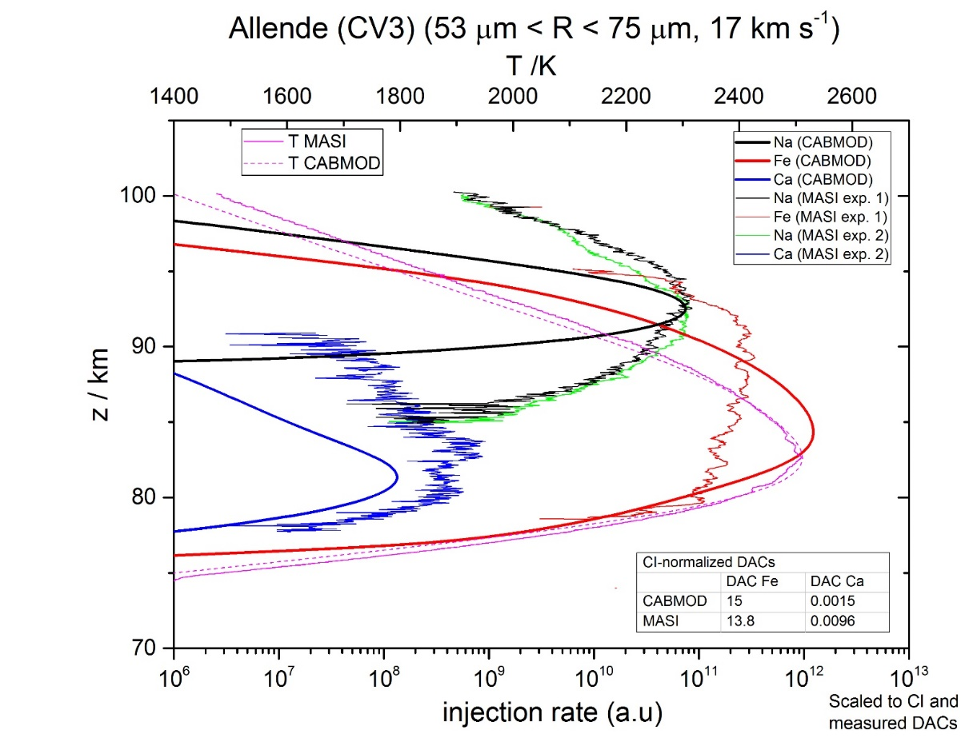
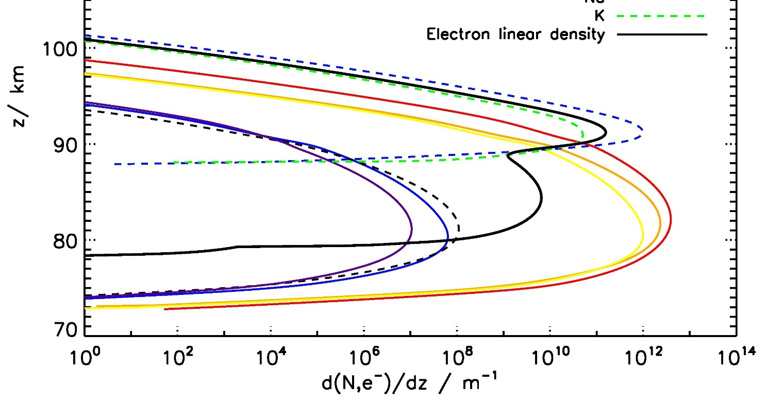
Summary
Electron linear density
Na
Na
Fe
Ca
Fe
CABMOD describes general features of ablation rate profiles
Differential ablation of Na (K) and Fe (Mg, Si) is behind the double peak in the head echo electron density profile.

Slide 15
Conclusions
First time resolved simulation of meteor ablation
First laboratory experimental confirmation of differential ablation
CABMOD contains a simplistic geometric and compositional description of particles.
Empirical corrections allow a satisfactory modelling of Na ablation:
  Reduces uncertainty in the calculation of electron density, relevant for radar meteor detection of small and slow particles.
CABMOD reproduces general features of the meteor ablation as well as overall differential ablation coefficients of Fe relative to Na:
  Gives confidence in the use in CABMOD as a tool for bridging astronomical and surface/atmospheric observations
Ca ablation sensitive to composition and mineralogy.
Future work: improve description of particle geometry and composition.

Slide 16
Thanks
School of Chemistry
FACULTY OF MATHEMATICS AND PHYSICAL SCIENCES

